Slide 1
IoT Security and Privacy
Introduction to Amazon AWS IoT

Slide 2
Learning Outcomes
Upon completion of this unit:
Students will understand the architecture of Amazon AWS IoT
Students will master the use of AWS IoT managing IoT devices
Students will master programming AWS IoT

Slide 3
Prerequisites and Module Time
Prerequisites
Students should have taken classes on operating system and computer architecture.
Students must have taken crypto and know how public key crypto and symmetric key crypto work.
Students should have mastered programming Raspberry Pi.
Students should know basic concepts of networking.
Module time
Two-hour lecture
Two-hour homework

Slide 4
Outline
Introduction
Device registry - thing, keys, certificate, policy
Security and identity
Device gateway – MQTT
Rules engine
Pricing
Example code with MQTT

Slide 5
Overview
Amazon AWS IoT basically sets up a server such as a MQTT server so that physical IoT devices and applications can use the server to communicate with each other
AWS IoT goes beyond the communication through MQTT and provides other Amazon services that process the data from IoT devices, for example, storing data via Amazon Simple Storage Service (S3).
AWS IoT supports other communication protocol such as REST API (https)
Protocol | Authentication | Port
MQTT | Client Certificate | 8883
MQTT over WebSocket | AWS Signature Version 4 | 443
HTTP | Client Certificate | 8443
HTTPS | AWS Signature Version 4 | 443
Notes:
Protocol Authentication Port MQTT
Client Certificate
8883
HTTP
Client Certificate
8443
HTTP
SigV4
443
MQTT + WebSocket
SigV4
443

Slide 6
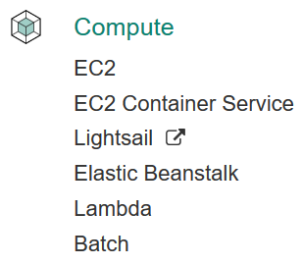



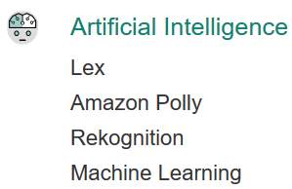













Current AWS Services
Applications
SDK
AWS Mobile SDK, API Endpoints, Management Console
Offered Services
Underlying Services
Computing
Storage
Networking
Analytics
Databases
AWS Infrastructure
Notes:
Such services are fully integrated with the rest of AWS offering, are optimized for mobile use cases, are accessible via a single Mobile SDK and share the same scalable, on-demand, global infrastructure of all our other AWS services.

Slide 7
AWS IoT service
Beta out in August 2015
Use of standard protocols
SDK, APIs
Partnership with different industry sectors
Bridge to other AWS Services, such as email, SMS, data analystics
Bi-Directional / Long lived connections

Slide 8
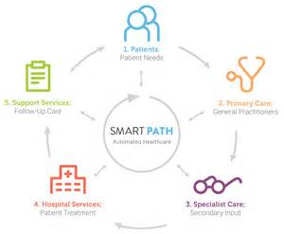

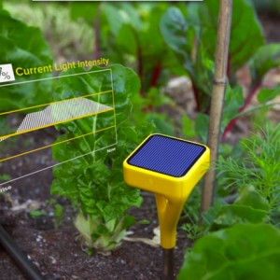

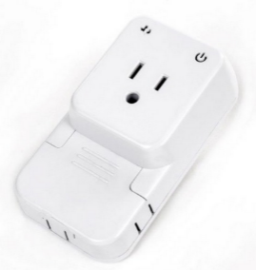


Smart Transportation
Smart Health
Smart Agriculture
AWS IoT Architecture & Ecosystem
Solutions
API
Thing Shadows
Rules Engine
Broker
AWS IoT Services
AWS IoT
C / Java
SDK
Things Registry
Secure Gateway
Regions & Availability Zones
Security
IoT Devices

Slide 9
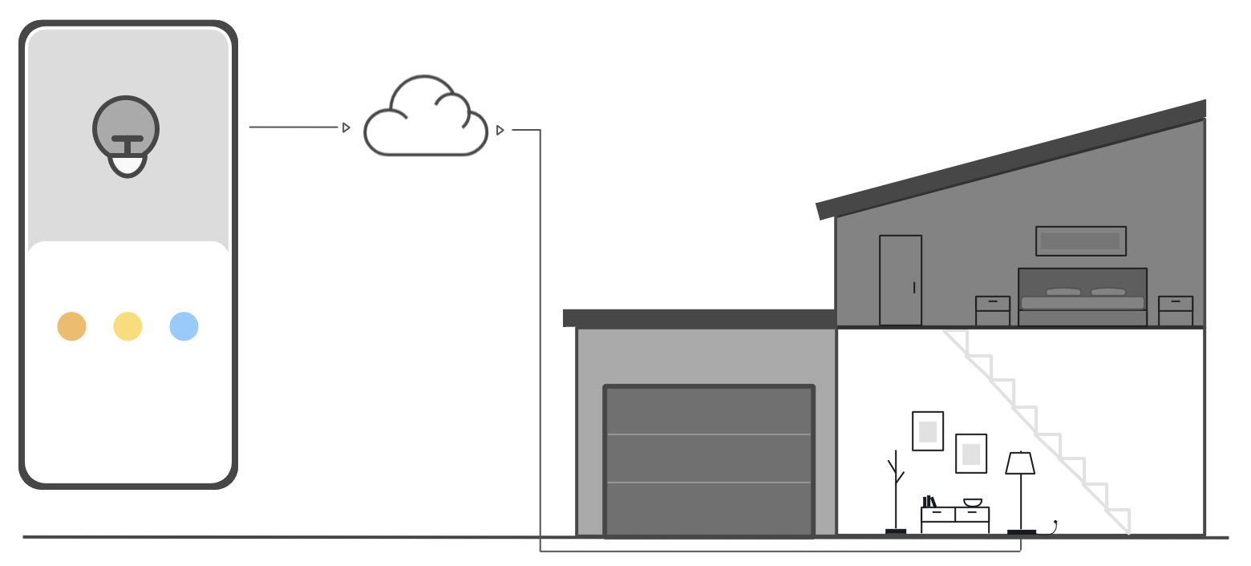
AWS IoT - Console Interactive Tutorial
Open the Learning hub in the AWS IoT console.

Slide 10
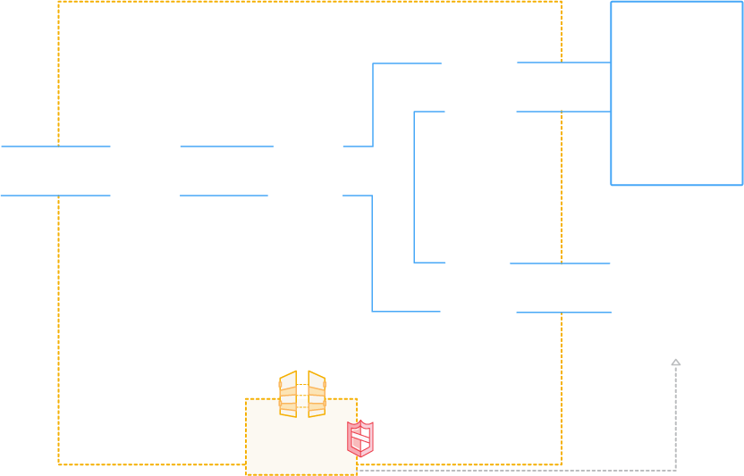









AWS IoT
AUTHENTICATION
AUTHORIZATION
Secure with mutual authentication and encryption
AWS Services
- - - - -
3rd party Services
RULES ENGINE
Transform messages based on rules and route to AWS Services
DEVICE SDK
Set of client libraries to connect, authenticate and exchange messages
DEVICE GATEWAY
Communicate with devices via MQTT and HTTP
APPLICATIONS
DEVICE SHADOW
Persistent thing state during intermittent connections
DEVICE REGISTRY
Identity and Management of your things
AWS IoT API

Slide 11
AWS IoT Components
Message broker
A secure relay between users (subscribers and publishers)
Protocols: MQTT, HTTP REST interface
Rules engine
Rules directing data to other AWS services such as Amazon S3, Amazon DynamoDB, and AWS Lambda
Thing Registry (Device Registry)
Virtual devices in the cloud, corresponding to physical things
Up to three custom attributes for a thing.
Association of certificates and MQTT client IDs with a thing

Slide 12
AWS IoT Components (Cont’d)
Thing Shadows service
Synchronization of states requested by users and at the physical devices (what if the connection is down?)
Thing shadow
A JSON document storing state information for a thing
Device gateway
Entry point for physical devices into the cloud
Security and identity service
Secure communication
Secure storage of credentials
Identification, authentication and authorization

Slide 13
Accessing AWS IoT
AWS Command Line Interface (AWS CLI)
Windows, Mac, and Linux
Refer to he AWS Command Line Interface User Guide.
AWS device SDKs
Open-source libraries, developer guides with samples, porting guides
Refer to AWS SDKs and Tools.
AWS IoT API
Libraries
Refer to Actions in the AWS IoT API Reference.
AWS IoT Thing SDK for C
For resource-constrained things, such as microcontrollers.

Slide 14
Closely Related AWS Services
Amazon Simple Storage Service (S3)
Scalable storage. Refer to Amazon S3.
Amazon DynamoDB
NoSQL databases. Refer to Amazon DynamoDB.
Amazon Kinesis
Real-time processing of streaming data. Refer to Amazon Kinesis.
AWS Lambda
Custom code running on Amazon EC2. Refer to AWS Lambda.
Amazon Simple Notification Service (SNS)
Notifications through email, SMS and others. Refer to Amazon SNS.

Slide 15
Outline
Introduction
Device registry - thing, keys, certificate, policy
Security and identity
Device gateway – MQTT
Rules Engine
Pricing
Example code with MQTT

Slide 16
Registry and Things
AWS IoT provides a registry that helps you manage things.
A thing is a representation of a specific device or logical entity.
It can be a physical device or sensor (e.g., a light bulb or a switch on a wall).
It can also be a logical entity like an instance of an application or physical entity that does not connect to AWS IoT but is related to other devices that do (for example, a car that has engine sensors or a control panel).
Things are identified by a name.
Things can also have attributes, which are name-value pairs you can use to store information about the thing, such as its serial number or manufacturer.

Slide 17
Use Case
A typical device use case involves the use of the thing name as the default MQTT client ID.
Although we do not enforce a mapping between a thing's registry name and its use of MQTT client IDs, certificates, or shadow state, we recommend you choose a thing name and use it as the MQTT client ID for both the registry and the Device Shadow service.
This provides organization and convenience to your IoT fleet without removing the flexibility of the underlying device certificate model or shadows.
Adding things to the registry allows you to manage and search for devices more easily.

Slide 18
AWS IoT Device Registry
THING REGISTRY
Identity and Management of your things
REGISTRY
Identity and Management of your things

Slide 19
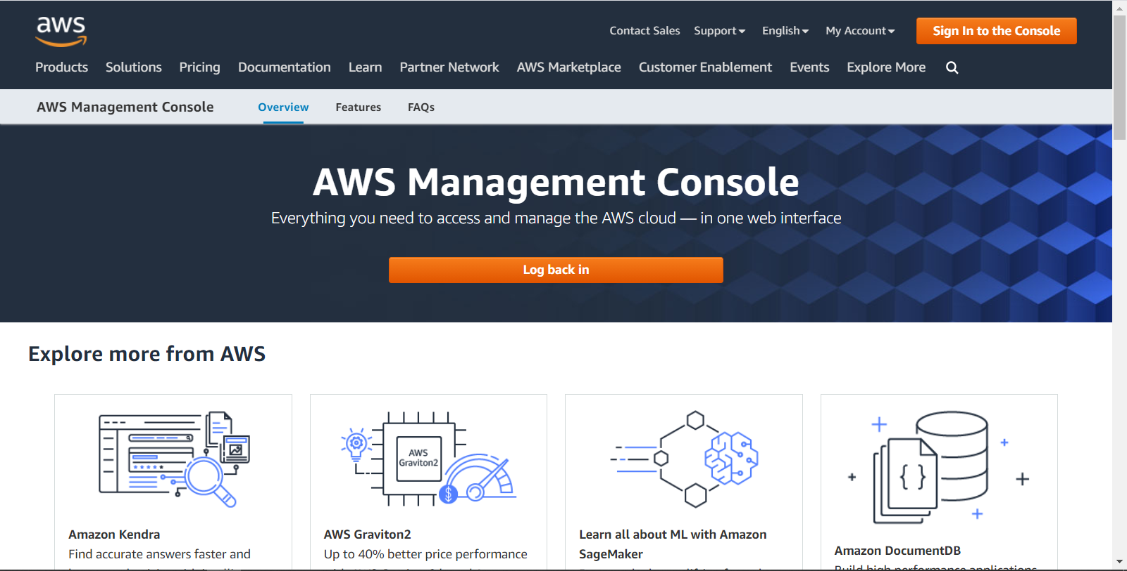
AWS Management Console Login

Slide 20
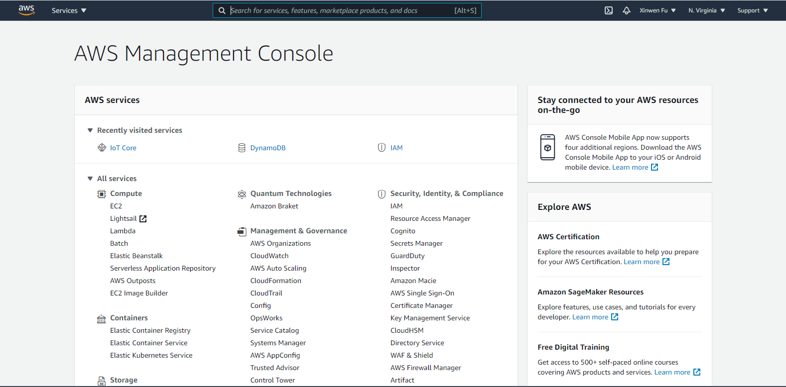
AWS Management Console

Slide 21
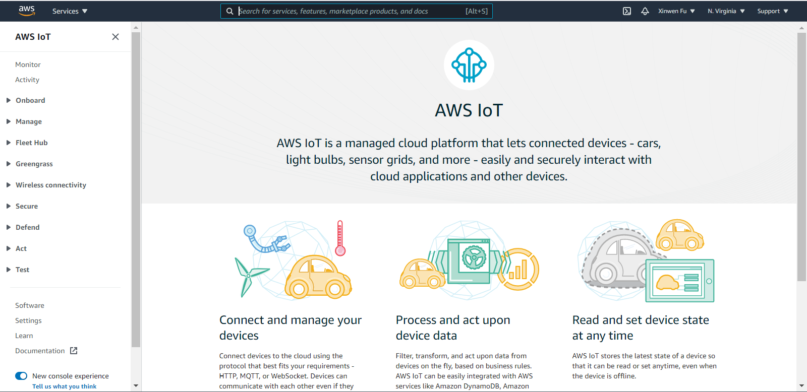
IoT Core

Slide 22
Create a DHT22 Thing
Manage -> Things -> Create Things -> Create a single thing
Specify thing properties such as thing name
Add a certificate for your thing
One-click certificate creation (recommended)->Create certificate
Download the keys
Attach a policy if available; Otherwise choose Done
Create a policy
How to find AWS IoT endpoint hostname
Your AWS IoT account has a unique endpoint hostname to connect to.
To find it, open the AWS IoT Console
click the "Settings" button on the bottom left side
The endpoint hostname is shown under the "Custom Endpoint" heading on this page

Slide 23
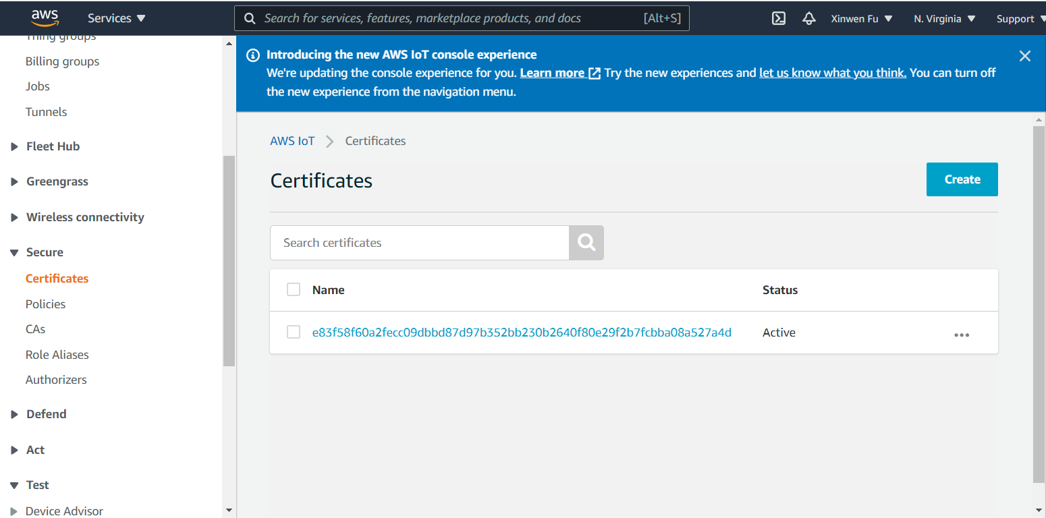
Create a certificate
Secure -> Certificate

Slide 24
Create a policy
An identity such as a thing with a certificate can execute AWS IoT Core operations only if it has a policy that grants it permission for those operations.
Secure -> Policies -> Create
Name
Add statements -> Advanced mode
{
"Version": "2012-10-17",
"Statement": [
{
"Effect": "Allow",
"Action": [
"iot:Connect",
"iot:Receive",
"iot:Publish",
"iot:Subscribe"
],
"Resource": "*"
}
]
}

Slide 25
AWS IoT Core policies
{
"Version": "2012-10-17",
"Statement": [
{
"Effect": "Allow",
"Action": [
"iot:Connect"
],
"Resource": [
"arn:aws:iot:us-east-1:123456789012:client/${iot:Connection.Thing.ThingName}"
]
},
{
"Effect": "Allow",
"Action": [
"iot:Publish"
],
"Resource": [
"arn:aws:iot:us-east-1:123456789012:topic/${iot:Connection.Thing.ThingName}/*"
]
}
]
}
This policy grants permission
to connect to AWS IoT Core using a client ID matching the thing name
to publish to any topic prefixed by the thing name

Slide 26
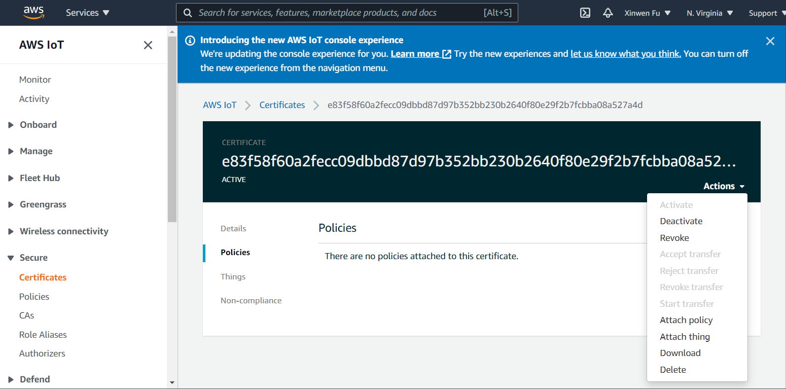
Attach a policy
Secure -> Certificates -> Click a particular certificate -> Policies -> Attach policy

Slide 27
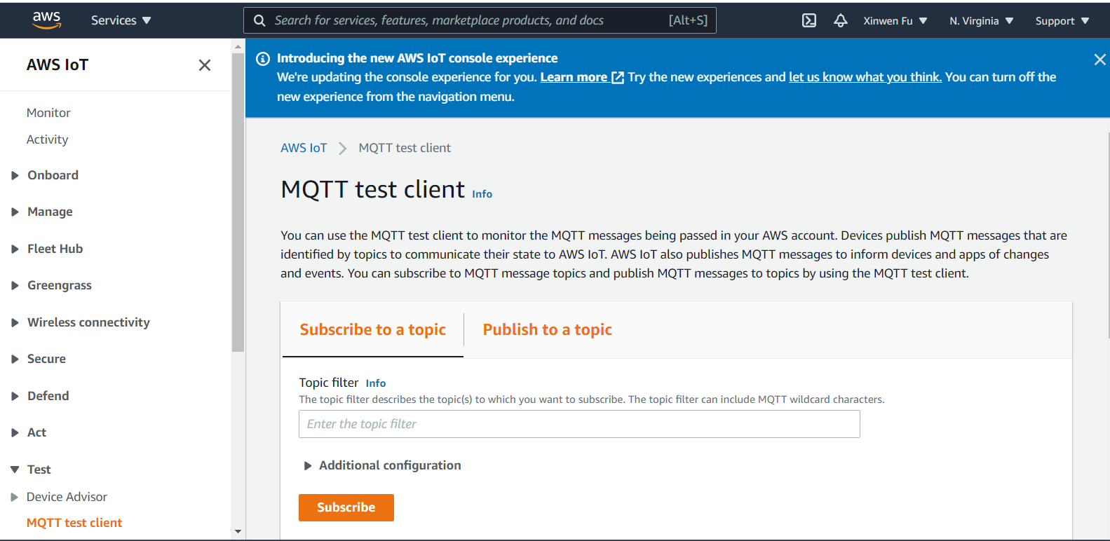
MQTT Test Client

Slide 28
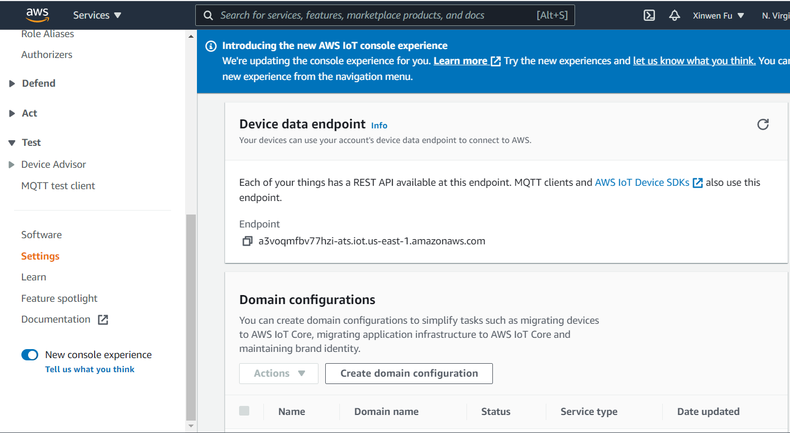
Settings
Your devices can use your account's device data endpoint to connect to AWS.

Slide 29
Use AWS IoT as MQTT Server
You do not need to create a thing in the registry to connect a device to AWS IoT, which can work as a message broker.
Just create a certificate, a policy and attach the policy to the certificate
Then our IoT kit can use the created private key and device certificate to connect to AWS IoT and publish messages
What is the problem?
Messages are transmitted in real time.
What if the IoT kit is down and you want to send it a control command?
Solution
Device shadow to be discussed later

Slide 30
Outline
Introduction
Device registry - thing, keys, certificate, policy
Security and identity
Device gateway – MQTT
Rules Engine
Pricing
Example code with MQTT

Slide 31
AWS IoT Security
AUTHENTICATION
AUTHORIZATION
Secure with mutual authentication and encryption
AUTHENTICATION
Secure with mutual authentication and encryption

Slide 32
Securing and Identifying Things: Mutual Authentication through TLS
Server authentication
Server sends its certificate.
Then?
Client authentication, similar to ssh certificate based authentication
Server stores a client’s certificate for later identification
Server performs the challenge response protocol to verify that the client has the private key

Slide 33
Security, Designed for Connected Devices
 | MQTT + Mutual Auth TLS | AWS Auth + HTTPS
Server Auth | TLS + Cert | TLS + Cert
Client Auth | TLS + Cert | AWS Access Keys
Confidentiality | TLS | TLS
Protocol | MQTT | HTTP
Identification | AWS ARNs | AWS ARNs
Authorization | AWS Policy | AWS Policy
Amazon Resource Names (ARNs)

Slide 34
Outline
Introduction
Device registry - thing, keys, certificate, policy
Security and identity
Device gateway – MQTT
Rules Engine
Pricing
Example code with MQTT

Slide 35
AWS IoT Device Gateway
DEVICE GATEWAY
Communicate with devices via MQTT and HTTP

Slide 36

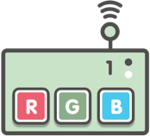


AWS IoT Device Gateway
Standard Protocol Support:
MQTT and HTTP
Publish/Subscribe Broker with Long-lived bi-directional messages
Clients (Devices and Apps) can receive commands and control signals from the cloud
Secure by Default
Connect securely via X509 Certs and TLS client mutual authentication
Highly scalable device gateway
Topic Based Architecture
(lights/thing-2/color)

Slide 37
AWS IoT Device Shadow service
AWS IoT Device Shadow service adds shadows to AWS IoT thing objects.
Shadows can make a device’s state available to apps and other services whether the device is connected to AWS IoT or not.
AWS IoT thing objects can have multiple named shadows so that your IoT solution has more options for connecting your devices to other apps and services.
AWS IoT thing objects do not have any named shadows until they are created explicitly
An unnamed, classic shadow is created for a thing when the thing is created.
Shadows can be created, updated, and deleted by using the AWS IoT console, devices, other web clients, and services

Slide 38

AWS IoT Device Shadow
APPLICATIONS
THING SHADOW
Persistent thing state during intermittent connections
SHADOW
Persistent thing state during intermittent connections

Slide 39

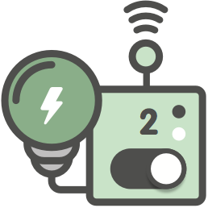




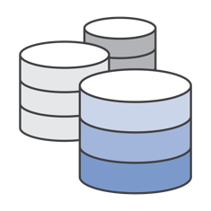
AWS IoT Shadow Flow
1. Device Publishes Current State
3. App requests device’s current state
5. Device Shadow sync’s updated state
4. App requests change the state
7. Device Shadow confirms state change
6. Device Publishes Current State
2. Persistent JSON Data Store
Device SDK

Slide 40
Accessing shadows
Every shadow has a reserved MQTT topic and HTTP URL that supports the get, update, and delete actions on the shadow.
Shadows use JSON shadow documents to store and retrieve data.
A shadow’s document contains a state property that describes these aspects of the device’s state:
desired -- Apps specify the desired states of device properties by updating the desired object.
reported -- Devices report their current state in the reported object.
delta -- AWS IoT reports differences between the desired and the reported state in the delta object.

Slide 41
Using shadows in devices, apps, and other cloud services
The AWS IoT Device Shadow service stores the shadow state, sends messages when the shadow state changes, and responds to messages that change its state.
The shadow state data is dynamic and can be altered by the devices, apps, and other cloud services with permission to access the shadow.
Devices, apps, and other cloud services in IoT solution must manage their state and keep it consistent with the device shadow's state.
Devices should write only to the reported property of the shadow state when communicating state data to the shadow.
Apps and other cloud services should write only to the desired property when communicating state change requests to the device through the shadow.

Slide 42
AWS IoT Device Shadow Topics (MQTT)
Thing SDK (C-SDK, JS-SDK)
makes it easy to build shadow functionality into a device so it can automatically synchronize the state with the device.
Sensor | Reported | Desired | Delta
LED1 | RED | YELLOW | LED1 = Yellow TEMP = 60F
Accelerometer | X=1,Y=5,Z=4 | X=1,Y=5,Z=4
TEMP | 83F | 60F
Reserved topics starting with $ (refer to topics)
// A thing or application publishes
// to this topic to update a shadow.
UPDATE: $aws/things/{thingName}/shadow/update
DELTA: $aws/things/{thingName}/shadow/update/delta
GET: $aws/things/{thingName}/shadow/get
DELETE: $aws/things/{thingName}/shadow/delete
// Get current shadow document
AWS IoT Thing Shadow
// Delete shadow and content
Notes:
accelerometer

Slide 43
Topic Names and Topic Filters
AWS IoT clients identify the messages they publish by giving the messages topic names.
Clients identify the messages to which they want to subscribe (receive) by registering a topic filter with AWS IoT Core.
The message broker uses topic names and topic filters to route messages from publishing clients to subscribing clients.

Slide 44
Topic wildcards for Subscription
Wildcard character | Matches | Notes
# | All strings at and below its level in the topic hierarchy. | Must be the last character in the topic filter. Must be the only character in its level of the topic hierarchy. Can be used in a topic filter that also contains the + wildcard character.
+ | Any string in the level that contains the character (i.e., +). | Must be the only character in its level of the topic hierarchy. Can be used in multiple levels of a topic filter.

Slide 45
Example use of Topic wildcards
A subscription to sensor/# receives messages published to sensor/, sensor/temperature, sensor/temperature/room1, but not messages published to Sensor.
A subscription to sensor/+/room1 receives messages published to sensor/temperature/room1 and sensor/humidity/room1, but not messages sent to sensor/temperature/room2 or sensor/humidity/room2.

Slide 46
Publish Using JSON
JSON (JavaScript Object Notation)
A lightweight data-interchange format
Easy for humans to read and write
Easy for machines to parse and generate.
A thing can send its current state to the Thing Shadows service by sending an MQTT message to the topic $aws/things/myLightBulb/shadow/update
{
"state": {
"reported": {
"color": "red"
}
}
}

Slide 47
RESTful API Accessing Shadow
curl is a tool to transfer data from or to a server, using one of the supported protocols including HTTP and HTTPS
Delete all data from a thing shadow by setting its state to null curl -H "Content-Type: application/json" -X POST -d '{"state":null}' -k --cert ./a5aedfc048-certificate.pem.crt --key ./a5aedfc048-private.pem.key https://A3VOQMFBV77HZI.iot.us-west-2.amazonaws.com:8443/things/IoT-motion-sensor/shadow
curl -H "Content-Type: application/json" -X POST -d '{"state":{"desired":{"motion":"0","time":"hello"}}}' -k --cert ./a5aedfc048-certificate.pem.crt --key ./a5aedfc048-private.pem.key "https://A3VOQMFBV77HZI.iot.us-west-2.amazonaws.com:8443/things/IoT-motion-sensor/shadow"
curl -H "Content-Type: application/json" -X POST -d '{"state":{"reported":{"motion":"0","time":"hello"}}}' -k --cert ./a5aedfc048-certificate.pem.crt --key ./a5aedfc048-private.pem.key https://A3VOQMFBV77HZI.iot.us-west-2.amazonaws.com:8443/things/IoT-motion-sensor/shadow

Slide 48
Outline
Introduction
Device registry - thing, keys, certificate, policy
Security and identity
Device gateway – MQTT
Rules Engine
Pricing
Example code with MQTT

Slide 49
Amazon DynamoDB
Table –A table is a collection of data
Item – Each table contains zero or more items. An item is a group of attributes that is uniquely identifiable among all of the other items
Attribute – Each item is composed of one or more attributes. An attribute is a fundamental data element, something that does not need to be broken down any further
Primary Key
Partition key – A simple primary key, composed of one attribute known as the partition key.
DynamoDB uses the partition key's value as input to an internal hash function. The output from the hash function determines the partition (physical storage internal to DynamoDB) in which the item will be stored.
All items with the same partition key value are stored together, in sorted order by sort key value.

Slide 50
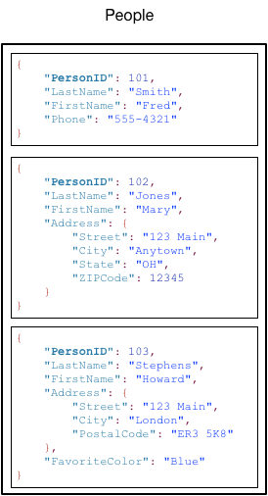
DynamoDB Table Example
Each item is composed of one or more attributes.
An attribute is a fundamental data element, something that does not need to be broken down any further.
For example, an item in a People table contains attributes called PersonID, LastName, FirstName, and so on.
item
attributes
item
item

Slide 51
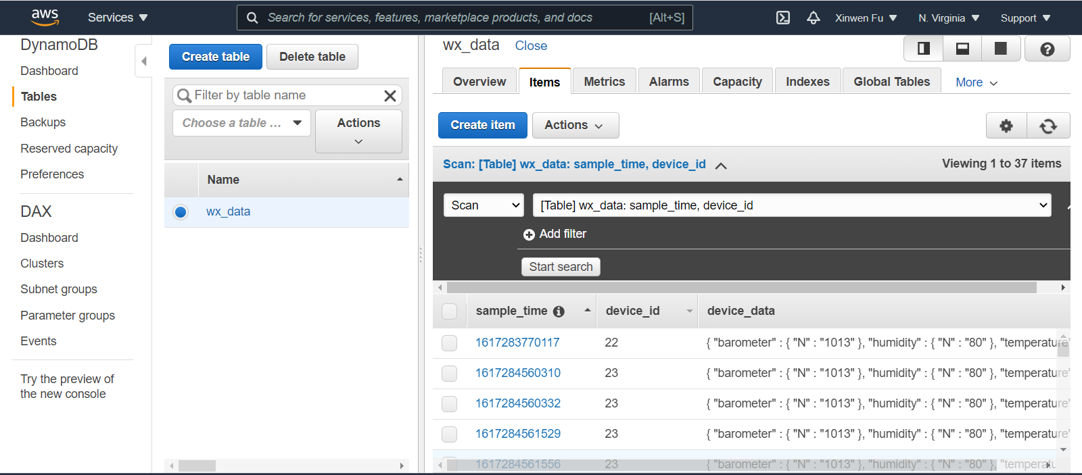
Table Example

Slide 52
AWS IoT Rules Engine
RULES ENGINE
Transform messages based on rules and route to AWS Services

Slide 53
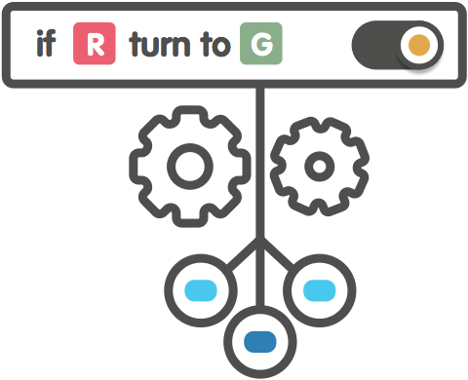


AWS IoT Rules Engine Basics
Rule
Name
Description
SQL Statement
Array of Actions
SELECT * FROM ‘things/thing-2/color’ WHERE color = ‘red’

Slide 54
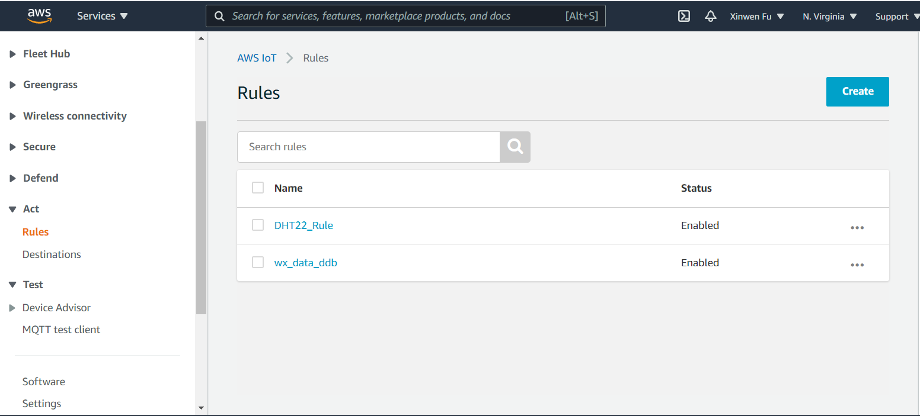
Rule
Act -> Rules

Slide 55
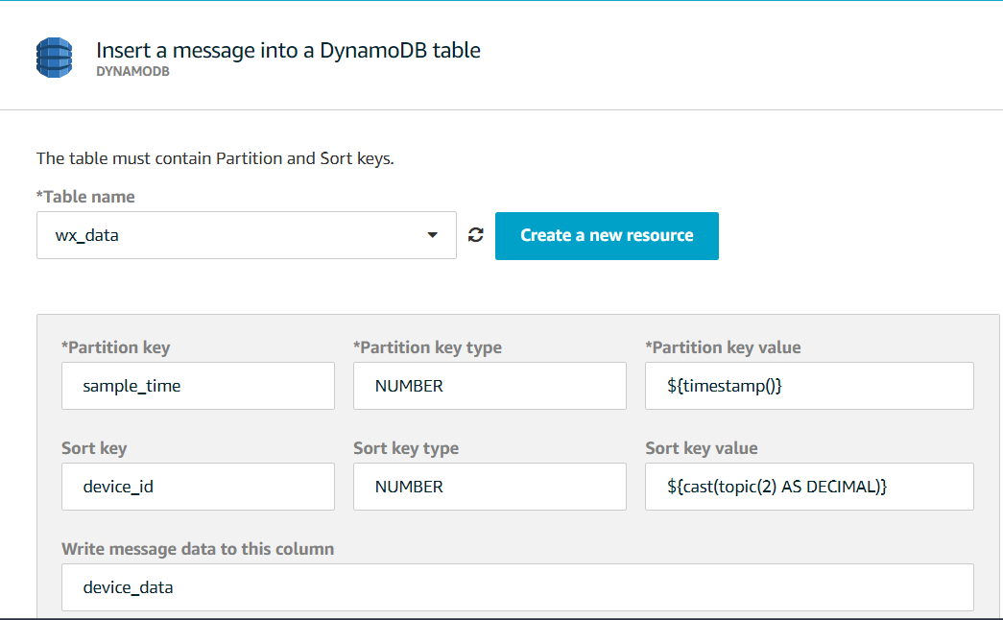
Rule Example: Insert a message into a DynamoDB table
Act -> Rules -> Create

Slide 56
AWS IoT Rules Engine Actions
AWS Services
- - - - -
3rd Party Services
AWS Services
- - - - -
3P Services
RULES ENGINE
Transform messages based on rules and route to AWS Services

Slide 57
Outline
Introduction
Device registry - thing, keys, certificate, policy
Security and identity
Device gateway – MQTT
Rules Engine
Pricing
Example code with MQTT

Slide 58
Pricing - Pay as You Go
No minimum
$5 per million messages published to, or delivered in US East (N. Virginia), US West (Oregon), EU (Ireland)
$8 per million in Asia Pacific (Tokyo)
No fees for Rules, Shadows, Deliveries to other AWS Services
Free Tier
250,000 Messages Per Month Free for first 12 Months

Slide 59
Outline
Introduction
Device registry - thing, keys, certificate, policy
Security and identity
Device gateway – MQTT
Rules Engine
Pricing
Example code with MQTT

Slide 60
Demo

Slide 61
References
[1] AWS account root user credentials and IAM user credentials, Accessed on 4/1/2021
[2] Create AWS IoT resources, Accessed on 4/1/2021
[3] Core Components of Amazon DynamoDB, Accessed on 4/1/2021
[4] Core Components of Amazon DynamoDB, Accessed on 4/1/2021
[5] Store device data in a DynamoDB table, Accessed on 4/1/2021
[6] MQTT topics, Accessed on 4/1/2021
[7] AWS IoT Device Shadow service, Accessed on 4/1/2021
[8] Device Shadow MQTT topics, Accessed on 4/2/2021

