Slide 1
IoT Security and Privacy
Secure Boot
Xinwen Fu

Slide 2
Outline
Introduction
Secure boot overview
Secure boot steps
Notes

Slide 3
Secure Boot v.s. Flash Access
Most data is stored in flash
Flash access does not need to be protected from physical access in order for secure boot to function, because critical data used in secure boot is stored (non-software-accessible) in eFuses internal to the chip
eFuses are used to store the secure bootloader key (in eFuse BLOCK2), and also a single eFuse bit (ABS_DONE_0) is burned (written to 1) to permanently enable secure boot on the chip

Slide 4
Chain of Trust
Both stages of the boot process (initial software bootloader load, and subsequent partition & app loading) are verified by the secure boot process, in a “chain of trust” relationship

Slide 5
Outline
Introduction
Secure boot overview
Secure boot steps
Notes

Slide 6
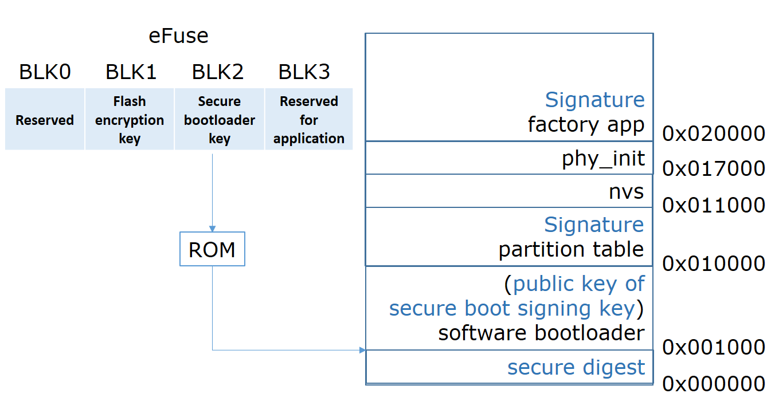
Flash Layout with Secure Boot

Slide 7
Secure Boot Process Overview
The options to enable secure boot are provided in the Project Configuration Menu (i.e. menuconfig), under “Security features”
Secure Boot defaults to signing images and partition table data during the build process

Slide 8
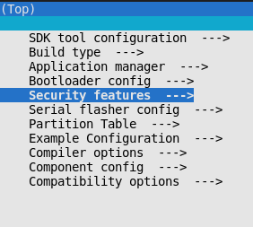
Menuconfig: Security Features

Slide 9
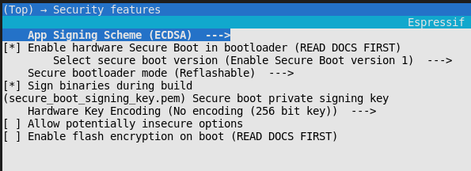
Menuconfig: Secure Boot

Slide 10
Keys
“Secure bootloader key”
256-bit AES key that is stored in eFuse block 2
The bootloader can generate this key itself from the internal hardware random number generator, e.g. in one-time flash mode
“Secure boot signing key”
A standard ECDSA public/private key pair
The public key from this key pair is compiled into the software bootloader and used to verify the second stage of booting (partition table, app image) before booting continues.
The private key from this key pair must be securely kept private, as anyone who has this key can authenticate to any bootloader that is configured with secure boot and the matching public key

Slide 11
Secure Boot Modes
One-Time Flash
Hardware generates a unique Secure bootloader key that is never stored outside the device
Reflashable
A user supplies a 256-bit binary key file that is used for the secure bootloader key
As you have the key file, you can generate new bootloader images and secure boot digests for them.
In the esp-idf build process, the SHA-256 digest of the private key of the ECDSA app signing key is used as the secure bootloader key in effuse
App can be changed in both modes

Slide 12
Outline
Introduction
Secure boot overview
Secure boot steps
Notes

Slide 13
Enable One-time Flash Mode of Secure Boot

Slide 14
Enable Secure Boot One-time Flash
Enable hardware Secure Boot in bootloader – “One-time Flash”
Select a name for the secure boot signing key
The file can be anywhere on your system. A relative path will be evaluated from the project directory
The file does not need to exist yet.
Set other menuconfig options (as desired)

Slide 15
Enable Secure Boot One-time Flash
The first time you run idf.py build, if the signing key is not found then an error message will be printed with a command to generate a signing key via espsecure.py generate_signing_key
Run idf.py bootloader to build a secure boot enabled bootloader.
The build output will include a prompt for a flashing command, using esptool.py write_flash.

Slide 16
Enable Secure Boot One-time Flash
When you’re ready to flash the bootloader, run the specified command (you have to enter it yourself, this step is not performed by make) and then wait for flashing to complete
Remember this is a one time flash, you can’t change the bootloader after this!
Run idf.py flash to build and flash partition table and just-built app image
The app image will be signed using the signing key you generated in step 4.
idf.py flash doesn’t flash the bootloader if secure boot is enabled.

Slide 17
Enable Secure Boot One-time Flash (Cont’d)
(First boot) Reset ESP32 and boot the software bootloader you flashed
The software bootloader will enable secure boot on the chip, and then it verifies the app image signature and boots the app.
Hardware secure boot support generates a device secure bootloader key (generated via hardware RNG, then stored read/write protected in eFuse), and a secure digest
The digest is derived from the key, an IV, and the bootloader image contents and is flashed at offset 0x0 in the flash
Depending on Secure Boot Configuration, eFuses are burned to disable JTAG and the ROM BASIC interpreter
Bootloader permanently enables secure boot by burning the ABS_DONE_0 eFuse
The software bootloader then becomes protected (the chip will only boot a bootloader image if the digest matches)
If the ESP32 is reset or powered down during the first boot, it will start the process again on the next boot.

Slide 18
Enable Secure Boot One-time Flash (Cont’d)
On subsequent boots the ROM bootloader sees that the secure boot eFuse is burned, reads the saved digest at 0x0 and uses hardware secure boot support to compare it with a newly calculated digest
If the digest does not match then booting will not continue.
The digest and comparison are performed entirely by hardware, and the calculated digest is not readable by software.
When running in secure boot mode, the software bootloader uses the secure boot signing key (the public key of which is embedded in the bootloader itself, and therefore validated as part of the bootloader) to verify the signature appended to all subsequent partition tables and app images before they are booted.

Slide 19
Enable Reflashable Mode of Secure Boot

Slide 20
Enable Secure Boot Reflashable
Enable hardware Secure Boot in bootloader – Reflashable
Bootloader is configured to this end
Generate secure boot signing key by user
Build bootloader
Append the public key component of the signing key to the software bootloader, and
Calculate the secure bootloader key, which is the SHA-256 digest of the private key of the ECDSA app signing key
Burn secure bootloader key into eFuse by user
Upload/flash the bootloader including secure digest
Flash app and others

Slide 21
Enable Secure Boot One-time Flash (Cont’d)
(First boot) Reset ESP32 and boot the software bootloader you flashed
The software bootloader will enable secure boot on the chip, and then it verifies the app image signature and boots the app
If the ESP32 is reset or powered down during the first boot, it will start the process again on the next boot
On subsequent boots,
the secure boot hardware will verify the software bootloader has not changed (using the secure bootloader key) and then
the software bootloader will verify the signed partition table and app image (using the public key portion of the secure boot signing key)

Slide 22
Outline
Introduction
Secure boot overview
Secure boot steps
Notes

Slide 23
Secure Boot & Flash Encryption
If secure boot is used without Flash Encryption, it is possible to launch “time-of-check to time-of-use” attack, where flash contents are swapped after the image is verified and running.
It is recommended to use both the features together.

Slide 24
JTAG Debugging
By default, when Secure Boot is enabled then JTAG debugging is disabled via eFuse.
The bootloader does this on first boot, at the same time it enables Secure Boot.

