Slide 1

IoT Security and Privacy
Introduction to Cryptography I

Slide 2
Outline
Introduction to cryptography
Some Trivial Codes
Types of Cryptography and their Applications

Slide 3
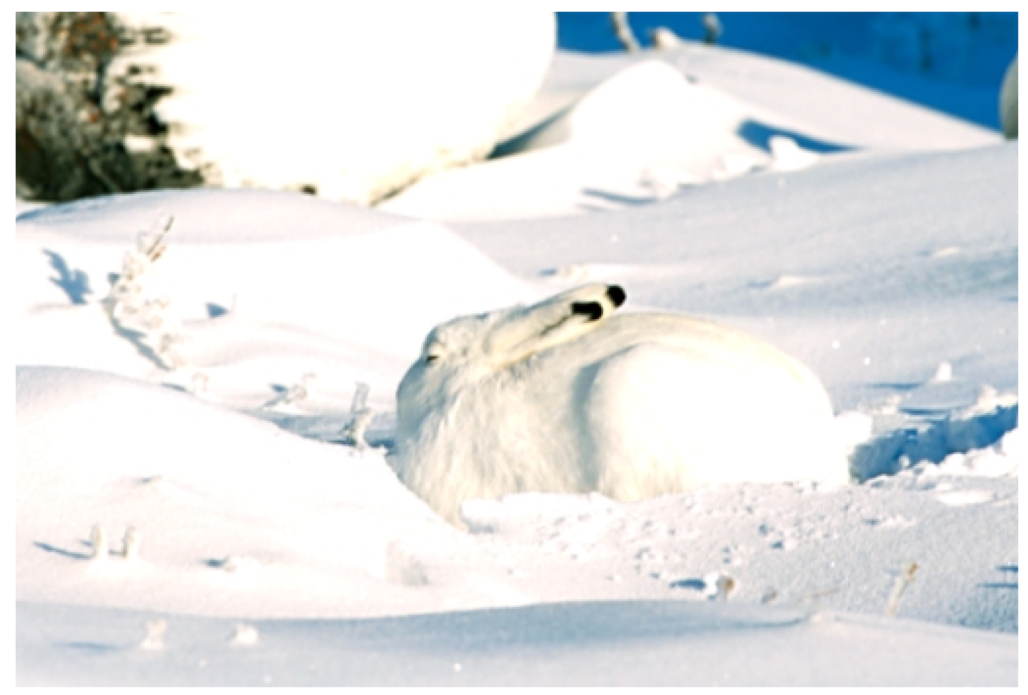
Cryptography
Cryptography
Original meaning: The art of secret writing
Becoming a science that relies on mathematics (number theory, algebra)
Process data into unintelligible form, reversible, without data loss
Usually one-to-one

Slide 4

Encryption/Decryption
plaintext
ciphertext
plaintext
encryption
decryption
encryption key
decryption key
Communication Media
Plaintext: a message in its original form
Ciphertext: a message in the transformed, unrecognized form
Encryption: the process that transforms a plaintext into a ciphertext
Decryption: the process that transforms a ciphertext to the corresponding plaintext
Key: the value used to control encryption/decryption

Slide 5
Cryptanalysis (algorithms are known)
Definition:
Assumption: The encryption/decryption algorithms are known.
Get the keys

Slide 6
Cryptanalysis (Cont.)
Ciphertext only:
Analyze only with the ciphertext
Example: Exhaustive search until “recognizable plaintext”
Smarter ways available
Known plaintext:
Secret may be revealed (by spy, time), thus <ciphertext, plaintext> pair is obtained
Chosen plaintext:
Choose text, get encrypted
Useful if limited set of messages

Slide 7
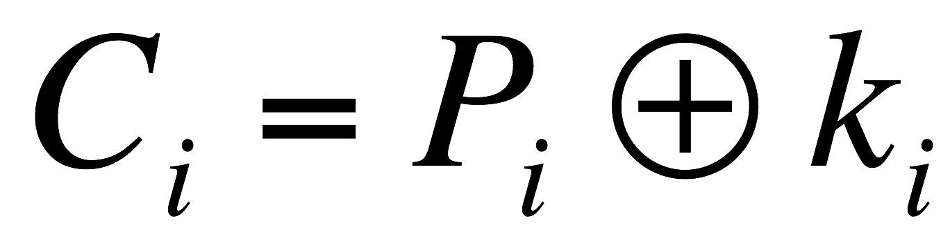
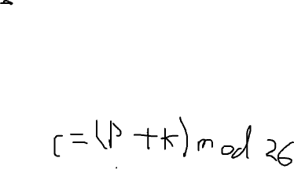
Security of An Encryption Algorithm
Unconditionally secure
It is impossible to decrypt the ciphertext
One-time pad (the key is as long as the plaintext)
Computationally secure
The cost of breaking the cipher exceeds the value of the encrypted information
The time required to break the cipher exceeds the useful lifetime of the information

Slide 8
Secret Keys v.s. Secret Algorithms
plaintext
ciphertext
encryption
key
Security by obscurity
We can achieve better security if we keep the algorithms secret
Hard to keep secret if used widely
Reverse engineering, social engineering
Publish the algorithms
Security of the algorithms depends on the secrecy of the keys
Less unknown vulnerability if all the smart (good) people in the world examine the algorithms

Slide 9
Secret Keys v.s. Secret Algorithms (Cont.)
Commercial world
Published
Wide review, trust
Military
Keep algorithms secret
Avoid giving enemy good ideas
Military has access to the public domain knowledge anyway

Slide 10
Outline
Introduction to cryptography
Some Trivial Codes
Types of Cryptography and their Applications

Slide 11
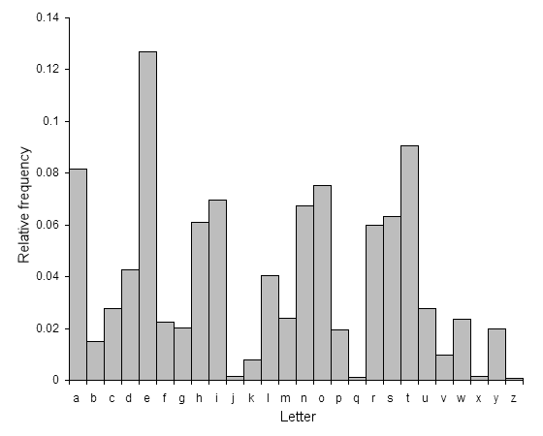
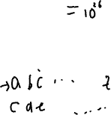
Some Trivial Codes
Mono-alphabetic cipher:
Arbitrary mapping of one letter to another
26!
Statistical analysis of letter frequencies
e
t
http://en.wikipedia.org/wiki/Letter_frequencies

Slide 12
Some Trivial Codes (Cont.)
Caesar cipher
Substitution cipher
Replace each letter with the one 3 letters later
A → D, B → E
x | y | z | a | b | c | d | e | f | g | h | i | j | k | l | m | n | o | p | q | r | s | t | u | v | w
a | b | c | d | e | f | g | h | i | j | k | l | m | n | o | p | q | r | s | t | u | v | w | x | y | z
hello
khoor

Slide 13
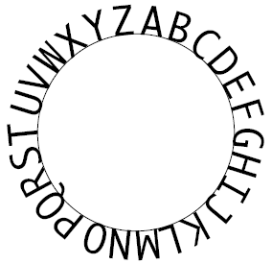
Captain Midnight Secret Decoder Rings
only 26 possibilities
Notes:
The Captain Midnight decoder ring (which is an "encoder" ring as well) allows you to do a simple substitution cipher. It usually has two concentric wheels of letters, A through Z. You rotate the outside ring and substitute the letters in your message found on the outside ring with the letters directly below on the inside ring (see diagram). Here, the algorithm is to offset the alphabet and the key is the number of characters to offset it. Julius Caesar used this simple scheme, offsetting by 3 characters (He would have put the "A" on the outer ring of letters over the "D" on the inner ring if he had owned a Captain Midnight decoder ring.) The word "EXPLORATORIUM" thus becomes "HASORUDWRULXP." Such a scheme was easily broken and showed a certain level of naivete on Caesar's part concerning the enemy's intelligence.

Slide 14
Some Trivial Codes (Cont.)
a | 0
b | 1
c | 2
d | 3
e | 4
f | 5
g | 6
h | 7
i | 8
j | 9
k | 10
l | 11
m | 12
n | 13
o | 14
p | 15
q | 16
r | 17
s | 18
t | 19
u | 20
v | 21
w | 22
x | 23
y | 24
z | 25
Affine Cipher
Encoding letters as numbers [0, 25]
E_{a,b}(x)=(ax+b)%26; (a,b) is the key
Reduction modulo N%m: N=qm+r, 0≤r<m; 7%6=?
E_{3,11}(a)=?
Multiple round affine cipher E_{a,b}(E_{a,b}(E_{a,b}(x)))
Notes:
The reduction modulo m of N is the remainder when N is divided by m

Slide 15
Some Trivial Codes (Cont.)
Poly-alphabetic Ciphers
A letter may be encrypted into different letters from time to time

Slide 16
Some Trivial Codes (Cont.)
All the previous codes are based on substitution
Transposition (permutation) - Columnar Transposition
Key | 1 | 2 | 3 | 4 | 5 | 6 | 7
 | 4 | 3 | 1 | 2 | 5 | 6 | 7
Plaintext: | A | T | T | A | C | K | P
 | O | S | T | P | O | N | E
 | D | U | N | T | I | L | T
 | W | O | A | M | X | Y | Z
Write in rows of fixed length
Read column by column in a scrambled order
Ciphertext: TTNAAPTMTSUOAODWCOIXKNLYPETZ
Notes:
In a columnar transposition, the message is written out in rows of a fixed length, and then read out again column by column, and the columns are chosen in some scrambled order. Both the length of the rows and the permutation of the columns are usually defined by a keyword.

Slide 17
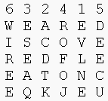
Columnar Transposition
The permutation
(transposition) is defined by the alphabetical order of the letters within the keyword
Plaintext
Ciphertext
Z E B R A S
Notes:
For example, the word ZEBRAS is of length 6 (so the rows are of length 6), and the permutation is defined by the alphabetical order of the letters in the keyword. In this case, the order would be "6 3 2 4 1 5".
In a regular columnar transposition cipher, any spare spaces are filled with nulls; in an irregular columnar transposition cipher, the spaces are left blank. Finally, the message is read off in columns, in the order specified by the keyword.
http://en.wikipedia.org/wiki/Transposition_cipher
For example, suppose we use the keyword ZEBRA and the message WE ARE DISCOVERED. FLEE AT ONCE. In a regular columnar transposition, we write this into the grid as

Slide 18
One time pad
E (x₁|…|x_{n})=(x₁+k₁)%26|…|(x_{n}+k_{n})%26
Where is it used?

Slide 19
Outline
Introduction to cryptography
Some Trivial Codes
Types of Cryptography and their Applications

Slide 20
Types of Cryptography
Number of keys
Hash functions: no key
Secret key cryptography: one key
Public key cryptography: two keys - public, private
The way in which the plaintext is processed
Block cipher: divides input elements into blocks
Stream cipher: process one element (e.g., byte) a time

Slide 21
Secret Key Cryptography
plaintext
ciphertext
plaintext
encryption
decryption
key
Same key
key
Same key is used for encryption and decryption
Also known as
Symmetric cryptography
Conventional cryptography

Slide 22
Secret Key Cryptography (Cont.)
Basic technique
Product cipher
Multiple applications of interleaved substitutions and permutations
plaintext
S
P
S
P
…
S
ciphertext
key
Notes:
break

Slide 23
Secret Key Cryptography (Cont.)
Ciphertext approximately the same length as plaintext
Examples
Stream Cipher: RC4
Block Cipher: DES, 3DES, IDEA, AES

Slide 24
Applications of Secret Key Cryptography
Transmitting over an insecure channel
Challenge: How to share the key?
Secure Storage on insecure media
Integrity check
Message integrity code (MIC)
Message
Encrypted Message

Slide 25
Authentication Using Secret Key Cryptography
Challenge-response
To prove the other party knows the secret key
Must be secure against chosen plaintext attack
Alice
Bob
r_{A}
Alice’s K_{A,B}(r_{A})
=
K_{A,B}(r_{A}) from Bob
K_{A,B}(r_{A})
?
r_{B}
K_{A,B}(r_{B})

Slide 26
Public Key Cryptography
plaintext
ciphertext
plaintext
encryption
decryption
Public key (e)
Private key (d)
Invented/published in 1975 (?)
A public/private key pair is used
Public key can be publicly known
Private key is kept secret by the owner of the key
Much slower than secret key cryptography
Also known as
Asymmetric cryptography

Slide 27

Applications of Public Key Cryptography
Data transmission:
Alice encrypts m_{a} using Bob’s public key e_{B}, Bob decrypts m_{a} using his private key d_{B}
Storage:
Can create a safety copy: using public key of trusted person
(e_{B}, d_{B})
d_{B}(e_{B}(message))=message
e_{B}(message)

Slide 28
Naive digital signature
(e_{B}, d_{B})
contract, d_{B}(contract)
contract
Yes/No
Sign
Verify
Digital
signature
Private key (d_{B})
Public key (e_{B})
?
e_{B}(d_{B}(contract))=contract
Only the party with the private key can create a digital signature
The digital signature is verifiable by anyone who knows the public key
The signer cannot deny that he/she has done so

Slide 29
Authentication Using Public Key Cryptography
No need to store secrets, only need public keys
Alice
Bob
e_{B}(r)
d_{B}(e_{B}(r))
r

Slide 30
Applications of Public Key Cryptography (Cont.)
Secret key cryptography: need to share secret key for every person to communicate with
Key exchange
Establish a common session key between two parties
Alice
Bob
e_{B}(session key)
d_{B}(e_{B}(session key))

Slide 31
Hash Algorithms
Message of
arbitrary length
A fixed-length
short message
Hash H
Also known as
Message digests
One-way transformations
One-way functions
Hash functions
Length of H(m) much shorter then length of m
Usually fixed lengths: 128 or 160 bits (16 bytes or 20 bytes)

Slide 32
Hash Algorithms (Cont.)
Desirable properties of hash functions
Performance: Easy to compute H(m)
One-way property: Given H(m) but not m, it’s difficult to find m
Weak collision free: Given H(m), it’s difficult to find m’ such that H(m’) = H(m).
Strong collision free: Computationally infeasible to find m₁, m₂ such that H(m₁) = H(m₂)

Slide 33

Applications of Hash Functions
message, d_{B}(message)
Primary application
Generate/verify digital signature
Message
m
H(m)
Signature
H
Sign
m, d_{B}(H(m))
Private key (d)
H(m)
H
Verify
Yes/No
e_{B}(d_{B}(H(m)))
m, d_{B}(H(m))
Public key (e)

Slide 34

Applications of Hash Functions (Cont.)
Password hashing
Doesn’t need to know password to verify it
Store H(password|salt) and salt, and compare it with the user-entered password
Salt makes dictionary attack more difficult
Message integrity
Keyed hash
Agree on a secret key k
Compute H(m|k) and send with m
But doesn’t require encryption algorithm, so the technology is exportable

