Slide 1
IoT Security and Privacy
Overview of IoT

Slide 2
Learning Outcomes
Upon completion of this unit:
Student will understand different visions of the Internet of Things (IoT) paradigm
Students will understand the enabling technologies, their advantages and disadvantages
Students will understand different aspects of IoT security and privacy

Slide 3
Outline
Different visions of the Internet of Things (IoT) paradigm
Enabling technologies, their advantages and disadvantages
IoT Applications

Slide 4
Impact of IoT
US National Intelligence Council (NIC) lists IoT as one of six ‘‘Disruptive Civil Technologies” giving US the edge in terms of national power
NIC foresees both benefits and threats
‘‘by 2025 Internet nodes may reside in everyday things – food packages, furniture, paper documents, and more”.
‘‘popular demand combined with technology advances could drive widespread diffusion of an Internet of Things (IoT) that could, like the present Internet, contribute invaluably to economic development”.
‘‘to the extent that everyday objects become information security risks, the IoT could distribute those risks far more widely than the Internet has to date”.

Slide 5
Challenges of IoT
Fully interoperate a large number of heterogeneous interconnected devices, which may
have low computation and energy capacity
require resource efficient solutions
require scalable solutions
Integrates high degree of smartness with adaptation and autonomous-ness
Guarantee trustworthiness with security and privacy

Slide 6
Views of IoT
Internet oriented
Interconnect things with standard communication protocols
Things oriented
Uniquely address things
Semantic oriented
Represent and store exchanged information

Slide 7
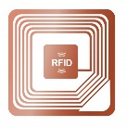
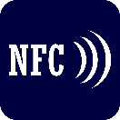
Internet of Things from different visions
[1]
“Things”
oriented visions
Everyday Objects
uID
Wireless Sensors and Actuators
WISP
Communicating
things
Smart Items
Connectivity for anything
Internet 0 (IP over anything)
Internet of Things
Semantic
Technologies
IPSO (IP for Smart Objects)
Smart Semantic Middleware
Reasoning over data
Web of Things
Semantic execution environments
“Internet”
oriented visions
“Semantic”
oriented visions

Slide 8
First definition of IoT
Comes from a ‘‘Things oriented” perspective
Interconnecting simple Radio-Frequency IDentification (RFID) tags
Coined by Auto-ID Labs, which
Are a world-wide organization of academic research laboratories on networked RFID and emerging sensing technologies.
Advocate the Electronic Product Code™ (EPC) for broad adoption of RFID in world-wide modern trading networks
Create the industry-driven global standards for the EPCglobal Network™

Slide 9
uID
Unique/Universal/Ubiquitous IDentifier (uID) is a competing architecture
Development of middleware based solutions for globally addressable objects
RFID is the mainstream driving the vision
RFID is mature, of low cost, and has strong support from the business community

Slide 10
Future of IoT
Will contain diverse device, network, and service technologies
Driving components linking the real world with the digital world
Near Field Communications (NFC)
Wireless Sensor and Actuator Networks (WSAN)
RFID
Ongoing major projects developing relevant platforms
WISP (Wireless Identification and Sensing Platforms) project.
Spime, a concept related to IoT, refers to an object
trackable through space and time throughout its lifetime
Sustainable
Enhanceable
Uniquely identifiable

Slide 11
the ITU vision of the IoT
ITU (International Telecommunication Union)
‘‘from anytime, anyplace connectivity for anyone, we will now have connectivity for anything”
‘‘Things having identities and virtual personalities operating in smart spaces using intelligent interfaces to connect and communicate within social, environmental, and user contexts”

Slide 12
Outline
Different visions of the Internet of Things (IoT) paradigm
Enabling technologies, their advantages and disadvantages
IoT Applications

Slide 13
Enabling technologies
Identification
Sensing
Communication technologies
Middleware

Slide 14
RFID
Architecture: one or more reader(s) and multiple RFID tags
Tags
A small microchip1 attached to an antenna, e.g. Hitachi tag 0.4 mm x 0.4 mm x 0.15 mm
Attached objects (including persons or animals).
A unique identifier
Readers
Generate a radio frequency signal to query tags
Trigger the tag transmission by the emitting signal
Receive tag IDs.
Properties
Monitor objects in real-time
No need of line-of-sight
Mapping objects into the virtual world
Various applications including logistics, e-health and security.

Slide 15
Different RFID Based on Power Capability
Passive RFID tags
No onboard power supplies
Harvest the energy from the query signal of a RFID to transmit their IDs
Semi-passive RFID tags
Batteries powered reception
Reader signal powered transmission
Active RFIDs
Battery powered reception and transmission
Highest radio coverage with higher production costs

Slide 16
Sensor networks
A sensor network
Sensing nodes communicate in a multi-hop fashion wirelessly.
Nodes report sensing results to sink nodes.
Design objectives of layers of communication
Energy efficiency, given energy is scarce
Scalability for the large number of nodes
Reliability in data transmission in case of urgent events
Robustness in case of failures

Slide 17
IEEE 802.15.4 Sensor Networks
Defines the physical and MAC layers for low-power, slow communications in wireless personal area networks (WPAN)
No specifications on the higher layers of the protocol stack, .e.g. connecting sensor nodes into the Internet.
Challenges for standardizing up-layer protocols
A very large number of nodes v.s. IP
802.15.4 physical layer packet is 127 bytes and too small for IP
Sensor nodes often in a sleep mode for energy saving are anomalous for IP networks.

Slide 18
Use of Sensor Networks
Integration of sensing technologies into passive RFID tags
New IoT applications into the IoT context, e.g. e-health
Intel wireless identification and sensing platforms (WISP).
Powered and read by passive RFID readers (no need of batteries),
Used to measure quantities such as light, temperature, acceleration, strain, and liquid level.

Slide 19
Comparison between RFID, wireless sensor networks, and RFID sensor networks
RFID sensor networks (RSN)
Small, RFID-based sensing and computing nodes
RFID readers as sink nodes and power source
Table 1 Comparison between RFID systems, wireless sensor networks, and RFID sensor networks.
[1]
 | Processing | Sensing | Communication | Range (m) | Power | Lifetime | Size | Standard
RFID | No | No | Asymmetric | 10 | Harvested | Indefinite | Very small | ISO 18000
WSN | Yes | Yes | Peer-to-peer | 100 | Battery | <3 years | Small | IEEE 802.15.4
RSN | Yes | Yes | Asymmetric | 3 | Harvested | Indefinite | Small | None

Slide 20
Middleware
A software layer or a set of sub-layers between underlying technological and application levels.
Hiding the details of lower layer technologies
Exempt programmers from hardware and system details
Enable programmer to focus on their applications enabled by the infrastructure

Slide 21
Service Oriented Architecture (SOA)
Decompose complex and monolithic systems into simpler and well-defined components.
Often not layered structure
Use common interfaces and standard protocols for easy interconnection
Abstract devices functionalities and communications functionalities
Common set of services
An environment for service composition

Slide 22
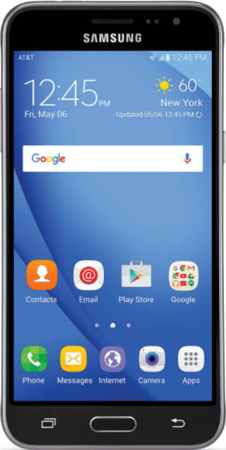
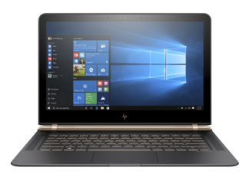
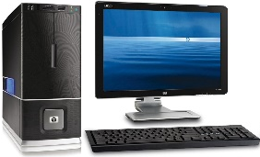
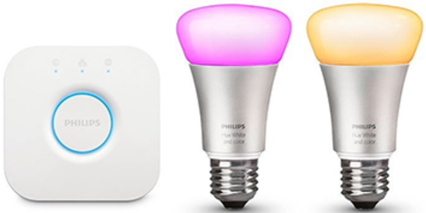
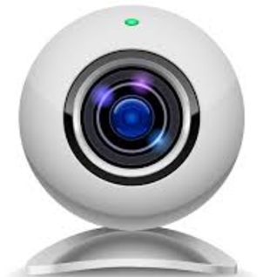
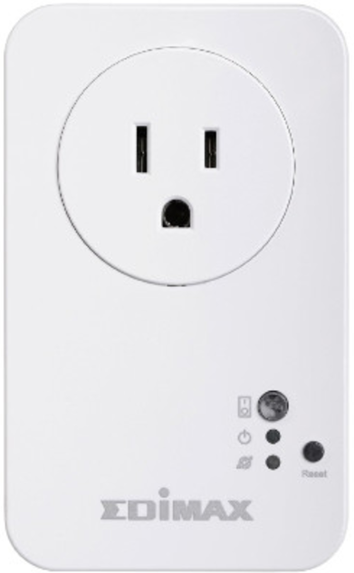
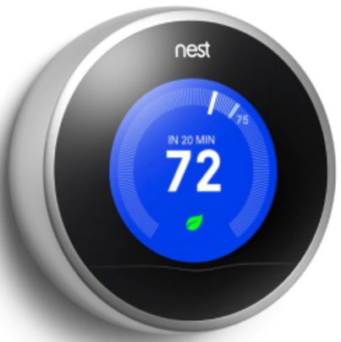
SOA-based Architecture
[1]
Applications
Service
Composition
Management of Trust, Privacy, Security
Service
Management
Object
Abstraction
Objects
Fig.2. SOA-based architecture for the IoT middleware

Slide 23
SOA Components
Applications – implementing the (distributed) system’s functionalities by using
Standard web service protocols
Service composition technologies
Service composition - Composition of single services for applications
Services are visible assets
Use business workflow languages to compose complex services

Slide 24
SOA Components (Cont’d)
Service management – providing object dynamic discovery, status monitoring, and service configuration
A service repository lists the catalogue of services and associated objects for easy reference
Object abstraction: standardizing access to different devices through a common language and procedure
Interface layer – use a web interface exposing the methods; manages communications with the external world.
The communication sub-layer – implementing the web service methods and communicating with the real-world objects

Slide 25
SOA Components (Cont’d)
Trust, privacy and security management
For example, malicious query of RFID tags for surveillance of our lives.
Managed by the middleware for all the exchanged data.
Built on one specific layer or distributed through all layers,
No obvious degradation of system performance

Slide 26
Other Architectures - Fosstrak
Management of RFID related applications
An open source RFID infrastructure implementing the EPC Network specifications
Data dissemination, aggregation, filtering, interpretation
Writing to a tag, trigger RFID reader from external sensors
fault and configuration management
Sharing RFID triggered business events, lookup and directory service
Tag identifier management, and privacy

Slide 27
Other Architectures - e-SENSE project
Capturing ambient intelligence through WSNs
Four logical subsystems
Application, management, middleware, and connectivity.
Each subsystem uses service access points to provide access to other subsystems
This entire stack is implemented in a full function sensor node and a gateway node?
A reduced-function sensor node has fewer functions.
The middleware subsystem works in a distributed fashion
The result can be sent to an actuating node and/or to the fixed infrastructure through a gateway

Slide 28
Outline
Different visions of the Internet of Things (IoT) paradigm
Enabling technologies, their advantages and disadvantages
IoT Applications

Slide 29
Applications and Example Scenarios
[1]
Transportation and logistics domain.
Healthcare domain.
Smart environment (home, office, plant) domain.
Personal and social domain
Transportation and logistics
Healthcare
Smart environments
Personal and social
Futuristic
Logistics
Tracking
Comfortable homes/offices
Social networking
Robot taxi
Assisted driving
Identification authentication
Historical queries
Industrial plants
City information model
Mobile ticketing
Losses
Data collection
Smart museum and gym
Enhanced game room
Environment monitoring
Sensing
Thefts
Augmented maps

Slide 30
Transportation and Logistics
Logistics: Real-time monitoring of the supply chain, such as raw material purchasing, transportation storage, and after-sales service, for example by use of RFID and NFC
Assisted driving: Collision avoidance, monitoring of transportation of hazardous materials, road traffic patterns
Mobile ticketing: NFC tag
Monitoring environmental parameters: transportation of fruits, fresh-cut produce, meat, and dairy product with monitored environment
Augmented maps: Tagged touristic maps for read by NFC-equipped phones

Slide 31
Healthcare Domain
Tracking: the identification of moving person or object Identification and authentication: patient identification, electronic medical record maintenance, and infant identification to prevent mismatching
Data collection: automatic form processing, process automation, automated care and procedure auditing, and medical inventory management
Sensing: diagnosing patient conditions, providing real-time information on patient health indicators

Slide 32
Smart Environments
Comfortable homes and offices
Industrial plants: automation through tagged production parts
Smart museum
Monitored museum environment good for expositions
Smart gym
Personalized training with loaded health parameters to prevent overtraining or ensure appropriate exercises.

Slide 33
Personal and Social
Social networking: RFID tags
Historical queries of where, how, and with whom or what through for example the Google Charts API
Losses: view the last recorded or real-time location of tagged objects
Thefts: similar to the loss

Slide 34
Futuristic applications domain
Robot taxi: adapt to real-time traffic, reduce congestion reduce congestion of busy roads
City information model: monitoring the status and performance of buildings and urban fabrics – such as pedestrian walkways, cycle paths and heavier infrastructure like sewers, rail lines, and bus corridors
Enhanced game room: body sensor network to sense location, movement, acceleration, humidity, temperature, noise, voice, visual information, heart rate and blood pressure.

Slide 35
Open Issues
[1]
Table 2 Open research issues
Open issue | Brief description of the cause | Details in
Standards | There are several standardization efforts but they are not integrated in a comprehensive framework | Section 5.1
Mobility support | There are several proposals for object addressing but none for mobility support in the IoT scenario, where scalability and adaptability to heterogeneous technologies represent crucial problems | Section 5.2
Naming | Object Name Servers (ONS) are needed to map a reference to a description of a specific object and the related identifier, and vice versa | Section 5.2
Transport protocol | Existing transport protocols fails in the IoT scenarios since their connection setup and congestion control mechanisms may be useless; furthermore, they require excessive buffering to be implemented in objects | Section 5.2
Traffic characterization and QoS support | The IoT will generate data traffic with patterns that are expected to be significantly different from those observed in the current Internet. Accordingly, it will also be necessary to define new QoS requirements and support schemes | Section 5.2
Authentication | Authentication is difficult in the IoT as it requires appropriate authentication infrastructures that will not be available in IoT scenarios. Furthermore, things have scarce resources when compared to current communication and computing devices. Also man-in-the-middle attack is serious problem | Section 5.3
Data integrity | This is usually ensured by protecting data with passwords. However, the password lengths supported by IoT technologies are in most cases too short to provide strong levels of protection | Section 5.3
Privacy | A lot of private information about a person can be collected without the person being aware. Control on the diffusion of all such information is impossible with current techniques | Section 5.3
Digital forgetting | All the information collected about a person by the IoT may be retained indefinitely as the cost of storage decreases. Also data mining techniques can be used to easily retrieve any information even after several years | Section 5.3

Slide 36
Standardization activity
[1]
Different sections of the Auto-ID Lab scattered all over the world
European Commission and European Standards Organizations (ETSI, CEN, CENELEC, etc.) and international counterparts ISO, ITU
IETF, EPCglobal, etc.
Standard | Objective | Status | Comm. Range(m) | Data rate (kbps) | Unitary cost ($)
EPCglobal | Integration of RFID technology into the electronic product code (EPC) framework, which allows for sharing of information related to products | Advanced | ~ 1 | ~ 10² | ~ 0.01
GRIFS | European Coordinated Action aimed at defining RFID standards supporting the transition from localized RFID applications to the Internet of Things | Ongoing | ~ 1 | ~ 10² | ~ 0.01
M2M | Definition of cost-effective solutions for machine-to-machine (M2M) communications, which should allow the related market to take off | Ongoing | N.S. | N.S. | N.S.
6LoWPAN | Integration of low-power IEEE 802.15.4 devices into IPv6 networks | Ongoing | 10 - 100 | ~ 10² | ~ 1
ROLL | Definition of routing protocols for heterogeneous low-power and lossy networks | Ongoing | N.S. | N.S. | N.S.
NFC | Definition of a set of protocols for low range and bidirectional communications | Advanced | ~ 10² | Up to 424 | ~ 0.1
Wireless Hart | Definition of protocols for self-organizing, self-healing and mesh architectures over IEEE 802.15.4 devices | Advanced | 10 - 100 | ~ 10² | ~ 1
ZigBee | Enabling reliable, cost-effective, low-power, wirelessly networked, monitoring and control products | Advanced | 10 - 100 | ~ 10² | ~ 1
Table 3 Characteristics of the most relevant standardization activities

Slide 37
Addressing and Networking Issues
6LoWPA: IPV6 addressing for low-power wireless
Enough?
Integration of RFID tags through 64–96 bit identifiers by EPCglobal, solutions into IPv6 networks
Open issues:
Mobility support
Object Name Service (ONS) like DNS
Reliable transmission and congestion control: tcp too costly in terms of overhead and buffering?

Slide 38
Security
Physical attack, eavesdropping, weak security schemes because of poor computation power
authentication and data integrity
proxy attack problem, also known as the man-in-the-middle attack
A
B’
A’
B
Query
Message(Query)
Copy of the Query
Reply
Message(Reply)
Copy of the Reply
Time
Time
Time
Time
Man in the middle attack

Slide 39
Security (Cont’d)
Data integrity to detect the data change
Unattended RFID systems
Data modified while stored in the node or during transmission
Typical cryptographic algorithms too costly for low energy and bandwidth IoT nodes

Slide 40
Privacy
IoT devices are pervasive
Privacy solutions
individuals control their data in terms of collection by who and when
Personal data should be used for only authorized services by authorized service providers
Personal data should be stored only when really needed

Slide 41
Privacy (Cont’d)
Challenges
Pervasive sensor networks monitoring individuals entering. How to control?
Solutions
Privacy broker
digital forgetting? (delete on purpose automatically)

Slide 42
References
[1] Luigi Atzori, Antonio Iera, Giacomo Morabito, The Internet of Things: A survey, Computer Networks 54 (2010) 2787–2805
[2] Jayavardhana Gubbia, Rajkumar Buyyab, Slaven Marusic, Marimuthu Palaniswami, Internet of Things (IoT): A vision, architectural elements, and future directions, Future Generation Computer Systems 29 (2013) 1645–1660
[3] Zhen Ling, Junzhou Luo, Yiling Xu, Chao Gao, Kui Wu, Xinwen Fu, "Security Vulnerabilities of Internet of Things: A Case Study of the Smart Plug System", accepted to appear in IEEE Internet of Things Journal (IoT-J), 2017.

