Slide 1
IoT Security and Privacy
Lab Environment
Xinwen Fu

Slide 2
Outline
Ubuntu VM for programming
Programming platform

Slide 3
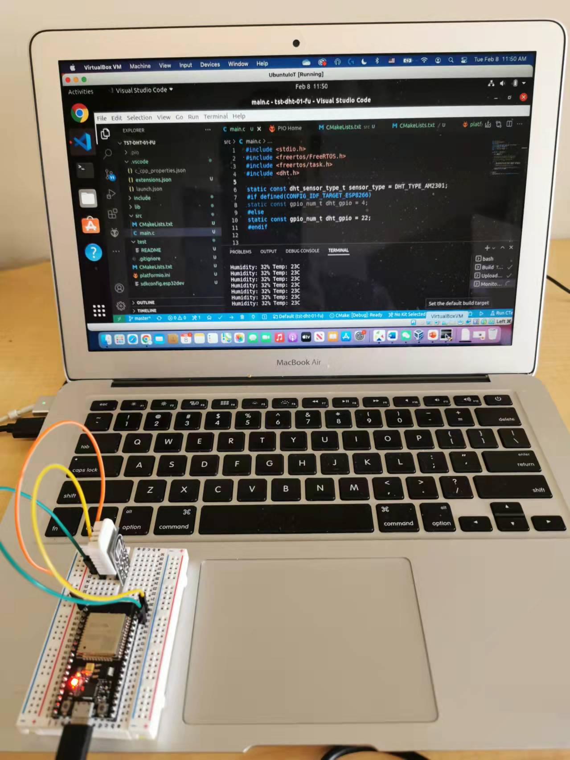
Example Lab VM
Host: MacOS
Guest: Ubuntu VM
Ubuntu VM
DHT22
ESP32
Micro USB Data Cable

Slide 4
Host and Guest Configuration
First configure Host -- Windows 10
Install CP210x USB to UART Bridge VCP Drivers (CP210x Universal Windows Driver)
Install VirtualBox and VirtualBox Extension Pack as Administrator
Second set up Guest -- Ubuntu
Click provided .ova and follow instructions to install Ubuntu VM
Set USB device filters within VirtualBox manager for Ubuntu VM to attach the IoT kit to Ubuntu VM
Start Ubuntu VM
Install guest Additions (Already installed; Optional)
Unplug and re-plug if the IoT kit is connected
Type in terminal -- ls /dev -- lists the device as ttyUSB0
In Windows 10, under Universal Bus Serial Controllers, shall see VirtualBox USB

Slide 5
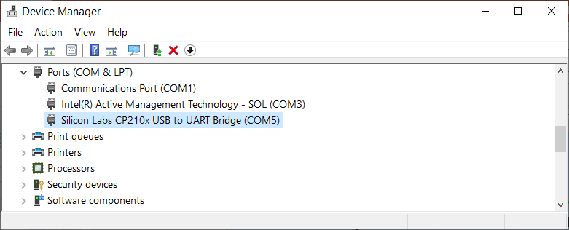
1. Installing CP210x Driver
Device manager shows Silicon Labs CP210x USB to UART Bridge (COMx), where x may be different at different computers
Don’t start VirtualBox yet

Slide 6
2. Install VirtualBox, Extension Pack and Guest Additions
Install VirtualBox as Administrator
Install VirtualBox Extension Pack
“Support for USB 2.0 and USB 3.0 devices, VirtualBox RDP, disk encryption, NVMe and PXE boot for Intel cards”
Click provided the .ova file and follow instructions to install Ubuntu VM
Set USB device filters within VirtualBox manager for Ubuntu VM to attach the IoT kit to Ubuntu VM
Start Ubuntu VM
Eject the CD image if necessary
install and Guest Additions
Click Devices -> Insert Guest Additions CD Image… The installation process shall automatically start and follow on-screen instructions

Slide 7
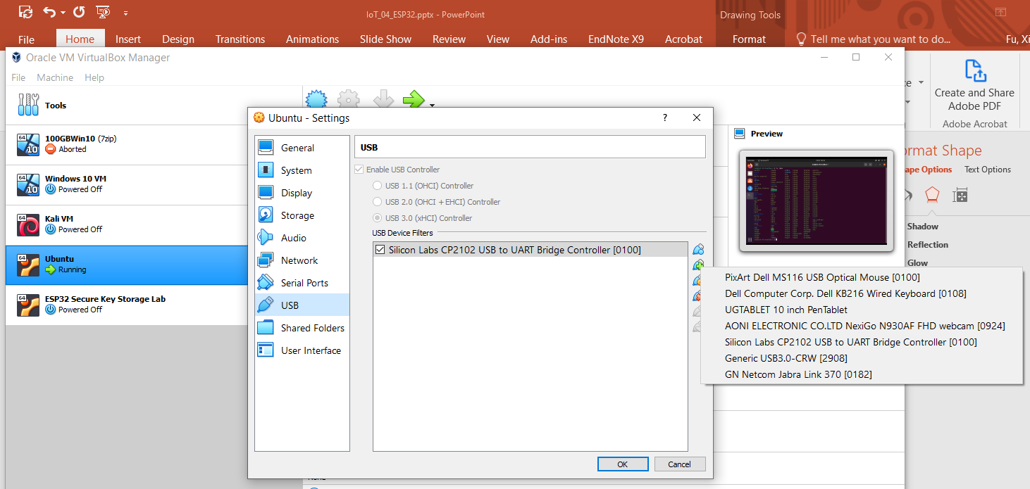
Notes: 4. Set USB device filters
Ubuntu -> Settings -> USB -> “Add USB filters with all fields set to the values of the selected USB device attached to the host PC”

Slide 8
7. Unplug and re-plug if the IoT kit is connected
Capturing a USB device in VirtualBox
Set USB device filters to add the particular USB device to the Ubuntu VM
Once attached to the Ubuntu VM, the host cannot use it any more
Unplugging and re-plugging will allow VirtualBox to capture the USB device
Our IoT kit is connected to the PC with a micro-USB cable

Slide 9
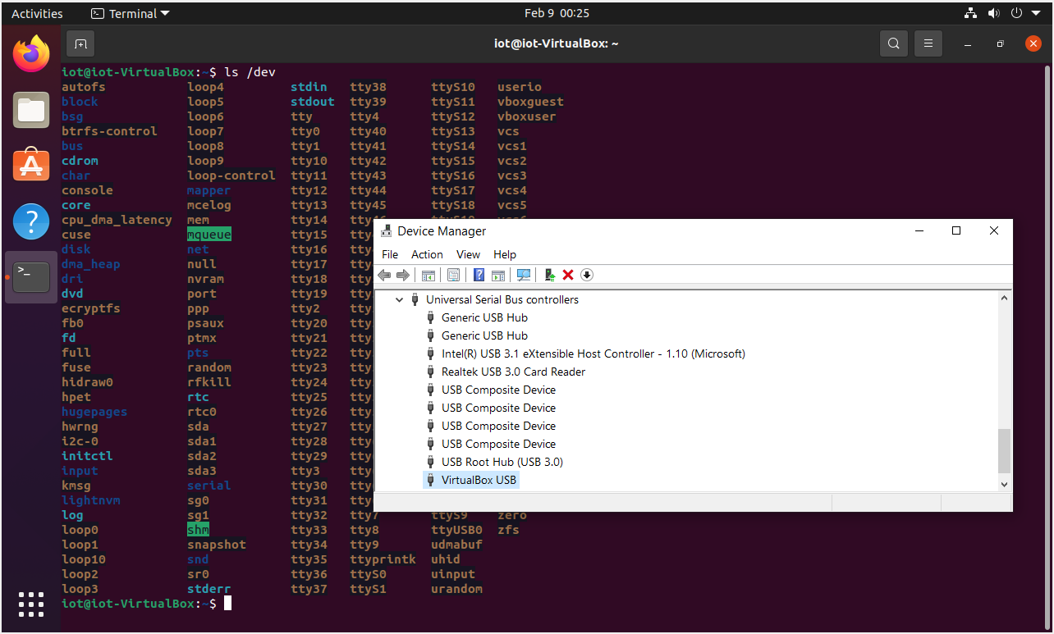
8. ls /dev -- ttyUSB0 and 9. VirtualBox USB
Device manager in Windows 10 shows VirtualBox USB
ls dev in Ubuntu shows ttyUSB0

Slide 10
Outline
Ubuntu VM for programming
Programming platform

Slide 11
Three Integrated Development Environments (IDEs)
Espressif IoT Development Framework (esp-idf)
/home/iot/esp
ESP-IDF VS Code Extension
Develop, build, flash, monitor, debug and more with Espressif chips using Espressif IoT Development Framework (ESP-IDF)
Arduino IDE
Show Application -> Arduino IDE
PlatformIO within Visual Studio Code (VS Code)
Show Application -> Visual Studio Code

Slide 12
1. ESP-IDF
Official development framework for the ESP32, ESP32-S and ESP32-C Series SoCs
Setting up Development Environment
Step 1. Install prerequisites for Windows, Linux, or macOS
Step 2. Get ESP-IDF
Step 3. Set up the tools
Step 4. Set up the environment variables
Creating Your First Project
Step 5. Start a Project
Step 6. Connect Your Device
Step 7. Configure
Step 8. Build the Project
Step 9. Flash onto the Device
Step 10. Monitor

Slide 13
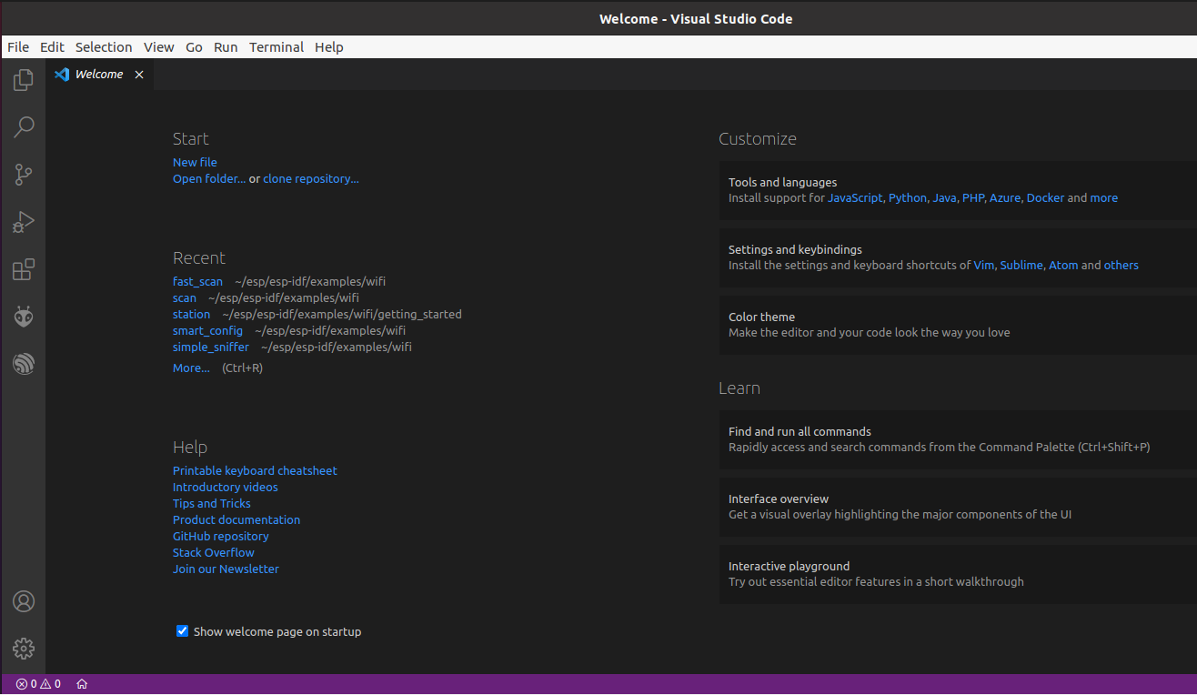
ESP-IDF VS Code Extension
Open Folder
ESP-IDF Explorer

Slide 14
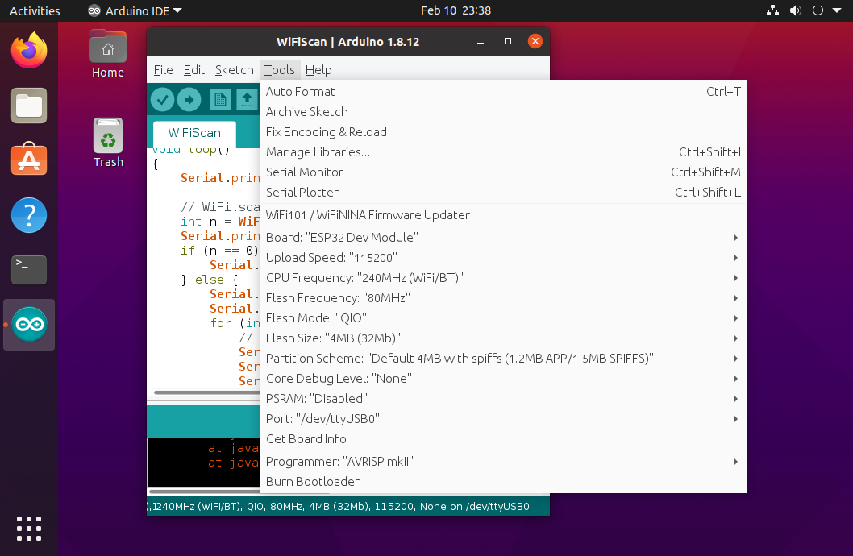
3. Arduino IDE
Open-source Arduino Software
Easy to write code and upload it to board
For our IoT kit, choose board ESP32 Dev Module

Slide 15
4. PlatformIO
PlatformIO is a user-friendly and extensible integrated development environment with a set of professional development instruments,
Providing modern and powerful features to speed up yet simplify the creation and delivery of embedded products
Visual Studio Code is a code editor redefined and optimized for building and debugging modern web and cloud applications
Open source
PlatformIO is over VS Code
Can use Arduino code and esp-idf code

Slide 16
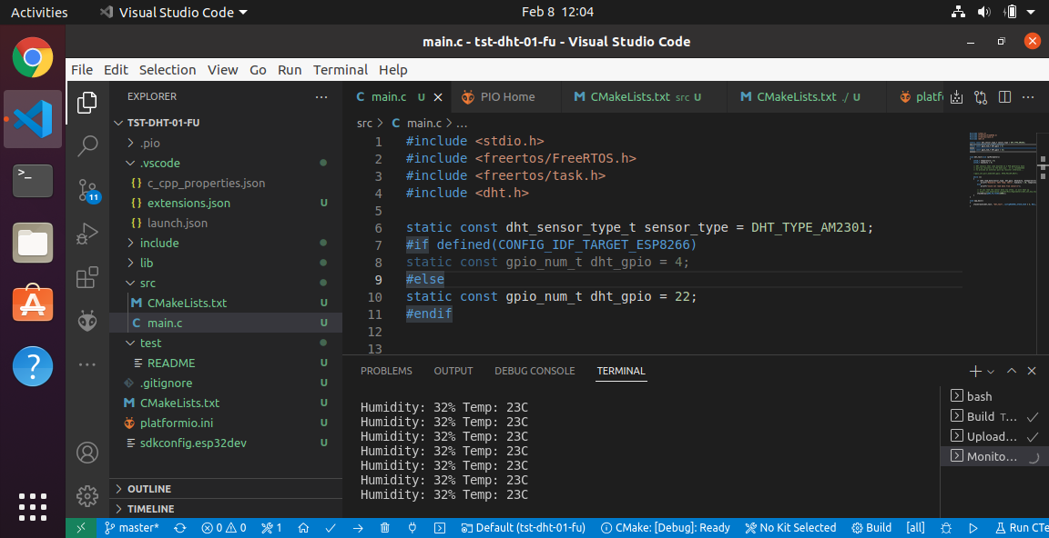
PlatformIO Interface
Visual Studio Code
PlatformIO
Build
Upload
Serial monitor

