Slide 1
IoT Security and Privacy
Introduction to ESP32
Xinwen Fu

Slide 2
Outline
ESP32 – Introduction
ESP32 – Programming
ESP32 – Flash layout
ESP32 – System overview

Slide 3
ESP8266
Esp8266 WiFi chip, made by Espressif.
It appeared on some Chinese webstores in middle of 2014
in the beginning it was used as a “bridge” to connect microcontrollers (Arduino…) to WiFi networks thanks to its very low cost (about $5 for a module).
Original firmware not well documented,
It has some bugs and offered only “standard” features (via AT commands),
Maker community developed some alternative firmwares
the most famous of which is surely NodeMCU
fully exploit the chip power and to build complete systems, without the need of external microcontrollers:

Slide 4
ESP32
In September 2016, after a beta testing phase lasted some months, Espressif announced and made available the successor of esp8266, named ESP32
The main features of the new chip are the following:
Tensilica LX6 dual core processor at 240 MHz
520Kb of SRAM memory
WiFi 802.11 b/g/n connectivity with support for WEP, WPA/WPA2 PSK/Enterprise
Bluetooth connectivity (classic and LE)
32 I/O pins with several built-in peripherals
hardware acceleration for security algorithms (AES, SHA2, RSA-4096)

Slide 5


Slide 6
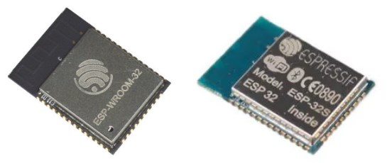
ESP32 Modules
The ESP32 needs some additional components to work:
a flash memory (to store firmware and data),
a crystal (for the RTC),
an antenna and some passive components.
ESP32 based surface-mount printed circuit board modules
(ESP-WROOM-32) by Espressif
(ESP-32S) by Ai-Thinker
Notes:
ESP32-WROOM-32
ESP32-WROOM-32 module soldered to the ESP32-DevKitC V4 board. Optionally ESP32-WROOM-32D, ESP32-WROOM-32U or ESP32-SOLO-1 module may be soldered instead of the ESP32-WROOM-32.
USB-UART Bridge
A single chip USB-UART bridge provides up to 3 Mbps transfers rates.
Boot
Download button: holding down the Boot button and pressing the EN button initiates the firmware download mode. Then user can download firmware through the serial port.
Micro USB Port
USB interface. It functions as the power supply for the board and the communication interface between PC and the ESP module.
5V Power On LED
This LED lights when the USB or an external 5V power supply is applied to the board. For details see schematic in Related Documents.
EN
Reset button: pressing this button resets the system.
I/O
Most of the pins on the ESP module are broken out to the pin headers on the board. Users can program ESP32 to enable multiple functions such as PWM, ADC, DAC, I2C, I2S, SPI, etc.

Slide 7
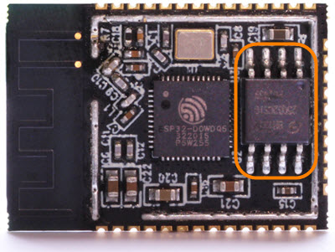
Flash
The esp32 chip requires an external flash memory to store programs, data, configuration parameters…
The external memory is connected to the chip via the SPI bus and the supported capacity is up to 16Mb.
The official Espressif module (ESP-WROOM-32) includes a 4Mb flash memory made by GigaDevice (GD25Q32):
“meandered inverted F” (“MIFA”) antenna with zigzag pattern
ESP32 D0WDQ6 chip

Slide 8
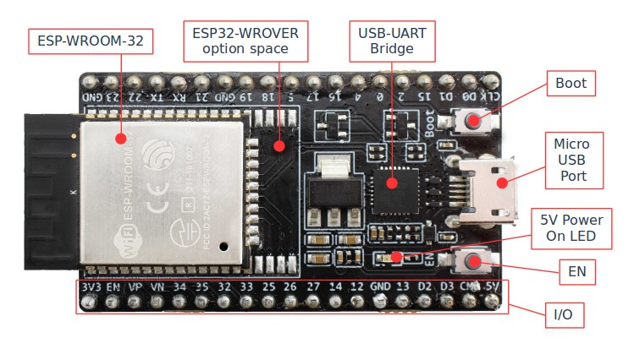
Development Boards
Development boards include the ESP32 module, the power supply, an USB connector… everything you need to start building your project!
Notes:
ESP32-WROOM-32
ESP32-WROOM-32 module soldered to the ESP32-DevKitC V4 board. Optionally ESP32-WROOM-32D, ESP32-WROOM-32U or ESP32-SOLO-1 module may be soldered instead of the ESP32-WROOM-32.
USB-UART Bridge
A single chip USB-UART bridge provides up to 3 Mbps transfers rates.
Boot
Download button: holding down the Boot button and pressing the EN button initiates the firmware download mode. Then user can download firmware through the serial port.
Micro USB Port
USB interface. It functions as the power supply for the board and the communication interface between PC and the ESP module.
5V Power On LED
This LED lights when the USB or an external 5V power supply is applied to the board. For details see schematic in Related Documents.
EN
Reset button: pressing this button resets the system.
I/O
Most of the pins on the ESP module are broken out to the pin headers on the board. Users can program ESP32 to enable multiple functions such as PWM, ADC, DAC, I2C, I2S, SPI, etc.

Slide 9
ESP32-WROOM-32
ESP32-WROOM-32 module soldered to the ESP32-DevKitC V4 board.
Optionally ESP32-WROOM-32D, ESP32-WROOM-32U or ESP32-SOLO-1 module may be soldered instead of the ESP32-WROOM-32.
USB-UART Bridge
A single chip USB-UART bridge provides up to 3 Mbps transfers rates.
Boot
Download button: holding down the Boot button (until the uploading starts) initiates the firmware download mode.
Then user can download firmware through the serial port.
Micro USB Port
It functions as the power supply for the board and the communication interface between PC and the ESP module.
5V Power On LED
This LED lights when the USB or an external 5V power supply is applied to the board.
EN -Reset button: pressing this button resets the system.
I/O
Most of the pins on the ESP module are broken out to the pin headers on the board.
Users can program ESP32 to enable multiple functions such as PWM, ADC, DAC, I2C, I2S, SPI, etc.

Slide 10
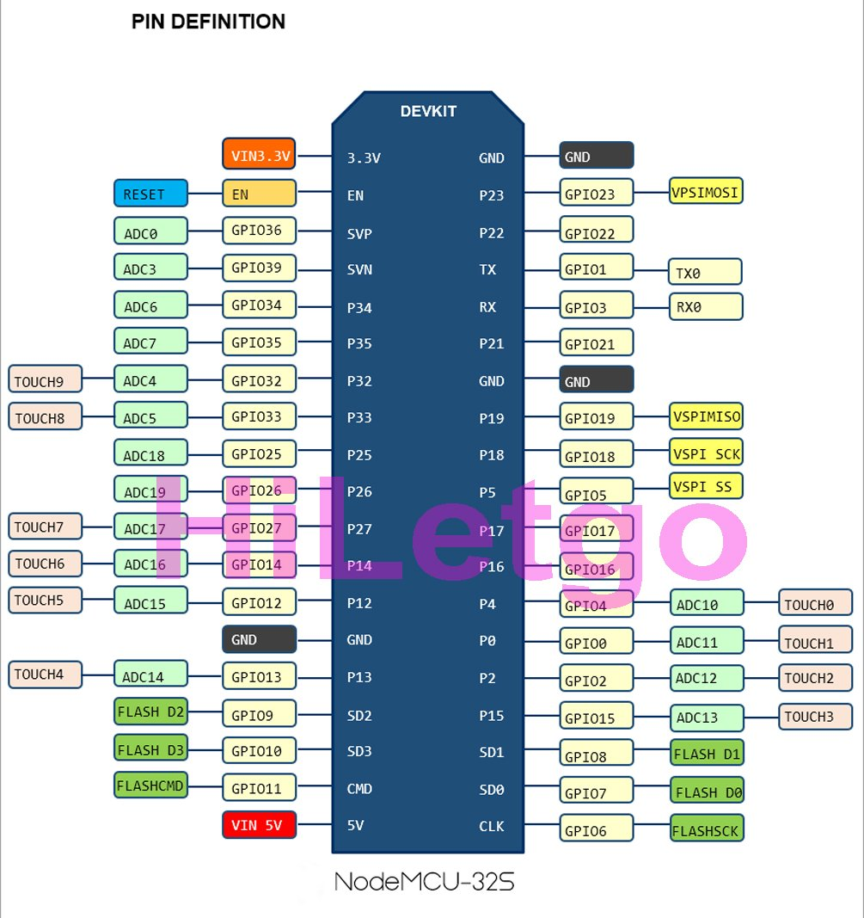
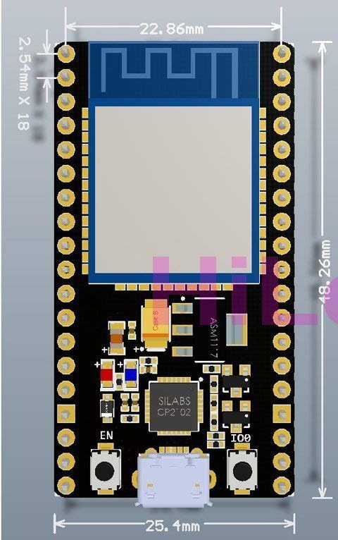
ESP32-WROOM-32 Pin Layout

Slide 11
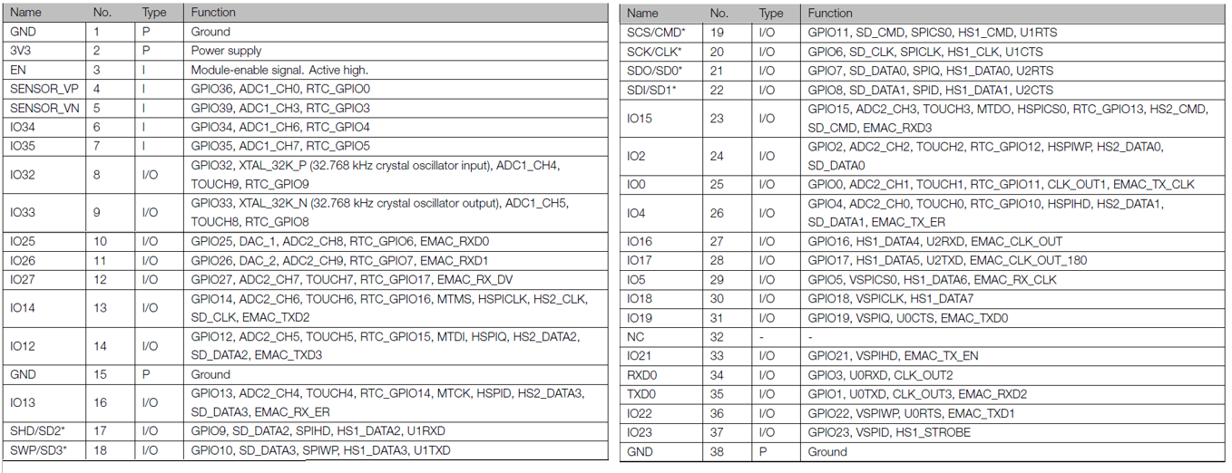
ESP32-WROOM-32 Pin Definition

Slide 12
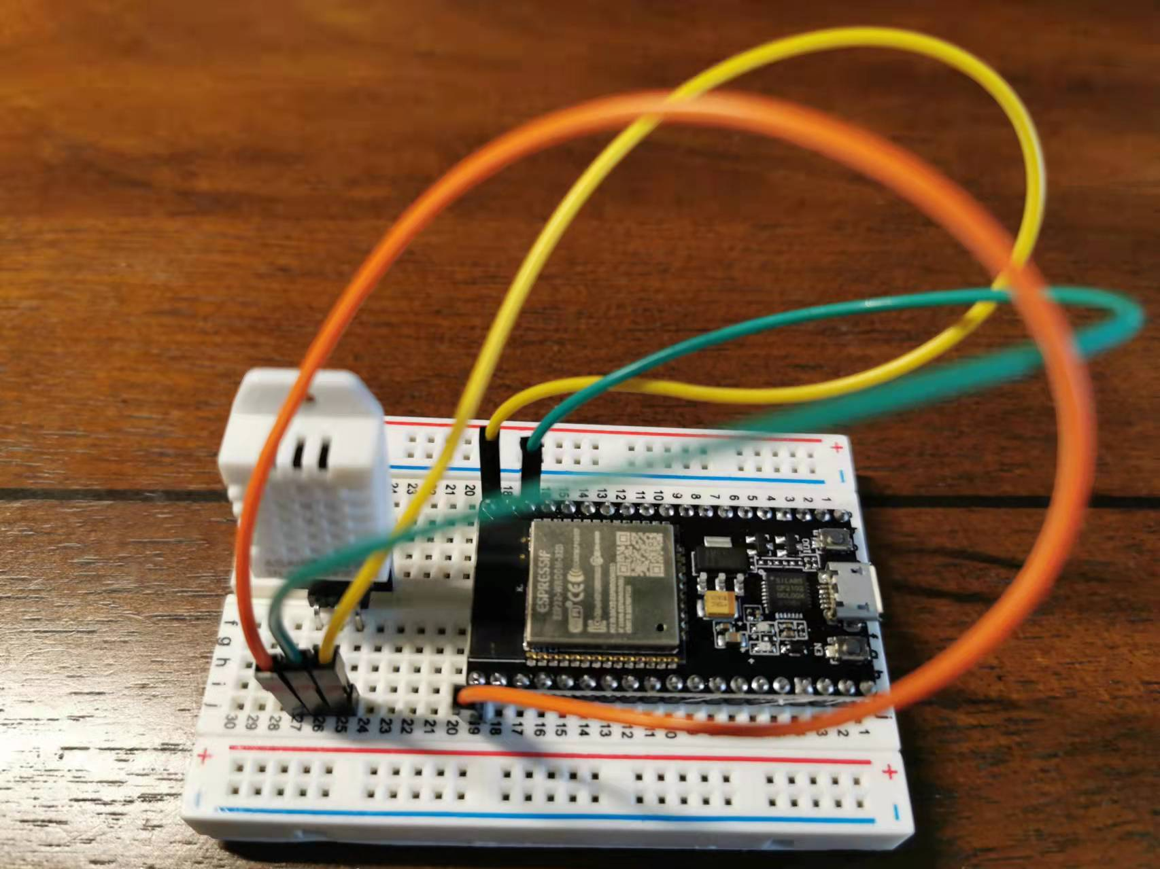

Our IoT Kit
GND
GPIO22
3.3V

Slide 13
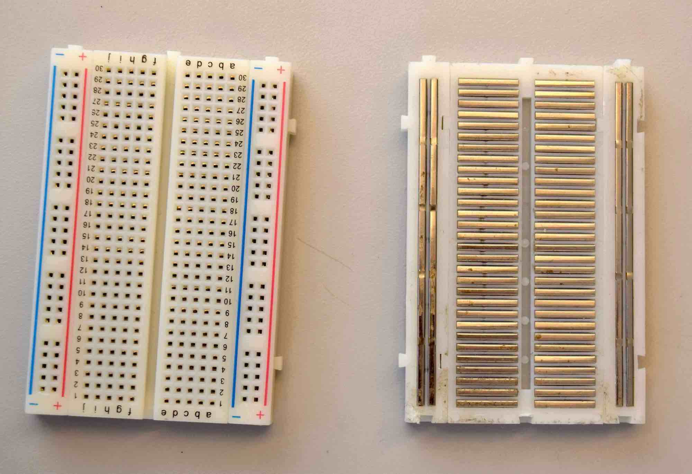
Breadboard Internal Wiring

Slide 14
Outline
ESP32 – Introduction
ESP32 – Programming
ESP32 – Flash layout
ESP32 – System overview

Slide 15
Get started with ESP-IDF and ESP32: Setting Up the Project
Click on “PlatformIO Home” button on the bottom PlatformIO Toolbar
Click on “New Project”
Select Espressif ESP32 Dev Module as the development board, Espressif IoT Development Framework as the framework and a path to the project location (or use the default one)

Slide 16
Adding Code to the Generated Project
Create a new file main.c in src folder and add the code
Or revise the default main.c
Compile the project
If everything went well, we should see a successful result message in the terminal window
Upload the firmware to the board
Connect the board to your computer and update the default monitor speed to 115200 in platformio.ini file
Open Serial Monitor to observe the output from the board

Slide 17

Typical PlatformIO project for the ESP-IDF v4.0 framework
A typical PlatformIO project for the ESP-IDF framework must have the following structure
project_dir
├── include
├── src
│ ├── CMakeLists.txt
│ └── main.c
├── CMakeLists.txt
└── platformio.ini

Slide 18
Additional ESP-IDF-specific files
Main CMakeLists.txt: enable features such as adding extra components
project-specific CMakeLists.txt in src folder
The minimal component CMakeLists.txt file simply registers the component to the build system using idf_component_register
optional default configuration file sdkconfig.defaults.
# The following lines of boilerplate have to be in your project's CMakeLists
# in this exact order for cmake to work correctly
cmake_minimum_required(VERSION 3.16.0)
include($ENV{IDF_PATH}/tools/cmake/project.cmake)
project(project-name)
idf_component_register(SRCS "foo.c" "bar.c")

Slide 19
ESP-IDF components
ESP-IDF modules as modular pieces of standalone code might be useful for structuring reusable code or including third party components that aren’t part of ESP-IDF
There are two possible ways of adding extra components to PlatformIO project:
By adding a new component to an optional folder called components in the root of your project.
This folder will be automatically scanned for valid components.
Using EXTRA_COMPONENT_DIRS option in the root CMakeLists.txt file
This option represents a list of extra directories to search for components.

Slide 20
An example of specifying esp-aws-iot as an extra component
# The following lines of boilerplate have to be in your project's CMakeLists
# in this exact order for cmake to work correctly
cmake_minimum_required(VERSION 3.16)
include($ENV{IDF_PATH}/tools/cmake/project.cmake)
list(APPEND EXTRA_COMPONENT_DIRS esp-aws-iot)
project(subscribe_publish)

Slide 21
Outline
ESP32 – Introduction
ESP32 – Programming
ESP32 – Flash layout
ESP32 – System overview

Slide 22
Flash
The flash memory can store different elements:
programs, data…
divided into sections (partitions).
The list of partitions, their size and position within the flash memory is stored in the memory itself (at address 0x8000) and it’s called partition table.
Two partition types are defined by default:
app (type 0) – partition that contains an application (program)
data (type 1) – partition that contains data
When writing a new program, the developer can decide how to organize the flash memory based on the program’s specific needs.

Slide 23
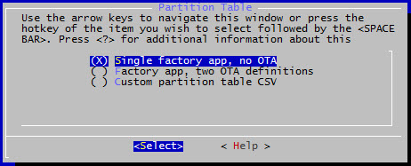
Flash (Cont’d)
The esp-idf framework offers two pre-configured memory layouts, you can choose from the configuration menu
Built-in Partition Tables
Creating Custom Tables

Slide 24
Flash (Cont’d)
idf.py partition_table to show the project’s partition table
Idf.py is a command from ESP-IDF
Non-volatile storage (NVS) data: mainly for key-value pairs
phy_init data: used for RF calibration and etc
Factory app: The bootloader will run this app by default.
*******************************************************************************
# ESP-IDF Partition Table
# Name, Type, SubType, Offset, Size, Flags
nvs,data,nvs,0x9000,24K,
phy_init,data,phy,0xf000,4K,
factory,app,factory,0x10000,1M,
*******************************************************************************

Slide 25
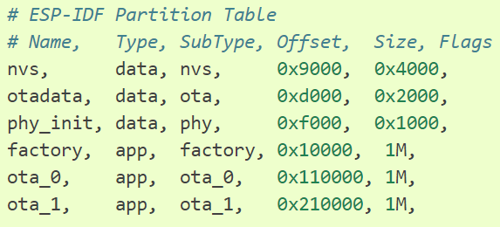
“Factory app, two OTA
There are now three app partition definitions. The type of the factory app (at 0x10000) and the next two “OTA” apps are all set to “app”, but their subtypes are different.
There is also a new “otadata” slot, which holds the data for OTA updates. The bootloader consults this data in order to know which app to execute
If “otadata” is empty, it will execute the factory app.

Slide 26
Example Flash Layout
ota_1
0x210000
ota_0
0x110000
factory app
0x010000
phy_init
0x00f000
otadata
0x00d000
nvs
0x009000
Partition table
0x008000
second-stage bootloader
0x001000
Secure boot data

Slide 27
Outline
ESP32 – Introduction
ESP32 – Programming
ESP32 – Flash layout
ESP32 – System overview

Slide 28
Application startup flow
First-stage bootloader in ROM loads second-stage bootloader image to RAM (IRAM & DRAM) from flash offset 0x1000.
Second-stage bootloader loads partition table and main app image from flash
Main app image executes
At this point the second CPU and RTOS scheduler can be started.

Slide 29
Bootloader
In the esp32 ROM memory there’s a small program, named first-stage bootloader.
executed at each reset of the chip:
configures the access to the external flash memory and,
if required, stores on it new data coming from the serial/USB port (flash process)?
Once finished, it accesses the flash memory (at address 0x1000) and loads and executes the second-stage bootloader.
It is possible to write a fully featured application which would work when flashed to offset 0x1000

Slide 30
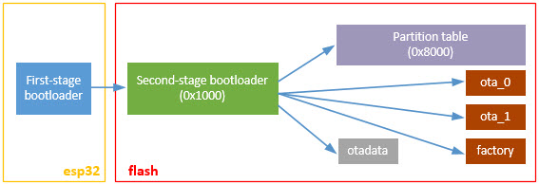
Second-stage Bootloader
The second-stage bootloader reads the partition table at address 0x8000 and searches for app partitions.
It decides which application has to be executed based on the content of the otadata partition:
if this partition is empty or doesn’t exist, the bootloaded executes the application stored in the factory partition.

Slide 31
Over-the-air (OTA) application update process
This allows to implement an over-the-air (OTA) application update process
you send the new version of your application to the esp32 chip
the version is stored in a new app partition.
Once the upload is completed, the id of the partition is saved in otadata and the chip is rebooted
the bootloader will execute the new version:

Slide 32

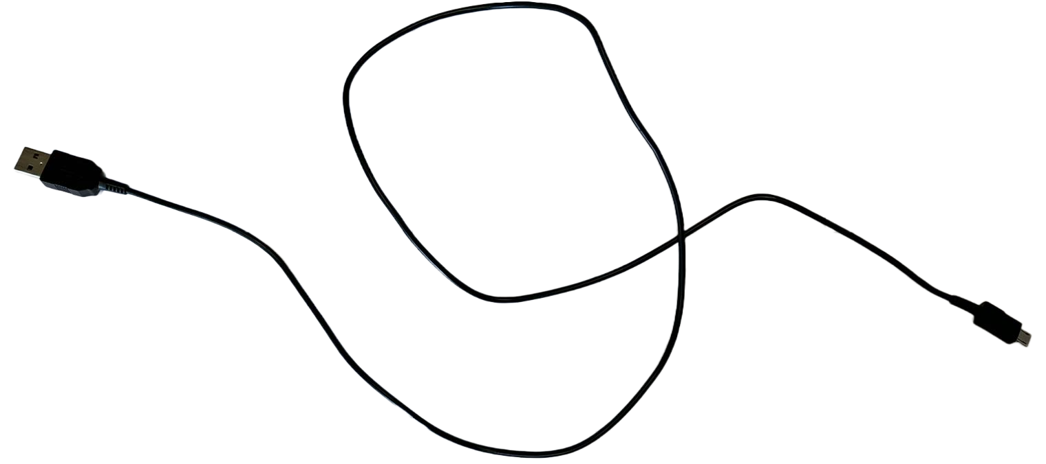

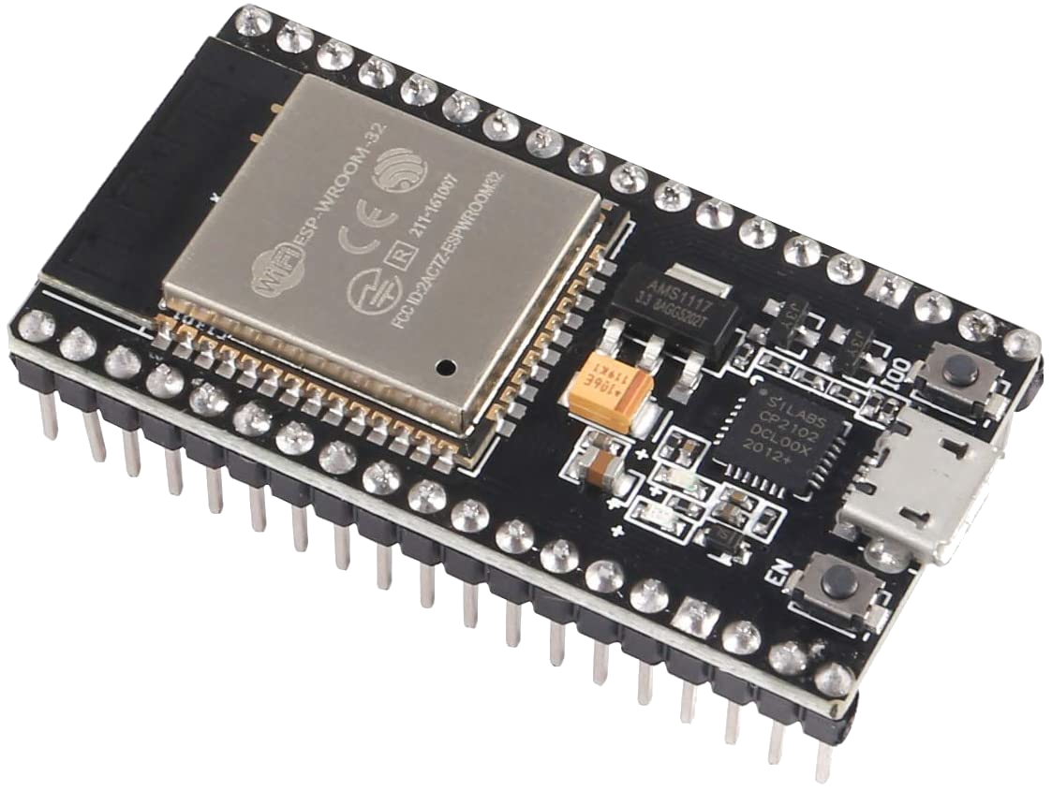
OTA Illustration
The laptop runs a web server hosting a new firmware
The laptop flashes the OTA enabled firmware into the ESP32
The ESP32 uses the OTA to upgrade its firmware

Slide 33
Custom Bootloader
The current bootloader implementation allows the customer to override it. To do this,
copy folder /esp-idf/components/bootloader and edit /your_project/components/bootloader/subproject/main/bootloader_main.c.
In the bootloader space, you can not use the drivers and functions from other components.
If necessary, then the required functionality should be placed in the folder bootloader (note that this will increase its size).
It is necessary to monitor its size because there can be overlays in memory with a partition table leading to damage.
At the moment the bootloader is limited to the partition table from the address 0x8000.

Slide 34
FreeRTOS
The esp-idf framework is based on the FreeRTOS Real-Time Operating System
It may sound strange to talk about operating systems when working on a “small” chip like the esp32…
but you don’t have to think that FreeRTOS is an operating system like Windows, Linux or MacOS.
The main feature an embedded operating system offers is multitasking, that is the ability to run different tasks in parallel
Thanks to its internal scheduler
We know that a microprocessor core can execute an instruction at a time
it seems that different applications run simultaneously because of the scheduler is rapidly switching between their tasks.

Slide 35
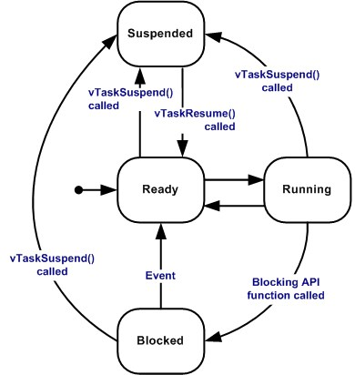
FreeRTOS (Cont’d)
A real-time operating system is designed to guarantee that task scheduling is deterministic
you can predict the behavior of its scheduler.
FreeRTOS allows the developer to define a priority for each task
The scheduler uses priority values to define the execution pattern of the different tasks.
Different task statuses in FreeRTOS

Slide 36
Task States
Running: Executing and utilizing the processor.
Ready: Are able to execute, not Blocked or Suspended
Blocked
Waiting for either a temporal or external event.
Suspended
Like tasks that are in the Blocked state, tasks in the Suspended state cannot be selected to enter the Running state, but tasks in the Suspended state do not have a time out.
Instead, tasks only enter or exit the Suspended state when explicitly commanded to do so through the vTaskSuspend() and xTaskResume() API calls respectively.
Notes:
Task States
A task can exist in one of the following states:
Running
When a task is actually executing it is said to be in the Running state. It is currently utilising the processor. If the processor on which the RTOS is running only has a single core then there can only be one task in the Running state at any given time.
Ready
Ready tasks are those that are able to execute (they are not in the Blocked or Suspended state) but are not currently executing because a different task of equal or higher priority is already in the Running state.
Blocked
A task is said to be in the Blocked state if it is currently waiting for either a temporal or external event. For example, if a task calls vTaskDelay() it will block (be placed into the Blocked state) until the delay period has expired - a temporal event. Tasks can also block to wait for queue, semaphore, event group, notification or semaphore event. Tasks in the Blocked state normally have a 'timeout' period, after which the task will be timeout, and be unblocked, even if the event the task was waiting for has not occurred.
Tasks in the Blocked state do not use any processing time and cannot be selected to enter the Running state.
Suspended
Like tasks that are in the Blocked state, tasks in the Suspended state cannot be selected to enter the Running state, but tasks in the Suspended state do not have a time out. Instead, tasks only enter or exit the Suspended state when explicitly commanded to do so through the vTaskSuspend() and xTaskResume() API calls respectively.

Slide 37
References
[1] Get Started (with ESP32 programming), Accessed on Feb. 18, 2019. (Good)
[2] Build System, Accessed on Feb. 18, 2019. (Good)
[3] vscode-esp-idf-extension, Accessed on Feb. 18, 2019. (Good)
[4] General Notes About ESP-IDF Programming, Accessed on Feb. 17, 2019
[5] (ESP32) API Guides, Accessed on Feb. 17, 2019
[6] API Reference, Accessed on Feb. 18, 2019

