Slide 1
Introduction to Cryptography: Symmetric Key Crypto
Xinwen Fu
Professor
Department of Computer Science
University of Massachusetts Lowell

Slide 2
Outline
Introduction to Cryptography
Some Trivial Codes
Secret Key Cryptography
Hands-on

Slide 3
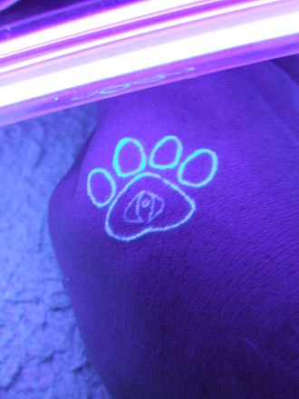
Cryptography
Original meaning
Art of secret writing
Becoming a science
Relies on mathematics (e.g., number theory, algebra)
One cryptographic technique is to encrypt data
Process data into unintelligible form, reversible, without data loss

Slide 4

Encryption/Decryption
plaintext
ciphertext
plaintext
encryption
decryption
encryption key
decryption key
Bob
Alice
Plaintext: a message in its original form
Ciphertext: a message in the transformed, unrecognized form
Encryption: the process that transforms a plaintext into a ciphertext
Decryption: the process that transforms a ciphertext to the corresponding plaintext
Key: the value used to control encryption/decryption

Slide 5
Cryptanalysis
Assumption
Encryption/decryption algorithms are known
Goal
Get the key(s)

Slide 6
Outline
Introduction to Cryptography
Some Trivial Codes
Secret Key Cryptography
Hands-on

Slide 7
Mono-alphabetic Cipher
Arbitrary mapping of one letter to another with one-to-one mapping
How many different mappings?
26!

Slide 8
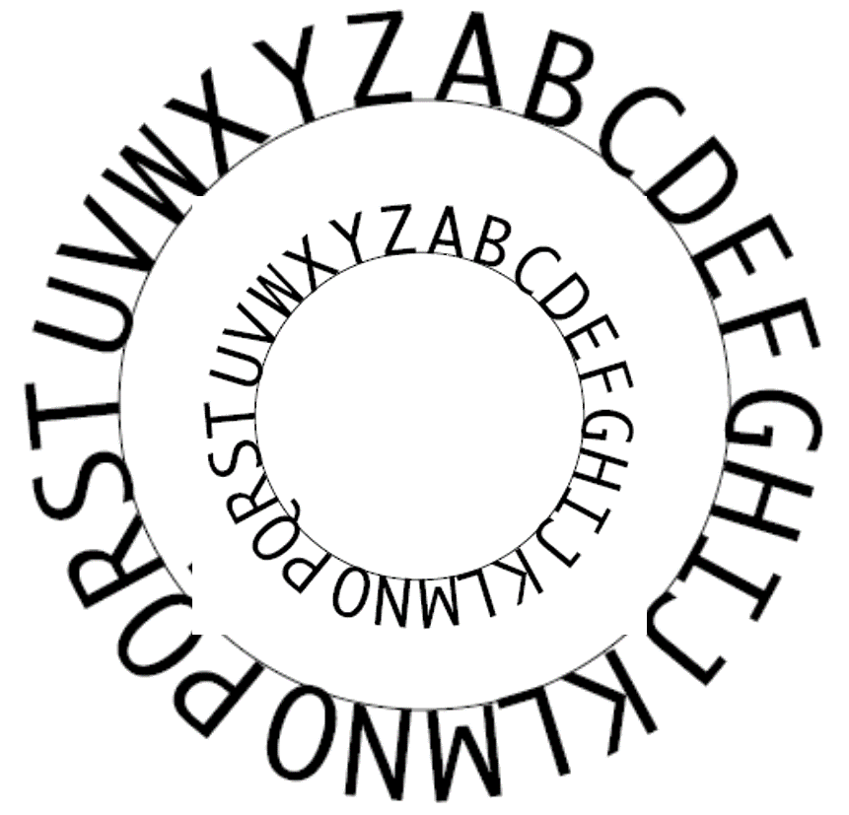
Caesar Cipher
Substitution cipher
Replace each letter with one K letters down the alphabet
K is the key
Only 26 possibilities
Notes:
The Captain Midnight decoder ring (which is an "encoder" ring as well) allows you to do a simple substitution cipher. It usually has two concentric wheels of letters, A through Z. You rotate the outside ring and substitute the letters in your message found on the outside ring with the letters directly below on the inside ring (see diagram). Here, the algorithm is to offset the alphabet and the key is the number of characters to offset it. Julius Caesar used this simple scheme, offsetting by 3 characters (He would have put the "A" on the outer ring of letters over the "D" on the inner ring if he had owned a Captain Midnight decoder ring.) The word "EXPLORATORIUM" thus becomes "HASORUDWRULXP." Such a scheme was easily broken and showed a certain level of naivete on Caesar's part concerning the enemy's intelligence.

Slide 9
Caesar Cipher Example
Replace each letter with the one 3 letters later
Shift=3, i.e., K=3
A → D, B → E
x | y | z | a | b | c | d | e | f | g | h | i | j | k | l | m | n | o | p | q | r | s | t | u | v | w
a | b | c | d | e | f | g | h | i | j | k | l | m | n | o | p | q | r | s | t | u | v | w | x | y | z
hello
khoor

Slide 10
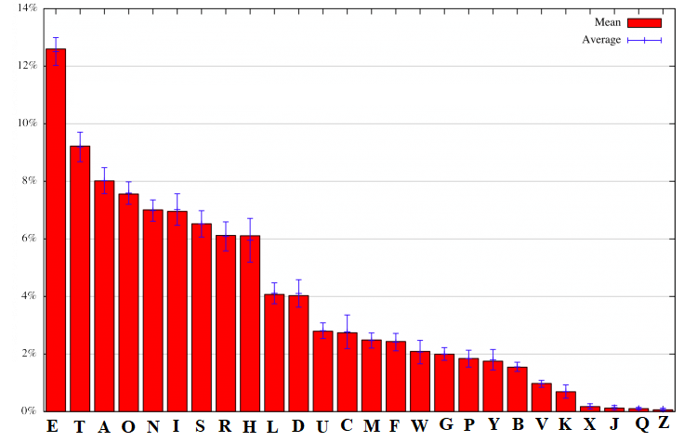
Cryptanalysis against Caesar Cipher
Assumption: The encryption/decryption algorithms are known.
Cryptanalysis: Get the keys
E.g., frequency analysis: statistical analysis of letter frequencies

Slide 11
Poly-alphabetic Ciphers
A letter may be encrypted into different letters from time to time

Slide 12
Columnar Transposition
All the previous codes are based on substitution
Transposition (permutation) - Columnar Transposition
Key | 4 | 3 | 1 | 2 | 5 | 6 | 7
Plaintext | A | T | T | A | C | K | P
 | O | S | T | P | O | N | E
 | D | U | N | T | I | L | T
 | W | O | A | M | X | Y | Z
Write in rows of fixed length
Read column by column in a scrambled order
Ciphertext: TTNAAPTMTSUOAODWCOIXKNLYPETZ

Slide 13
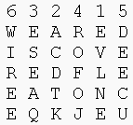
Columnar Transposition Example
The permutation
(transposition) is defined by the alphabetical order of the letters within the keyword
Plaintext
Ciphertext
Z E B R A S
Notes:
For example, the word ZEBRAS is of length 6 (so the rows are of length 6), and the permutation is defined by the alphabetical order of the letters in the keyword. In this case, the order would be "6 3 2 4 1 5".
In a regular columnar transposition cipher, any spare spaces are filled with nulls; in an irregular columnar transposition cipher, the spaces are left blank. Finally, the message is read off in columns, in the order specified by the keyword.
http://en.wikipedia.org/wiki/Transposition_cipher
For example, suppose we use the keyword ZEBRA and the message WE ARE DISCOVERED. FLEE AT ONCE. In a regular columnar transposition, we write this into the grid as

Slide 14
Outline
Introduction to cryptography
Some Trivial Codes
Secret Key Cryptography
Hands-on

Slide 15
Secret Key Cryptography
plaintext
ciphertext
plaintext
encryption
decryption
key
Same key
key
Bob
Alice
Same key is used for encryption and decryption
Also known as
Symmetric cryptography
Conventional cryptography

Slide 16
Basic Technique
Product cipher
Multiple applications of interleaved substitutions and permutations
Ciphertext approximately the same length as plaintext
plaintext
S
P
S
P
…
S
ciphertext
key
Notes:
break

Slide 17
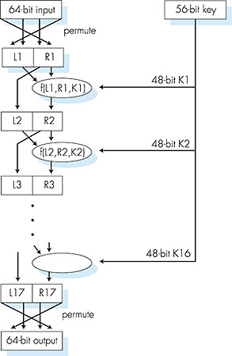
Symmetric key crypto: DES
DES operation
initial permutation
16 identical “rounds” of function application, each using different 48 bits of key
final permutation

Slide 18
AES: Advanced Encryption Standard
symmetric-key NIST standard, replaced DES (Nov 2001)
processes data in 128 bit blocks
128, 192, or 256 bit keys
brute force decryption (try each key) taking 1 sec on DES, takes 149 trillion years for AES
Question: How to encrypt a long text?

Slide 19
Applications of Secret Key Cryptography
Transmitting over an insecure channel
Challenge: How to share the key?
Secure Storage on insecure media
Integrity check
Message integrity code (MIC)
Message
Encrypted Message

Slide 20
Authentication Using Secret Key Cryptography
Challenge-response
To prove the other party knows the secret key
Must be secure against chosen plaintext attack
Alice
Bob
r_{A}
Alice’s K_{A,B}(r_{A})
=
K_{A,B}(r_{A}) from Bob
K_{A,B}(r_{A})
?
r_{B}
K_{A,B}(r_{B})

Slide 21
OpenSSL
OpenSSL is a crypto library
openssl is a command line tool
Uses various cryptography functions of OpenSSL's crypto library
Can be used for
Encryption and Decryption with Ciphers
Calculation of Message Digests
Creation and management of private keys, public keys and parameters
More…

Slide 22
Outline
Introduction to Cryptography
Some Trivial Codes
Secret Key Cryptography
Hands-on

Slide 23
Hands-on 1: Decipher Caesor cipher encrypted text
The plaintext is English paragraphs, encrypted with Caesar Cipher of a particular shift
Tools to use for decrypting the ciphertext
Frequency analysis
Ceasar shift table
Caesar cipher tools
What is the plaintext message?

Slide 24
Hands-on 2: Encryption with AES
echo "OpenSSL" | openssl enc -iter 1000 -aes-256-cbc -a -k hello
|: with the pipe character, redirecting the output of the first command to the input of the second command
enc: performing secret key crypto encryption and decryption
-k hello: The key will be generated from hello
-iter 1000 is related to creating a strong key from the password
-a: means BASE64 output
Notes:
https://wiki.openssl.org/index.php/Enc

Slide 25
Hands-on 3: Decryption with AES
echo "U2FsdGVkX1+lVCnMEVpKXisqA1IlycMvDFkv72ILasg=" | openssl enc -aes-256-cbc -iter 1000 -a -d -k hello
-d: means decryption
-a: means BASE64 encoded input
-k hello: hello was used to generate the key
Notes:
https://wiki.openssl.org/index.php/Enc
https://wiki.openssl.org/index.php/Command_Line_Utilities

Slide 26
Hands-on 4: Encrypting and Decrypting File with AES
Encryption
openssl aes-256-cbc -a -salt -in secrets.txt -out secrets.txt.enc -iter 1000 -k hello
-aes-256-cbc. Use aes-256-cbc algorithm
-salt. Use salt in stronger key derivation
Decryption
openssl aes-256-cbc -d -a -in secrets.txt.enc -out secrets.txt.new -iter 1000 -k hello

Slide 27
Hands-on 5: Send Encrypted Message via Chat Server
One person encrypts messages and sends
The other person receives encrypted messages and decrypts

