Slide 1
Digital Signature
Xinwen Fu, Ph.D
Professor
Department of Computer Science
University of Massachusetts Lowell

Slide 2
Outline
Introduction to digital signature
Introduction to certificate
Hands-on

Slide 3

Conventional Signature
Verifies that the signer approves the writing
How do we sign a digital document like a pdf file?

Slide 4
Public Key Crypto Property
e_{B}(d_{B}(m)) = m = d_{B}(e_{B}(m))
use private key first, followed by public key
use public key first, followed by private key
result is the same!

Slide 5
Naive Digital Signature
(e_{B}, d_{B})
contract, d_{B}(contract)
contract
Yes/No
Sign
Verify
Private key (d_{B})
Public key (e_{B})
Bob
?
e_{B}(d_{B}(contract))=contract
Bob encrypts the contract with his private key
d_{B}(contract) is the signature
Those who have Bob’s public key can verify the signature
Decrypt the signature
Compare the decrypted contract with the contract sent over

Slide 6
Problem of Naive Digital Signature?
contract, d_{B}(contract)
Signature too long!

Slide 7

Real-world Digital Signature
Generate message hash
Encrypt the hash with the private key
Message
m
H(m)
Signature
H
Sign
m, d_{B}(H(m))
Private key (d)
Bob
Carol

Slide 8
Verification of True Digital Signature
Hash the message m that was sent over to get H(m)
Decrypt digital signature d_{B}(H(m)) with Carol’s public key
Compare H(m) and e_{B}(d_{B}(H(m)))
H
H(m)
m, d_{B}(H(m))
Compare
Yes/No
e_{B}(.)
Carol is verifying
signature
e_{B}(d_{B}(H(m)))

Slide 9
Outline
Introduction to digital signature
Introduction to certificate
Hands-on

Slide 10

Question
We need someone’s public key, e.g., for verifying digital signature
How can you safely give your public key to everyone?
Is this her public key?
(e_{C}, d_{C})
e_{C}
Carol
Bob

Slide 11





Obtain a Certificate Issued by a Certificate Authority (CA)
Carol generates her key pair (e_{c}, d_{c})
She goes to a CA face-to-face
CA verifies her information: email, ID, address, etc.
CA issues Carol a certificate, which contains
Carol’s identity, other information and her public key e_{C}
Signed by CA, d_{ca}(H(ID_{C} | Other Info | e_{c}))
Carol
CA
e_{c}
(e_{c}, d_{c})
Carol
ID
…
m
(e_{ca}, d_{ca})
e_{c}
Signature

Slide 12

Verify a Certificate
Carol can get a certificate from a certificate authority (CA)
Every computer is shipped with the CA’s public key in the format of a certificate
When Carol sends its certificate to a computer, how can the computer verify Carol’s public key is genuine?
Signature is d_{ca}(H(m))
Carol
ID
…
m
e_{c}
Signature
Stores e_{ca}

Slide 13
Terms for Certificates
The owner of a certificate is called a subject
Common name is the identity of the owner
Subject’s CommonName can be:
An explicit name, e.g. cs.uml, or
A name with a wildcard character, e.g. *.uml.edu
Carol
ID
…
m
e_{c}
Signature

Slide 14
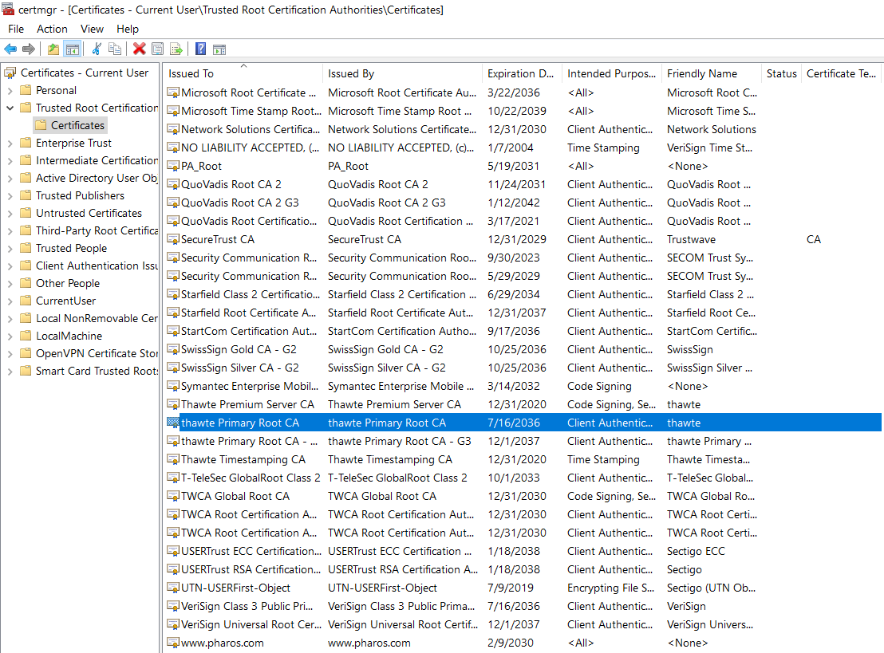
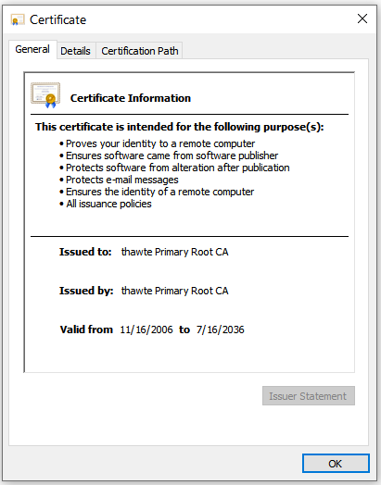
Windows 10 Certificate Store
Type here to search -> certmgr.msc

Slide 15
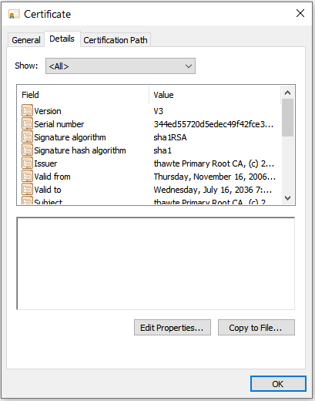
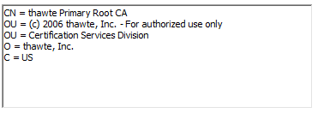
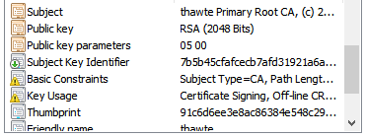
Example Certificate Details
Click subject

Slide 16
Kali Certificate Store
/etc/ssl/certs
Command to view a certificate
openssl x509 -in certificate-name.pem -text

Slide 17
Outline
Introduction to digital signature
Introduction to certificate
Hands-on
Windows 10 certificate store
Sign and verify a file locally
Sign and verify a message through chat server
Notes:
https://opensource.com/article/19/6/cryptography-basics-openssl-part-2

Slide 18
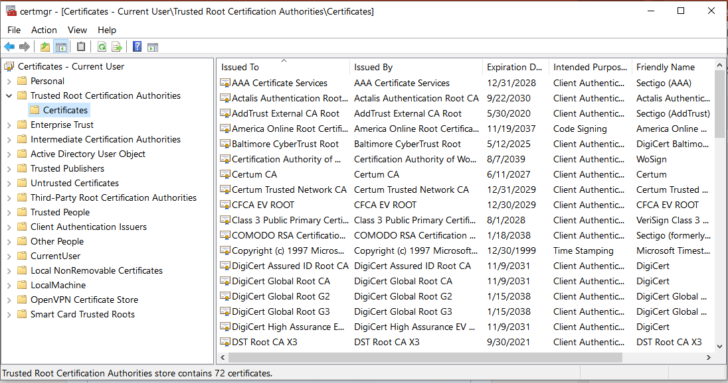
Hands-on 1: Windows 10 Certificate Store
Find Windows 10 certificate store
All people check content of a certificate from Trusted Root Certificate Authorities
Group discussion: why are these certificates needed?

Slide 19
Hands-on 2: Generate Public and Private Key Pair
If done before, no need
Generate public and private key pair
openssl genpkey -out privkey.pem -algorithm rsa
Note: privkey.pem can be used as the private key although it contains the public key
Extract the public key from privkey.pem
openssl rsa -in privkey.pem -outform PEM -pubout -out pubkey.pem
Publish your pubkey.pem, e.g. to our chat server
Never share privkey.pem
Notes:
https://opensource.com/article/19/6/cryptography-basics-openssl-part-2

Slide 20
Hands-on 3: Sign a file at Your Computer
Sign a file called changelog or messages saved in a file
openssl dgst -sha256 -sign privkey.pem -out sign.sha256 changelog
The output sign.sha256 is binary
Encode the binary signature with base64
openssl enc -base64 -in sign.sha256 -out sign.sha256.base64
Not really needed. It is needed here since we can send the base64 encoded message to our chat server
Send both message and base64 encoded signature to our chat server

Slide 21
Hands-on 4: Verify the Signature
Save received signature into a file, e.g., called sign.sha256.base64
Decode sign.sha256.base64 and get the binary signature
openssl enc -base64 -d -in sign.sha256.base64 -out sign.sha256
Verify the signature with the public key
openssl dgst -sha256 -verify pubkey.pem -signature sign.sha256 changelog

Slide 22
Message Signature via Chat Server
Sender generates public and private key pair (no need to do it if already done)
Sender sends the public key (content of pubkey.pem) to Receiver
Receiver saves the public key into a file, e.g. called pubkey.pem
Sender sends a message to receiver and saves the message into a file called, e.g., msg
Receiver saves the received message into a file called, e.g., msg
Sender signs its msg, generate the signature file and encodes it with base64, e.g. called sign.sha256.base64
Sender sends the content of sign.sha256.base64 to Receiver
Receiver saves it into a file, e.g., called sign.sha256.base64
Receiver decodes sign.sha256.base64 into the binary signature file and verifies it

Slide 23
Hands-on 5: Discussion: Message under MITM
Assume the message is changed by MITM during transmission
That is, hahaha… is added to the received message
Repeat the same procedure
Is the verification ok this time?

Slide 24
Backup

Slide 25

Review of Public Key Cryptography
e_{B}
Bob’s public key
d_{B}
Bob’s private key
plaintext
message, m
encryption
algorithm
ciphertext
decryption
algorithm
plaintext
message
e_{B}(m)
m = d_{B}(e_{B}(m))
(e_{C}, d_{C})
(e_{B}, d_{B})
Carol
Bob

Slide 26
Public Key Encryption Properties
.
1
need e and d such that
d_{B}(e_{B}(m)) = m
2
given public key e_{B}, it should be impossible to compute private key d_{B}
RSA: Rivest, Shamir, Adelson algorithm

Slide 27
Generate Public and Private Key Pair
Generate public and private key pair
openssl genpkey -out privkey.pem -algorithm rsa
Note: privkey.pem contains both public and private keys
Extract public key from privkey.pem and save it in pubkey.pem
openssl rsa -in privkey.pem -outform PEM -pubout -out pubkey.pem

Slide 28
Encryption with RSA
Create a file
echo "Welcome to LinuxCareer.com" > encrypt.txt
Encryption
openssl rsautl -encrypt -inkey pubkey.pem -pubin -in encrypt.txt -out encrypt.dat
Encode the binary ciphertext with base64
openssl enc -base64 -in encrypt.dat -out encrypt.dat.base64
Note: encoding is not necessary, but needed for sending the ciphertext through our chat server
Notes:
https://linuxconfig.org/using-openssl-to-encrypt-messages-and-files-on-linux

Slide 29
Decryption with RSA
Decode encrypt.dat.base64 and get the binary ciphertext
openssl enc -base64 -d -in encrypt.dat.base64 -out encrypt.dat
Decryption
openssl rsautl -decrypt -inkey privkey.pem -in encrypt.dat -out new_encrypt.txt
Notes:
https://linuxconfig.org/using-openssl-to-encrypt-messages-and-files-on-linux

