Slide 1
Drive and Programming
By Mihir Shah

Slide 2
What is Drive and Programming?
A core function of the robot game.
It involves the study, actual programming, and testing during the season.
At competitions, this team runs practice rounds and makes on site changes as required.
Team also provides 2 drivers and a drive coach for the actual matches with backups.
SO LETS DIVE IN AND LEARN FUNDAMENTALS OF D&P.

Slide 3
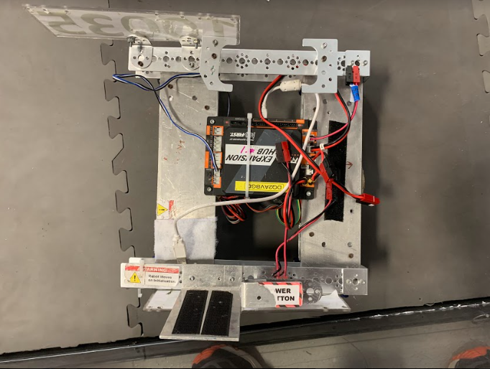
On the Robot
The Control Hub is the base of the system. It sends/receives information through its ports to/from actuators (e.g. motors)/sensors. Each port is labeled from 1 to 4. For example, the motor to run the left wheel in the front could be wired to port 1, and the motor to run the right wheel in the front could be wired to port 2.
Control Hub

Slide 4
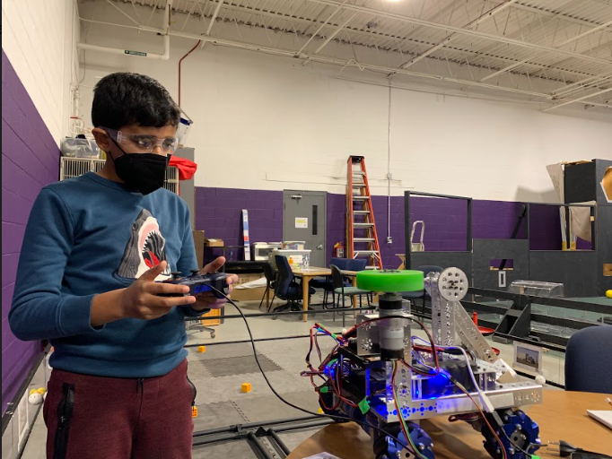
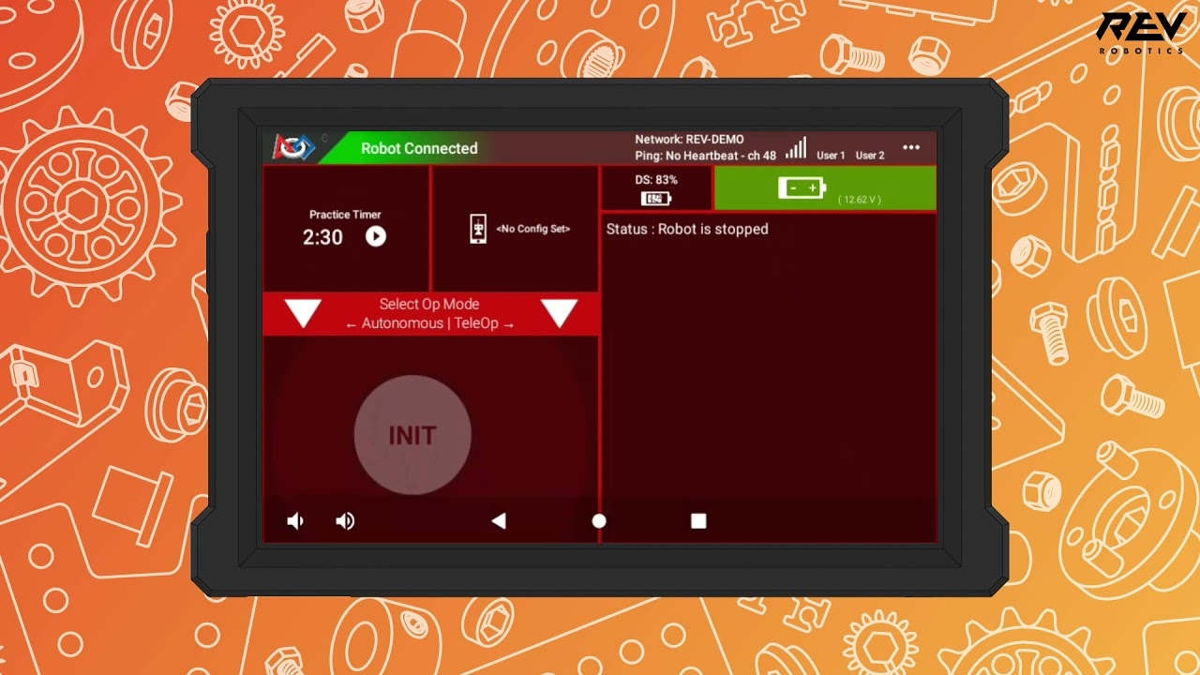
Off the Robot
LAPTOP
OnBot Java - All software on a robot can be accessed via a URL (e.g. 192.42.1.8080) over WifiDirect. This means you can program from any device using the URL. On a laptop, this URL is entered and then the code is written there in the OnBot Java style.
Android Studio - The application is installed on a single laptop and code is written there and transferred to the robot.
Driver Hub and all of its features.
GamePad
Program start button(Init)
This cable connects the GamePad with the Driver Hub.

Slide 5
Off the Robot
Driver Hub - Stores the config for the devices connected to the Control Hub. Connect with GamePads and send out the config/gamepad info to the robot controller. Start button used to initiate the program in the RC, and RC sends it the Rev Hub. The connection between the RC/DS is on Wifi Direct.
Driver Hub and all of its features.
GamePad
Program start button(Init)
This cable connects the GamePad with the Driver Hub.

Slide 6
Off the Robot
GamePad – Drives the Robot in TeleOp. By moving the sticks up or down in certain ways, you can make the motors make the robot move left, right, forward, and backwards.
Driver Hub and all of its features.
GamePad
Program start button(Init)
This cable connects the GamePad with the Driver Hub.

Slide 7
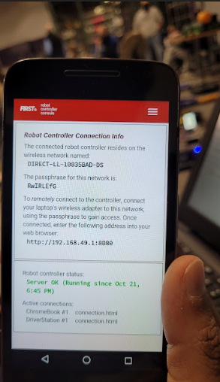
Wifi Direct Password(for OnBot Java ONLY)
In order to code with OnBot Java, you have to connect with the Wifi Direct.
To connect, go to the Driver Hub and click the drop-down menu in the top right corner.
Click on Program and Manage. The image shown on the right shows what will pop up next.
The combination of letters and numbers at the top(DIRECT-LL-10035BAD-DS) is the network.
The combination below that(in this case, RwIRLEfG) is the password.
Use this network/password to connect laptop to WifiDirect.

Slide 8
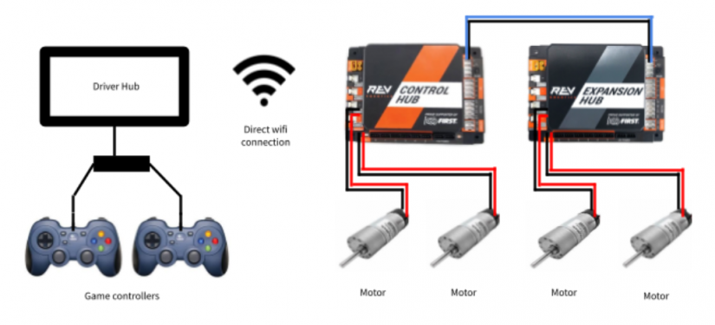
The Full System
This is how the full system will look like; the Driver Hub, the Control Hub, & the GamePads.
Robot

Slide 9
TeleOp and Autonomous Programming
Autonomous - Robot runs according to pre-programmed instructions(this is how you programmed in FLL).
TeleOp - Robot follows GamePad commands with driver input.
In the 2-minute long match, the first 30 seconds are autonomous.
Then, the drivers pick up their GamePads and for the remainder of the match, the robot is ‘tele-operated’.
Minimum TeleOp required because it is the longer part of the competition.

Slide 10
Programming: Three Styles
Blocks – Drag and drop blocks instructions similar to FLL style written in English.
OnBot Java – Text Based Programming directly OnBot (i.e on the Control Hub).
Full Android Studio Based Setup - Set up the Android Studio on a computer. It allows for more editor based programming.

Slide 11
THANK YOU!
ANY QUESTIONS???

Slide 12
Programming - Hardware Mapping
leftFrontMotor = hardwareMap.dcMotor.get("left_front_drive");
leftBackMotor = hardwareMap.dcMotor.get("left_back_drive");
rightFrontMotor = hardwareMap.dcMotor.get("right_front_drive");
rightBackMotor = hardwareMap.dcMotor.get("right_back_drive");
The configuration in DS stores information on which motors run to which ports on the Control Hub.
In the actual program, the variable names are matched with the configuration names.
For example, in the configuration, the name of a motor could be left_front_drive and in the code a variable name, like leftFrontMotor. This process of matching names is called hardware mapping.

Slide 13
Programming - Tele-Op
Make a forever loop, meaning that until the end of the program, certain commands will keep running.
public void loop() {
leftFrontMotor.setPower(-gamepad1.left_stick_y*0.8);
leftBackMotor.setPower(-gamepad1.left_stick_y*0.8);
rightFrontMotor.setPower(-gamepad1.right_stick_y*0.8);
rightBackMotor.setPower(-gamepad1.right_stick_y*0.8);
}
leftFrontMotor.setPower –
Tells the name of the motor to set power for.
Part in parentheses tells which GamePad (e.g. 1) and which stick (e.g. left/right) moves which motor.
For example, both left motors are moved by moving the GamePad1 left stick and similarly for the right motors would be the right stick.
0.8, shows how much power (80% of max) the motors will apply on the wheels.

Slide 14
Programming - Autonomous
For moving the robot forward:
leftFrontMotor.setPower(0.5);
leftBackMotor.setPower(0.5);
rightFrontMotor.setPower(0.5);
rightBackMotor.setPower(0.5);
sleep(1500);
The first part sets the power of each motor (e.g 50%). To go forward, we need all the powers to be positive. The ‘sleep’ command tells for how long to move. 1000 ms is a second. For one and a half seconds, we’d tell the robot to sleep for 1500 units.
Now for the turn. Write:
runtime.reset();
while(runtime.seconds()<1.7){
leftFrontMotor.setPower(-0.1);
leftBackMotor.setPower(-0.1);
rightFrontMotor.setPower(0.5);;
rightBackMotor.setPower(0.5);
The ‘runtime reset’ command resets the count of seconds from the 1500 back to 0, so you can count fresh from 0.
The second line says to perform the following four lines command for 1.7 seconds.
The robot has to turn left, so the left motors have to have less power than the right.
To make a bigger left turn, make the right motors have more power or have the left side with less power.

Slide 15
Programming - Software Version Control/Documentation
Why -
Allows us to have a track of our work and function in an organized manner.
Also, if someone missed a meeting, they can go back into the version control and see what was changed.
How -
Google Drive Folders
Git/GitHub
Typically after every session/as required before we lose the changes.

Slide 16
BACKUP

Slide 17
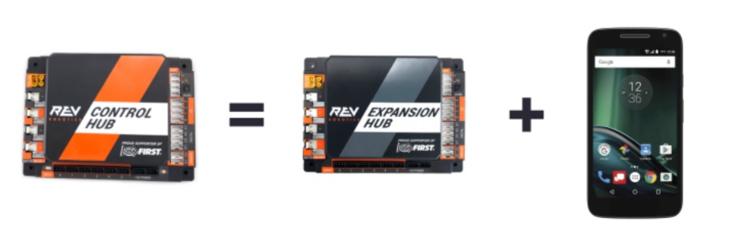
Upcoming Key D&P Goals - The Control Hub(1)
The new Rev Hub has the Robot Controller phone inside it. Basically, it can perform all the duties of the original Rev Hub and also the Robot Controller phone. So, we have one less phone to manage.
The Robot Controller phone
The old Rev Hub
The new Rev Hub

Slide 18
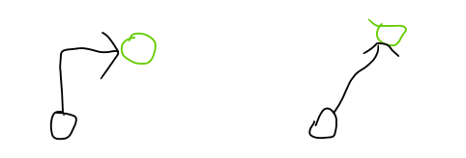
Upcoming Key D&P Goals - Strafing(2)
The second goal is to program the robot to strafe. In other words, make the robot move directly to a specific location (i.e. angle turns not required). In the following video, you’ll see what it looks like.
https://www.youtube.com/watch?v=8oGgofN_vUE

Slide 19
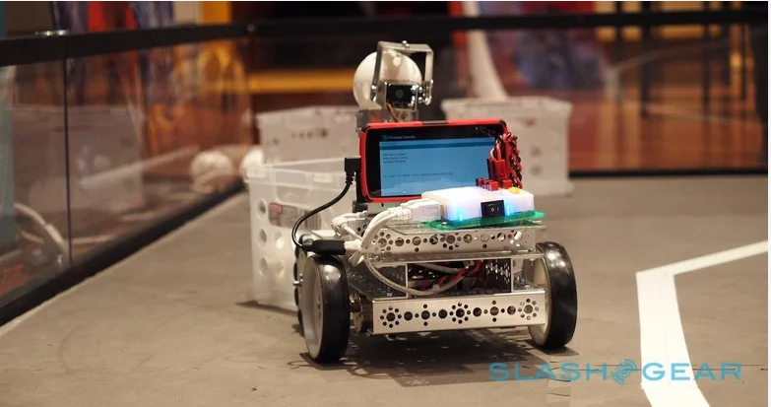
Upcoming Key D&P Goals - The Camera(3)
Add a camera, or color sensor, on the robot.
We’d have to mount it on the robot, program it to work, and use its info in the program.
Also, all these three goals that we just talked about are not part of the mission itself.
They are ways to make the mission further successful and are also something great to learn!
Camera

Slide 20
D&P Coaching/Mentor
We need the help of some assigned coach(s) and mentor(s) for the D&P team who can responsibly guide us through the season.
They will be our technical expert who can guide us through the challenges as we execute the mission.
Lets have fun in drive and programming!!!
Your coaches, mentors, and teammates are all there for you. Enjoy the experience and learn something from it. Welcome to the Robo Rangers!!!

Slide 21
How to Install Driver Station and Robot Controller Apps
On a computer, go to FTC Robot Controller GitHUB repository, releases area.
https://github.com/FIRST-Tech-Challenge/FtcRobotController/releases
Scroll down to ‘Assets’
Click ‘FtcDriverStation-release.apk’ and download it.
Confirm that you don’t have MotoG or Android phone for downloading
Connect phone to computer and transfer apk to phone's Downloads folder
Install from ‘downloads’ section on phone.
Repeat steps 4-6 with ‘FtcRobotController-release.apk’

