Slide 1


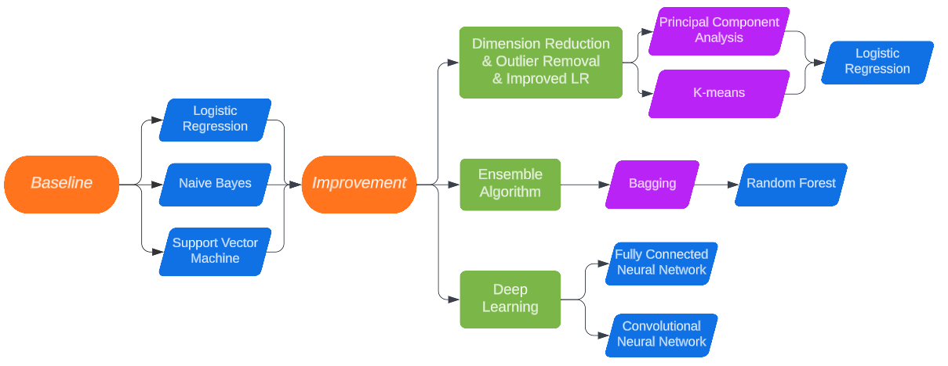
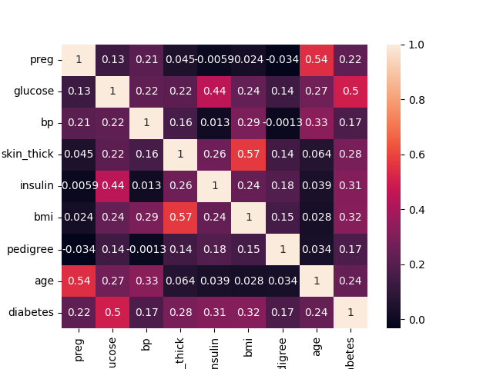
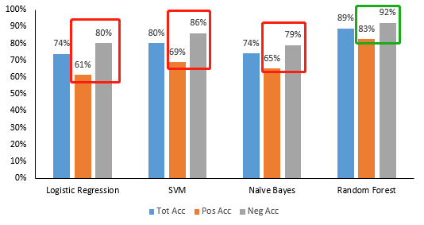
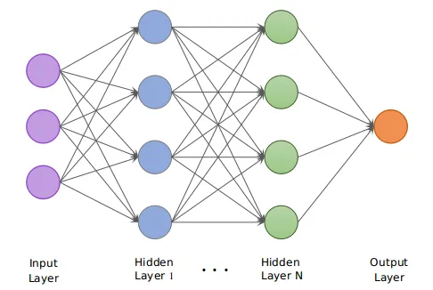
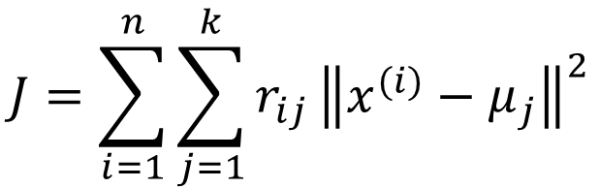
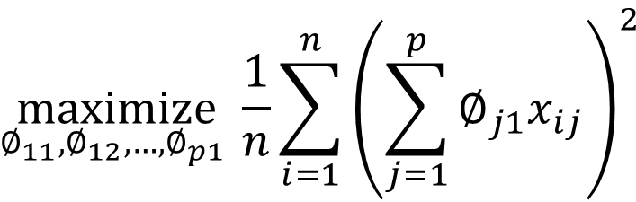
Diabetes Mellitus Prediction Using Machine Learning Algorithms
Xinxie Wu, xinxiewu@stanford.edu
Predicting
Dataset & Features: Pima Indian Diabetes (PID)
2-Part Methodology: Models & Workflow
Diabetes Mellitus (DM) is a chronic disease with high blood sugar and doesn’t have a permanent cure; hence early detection is required.
This research applies a 2-part methodology into diabetes prediction, based on PID dataset.
In baseline approach, we train Logistic Regression, Naïve Bayes & SVM, with total accuracy of ~75% but imbalanced gap, 20%, between positive and negative.
In improvement approach, Random Forest shrinks the imbalance gap down to <10%; PCA/K-means refined the dataset and LR’s retraining results in 95% accuracy;
Multiple Layers’ Neural Network is trained by changing hyperparameters and gets 89% accuracy, convolutional layer is added, and the accuracy is improved to 90.91%.
PID has 768 observations in total, 268 (34.9%) as diabetes. PID includes 8 numeric attributes covering the personal health status and medical examination results. All features are used and further selected by PCA & K-means.
EDA:
Missing Value – Median
Normalization
Correlation Matrix – Glucose 0.5
Training vs Testing: 70% / 30%
Principal Component Analysis (7)
K-means (2)
Baseline & Random Forest
$$\underset{∅_{11},∅_{12},…, ∅_{p1} }{maximize}{\frac{1}{n}\sum_{i=1}^{n}{{\left(\sum_{j=1}^{p}{∅_{j1}x_{ij}}\right)}^{2}}}$$
LR re-training determines the optional number as 7
$$J=\sum_{i=1}^{n}{\sum_{j=1}^{k}{r_{ij}}{\left\|x^{(i)}−μ_{j}\right\|}^{2}}$$
In baseline, SVM (80.09%) performs the best, followed by Naïve Bayes (74.03%) and Logistic Regression (73.59%), all with negative-positive gap 15-20%.
Although both small-size dataset and normalized features bring a higher expectation on NB than LR, but gap is small, which can be explained by some features’ high correlation.
1,000 Random Forests are trained, the best-performance one is picked. Negative-positive gap shrinks to less than 10%.
Neural Network
Results & Discussion
Dataset is split into training (80%), validation (10%) and testing (10%).
Neural networks, with different number of hidden layers (2, 3, 4) and neurons, are trained; best-performance one in validation is picked and test.
Convolutional layer is also added and tested.
Results & Discussion:
Baseline models show total accuracy ~75%, but 20% negative-positive gap;
Random Forest help to shrink the negative-positive gap down to <10%;
PCA returns an optimal number as 7, 2-cluster K-means removes 194 outliers. Improved LR reaches accuracy 95.95%;
4-layers network performs best with 89.61%; 90.91% if convolutional layers are added.
Future Work
References
For the future work, k-fold cross-validation is under consideration since our research focused on 7/3 dataset split. Also, neural networks with more different number of layers/neurons need to be trained and compare the performance. Finally, the dataset’s small size is another point we need to consider, such as if the accuracy would be impacted by the size of the dataset.
[1] Sharma, T., & Shah, M. (2021). A comprehensive review of machine learning techniques on diabetes detection.
[2] Aishwarya Mujumdar, and Dr. Vaidehi V. Diabetes Prediction using Machine Learning Algorithms, 2019.
[3] Tejas N. Joshi, and Prof. Pramila M. Chawan. Diabetes Prediction using Machine Learning Techniques, 2018.
[4] Jobeda Jamal Khanam, and Simon Y. Foo. A comparison of machine learning algorithms for diabetes prediction, 2021.
[5] [3] Jingyu Xue et al (2020). Research on Diabetes Prediction Method Based on Machine Learning.
Notes:
Hi TA team,
Thanks for the awesome semester, I learned a lot, and I’m feeling excited to share my final project which is a combo of what I learned from the past 2 months.
Okay, let’s start. This is my poster, my project is to discuss the diabetes prediction using machine learning algorithms. Let’s go through piece by piece.
First, predicting. Focusing on diabetes prediction, this research used 2-part/step methodology: baseline and improvement. In baseline, we tried LR, NB and SVM. For these three models, the total accuracy is around 75%, but positive accuracy is around 20% lower than the negative one. So, in the next step, improvement, we hope to discuss two things: first, how to improve the total accuracy, second, how to deal with imbalanced issue. Random Forest was used for the imbalance issue and it works; For total accuracy, first we tried PCA for dimensionality reduction and k-means for outlier removal, we would have new dataset and then re-train LR, the accuracy went up to 95%; second, we also tried building neural networks, it bring 89% accuracy, if we add convolutional layer, then 90%. So, I would say, both unsupervised learning and deep learning help the accuracy improvement.
The dataset we used in this project is PID, all features were used and analyzed. In data preparation, we did three things: we use median for missing values, we normalized features and we did correlation matrix, we can see glucose has the highest relations with diabetes.
As we mentioned, we use 2-step methodology in this research, baseline and improvement. This flowchart shows the path we went.
For baseline, SVM performs the best, while the other two almost the same. As we learned in this course, NB is a generative algorithm, it should have higher performance if the features follow the normal distribution, and the dataset is small. Our dataset meets these 2 conditions, so our expectation on Naïve Bayes goes up; However, as we saw in the correlation matrix, some features are highly correlated, which breaks the independence assumption, so our expectation goes down again. Finally, these two models, LR & NB, performs almost the same. For random forest, because it’s random, we trained 1000 models or forests, the best one was selected. We can see here, the neg-pos gap drops to lower than 10%. So, random forest did help on the imbalance issue.
For neural network, we build with 2/3/4 hidden layers and different number of neurons. 4 layers perform the best in our research. Also, we tried adding convolutional layer and see if this layer helps on the performance. Answer is Yes, the later table will show this.
For unsupervised learning part, first we used PCA, with # of components from 1 to 8, and then pick the number 7. The criteria to pick this number is that after we got a certain number PCA, we run it using LR; the best-performance one is picked, then after 8 times try, 7 is the best number. After PCA and we use the dataset from PCA-7 to run k-means, 2 clusters of course. The same thing to random forest, we set the initialization points as random or auto, and tried 1000 times of K-means, the best-performance one is picked. Based on the best k-means, we removed those incorrect clustered and got the refined dataset. Finally, using this refined dataset, we re-run LR, the accuracy goes up.
Okay, let’s see results of our research.
For future work

