Slide 1
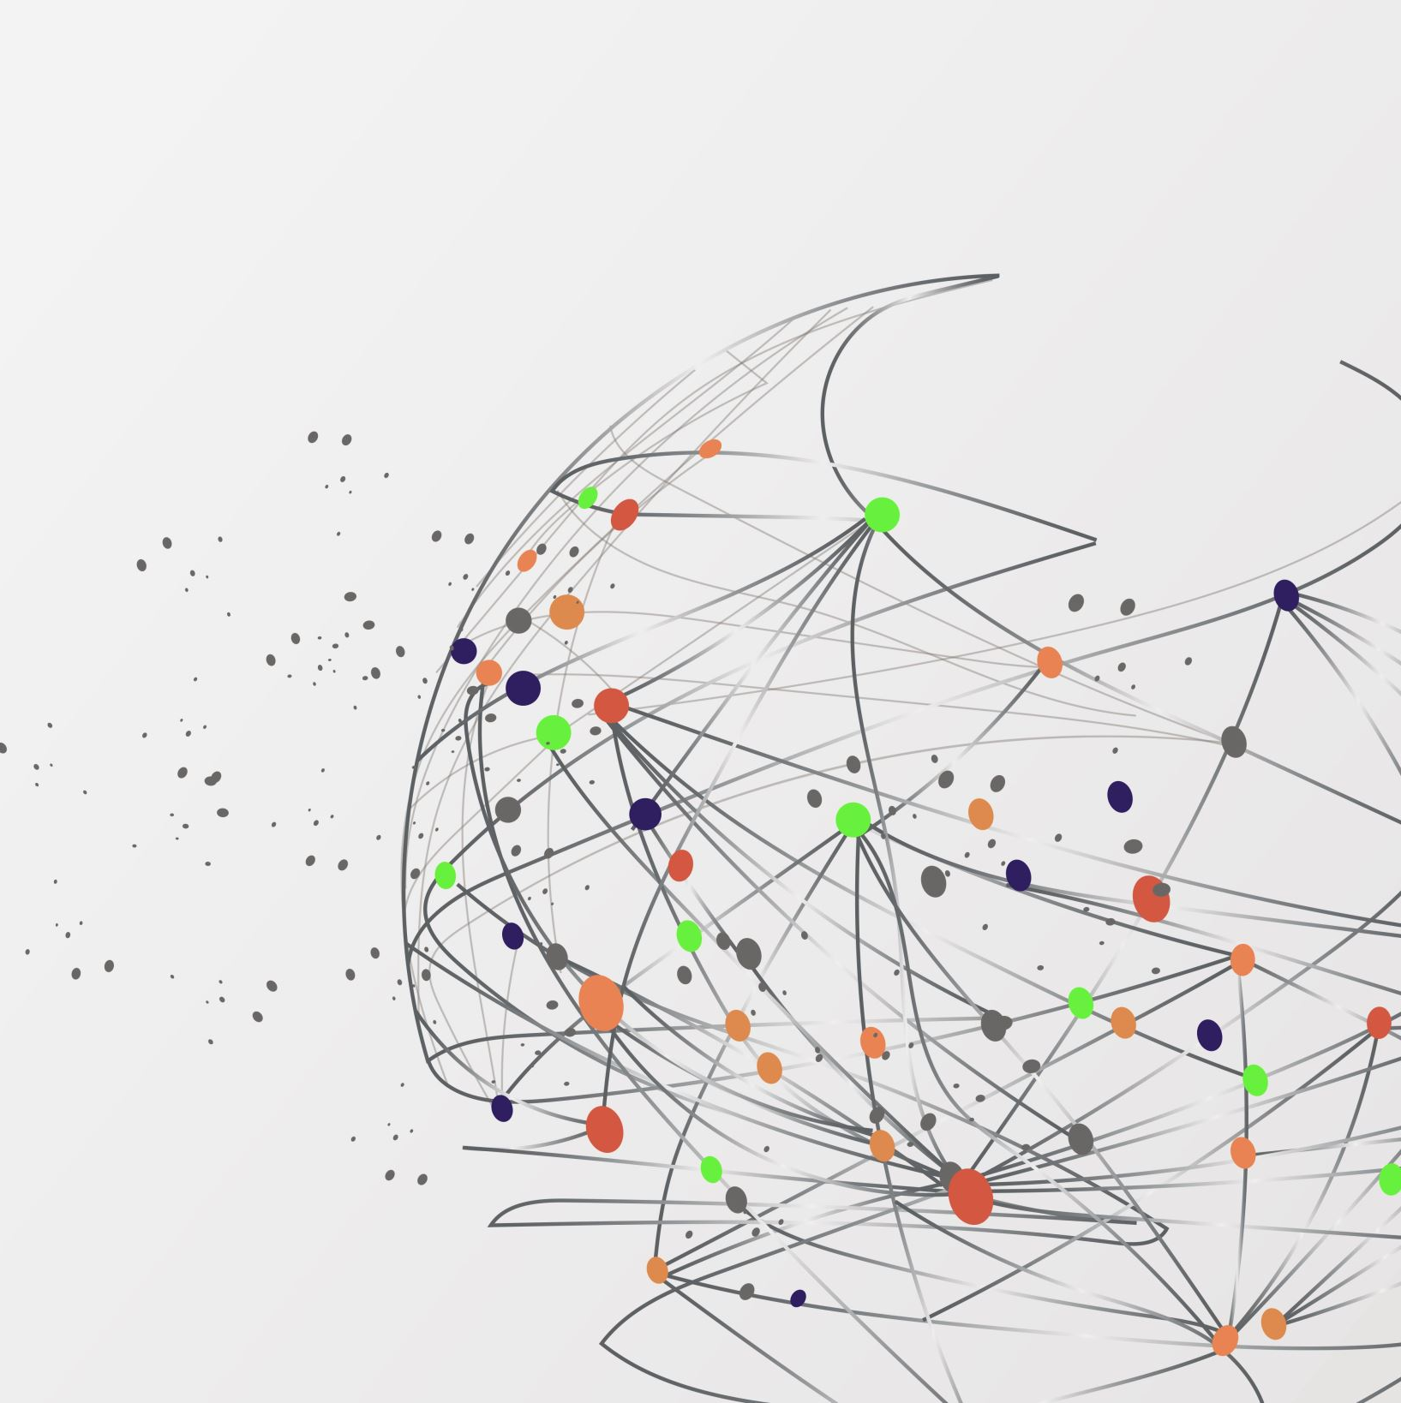
Customer Personality Analysis
Presenter: Xinxin Chen
Date: 11/29/2021

Slide 2
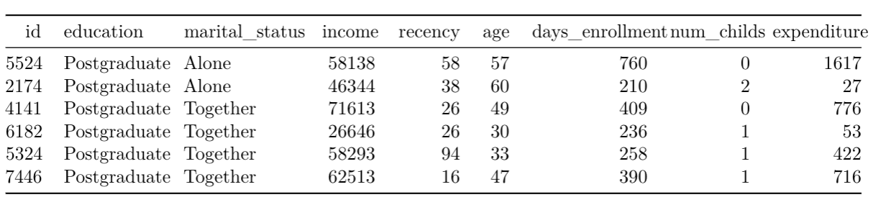
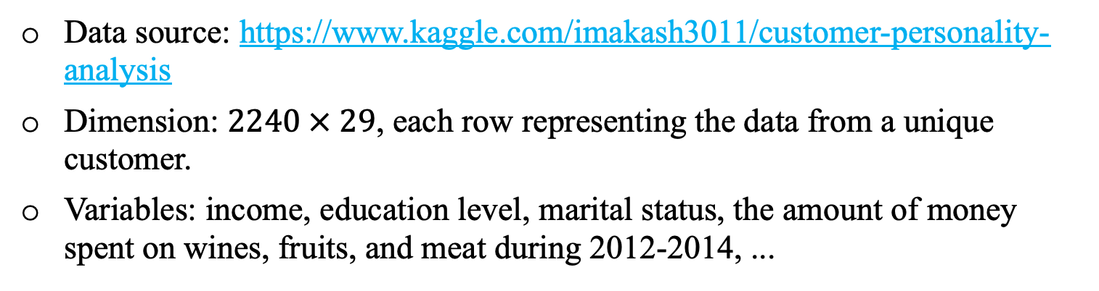
Background
Data source: https://www.kaggle.com/imakash3011/customer-personality-analysis
Dimension: $2240 × 29$, each row representing the data from a unique customer.
Variables: income, education level, marital status, the amount of money spent on wines, fruits, and meat during 2012-2014, ...

Slide 3
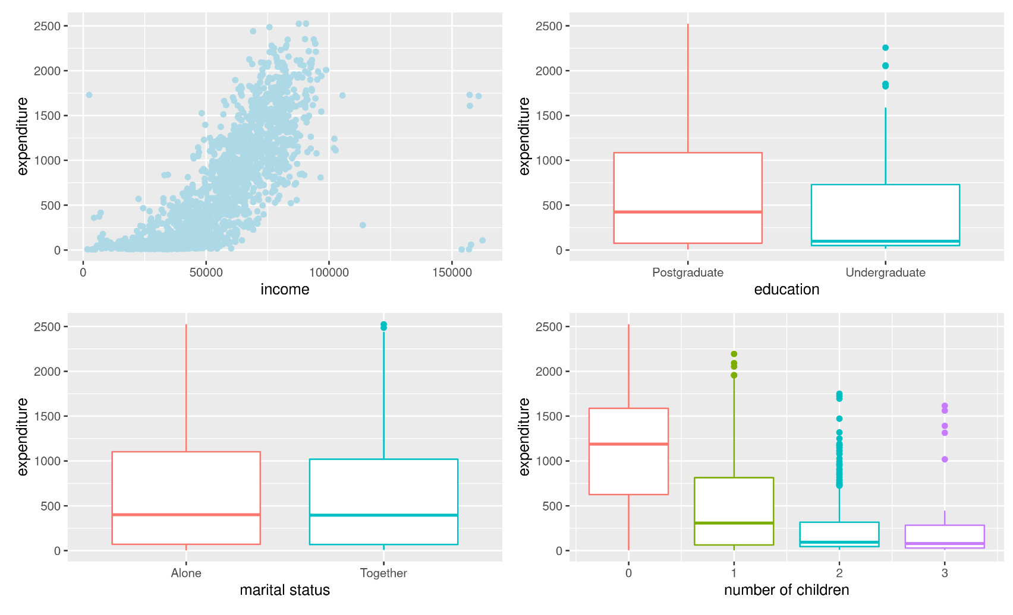
Initial Analysis

Slide 4
RFM Analysis
RFM stands for Recency, Frequency, and Monetary and is used to categorize customers based on these three quantitative factors.
Recency, frequency, and monetary scores (ranged from 1-5) are assigned to each customer. Higher scores usually represent better customers. The ideal customer would have a high score in each factor.
RFM score is generated by concatenating these three scores into a single value.
Notes:
Recency: How recently a customer made a purchase. Customers with the most recent purchase dates receive a recency score 5.
Frequency: How often a customer makes a purchase.
Monetary Value: How much money a customer has spent on purchases.

Slide 5
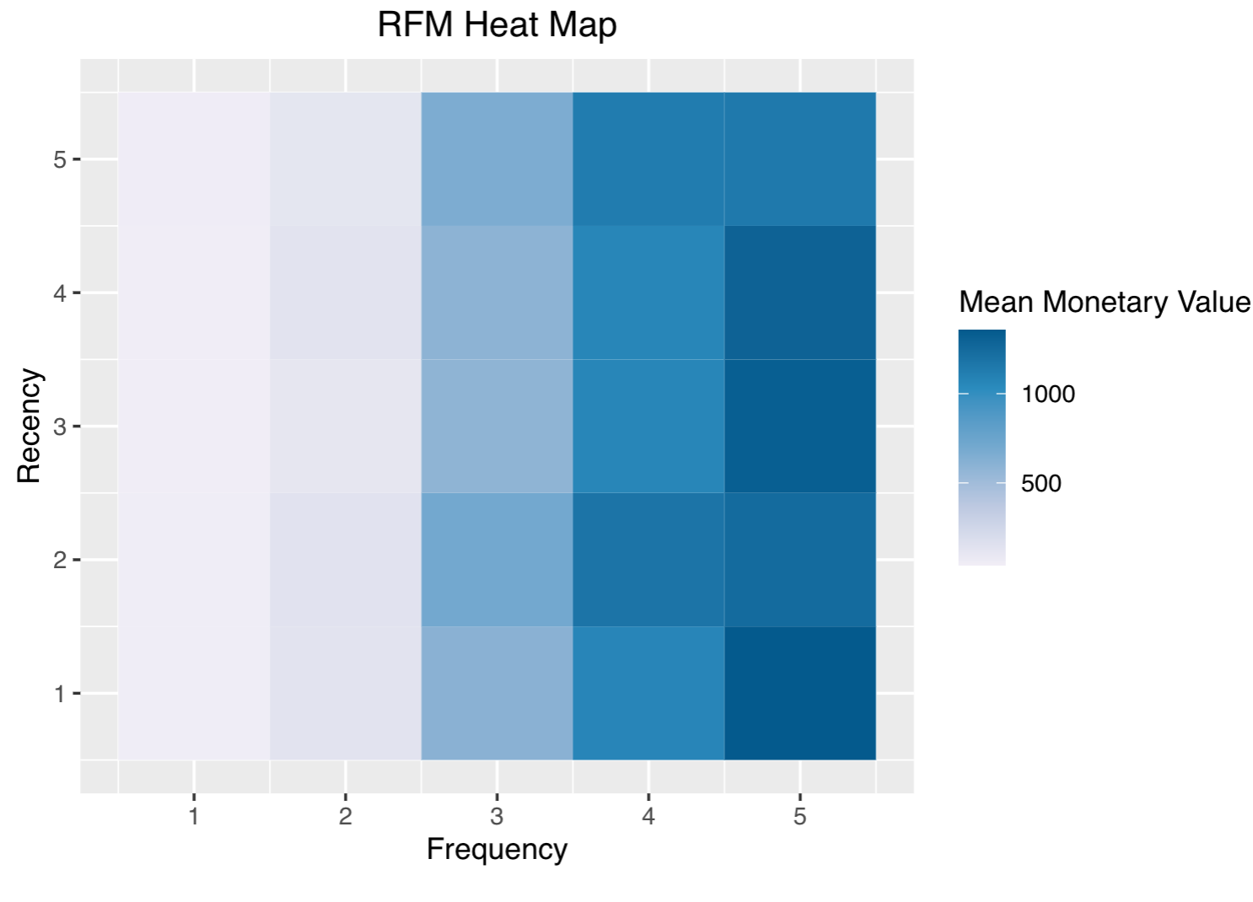
RFM Analysis
Monetary Value is concentrated in the high frequency
Notes:
We see that a big portion of the monetary value is concentrated around frequent shoppers.

Slide 6
Segment
Segment | Description | R Score | F Score | M Score | Customer Percentage
Loyal Customers | Spend good amount, bought frequently | 2-5 | 3-5 | 3-5 | 34.09%
Potential Loyalist | Recent customers, spent good amount, bought more than once | 3-5 | 1-3 | 1-3 | 25.41%
Need Attention | Average recency, frequency & monetary values | 2-3 | 2-3 | 2-3 | 3.07%
At Risk | Spent good amount, purchased often but long time ago | <=2 | 2-5 | 2-5 | 14.69%
Lost | Lowest recency, frequency & monetary scores | <=2 | <=2 | <=2 | 5.11%
……

Slide 7
Prediction of Expenditure
Convert the expenditure variable into a nominal variable with 5 levels: <=100, 100-500, 500-1000, 1000-1500, >1500.
Predict expenditure based on customers’ education level, marital status, income, age, days since enrollment with the company, and number of children.
Models considered: proportional odds model (POR), quadratic discriminant analysis (QDA), k-nearest neighbors (KNN) with k = 15, support vector machine (SVM), random forests (RF), and naive bayes (NB).

Slide 8
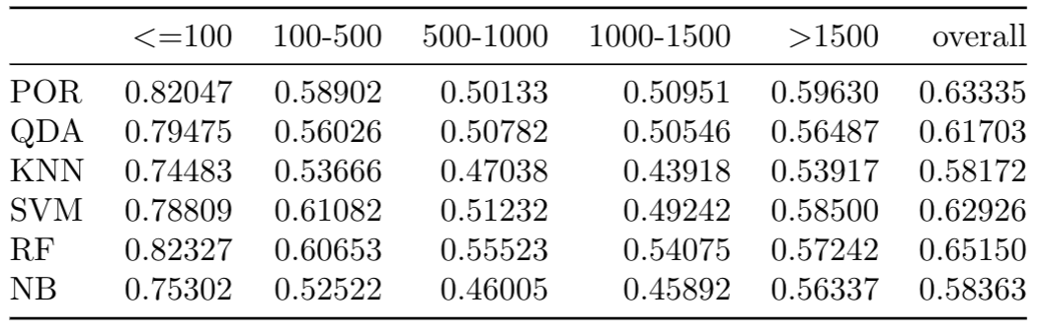
Model Prediction Accuracy Comparison
Notes:
Overall poor prediction accuracy. All methods tend to perform well on the first category: <=100, but not much better than random guessing on other categories.

