Slide 1
eCommerce NLP: Ranking Forecast on Hair Care Products
Anqi Dong (A0218944W), Hui Xinyao (A0148006M)
Zhao Dongyu (A0206513R), Xinyi Li (A0218908W), Zhang Yixuan (A0218975M)

Slide 2
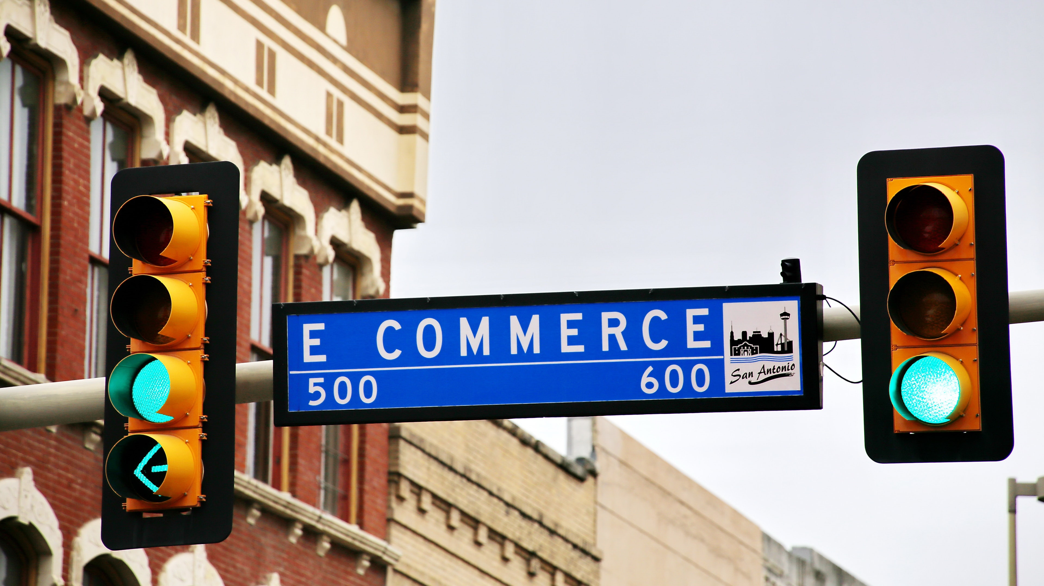
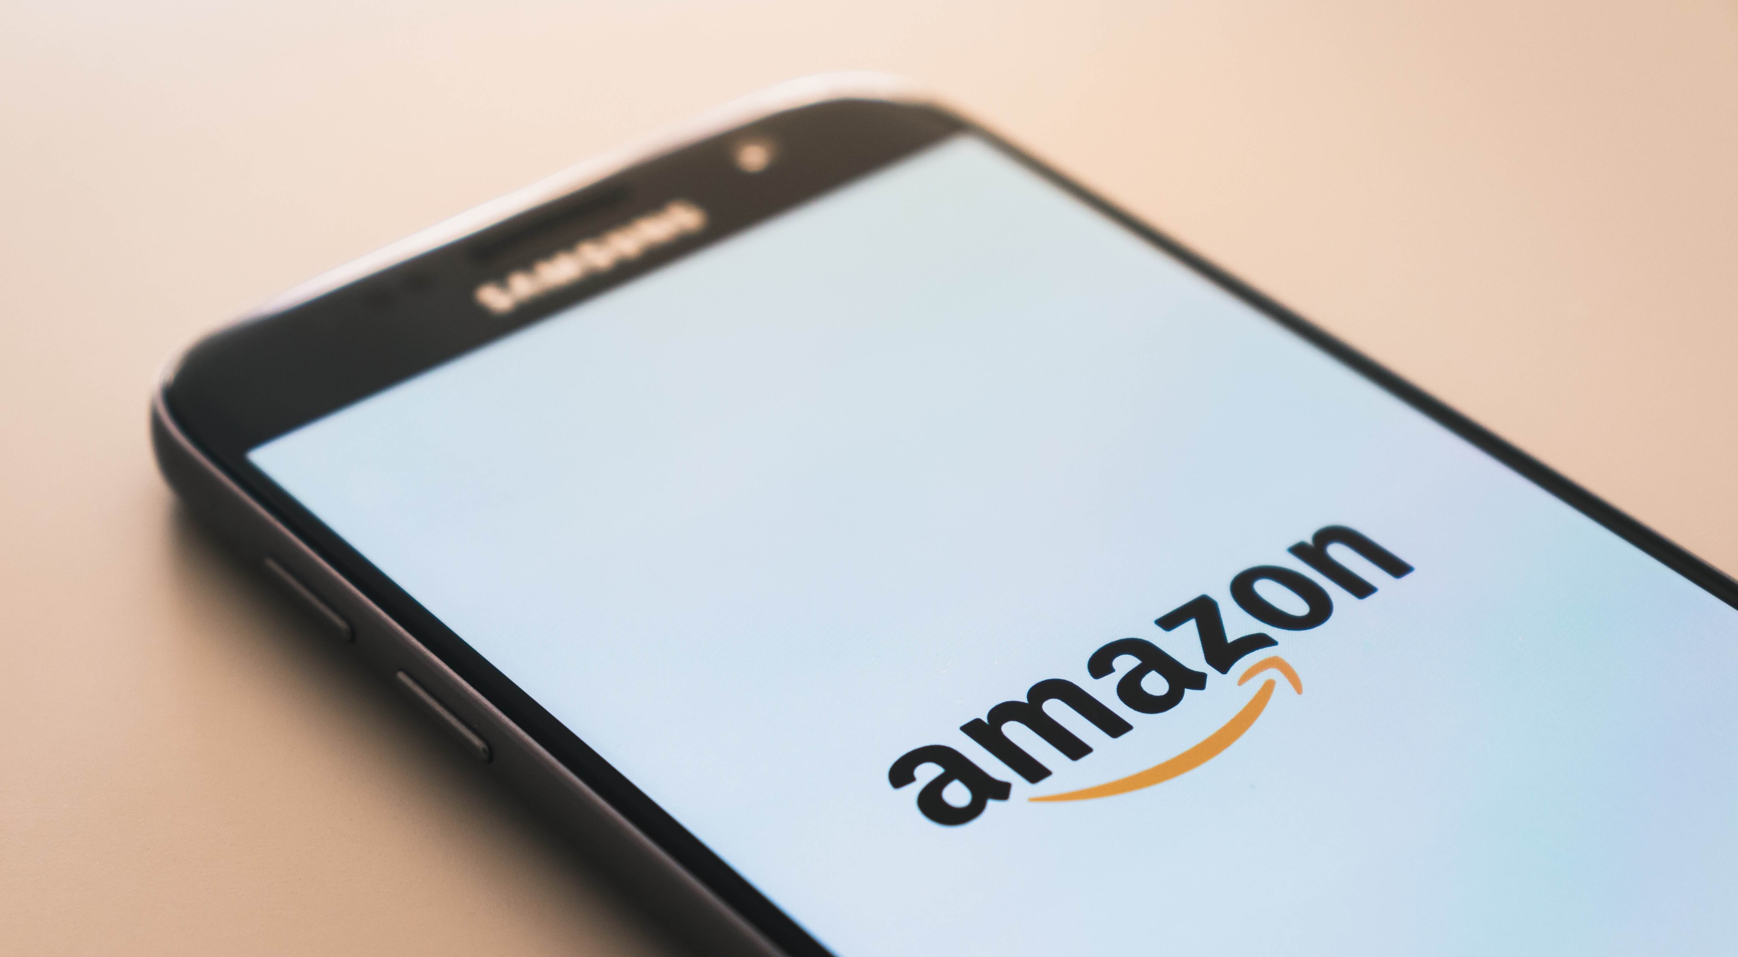

Problem statement
eCommerce is booming
R&R is important to eCommerce
From review to product ratings
Nowadays, consumers shop more often online than offline, in 2020, e-Commerce share of total global retail sales will reach 16.1%, and the number is set to reach 22% by 2023.
Ratings & reviews is considered as one of the most important aspects that eCommerce brands would use to validate their business success
Therefore, the study is focused on analyzing how platform reviews would affect product rating, and providing key insights for brands to better manage their products

Slide 3
Data Description
2 Data Sets
Meta Data | asin | imURL | price | salesRank | title | brand
Review Data | asin | helpful | overall (rating) | review text | review time | reviewer ID | reviewer name | summary
Merge Key
Text Objects
Product /Review Description
13,132 Products
133,159 Reviews

Slide 4
Data Description
2 Data Sets
Meta Data | asin | imURL | price | salesRank | title | brand
Review Data | asin | helpful | overall (rating) | review text | review time | reviewer ID | reviewer name | summary
Merge Key
Text Objects
Product /Review Description
13,132 Products
133,159 Reviews

Slide 5
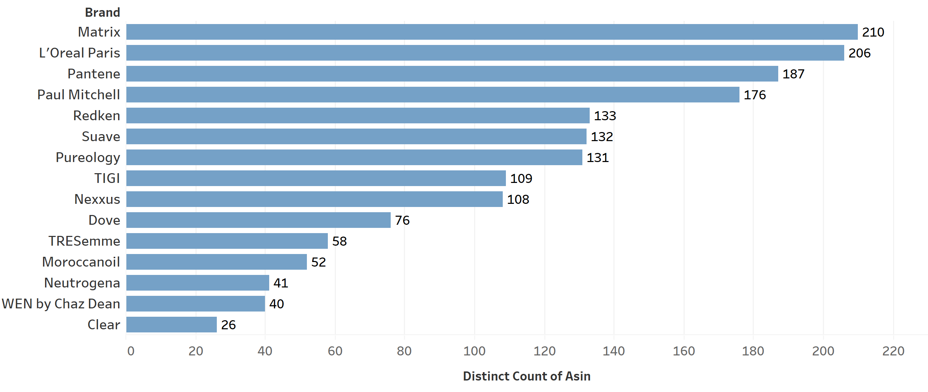
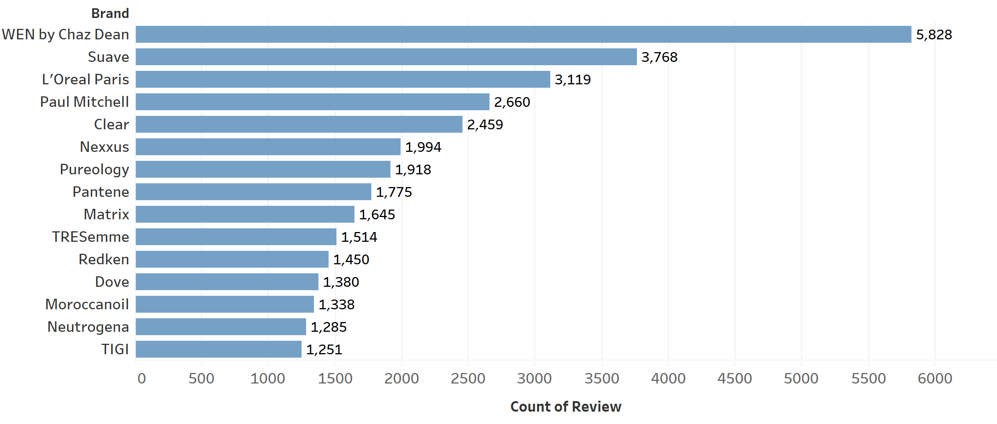
Data Description
Top brands have more product asins and reviews in total.
Number of the product asins and number of reviews do not necessarily align.
Top15 Brands with Most Product Asins
Top15 Brands with Most Reviews

Slide 6
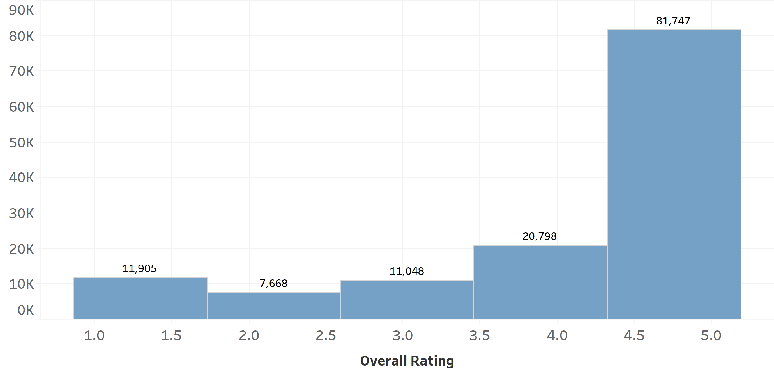
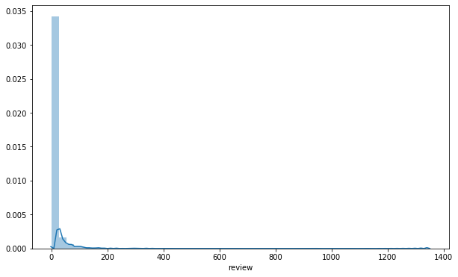
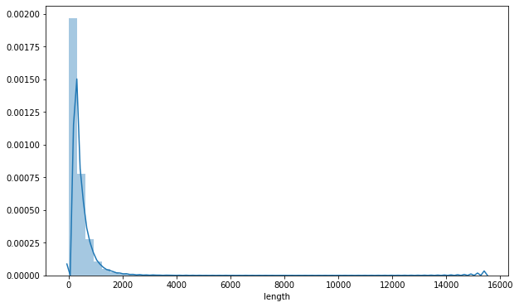
Data Description
Distribution of Overall Ratings
Overall, our dataset has a theme of long-tail distribution.
Most ratings reflected by reviews lie in the range between 4.5 and 5.0
Most products have only several reviews, while a few have over 1,000 reviews.
Most reviews are of 1 ore 2-sentence length, while some have over 4,000 letters.
Distribution of Review Counts
Distribution of Review Lengths
1 review: 31.6%

Slide 7
Functionality Keywords Extraction
1
(Product) Title | kms headremedy dandruff conditioner 8.5oz
Review | ‘Really works for me. Dandruff evidently decreased. Will definitely purchase again.’
Promised Functions
From a review mentioning the promised function, the keyword should be extracted and this review will thus be considered to remark that the product has met the basic standard.
Note that there are many different expressions standing for a same function.
2
(Product) Title | kms headremedy dandruff conditioner 8.5oz
Review | ‘Not only controls dandruff, but also strengthens hair. Nice product.’
Extra Functions
From a review mentioning some functions other than the promised function, this review will be considered to remark that the product has some extra functions.
Reviews mentioning extra functions may not simultaneously mention the promised function.

Slide 8
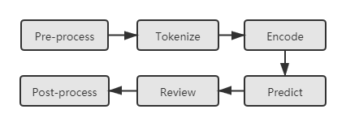
Sentiment by Aspect (1st approach)
Four general aspects: Price, Customer service, Delivery, Package
For each aspect, set a list of keywords
For each review, detect whether it contains keywords
If contain keywords, use ABSA package to retrieve sentiment score: neutral, positive and negative; Otherwise, assign zero
Aspect-based-sentiment-analysis:
Python package
BERT + Tensorflow
result
F
0
Review
ContainsAspect
T/F
ABSA package
score
T
Notes:
ASBA package’s github link can be found at: https://github.com/ScalaConsultants/Aspect-Based-Sentiment-Analysis

Slide 9
Sentiment by Aspect (1st approach)
result
For each aspect, set a list of keywords
For each review, detect whether it contains keywords
If contain keywords, use ABSA package to retrieve sentiment score
F
0
Review
ABSA package
score
T
ContainKeywords
T/F
Input parmeter
keywords
Notes:
存档

Slide 10

Sentiment by Aspect (2nd approach)
sentence
F
0
sentence
tokenize
sentence
F
0
Review
result
sentence
T: get sentiment
x
(x+y)/2
sentence
T: get sentiment
y
ContainKeywords
T/F
T
nltk.sentiment.vader
Notes:
Thank you yixuan, now I will elborate on the second approach we used for sentiment by aspect analysis.
As the ready package aspect-based-sentiment-analysis might leads to biased sentiments, we implemented another simple approach based on nltk.
Firstly, we set a list of keywords has been set for each aspect. For example, ['price', 'pricing', 'cost', 'charge’] are the keywords for aspect Price. Each review is then divided into sentences using sentence tokenizer in nltk. If the sentence contains at least one of the keywords, the sentiment score generated using nltk.sentiment.vade will be recorded. The final sentiment of the review for certain aspect will be the average of recorded sentiment scores.
This approach is easy to implement and understand. However, it can also lead to potential bias. For example, it is possible that one sentence will contain the keywords from 2 aspects. Although it may not be common, in such scenario, approach 2 can generate same sentiment score for 2 different aspects based on same sentence

Slide 11
Feature Engineering
Overall score
Helpful count
Price
Brand
Review length
… ...
Basic Information
Cleansing
Dandruff
Growth
Moisture
Repair
Color
Satisfactory
Functional Aspects
General Product Aspects
Delivery
Price
Service
Package
Overall Sentiment

Slide 12
Feature Engineering
Feature | Method | Feature | Method
Overall score | Average | Total sentimental score | Average
Helpful overall |  | General product aspects | Average
Helpful positive |  |  | Average without 0
Review length |  | Brand | Take top 19 big brands as dummy and merge the rest as ‘others’
 |  |  | (20 columns overall)
Price |  | Helpful sentimental score | Helpful overall * polarity score
Functional aspects |  | Number of reviews | Count

Slide 13



Feature Engineering
Avoid multicollinearity
Avoid reversed causality
Rank category
Since positive score + negetive score + neutral score = 1, drop neural scores
Drop features such as number of review, that has data leakage issues.
Convert the regression into classification:
High class: 0%-10%
Middle class: 10%-40%
Low class: 40%-100%

Slide 14

Modelling
Sentimental Method
Package-based
Self-designed
Average Method
Average all rows
Average without 0
Mixed
Model
RandomForest
XGBoost
Neural Network
 | Features: All Average by Product
 | Sentiment from Package | Hand Code Sentiment | Mixed Features
Best model | XGBClassifier | XGBClassifier | XGBClassifier
Best score | 0.64 | 0.64 | 0.65
NN score | 0.61 | 0.62 | 0.63
 | Features: Average on Positive Numbers
 | Sentiment from Package | Hand Code Sentiment | Mixed Features
Best model | XGBClassifier | XGBClassifier | XGBClassifier
Best score | 0.65 | 0.63 | 0.64
NN score | 0.61 | 0.62 | 0.61

Slide 15
Insights – predictability
The model can accurately predict lower class products using sentiment and keywords. However, the model is struggling on classifying the middle- and high-class products.
Prediction improvement
Prediction baseline: 60%
Model performance: 65%
Top classes has 60% of the population
Features: all average by product, with mixed features
Model: XGBoostClassifier
Class | Precision | Recall | F1-score
Low class | 0.71 | 0.86 | 0.78
Middle class | 0.47 | 0.34 | 0.39
High class | 0.59 | 0.34 | 0.43
Classification achievements

Slide 16
Insights – features
Sentiment wise, a reasonable pricing, a high-quality customer service, and an effective delivery are the key to success.
Product function wise, hair-repair, hair-cleansing, and dandruff removal are the top functions that influence the product ranking
Feature | Type | Explanation | Importance
pos_price_package_avg | Sentiment | Positive on price | 3.87%
neg_price_avg | Sentiment | Negative on price | 3.18%
r_func_repair_avg | Keywords | Contains repair function | 3.12%
polarity_price_avg | Sentiment | Polarity score on price | 2.37%
neg_service_package_avg | Sentiment | Negative on service | 2.29%
pos_delivery_avg | Sentiment | Positive on delivery | 1.99%
r_func_cleansing_avg | Keywords | Contains cleansing function | 1.92%
r_func_dandruff_avg | Keywords | Contains dandruff removal function | 1.89%
pos_shipment_package_avg | Sentiment | Positive on shipment | 1.80%
polarity_service_avg | Sentiment | Polarity score on service | 1.74%

Slide 17

Future works
Advanced sentiment analysis
Explore other advanced sentiment analysis approaches
Update sentiment analysis with recent online review behaviours
Integrate the analysis with other eCommerce analysis
Combine the review analysis with other eCommerce considerations such as pricing, product distributions, and advertisements.
Individual level prediction explanations
Each product’s ranking potentials could be different. Therefore, individual predictions such as LIME/Sharpley value could be applied.

Slide 18
REFERENCES
Devlin, J., Chang, M. W., Lee, K., & Toutanova, K. (2018). Bert: Pre-training of deep bidirectional transformers for language understanding. arXiv preprint arXiv:1810.04805.
Fan, S., Yao, J., Sun, Y., & Zhan, Y. (2020). A Summary of Aspect-based Sentiment Analysis. Journal of Physics: Conference Series, 1624, 022051. https://doi.org/10.1088/1742-6596/1624/2/022051
Liu, B. (2012). Sentiment Analysis and Opinion Mining. Synthesis Lectures on Human Language Technologies, 5(1), 1–167. https://doi.org/10.2200/s00416ed1v01y201204hlt016
Scalac, & Rolczyński, R. ł. (2021, March). Do You Trust in Aspect-Based Sentiment Analysis? Testing and Explaining Model Behaviors. https://rafalrolczynski.com/2021/03/07/aspect-based-sentiment-analysis/
Radford, A., Wu, J., Child, R., Luan, D., Amodei, D., & Sutskever, I. (2019). Language models are unsupervised multitask learners. OpenAI blog, 1(8), 9.
Tang, T. Y., Fang, E. E., & Wang, F. (2014). Is Neutral Really Neutral? The Effects of Neutral User-Generated Content on Product Sales. Journal of Marketing, 78(4), 41–58. https://doi.org/10.1509/jm.13.0301

Slide 19
Quotations are commonly printed as a means of inspiration and to invoke philosophical thoughts from the reader.

