Slide 1



Learning to Rank Relevant Files for Bug Reports using Domain Knowledge
Xin Ye, Razvan Bunescu, Chang Liu
School of Electrical Engineering and Computer Science
Ohio University, Athens OH, USA
The 22nd ACM SIGSOFT International Symposium on the Foundations of Software Engineering (FSE 2014), November 16 – 21, 2014, Hong Kong
Notes:
Alternate Layout
See slide one for tips on photo usage.
Change the footer by changing “Avionics Engineering Center” to your unit’s name or by deleting “Avionics Engineering Center.”
Do not delete “Ohio University” from the footer.
For university brand guidelines, go to http://www.ohiou.edu/ucm/styleguide/.

Slide 2
INTRODUCTION AND MOTIVATION
Bug ID: 339286
Summary: Toolbars missing icons and show wrong menus.
Description: The toolbars for my stacked views were: missing icons, showing the wrong drop-down menus (from others in the stack), showing multiple drop-down menus, missing the min/max buttons ...
Eclipse bug report 339286
Example 1
https://bugs.eclipse.org/bugs/show_bug.cgi?id=339286
Notes:
Alternate Layout
This layout allows for the use of photos on either the left or right side of the slide title title.
See slide one for tips on photo usage.
Change the footer by changing “Avionics Engineering Center” to your unit’s name or by deleting “Avionics Engineering Center.”
Do not delete “Ohio University” from the footer.

Slide 3
INTRODUCTION AND MOTIVATION
Bug ID: 339286
Summary: Toolbars missing icons and show wrong menus.
Description: The toolbars for my stacked views were: missing icons, showing the wrong drop-down menus (from others in the stack), showing multiple drop-down menus, missing the min/max buttons ...
Eclipse bug report 339286
PartRenderingEngine.java was modified in commit 7cb5c1 that fixed this bug.
https://git.eclipse.org/c/platform/eclipse.platform.ui.git/commit/?id=7cb5c12e774aa1bd97c383baab6baabf35d6374d
Notes:
Alternate Layout
This layout allows for the use of photos on either the left or right side of the slide title title.
See slide one for tips on photo usage.
Change the footer by changing “Avionics Engineering Center” to your unit’s name or by deleting “Avionics Engineering Center.”
Do not delete “Ohio University” from the footer.

Slide 4
INTRODUCTION AND MOTIVATION
Bug ID: 339286
Summary: Toolbars missing icons and show wrong menus.
Description: The toolbars for my stacked views were: missing icons, showing the wrong drop-down menus (from others in the stack), showing multiple drop-down menus, missing the min/max buttons ...
Eclipse bug report 339286
public class PartRenderingEngine implements IPresentationEngine {
private EventHandler trimHandler = new EventHandler() {
public void handleEvent(Event event) { ...
MTrimmedWindow window =
(MTrimmedWindow) changedObj;
... } ... } ... }
PartRenderingEngine.java
Notes:
Alternate Layout
This layout allows for the use of photos on either the left or right side of the slide title title.
See slide one for tips on photo usage.
Change the footer by changing “Avionics Engineering Center” to your unit’s name or by deleting “Avionics Engineering Center.”
Do not delete “Ohio University” from the footer.

Slide 5
INTRODUCTION AND MOTIVATION
Bug ID: 339286
Summary: Toolbars missing icons and show wrong menus.
Description: The toolbars for my stacked views were: missing icons, showing the wrong drop-down menus (from others in the stack), showing multiple drop-down menus, missing the min/max buttons ...
Eclipse bug report 339286
Interface MUILabel
All Known Subinterfaces: MTrimmedWindow, ...
Description: A representation of the model object 'UI Label'. This is a mix in that will be used for UI Elements that are capable of showing label information in the GUI (e.g. Parts, Menus / Toolbars, Perspectives, ...). The following features are supported: Label, Icon URI, Tooltip ...
API description of the MUILabel interface
http://help.eclipse.org/kepler/index.jsp?topic=/org.eclipse.platform.doc.isv/reference/api/org/eclipse/e4/ui/model/application/ui/MUILabel.html
Notes:
Alternate Layout
This layout allows for the use of photos on either the left or right side of the slide title title.
See slide one for tips on photo usage.
Change the footer by changing “Avionics Engineering Center” to your unit’s name or by deleting “Avionics Engineering Center.”
Do not delete “Ohio University” from the footer.

Slide 6
INTRODUCTION AND MOTIVATION
Bug ID: 378535
Summary: “Close All" and “Close Others" menu options available when right clicking on tab in PartStack when no part is closeable.
Description: If I create a PartStack that contains multiple parts but none of the parts are closeable, when I right click on any of the tabs I get menu options for “Close All“ and “Close Others". Selection of either of the menu options doesn't cause any tabs to be closed since none of the tabs can be closed. I don't think the menu options should be available if none of the tabs can be closed ...
Eclipse bug report 378535
Example 2
https://bugs.eclipse.org/bugs/show_bug.cgi?id=378535
Notes:
Alternate Layout
This layout allows for the use of photos on either the left or right side of the slide title title.
See slide one for tips on photo usage.
Change the footer by changing “Avionics Engineering Center” to your unit’s name or by deleting “Avionics Engineering Center.”
Do not delete “Ohio University” from the footer.

Slide 7
INTRODUCTION AND MOTIVATION
Bug ID: 378535
Summary: “Close All" and “Close Others" menu options available when right clicking on tab in PartStack when no part is closeable.
Description: If I create a PartStack that contains multiple parts but none of the parts are closeable, when I right click on any of the tabs I get menu options for “Close All“ and “Close Others". Selection of either of the menu options doesn't cause any tabs to be closed since none of the tabs can be closed. I don't think the menu options should be available if none of the tabs can be closed ...
Eclipse bug report 378535
StackRenderer.java is the relevant file for this bug 378535.
StackRenderer.java had been found to be relevant for three other previously fixed bug reports 329950, 325722, 313328.
Notes:
Alternate Layout
This layout allows for the use of photos on either the left or right side of the slide title title.
See slide one for tips on photo usage.
Change the footer by changing “Avionics Engineering Center” to your unit’s name or by deleting “Avionics Engineering Center.”
Do not delete “Ohio University” from the footer.

Slide 8
INTRODUCTION AND MOTIVATION
Bug ID: 378535
Summary: “Close All" and “Close Others" menu options available when right clicking on tab in PartStack when no part is closeable.
Description: If I create a PartStack that contains multiple parts but none of the parts are closeable, when I right click on any of the tabs I get menu options for “Close All“ and “Close Others". Selection of either of the menu options doesn't cause any tabs to be closed since none of the tabs can be closed. I don't think the menu options should be available if none of the tabs can be closed ...
Eclipse bug report 378535
Bug ID: 329950
Summary: “Close All" and “Close Others" may cause bundle activation.
Bug ID: 325722
Summary: “Close"-related context menu actions should show up for all stacks and apply to all items.
Bug ID: 313328
Summary: Close parts under stacks with middle mouse click.
Bug reports that are similar with 378535
Notes:
Alternate Layout
This layout allows for the use of photos on either the left or right side of the slide title title.
See slide one for tips on photo usage.
Change the footer by changing “Avionics Engineering Center” to your unit’s name or by deleting “Avionics Engineering Center.”
Do not delete “Ohio University” from the footer.

Slide 9
INTRODUCTION AND MOTIVATION
A ranking problem: source files (documents) are ranked with respect to their relevance to a given bug report (query).
The ranking function: a weighted combination of features.
Features: a type of information that measure the relevance between the bug report and the source code file.
draw heavily on knowledge specific to the software engineering domain
functional decompositions of source code files into methods, API descriptions of library components used in the code, the bug-fixing history, and the code change history
Notes:
Alternate Layout
This layout allows for the use of photos on either the left or right side of the slide title title.
See slide one for tips on photo usage.
Change the footer by changing “Avionics Engineering Center” to your unit’s name or by deleting “Avionics Engineering Center.”
Do not delete “Ohio University” from the footer.

Slide 10
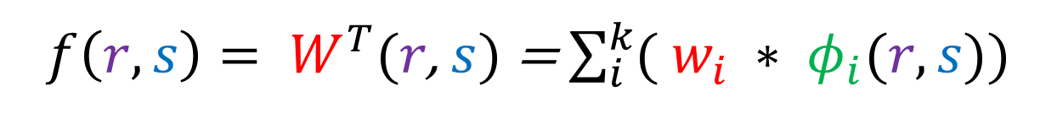
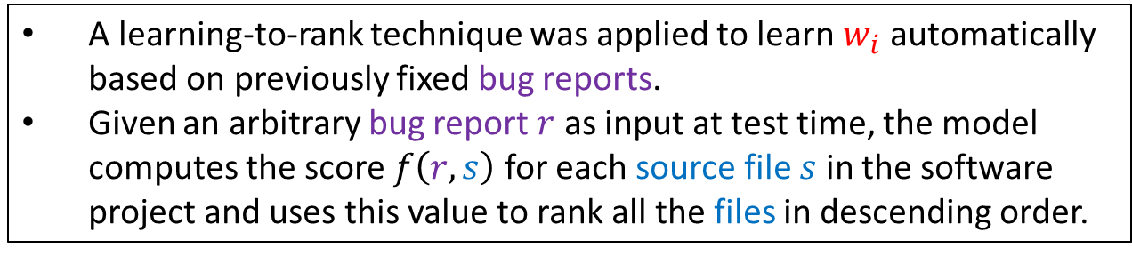
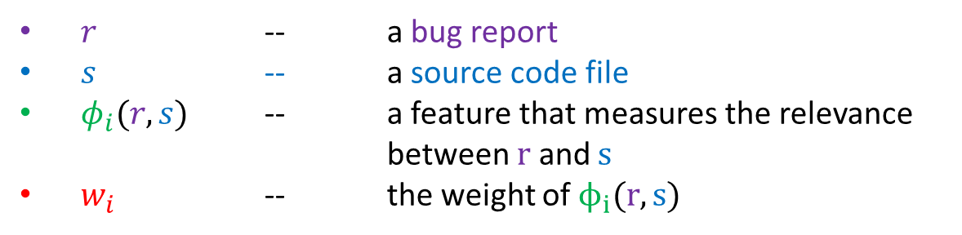
RANKING MODEL
$f\left(r, s\right)= W^{T}(r$, $s)$ = $\sum_{i}^{k}{( w_{i} ∗ φ_{i}(r, s))}$
$r$ -- a bug report
$s$ -- a source code file
$φ_{i}(r, s)$ -- a feature that measures the relevance between $r$ and $s$
$w_{i}$ -- the weight of $ϕ_{i}(r, s)$
A learning-to-rank technique was applied to learn $w_{i}$ automatically based on previously fixed bug reports.
Given an arbitrary bug report $r$ as input at test time, the model computes the score $f\left(r, s\right)$ for each source file $s$ in the software project and uses this value to rank all the files in descending order.
Notes:
Alternate Layout
This layout allows for the use of photos on either the left or right side of the slide title title.
See slide one for tips on photo usage.
Change the footer by changing “Avionics Engineering Center” to your unit’s name or by deleting “Avionics Engineering Center.”
Do not delete “Ohio University” from the footer.

Slide 11
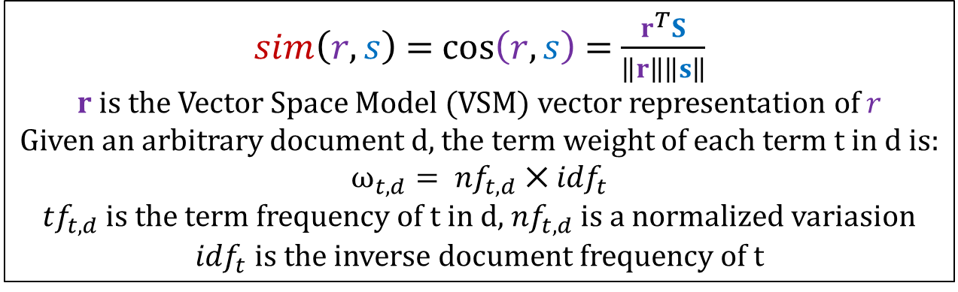
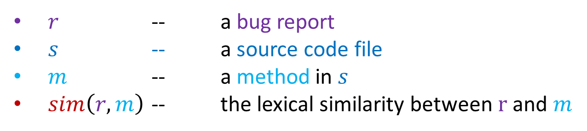
FEATURE ENGINEERING
feature 1 - Surface Lexical Similarity
$$φ_{1}\left(r, s\right)=max⁡( \left\{sim(r, s)\right\} ∪ \left\{sim\left(r, m\right) ∣ m ∈s\right\})$$
$r$ -- a bug report
$s$ -- a source code file
$m$ -- a method in $s$
$sim\left(r, m\right)$ -- the lexical similarity between $r$ and $m$
$sim\left(r,s\right)$ = $\cos\left(r,s\right)$ = $\frac{r^{T}S}{\left\|r\right\|\left\|s\right\|}$
$r$ is the Vector Space Model (VSM) vector representation of $r$
Given an arbitrary document d, the term weight of each term t in d is:
$$ω_{t,d}= {nf}_{t,d} ⨉ {idf}_{t}$$
${tf}_{t,d}$ is the term frequency of t in d, ${nf}_{t,d}$ is a normalized variasion
${idf}_{t}$ is the inverse document frequency of t
Notes:
Alternate Layout
This layout allows for the use of photos on either the left or right side of the slide title title.
See slide one for tips on photo usage.
Change the footer by changing “Avionics Engineering Center” to your unit’s name or by deleting “Avionics Engineering Center.”
Do not delete “Ohio University” from the footer.

Slide 12
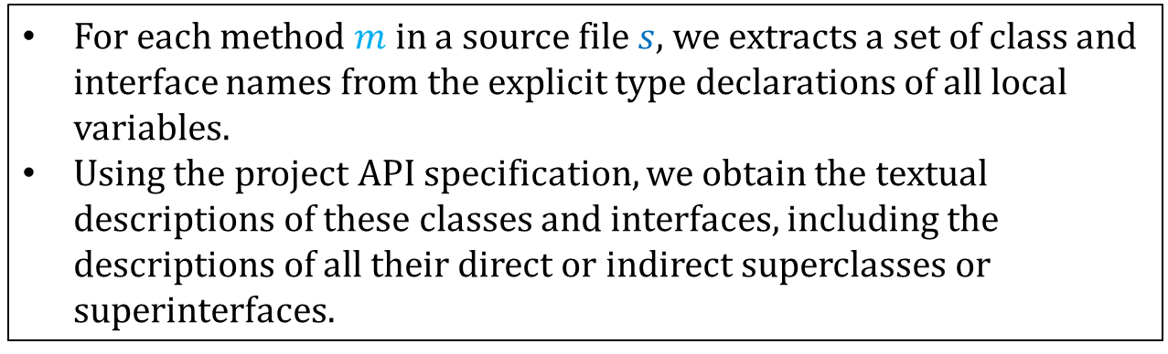
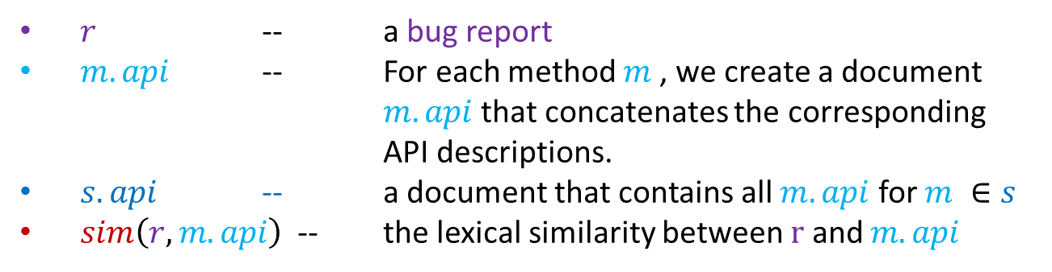
FEATURE ENGINEERING
feature 2 - API-Enriched Lexical Similarity
$$φ_{2}\left(r, s\right)=max⁡( \left\{sim(r, s.api)\right\} ∪ \left\{sim\left(r, m.api\right) ∣ m ∈s\right\})$$
$r$ -- a bug report
$m.api$ -- For each method $m$, we create a document $m.api$that concatenates the corresponding API descriptions.
$s.api$ -- a document that contains all $m.api$ for $m ∈s$
$sim\left(r, m.api\right)$-- the lexical similarity between $r$ and $m.api$
For each method $m$in a source file $s$, we extracts a set of class and interface names from the explicit type declarations of all local variables.
Using the project API specification, we obtain the textual descriptions of these classes and interfaces, including the descriptions of all their direct or indirect superclasses or superinterfaces.
Notes:
Alternate Layout
This layout allows for the use of photos on either the left or right side of the slide title title.
See slide one for tips on photo usage.
Change the footer by changing “Avionics Engineering Center” to your unit’s name or by deleting “Avionics Engineering Center.”
Do not delete “Ohio University” from the footer.

Slide 13
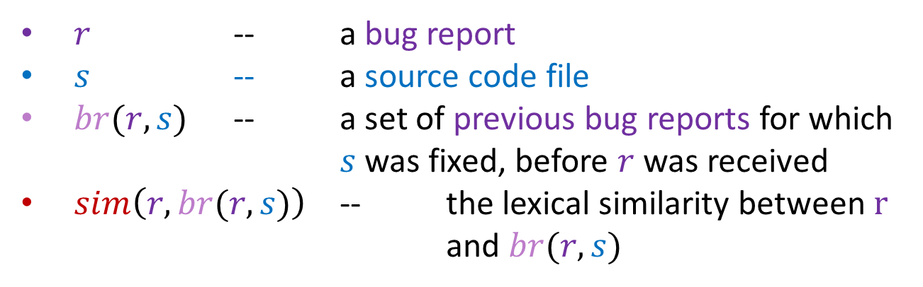
FEATURE ENGINEERING
feature 3 - Collaborative Filtering Score
$$φ_{3}\left(r, s\right)=sim\left(r, br(r, s)\right)$$
$r$ -- a bug report
$s$ -- a source code file
$br(r, s)$ -- a set of previous bug reports for which $s$ was fixed, before $r$ was received
$sim\left(r, br(r, s)\right)$ -- the lexical similarity between $r$ and $br(r, s)$
Notes:
Alternate Layout
This layout allows for the use of photos on either the left or right side of the slide title title.
See slide one for tips on photo usage.
Change the footer by changing “Avionics Engineering Center” to your unit’s name or by deleting “Avionics Engineering Center.”
Do not delete “Ohio University” from the footer.

Slide 14

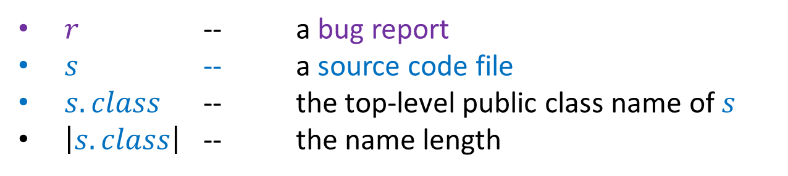
FEATURE ENGINEERING
feature 4 - Class Name Similarity
$$φ_{4}\left(r, s\right)= \left\{\begin{aligned}\left|s.class\right| if s.class∈r \\ 0 otherwise\end{aligned}\right.$$
$r$ -- a bug report
$s$ -- a source code file
$s.class$ -- the top-level public class name of $s$
$\left|s.class\right|$ -- the name length
Notes:
Alternate Layout
This layout allows for the use of photos on either the left or right side of the slide title title.
See slide one for tips on photo usage.
Change the footer by changing “Avionics Engineering Center” to your unit’s name or by deleting “Avionics Engineering Center.”
Do not delete “Ohio University” from the footer.

Slide 15
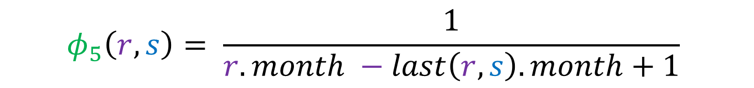
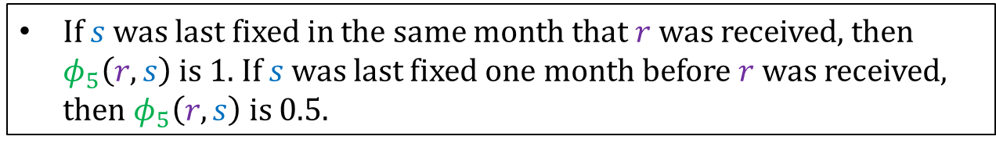
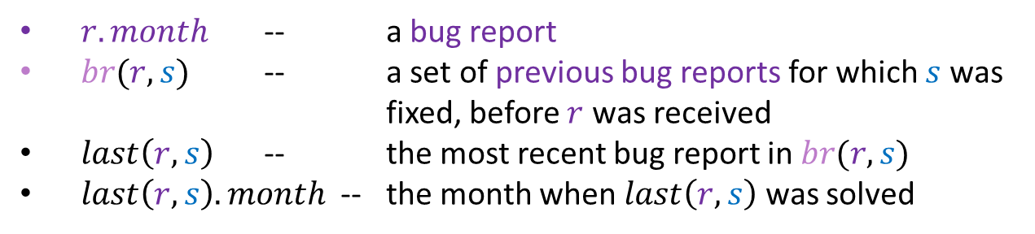
FEATURE ENGINEERING
feature 5 - Bug-fixing Recency
$$φ_{5}\left(r, s\right)= \frac{1}{r.month −last\left(r, s\right).month+1}$$
$r.month$ -- a bug report
$br(r, s)$ -- a set of previous bug reports for which $s$ was fixed, before $r$ was received
$last\left(r, s\right)$ -- the most recent bug report in $br(r, s)$
$last\left(r, s\right).month$-- the month when $last\left(r, s\right)$ was solved
If $s$ was last fixed in the same month that $r$ was received, then $φ_{5}\left(r, s\right)$ is 1. If $s$ was last fixed one month before $r$ was received, then $φ_{5}\left(r, s\right)$ is 0.5.
Notes:
Alternate Layout
This layout allows for the use of photos on either the left or right side of the slide title title.
See slide one for tips on photo usage.
Change the footer by changing “Avionics Engineering Center” to your unit’s name or by deleting “Avionics Engineering Center.”
Do not delete “Ohio University” from the footer.

Slide 16
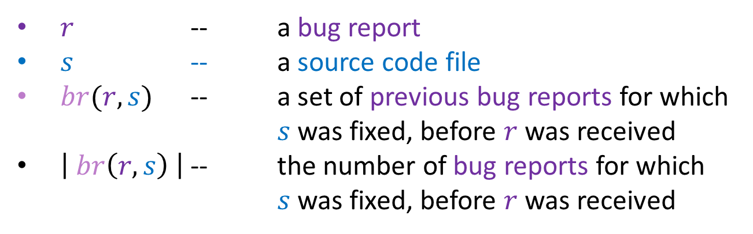
FEATURE ENGINEERING
feature 6 - Bug-fixing Frequency
$$φ_{6}\left(r, s\right)= \left| br\left(r, s\right) \right|$$
$r$ -- a bug report
$s$ -- a source code file
$br(r, s)$ -- a set of previous bug reports for which $s$ was fixed, before $r$ was received
$\left| br\left(r, s\right) \right|$ -- the number of bug reports for which $s$ was fixed, before $r$ was received
Notes:
Alternate Layout
This layout allows for the use of photos on either the left or right side of the slide title title.
See slide one for tips on photo usage.
Change the footer by changing “Avionics Engineering Center” to your unit’s name or by deleting “Avionics Engineering Center.”
Do not delete “Ohio University” from the footer.

Slide 17
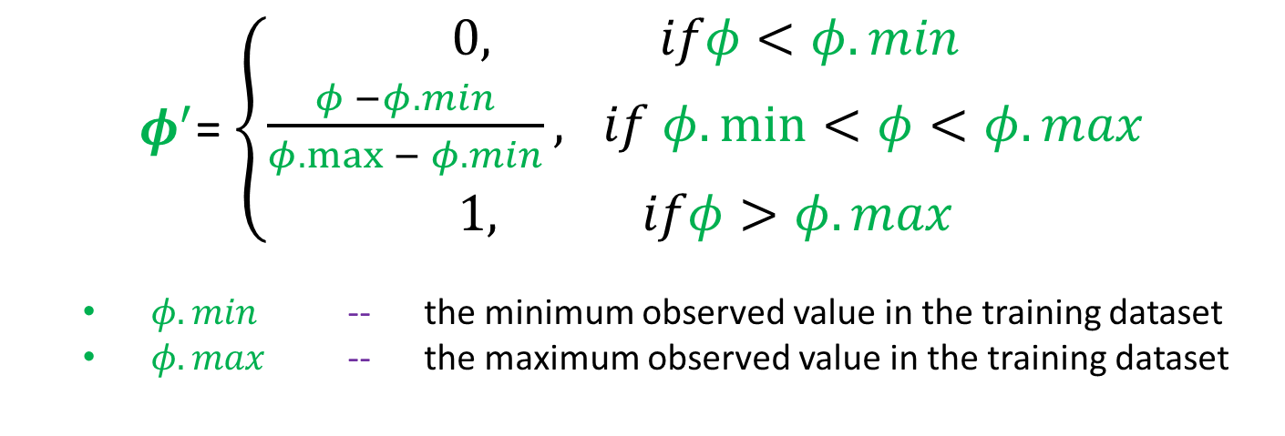
FEATURE ENGINEERING
Feature Scaling
Feature scaling helps bring all features to the same scale so that they become comparable with each other.
Notes:
Alternate Layout
This layout allows for the use of photos on either the left or right side of the slide title title.
See slide one for tips on photo usage.
Change the footer by changing “Avionics Engineering Center” to your unit’s name or by deleting “Avionics Engineering Center.”
Do not delete “Ohio University” from the footer.

Slide 18
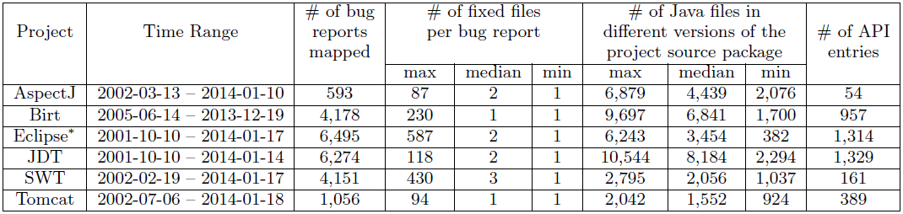
BENCHMARK DATASETS
AspectJ: an aspect-oriented programming extension for Java.
http://eclipse.org/aspectj/
Birt: an Eclipse-based business intelligence and reporting tool.
https://www.eclipse.org/birt/
Eclipse Platform UI: the user interface of an integrated development platform.
http://projects.eclipse.org/projects/eclipse.platform.ui
JDT: a suite of Java development tools for Eclipse.
http://www.eclipse.org/jdt/
SWT: a widget toolkit for Java.
http://www.eclipse.org/swt/
Tomcat: a web application server and servlet container.
http://tomcat.apache.org
Notes:
Alternate Layout
This layout allows for the use of photos on either the left or right side of the slide title title.
See slide one for tips on photo usage.
Change the footer by changing “Avionics Engineering Center” to your unit’s name or by deleting “Avionics Engineering Center.”
Do not delete “Ohio University” from the footer.

Slide 19
BENCHMARK DATASETS
Search for phrases such as “bug 319463” and “fix for 319463” from their Git log messages.
Based on these Git log messages, map a commit from the project Git repository to a bug report in the project bug databse on Bugzilla.
Ignore those mappings that are not one-to-one.
Notes:
Alternate Layout
This layout allows for the use of photos on either the left or right side of the slide title title.
See slide one for tips on photo usage.
Change the footer by changing “Avionics Engineering Center” to your unit’s name or by deleting “Avionics Engineering Center.”
Do not delete “Ohio University” from the footer.

Slide 20
BENCHMARK DATASETS
older--- code version A (a bug C was reported on A) -- time line -- code version B (used for evaluation)--current
Problems of using one code revision for evaluation on multiple bug reports:
The fixed version B that is used for evaluation may contain future bug-fixing information for the old bug report C.
A buggy file in A that is relevant to an old bug report C might not even exist in the fixed code version B, if it was deleted after the bug report C was solved.
Notes:
Alternate Layout
This layout allows for the use of photos on either the left or right side of the slide title title.
See slide one for tips on photo usage.
Change the footer by changing “Avionics Engineering Center” to your unit’s name or by deleting “Avionics Engineering Center.”
Do not delete “Ohio University” from the footer.

Slide 21
BENCHMARK DATASETS
Strong benchmark: check out a before-fix version of the project for every bug report.
It may not be the exact same version based on which the bug was reported originally.
However, since the corresponding fix had not been checked in, the bug still existed in its before-fix version.
For 22,747 bug reports, check out 22,747 before-fix versions of the project source code package.
http://dx.doi.org/10.6084/m9.figshare.951967
Notes:
Alternate Layout
This layout allows for the use of photos on either the left or right side of the slide title title.
See slide one for tips on photo usage.
Change the footer by changing “Avionics Engineering Center” to your unit’s name or by deleting “Avionics Engineering Center.”
Do not delete “Ohio University” from the footer.

Slide 22


LEARNING-TO-RANK
$f\left(r, s\right)= W^{T}(r$, $s)$ = $\sum_{i}^{k}{( w_{i} ∗ φ_{i}(r, s))}$
The model parameters $w_{i}$ are trained using the learning-to-rank approach [1], as implemented in the ${SVM}^{rank}$[2] package.
If $s1$ is relevant for bug report $r$ and $s2$ is irrelevant, then the objective of the optimization procedure is to find $w_{i}$ such that $f\left(r, s1\right)$ > $f\left(r, s2\right)$.
The format of the input data for ${SVM}^{rank}$:
2 qid:1 1:0.0597664407357 2:0.0888075047148 3:0.189473390115 4:0.0526315789474 5:0.116279069767 6:0
1 qid:1 1:0.0532524839072 2:0 3:0 4:0 5:0 6:0
…
2 qid:2 1:0.136007924647 2:0.0628942151732 3:0.216708084093 4:1.0 5:0.149425287356 6:0
1 qid:2 1:0.0724027253163 2:0.0587791658721 3:0.103258844513 4:0.0384615384615 5:0.0689655172414 6:0
…
2 – positive
1 - negative
bug report id
feature:value
[1] T. Joachims. Optimizing search engines using clickthrough data. In Proc. KDD '02, pages 133 - 142, 2002.
[2] T. Joachims. Training linear SVMs in linear time. In Proc. KDD '06, pages 217 - 226, 2006.
Notes:
Alternate Layout
This layout allows for the use of photos on either the left or right side of the slide title title.
See slide one for tips on photo usage.
Change the footer by changing “Avionics Engineering Center” to your unit’s name or by deleting “Avionics Engineering Center.”
Do not delete “Ohio University” from the footer.

Slide 23

LEARNING-TO-RANK
$f\left(r, s\right)= W^{T}(r$, $s)$ = $\sum_{i}^{k}{( w_{i} ∗ φ_{i}(r, s))}$
The model parameters $w_{i}$ are trained using the learning-to-rank approach [1], as implemented in the ${SVM}^{rank}$[2] package.
If $s1$ is relevant for bug report $r$ and $s2$ is irrelevant, then the objective of the optimization procedure is to find $w_{i}$ such that $f\left(r, s1\right)$ > $f\left(r, s2\right)$.
For Eclipse bug 384108, there are 1 relevant and 6,243 irrelevant source files (the positive/negative ratio is 1/6,243), which would make the training time infeasible.
Therefore, for each bug report $r$:
we first use the VSM cosine similarity feature $φ_{i}(r, s)$to rank all the files in the dataset,
and then select only the top 300 irrelevant files for training.
[1] T. Joachims. Optimizing search engines using clickthrough data. In Proc. KDD '02, pages 133 - 142, 2002.
[2] T. Joachims. Training linear SVMs in linear time. In Proc. KDD '06, pages 217 - 226, 2006.
Notes:
Alternate Layout
This layout allows for the use of photos on either the left or right side of the slide title title.
See slide one for tips on photo usage.
Change the footer by changing “Avionics Engineering Center” to your unit’s name or by deleting “Avionics Engineering Center.”
Do not delete “Ohio University” from the footer.

Slide 24
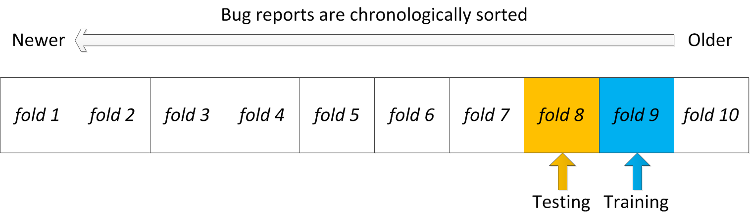
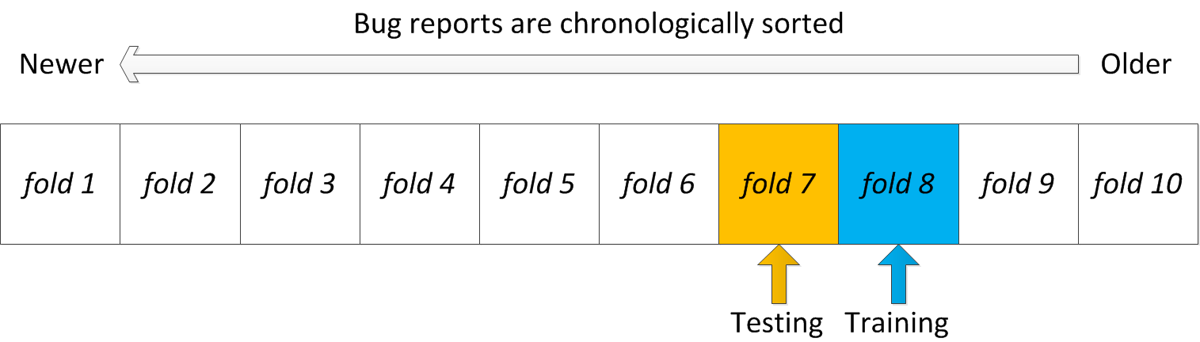
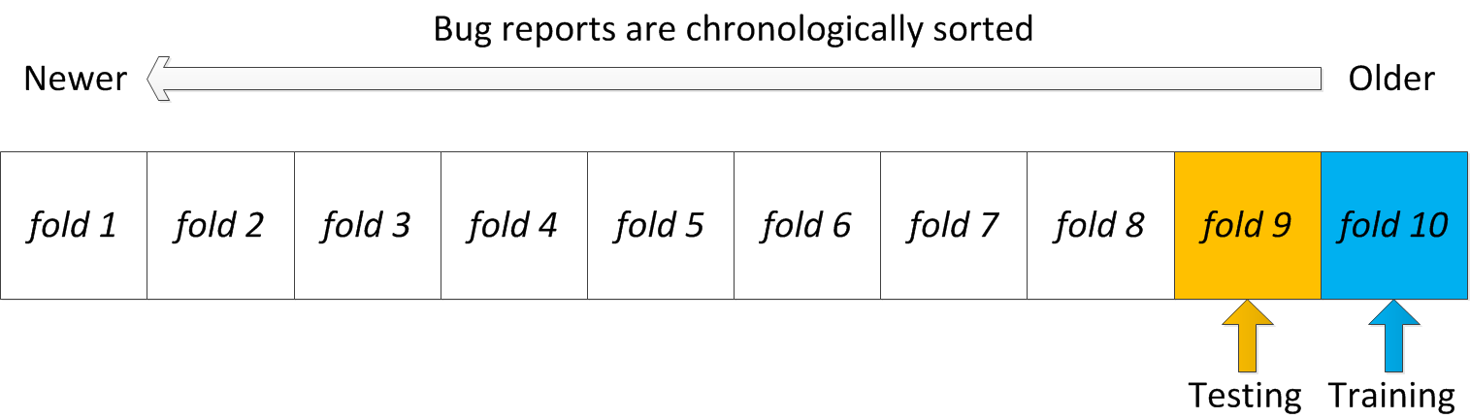
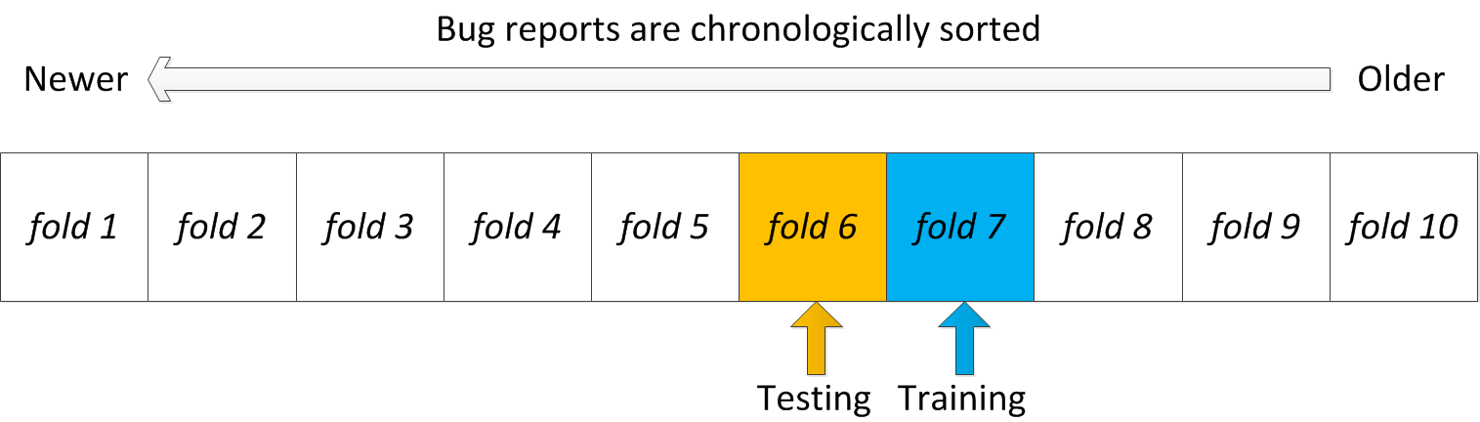
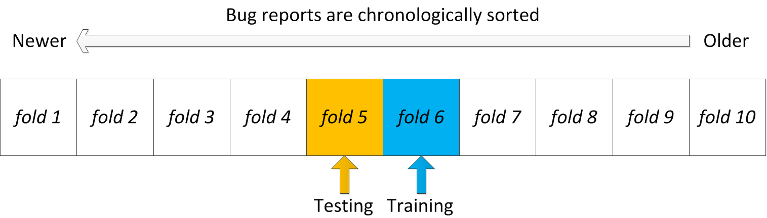
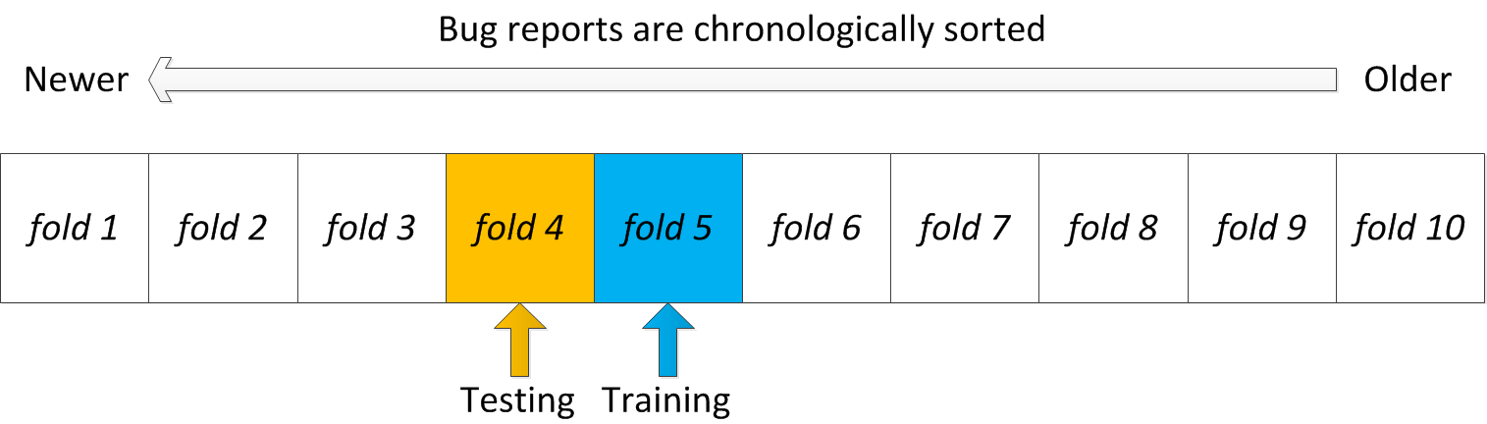
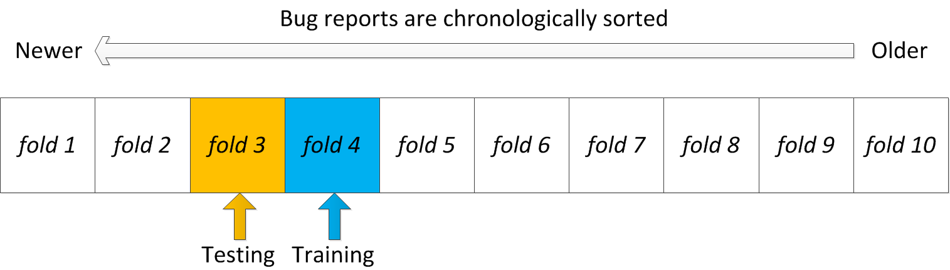
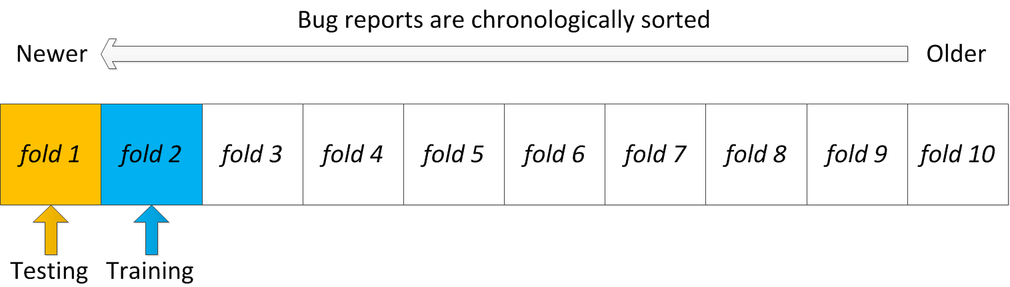
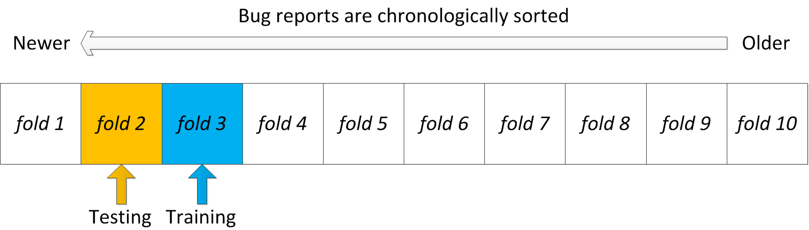
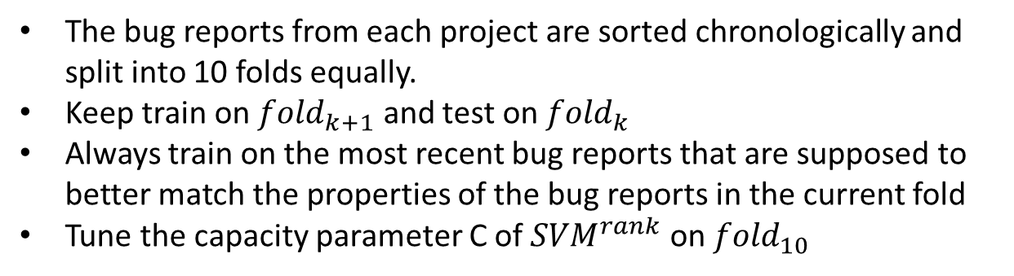
LEARNING-TO-RANK
The bug reports from each project are sorted chronologically and split into 10 folds equally.
Keep train on ${fold}_{k+1}$ and test on ${fold}_{k}$
Always train on the most recent bug reports that are supposed to better match the properties of the bug reports in the current fold
Tune the capacity parameter C of ${SVM}^{rank}$ on ${fold}_{10}$
Notes:
Alternate Layout
This layout allows for the use of photos on either the left or right side of the slide title title.
See slide one for tips on photo usage.
Change the footer by changing “Avionics Engineering Center” to your unit’s name or by deleting “Avionics Engineering Center.”
Do not delete “Ohio University” from the footer.

Slide 25
EVALUATION METRIC
Accuracy@k -- measures the percentage of bug reports for which our model can make correction recommendations in top k
Mean Average Prevision (MAP) -- measures the average precision of out model across all bug reports
Mean Reciprocal Rank (MRR) – measures the performance of our model on making correct recommendations on top 1
Notes:
Alternate Layout
This layout allows for the use of photos on either the left or right side of the slide title title.
See slide one for tips on photo usage.
Change the footer by changing “Avionics Engineering Center” to your unit’s name or by deleting “Avionics Engineering Center.”
Do not delete “Ohio University” from the footer.

Slide 26
COMPARISONS
Two baselines:
The standard VSM method that ranks source files based on their textual similarity with the bug report.
The Usual Suspects method that recommends only the top k most frequently fixed files [3].
Two related works:
BugLocator [4] ranks source files based on textual similarity, the size of source files, and information about previous bug fixes.
BugScout [5] classifies source files as relevant or not based on an extension to Latent Dirichlet Allocation (LDA).
[3] D. Kim, Y. Tao, S. Kim, and A. Zeller. Where should we fix this bug? A two-phase recommendation model. IEEE Trans. Softw. Eng., 39(11):1597-1610, Nov. 2013.
[4] J. Zhou, H. Zhang, and D. Lo. Where should the bugs be fixed? - more accurate information retrieval-based bug localization based on bug reports. In Proc. ICSE'12, pages 14-24, 2012.
[5] A. T. Nguyen, T. T. Nguyen, J. Al-Kofahi, H. V. Nguyen, and T. N. Nguyen. A topic-based approach for narrowing the search space of buggy files from a bug report. In Proc. ASE '11, pages 263-272, 2011.
Notes:
Alternate Layout
This layout allows for the use of photos on either the left or right side of the slide title title.
See slide one for tips on photo usage.
Change the footer by changing “Avionics Engineering Center” to your unit’s name or by deleting “Avionics Engineering Center.”
Do not delete “Ohio University” from the footer.

Slide 27
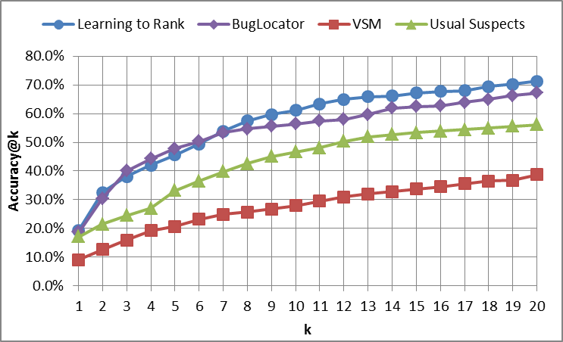
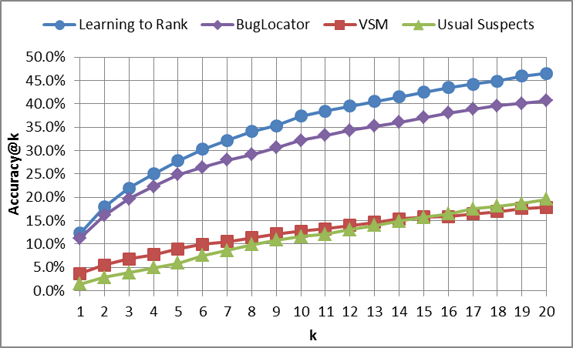
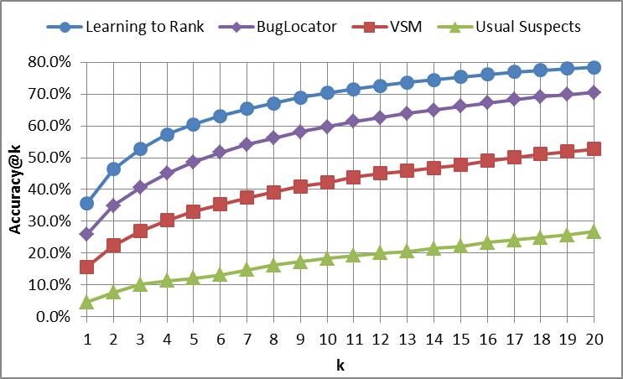
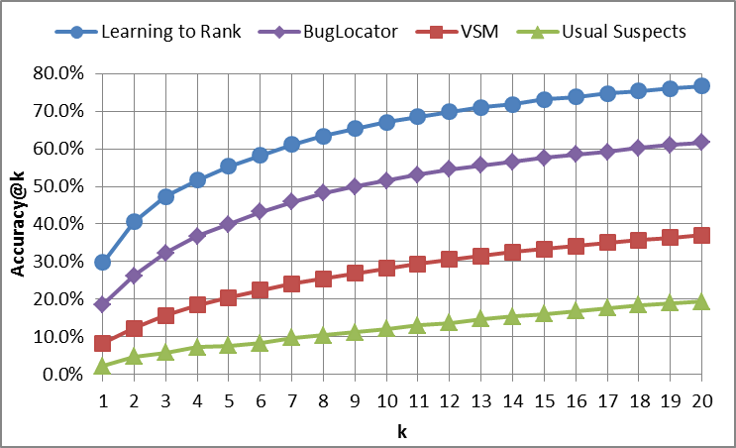
COMPARISONS
Accuracy graphs on AspectJ
Accuracy graphs on Birt
Accuracy graphs on Eclipse Platform UI
Accuracy graphs on JDT
Notes:
Alternate Layout
This layout allows for the use of photos on either the left or right side of the slide title title.
See slide one for tips on photo usage.
Change the footer by changing “Avionics Engineering Center” to your unit’s name or by deleting “Avionics Engineering Center.”
Do not delete “Ohio University” from the footer.

Slide 28
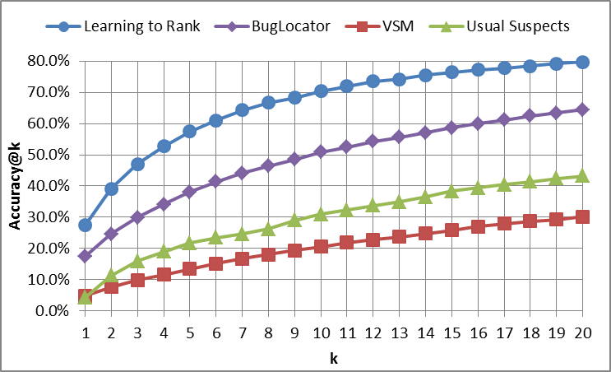
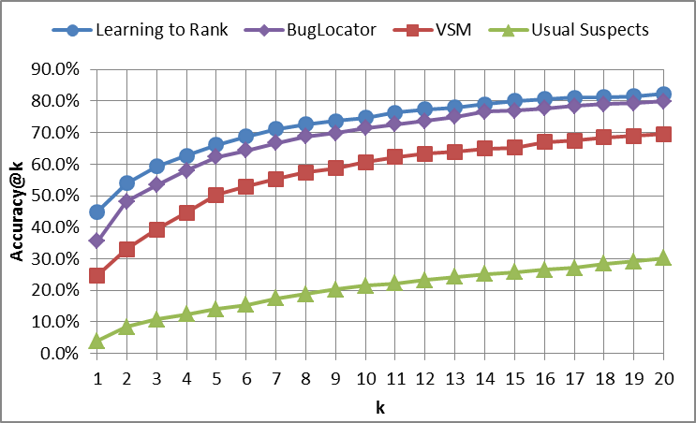
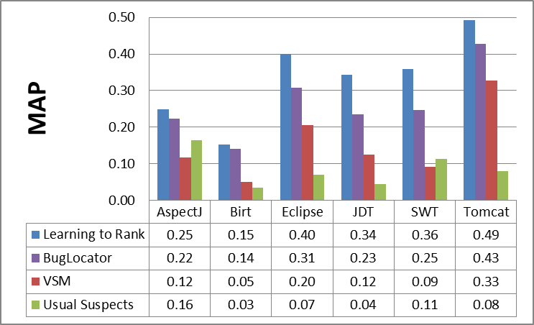
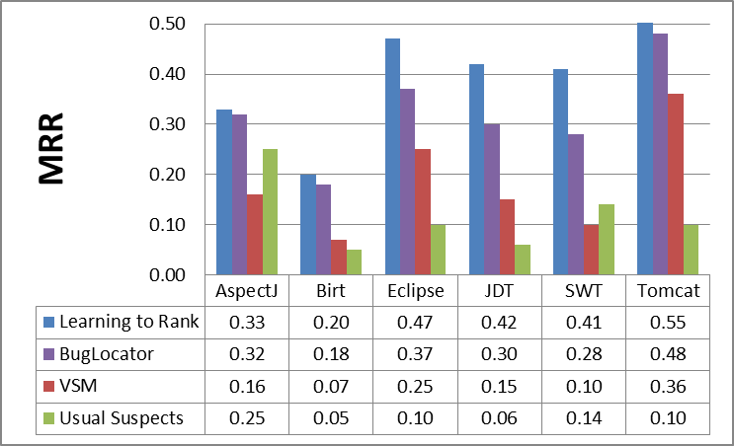
COMPARISONS
Accuracy graphs on SWT
Accuracy graphs on Tomcat
MAP
MRR
Notes:
Alternate Layout
This layout allows for the use of photos on either the left or right side of the slide title title.
See slide one for tips on photo usage.
Change the footer by changing “Avionics Engineering Center” to your unit’s name or by deleting “Avionics Engineering Center.”
Do not delete “Ohio University” from the footer.

Slide 29
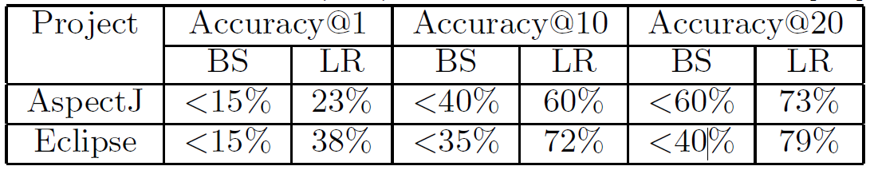
COMPARISONS
Comparison between BugScout (BS) and Learning-to-Rank (LR) on a replicated data set.
Notes:
Alternate Layout
This layout allows for the use of photos on either the left or right side of the slide title title.
See slide one for tips on photo usage.
Change the footer by changing “Avionics Engineering Center” to your unit’s name or by deleting “Avionics Engineering Center.”
Do not delete “Ohio University” from the footer.

Slide 30
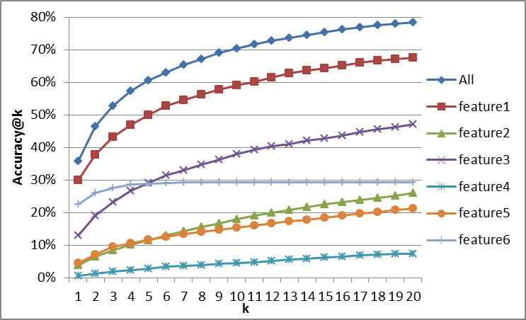
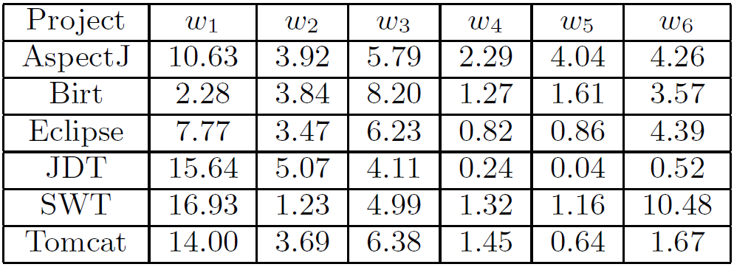
EVALUATION OF FEATURE UTILITY
Single feature performance on Eclipse
The average model parameters
Notes:
Alternate Layout
This layout allows for the use of photos on either the left or right side of the slide title title.
See slide one for tips on photo usage.
Change the footer by changing “Avionics Engineering Center” to your unit’s name or by deleting “Avionics Engineering Center.”
Do not delete “Ohio University” from the footer.

Slide 31
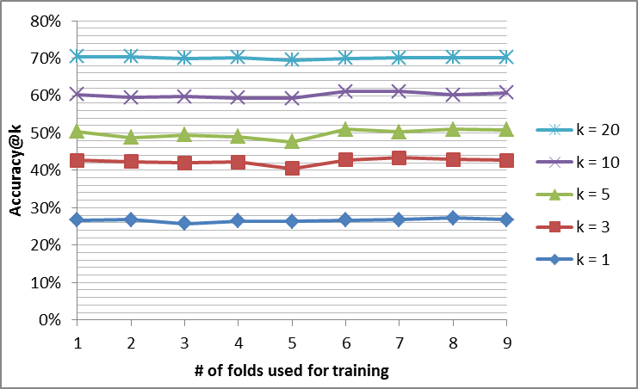
IMPACT OF TRAINING DATA SIZE
Learning Curves for Eclipse Platform UI
Notes:
Alternate Layout
This layout allows for the use of photos on either the left or right side of the slide title title.
See slide one for tips on photo usage.
Change the footer by changing “Avionics Engineering Center” to your unit’s name or by deleting “Avionics Engineering Center.”
Do not delete “Ohio University” from the footer.

Slide 32
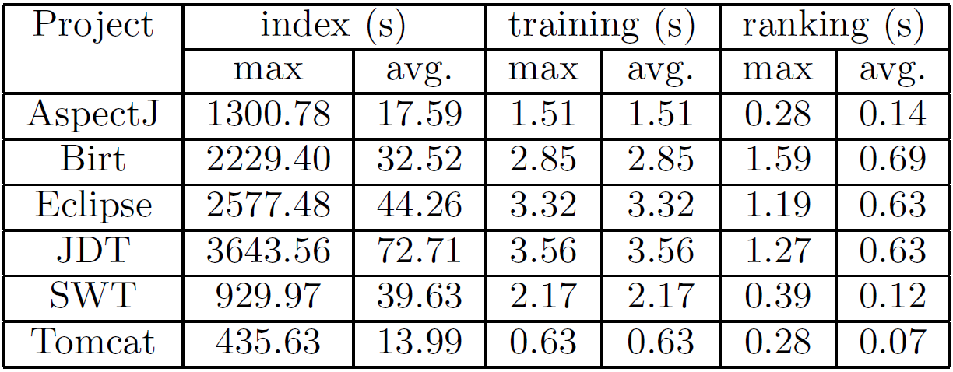
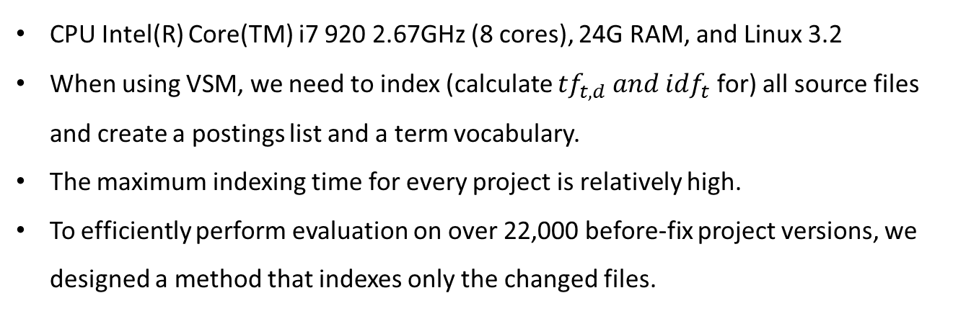
RUNTIME PERFORMANCE
CPU Intel(R) Core(TM) i7 920 2.67GHz (8 cores), 24G RAM, and Linux 3.2
When using VSM, we need to index (calculate ${tf}_{t,d} and {idf}_{t}$for) all source files and create a postings list and a term vocabulary.
The maximum indexing time for every project is relatively high.
To efficiently perform evaluation on over 22,000 before-fix project versions, we designed a method that indexes only the changed files.
Notes:
Alternate Layout
This layout allows for the use of photos on either the left or right side of the slide title title.
See slide one for tips on photo usage.
Change the footer by changing “Avionics Engineering Center” to your unit’s name or by deleting “Avionics Engineering Center.”
Do not delete “Ohio University” from the footer.

Slide 33
RUNTIME PERFORMANCE
Taking the Eclipse bug 420972 as an example, we checkout its before-fix version “2143203”, index 6,188 Java files and perform evaluation.
When we turn to bug 423588, we check out its before-fix version “602d549" and use the git diff command to obtain the list of changed (“Added", “Modied", and “Deleted") files.
We then remove 16 “Deleted" and 77 “Modified“ files from the postings list and the term vocabulary, and index only 14 “Added" plus 77 “Modified“ files, instead of re-indexing 6,186 Java files in version “602d549".
Notes:
Alternate Layout
This layout allows for the use of photos on either the left or right side of the slide title title.
See slide one for tips on photo usage.
Change the footer by changing “Avionics Engineering Center” to your unit’s name or by deleting “Avionics Engineering Center.”
Do not delete “Ohio University” from the footer.

Slide 34

CONCLUSION AND FUTURE WORK
We proposed:
A ranking model that leverages project specific software engineering domain knowledge such as: API specifications, the syntactic structure of code, code revision history, and issue tracking history.
A learning-to-rank approach to learn $w_{i} for$ $φ_{i}$ automatically.
A strong benchmark dataset by checking out a before-fix version of the source code package for every bug report.
The experiment result shows:
Our system outperforms two recent state-of-the-art approaches.
In future works:
PageRank scores associated within the file dependency graph
Evaluation on projects in other programming languages
Notes:
Alternate Layout
This layout allows for the use of photos on either the left or right side of the slide title title.
See slide one for tips on photo usage.
Change the footer by changing “Avionics Engineering Center” to your unit’s name or by deleting “Avionics Engineering Center.”
Do not delete “Ohio University” from the footer.

Slide 35
Questions?
THANK YOU!
Notes:
Alternate Layout
This layout allows for the use of photos on either the left or right side of the slide title title.
See slide one for tips on photo usage.
Change the footer by changing “Avionics Engineering Center” to your unit’s name or by deleting “Avionics Engineering Center.”
Do not delete “Ohio University” from the footer.

