Slide 1
Recommendation System for Neighborhoods

Slide 2

Recommendation System
When you buy a house, you aren’t just buying a house. In a way, you’re buying a neighborhood.
This is a resident who is looking for houses or apartments in the boroughs of Toronto. This resident wants to find similar neighborhoods like the old one. This neighborhood may contain many places such as Grocery Store, Bank, Park, Shopping Mall, Restaurant, Pharmacy, Gym and School.
This resident can assess new neighborhoods based on old neighborhood and find those most close options to make final decision.

Slide 3
Data
We will need geo-locational data about the neighborhoods in borough.
Those data included neighborhoods’ name, latitude and longitude. If we know neighborhood names in the borough, we can use geopy library to get the latitude and longitude values of neighborhood. And we can use Folium to visualize those neighborhoods on map.
We will need venues data in neighborhoods.
If we have the neighborhood name, latitude and longitude, we can use Foursquare to get venues data in the neighborhood in certain distance. The venues data included venue name, location, latitude, longitude, distance and PostalCode.

Slide 4
Data Analyze
Foursquare
Folium
Base neighborhood data with Borough name,
Find latitude and longitude.
Find venue name and category in neighborhoods.

Slide 5
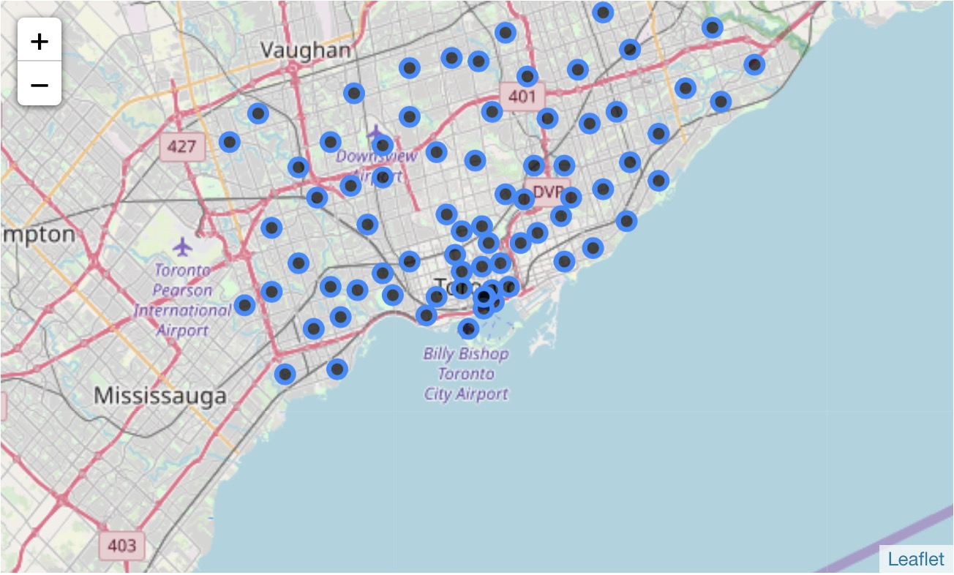
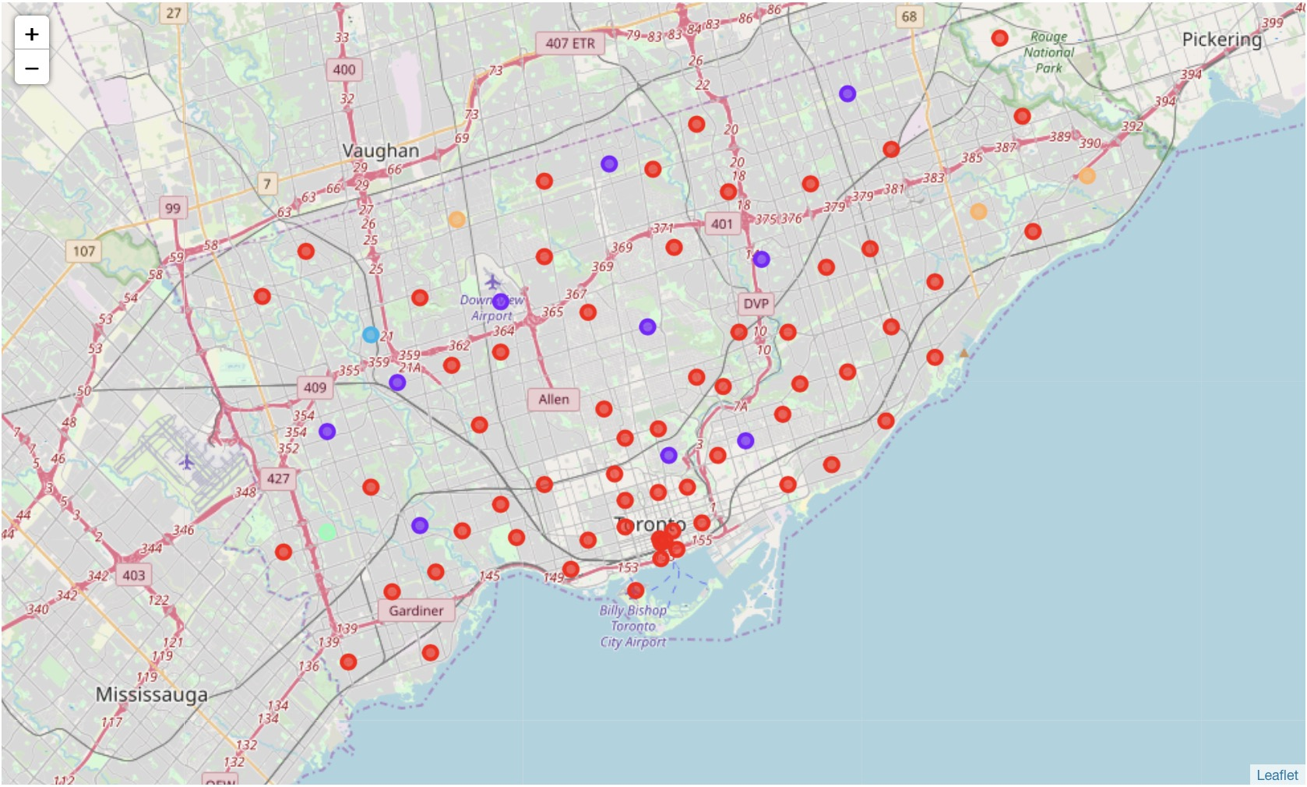
K-Means Model
We choose K-means Clustering Model to cluster all neighborhoods. K-means Modeling can use in neighborhood segmentation. With K-means Modeling, neighborhoods can be clustered to k partitions. Each cluster have most similar features and same label.

Slide 6
Conclusion
After data analyze and predictive modeling, we have the labeled map. When the resident plan to move, he should know his old neighborhood belongs to which cluster and to find other neighborhoods in the same cluster. The same labeled neighborhood are those have most similar venues compare to the old neighborhood.

Slide 7
Thanks

