Slide 1
框架介绍

Slide 2
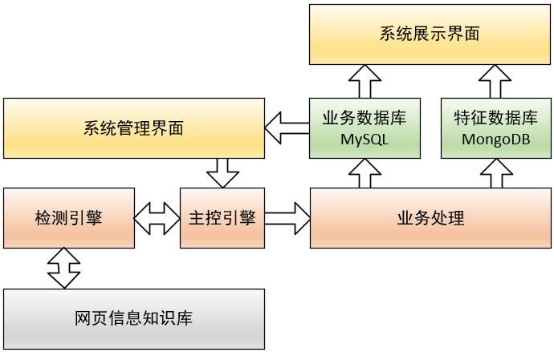
系统架构

Slide 4
Task:
{
"user_id": 1,
"task_list":
[ "www.baidu.com" ],
"cmd": "GRAYS_CHECK",
"cmd_hash": "55ee83f672c7a
7dd6c0f50fc6bd96341",
"task_name": "CHECK test",
"output": null,
"task_engine": "04-05-08",
"engine_result": XXX
.
.
.
.
}

Slide 5
结束 thanks

