Slide 1

Two-step optimization model for chemotherapy scheduling considering random service time

Slide 2
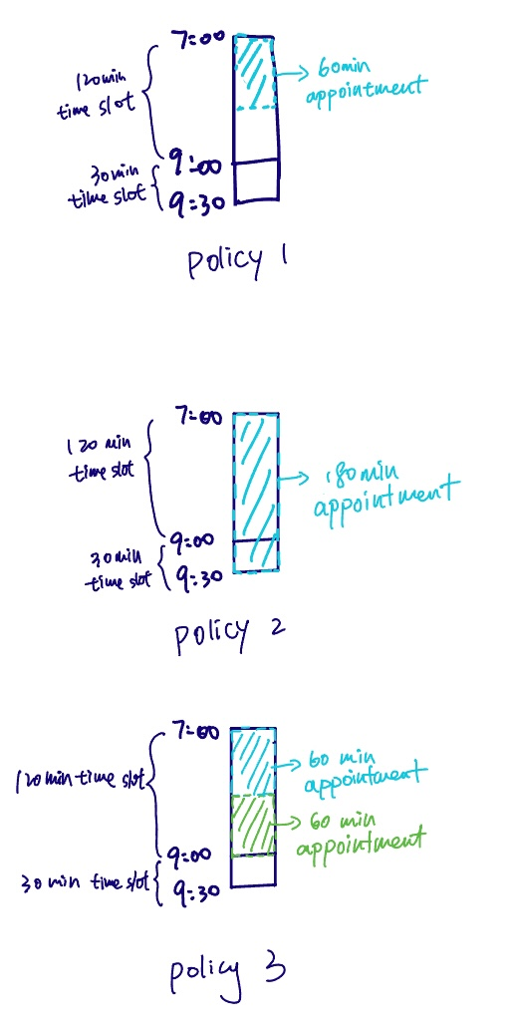
Introduction
Objective: We want to schedule the appointments into the time slot by minimizing the the number of override policies, and the appointment wait time, the bed idle time and the service overtime caused by random service time.
Override Policies:
Policy1: Place a patient in a longer appointment when the designated slot is no longer available.
Policy2: Combine two subsequent slots to create a slot that is equal to or greater than the amount of time required for the treatment.
Policy3: Break a longer appointment slot into two shorter slots.
Appointment wait time appears when the previous service end time is more than current appointment scheduled start time.
Bed idle time appears when the current service time is less than this appointment scheduled end time
Service overtime appears when the last service time is more than the bed overtime

Slide 3
Model
The first step:
Objective:
Minimize the difference between the number of appointment assigned and the number of time slot assigned for each type in each bed
Minimize the bed used
Maximize the number of time slot assigned in each bed
Maximize the number of appointment assigned
Decision: the number of each type of the appointment assigned to each bed
The second step:
Objective:
Minimize the number of override polices used
Minimize the appointment wait time, bed idle time, and service overtime due to the random service time
Decision: the scheduled start time and duration for the appointments in each bed
Notes:
We split the model to achieve out objective into 2 stapes because solving in one step takes long computation time. The first step is to figure out how the appointment can be assigned to each bed. And the second step is to solve how the appointments to be ordered in each bed. For example, now we have 10 30 min appointments 5 60 minute appointments and 3 120 minute appointments and a template of 3 beds. In the first step, we will have the solution like 4 30 minutes appointment, 2 60 minute appointment and 1 120 minute appointment in bed one. And then in the second step, we will order the appointments assigned to bed 1 and assign the start and end time to each appointment. Finally we will get a schedule of appointment assignment

Slide 4
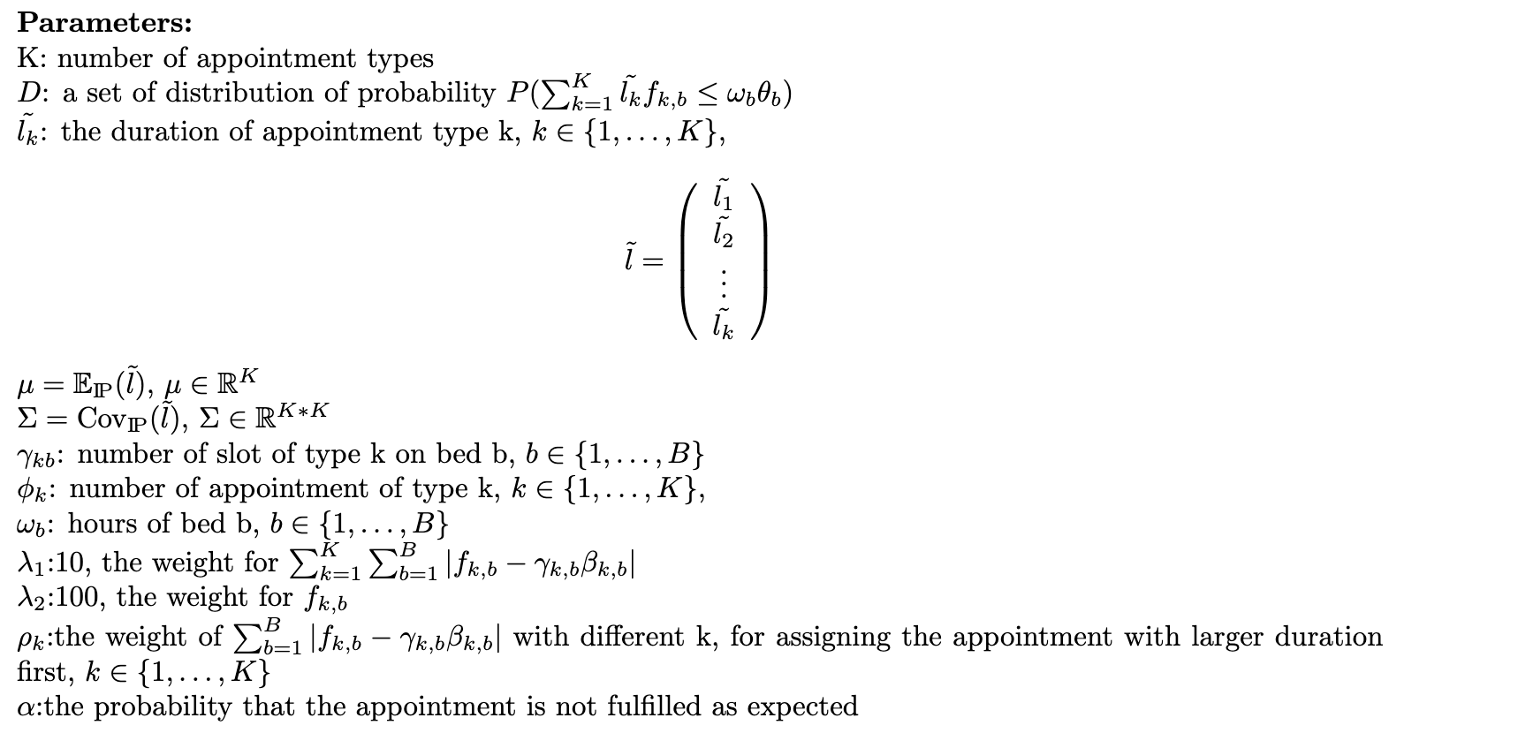
Model
The first step:

Slide 5
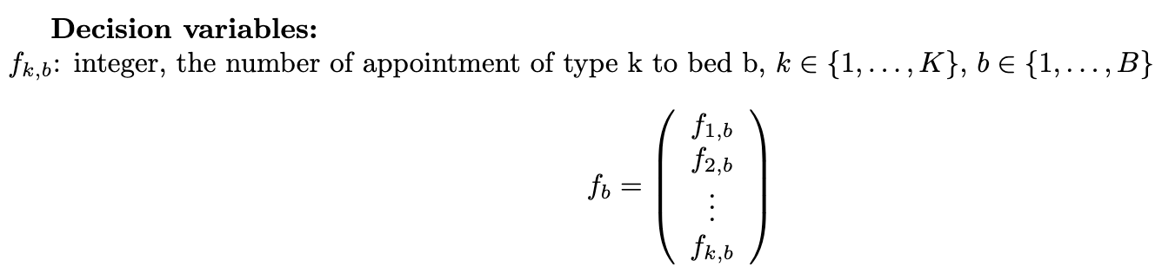
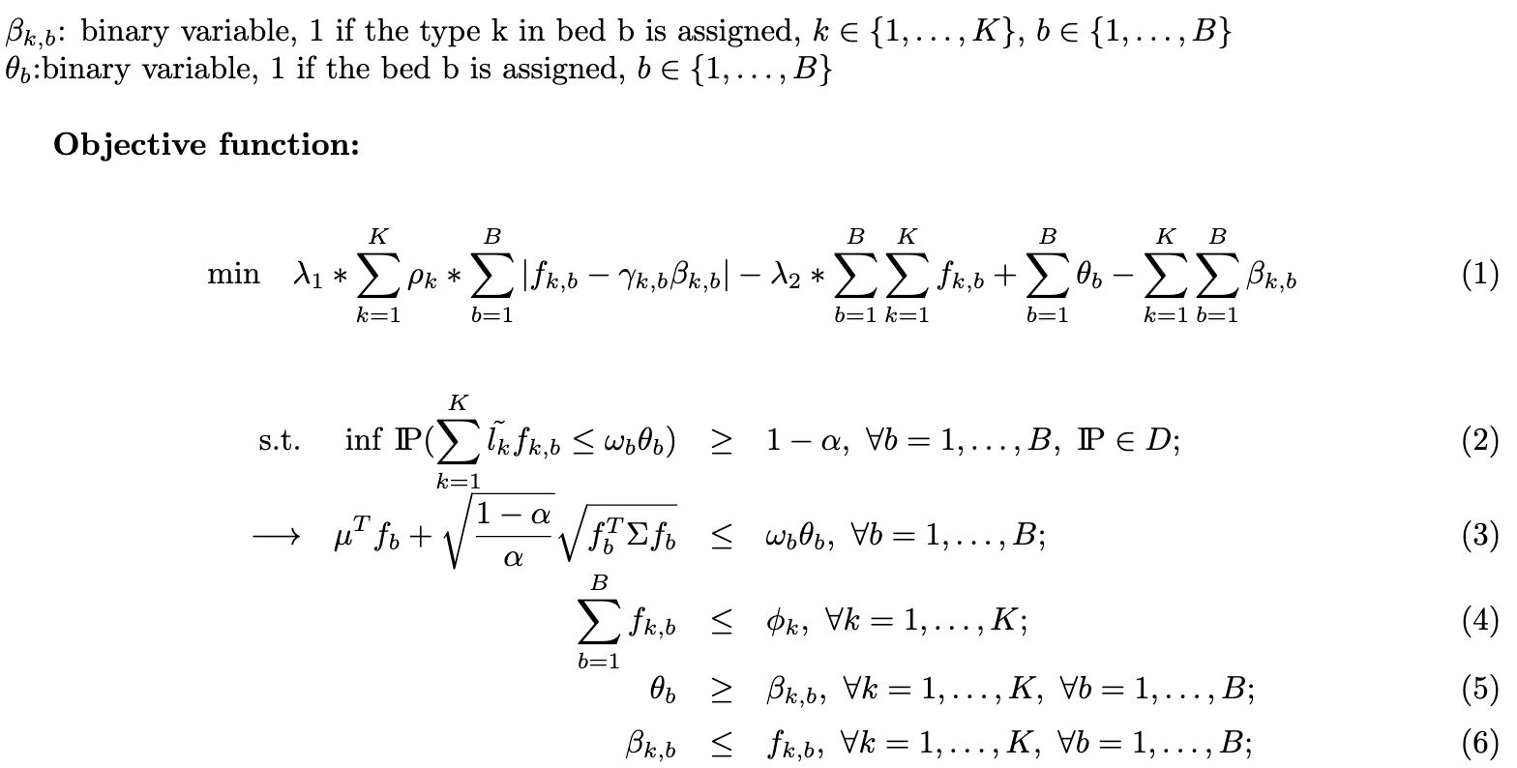
Model
The first step:

Slide 6
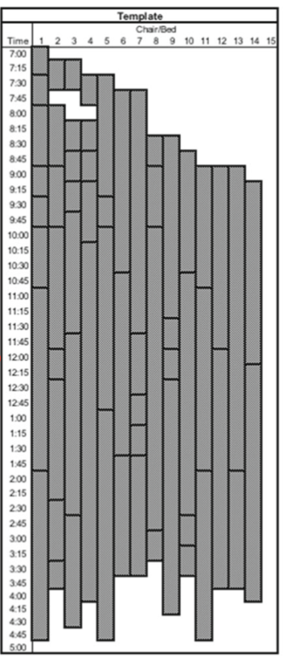
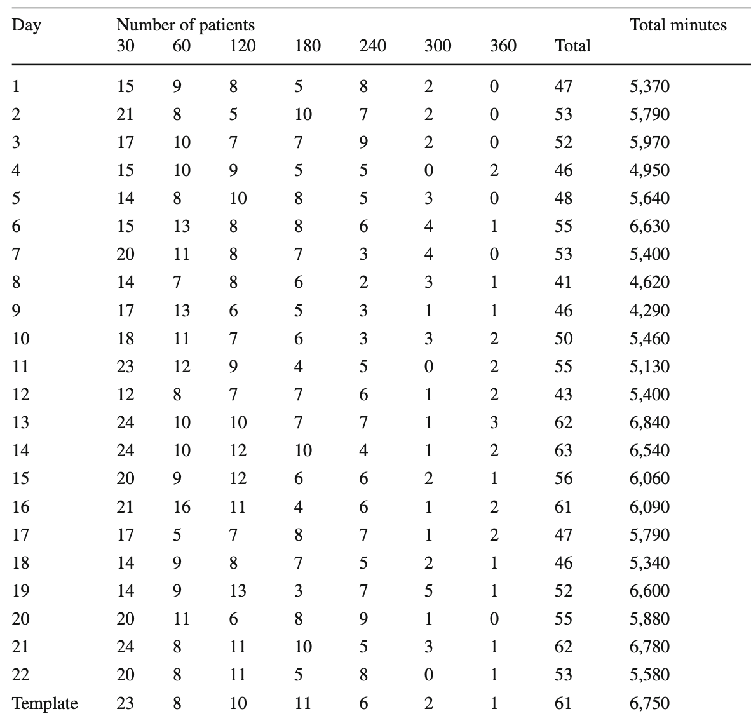
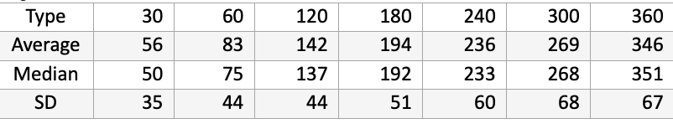
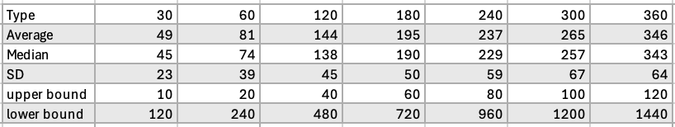
Results
Data
Mean, median, standard deviation given
Mean, median, standard deviation from generated data used, and upper bound, lower bound of each patient type used in the model
Bed template (Huang et al., 2020)
Number of appointments in each day used(Huang et al., 2020

Slide 7
Results
The first step:
When ⍺ becomes larger,
the more appointment assigned into the templates
more appointment with long duration is scheduled
 | Average percentage of appointments assigned in stochastic case
⍺ | All appointments | 30 | 60 | 120 | 180 | 240 | 300 | 360
0.05 | 0.67 | 1 | 0.99 | 0.76 | 0.09 | 0 | 0 | 0
0.1 | 0.77 | 1 | 1 | 0.88 | 0.64 | 0.04 | 0 | 0
0.2 | 0.84 | 1 | 1 | 1 | 0.88 | 0.24 | 0.04 | 0
0.5 | 0.92 | 1 | 1 | 1 | 0.99 | 0.68 | 0.21 | 0.19
0.8 | 0.95 | 0.88 | 1 | 1 | 1 | 0.89 | 0.44 | 0.28
1.0 | 0.98 | 1 | 1 | 1 | 1 | 0.98 | 0.84 | 0.56
Average percentage of appointments assigned in deterministic case
All appointments | 30 | 60 | 120 | 180 | 240 | 300 | 360
0.99 | 1 | 1 | 1 | 1 | 1 | 0.98 | 0.98
⍺: the probability that the total actual actual service time is over the total time of the bed in the template
Notes:
Question: how to pick a reasonable alpha

Slide 8
Results
The first step:
⍺ | Average percentage of appointments assigned | Average solving time(s) | Standard deviation of solving time | Average gap | Average objective
0.05 | 0.67 | 11.09 | 7.20 | 0 | -3268.08
0.1 | 0.77 | 770.35 | 838.07 | 0 | -3795.28
0.2 | 0.84 | 4488.57 | 1390.29 | 1.24 | -4194.46
0.5 | 0.92 | 3836.38 | 1860.37 | 0.57 | -4588.93
0.8 | 0.95 | 1635.39 | 2064.47 | 0.079 | -4829.37
1.0 | 0.98 | 0.44 | 0.46 | 0 | -4998.27
under stochastic case
Average percentage of appointments assigned | Average solving time(s) | Standard deviation of solving time | Average gap | Average objective
0.99 | 0.34 | 0.72 | 0 | -5161.2823
under deterministic case
Notes:
The problem is the hardest in all cases when the degree of freedom is larger than 0.1 but smaller than 0.5
Question: how to choose alpha

Slide 9
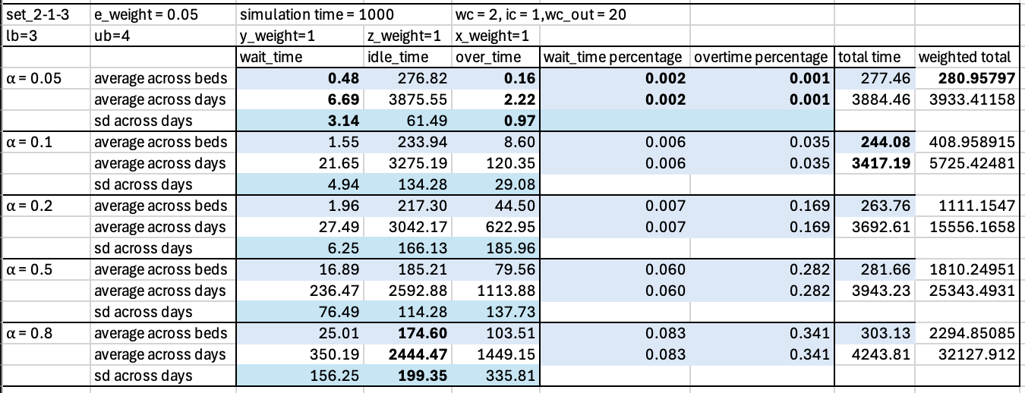
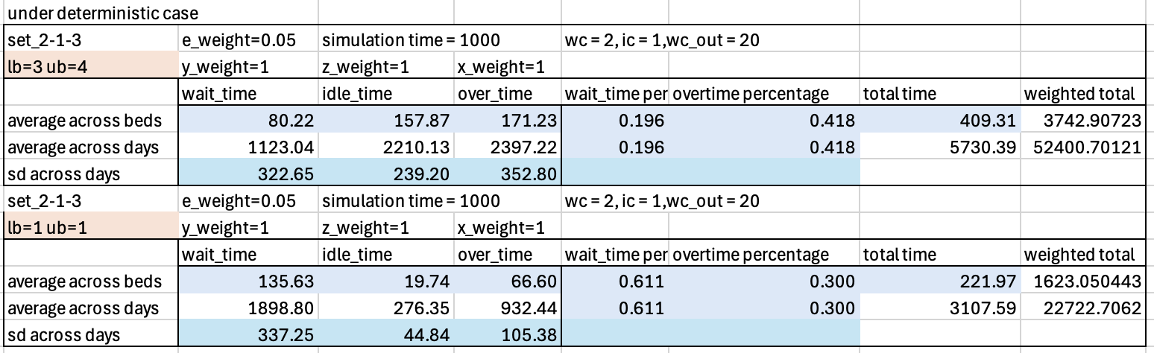
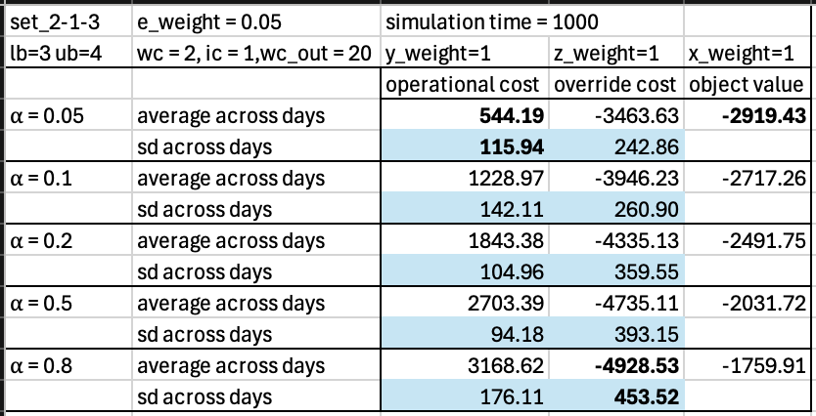
Results
The second step:
How $α$ influences wait time, idle time, and over time
*sd is standard deviation
Notes:
Here we tried different values of alpha and fixed other parameters, we found that when alpha is larger, wait time is longer, idle time is smaller and overtime is longer. Minimum total time appears when alpha = 0.1, while other experiments suggested that minimum total time also depends on e_weight. In addition the percentage of wait time and overtime also increases when alpha gets larger.

Slide 10
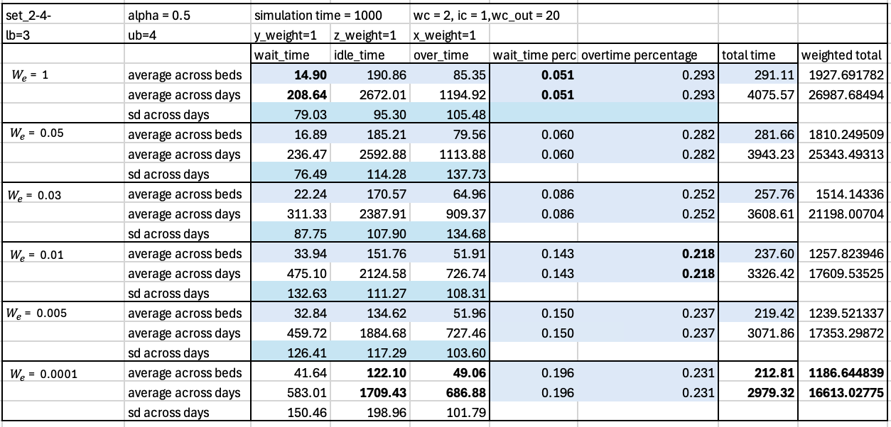
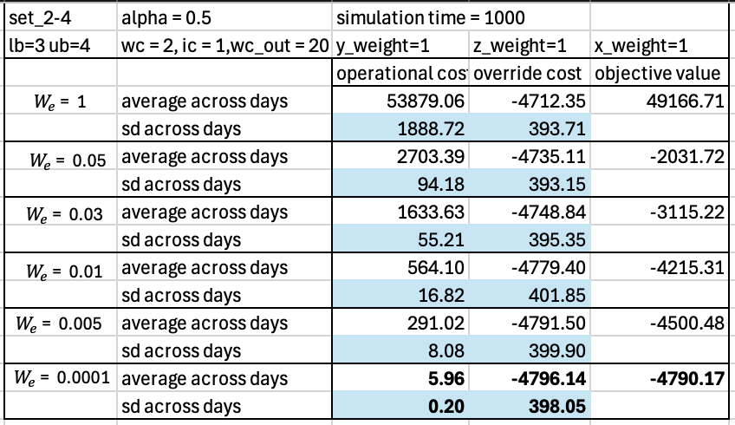
Results
The second step:
How $W_{e}$influence the wait time, idle time, and over time
Notes:
When changing values of e weight, we found that when e_weight is smaller, the wait time is longer, the idle time is shorter, the overtime is shorter generally, and total time is shorter. When e_weight is smaller, we prefer to minimize the number of override policy over to minimize the operational cost caused by random service time. Therefore, more override policy 1 is used in the case of smaller e_weight which we will show later. More override policy 1 means that more time slots are assigned to a smaller appointments, and less time slots are combined or slitted. Because less slots can be combined, the model can not always assign the upper bound to the appointment, which will reduce the idle time, while it causes more wait time if long service time appears. However, based on the results of simulation, having more preference on minimizing the number of override policy leads to lower total time of wait time, idle time, and over time because of the more use of override policy 1.

Slide 11
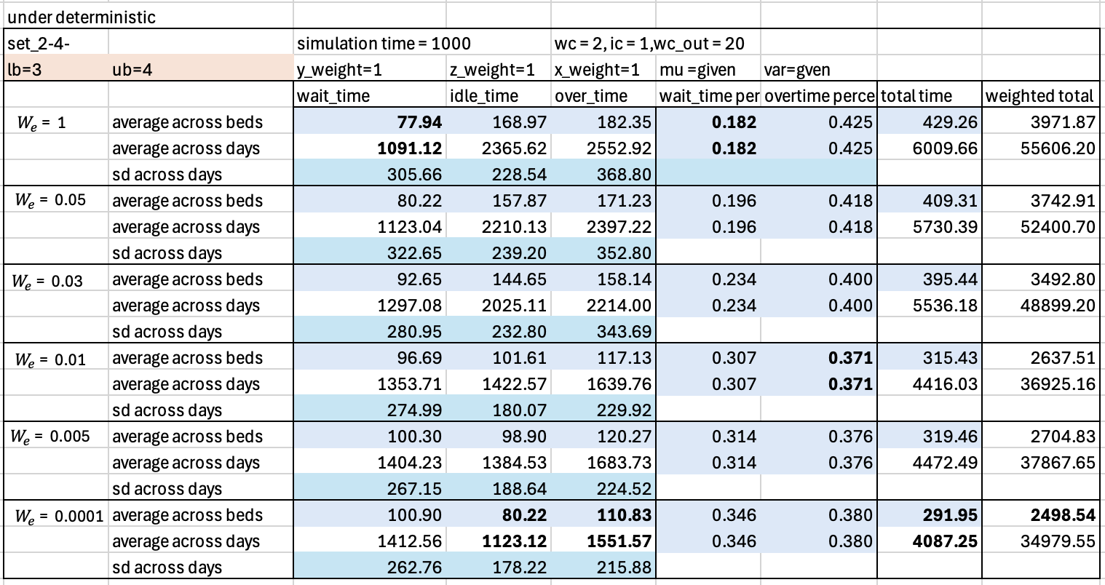
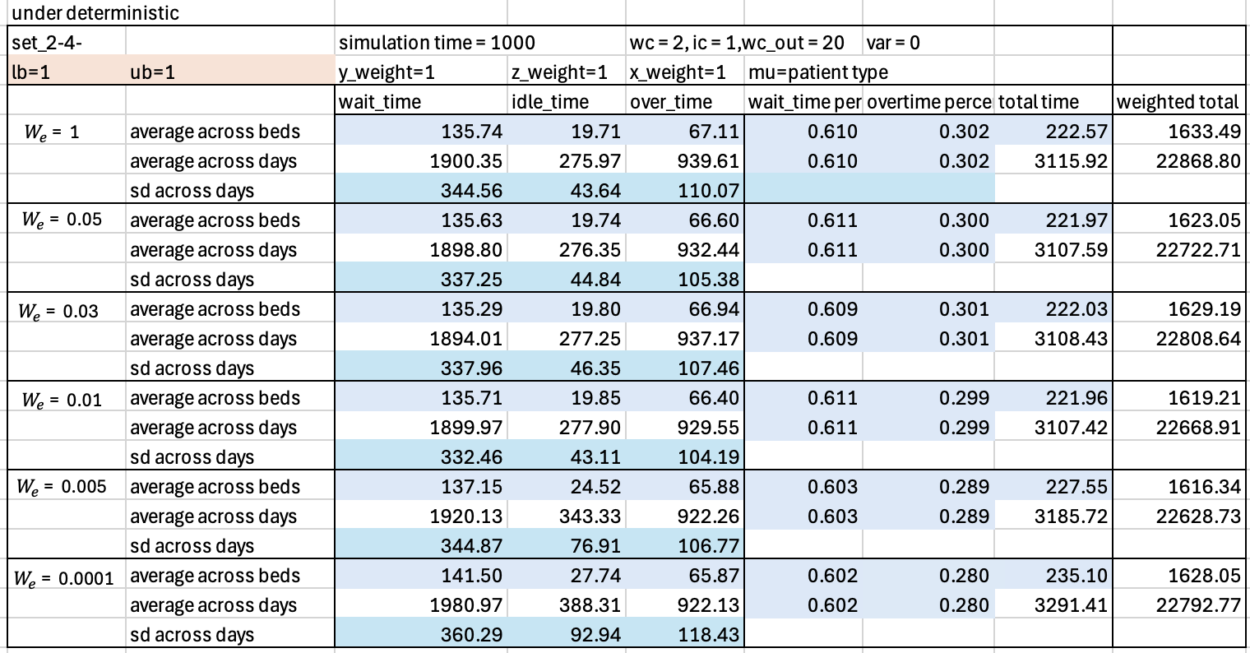
Results
The second step:
How $W_{e}$influence the wait time, idle time, and over time
Notes:
When changing values of e weight, we found that when e_weight is smaller, the wait time is longer, the idle time is shorter, the overtime is shorter generally, and total time is shorter. When e_weight is smaller, we prefer to minimize the number of override policy over to minimize the operational cost caused by random service time. Therefore, more override policy 1 is used in the case of smaller e_weight which we will show later. More override policy 1 means that more time slots are assigned to a smaller appointments, and less time slots are combined or slitted. Because less slots can be combined, the model can not always assign the upper bound to the appointment, which will reduce the idle time, while it causes more wait time if long service time appears. However, based on the results of simulation, having more preference on minimizing the number of override policy leads to lower total time of wait time, idle time, and over time because of the more use of override policy 1.

Slide 12
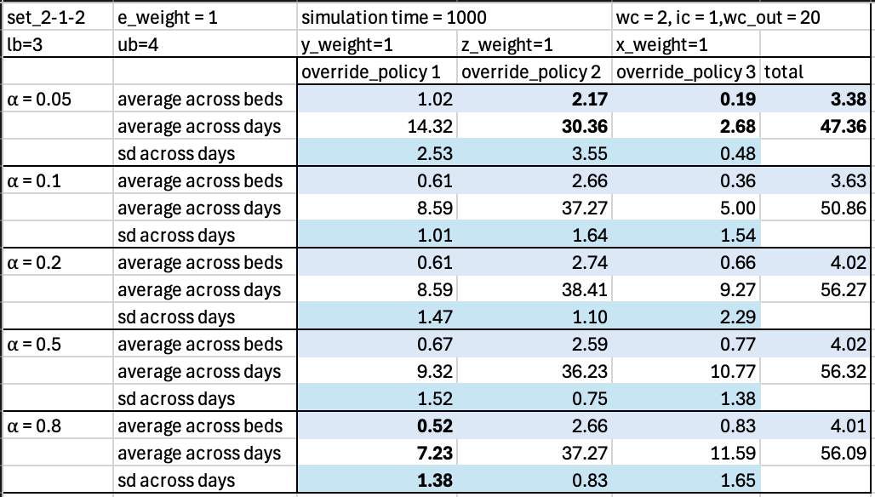
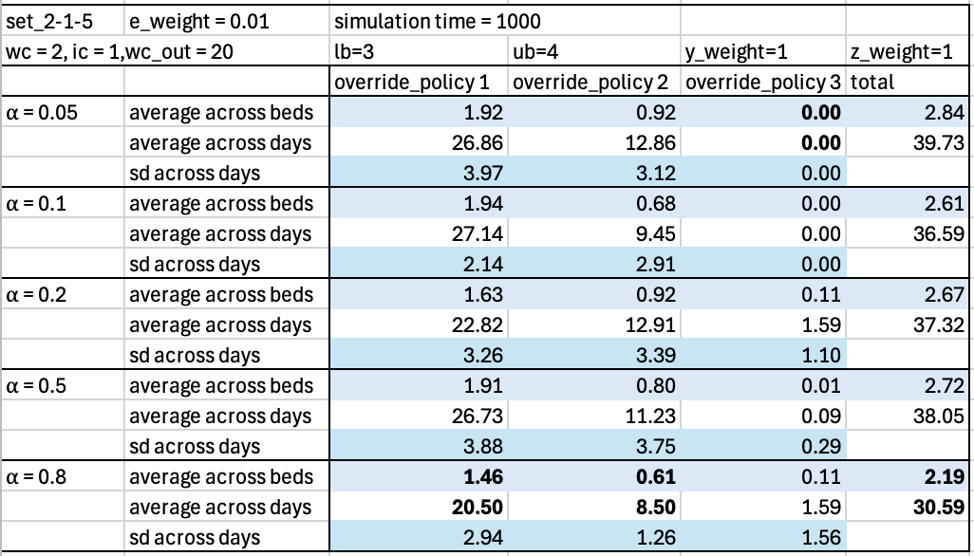


Results
The second step:
How $α$ influences the number of override policy
Under $W_{e}=1$
Under $W_{e}=0.01$
Notes:
The number of override policy 1 is reduced when ⍺ gets larger. When e_weight is larger then 0.01, the number of override policy 2 and 3 and the total number of override policy is the least when alpha = 0.05, and gradually increased. While when e_weight is smaller than 0.05, the number of total override policy is the lease when alpha = 0.8. We think it may because when e_weight is larger than 0.01, the weight of override policy is way smaller than the operational cost, so the model tries to sacrifice the number of override policy to minimize the operational cost. When alpha is larger, more appointments are assigned, so more number of override policy is needed. While when e_weight is less than 0.01, the model enforces more on minimizing the number of override policy, so although there are more appointments assigned, the model tries to find way to minimize the use of override policy.

Slide 13
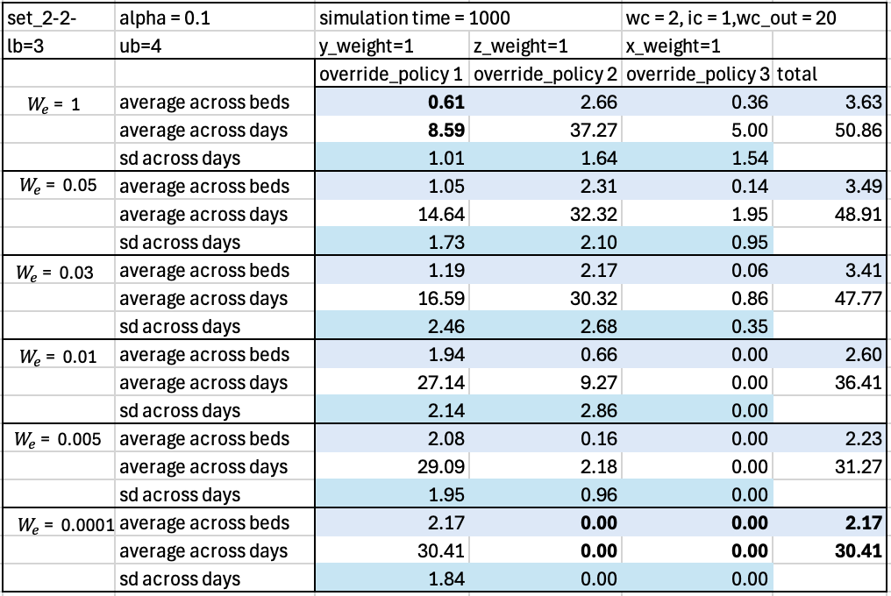
Results
The second step:
How $W_{e}$ influences number of override policy
Notes:
We found that when e_weight is larger, total number of override policy is less, override policy 1 is more and override policy2 and override policy 3 is less. It makes sense because when e weight is smaller, the model emphasizes more on minimizing number of override policy.

Slide 14
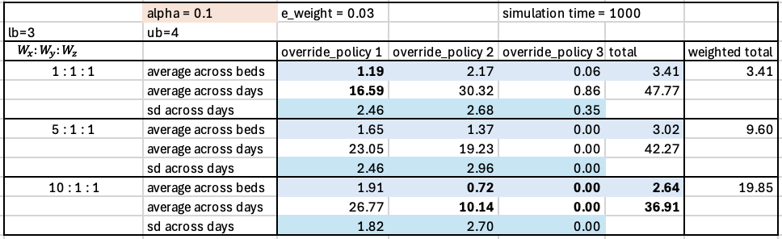
Results
The second step:
How $W_{x},W_{y}$,$W_{z}$influences number of override policy
Notes:
From the experiment, we found that the model prefers override policy 1 when w_e gets smaller. This table shows that if we fix W_e and alpha, how number of override policy would change based on different weights of override policy. We first changed the Wx and it shows that the override policy 1 is actually increased but override policy 2 and 3 is decreased, and overall total number of override policy is decreased.

Slide 15
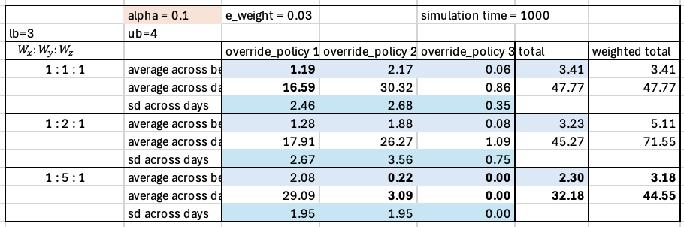
Results
The second step:
How $W_{x},W_{y}$,$W_{z}$influences number of override policy
Notes:
This table changed the weight of override policy 2. It also shows that when override policy 2 gets more weight, the number of override policy 2 is less and the total number of override policy is less.

