Slide 1

Chapter 1
C++ Basics
Copyright © 2017 Pearson Education, Ltd. All rights reserved.

Slide 2

想一想
主角在遊戲中，會移動、攻擊、受傷和升級等等。
程式中，如何記錄他們呢?
資料記錄要分成幾種大類型?
記錄時，需要那些訊息?
如何與電腦互動輸入及輸出?
血量?
等級?
裝備?
Notes:
設計一個主角會需要那些參數?
血量。
經驗值。
…
這些參數又需要那些型別?
這些參數又會在那些機制中用到? 如何使用?
打怪時經驗值會增加。
經驗值滿時會歸零並使等級提升。
…

Slide 3
Learning Objectives
Introduction to C++
Origins, Object-Oriented Programming, Terms
Variables, Expressions, and Assignment Statements
Data type, constant, type cast, precision, …
Console Input/Output
Program Style
Libraries and Namespaces

Slide 4
Introduction to C++
C++ Origins (Introduction Slides)
Low-level languages
Machine, assembly
High-level languages
C, C++, ADA, COBOL, FORTRAN
Object-Oriented-Programming in C++
C++ Terminology
Programs and functions
Basic Input/Output (I/O) with cin and cout

Slide 5
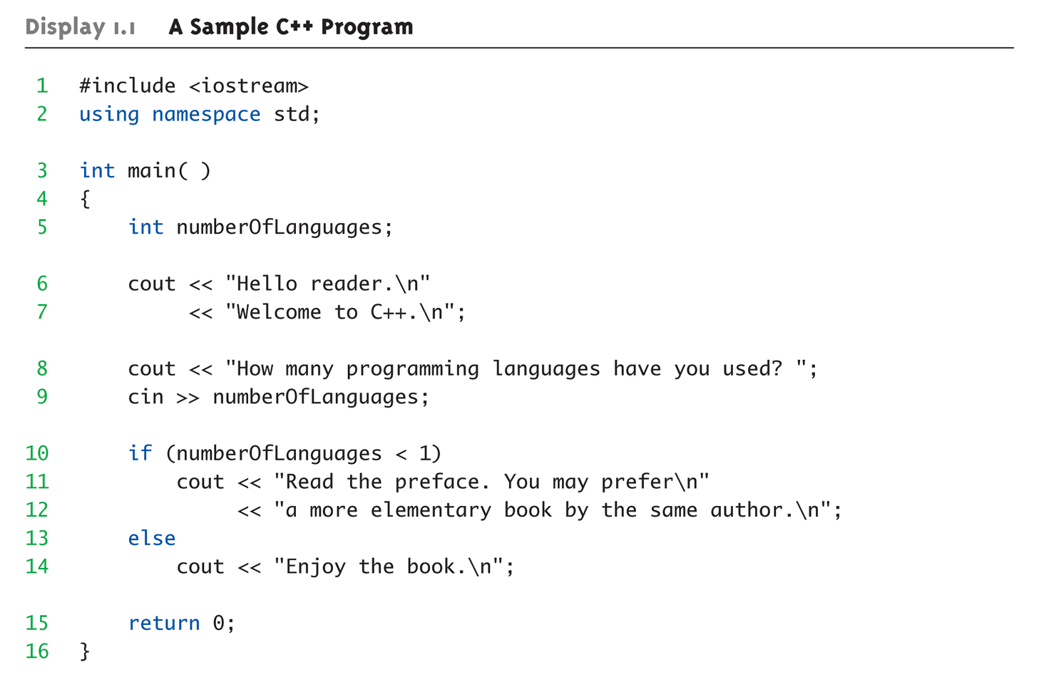
Display 1.1 A Sample C++ Program (1 of 2)

Slide 6
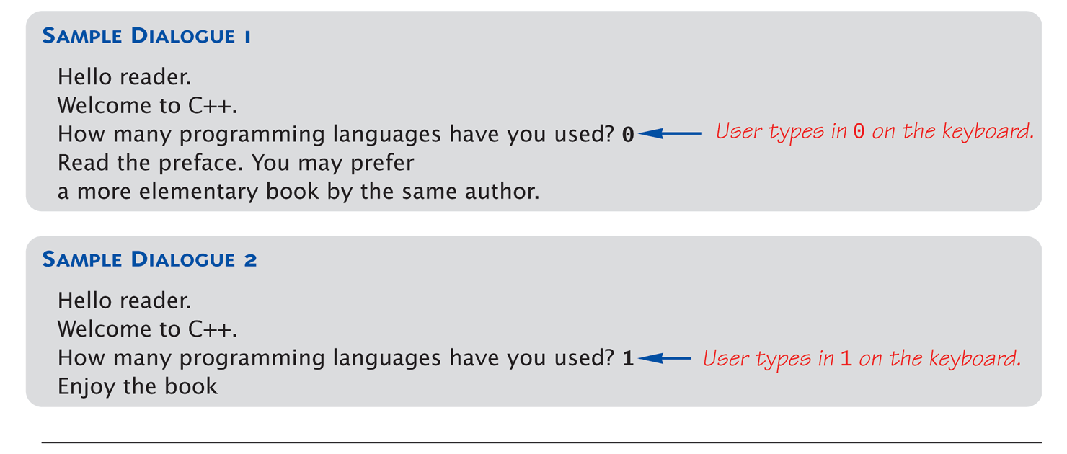
Display 1.1 A Sample C++ Program (2 of 2)

Slide 7
C++ Variables
int health = 0;
C++ Identifiers (short, int, long, float, double, long double, char, bool)
Keywords/reserved words vs. Identifiers
Case-sensitivity and validity of identifiers
Meaningful names!
Variables
A memory location to store data for a program
Must declare all data before use in program
Notes:
Identifier: the name of a variable

Slide 8
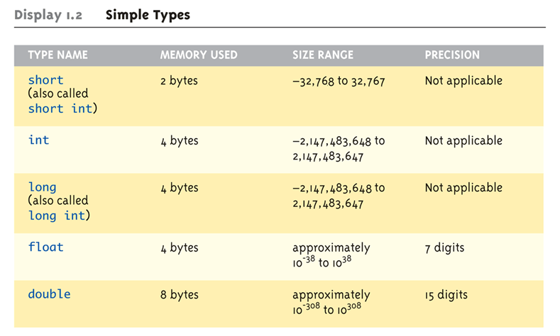
Data Types: Display 1.2 Simple Types (1 of 2)

Slide 9
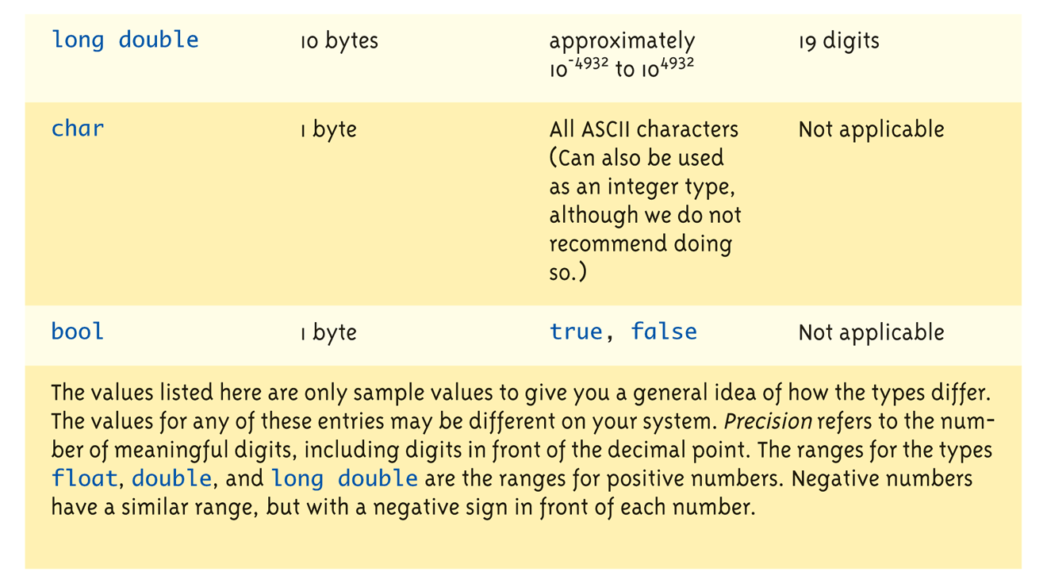
Data Types: Display 1.2 Simple Types (2 of 2)

Slide 10
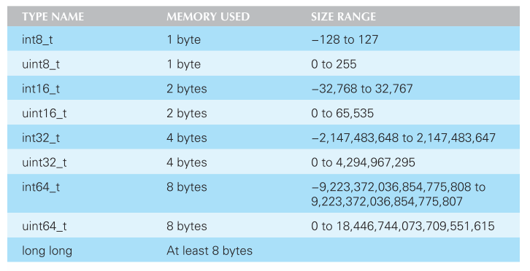
C++11 Fixed Width Integer Types
Avoids problem of variable integer sizes for different CPUs
You can use “typedef BaseType NewTpye;” for create new type.

Slide 11
New C++11 Types
auto
Deduces the type of the variable based on the expression on the right side of the assignment statement
auto distance = expression;
More useful later when we have verbose types
decltype
Determines the type of the expression. In the example below, distance*3.5 is a double so time is declared as a double.
decltype(distance / 3.5) time;

Slide 12
Assigning Data
Initializing data in declaration statement
Results "undefined" if you don’t!
int health = 0;
Assigning data during execution
Lvalues (left-side) & Rvalues (right-side)
Lvalues must be variables
Rvalues can be any expression
Example: distance = updateSpeed * time; Lvalue: "distance" Rvalue: "rate * time“
Be aware of “=” and “==”
+=, -=, *=, \=, …

Slide 13
Data Types
//Struct will be taught in Chapter 6
//Define new data type
struct Position {
int x; // x, y Coordinate
int y;
};
x+1
y+1

Slide 14
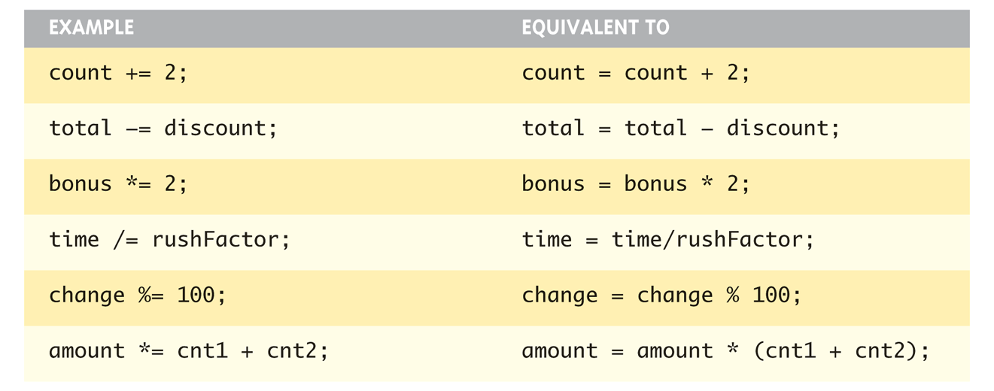
Assigning Data: Shorthand Notations

Slide 15
Data Assignment Rules
Compatibility of Data Assignments
Type mismatches
General Rule: Cannot place value of one type into variable of another type
int updateSpeed = 2.99; // 2 is assigned to intVar!
Only integer part "fits", so that’s all that goes
Called "implicit" or "automatic type conversion"
Notes:
Literal = constant

Slide 16
Literal Data
Literals
Examples:
2 // Literal constant int
5.75 // Literal constant double
"Z" // Literal constant char
"Hello World" // Literal constant string
Cannot change values during execution
Called "literals" because you "literally typed" them in your program!

Slide 17
Escape Sequences
"Extend" character set
Backslash, \ preceding a character
Instructs compiler: a special "escape character" is coming
\n, \r, \t, \a, \v, \b, \f
Following character treated as "escape sequence char“
\\, \”, \?, \’, \”, \?

Slide 18
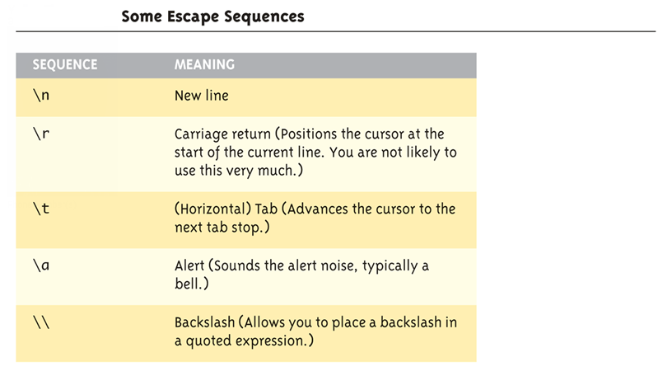
Display 1.4 Some Escape Sequences (1 of 2)

Slide 19
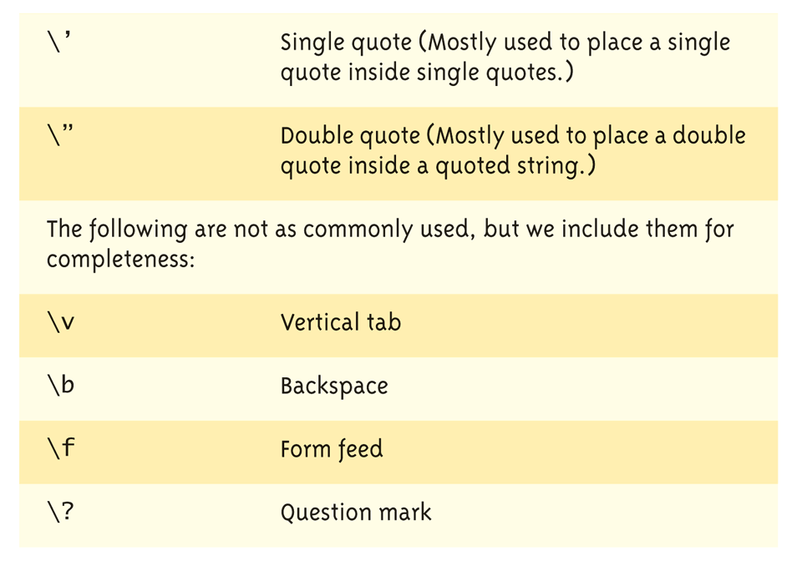
Display 1.4 Some Escape Sequences (2 of 2)

Slide 20
Raw String Literals
Introduced with C++11
Avoids escape sequences by literally interpreting everything in parents
string s = R“(\t\\t\n)”;
The variable s is set to the exact string “\t\\t\n”
Useful for filenames with \ in the filepath

Slide 21
Constants
Naming your constants
Literal constants are "OK", but provide little meaning
e.g., seeing 24 in a program, tells nothing about what it represents
Use named constants instead
Meaningful name to represent data
const int LENGTH_OF_CANVAS = 24;
Called a "declared constant" or "named constant"
Now use it’s name wherever needed in program
Added benefit: changes to value result in one fix

Slide 22
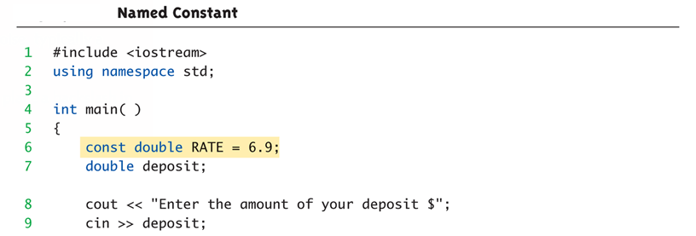
Arithmetic Operators: Display 1.5 Named Constant (1 of 2)
Standard Arithmetic Operators
Precedence rules – standard rules

Slide 23
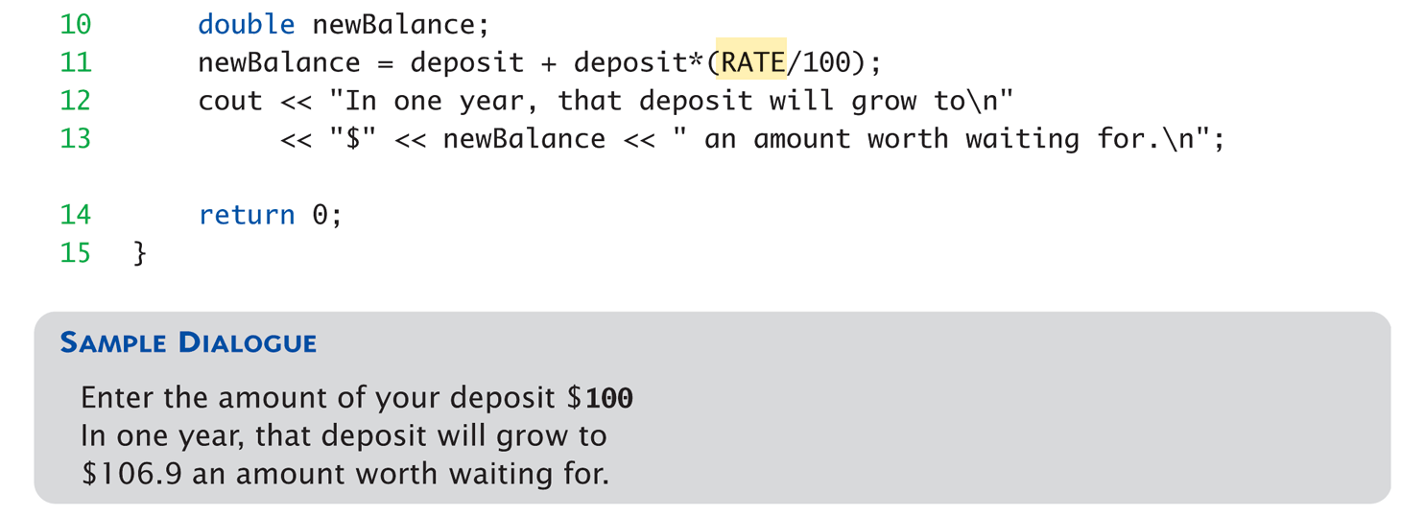
Arithmetic Operators: Display 1.5 Named Constant (2 of 2)

Slide 24
Arithmetic Precision
Precision of Calculations
VERY important consideration!
Expressions in C++ might not evaluate as you’d "expect"!
"Highest-order operand" determines type of arithmetic "precision" performed
Common pitfall!

Slide 25
Arithmetic Precision Examples
Examples:
17 / 5 evaluates to 3 in C++!
Both operands are integers
Integer division is performed!
17.0 / 5 equals 3.4 in C++!
Highest-order operand is "double type"
Double "precision" division is performed!
int updateSpeed =1, distance=2; distance / updateSpeed;
Performs integer division!
Result: 0!

Slide 26
Individual Arithmetic Precision
Calculations done "one-by-one"
1 / 2 / 3.0 / 4 performs 3 separate divisions.
First→ 1 / 2 equals 0
Then→ 0 / 3.0 equals 0.0
Then→ 0.0 / 4 equals 0.0!
So not necessarily sufficient to change just "one operand" in a large expression
Must keep in mind all individual calculations that will be performed during evaluation!

Slide 27
Type Casting
Casting for Variables
Can add ".0" to literals to force precision arithmetic, but what about variables?
We can’t use "myInt.0"!
static_cast<double> elapsedTime
Explicitly "casts" or "converts" intVar to double type
Result of conversion is then used
Example expression: elapsedTime = static_cast<double>distance / updateSpeed;
Casting forces double-precision division to take place among two integer variables!

Slide 28
Type Casting
Two types
Implicit—also called "Automatic"
Done FOR you, automatically 17 / 5.5 This expression causes an "implicit type cast" to take place, casting the 17 → 17.0
Explicit type conversion
Programmer specifies conversion with cast operator (double)17 / 5.5
Same expression as above, using explicit cast (double)myInt / myDouble
More typical use; cast operator on variable

Slide 29
Shorthand Operators
Increment & Decrement Operators (Pre—XX, and Post—XX )
Just short-hand notation
Increment operator, ++ time++; is equivalent to time = time + 1;
Decrement operator, -- health--; is equivalent to health = health – 1;

Slide 30
Shorthand Operators: Two Options
Post-Increment intVar++
Uses current value of variable, THEN increments it
Pre-Increment ++intVar
Increments variable first, THEN uses new value
"Use" is defined as whatever "context" variable is currently in
No difference if "alone" in statement: intVar++; and ++intVar; → identical result

Slide 31
Post-Increment in Action
Post-Increment in Expressions: int n = 2, valueProduced; valueProduced = 2 * (n++); cout << valueProduced << endl; cout << n << endl;
This code segment produces the output: 4 3
Since post-increment was used

Slide 32
Pre-Increment in Action
Now using Pre-increment: int n = 2, valueProduced; valueProduced = 2 * (++n); cout << valueProduced << endl; cout << n << endl;
This code segment produces the output: 6 3
Because pre-increment was used

Slide 33
Console Input/Output
I/O objects cin, cout, cerr
Defined in the C++ library called <iostream>
Must have these lines (called pre-processor directives) near start of file:
#include <iostream> using namespace std;
Tells C++ to use appropriate library so we can use the I/O objects cin, cout, cerr

Slide 34
Console Output
What can be outputted?
Any data can be outputted to display screen
Variables
Constants
Literals
Expressions (which can include all of above)
cout <<“Hero has ” << health << " HP remaining."; 2 values are outputted: "value" of variable health, literal string “HP remaining”.
Cascading: multiple values in one cout

Slide 35
Separating Lines of Output
New lines in output
Recall: "\n" is escape sequence for the char "newline"
A second method: object endl
Examples:
cout << “Game Start\n";
Sends string "Hello World" to display, & escape sequence "\n", skipping to next line
cout << “Game Start" << endl;
Same result as above

Slide 36
String type
C++ has a data type of “string” to store sequences of characters
Not a primitive data type; distinction will be made later
Must add #include <string> at the top of the program
The “+” operator on strings concatenates two strings together
cin >> str where str is a string only reads up to the first whitespace character

Slide 37
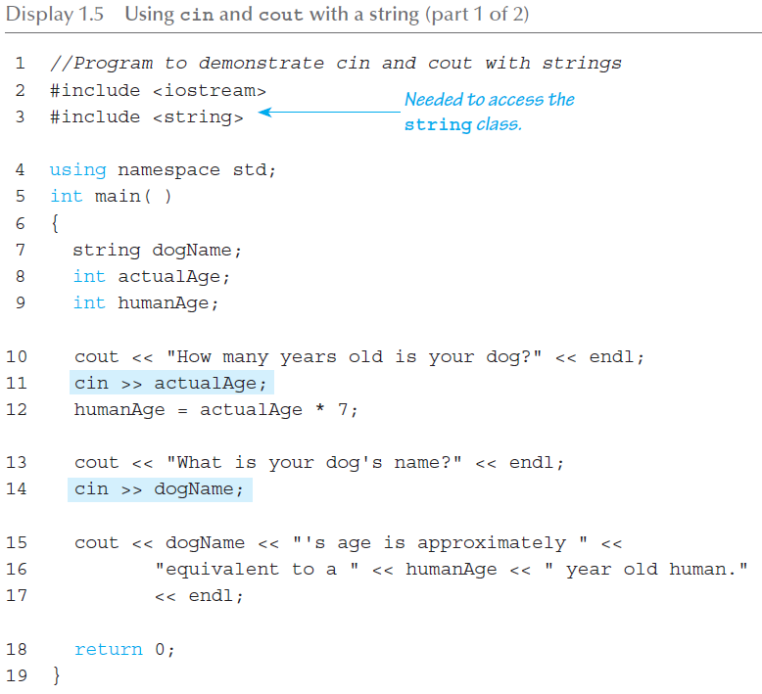
Input/Output (1 of 2)

Slide 38
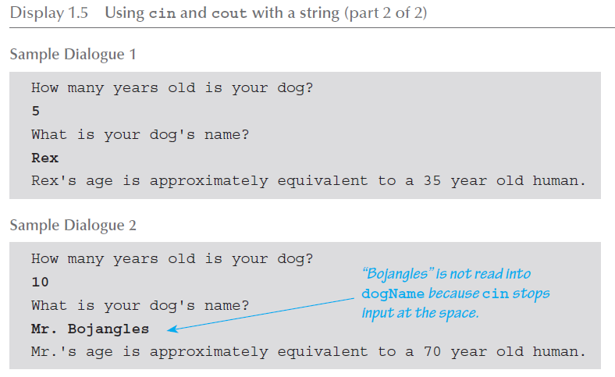
Input/Output (2 of 2)

Slide 39
Formatting Output
Formatting numeric values for output
Values may not display as you’d expect! cout << "The price is $" << price << endl;
If price (declared double) has value 78.5, you might get:
The price is $78.500000 or:
The price is $78.5
We must explicitly tell C++ how to output numbers in our programs!

Slide 40
Formatting Numbers
"Magic Formula" to force decimal sizes: cout.setf(ios::fixed); cout.setf(ios::showpoint); cout.precision(2);
These stmts force all future cout’ed values:
To have exactly two digits after the decimal place
Example: cout << "The price is $" << price << endl;
Now results in the following: The price is $78.50
Can modify precision "as you go" as well!

Slide 41
Error Output
Output with cerr
cerr works same as cout
Provides mechanism for distinguishing between regular output and error output
Re-direct output streams
Most systems allow cout and cerr to be "redirected" to other devices
e.g., line printer, output file, error console, etc.

Slide 42
Input Using cin
cin for input, cout for output
Differences:
">>" (extraction operator) points opposite
Think of it as "pointing toward where the data goes"
Object name "cin" used instead of "cout"
No literals allowed for cin
Must input "to a variable"
cin >> num;
Waits on-screen for keyboard entry
Value entered at keyboard is "assigned" to num

Slide 43
Prompting for Input: cin and cout
Always "prompt" user for input cout << "Enter number of dragons: "; cin >> numOfDragons;
Note no "\n" in cout. Prompt "waits" on same line for keyboard input as follows:
Enter number of dragons: ____
Underscore above denotes where keyboard entry is made
Every cin should have cout prompt
Maximizes user-friendly input/output

Slide 44
Program Style
Bottom-line: Make programs easy to read and modify
Comments, two methods:
// Two slashes indicate entire line is to be ignored
/*Delimiters indicates everything between is ignored*/
Both methods commonly used
Identifier naming
ALL_CAPS for constants
lowerToUpper for variables
Most important: MEANINGFUL NAMES!

Slide 45
Libraries
C++ Standard Libraries
#include <Library_Name>
Directive to "add" contents of library file to your program
Called "preprocessor directive"
Executes before compiler, and simply "copies" library file into your program file
C++ has many libraries
Input/output, math, strings, etc.

Slide 46
Namespaces
Namespaces defined:
Collection of name definitions
For now: interested in namespace "std"
Has all standard library definitions we need
Examples: #include <iostream> using namespace std;
Includes entire standard library of name definitions
#include <iostream>
using std::cin; using std::cout;
Can specify just the objects we want

Slide 47
Summary 1
C++ is case-sensitive
Use meaningful names
For variables and constants
Variables must be declared before use
Should also be initialized
Use care in numeric manipulation
Precision, parentheses, order of operations
#include C++ libraries as needed

Slide 48
Summary 2
Object cout
Used for console output
Object cin
Used for console input
Object cerr
Used for error messages
Use comments to aid understanding of your program
Do not overcomment

