Slide 1
Chapter 2
Flow of Control

Slide 2

想一想
要怎麼讓遊戲不斷更新及進行呢? 要如何處理連續的讀入？ (CPU一秒跑好多次，要怎麼做才不會讓連續讀進方向指令)
要如何控制沒有限制的回合數的更新？如何控制並確保有固定或不固定數量的遊戲角色以及物件都有被讀取並更新狀態？
在遊戲中，遊戲有那些不同狀態?如何判斷現在遊戲是在什麼狀態?
例如，結束遊戲。
如何記錄跟儲存遊戲狀態？(Week 8: IOStream)

Slide 3
想一想
在遊戲中會不斷loop每個回合，直到判斷遊戲結束。遊戲中也有許多地方會用到這兩類程式邏輯。
那些遊戲機制會需要用判斷處理? 用if 或 switch 哪個較合適?
接收處理使用者操作輸入、判斷遊戲結束
……
那些遊戲機制會需要用loop處理? 用for-loop 或 while-loop哪個較合適?
場景中生物群活動、在迷宮中配置多個陷阱或生物
……
fstream 可以讀檔也可以寫檔，也可以用來儲存遊戲進度。
在迷宮遊戲中要儲存甚麼資料，才可以確保讀檔時遊戲內容會一樣?
主角等級、迷宮等級、裝備名稱
……
遊戲儲存的資料，以甚麼方式輸出，以後讀檔才方便?

Slide 4
Learning Objectives
Boolean Expressions
Building, Evaluating & Precedence Rules
Branching Mechanisms
if-else
switch
Nesting if-else
Loops
While, do-while, for
Nesting loops
Introduction to File Input

Slide 5
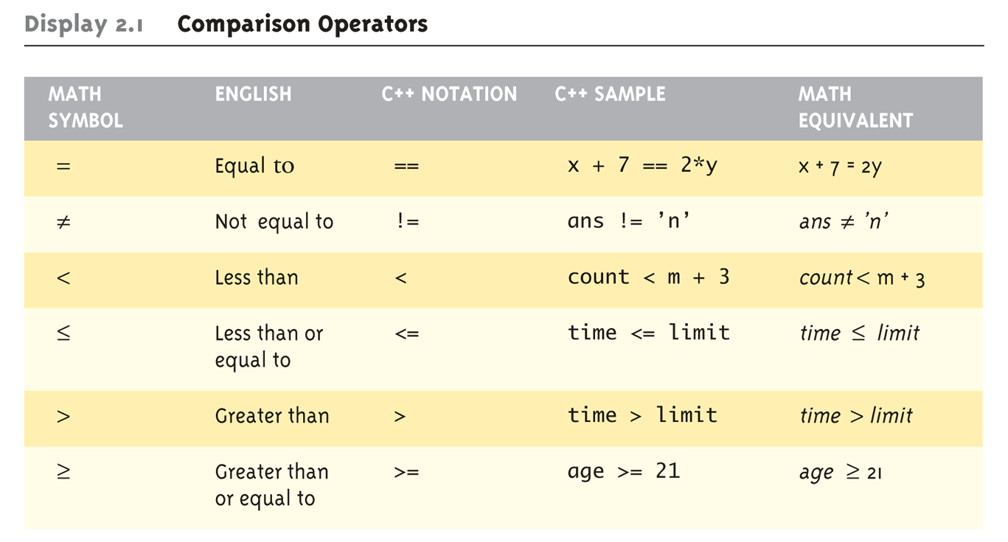
Boolean Expressions: Display 2.1 Comparison Operators
Logical Operators
Logical AND (&&)
Logical OR (||)

Slide 6
Evaluating Boolean Expressions
Data type bool
Returns true or false
true, false are predefined library constants
Truth tables
Display 2.2 next slide

Slide 7
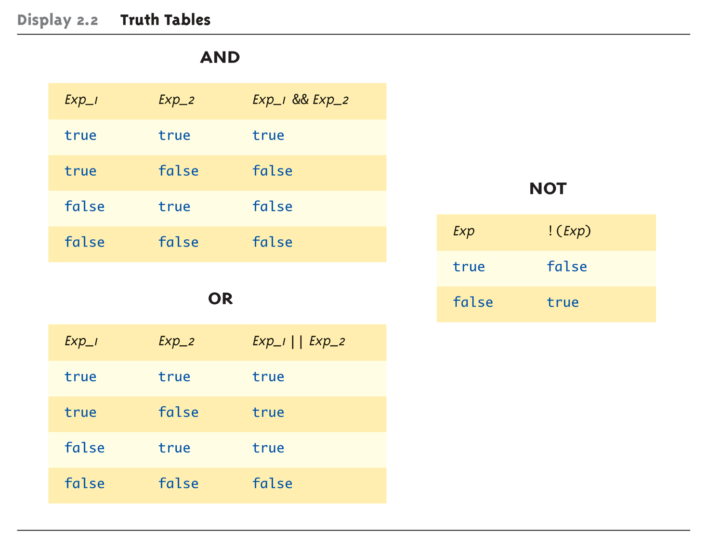
Evaluating Boolean Expressions: Display 2.2 Truth Tables

Slide 8
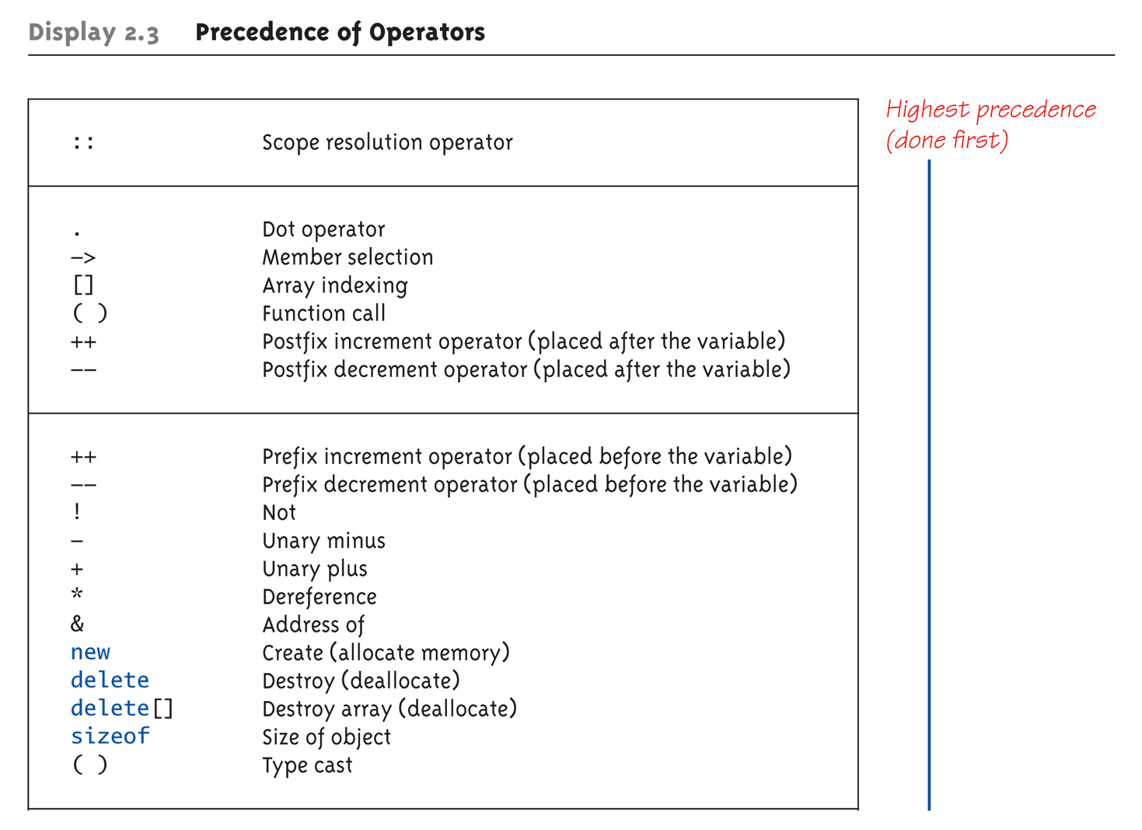
Display 2.3 Precedence of Operators (1 of 4)
Notes:
建議用()

Slide 9
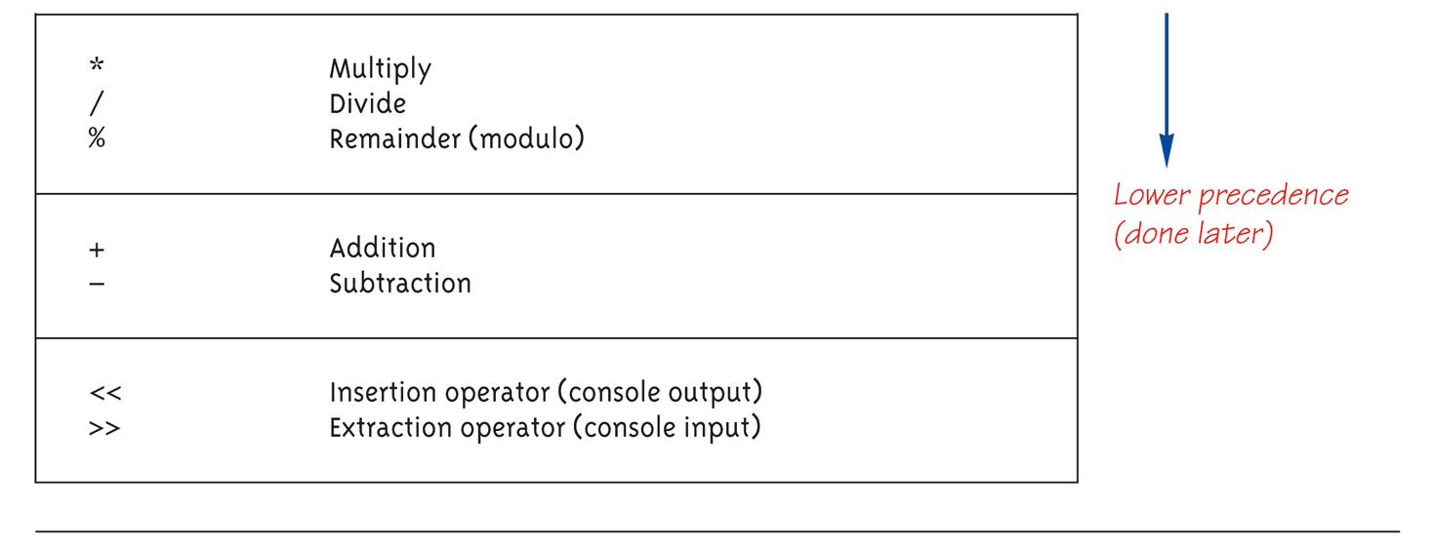
Display 2.3 Precedence of Operators (2 of 4)

Slide 10
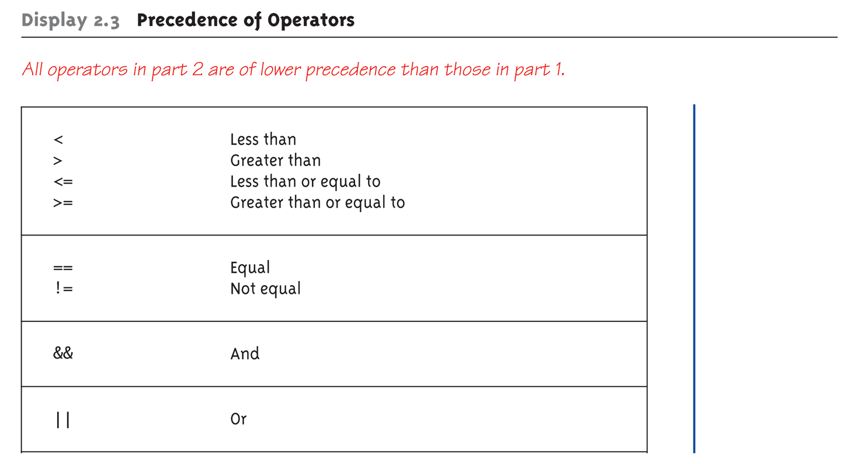
Display 2.3 Precedence of Operators (3 of 4)

Slide 11
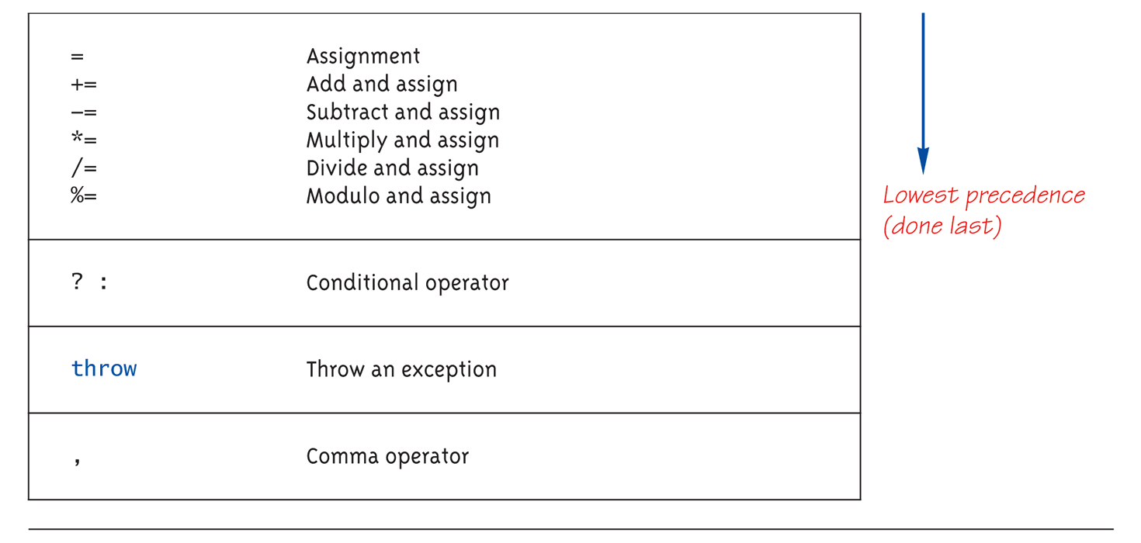
Display 2.3 Precedence of Operators (4 of 4)

Slide 12
Precedence Examples
Arithmetic before logical
x + 1 > 2 || x + 1 < -3 means:
(x + 1) > 2 || (x + 1) < -3
Short-circuit evaluation
(x >= 0) && (y > 1)
Be careful with increment operators!
(x > 1) && (y++)
Integers as boolean values
All non-zero values → true
Zero value → false

Slide 13
Branching Mechanisms
if-else statements
Choice of two alternate statements based on condition expression
Example: if (hrs > 40) grossPay = rate*40 + 1.5*rate*(hrs-40); else grossPay = rate*hrs;

Slide 14
if-else Statement Syntax
Formal syntax: if (<boolean_expression>) <yes_statement> else <no_statement>
Note each alternative is only ONE statement!
To have multiple statements execute in either branch → use compound statement

Slide 15
Compound/Block Statement
Only "get" one statement per branch
Must use compound statement { } for multiples
Also called a "block" stmt
Each block should have block statement
Even if just one statement
Enhances readability

Slide 16
Compound Statement in Action
Note indenting in this example: if (myScore > yourScore) { cout << "I win!\n"; wager = wager + 100; } else { cout << "I wish these were golf scores.\n"; wager = 0; }

Slide 17
Common Pitfalls
Operator "=" vs. operator "=="
One means "assignment" (=)
One means "equality" (==)
VERY different in C++!
Example: if (x = 12) ←Note operator used! Do_Something else Do_Something_Else

Slide 18
The Optional else
else clause is optional
If, in the false branch (else), you want "nothing" to happen, leave it out
Example: if (sales >= minimum) salary = salary + bonus; cout << "Salary = %" << salary;
Note: nothing to do for false condition, so there is no else clause!
Execution continues with cout statement

Slide 19
Nested Statements
if-else statements contain smaller statements
Compound or simple statements (we’ve seen)
Can also contain any statement at all, including another if-else stmt!
Example: if (speed > 55) if (speed > 80) cout << "You’re really speeding!"; else cout << "You’re speeding.";
Note proper indenting!

Slide 20
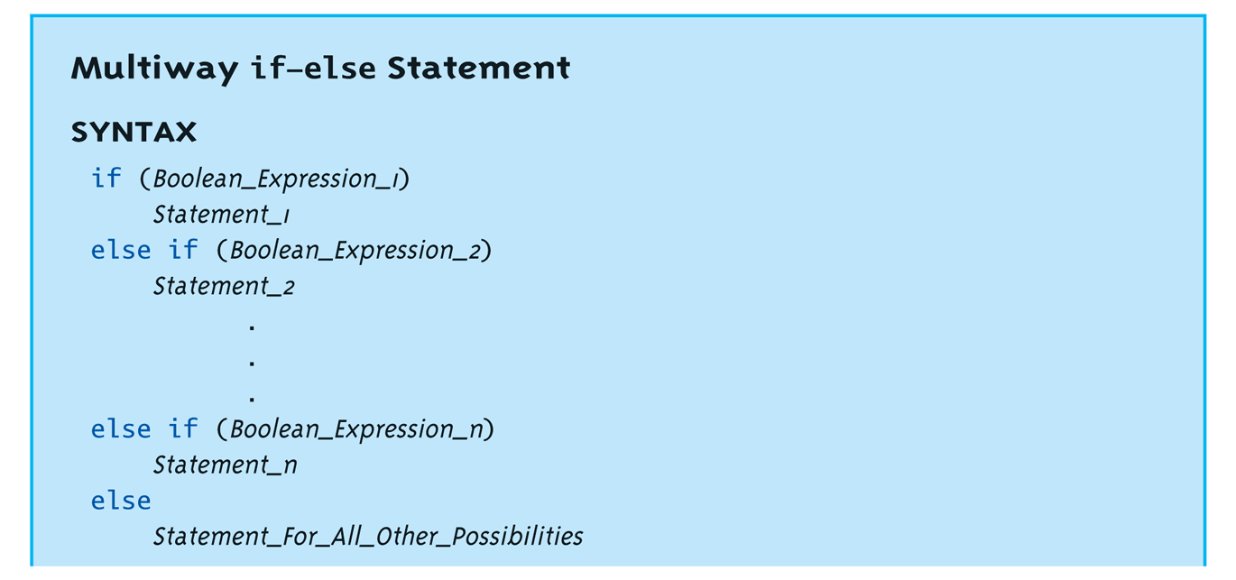
Multiway if-else
Not new, just different indenting
Avoids "excessive" indenting
Syntax:

Slide 21
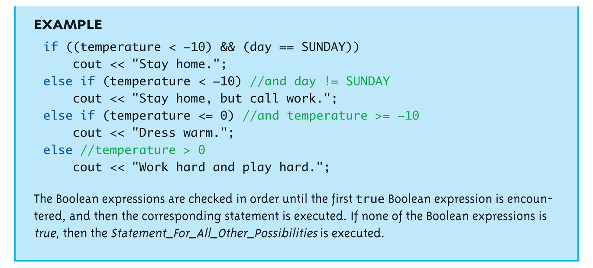
Multiway if-else Example

Slide 22



if-else Example:生物行為判斷
生物在行動前會判斷玩家加是否在附近，如果玩家在隔壁會攻擊，如果玩家在視線內會朝玩家移動，如果皆非則往隨機方向移動。
// 生物行為
if(range(creature, player) <= 1) // 生物在玩家隔壁
// 攻擊玩家
else if(canSee(creature, player)) // 生物看得到玩家
// 往玩家方向移動
else
// 隨機移動
攻擊玩家
在玩家隔壁
朝玩家移動
看得到玩家
隨機移動
在玩家隔壁

Slide 23
The switch Statement
A statement for controlling multiple branches
Can do the same thing with if statements but sometimes switch is more convenient
Uses controlling expression which returns bool data type (true or false)
Syntax:
Next slide

Slide 24
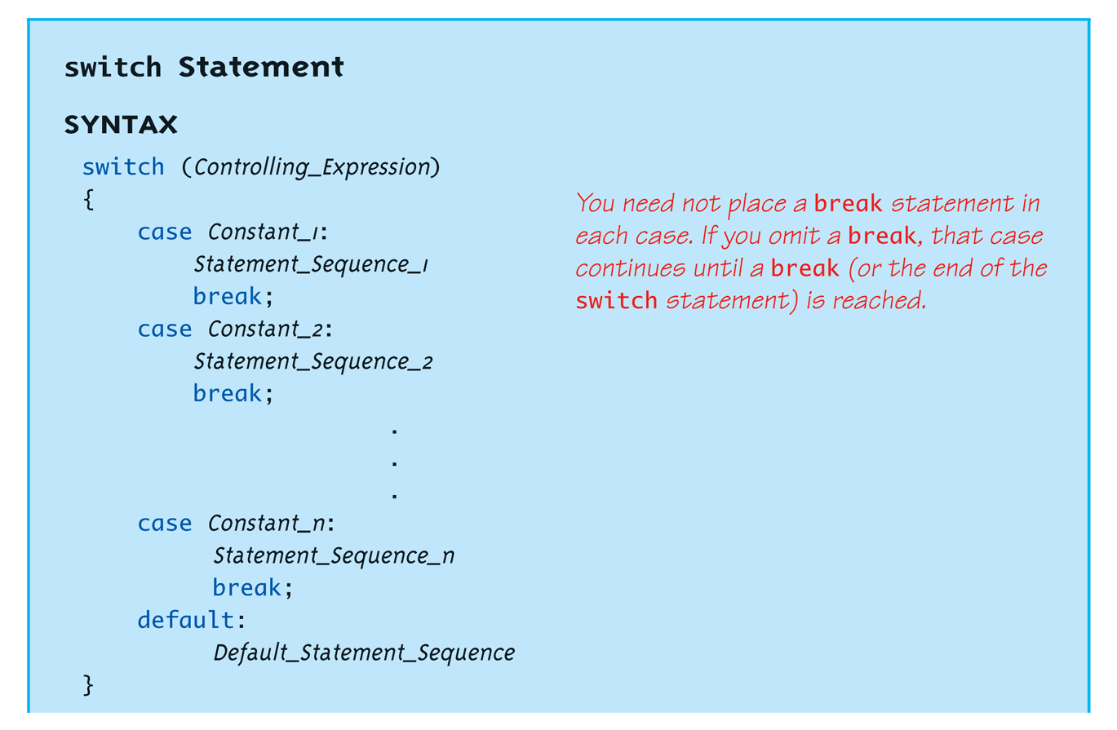
The switch Statement Syntax
The controlling expression must be integral! This includes char.

Slide 25
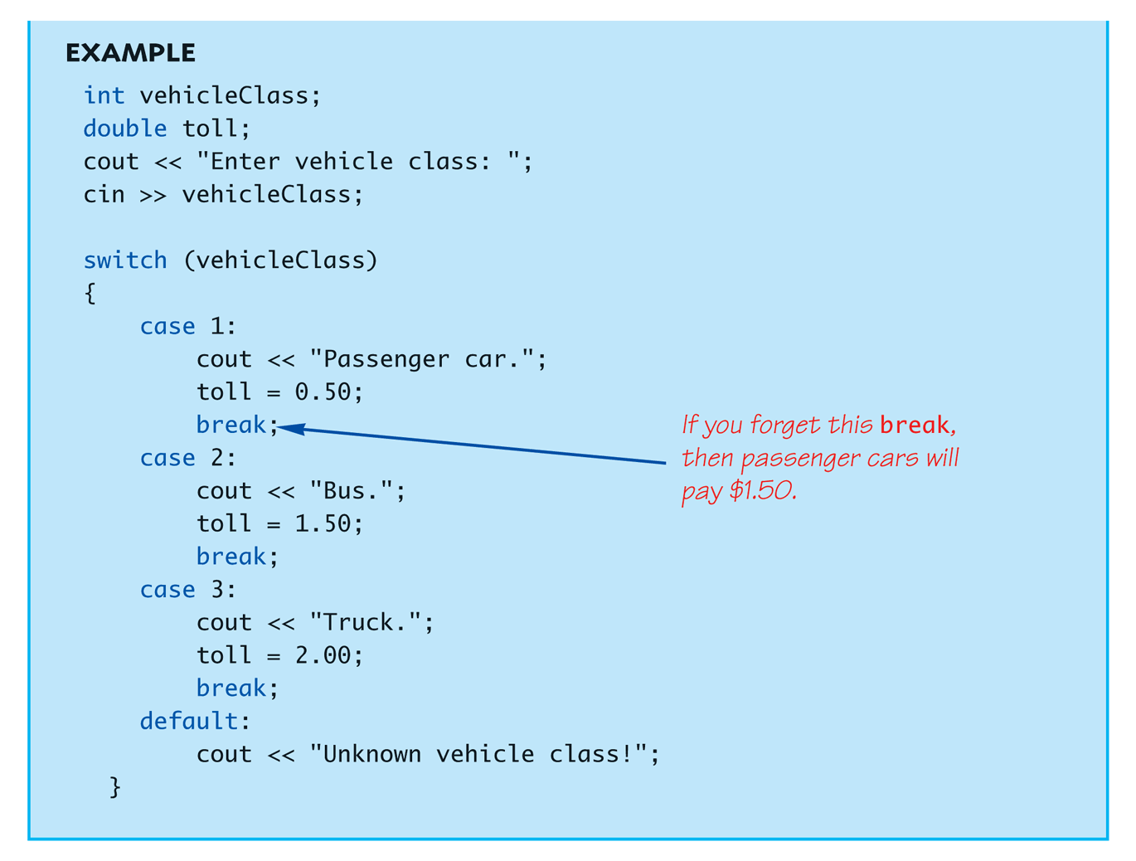
The switch Statement in Action

Slide 26
The switch: multiple case labels
Execution "falls thru" until break
switch provides a "point of entry“
Example: case 'A': case 'a': cout << "Excellent: you got an "A"!\n"; break; case 'B': case 'b': cout << "Good: you got a "B"!\n"; break;
Note multiple labels provide same "entry"

Slide 27
switch Pitfalls/Tip
Forgetting the break;
No compiler error
Execution simply "falls thru" other cases until break;
Biggest use: MENUs
Provides clearer "big-picture" view
Shows menu structure effectively
Each branch is one menu choice

Slide 28
switch Menu Example
Switch stmt "perfect" for menus: switch (response) { case 1: // Execute menu option 1 break; case 2: // Execute menu option 2 break; case 3: // Execute menu option 3 break; default: cout << "Please enter valid response."; }

Slide 29
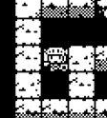

Switch Example: 輸入判斷
玩家在遊戲中可以輸入方向(W、S、A、D)控制移動方向。
char input; cin >> input;
switch (input) { case ‘w’: // 玩家向上移動 break; case ‘s’: //玩家向下移動 break; case ‘a’: //玩家向左移動 break;
case ‘d’: //玩家向右移動
break; default: cout << "Please enter valid input."; }
角色移動
玩家輸入方向
X
X

Slide 30
Conditional Operator
Also called "ternary operator"
Allows embedded conditional in expression
Essentially "shorthand if-else" operator
Example: if (creatureAttack > heroArmor) heroArmor = 0; else heroArmor -= creatureAttack;
Can be written: heroArmor = (creatureAttack > heroArmor) ? 0 : heroArmor - creatureAttack;
"?" and ":" form this "ternary" operator

Slide 31
Loops
3 Types of loops in C++
while
Most flexible
No "restrictions"
do-while
Least flexible
Always executes loop body at least once
for
Natural "counting" loop
Notes:
Initialization, increment, terminator.

Slide 32
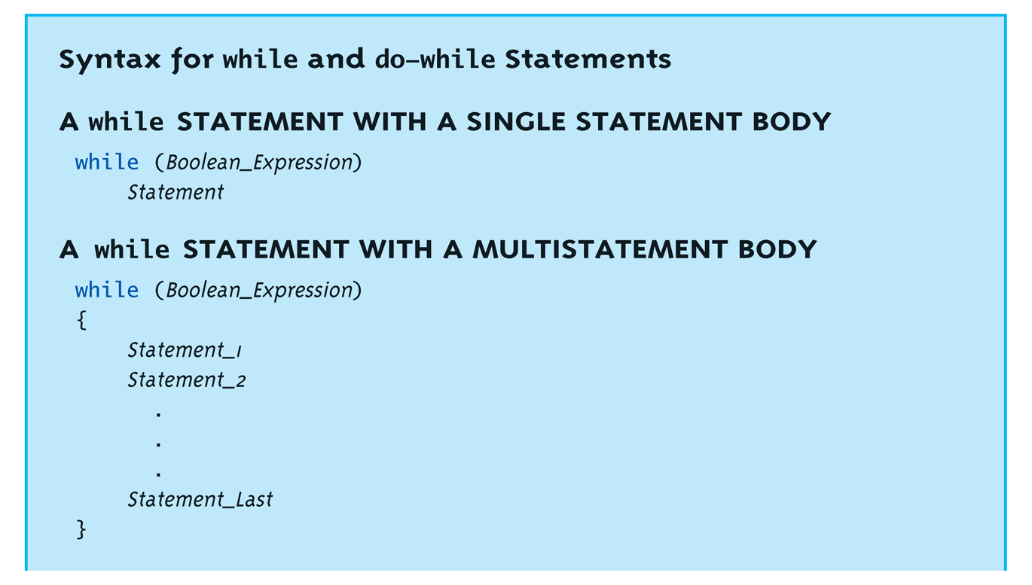
while Loops Syntax

Slide 33
while Example
Consider: count = 0; // Initialization while (count < 3) // Loop Condition { cout << "Hi "; // Loop Body count++; // Update expression }
Loop body executes how many times?

Slide 34

while Loop: 遊戲回合執行
遊戲在執行時會不斷loop每個回合，直到判斷遊戲結束。
bool gameOver = false; while (!gameOver)//直到遊戲結束，一直重複下個回合 { //偵測輸入
//操作角色
//判斷事件觸發
//操作生物
//操作場景物件
//……
if(player.health <= 0)//血量歸零
gameOver = true; }
偵測輸入
操作角色
判斷事件觸發
操作生物
操作場景物件
……
GameManager

Slide 35
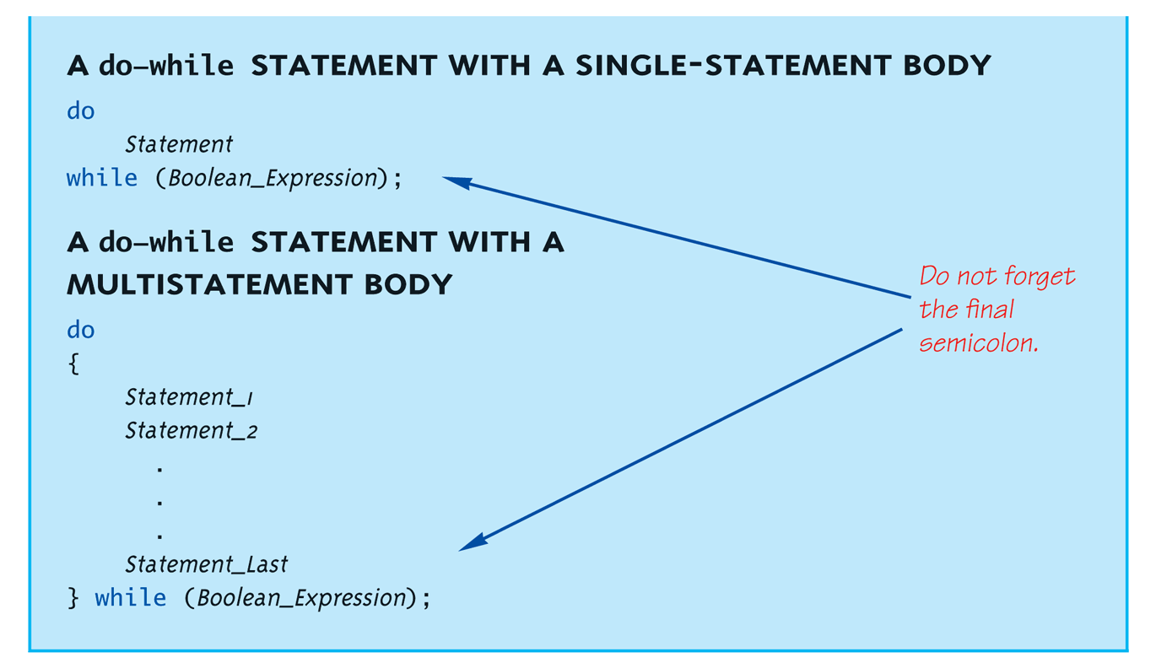
do-while Loop Syntax

Slide 36
do-while Loop Example
count = 0; // Initialization do { cout << "Hi "; // Loop Body count++; // Update expression } while (count < 3); // Loop Condition
Loop body executes how many times?
do-while loops always execute body at least once!

Slide 37
while vs. do-while
Very similar, but…
One important difference
Issue is "WHEN" boolean expression is checked
while: checks BEFORE body is executed
do-while: checked AFTER body is executed
After this difference, they’re essentially identical!
while is more common, due to it’s ultimate "flexibility"

Slide 38
Comma Operator
Evaluate list of expressions, returning value of the last expression
Most often used in a for-loop
Example: first = (first = 2, second = first + 1);
first gets assigned the value 3
second gets assigned the value 3
No guarantee what order expressions will be evaluated.

Slide 39
for Loop Syntax
for (Init_Action; Bool_Exp; Update_Action)
Body_Statement
Like if-else, Body_Statement can be a block statement
Much more typical

Slide 40
for Example
for (count=0;count<3;count++) { cout << "Hi "; // Loop Body }
How many times does loop body execute?
Initialization, loop condition and update all "built into" the for-loop structure!
A natural "counting" loop

Slide 41
for: 生物行為處理
在遊戲中，複數的生物群是用陣列方式儲存管理，並用index編號辨別。
當遊戲需要處理不同生物的行為時可利用for loop 管理。 // 用for loop 管理生物群 for (count=0; count<creature.length; count++) { // 生物行為，處理移動攻擊等等 creature[count].active(); }
生物1號
生物2號
…
生物(length - 1)號

Slide 42
Loop Issues
Loop’s condition expression can be ANY boolean expression
Examples:
while (time < stopTime && health!=0) { // Do something }
for (time = 0;time < stopTime && health != 0) { // Do something }

Slide 43
Loop Pitfalls: Misplaced ;
Watch the misplaced ; (semicolon)
Example: while (health != 0) ;← { cout << "Enter direction: "; cin >> direction; }
Notice the ";" after the while condition!
Result here: INFINITE LOOP!

Slide 44
Loop Pitfalls: Infinite Loops
Loop condition must evaluate to false at some iteration through loop
If not → infinite loop.
Example: while (1) { cout << “Current time: “ << time << “ secs”; }
A perfectly legal C++ loop → always infinite!
Infinite loops can be desirable
e.g., "Embedded Systems"

Slide 45
The break and continue Statements
Flow of Control
Recall how loops provide "graceful" and clear flow of control in and out
In RARE instances, can alter natural flow
break;
Forces loop to exit immediately.
continue;
Skips rest of loop body
These statements violate natural flow
Only used when absolutely necessary!

Slide 46
Nested Loops
Recall: ANY valid C++ statements can be inside body of loop
This includes additional loop statements!
Called "nested loops"
Requires careful indenting: for (outer=0; outer<5; outer++) for (inner=7; inner>2; inner--) cout << outer << inner;
Notice no { } since each body is one statement
Good style dictates we use { } anyway

Slide 47
Introduction to File Input
We can use cin to read from a file in a manner very similar to reading from the keyboard
Only an introduction is given here, more details are in chapter 12
Just enough so you can read from text files and process larger amounts of data that would be too much work to type in

Slide 48
Opening a Text File
Add at the top
#include <fstream> using namespace std;
You can then declare an input stream just as you would declare any other variable.
ifstream inputStream;
Next you must connect the inputStream variable to a text file on the disk.
inputStream.open(“level1.txt");
The “filename.txt” is the pathname to a text file or a file in the current directory

Slide 49
Reading from a Text File
Use
inputStream >> HP;
The result is the same as using cin >> HP except the input is coming from the text file and not the keyboard
When done with the file close it with
inputStream.close();

Slide 50
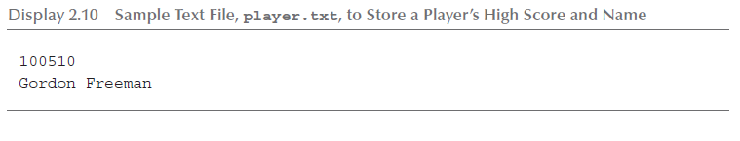
File Input Example (1 of 2)
Consider a text file named player.txt with the following text

Slide 51
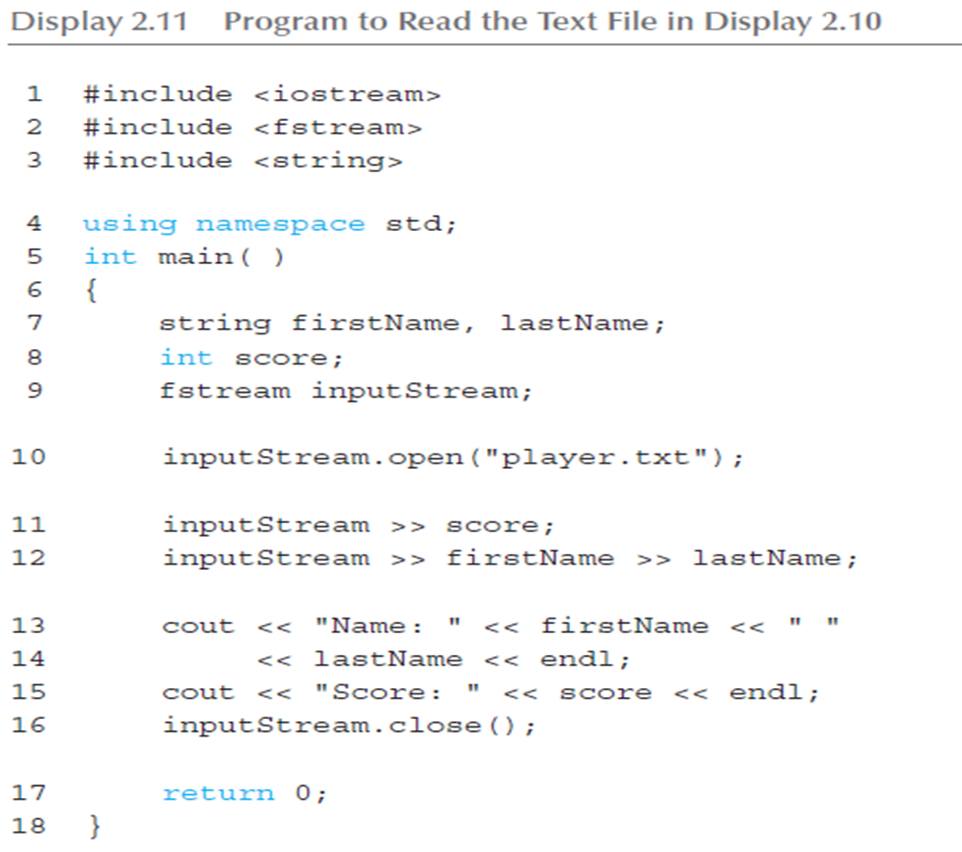
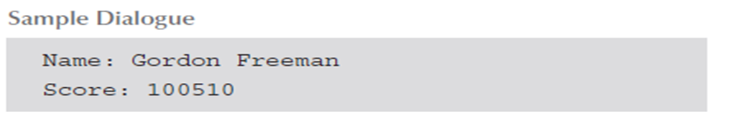
File Input Example (2 of 2)

Slide 52
Notes on Display 2.11
fstream
https://msdn.microsoft.com/zh-tw/library/6z061fh0.aspx
basic_fstream: https://msdn.microsoft.com/zh-tw/library/a33ahe62.aspx
Member function
.close():
.open()
http://en.cppreference.com/w/cpp/io/basic_fstream

Slide 53
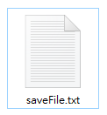
ifstream: 遊戲讀取存檔
// 用ifstream讀取原先已自錄儲存之原始位置狀態
void readFile() {
std::ifstream file;
file.open("savefile.txt");
int heroX, heroY, triggerX, triggerY, creatureX, creatureY; std::string buffer;
file >> heroX >> heroY;
file >> triggerX >> triggerY;
file >> creatureX >> creatureY;
gCreature.setPos(creatureX, creatureY);
gTrigger.setPos(triggerX, triggerY);
gHero.setPos(heroX, heroY);
setupBoard();
file.close();
}
(x,y)
(x,y)
(x,y)

Slide 54
ofstream: 遊戲讀取存檔
// 用ofstream記錄現今遊戲狀態
void saveFile() {
std::ofstream outfile("saveFile.txt");
outfile << hero.x << ' ' << hero.y << std::endl;
outfile << trig.x << ' ' << trig.y << std::endl;
outfile << cre.x << ' ' << cre.y << std::endl;
outfile.close();
}
(x,y)
(x,y)
(x,y)

Slide 55
Summary 1
Boolean expressions
Similar to arithmetic → results in true or false
C++ branching statements
if-else, switch
switch statement great for menus
C++ loop statements
while
do-while
for

Slide 56
Summary 2
do-while loops
Always execute their loop body at least once
for-loop
A natural "counting" loop
Loops can be exited early
break statement
continue statement
Usage restricted for style purposes
Reading from a text file is similar to reading from cin

