Slide 1
Chapter 3
Function Basics

Slide 2
Learning Objectives
Predefined Functions (standard library)
Those that return a value and those that don’t
Programmer-defined Functions
Defining, Declaring, Calling
Recursive Functions
Scope Rules
Local variables
Global constants and global variables
Blocks, nested scopes

Slide 3
Introduction to Functions
Building Blocks of Programs
Other terminology in other languages:
Procedures, subprograms, methods
In C++: functions
I-P-O
Input – Process – Output
Basic subparts to any program
Use functions for these "pieces"

Slide 4
Predefined Functions
Libraries full of functions for our use!
Two types:
Those that return a value
Those that do not (void)
Must "#include" appropriate library
e.g.,
<cmath>, <cstdlib> (Original "C" libraries)
<iostream> (for cout, cin)

Slide 5
Using Predefined Functions
Math functions very plentiful
Found in library <cmath>
Most return a value (the "answer")
Example: theRoot = sqrt(9.0);
Components: sqrt = name of library function theRoot = variable used to assign "answer" to 9.0 = argument or "starting input" for function
In I-P-O:
I = 9.0
P = "compute the square root"
O = 3, which is returned & assigned to theRoot

Slide 6
The Function Call
Back to this assignment: theRoot = sqrt(9.0);
The expression “sqrt(9.0)” is known as a function call, or function invocation
The argument in a function call (9.0) can be a literal, a variable, or an expression
The call itself can be part of an expression:
bonus = sqrt(sales)/10;
A function call is allowed wherever it’s legal to use an expression of the function’s return type

Slide 7
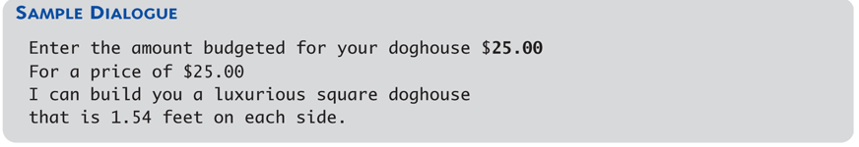
#include <iostream>
#include <cmath>
using namespace std;
int main( )
{
const double COST_PER_SQ_FT = 10.50;
double budget, area, lengthSide;
cout << "Enter the amount budgeted for your dog house $";
cin >> budget;
area = budget/COST_PER_SQ_FT;
lengthSide = sqrt(area);
cout.setf(ios::fixed);
cout.setf(ios::showpoint);
cout.precision(2);
cout << "For a price of $" << budget << endl
<< "I can build you a luxurious square dog house\n"
<< "that is " << lengthSide
<< " feet on each side.\n";
return 0;
}

Slide 8
Notes on Display 3.1
Cmath functions
http://en.cppreference.com/w/cpp/header/cmath

Slide 9
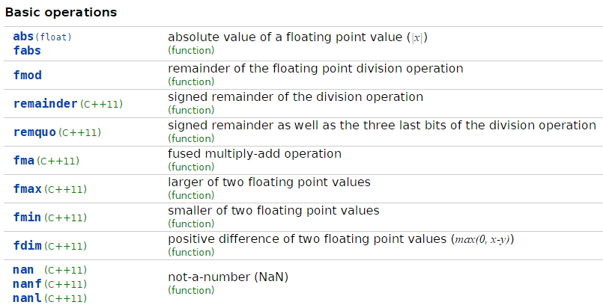

Slide 10
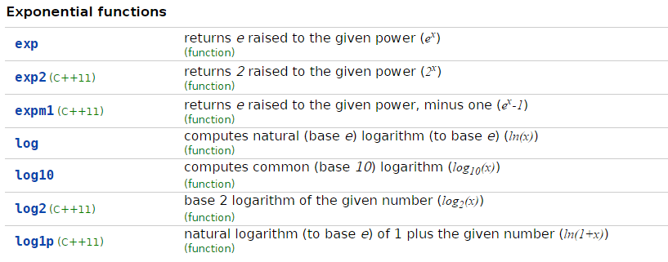

Slide 11
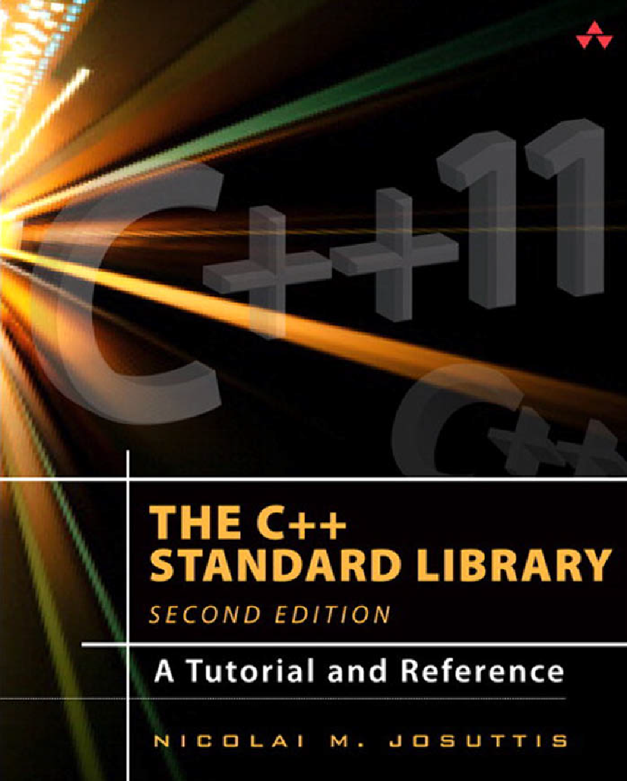
C++ Standard Library
http://en.cppreference.com/w/cpp/header

Slide 12
More Predefined Functions
#include <cstdlib>
Library contains functions like:
abs() // Returns absolute value of an int
labs() // Returns absolute value of a long int
*fabs() // Returns absolute value of a float
*fabs() is actually in library <cmath>!
Can be confusing
Remember: libraries were added after C++ was "born," in incremental phases
Refer to appendices/manuals for details

Slide 13
More Math Functions
pow(x, y) sqrt(x)
Returns distance to (0, 0) of (x, y) double distance, x = 3.0, y = 2.0; distance = sqrt (pow(x, 2) + pow(y, 2)); cout << distance;
Notice this function receives two arguments
A function can have any number of arguments, of varying data types

Slide 14
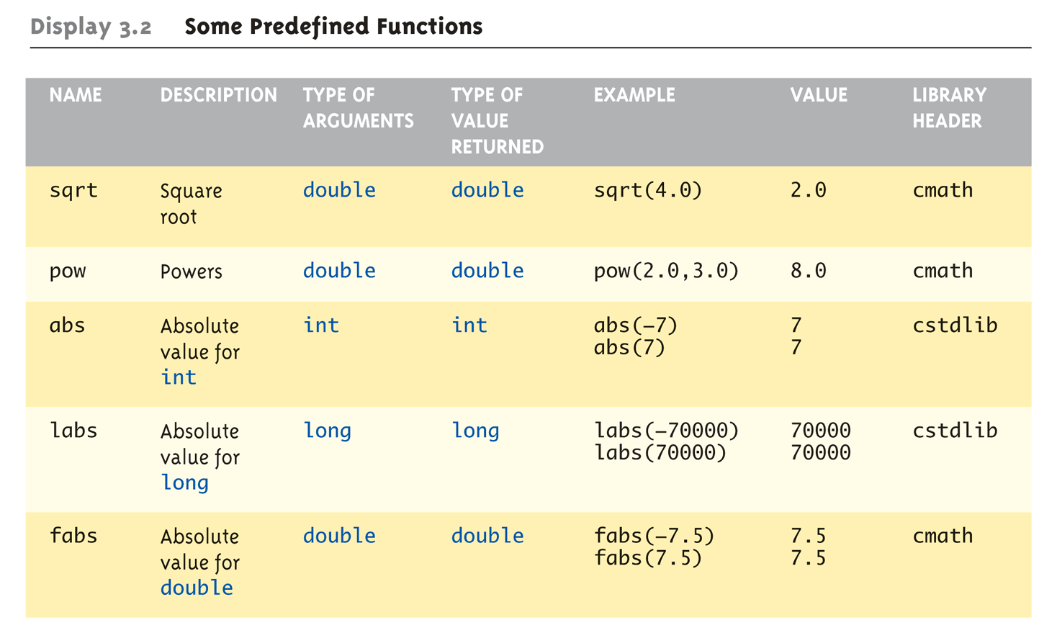
Even More Math Functions: Display 3.2 Some Predefined Functions (1 of 2)

Slide 15
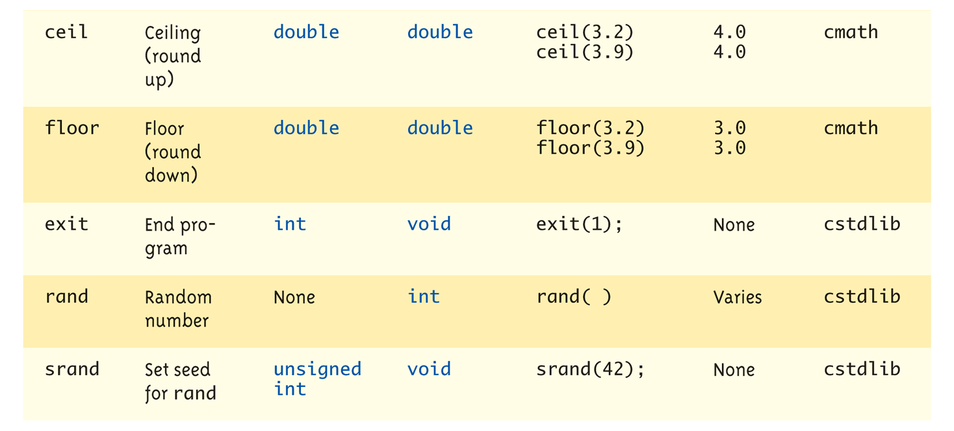
Even More Math Functions: Display 3.2 Some Predefined Functions (2 of 2)

Slide 16
Predefined Void Functions
No returned value
Performs an action, but sends no "answer"
When called, it’s a statement itself
exit(1);// No return value, so not assigned
This call terminates program
void functions can still have arguments
All aspects same as functions that "return a value"
They just don’t return a value!

Slide 17
Random Number Generator
Return "randomly chosen" number
Used for simulations, games
rand()
Takes no arguments
Returns value between 0 & RAND_MAX
Scaling
Squeezes random number into smaller range rand() % 6
Returns random value between 0 & 5
Shifting rand() % 6 + 1
Shifts range between 1 & 6 (e.g., die roll)

Slide 18
Random Number Seed
Pseudorandom numbers
Calls to rand() produce given “sequence” of random numbers
Use "seed" to alter sequence srand(seed_value);
void function
Receives one argument, the "seed"
Can use any seed value, including system time: srand(time(0));
time() returns system time as numeric value
Library <time> contains time() functions

Slide 19
Random Examples
Random double between 0.0 & 1.0: (RAND_MAX – rand())/static_cast<double>(RAND_MAX)
Type cast used to force double-precision division
Random int between 1 & 6: rand() % 6 + 1
"%" is modulus operator (remainder)
Random int between 10 & 20: rand() % 10 + 10

Slide 20
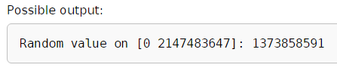
Standard library Examples
#include <cstdlib>
#include <iostream>
#include <ctime>
int main()
{
std::srand(std::time(0)); // use current time
// as seed for random
// generator
int random_variable = std::rand();
std::cout << "Random value on [0 " << RAND_MAX << "]: "
<< random_variable << '\n';
return 0;
}

Slide 21
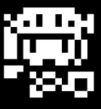
想一想
遊戲中，反覆出現的功能有那些?
要如何處理他們呢?
如何減少開發時間及除錯時間呢?

Slide 22
想一想
遊戲中，反覆出現的功能有那些?
取得使用者的輸入，移動。觸發後的反應……
要如何處理他們呢？
使用相同的Function做相同的事情重複call
如何減少開發時間及除錯時間呢?
若把功能做成Function可以減少相同Code的出現，就不會重複打類似的東西並且若出錯只需要針對Function做修正

Slide 23
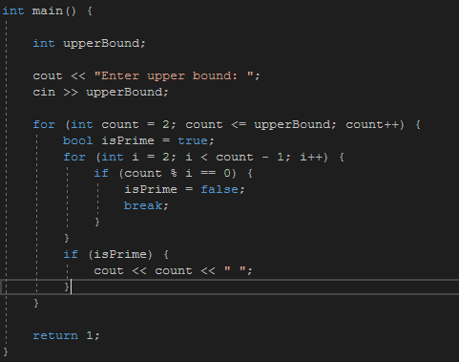
想一想
How to improve this?

Slide 24
Library與Function
function定義了常用的演算法，在程式中重複利用，省去程式中冗贅的部分。這些function更可以被包裝成library提供給其他專案，節省開發時間。
利用第三方或C++皆提供的library，寫程式不用/不要全部自己刻。
遊戲中用到的C++與Visual Studio提供的function
int rand()
C標準函式庫->stdlib.h
用於產生隨機數值，在建立隨機迷宮或是決定生物行為都很有用。
SHORT GetAsyncKeyState(int key)
User32.lib -> Winuser.h
用於偵測鍵盤被按下，比cin更適用於角色操作。

Slide 25
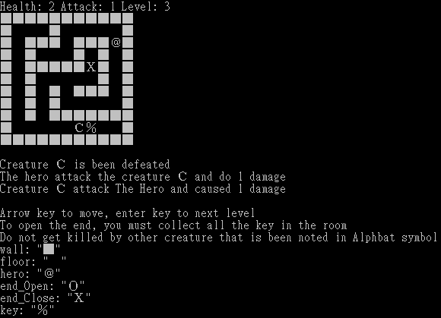


Library與Function
遊戲中定義的function
void draw()
在遊戲需要更新畫面時用到，會將輸出視窗刷新並一行一行cout 輸出遊戲畫面。
string** createCanvas(int width,int height)
函式實作了產生地圖的演算法並輸出二維的陣列資料。該資料在遊戲中的環境判斷與畫面輸出都會用到。
在實驗室中常用的方便library
OpenGL(開放)，用於繪製2D和3D畫面的圖形資料庫。
提供在GPU上繪製2D和3D圖形的圖形處理函式，在開發圖形化程式時極為有用。
OpenCV(學術開放)，跨平台的電腦視覺資料庫。
有非常豐富的圖片處理函式，包括大小轉換、顏色轉換和邊界偵測等各種功能。

Slide 26
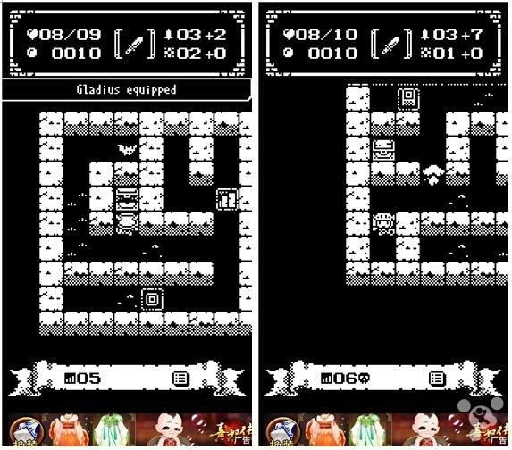



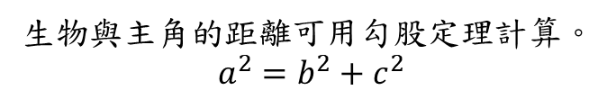
Cmath Examples:攻擊英雄
遊戲中生物需要計算與主角的距離，若距離在攻擊範圍內則攻擊主角。
計算兩點間的距離可利用<Math.h> 擁有的數學函式sqrt() 與 pow()計算。
a
b
c
生物在行動時會先判斷主角與自己的距離，若在自己的攻擊範圍內則對主角造成傷害。

Slide 27
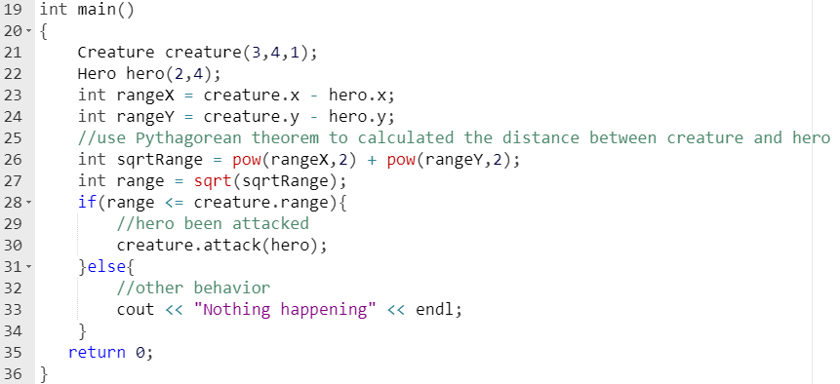
攻擊英雄:Example Code

Slide 28
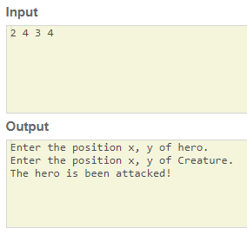
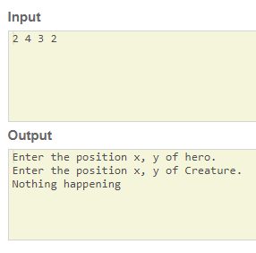
攻擊英雄:Output
輸入 2 4 3 4
輸入 2 4 3 2
(3, 2)
(2, 4)
(3, 4)
生物在主角身旁，並攻擊主角。
(2, 4)
生物與主角錯開，沒發生攻擊事件。

Slide 29
Programmer-Defined Functions
Write your own functions!
Building blocks of programs
Divide & Conquer
Readability
Re-use
Your "definition" can go in either:
Same file as main()
Separate file so others can use it, too

Slide 30
Components of Function Use
3 Pieces to using functions:
Function Declaration/prototype
Information for compiler
To properly interpret calls
Function Definition
Actual implementation/code for what function does
Function Call
Transfer control to function

Slide 31
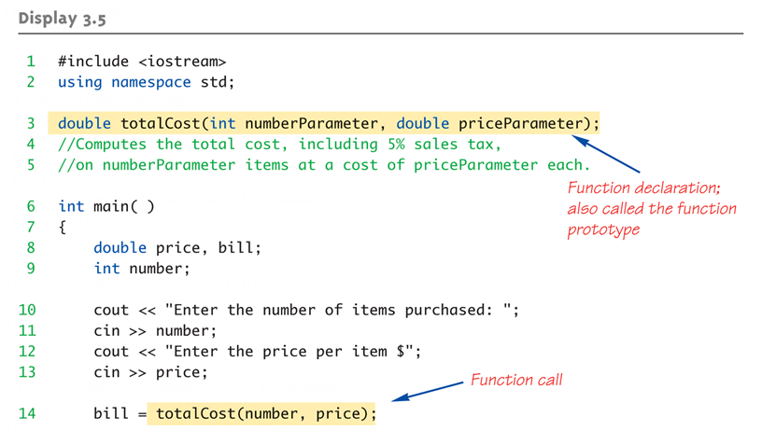
Function Example: Display 3.5 A Function to Calculate Total Cost (1 of 2)

Slide 32
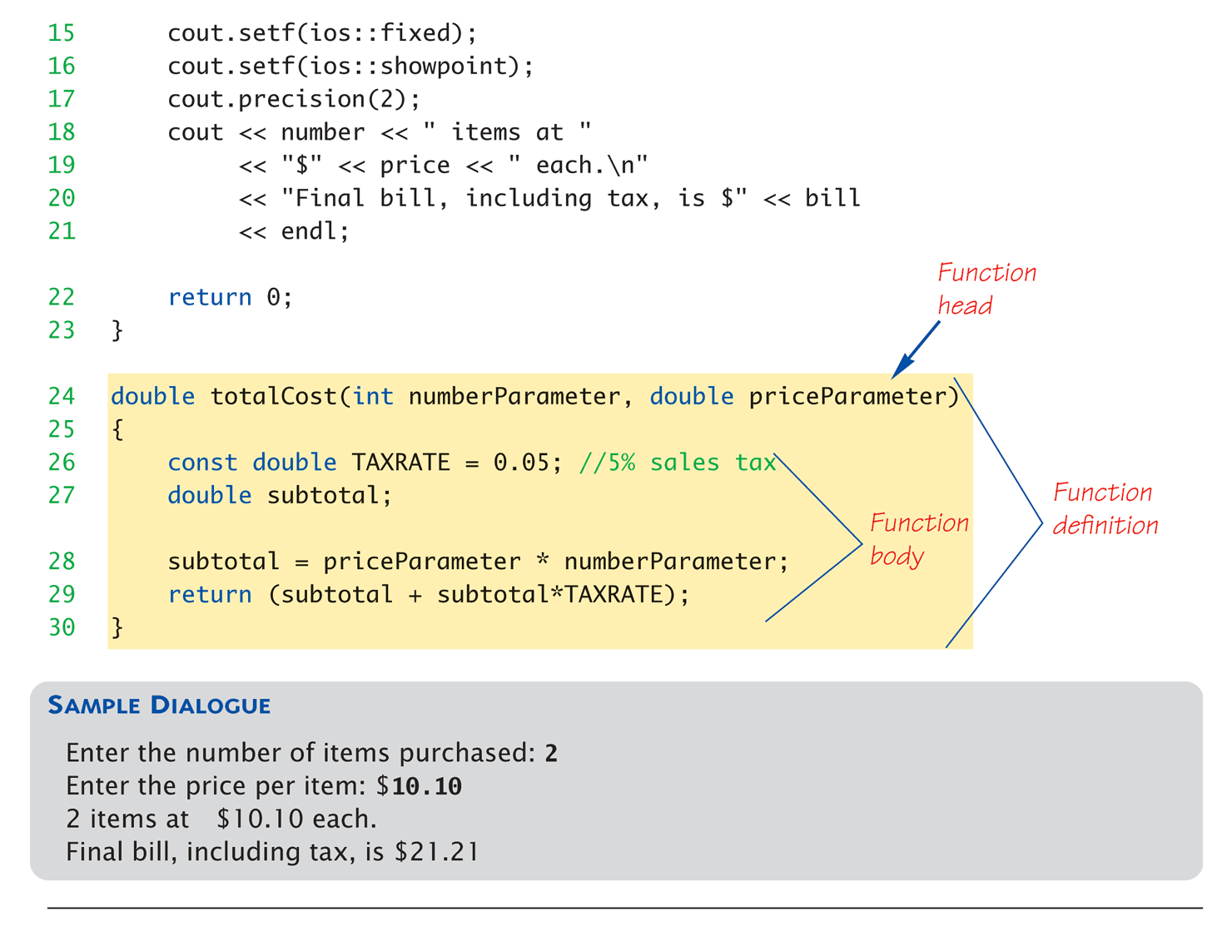
Function Example: Display 3.5 A Function to Calculate Total Cost (1 of 2)

Slide 33
Function Declaration
Also called function prototype
An "informational" declaration for compiler
Tells compiler how to interpret calls
Syntax: <return_type> FnName(<formal-parameter-list>);
Example: int updateHealth(int HP, double distance);
Placed in the declaration space of main()
Or above main() in global space

Slide 34
Function Definition
Implementation of function
Just like implementing function main()
Example:
int updateHealth( int HP, double distance)
{ const double attack = 5.0; double newHealth; newHealth = HP – (attack / distance); return (int)newHealth; }
Notice proper indenting

Slide 35
Function Definition Placement
Placed after function main()
NOT "inside" function main()!
Functions are “equals”; no function is ever "part" of another
Formal parameters in definition
"Placeholders" for data sent in
"Variable name" used to refer to data in definition
return statement
Sends data back to caller

Slide 36
Function Call
Just like calling predefined function health = updateHealth(HP, distance);
Recall: updateHealth returns int value
Assigned to variable named “health"
Arguments here: HP, distance
Recall arguments can be literals, variables, expressions, or combination
In function call, arguments often called "actual arguments"
Because they contain the "actual data" being sent

Slide 37
Alternative Function Declaration
Recall: Function declaration is "information“ for compiler
Compiler only needs to know:
Return type
Function name
Parameter list
Formal parameter names not needed: double updateHealth(int, double);
Still "should" put in formal parameter names
Improves readability

Slide 38
Parameter vs. Argument
Terms often used interchangeably
Formal parameters/arguments
In function declaration
In function definition’s header
Actual parameters/arguments
In function call
Technically parameter is "formal" piece while argument is "actual" piece*
*Terms not always used this way

Slide 39
Functions Calling Functions
We’re already doing this!
main() IS a function!
Only requirement:
Function’s declaration must appear first
Function’s definition typically elsewhere
After main()"s definition
Or in separate file
Common for functions to call many other functions
Function can even call itself → "Recursion"

Slide 40
Boolean Return-Type Functions
Return-type can be any valid type
Given function declaration/prototype: bool isAlive(int HP);
And function’s definition: bool isAlive(int HP) { return (HP > 0); }
Returns "true" or "false"
Function call, from some other function: if (isAlive(HP)) cout << “Creature is alive\n";

Slide 41
Example (Contd.)
隨機移動
void randomCreatureMovement(int *creaturePosX, int *creaturePosY)
{
srand(time(NULL));
int random = rand();
if (random % 4 == 0)
*creaturePosX += 1;
if (random % 4 == 1)
*creaturePosX -= 1;
if (random % 4 == 2)
*creaturePosY += 1;
if (random % 4 == 3)
*creaturePosY -= 1;
}
?

Slide 42

Example (Contd.)
#include <iostream>
unsigned fibonacci(unsigned n){
if (n < 2) return n;
return fibonacci(n-1) + fibonacci(n-2);
}
int main(){
unsigned r;
while(std::cin >> r){
std::cout << fibonacci(r) << “\n”;
}
return 0;
}

Slide 43
Example (Contd.)
#include <iostream>
#include <chrono>
#include <ctime>
long fibonacci(unsigned n){
if (n < 2) return n;
return fibonacci(n-1) + fibonacci(n-2);
}
int main(){
std::chrono::time_point<std::chrono::system_clock> start, end;
start = std::chrono::system_clock::now();
std::cout << "f(42) = " << fibonacci(42) << '\n';
end = std::chrono::system_clock::now();
std::chrono::duration<double> elapsed_seconds = end-start;
std::time_t end_time = std::chrono::system_clock::to_time_t(end);
std::cout << "finished computation at " << std::ctime(&end_time)
<< "elapsed time: " << elapsed_seconds.count() << "s\n";
return 0;
}
f(42) = 267914296
finished computation at Mon Jul 29 08:41:09 2013
elapsed time: 0.670427s

Slide 44
Function Example: heroMove
主角在遊戲中會接收方向移動的指令heroMove(int x, int y)，並回傳bool確認是否成功移動。
主角在移動時需判斷移動位置是否為空地，否則停止移動，
X
X
根據輸入判斷移動方向
根據判斷目的地是否為空地，若該方向被擋住則取消操作
移動主角

Slide 45
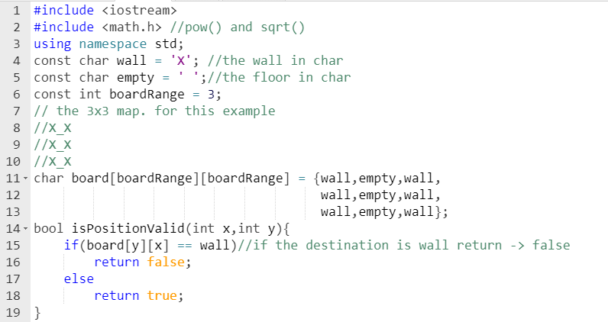
heroMove:Example Code
範例用預設版面
判斷版面中位置是否為空地

Slide 46
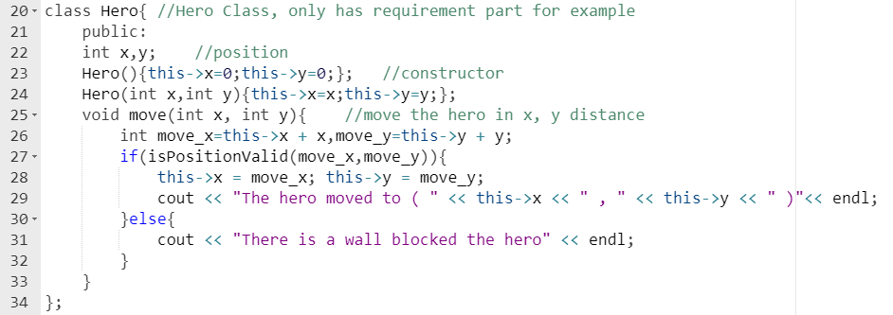
heroMove:Example Code
若移動位置為空地，則移動主角
反之則取消移動

Slide 47
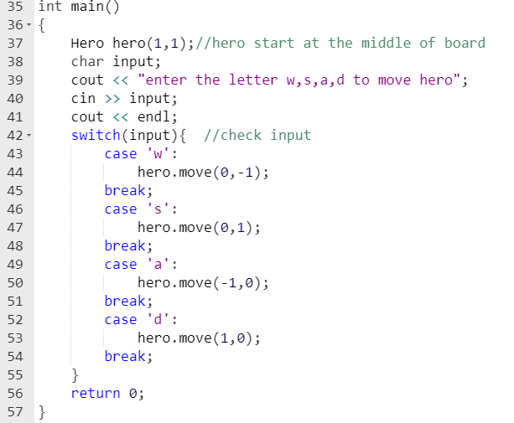
heroMove:Example Code
用cin取得輸入
用switch判斷輸入方向

Slide 48
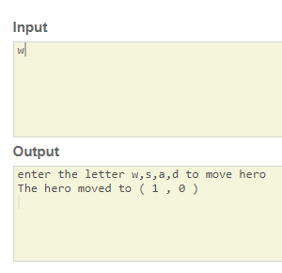
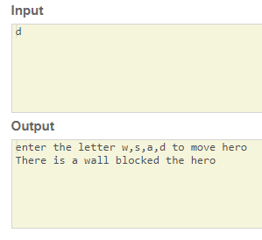
heroMove:Output
輸入向上
輸入向右
主角位置
X
主角向上移動。
主角右方被牆壁擋住，取消移動。

Slide 49
Declaring Void Functions
Similar to functions returning a value
Return type specified as "void"
Example:
Function declaration/prototype: void printStatus(int HP);
Return-type is "void"
Nothing is returned

Slide 50
Declaring Void Functions
Function definition: void printStatus(int HP) { if(HP > 0) { cout << “Hero is alive”<< endl; } else { cout << “Hero is dead”<< endl; } }
Notice: no return statement
Optional for void functions

Slide 51
Calling Void Functions
Same as calling predefined void functions
From some other function, like main():
printStatus(HP);
printStatus(100);
Notice no assignment, since no value returned
Actual arguments (HP)
Passed to function
Function is called to "do it’s job" with the data passed in

Slide 52
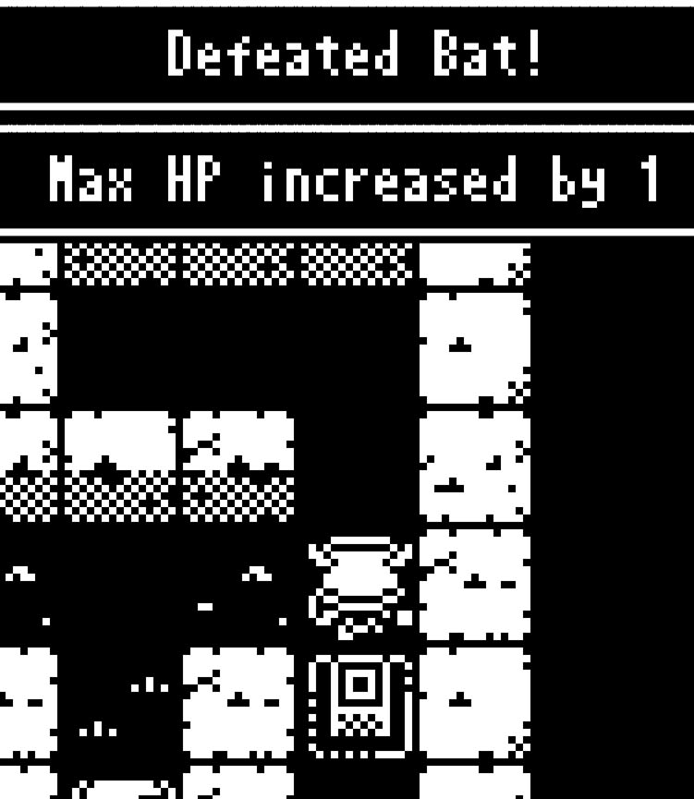
Function Example: gainExp()
當生物被英雄擊敗時會得到經驗值，若經驗值滿了提升等級與生命最大值。
每次提升等級時，下次升等所需的經驗值會越來越多。
相關變數:
當前等級
當前經驗值
升級所需經驗值
在遊戲中擊敗怪物會獲得經驗值
並在升級後增加血量上限。

Slide 53
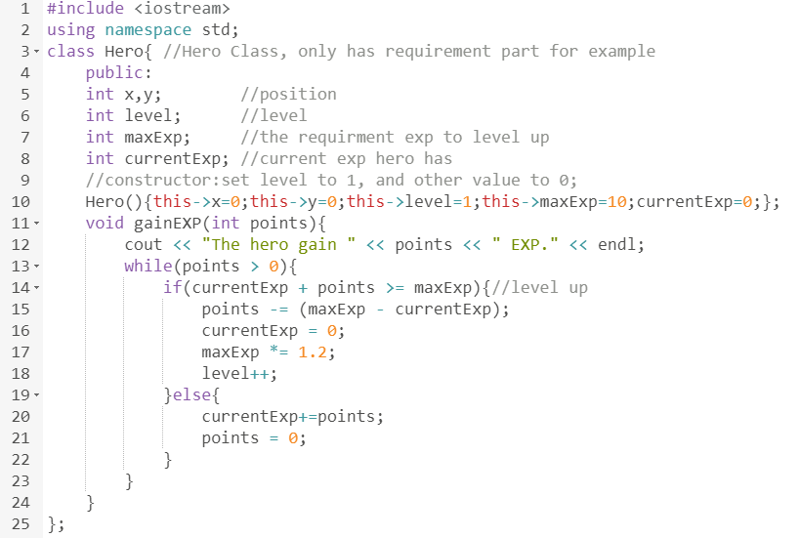
gainExp:Example Code
預設1等所需經驗為10
每次升等漲幅1.2倍
若達到升級條件，則將多餘的經驗值累加至下一個等級中，直到不再升級為止

Slide 54
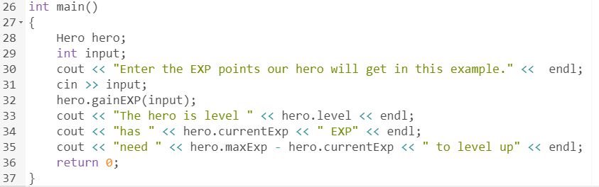
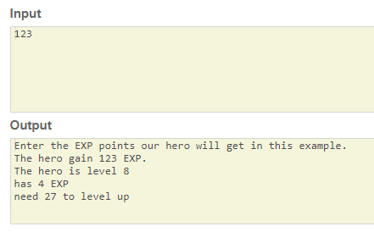
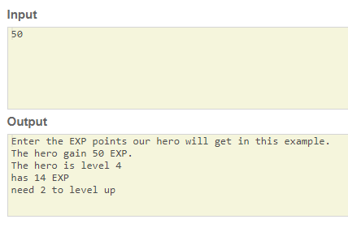
gainExp:Output
獲得123點經驗 =>
主角升到了等級八
獲得50點經驗 =>
主角升到了等級四

Slide 55
More on Return Statements
Transfers control back to "calling" function
For return type other than void, MUST have return statement
Typically the LAST statement in function definition
return statement optional for void functions
Closing } would implicitly return control from void function

Slide 56
Preconditions and Postconditions
Similar to "I-P-O" discussion
Comment function declaration: int updateHealth(int HP, double distance); //Precondition: distance is nonnegative and HP is larger // than one //Postcondition: New health after attack…
Often called Inputs & Outputs

Slide 57
main(): "Special"
Recall: main() IS a function
"Special" in that:
One and only one function called main()will exist in a program
Who calls main()?
Operating system
Tradition holds it should have return statement
Value returned to "caller“ → Here: operating system
Should return "int" or "void"

Slide 58
Scope Rules
Local variables
Declared inside body of given function
Available only within that function
Can have variables with same names declared in different functions
Scope is local: "that function is it’s scope"
Local variables preferred
Maintain individual control over data
Need to know basis
Functions should declare whatever local data needed to "do their job"

Slide 59
Procedural Abstraction
Need to know "what" function does, not "how" it does it!
Think "black box"
Device you know how to use, but not it’s method of operation
Implement functions like black box
User of function only needs: declaration
Does NOT need function definition
Called Information Hiding
Hide details of "how" function does it’s job

Slide 60
Global Constants and Global Variables
Declared "outside" function body
Global to all functions in that file
Declared "inside" function body
Local to that function
Global declarations typical for constants:
const double ATTACK = 20;
Declare globally so all functions have scope
Global variables?
Possible, but SELDOM-USED
Dangerous: no control over usage!

Slide 61
Blocks
Declare data inside compound statement
Called a "block"
Has "block-scope"
Note: all function definitions are blocks!
This provides local "function-scope"
Loop blocks: for (int round = 1; round <= 10; round++) { cout << “This is round ” << round << endl; }
Variable round has scope in loop body block only

Slide 62
Nested Scope
Same name variables declared in multiple blocks
Very legal; scope is "block-scope"
No ambiguity
Each name is distinct within its scope

Slide 63
Block Example: draw()
當輸出遊戲畫面時，需要依序畫出場上的物件。
畫面顯示遊戲中分三層。
地板與牆壁
機關與道具，並覆蓋上一層顯示
生物與主角，並覆蓋上一層顯示
加入玩家、生物、……
遊戲中輸出的畫面以字元陣列的方式輸出

Slide 64
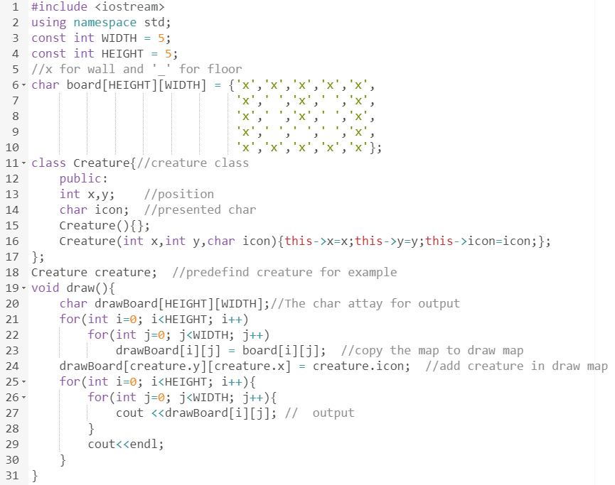
預設版面
假設迷宮中只有一支生物，且由使用者輸入控制生物擺放位置與表示字元
複製地圖資訊
將生物字元覆蓋在地圖上
輸出畫面

Slide 65
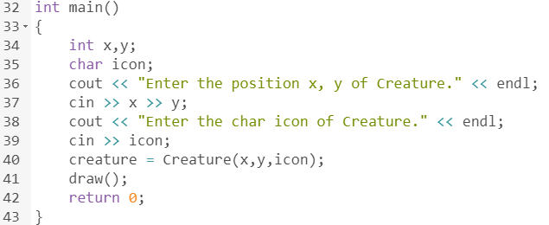
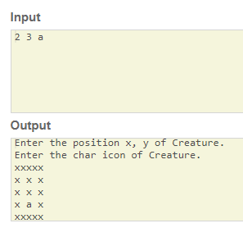
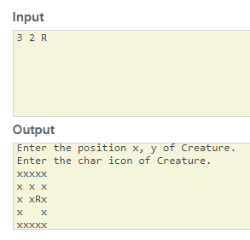
draw():Output
輸入 2 3 a =>
生物在(2, 3) 且用 ‘a’表示
輸入 3 2 R =>
生物在(3, 2) 且用 ‘R’表示
R
a

Slide 66
Chap03-02.cpp
#include <iostream>
#include <vector>
using namespace std;
int main()
{
vector<int> dynArrNums (3);
dynArrNums[0] = 365;
dynArrNums[1] = -421;
dynArrNums[2]= 789;
cout << "Number of integers in array: " << dynArrNums.size() << endl;
cout << "Enter another number for the array" << endl;
int anotherNum = 0;
cin >> anotherNum;
dynArrNums.push_back(anotherNum);
cout << "Number of integers in array: " << dynArrNums.size() << endl;
cout << "Last element in array: " << dynArrNums[ dynArrNums.size() - 1] << endl;
return 0;
}

Slide 67
Note on Chap03-02.cpp
Vector
http://en.cppreference.com/w/cpp/container/vector

Slide 68
Examples of Vector
#include <iostream>
#include <vector>
int main()
{
// Create a vector containing integers
std::vector<int> v = {7, 5, 16, 8};
// Add two more integers to vector
v.push_back(25);
v.push_back(13);
// Iterate and print values of vector
for(int n : v) { // Range-based for loop to iterate through the array.
std::cout << n << '\n';
}
}
7
5
16
8
25
13

Slide 69
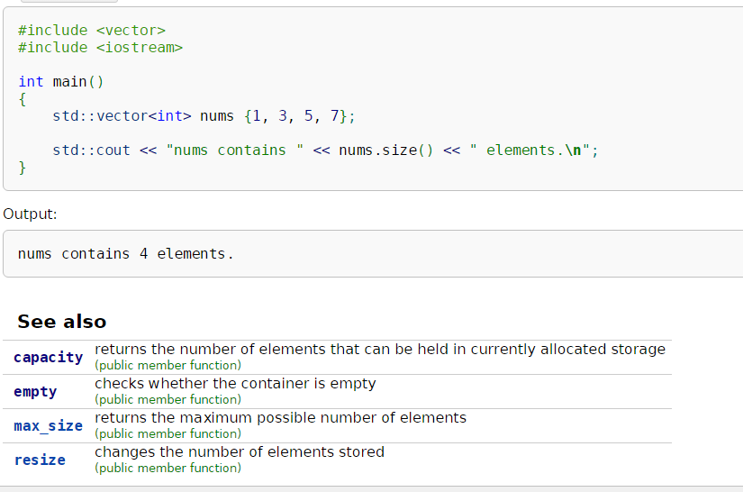
Examples of Vector

Slide 70
Summary 1
Two kinds of functions:
"Return-a-value" and void functions
Functions should be "black boxes"
Hide "how" details
Declare own local data
Function declarations should self-document
Provide pre- & post-conditions in comments
Provide all "caller" needs for use

Slide 71
Summary 2
Local data
Declared in function definition
Global data
Declared above function definitions
OK for constants, not for variables
Parameters/Arguments
Formal: In function declaration and definition
Placeholder for incoming data
Actual: In function call
Actual data passed to function

