Slide 1
Chapter 4
Parameters and Overloading

Slide 2
Learning Objectives
Parameters
Call-by-value
Call-by-reference
Mixed parameter-lists
Overloading and Default Arguments
Examples, Rules
Testing and Debugging Functions
assert Macro
Stubs, Drivers

Slide 3
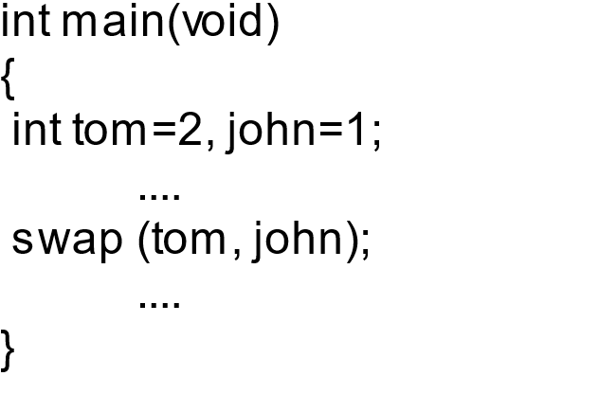
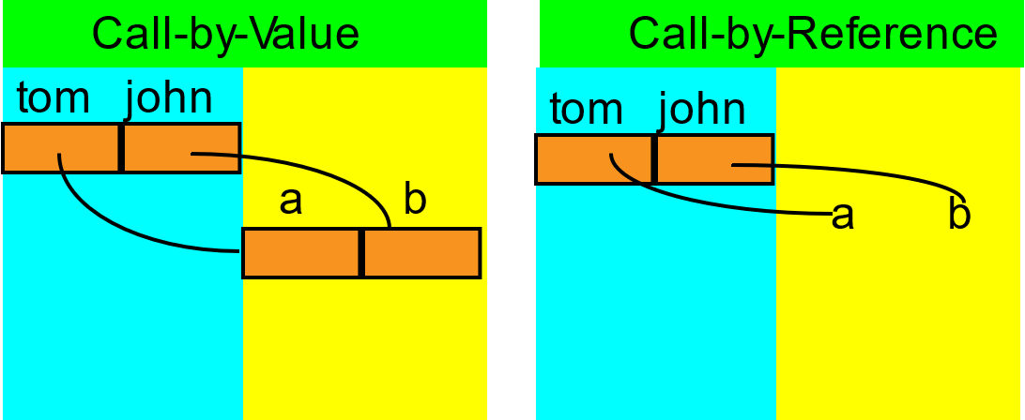
Parameters
Two methods of passing arguments as parameters
Call-by-value : void swap (int a, int b);
“copy” of value is passed
Call-by-reference : void swap(int &a, int &b);
"address of" actual argument is passed
Call-by-pointer：void swap(int *a, int *b);

Slide 4
Call-by-Value Parameters
Copy of actual argument passed
Considered "local variable" inside function
If modified, only "local copy" changes
Function has no access to “actual argument” from caller
This is the default method
Used in all examples thus far

Slide 5
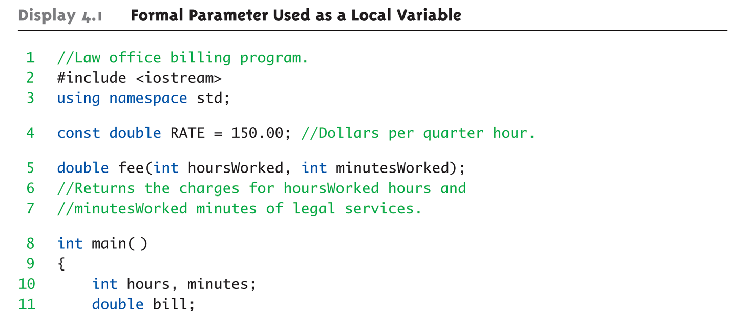
Call-by-Value Example: Display 4.1 Formal Parameter Used as a Local Variable

Slide 6
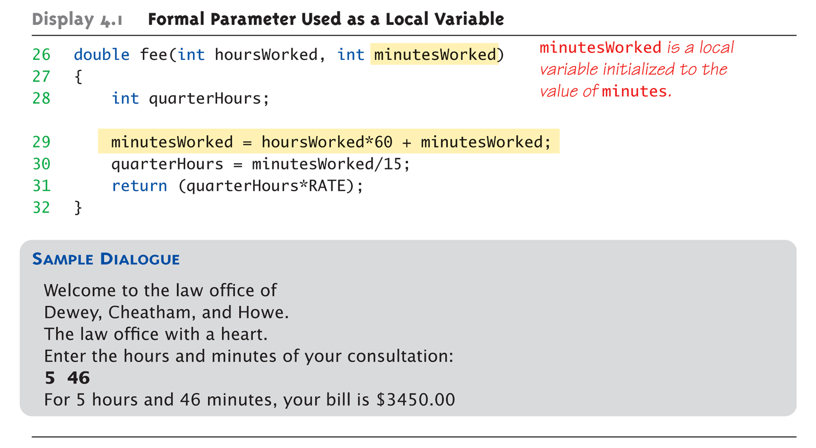
Call-by-Value Example: Display 4.1 Formal Parameter Used as a Local Variable (3 of 3)

Slide 7
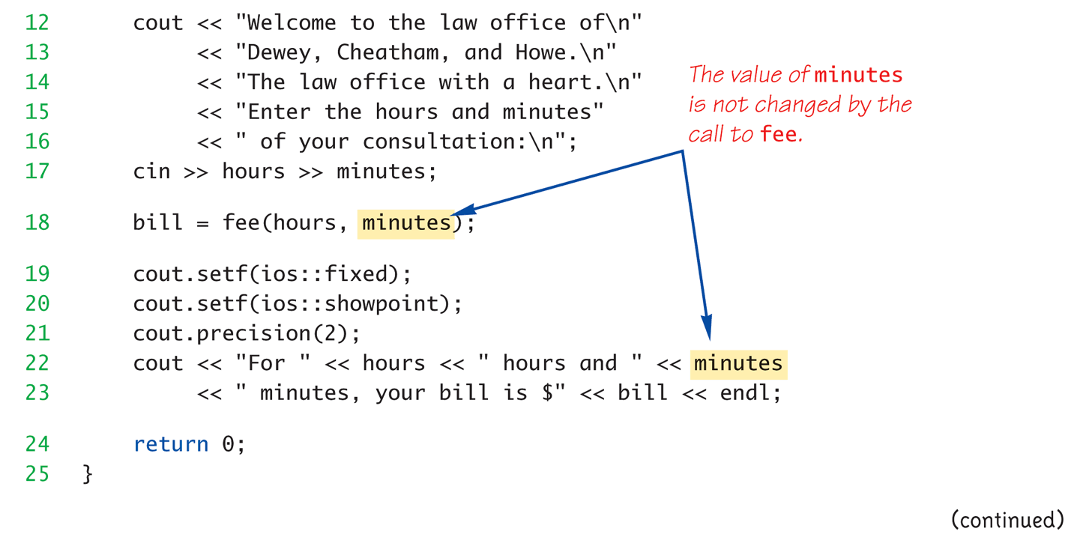
Call-by-Value Example: Display 4.1 Formal Parameter Used as a Local Variable (2 of 3)

Slide 8
Call-by-Value Pitfall
Common Mistake:
Declaring parameter “again” inside function: double fee(int HP, Position hPos) { int health; // local variable position hPos; // NO! }
Compiler error results
"Redefinition error…"
Value arguments ARE like "local variables"
But function gets them "automatically"

Slide 9
Call-By-Reference Parameters
Used to provide access to caller’s actual argument
Caller’s data can be modified by called function!
Typically used for input function
To retrieve data for caller
Data is then "given" to caller
Specified by ampersand, &, after type in formal parameter list

Slide 10
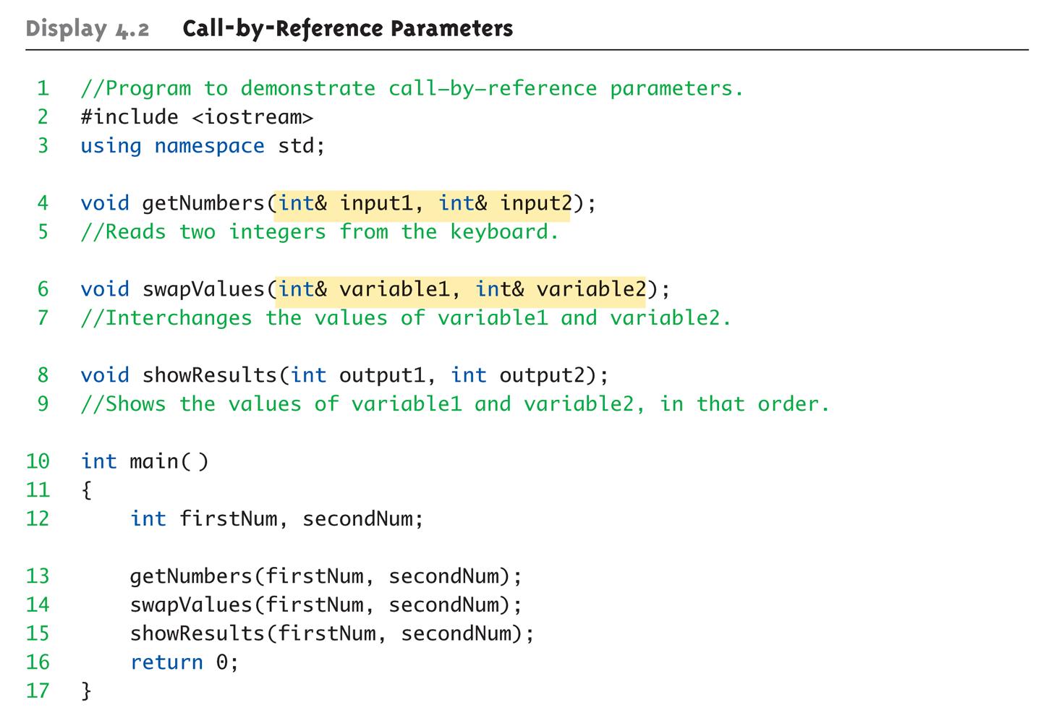
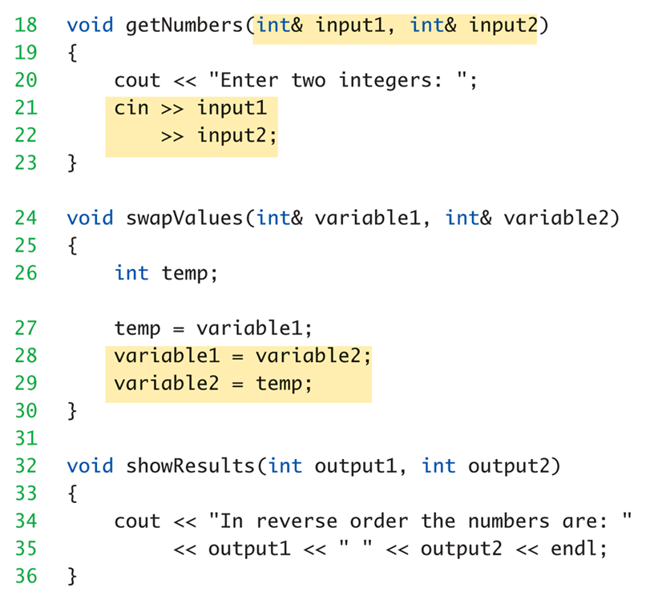
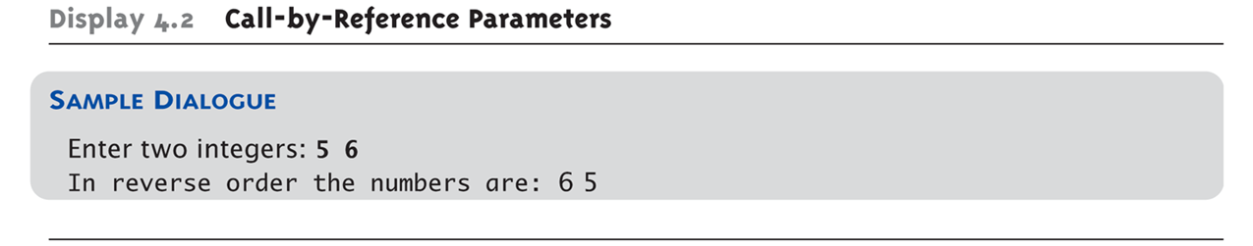
Call-By-Reference Example: Display 4.1 Call-by-Reference Parameters

Slide 11
Call-By-Reference Details
What’s really passed in?
A “reference” back to caller’s actual argument!
Refers to memory location of actual argument
Called “address”, which is a unique number referring to distinct place in memory

Slide 12
Constant Reference Parameters
Reference arguments inherently "dangerous"
Caller’s data can be changed
Often this is desired, sometimes not
To "protect" data, & still pass by reference:
Use const keyword
void sendConstRef( const int &par1, const int &par2);
Makes arguments "read-only" by function
No changes allowed inside function body
Why “const”?

Slide 13
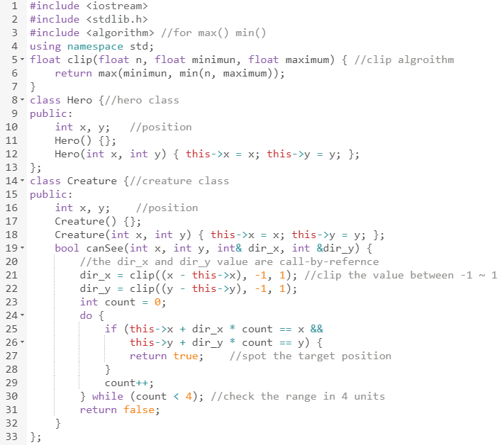
canSee():Example Code
Clip 演算法
計算生物與玩家間的方向
尋找該方向是否有主角的位置
參數dir_x 與 dir_y
在函式中被更改

Slide 14
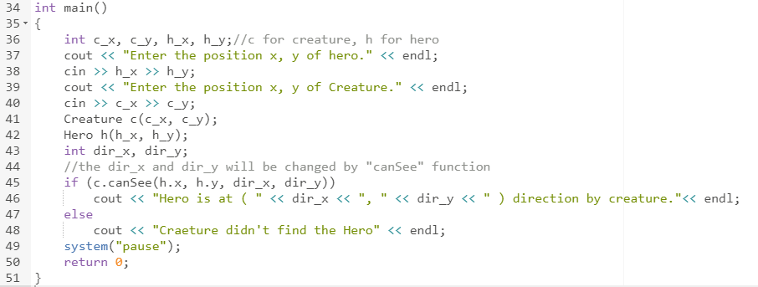
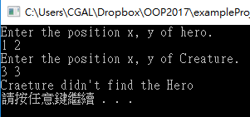


canSee():Output
輸入 1 2 3 4:
輸入 1 2 3 3:
(-1, -1) miss
(1, 2)
(-1, -1)
!
??
(3, 4)
(1, 2)
主角在生物(-1,-1)
的方向並被生物看到
主角在生物(-1,-1)
的方向並躲過生物偵查
(3, 3)

Slide 15
Mixed Parameter Lists
Can combine passing mechanisms
Parameter lists can include pass-by-value and pass-by-reference parameters
Order of arguments in list is critical: void mixedCall(int & par1, int par2, double * par3);
Function call: mixedCall(arg1, arg2, arg3);
arg1 must be integer type, is passed by reference
arg2 must be integer type, is passed by value
arg3 must be double type, is passed by pointer value

Slide 16
Choosing Formal Parameter Names
Same rule as naming any identifier:
Meaningful names!
Functions as "self-contained modules"
Designed separately from rest of program
Assigned to teams of programmers
All must "understand" proper function use
OK if formal parameter names are same as argument names
Choose function names with same rules

Slide 17
Overloading
Same function name
Different parameter lists
Two separate function definitions
Function "signature"
Function name & parameter list
Must be "unique" for each function definition
Allows same task performed on different data
e.g. std::cout::operator<<()
https://zh.cppreference.com/w/cpp/io/basic_ostream/operator_ltlt

Slide 18
Overloading Example: Average
Function computes average of 2 numbers: double average(double n1, double n2) { return ((n1 + n2) / 2.0); }
Now compute average of 3 numbers: double average(double n1, double n2, double n3) { return ((n1 + n2+ n3) / 3.0); }
Same name, two functions

Slide 19
Overloaded Average() Cont’d
Which function gets called?
Depends on function call itself:
avg = average(5.2, 6.7);
Calls "two-parameter average()"
avg = average(6.5, 8.5, 4.2);
Calls "three-parameter average()"
Compiler resolves invocation based on signature of function call
"Matches" call with appropriate function
Each considered separate function

Slide 20
Overloading Pitfall
Only overload "same-task" functions
An average() function should always perform same task, in all overloads
Otherwise, unpredictable results
C++ function call resolution:
1st: looks for exact signature
2nd: looks for "compatible" signature

Slide 21
Overloading Resolution
1st: Exact Match
Looks for exact signature
Where no argument conversion required
2nd: Compatible Match
Looks for “compatible” signature where automatic type conversion is possible:
1st with promotion (e.g., int → double)
No loss of data
2nd with demotion (e.g., double → int)
Possible loss of data

Slide 22
Overloading Resolution Example
Given following functions:
1. void f(int n, double m); 2. void f(double n, int m); 3. void f(int n, int m);
These calls: f(98, 99); → Calls #3 f(5.3, 4); → Calls #2 f(4.3, 5.2); → Calls ???
Avoid such confusing overloading

Slide 23

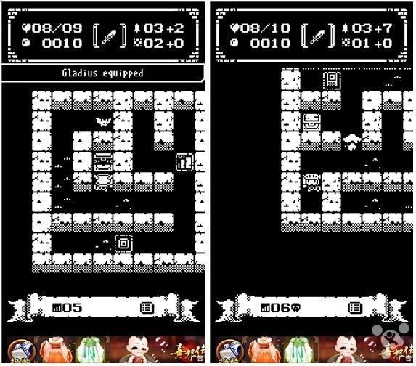
想一想
不同種類的怪物，會需要那些相同的功能呢?
如何處理?
機關與陷阱皆需要由主角觸發才會啟動
遊戲中配置生物與機關時皆不能生成在被占據的位子上

Slide 24
想一想
不同種類的怪物，會需要那些相同的功能呢?
產生，移動，攻擊，有沒有撞到牆等等
如何處理?
Function overloading with different parameter types
機關與陷阱皆需要由主角觸發才會啟動
遊戲中配置生物與機關時皆不能生成在被占據的位子上

Slide 25
想一想
Given the following overloading functions:
void eat(Rice r);
void eat(Noodle n);
void eat(Sandwich s);
Why not just name the functions like the followings?
void eatRice(Rice r);
void eatNoodle(Noodle n);
void eatSandwich(Sandwich s);
Originally proposed to make the invoking process as easy as possible!
Only needs to maintain whether the data is eatable or not.
A more elegant way for such issue in C++: overriding!

Slide 26
Call-By-Reference Example: canSee()
在生物行動時，會檢視是否看的到玩家，如果是則回傳移動方向。
檢查玩家與生物的方向
生物有視線範圍限制
生物有視線方向限制
可透過玩家與生物間的位置取得方向
生物只能看向8種方向，且有範圍限制
若生物看得到主角，則往主角方向移動

Slide 27
Overloading Example: isPositionValid
在地城遊戲許多狀況會需要檢查地格是否被占據
生成迷宮生物、主角移動、生物行為判斷
其中分為三種
只檢查是不是牆壁
額外檢查是否有”生物”或”主角”佔據該位置
額外檢查是否有”開關”或”出口”佔據該位置
建立isPositionValid()檢查該位置是否可放置物體
放置炸彈或是陷阱時需確認不是放在牆壁上
在主角移動時需檢查是否被其他東西擋住
遊戲中會需要確認機關是否被採到或觸發

Slide 28
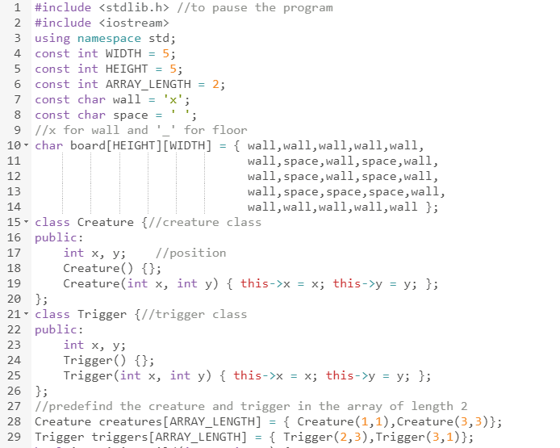
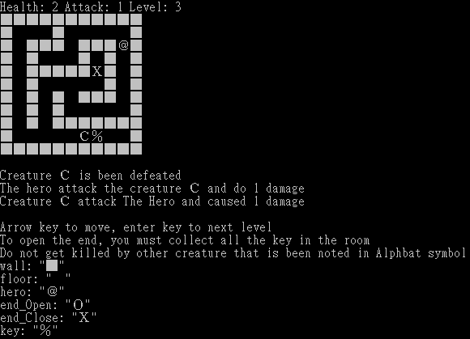
isPositionValid(): Example Code
預設版面
假設生物與機關已擺放至迷宮中
C
T
T
C

Slide 29
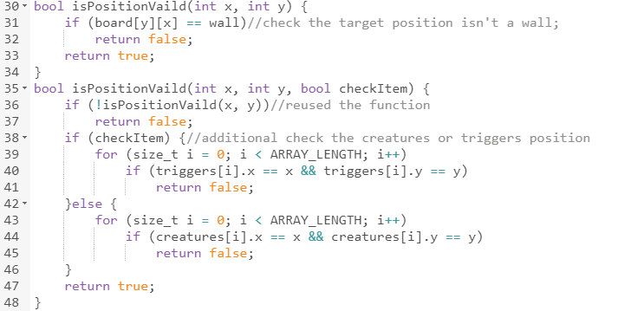
isPositionValid(): Example Code
檢查地圖位置(x, y)是否為空地
重複利用宣告過的函示
視參數檢查該位置是否被生物或機關佔據

Slide 30
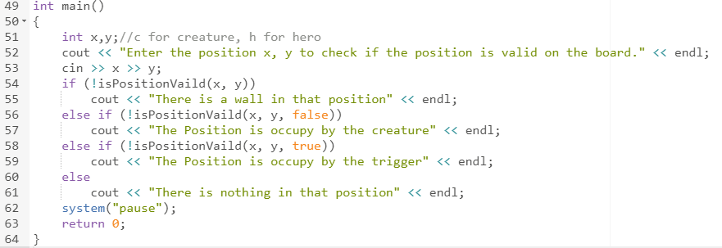
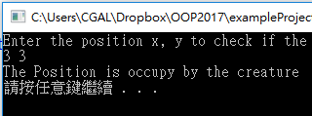
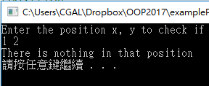
isPositionValid():Output
輸入位置(3, 3)
輸入位置(1, 2)
C
T
C
T
T
C
T
C
該位置已被生物佔據
該位置為空地

Slide 31
Automatic Type Conversion and Overloading
Numeric formal parameters typically made "double" type
Allows for "any" numeric type
Any "subordinate" data automatically promoted
int → double
float → double
char → double *More on this later!
Avoids overloading for different numeric types

Slide 32
Automatic Type Conversion and Overloading Example
double attack(double length, double damage) { return (damage / length); }
Example function calls:
hpLoss = attack(5, 20);
Converts 5 & 20 to doubles, then passes
hpLoss = attack(5.8, 20.2);
No conversion necessary
hpLoss = attack(5, 2.4);
Converts 5 to 5.0, then passes values to function

Slide 33
Default Arguments
Allows omitting some arguments
Specified in function declaration/prototype
void attack(int distance, int range = 1, int damage = 1);
Last 2 arguments are defaulted
Possible calls:
attack(2, 4, 6); //All arguments supplied
attack(3, 5); //height defaulted to 1
attack(7); //width & height defaulted to 1
Ex：std::string::find()
https://zh.cppreference.com/w/cpp/string/basic_string/find

Slide 34
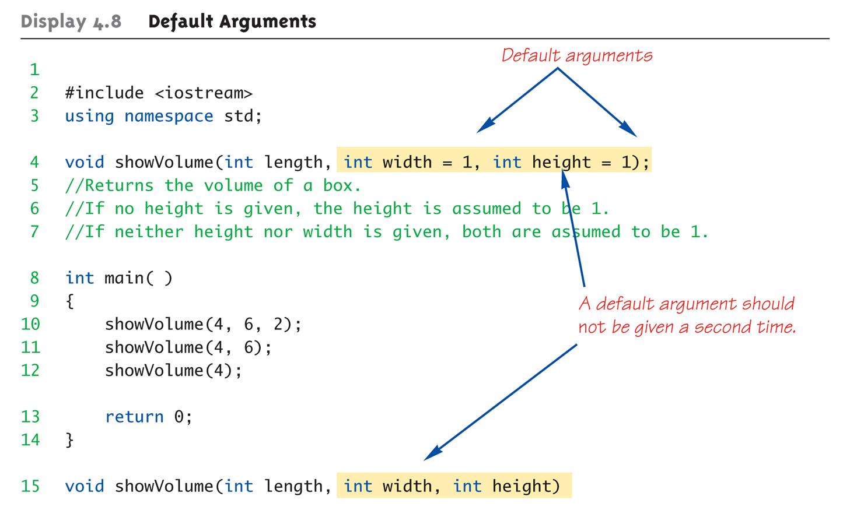
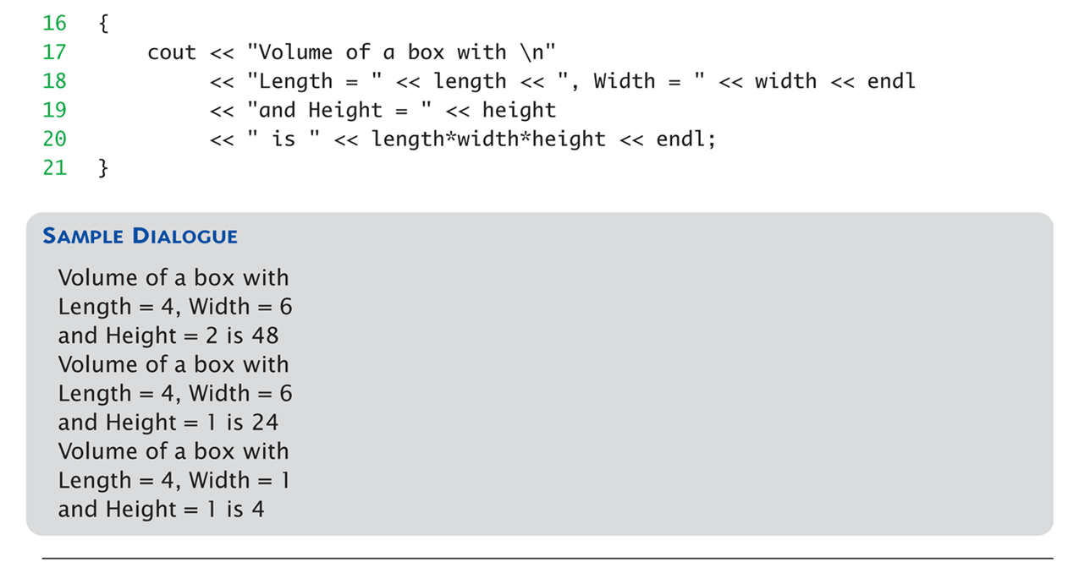
Default Arguments Example: Display 4.1 Default Arguments

Slide 35
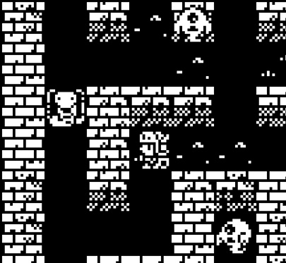
Default Arguments Example: 產生生物
在每個關卡的開始時會產生定量的生物在放置在場上中。
建立createCreature()將生物放置在迷宮中
建立在迷宮中的生物要有擺放位置
已有生物的位置不能生成新生物
牆壁等無法穿越之障礙不能生成新生物
無法生成負數或超過迷宮負荷量的生物數量
使用Default Arguments 處理例外狀況
X
C
X
C
O
生物不可生成在非法的位置
遊戲隨關卡進行生物也越多

Slide 36
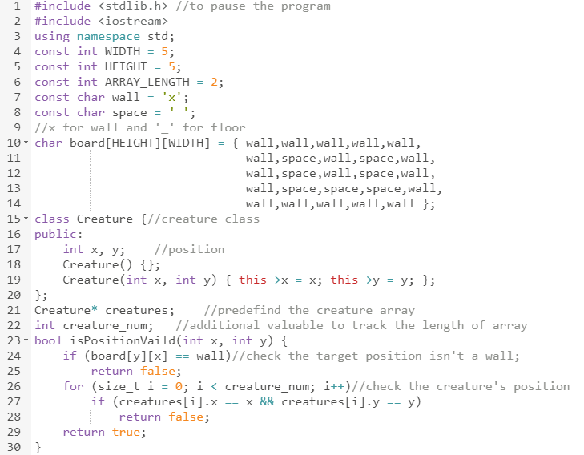
createCreature:Example Code
預設版面
擺設生物時，需要用到前述的範例判斷位置是否可擺放

Slide 37
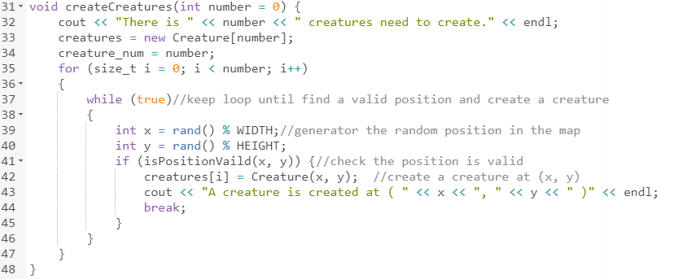
createCreature:Example Code
產生需要數量的生物
隨機產生位置，若該位置非法則再生一組位置

Slide 38
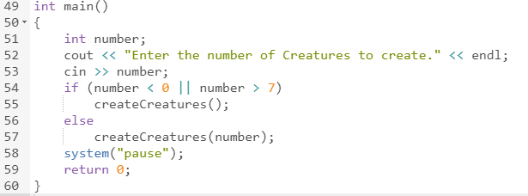
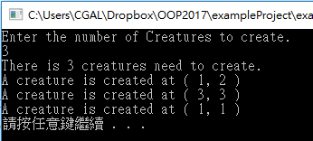
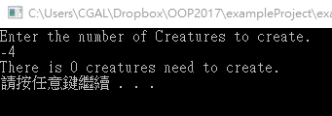
createCreature:Output
若輸入發生例外，
呼叫default argument 函式
輸入3:產生三隻生物
輸入-4:呼叫預設參數，產生零隻生物
C
C
C

Slide 39
Testing and Debugging Functions
Many methods:
Lots of cout statements
In calls and definitions
Used to "trace" execution
Compiler Debugger
Environment-dependent
assert Macro
Early termination as needed
Stubs and drivers
Incremental development

Slide 40
The assert Macro
Assertion: a true or false statement
Used to document and check correctness
Preconditions & Postconditions
Typical assert use: confirm their validity
Syntax: assert(<assert_condition>);
No return value
Evaluates assert_condition
Terminates if false, continues if true
Predefined in library <cassert>
Macros used similarly as functions

Slide 41
An assert Macro Example
Given Function Declaration: void computeCoin(int coinValue, int& number, int& amountLeft);
//Precondition: 0 < coinValue < 100, 0 <= amountLeft <100 //Postcondition: number set to max. number of coins
Check precondition:
assert ((0 < currentCoin) && (currentCoin < 100) && (0 <= currentAmountLeft) && (currentAmountLeft < 100));
If precondition not satisfied, i.e., condition is false → program execution terminates!

Slide 42
An assert Macro Example Cont’d
Useful in debugging
Stops execution so problem can be investigated

Slide 43
assert On/Off
Preprocessor provides means
#define NDEBUG #include <cassert>
Add "#define" line before #include line
Turns OFF all assertions throughout program
Remove "#define" line (or comment out)
Turns assertions back on

Slide 44
Stubs and Drivers
Separate compilation units
Each function designed, coded, tested separately
Ensures validity of each unit
Divide & Conquer
Transforms one big task into smaller, manageable tasks
But how to test independently?
Driver programs

Slide 45
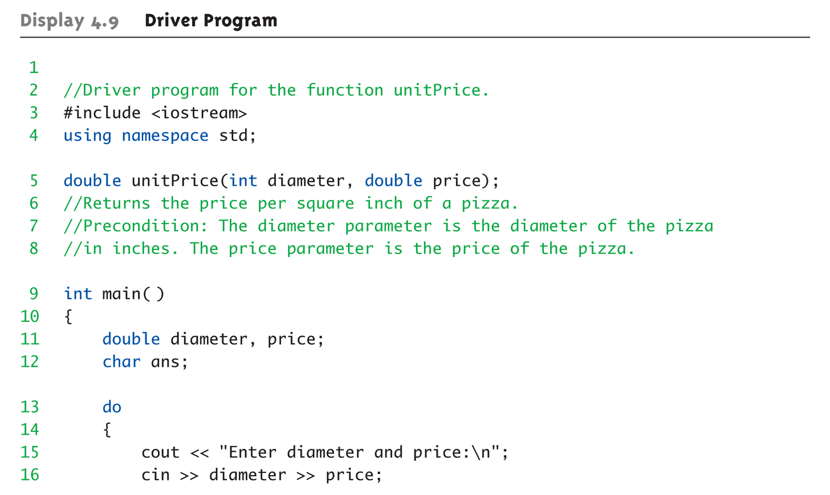
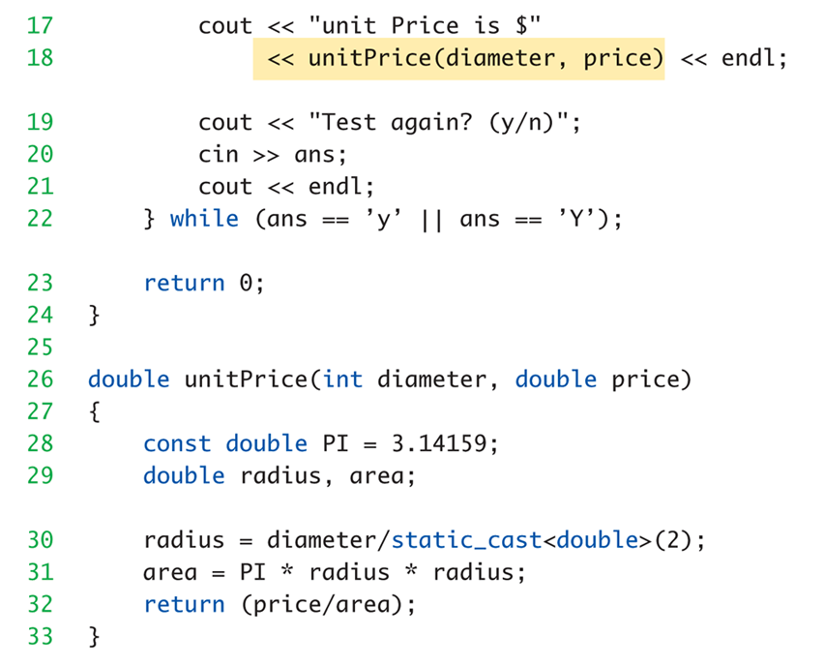
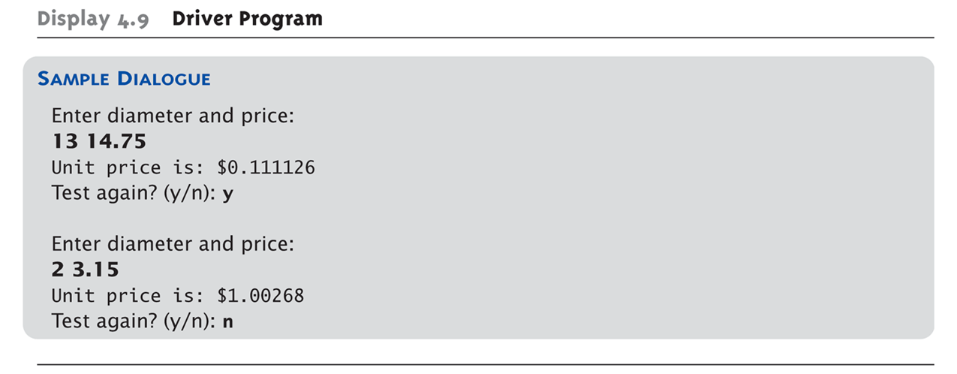
Driver Program Example: Display 4.9 Driver Program

Slide 46
Stubs
Develop incrementally
Write "big-picture" functions first
Low-level functions last
"Stub-out" functions until implementation
Example: double unitPrice(int diameter, double price) { return (9.99); // not valid, but noticeably a "temporary" value }
Calls to function will still "work"

Slide 47
Fundamental Testing Rule
To write "correct" programs
Minimize errors, "bugs"
Ensure validity of data
Test every function in a program where every other function has already been fully tested and debugged
Avoids "error-cascading" & conflicting results

Slide 48
Summary 1
Formal parameter is placeholder, filled in with actual argument in function call
Call-by-value parameters are "local copies" in receiving function body
Actual argument cannot be modified
Call-by-reference passes memory address of actual argument
Actual argument can be modified
Argument MUST be variable, not constant

Slide 49
Summary 2
Multiple definitions of same function name possible: called overloading
Default arguments allow function call to "omit" some or all arguments in list
If not provided 🡪 default values assigned
assert macro initiates program termination if assertions fail
Functions should be tested independently
As separate compilation units, with drivers

