Slide 1
Chapter 5
Arrays

Slide 2
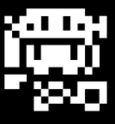
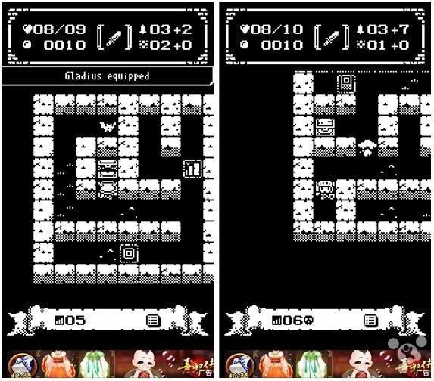
想一想
遊戲中有許多類型相似的物體，像是什麼？
要如何有效率的控制同類，但是，重複的行為與資料?
遊戲中每個關卡多有複數的生物、機關等物體

Slide 3
想一想
遊戲中有許多類型相似的物體，像是什麼？
迷宮結構。
生物群。
機關。
…。
要如何有效率的控制同類，但是，重複的行為與資料?
將相同性質物件用Array儲存並利用迴圈輪流Call其中function

Slide 4
Learning Objectives
Introduction to Arrays
Declaring and referencing arrays
For-loops and arrays
Arrays in memory
Arrays in Functions
Arrays as function arguments, return values
Programming with Arrays
Partially Filled Arrays, searching, sorting
Multidimensional Arrays

Slide 5
Introduction to Arrays
Array definition:
A collection of data of same type
First "aggregate" data type
Means "grouping"
int, float, double, and char are simple data types
Used for lists of like items
Test scores, temperatures, names, etc.
Avoids declaring multiple simple variables.
Can manipulate "list" as one entity.

Slide 6
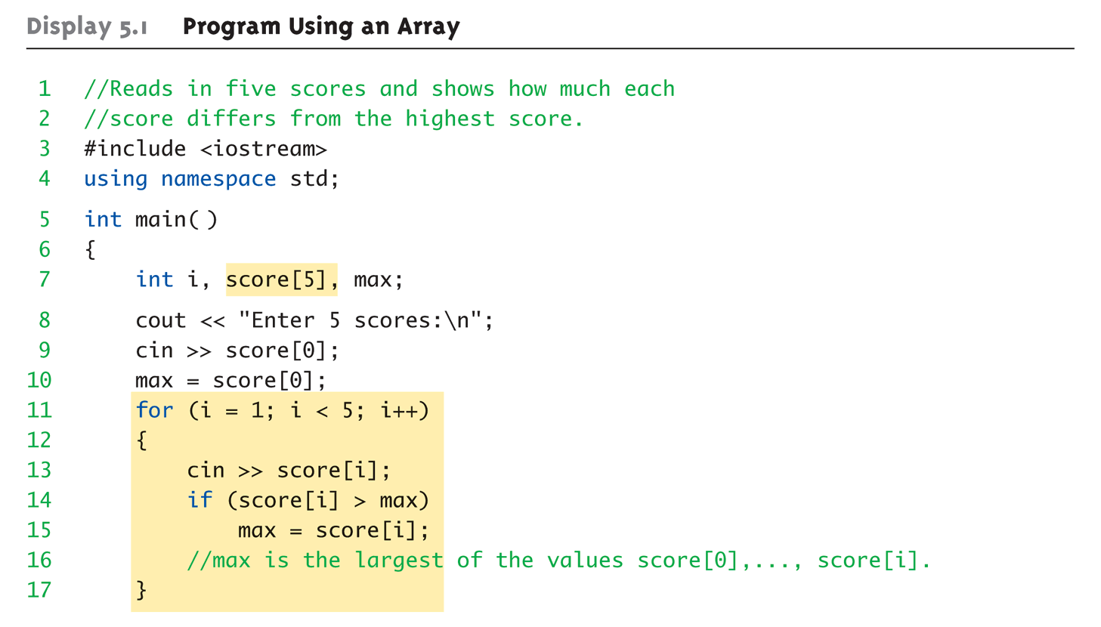
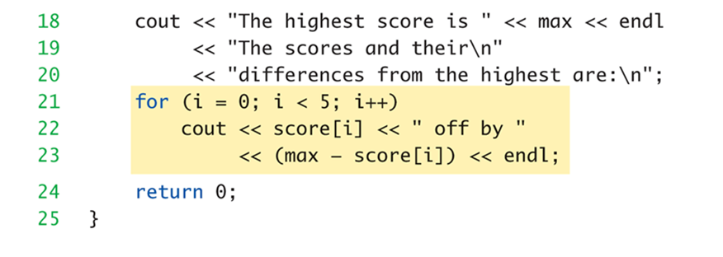
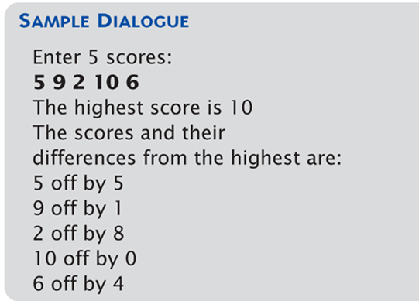
Array Program Example: Display 5.1 Program Using an Array

Slide 7
Declaring Arrays
Declare the array → allocates memory Creature creatures[5];
Declares array of 5 integers named "score"
Similar to declaring five variables:
Individual parts called many things:
creatures[0], creatures[1], …
Indexed or subscripted variables
"Elements" of the array
Value in brackets called index or subscript
Numbered from 0 to size – 1
Always use defined/named constant for array size
Example: const int NUMBER_OF_CREATRURES = 3; Creature creatures[NUMBER_OF_CREATURES];
Improves readability, versatility, and maintainability

Slide 8
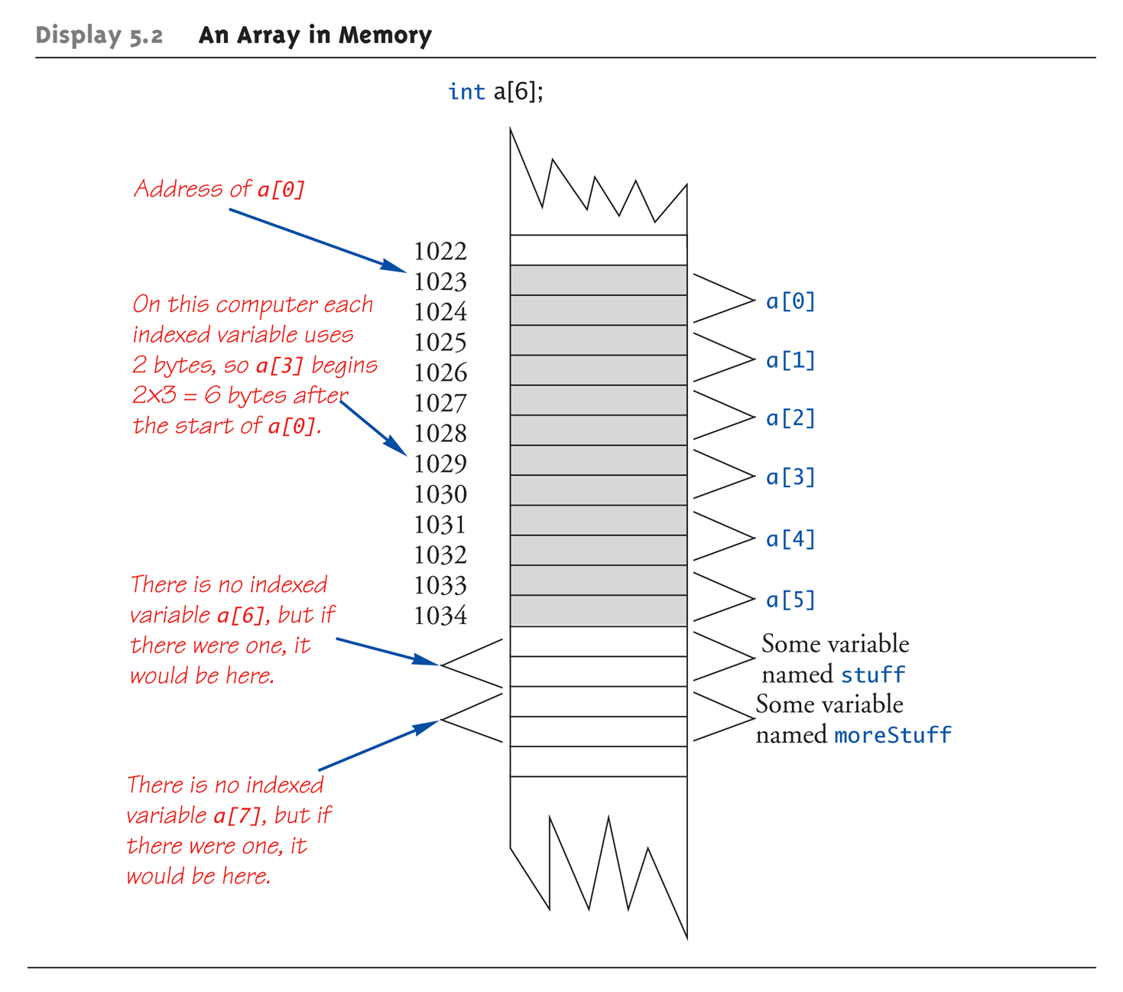
An Array in Memory
Recall simple variables:
Allocated memory in an "address"
Array declarations allocate memory for entire array
Sequentially-allocated
Means addresses allocated "back-to-back"
Allows indexing calculations
Simple "addition" from array beginning (index 0)

Slide 9
Accessing Arrays
Access using index/subscript
cout << creatures[3].health;
Note two uses of brackets:
In declaration, specifies SIZE of array
Anywhere else, specifies a subscript
Size, subscript need not be literal
Creature creatures[NUMBER_OF_CREATRURES];
creatures[n+1] = 99;
If n is 2, identical to: creatures[3]
No size declaration with non-constant variable
Powerful storage mechanism
Can issue command like:
"Do this to i^{th} indexed variable“ where i is computed by program
"Display all elements of array score"
"Fill elements of array score from user input"
"Find highest/lowest value in array score"

Slide 10
for-loops with Arrays
Natural counting loop
Naturally works well "counting through" elements of an array
Example:
int f[100];
f[0] = 1, f[1] = 1;
for (int idx = 2; idx<100; idx++){ f[idx] = f[idx-1] + f[idx-2]; }
Loop control variable (idx) counts from [2, 100)

Slide 11
Major Array Pitfall
C++ array indexes always start with zero!
Zero is the "first" number to computer scientists
C++ will "let" you go beyond range
Unpredictable results
Compiler will not detect these errors!
Up to programmer to "stay in range"

Slide 12
Major Array Pitfall Example
Indexes range from 0 to (array_size – 1)
Example: double temperature[24]; // 24 is array size // Declares array of 24 double values called // temperature
They are indexed as: temperature[0], temperature[1] … temperature[23]
Common mistake: temperature[24] = 5;
Index 24 is "out of range"!
No warning, possibly disastrous results

Slide 13
Uses of Defined Constant
Use everywhere size of array is needed
In for-loop for traversal: for (idx = 0; idx < NUMBER_OF_STUDENTS; idx++){ // Manipulate array }
In calculations involving size: lastIndex = (NUMBER_OF_STUDENTS – 1);
When passing array to functions (later)
If size changes → requires only ONE change in program!

Slide 14
Initializing Arrays (1 of 2)
As simple variables can be initialized at declaration: int health = 20;// 20 is initial value
Arrays can as well: int canvasNum[3] = {2, 3, 1};
Equivalent to following: int canvasNum[3]; canvasNum[0] = 2; canvasNum[1] = 3; canvasNum[2] = 1;
If fewer values than size supplied:
Fills from beginning
Fills "rest" with zero of array base type
Remember that that following expressions are not equivalent!
int children[3]; // memory allocated but not initialized
int children[3] = {}; // all set to 0

Slide 15
Initializing Arrays (2 of 2)
If array-size is left out
Declares array with size required based on number of initialization values
Example: int canvasNum[] = {2, 3, 1};
Allocates array canvas to size 3

Slide 16
Arrays in Functions
As arguments to functions
Indexed variables
An individual “element” of an array can be function parameter
Entire arrays
All array elements can be passed as "one entity“
For example
int main (int argc, char **argv)
As return value from function
Can be done → chapter 10

Slide 17
Indexed Variables as Arguments
Indexed variable handled same as simple variable of array base type
Given this function declaration: bool canSee(double distance);
And these declarations: int length; double distance; double creature[2].length;
Can make these function calls: canSee(length); //converted to double canSee(distance); //is double canSee(creature[2].length); //is double

Slide 18
Subtlety of Indexing
Consider: canSee(creature[i]);
Value of i is determined first
It determines which indexed variable is sent
canSee(creature[i*5]);
Perfectly legal, from compiler’s view
Programmer responsible for staying "in-bounds" of array

Slide 19
Entire Arrays as Arguments
Formal parameter can be entire array
Argument then passed in function call is array name
Called "array parameter"
Send size of array as well
Typically done as the second parameter
Simple int type formal parameter
Example
int canvasNum[5], numberOfCanvas = 5; fillCanvas(canvasNum, numberOfCanvas);
1st argument is entire array
2nd argument is integer value
Note no brackets in array argument!

Slide 20
Array as Argument: How?
What’s really passed?
Think of array as 3 "pieces"
Address of first indexed variable ( creatures[0])
Array base type
Size of array
Only 1st piece is passed!
Just the beginning address of array
Very similar to "pass-by-reference"

Slide 21
Array Parameters
May seem strange
No brackets in array argument
Must send size separately
One nice property:
Can use SAME function to fill any size array!
Exemplifies "re-use" properties of functions
Example: int length[5], distance[10]; canAllSee(distance, 10); canAllSee(length, 5);

Slide 22
The const Parameter Modifier
Recall: array parameter actually passes address of 1st element
Similar to pass-by-reference
Function can then modify array!
Often desirable, sometimes not!
Protect array contents from modification
Use "const" modifier before array parameter
Called "constant array parameter"
Tells compiler to "not allow" modifications

Slide 23
Functions that Return an Array
Functions cannot return arrays same way simple types are returned
Requires use of a "pointer"
Will be discussed in chapter 10…

Slide 24

Example: 機關觸發
當主角移動時，每個機關都要檢查是否被主角觸發。
主角是否與機關同一個位置
觸發後的機關會執行處發事件，並改變觸發狀態
當主角與機關位置相同時觸發該機關

Slide 25
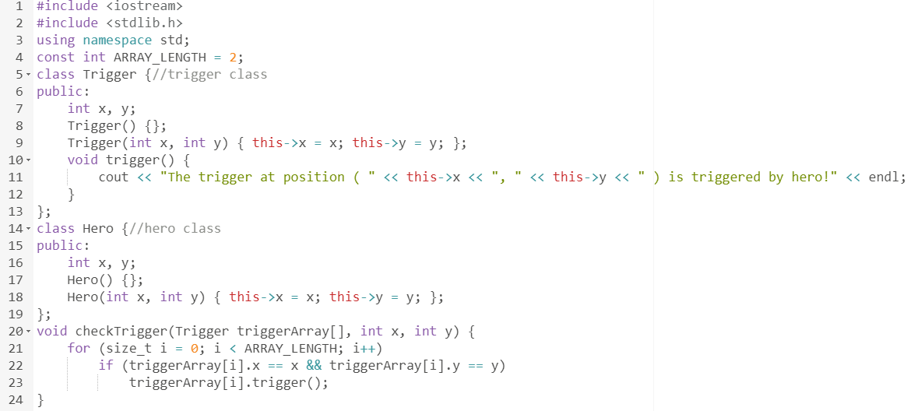
Example: 機關觸發
機關類別
主角類別
將陣列作為參數擺入函式中處理
檢查機關與主角位置是否相同。如果是，觸發事件。

Slide 26
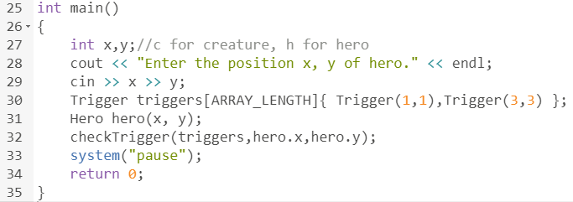
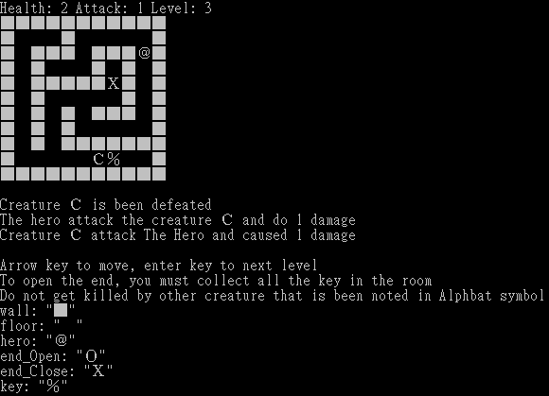
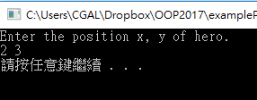
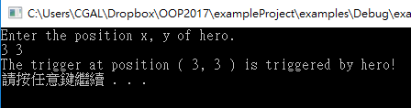
Example: 機關觸發
預設機關位置
使用者輸入主角位置
將陣列作為參數擺入函式中處理
主角位置與機關錯開
主角踩在機關上並觸發機關

Slide 27
Multidimensional Arrays
Arrays with more than one index
char canvas[30][100];
Two indexes: An "array of arrays"
Visualize as: canvas[0][0], canvas[0][1], …, canvas[0][99] canvas[1][0], canvas[1][1], …, canvas[1][99] … canvas[29][0], canvas[29][1], …, canvas[29][99]
C++ allows any number of indexes
Typically no more than two

Slide 28
Multidimensional Array Parameters
Similar to one-dimensional array
1st dimension size not given
Provided as second parameter
2nd dimension size IS given
Example: void DisplayCanvas(const char p[][100], int length) { for (int index1=0; index1< length; index1++) { for (int index2=0; index2 < 100; index2++) cout << p[index1][index2]; cout << endl; } }

Slide 29
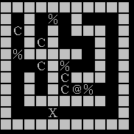
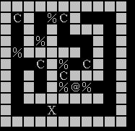
Example: 迷宮資訊管理
迷宮中的版圖資訊可用字元符號儲存成二維陣列並表示。
用x, y兩個變數存取在(x, y)位置的版圖資料
在需要用迴圈繞行迷宮資訊時，可用兩層迴圈處理
在Console版中，畫面的呈現是由字元所表示
將邊界填滿牆壁後的結果

Slide 30
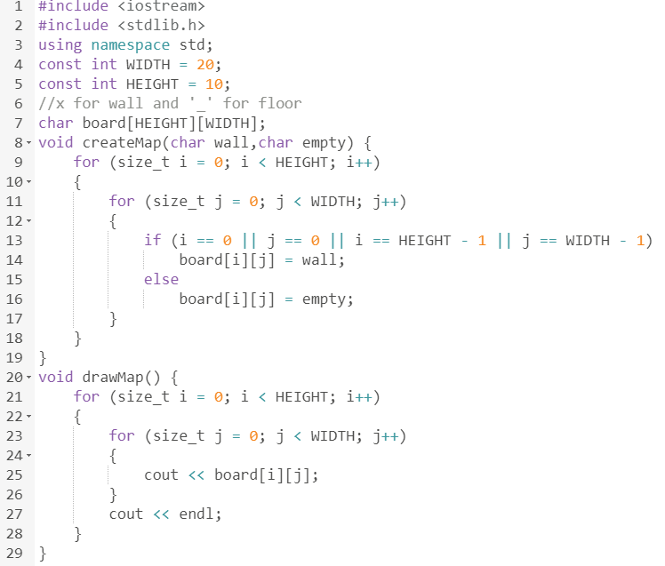
Example: 迷宮資訊管理
設定版圖大小
宣告二維陣列
產生迷宮外框，使用兩層迴圈繞行陣列
輸出顯示迷宮資料，使用兩層迴圈繞行陣列

Slide 31
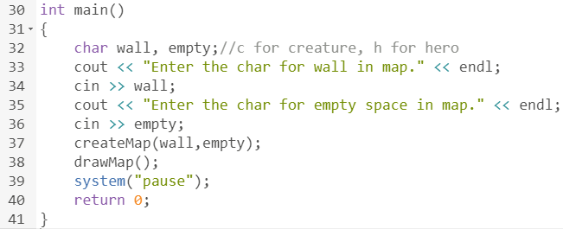
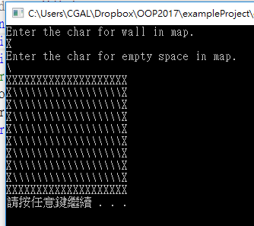
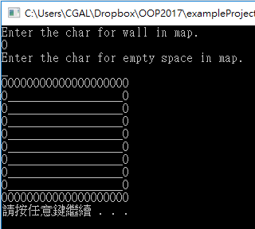
Example: 迷宮資訊管理
使用者輸入牆壁與空地使用的符號
產生並輸出迷宮
用X代表牆壁
用\代表空地
用O代表牆壁
用_代表空地

Slide 32
Example: 地圖結構
遊戲在創建時會在會產生一地圖，而其中可能有許多地圖物件，等著主角觸發。
地圖要有辦法清楚分辨牆以及可行走範圍的差別
人不可以穿牆，其與地圖的互動有一定的限制。
在主角做完行為後，須檢查所有互動是否合法。
地圖的生成可以為隨機，亦可做指定 (動態陣列)
指定的部分包含物件位置，地圖範圍等

Slide 33
Example: 機關
遊戲在創建時會在地圖中生成複數的機關(Trigger)，等著主角觸發。
機關須放置在迷宮中，可經過的區域。
機關與機關之間，不能擺放在同一個位置。
在主角做完行為後，須檢查所有機關是否被觸發。
觸發前 => 觸發後
機關會擺設在地圖中隨機的位置

Slide 34
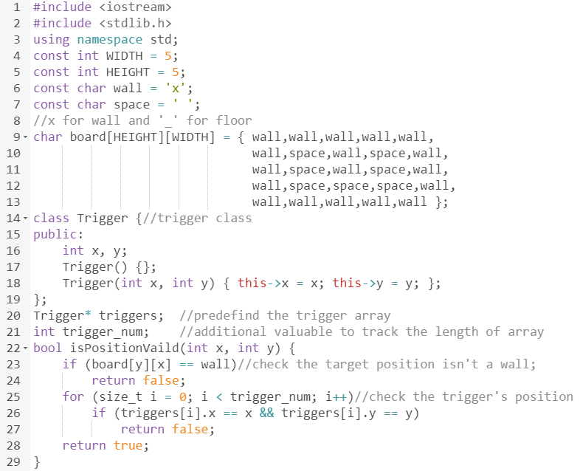
Example: 機關
預設版面
機關類別
管理機關的機關動態陣列
判斷位置是否可擺設機關

Slide 35
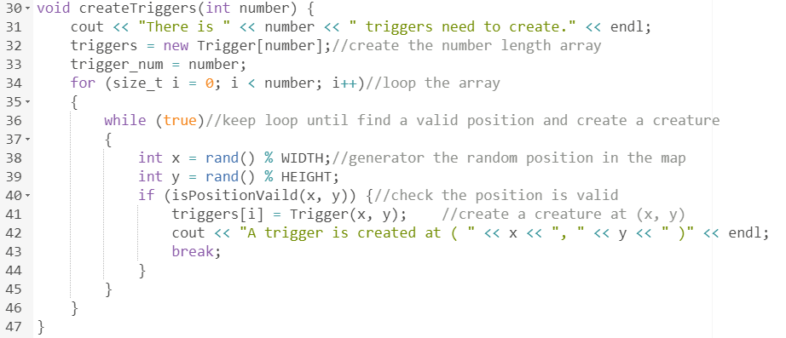
Example: 機關
產生N個機管並擺設在迷宮中
宣告陣列大小
用迴圈繞行陣列元素
初始化陣列元素

Slide 36
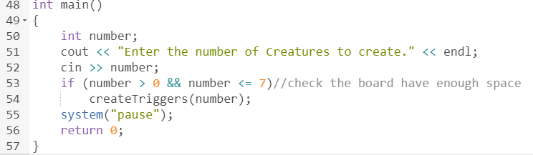
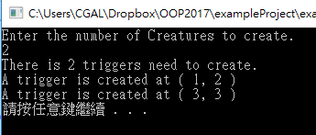
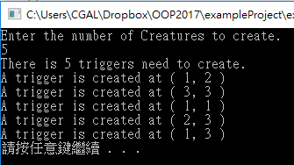
Example: 機關
使用者輸入要產生多少個機關
產生兩個機關
產生五個機關

Slide 37
Example: 機關
遊戲在創建時會在地圖中，生成複數的機關(Trigger)，等著主角觸發。
Trigger triggers = Trigger[TRIGGER_NUMBER];//宣告陣列
for(int i = 0; i< TRIGGER_NUMBER; i++){
int x, y;
getValidPosition(x, y);//取得合法位置
triggers[i] = Trigger(x, y);//初始化物件
}
機關會擺設在地圖中隨機的位置

Slide 38
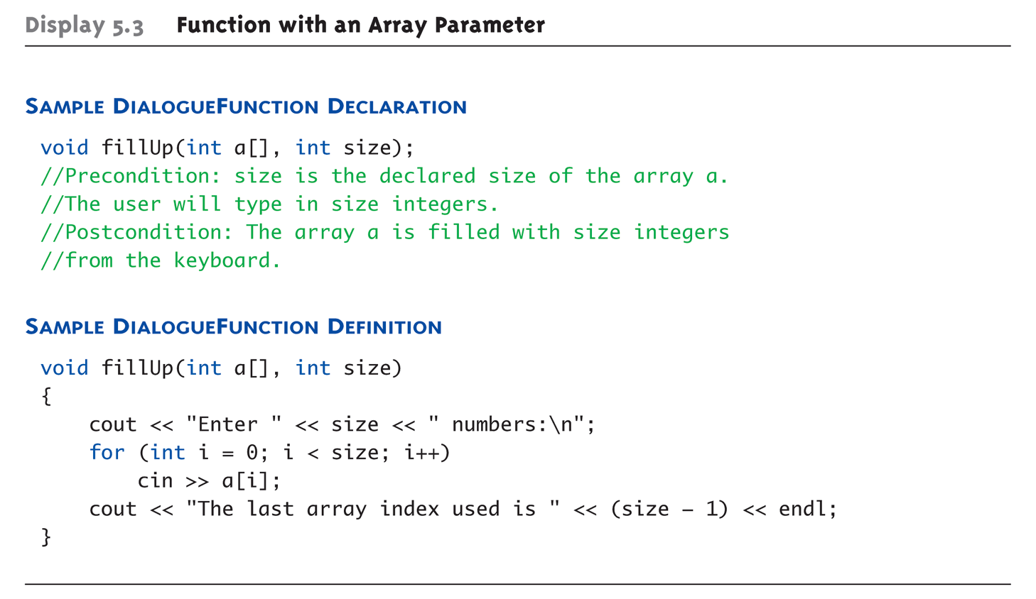
Entire Array as Argument Example: Display 5.3 Function with an Array Parameter
int score[5], numberOfScores = 5; fillup(score, numberOfScores);
1st argument is entire array
2nd argument is integer value

Slide 39
Programming with Arrays
Plenty of uses
Partially-filled arrays
Must be declared some "max size"
Sorting
Searching

Slide 40
Partially-filled Arrays
Difficult to know exact array size needed
Must declare to be the largest possible size
Must then keep "track" of valid data in array
Additional "tracking" variable needed
int numberUsed;
Tracks current number of elements in array

Slide 41
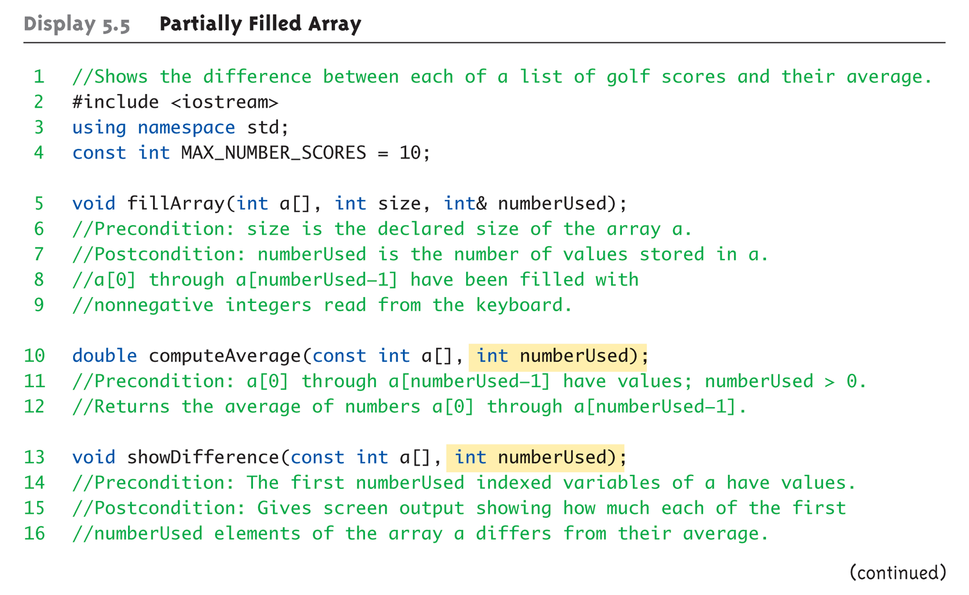
Partially-filled Arrays Example: Display 5.5 Partially Filled Array (1 of 5)

Slide 42
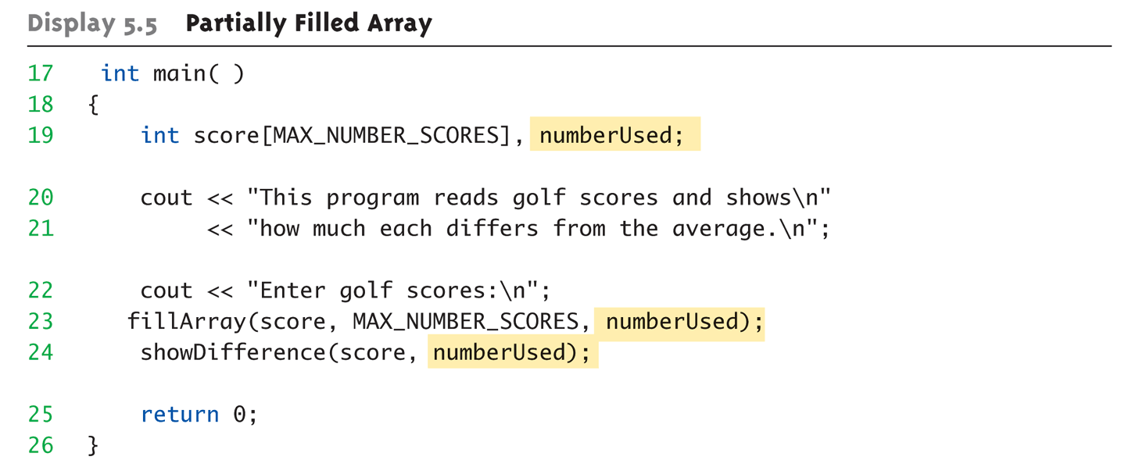
Partially-filled Arrays Example: Display 5.5 Partially Filled Array (2 of 5)

Slide 43
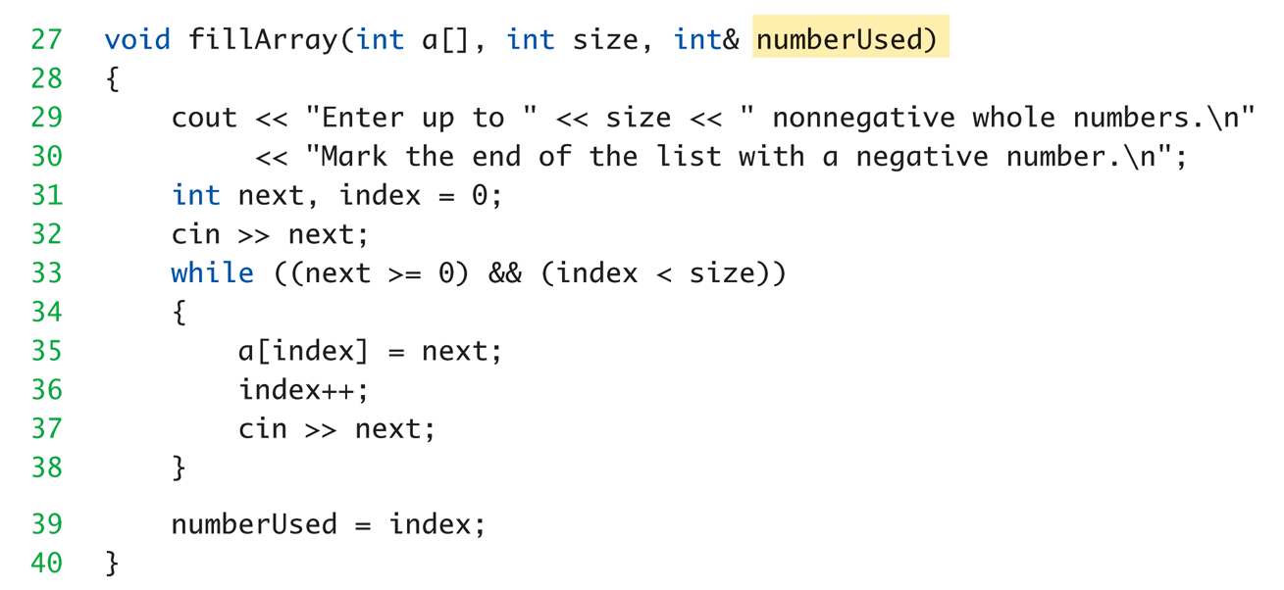
Partially-filled Arrays Example: Display 5.5 Partially Filled Array (3 of 5)

Slide 44
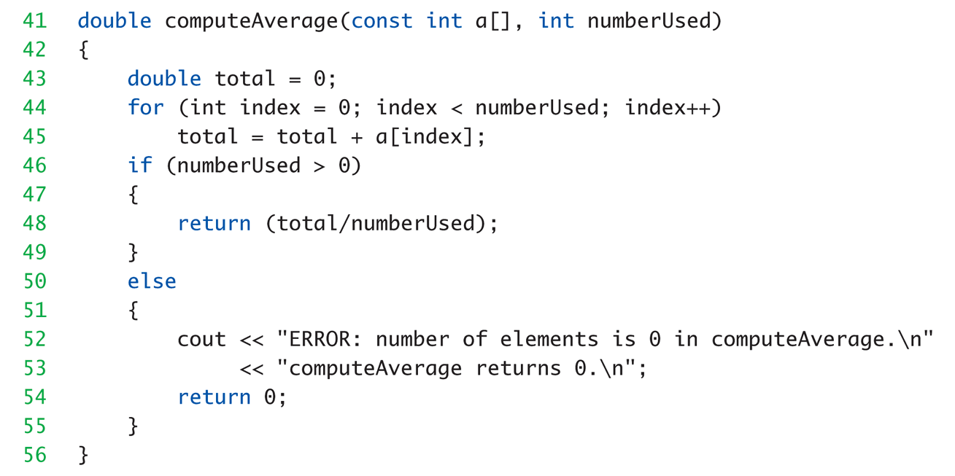
Partially-filled Arrays Example: Display 5.5 Partially Filled Array (4 of 5)

Slide 45
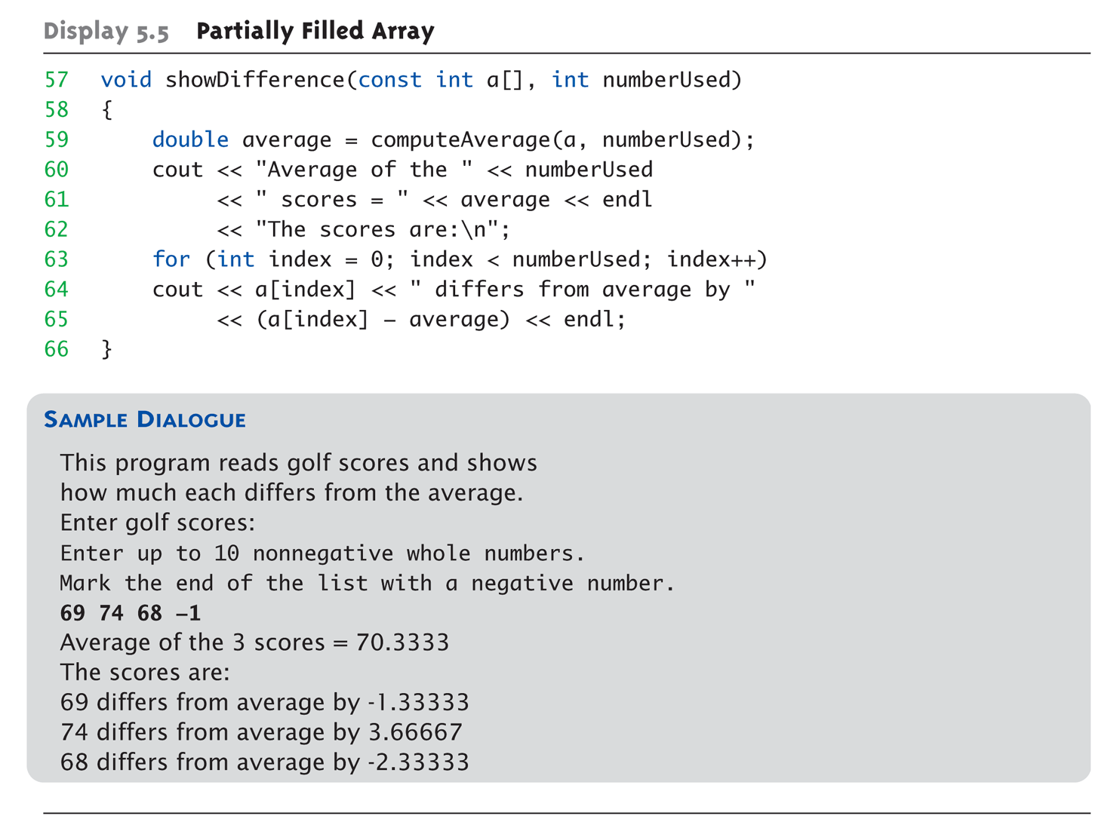
Partially-filled Arrays Example: Display 5.5 Partially Filled Array (5 of 5)

Slide 46
Example: 管理陣列
遊戲中的每一關放置的機關數量都不一樣，因此需未陣列配置足夠長度的記憶體，省去重複宣告陣列的麻煩。
每一關產生的機關會越來越多
遊戲中能產生的機關數有最高上限
重複宣告陣列不僅會造成記憶體的問題，對陣列管理也造成麻煩。

Slide 47
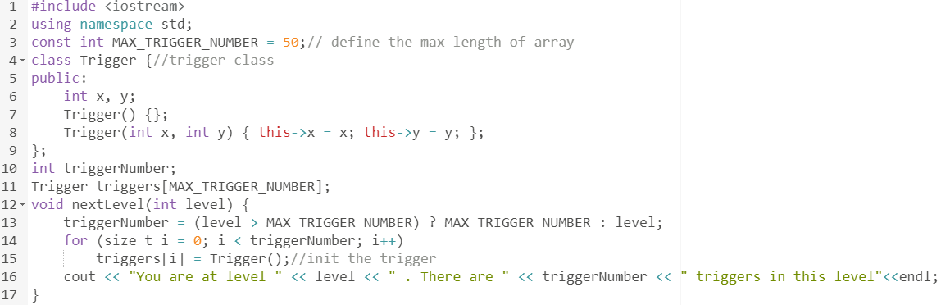
Example: 管理陣列
設定陣列最大值
使用變數紀錄實際用到的機關數量
每進一關，用到的機關數量增加，需要初始化的陣列元素也會增加。

Slide 48
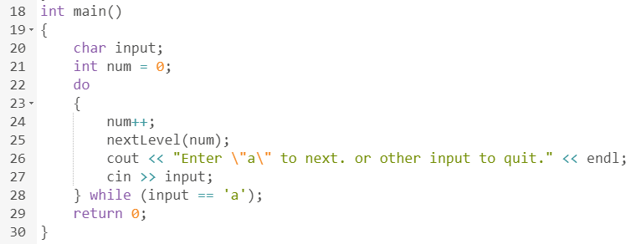
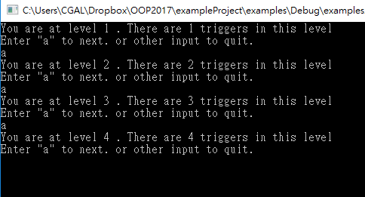
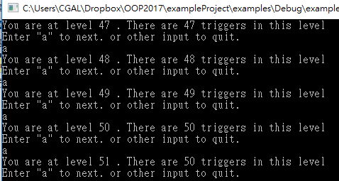
Example: 管理陣列
使用者輸入 a 查看下一關產生的機關數量
前幾關中，機關的數量隨關卡數增加
超過50關後，機關的數量不再增加

Slide 49
Global Constants vs. Parameters
Constants typically made "global"
Declared above main()
Functions then have scope to array size constant
No need to send as parameter then?
Technically yes
Why should we anyway?
Function definition might be in separate file
Function might be used by other programs!

Slide 50
Search An Array
//Searches a partially filled array of nonnegative integers.
#include <iostream>
using namespace std;
const int DECLARED_SIZE = 20;
void fillArray(int a[], int size, int& numberUsed);
//Precondition: size is the declared size of the array a.
//Postcondition: numberUsed is the number of values stored in a.
//a[0] through a[numberUsed-1] have been filled with
//nonnegative integers read from the keyboard.
int search(const int a[], int numberUsed, int target);
//Precondition: numberUsed is <= the declared size of a.
//Also, a[0] through a[numberUsed -1] have values.
//Returns the first index such that a[index] == target,
//provided there is such an index, otherwise returns -1.

Slide 51
Search An Array
int main( )
{
int arr[DECLARED_SIZE], listSize, target, result;
fillArray(arr, DECLARED_SIZE, listSize);
char ans;
do
{
cout << "Enter a number to search for: ";
cin >> target;
result = search(arr, listSize, target);
if (result == -1)
cout << target << " is not on the list.\n";
else
cout << target << " is stored in array position " << result << endl<< "(Remember: The first position is 0.)\n";
cout << "Search again?(y/n followed by return): ";
cin >> ans;
}while ((ans != 'n') && (ans != 'N'));
cout << "End of program.\n";
return 0;
}

Slide 52
Search An Array
void fillArray(int a[], int size, int& numberUsed)
{
cout << "Enter up to " << size << " nonnegative whole numbers.\n"
<< "Mark the end of the list with a negative number.\n";
int next, index = 0;
cin >> next;
while ((next >= 0) && (index < size))
{
a[index] = next;
index++;
cin >> next;
}
numberUsed = index;
}

Slide 53
Search An Array
int search(const int a[], int numberUsed, int target)
{
int index = 0;
bool found = false;
while ((!found) && (index < numberUsed))
if (target == a[index])
found = true;
else
index++;
if (found)
return index;
else
return -1;
}

Slide 54
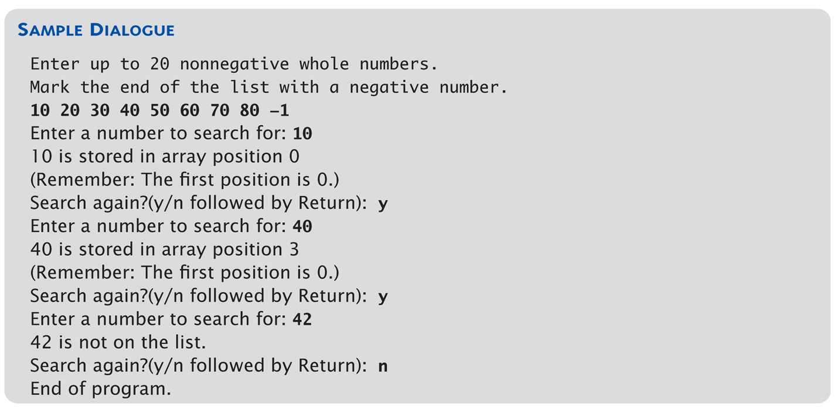
Display 5.6 Searching an Array

Slide 55
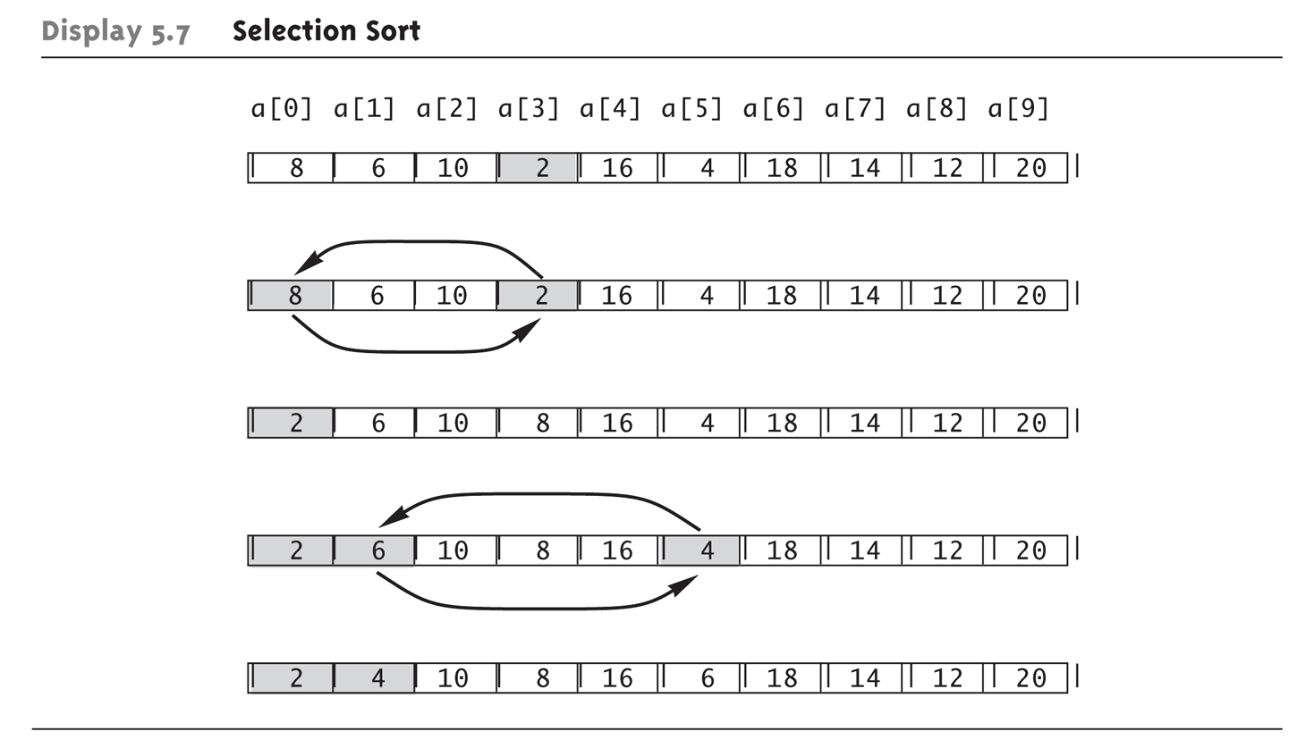
Sorting an Array: Display 5.7 Selection Short
Selection Sort Algorithm

Slide 56
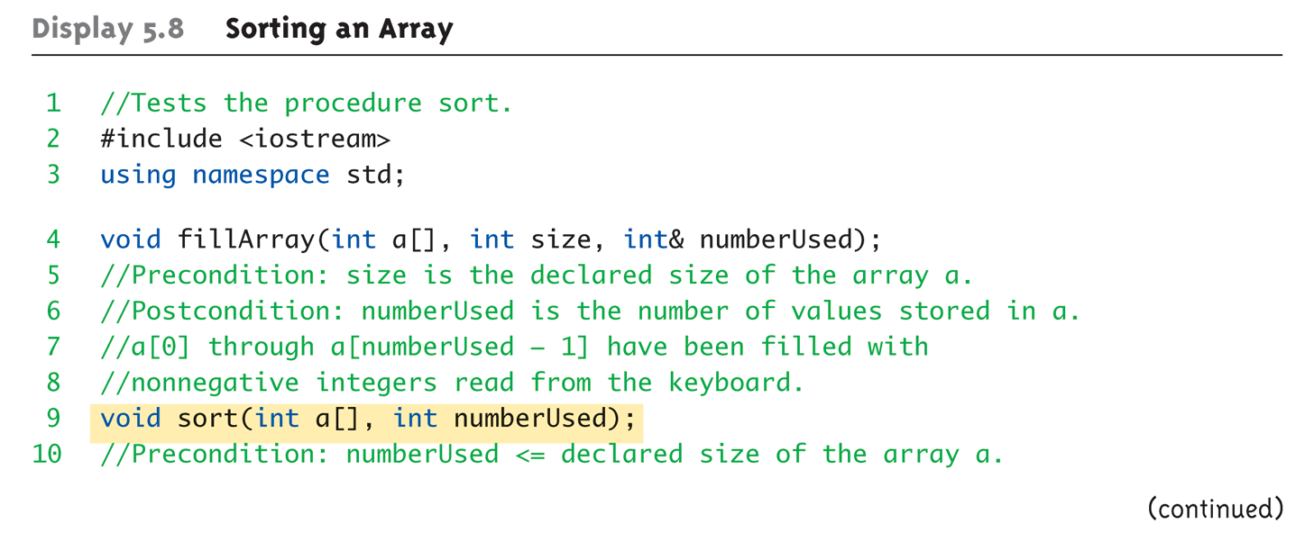
Sorting an Array Example: Display 5.8 Sorting an Array (1 of 4)

Slide 57
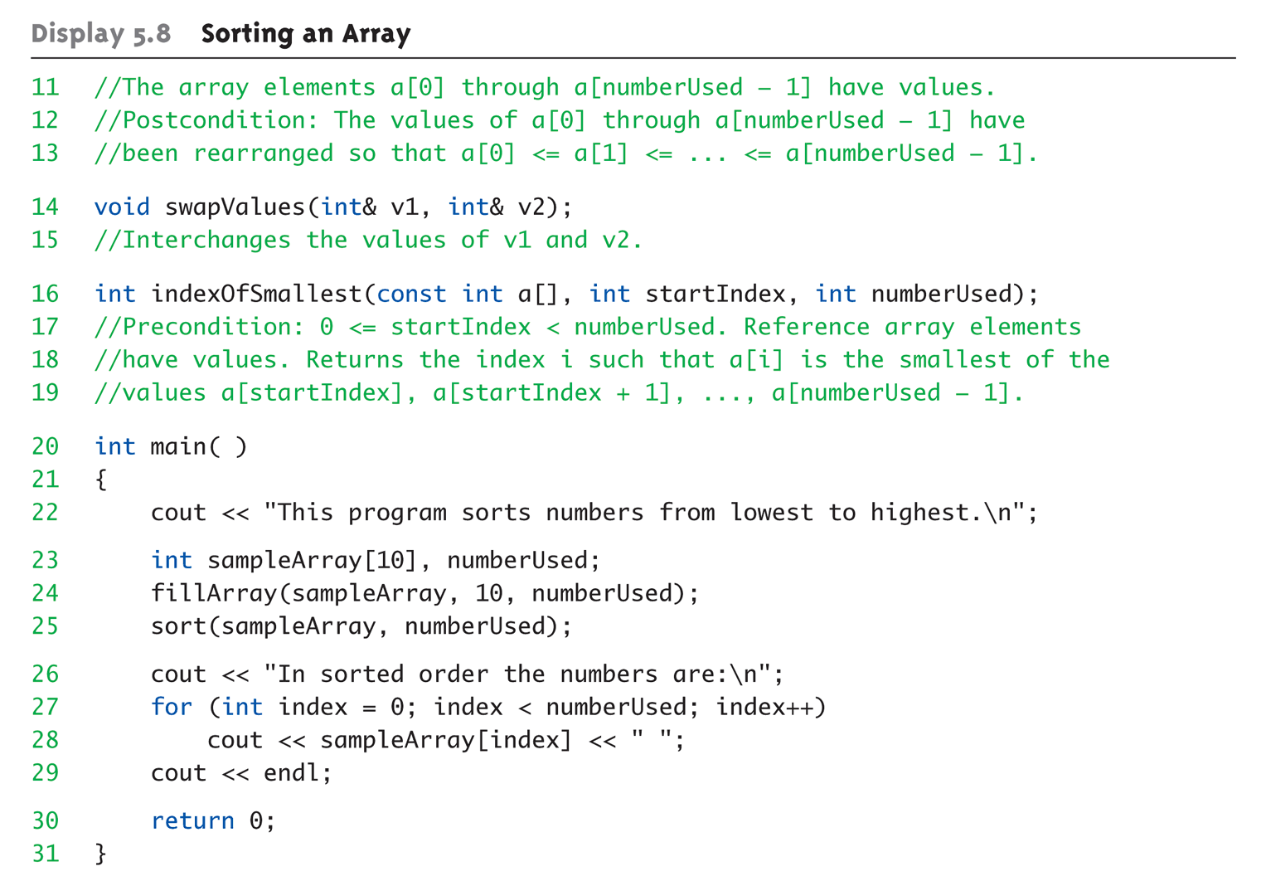
Sorting an Array Example: Display 5.8 Sorting an Array (2 of 4)

Slide 58
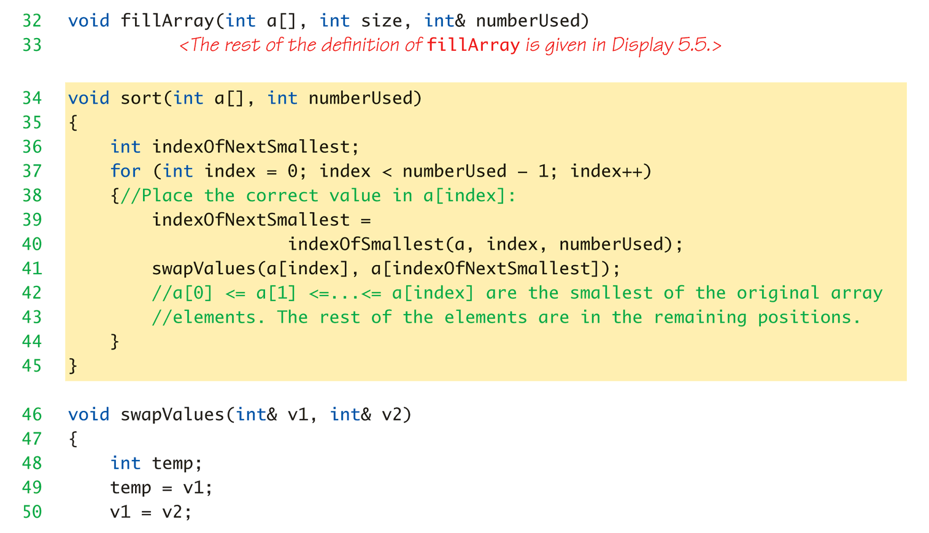
Sorting an Array Example: Display 5.8 Sorting an Array (3 of 4)

Slide 59
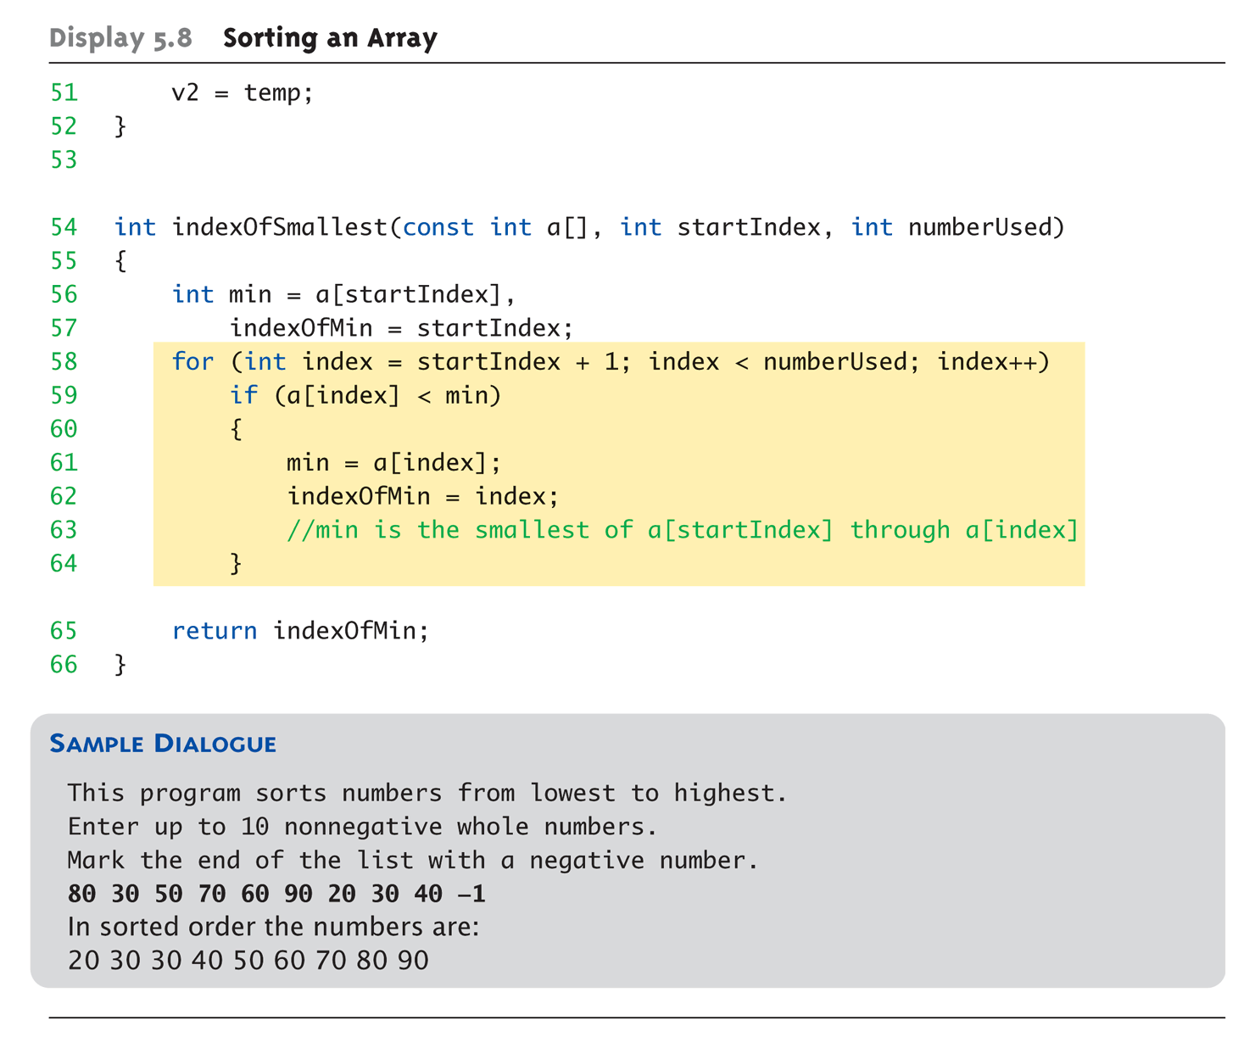
Sorting an Array Example: Display 5.8 Sorting an Array (4 of 4)

Slide 60
Any Disadvantages?
Using:
int canvas[SIZE], void fillCanvas(int a[], int size, int& numberUsed);
char canvas[30][100]; void displayCanvas(const char p[][100], int length)
Have disadvantages about?
Declaration,
Parameter passing,
Resizing (insertion, deletion), etc.

Slide 61
Vectors
Vector Introduction
Recall: arrays are fixed size
Vectors: "arrays that grow and shrink“ during program execution
Formed from Standard Template Library (STL) using template class.
Similar to array: Has base type and stores collection of base type values
Declared differently:
Syntax: vector<Base_Type>
Indicates template class
Any type can be "plugged in" to Base_Type
Produces "new" class for vectors with that type
Example declaration: vector<int> creatures;

Slide 62
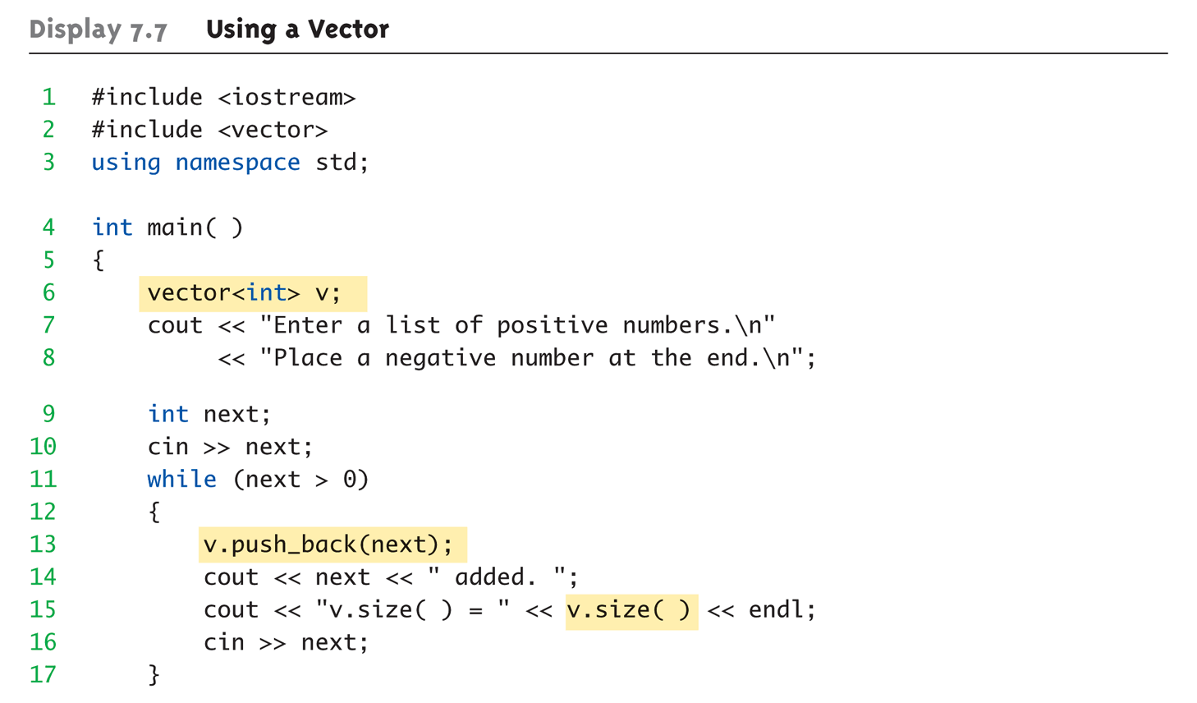
Vector Example: Display 7.7 Using a Vector (1 of 2)

Slide 63
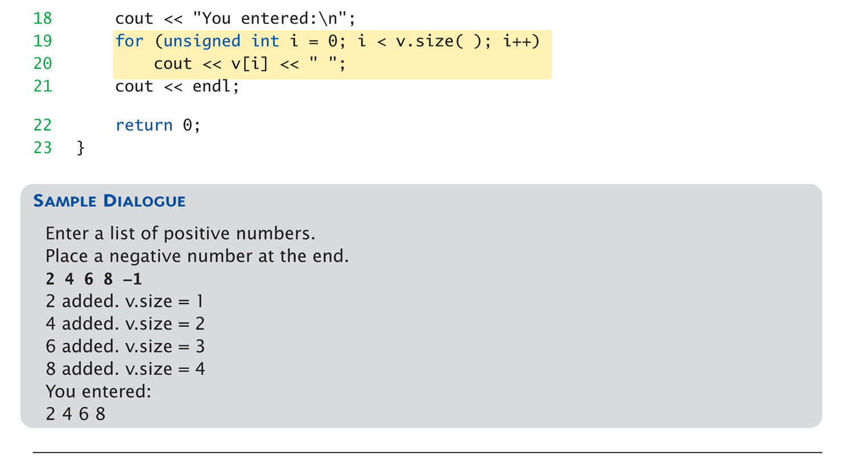
Vector Example: Display 7.7 Using a Vector (2 of 2)

Slide 64
Vector Basics
Similar to array:
Has base type
Stores collection of base type values
Declared differently:
Syntax: vector<Base_Type>
Indicates template class
Any type can be "plugged in" to Base_Type
Produces "new" class for vectors with that type
Example declaration: vector<int> v;

Slide 65
Vector Use
To add elements:
Must call member function push_back
Indexed like arrays for access
Member function size()
Returns current number of elements
Member function capacity()
Returns memory currently allocated
Not same as size()
Capacity typically > size
Automatically increased as needed
If efficiency critical:
Can set behaviors manually
v.reserve(32); //sets capacity to 32
v.reserve(v.size()+10); //sets capacity to 10 more than size

Slide 66
Vector Initializations
Put initialization parameters into () after the variable name
vector<int> values(10);
10 is used to initialize the variable values
() can be omitted when no parameters are given
Formally called construction (with constructor)
We will see in Chapter 7!
Initialize the vector with given values
vector<int> values = {2, 3, 4}; //int[] values = {2, 3, 4};
vector<int> values(10); //int[10] values = {};
vector<int> values(5, 10); //initialize values with five 10 elements

Slide 67
Using vector Instead
#include <iostream>
#include <vector>
using namespace std;
int binarySearch(int , int , int , vector<int>&);
int main()
{
vector<int> random(100);
int search4(3), found, first = 0, last = 99;
found = binarySearch(first, last, search4, random);
return(0);
}
int binarySearch(int first, int last, int search4, vector<int>& random)
{
do
{
int mid = (first + last) / 2;
if (search4 > random[mid]) first = mid + 1;
else if (search4 < random[mid]) last = mid - 1;
else return mid;
} while (first <= last);
return -(first + 1);
}
Why &?
Better?

Slide 68
const Example
void f1(vector<int> & v)
{
//do what you want here...
}
void f2(const vector<int> & v)
{
//do what you want here...
}
int main()
{
vector<int> v1;
vector<int> v2;
f1(v1);
f2(v2);
return 0;
}
Why const?

Slide 69
Multidimensional Arrays using vector
std::vector<int> va(5, 1); // vector a
std::vector<int> vb(5, 2); // vector b
std::vector<int> vc(5, 3); // vector c
std::vector<std::vector<int> > vv {va, vb, vc}; // vector of vectors

Slide 70
Multidimensional Arrays using vector
vector<vector<point> > canvas; // 2D array
canvas.push_back(vector<point>());
point p, pp;
canvas[0].push_back(p);
a[0][0]+= pp; // so a[0][0]= ?
canvas[0].push_back(pp); // a[0][1]= ?
canvas[0][2]= canvas[0][1]+ canvas[0][0]; // a[0][2]= ?

Slide 71
Multidimensional Arrays using vector
If you know how many items you will have from the start, you can do :
vector<vector<char> > canvas(10, vector<char>(10));
It's a vector containing 10 vectors containing 10 point. Then you can use
a[4][4] = ‘_’; // access an element at a[4][4]

Slide 72
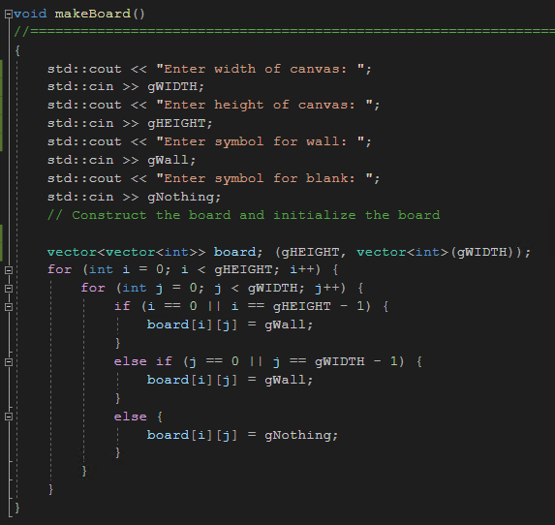
Dynamic canvas using 2-D vector
gWIDTH
W | W | W | W
W |  |  | W
W |  |  | W
W |  |  | W
W |  |  | W
W | W | W | W
gHEIGHT

Slide 73
3D Array with vectors
#include <vector>
using std::vector;
#define HEIGHT 5
#define WIDTH 3
#define DEPTH 7
int main() {
vector<vector<vector<int> > > array3D;
// Set up sizes. (HEIGHT x WIDTH)
array3D.resize(HEIGHT);
for (int i = 0; i < HEIGHT; ++i) {
array3D[i].resize(WIDTH);
for (int j = 0; j < WIDTH; ++j)
array3D[i][j].resize(DEPTH);
}
// Put some values in
array3D[1][2][5] = 6.0;
array3D[3][1][4] = 5.5;
return 0;
}

Slide 74
Summary 1
Array is collection of "same type" data
Indexed variables of array used just like any other simple variables
for-loop "natural" way to traverse arrays
Programmer responsible for staying "in bounds" of array
Array parameter is "new" kind
Similar to call-by-reference

Slide 75
Summary 2
Array elements stored sequentially
"Contiguous" portion of memory
Only address of 1st element is passed to functions
Partially-filled arrays → more tracking
Constant array parameters
Prevent modification of array contents
Multidimensional arrays
Create "array of arrays"

