Slide 1
Chapter 6
Structures and Classes

Slide 2
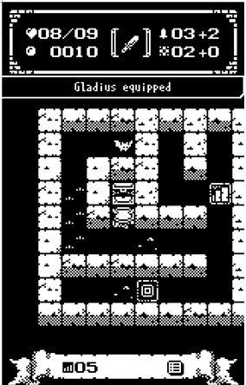



想一想
遊戲裡有多少物件需要實作？
那些又會與其他物件互動？

Slide 3
想一想
遊戲裡有多少物件需要實作？
主角、生物、迷宮和裝備等等
……
那些又會與其他物件互動
主角與生物相互攻擊。
生物在迷宮中走動。
……
遊戲中有主角、生物、裝備等各式物件

Slide 4
Learning Objectives
Structures
Structure types
Structures as function arguments
Initializing structures
Classes
Defining, member functions
Public and private members
Accessor and mutator functions
Structures vs. classes

Slide 5
Structures
2nd aggregate data type: struct
Recall: aggregate meaning "grouping"
Recall array: collection of values of same type
Structure: collection of values of arbitrary types
Treated as a single item, like arrays
Major difference: Must first "define" struct
Prior to declaring any variables

Slide 6
Structure Types
Define struct globally (typically)
No memory is allocated: Just a "placeholder" for what our struct will "look like"
Definition:
struct CDAccountV1 // Name of new struct “type” { double balance; // member names double interestRate; int term; }; //<- REQUIRED semicolon! since you "can" declare structure variables in this location
struct Position {
int x, y;
} p; //<- also declare p

Slide 7
Structure Types
通常配合 typedef 與 C 相容
struct Position {
int x, y;
};
typedef struct Player{
struct Position pos;
int HP;
} Player;
Player p;

Slide 8
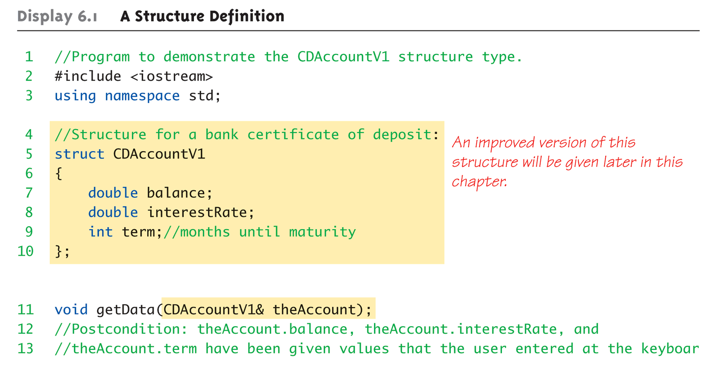
Structure Example: Display 6.1 A Structure Definition (1 of 3)

Slide 9
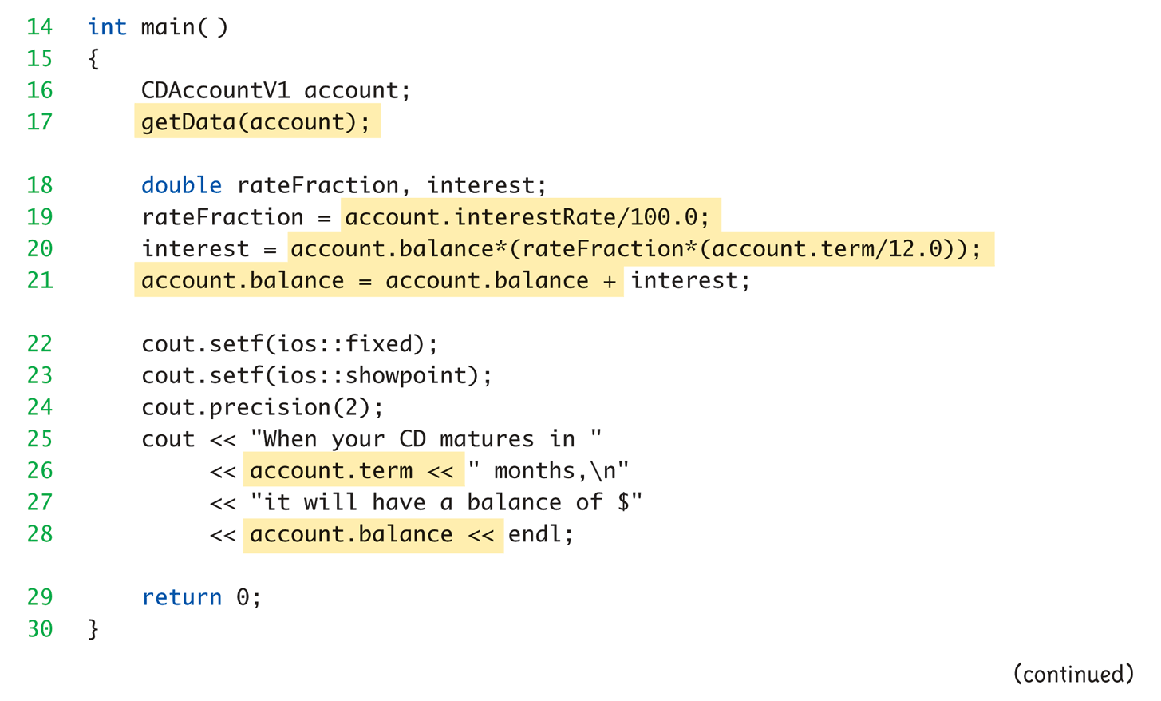
Structure Example: Display 6.1 A Structure Definition (2 of 3)

Slide 10
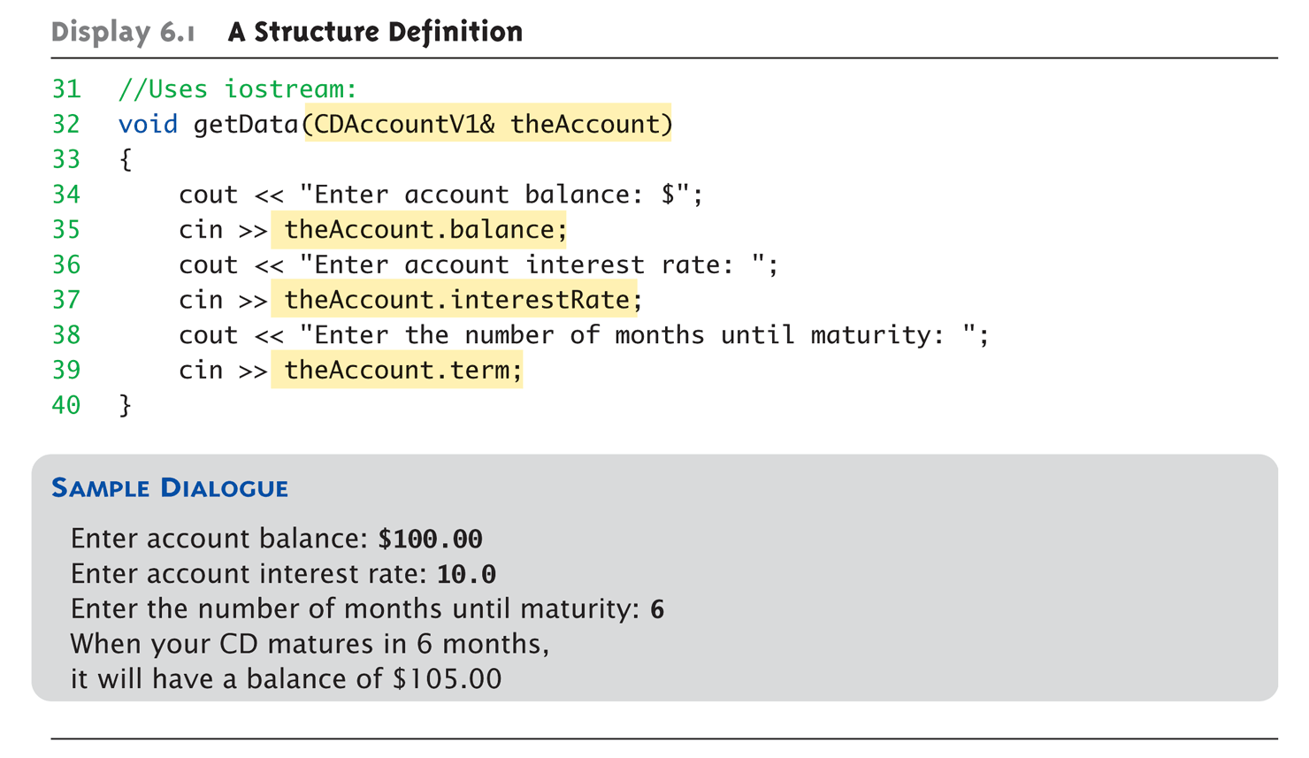
Structure Example: Display 6.1 A Structure Definition (3 of 3)

Slide 11
Declare and Access
While defined, now declare variables of this new type: CDAccountV1 account;
Just like declaring simple types
Variable account now of type CDAccountV1
It contains "member values"
Each of the struct "parts“
Dot Operator to access members
account.balance
account.interestRate
account.term
Called "member variables"
The "parts" of the structure variable
Different structs can have same name member variables
No conflicts

Slide 12
Declare and Access
Struct Account {
int term; double balance; double interestRate; };
1000 | term
1004 | balance
1008
100C | interestRate
1010
Account a;

Slide 13
Example: Position
遊戲中位置的概念時常會用到。
主角與生物在迷宮中移動。
生成生物與機關時的擺放位置。
判斷兩個物體間的距離。
之前的範例中位置是用兩個整數表示，使用 Position 結構使程式更具彈性與可讀性。
簡化函式參數
isPositionValid(int x, int y) => isPositionValid(Position pos)
增加程式可讀性
if(trigger.x == hero.x && trigger.y == hero.y){……}
if(trigger.position == hero.position){……}
主角、生物與其他遊戲物體都需要資訊紀錄在迷宮中的位置

Slide 14
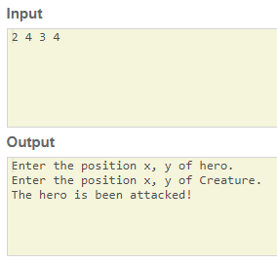
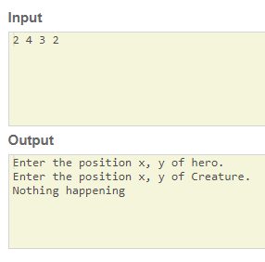

Example: Position
輸入 2 4 3 4
輸入 2 4 3 2
(3, 2)
(2, 4)
(3, 4)
生物在主角身旁，並攻擊主角。
(2, 4)
生物與主角錯開，沒發生攻擊事件。

Slide 15
Structure Pitfall
Semicolon after structure definition
; MUST exist: struct WeatherData { double temperature; double windVelocity; }; ← REQUIRED semicolon!
Required since you "can" declare structure variables in this location

Slide 16
Structure Assignments and Initializations
Given structure named GameObject
Declare two structure variables: GameObject hero, creature;
Simple assignments are legal: hero = creature;
Simply copies each member variable from hero into member variables from creature
Can initialize at declaration
Example: struct Position { int xPos; int yPos; }; Position heroPos = {12, 31};
Declaration provides initial data to two member variables

Slide 17
Structures as Function Arguments
Passed like any simple data type
Pass-by-value
Pass-by-reference
Can also be returned by function
Return-type is structure type
Return statement in function definition sends structure variable back to caller
typedef struct Coord{ float x, y; } Coord;
Coord add(const Coord &a, const Coord &b){
Coord d = {a.x+b.x, a.y+b.y};
return d;
}

Slide 18
Classes
Similar to structures in definition, declaration, and access.
Adds member FUNCTIONS
Not just member data
Integral to object-oriented programming
Focus on objects
Object: Contains data and operations
In C++, variables of class type are objects
Example: class Position { // name of new class type public: Position getPos(); // member function! int xPos; int yPos; };
Notice only member function’s prototype
Function’s implementation is elsewhere

Slide 19
Display 6.3 Class With a Member Function
#include <iostream>
using namespace std;
class DayOfYear
{
public:
int month;
int day;
void output( );
};

Slide 20
Display 6.3 Class With a Member Function
void DayOfYear::output( )
{
switch (month)
{
case 1:
cout << "January "; break;
case 2:
cout << "February "; break;
case 3:
cout << "March "; break;
case 4:
cout << "April "; break;
case 5:
cout << "May "; break;
case 6:
cout << "June "; break;
case 7:
cout << "July "; break;
case 8:
cout << "August "; break;
case 9:
cout << "September "; break;
case 10:
cout << "October "; break;
case 11:
cout << "November "; break;
case 12:
cout << "December "; break;
default:
cout << "Error in DayOfYear::output. Contact software vendor.";
}
cout << day;
}

Slide 21
Declaring and Access
Declared the same as all variables
Predefined types, structure types
Example: DayOfYear today, birthday;
Declares two objects of class type DayOfYear
Objects include:
Data
Members month, day
Operations (member functions)
output()
Members accessed same as structures
Example: today.month today.day
And to access member function: today.output(); ← Invokes member function

Slide 22
Class Member Functions
Must define or "implement" class member functions
Like other function definitions
Can be after main()definition
Must specify class: Position Position::getPos(){…}
:: is scope resolution operator
Instructs compiler "what class" member is from
Item before :: called type qualifier
Refers to member data of class
No qualifiers
Function used for all objects of the class
Will refer to "that object’s" data when invoked
Example: heroPos.getPos();
Displays data of heroPos

Slide 23
Class Member Functions
class Vector // name of new class type { public:
Vector(float rx=0, float ry=0); // 建構子(Constructor)
void add(const Vector &r); // member function!
inline Vector added(const Vector &r) {return Vector(_x+r._x, _y+r._y);} float _x; float _y; };
Vector::Vector(float rx, float ry){
_x=rx; _y=ry;
}
void Vector::add(const Vector &r){
this->_x += r._x;
this->_y += r._y;
}

Slide 24
Class Member Functions
// vector.h
class Vector // name of new class type { public:
Vector(float rx=0, float ry=0); // 建構子(Constructor)
void add(const Vector &r); // member function!
Vector added(const Vector &r); float _x; float _y; };
// vector.cpp
#include “vector.h”
Vector::Vector(float rx, float ry){
_x=rx; _y=ry;
}
void Vector::add(const Vector &r){
this->_x += r._x;
this->_y += r._y;
}
Vector Vector::added(const Vector &r){
return Vector(_x+r._x, _y+r._y);
}

Slide 25
Example: Creature
生物在迷宮中有各式各樣的行為。
移動、偵測主角、攻擊主角、死亡、…。
要具備上述的行為，生物需要具有多個參數紀錄狀態。
位置、攻擊力、偵測範圍、生命、…。
攻擊玩家
移動
死亡
在玩家隔壁
朝玩家移動
偵測主角
使用技能
看得到玩家
攻擊
……
隨機移動
其他
生物類別在遊戲中，會執行各種行為，威脅玩家。
其中最基本的行為包括移動、偵測與攻擊

Slide 26
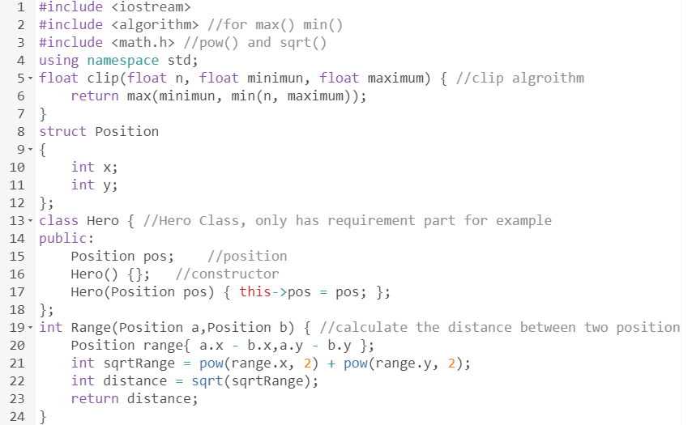
Example: Creature
Clip演算法，用於偵測方向
Position結構
英雄類別
利用Position計算兩位置間的距離

Slide 27
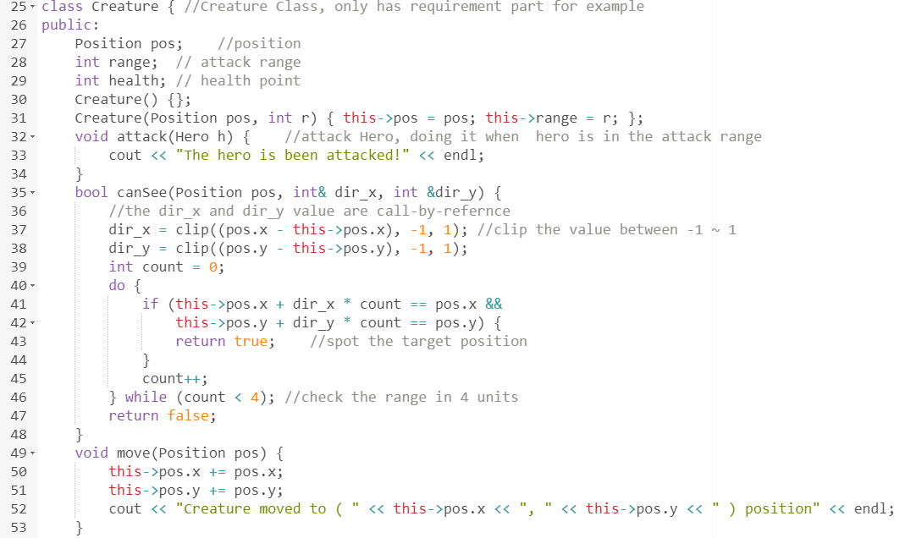
Example: Creature
實作各種行為時需要的狀態參數
攻擊行為實作
偵測行為實作，會回傳是否找到玩家與移動方向
移動行為實作

Slide 28
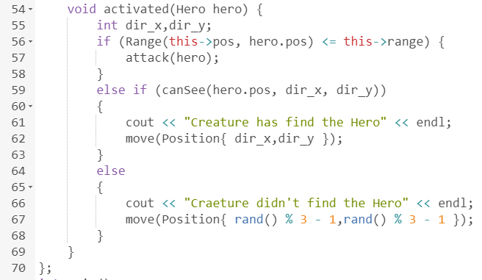
Example: Creature
行為實作
攻擊玩家
在玩家隔壁
朝玩家移動
看得到玩家
隨機移動
其他

Slide 29
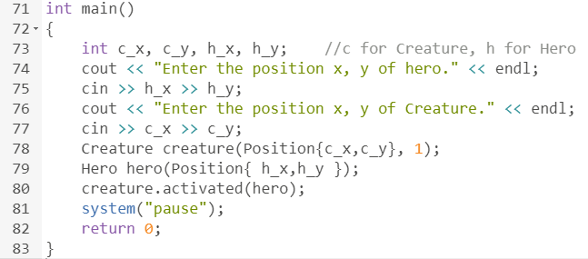
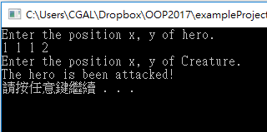
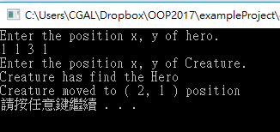
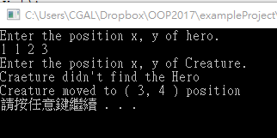
Example: Creature
使用者輸入主角與生物的位置
攻擊玩家
在玩家隔壁
朝玩家移動
看得到玩家
隨機移動
其他

Slide 30
A Class’s Place
Class is full-fledged type!
Just like data types int, double, etc.
Can have variables of a class type
We simply call them "objects"
Can have parameters of a class type
Pass-by-value
Pass-by-reference
Can use class type like any other type!

Slide 31
Encapsulation
Any data type includes
Data (range of data)
Operations (that can be performed on data)
Example: int data type has: Data: -2147483648 to 2147483647 (for 32 bit int) Operations: +,-,*,/,%,logical,etc.
Same with classes
But WE specify data, and the operations to be allowed on our data!

Slide 32
Abstract Data Types
"Abstract"
Programmers don’t know details
Abbreviated "ADT“: Collection of data values together with set of basic operations defined for the values
ADT’s often "language-independent"
We implement ADT’s in C++ with classes
C++ class "defines" the ADT
Other languages implement ADT’s as well
"Abstract data type" is a model. "Abstract class" is a programming technique

Slide 33
Principles of OOP
Information Hiding
Details of how operations work not known to "user" of class
Data Abstraction
Details of how data is manipulated within ADT/class not known to user
Encapsulation
Bring together data and operations, but keep "details" hidden

Slide 34
Public and Private Members
Data in class almost always designated private in definition!
Upholds principles of OOP
Hide data from user
Allow manipulation only via operations
Which are member functions
Public items (usually member functions) are "user-accessible"

Slide 35
Public and Private Example
Modify previous example: class Vector{ public:
Vector(float rx=0, float ry=0);
void add(const Vector &r);
Vector added(const Vector &r);
private: float _x; float _y; };
Data now private
Objects have no direct access

Slide 36
Public and Private Example 2
Given previous example
Declare object: Vector heroPos;
Object today can ONLY access public members
cin >> heroPos._x; // NOT ALLOWED!
cout << heroPos._y; // NOT ALLOWED!
Must instead call public operations:
heroPos.add(step);
heroPos.added(step);

Slide 37
Example : Hero Attack
英雄/生物兩Class之間互動：
英雄在攻擊生物時會使得生物生命值降低。
生物若是血量歸零則死亡。
英雄與生物都有攻擊力與生命力兩種基本參數。
英雄類別無法直接改變生物的血量值，而生物也無法直接取得英雄的攻擊力。
透過呼叫雙方類別的public函式 ，傳遞private的變數資訊。
我要敵方攻擊生物，我要呼叫他的getHurt(int power)函式，告知他被攻擊了。
我的getHurt(int power)函式，被呼叫了。
我必須讓我的生命 -= power

Slide 38
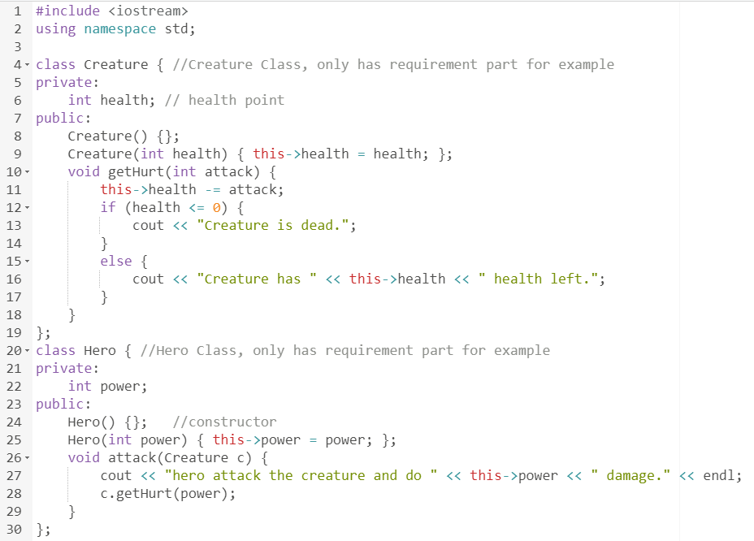
Example : Hero Attack
私有欄位，只有自己可以存取該變數
生物受傷實作
英雄可透過呼叫生物的公有函式間接改變生物狀態

Slide 39
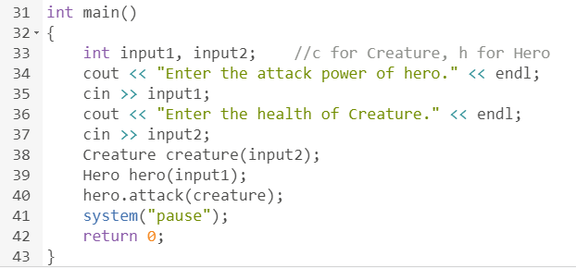
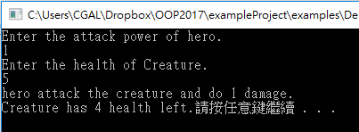
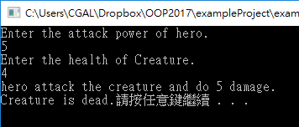
Example : Hero Attack
使用者輸入英雄的攻擊力與生物的生命值
攻擊力 5
生命值 4
攻擊力 1
生命值 5
-5
我不行了
-1
我還頂得住

Slide 40
Public and Private Style
Can mix & match public & private
More typically place public first
Allows easy viewing of portions that can be USED by programmers using the class
Private data is "hidden", so irrelevant to users
Outside of class definition, cannot change (or even access) private data
Except: friend

Slide 41
Accessor and Mutator Functions
Object needs to "do something" with its data
Call accessor member functions
Allow object to read data
Also called "getter member functions"
Simple retrieval of member data
Mutator member functions
Allow object to change data
Manipulated based on application

Slide 42
Separate Interface and Implementation
User of class need not see details of how class is implemented
Principle of OOP → encapsulation
User only needs "rules"
Called "interface" for the class
In C++ → public member functions and associated comments
Implementation of class hidden
Member function definitions elsewhere
User need not see them

Slide 43
Structures versus Classes
Structures
All members public
Classes
Typically all data members private
Interface member functions public

Slide 44
Thinking Objects
Focus for programming changes
Before → algorithms center stage
OOP → data is focus
Algorithms still exist
They simply focus on their data
Are "made" to "fit" the data
Designing software solution
Define variety of objects and how they interact

Slide 45
Distribute Codes
Separate codes into different files for
better organization
more efficient compiling
Typically codes of 1 class would be organized in 2 files
class_name.h
contains the declaration
class_name.cpp
contains the definition
Inside main.cpp, add #include "class_name.h" to use the declared class
Inside class_name.cpp, add #include "class_name.h" to define the member functions

Slide 46
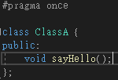
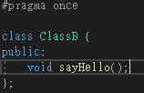
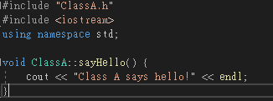
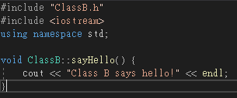
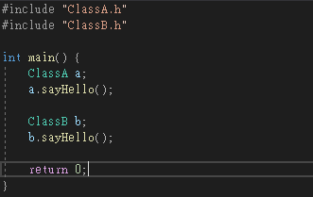
Example : Code Distribution
ClassA.h
ClassB.h
ClassA.cpp
ClassB.cpp
main.cpp

Slide 47
Example : Code Distribution
What is the #pragma once for?
ClassA.h
ClassB.h

Slide 48
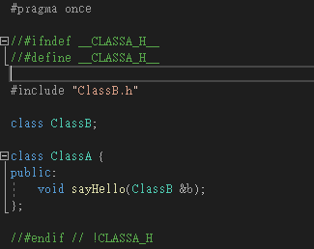
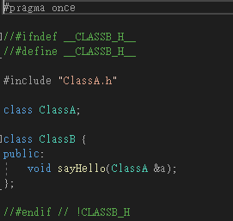
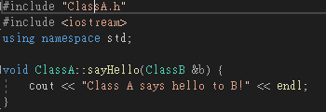
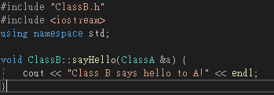
Example : Duplicated Include
ClassA.h
ClassB.h
ClassA.cpp
ClassB.cpp

Slide 49
Summary 1
Structure is collection of different types
Class used to combine data and functions into single unit -> object
Member variables and member functions
Can be public → accessed outside class
Can be private → accessed only in a member function’s definition
Class and structure types can be formal parameters to functions

Slide 50
Summary 2
C++ class definition
Should separate two key parts
Interface: what user needs
Implementation: details of how class works

