Slide 1
Chapter 6
Constructors and Other Tools

Slide 2

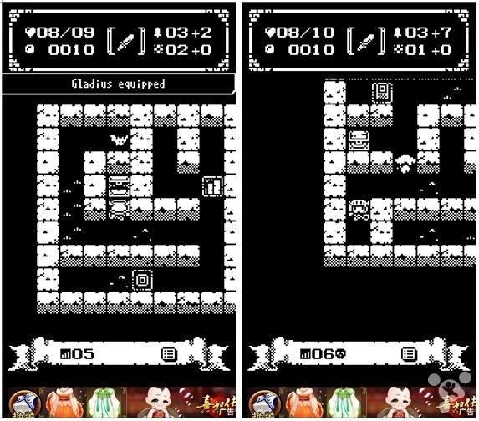

想一想
遊戲中有哪些類別，遊戲中又會用到這些類別的那些資訊?
又有哪些資訊是遊戲中通用的?
遊戲中有主角、機關、生物等各式類別

Slide 3
想一想
遊戲中有哪些類別，遊戲中又會用到這些類別的那些資訊?
英雄: 血量、位置、攻擊力、…。
生物: 血量、行為類型、…。
…。
又有哪些資訊是遊戲中通用的?
同一種類生物數量、樓層數、…。

Slide 4
Learning Objectives
Constructors
Definitions
Calling
More Tools
const parameter modifier
inline functions
static member data
Vectors
Introduction to vector class
Notes:
1. Constructor, initialize the data and validate the data and related information. 2. Very important C++

Slide 5
Constructors (建構子)
Initialization of objects
Initialize some or all member variables
Other actions possible as well
A special kind of member functions
Automatically called when object declared
Constructors defined like any member function except:
Must have same name as class
Cannot return a value; not even void!

Slide 6
Constructor Definition Example
Class definition with constructor:
class Position { public: //Initializes x and y to arguments.
Position(int x, int y);
// Initializes y to 0 of given x.
Position(int x);
//Initializes the position to (0,0).
Position( ); void input(); void output(); … private: int x = 0; int y = 0; }

Slide 7
Constructor Notes
Notice name of constructor: Position
Same name as class itself!
Constructor declaration has no return-type
Not even void!
Constructor in public section
It’s called when objects are declared
If private, could not declare(or instantiate) objects normally
Sometimes we intend to make the constructor private!

Slide 8
Constructor Code
Constructor definition is like all other member functions:
Note same name around ::
Clearly identifies a constructor
Note no return type, just as in class declaration
Position::Position(int xPosition, int yPosition){ x = xPosition; y = yPosition; }

Slide 9
Alternative Definition
Previous definition equivalent to: Position::Position( int xPos, int yPos) : x(xPosition), y(yPosition) {…}
Third line called "Initialization Section"
Body left empty
Preferable definition version
Variables are initialized through constructor instead of assignment

Slide 10
Calling
Declare objects: Position heroPos(7,4), creaturePos(5,5);
Objects are created here
Constructor is called
Values in parentheses passed as arguments to constructor
Member variables initialized: heroPos.x = 7 creaturePos.x = 5 heroPos.y = 4 creaturePos.y = 5
Consider:
Position heroPos, creaturePos; heroPos.Position(7, 4); // ILLEGAL! creaturePos.Position(5, 5); // ILLEGAL!
Seemingly OK…
CANNOT call constructors like other member functions!

Slide 11
Constructor Additional Purpose
Not just initialize data
Body doesn’t have to be empty
In initializer version
Validate the data!
Ensure only appropriate data is assigned to class private member variables
Powerful OOP principle

Slide 12
Overloaded Constructors
Can overload constructors just like other functions
Recall: a signature consists of:
Name of function
Parameter list
Provide constructors for all possible argument-lists
Particularly "how many"

Slide 13
Example
class DayOfYear
{
public:
DayOfYear(int monthValue, int dayValue);
//Initializes the month and day to arguments.
DayOfYear(int monthValue);
//Initializes the date to the first of the given month.
DayOfYear( );
//Initializes the date to January 1.
void output( );
private:
int month;
int day;
};

Slide 14
Example
DayOfYear::DayOfYear(int monthValue, int dayValue)
: month(monthValue), day(dayValue)
{
testDate( );
}
DayOfYear::DayOfYear(int monthValue) : month(monthValue), day(1)
{
testDate( );
}
DayOfYear::DayOfYear( ) : month(1), day(1)
{ /*Body intentionally empty.*/ }

Slide 15
Example
void DayOfYear::output( )
{
switch (month)
{
case 1:
cout << "January "; break;
case 2:
cout << "February "; break;
case 3:
cout << "March "; break;
case 4:
cout << "April "; break;
case 5:
cout << "May "; break;
case 6:
cout << "June "; break;
case 7:
cout << "July "; break;
case 8:
cout << "August "; break;
case 9:
cout << "September "; break;
case 10:
cout << "October "; break;
case 11:
cout << "November "; break;
case 12:
cout << "December "; break;
default:
cout << "Error in DayOfYear::output. Contact software vendor.";
}
cout << day;
}

Slide 16
Example
#include <iostream>
#include <cstdlib> //for exit
using namespace std;
int main( )
{
DayOfYear date1(2, 21), date2(5), date3;
cout << "Initialized dates:\n";
date1.output( ); cout << endl;
date2.output( ); cout << endl;
date3.output( ); cout << endl;
date1 = DayOfYear(10, 31);
cout << "date1 reset to the following:\n";
date1.output( ); cout << endl;
return 0;
}

Slide 17
Example: Creature
建立生物類別時需要產生基本的狀態資訊
初始位置、血量、表示符號、…。
這些狀態資訊可透過constructor 在建立類別時賦予。
位置
血量
圖像
遊戲中的生物有著許多資訊

Slide 18
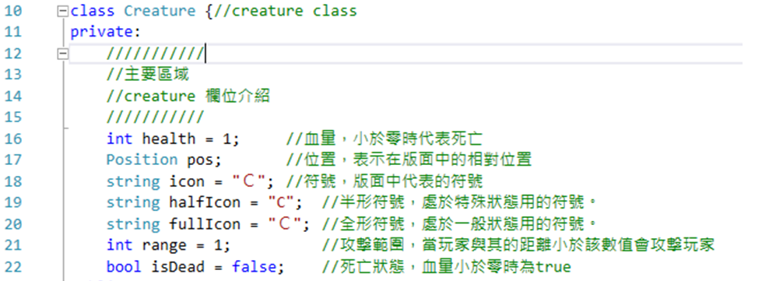
Example: Creature
實作生物類別所需的基本欄位

Slide 19
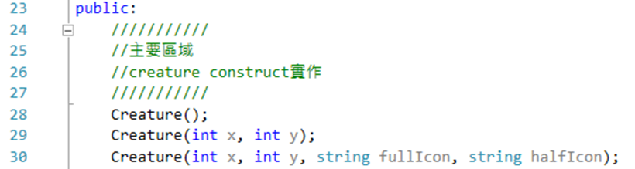
Example: Creature
生物類別建構子

Slide 20
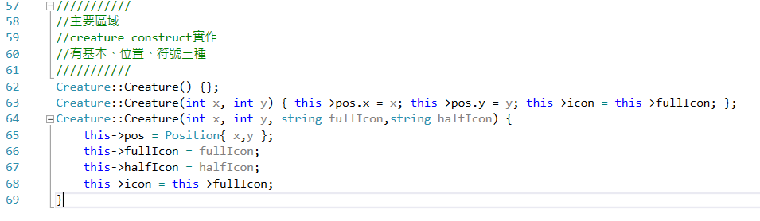
Example: Creature
生物類別建構子:將輸入資訊賦予對應欄位資料

Slide 21
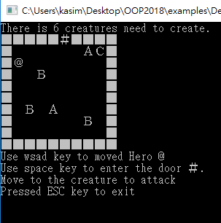
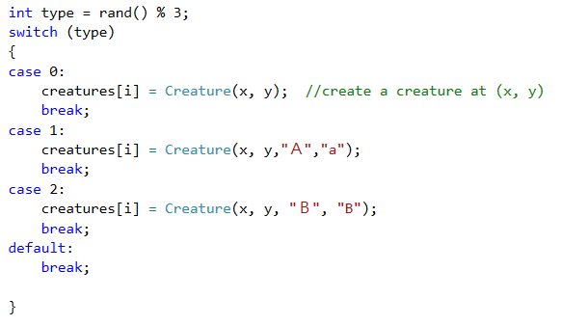
Example: Same Creatures
迷宮中的生物:
透過不同的建構子參數產生不同外觀

Slide 22
Default Constructor
Defined as: constructor w/ no arguments
Confusing while standard functions with no arguments:
callFunction(); // Including empty parentheses
Object declarations with no "initializers":
Position heroPos; // This way!
Position heroPos(); // NO!
Compiler sees a function declaration/prototype!
One should always be defined
Auto-Generated?
Yes & No
If no constructors AT ALL are defined → Yes
If any constructors are defined → No
If no default constructor:
Cannot declare: MyClass myObject;
With no initializers

Slide 23
Default Constructor
可以明確指定要使用 Default Constructor
class Position{
public:
Position() = default;
};
也可明確指定不要
class Position{
public:
Position() = delete;
};
Behavior of defaulted default constructor → invoke the default constructor of its base class and not-static class members

Slide 24
Copy Constructor
定義：有一個自己型別的參考(reference)作為參數的建構子
class Position{
public:
Position(const Position&) = default;
};
只要使用者沒定義，且類別所有成員都具備複製建構子，就會產生預設的複製建構子
同樣可以明確指定使用預設與否
呼叫方式：
Position a; //default constructor
Position b(a); //copy constructor

Slide 25
Copy Constructor
使用傳值呼叫的函數時，會對該參數執行一次複製建構子
void f(Position p){
// p is copied by copy constructor
std::cout << p.x << “, ” << p.y << “\n”
}
void main(){
Position a(0, 0);
f(a); // Position p(a);
}
Position a = b; // copy constructor as well

Slide 26
Explicit Constructor Call Example
Such a call returns "anonymous object"
Which can then be assigned
In Action: Position heroPos(7, 4);
heroPos = Position(5, 5);

Slide 27
Destructors(解構子)
定義
class Position{
public:
~Position() {}
};
當物件被刪除時執行
delete
{} 結尾處，刪除區域變數時
未明確定義會產生預設解構子
同樣可以明確指定使用預設與否
若類別成員有指標需要管理記憶體，必須自行定義解構子釋放之

Slide 28
Constructor + Destructors
class Vector{
public:
Vector(){}
Vector(const Vector&) = default;
~Vector(){}
private:
float _x=0.0f;
float _y=0.0f;
};

Slide 29
Class Type Member Variables
Class member variables can be any type
Including objects of other classes!
Type of class relationship
Powerful OOP principle
Need special notation for constructors
So they can call "back" to member object’s constructor

Slide 30
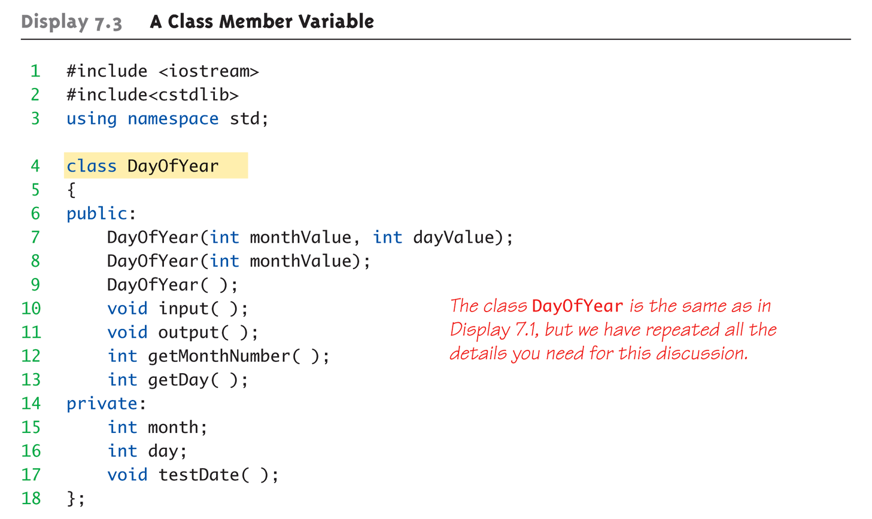
Class Member Variable Example: Display 7.3 A Class Member Variable (1 of 5)

Slide 31
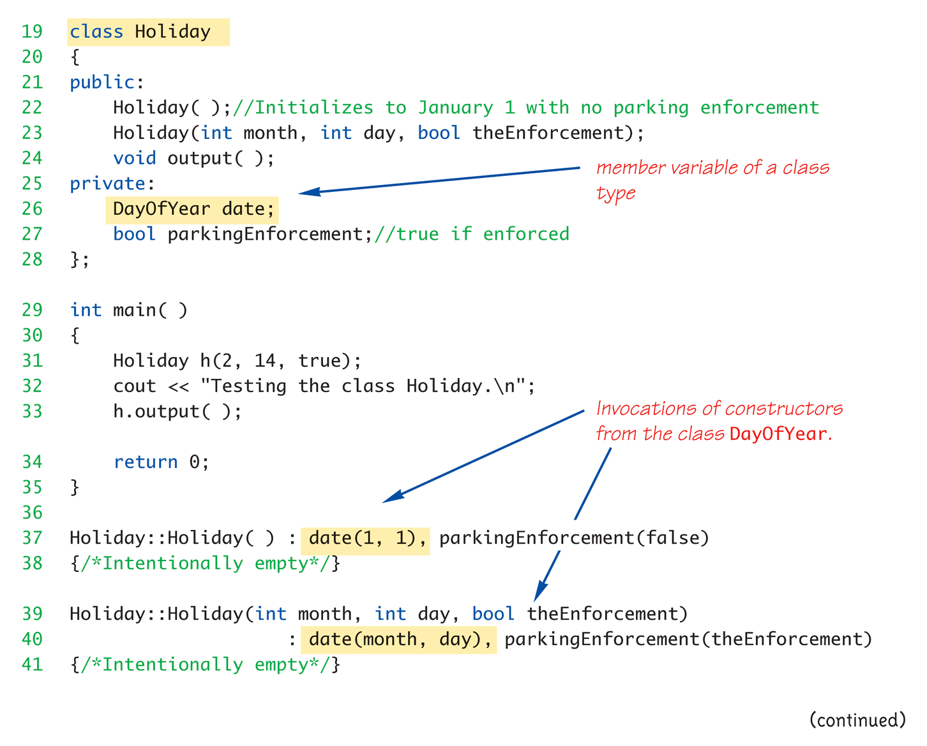
Class Member Variable Example: Display 7.3 A Class Member Variable (2 of 5)

Slide 32
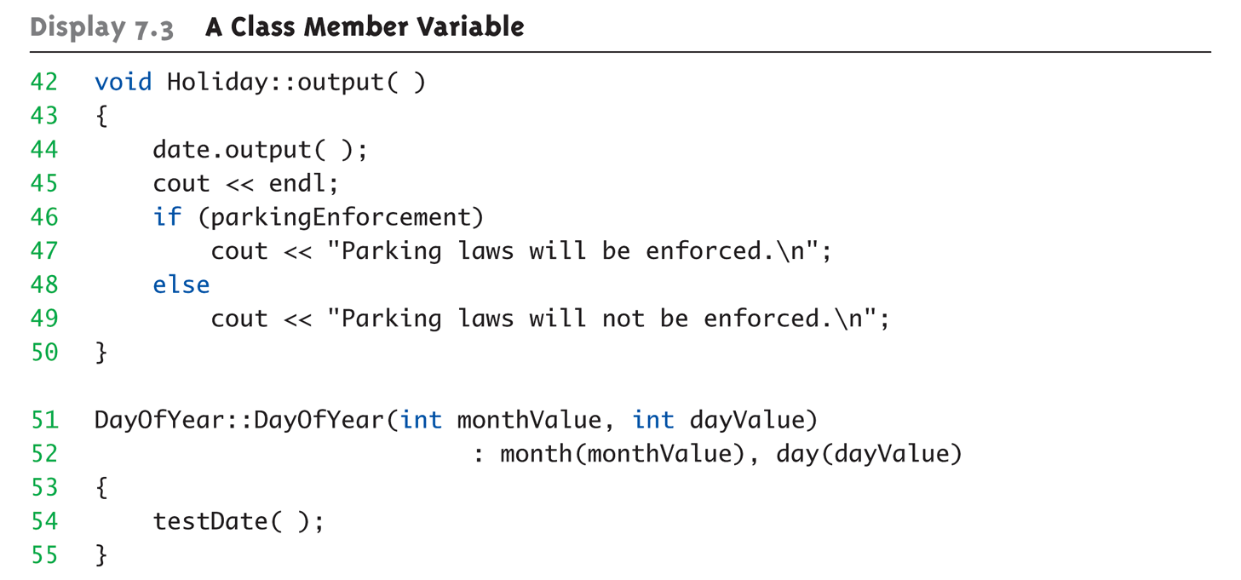
Class Member Variable Example: Display 7.3 A Class Member Variable (3 of 5)

Slide 33
Parameter Passing Methods
Efficiency of parameter passing
Call-by-value
Requires copy be made → Overhead
Call-by-reference
Placeholder for actual argument
Most efficient method
Negligible difference for simple types
For class types → clear advantage
Call-by-reference desirable
Especially for "large" data, like class types

Slide 34
The const Parameter Modifier
Large data types (typically classes)
Desirable to use pass-by-reference
Even if function will not make modifications
Protect argument
Use constant parameter
Also called constant call-by-reference parameter
Place keyword const before type
Makes parameter "read-only"
Attempt to modify parameter results in compiler error

Slide 35
Use of const
All-or-nothing
If no need for function modifications
Protect parameter with const
Protect ALL such parameters
This includes class member function parameters

Slide 36
Example: Direction
遊戲中的方向使用(x, y)兩個數值表示，其中又以少部分方向在遊戲中會經常性使用到。
上、下、左、右。
利用 const 將常用到的類別狀態宣告，增加程式可讀性
玩家在移動時可選擇的方向是固定的

Slide 37
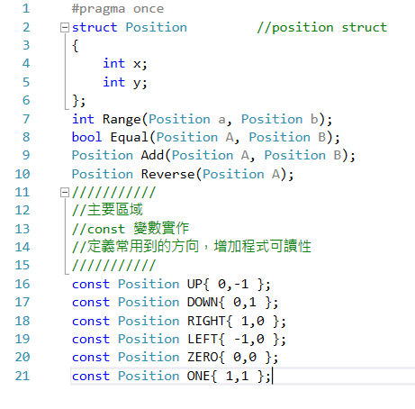
const Example :Direction
位置結構與常用涵式
定義常用到的方向，在程式需要時可直接呼叫，增加可讀性

Slide 38
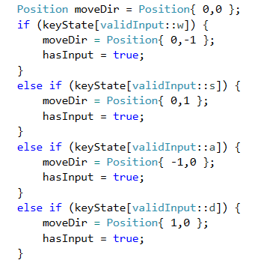
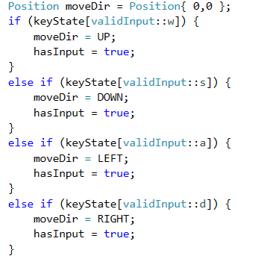
const Example :Direction
利用建構子產生需要的方向
使用const定義好的參數，程式可讀性較佳

Slide 39
Constant Member Function
The member function can be marked as constant
class Position{
public:
int getX() const { return _x;}
int getY() const;
void test() const;
void test2();
private:
int _x, _y;
};
int Position::getY() const { return _y; }
For constant member function, no member data can be modified
void Position::test() const { _x = 0; } // illegal!
void Position::test() const { test2(); } // illegal!

Slide 40
inline Functions
For non-member functions:
Use keyword inline in function declaration and function heading
For class member functions:
Place implementation (code) for function IN class definition
automatically inline
Use inline to define separately, in different file
Use for very short functions only
Code actually inserted in place of call
Eliminates overhead
More efficient, but only when short!
If too long → actually less efficient! → compiler may ignore the specifier

Slide 41
Which One Are inline Functions
class Account
{
public:
Account(double initial_balance) { balance = initial_balance; }
double GetBalance();
double Deposit( double Amount );
double Withdraw( double Amount );
private:
double balance;
};
inline double Account::GetBalance() { return balance; }
inline double Account::Deposit( double Amount )
{
return ( balance += Amount );
}
inline double Account::Withdraw( double Amount )
{
return ( balance -= Amount );
}
int main() { … }

Slide 42
Inline member function examples
A function defined in the body of a class declaration is an inline function.
Example
the Account constructor is an inline function.
The member functions GetBalance, Deposit, and Withdraw are not specified as inline but can be implemented as inline functions.

Slide 43
inline functions vs. macros
inline functions are similar to macros
The function code is expanded at the point of the call at compile time
inline functions are parsed by the compiler
macros are expanded by the preprocessor
Important differences:
inline functions follow all the protocols of type safety enforced on normal functions.
which one can deliver private class data to outside?
Expressions passed as arguments to inline functions are evaluated once. In some cases, expressions passed as arguments to macros can be evaluated more than once.

Slide 44
Example
// inline_functions_macro.c
#include <stdio.h>
#include <ctype.h>
#define toupper(a) ((a) >= 'a' && ((a) <= 'z') ? ((a)-('a'-'A')):(a))
int main() {
char ch;
printf("Enter a character: ");
ch = toupper( getc(stdin) );
printf( "%c", ch );
}
// Sample Input: xyz
// Sample Output: Z
getc is executed to determine whether the character is
>= "a," and
<= "z.“
converted to uppercase.
// inline_functions_inline.cpp
#include <stdio.h>
#include <ctype.h>
inline char toupper( char a ) {
return ((a >= 'a' && a <= 'z') ? a-('a'-'A') : a );
}
int main() {
printf("Enter a character: ");
char ch = toupper( getc(stdin) );
printf( "%c", ch );
}
// Sample Input: a
// Sample Output: A
getc is executed once!

Slide 45
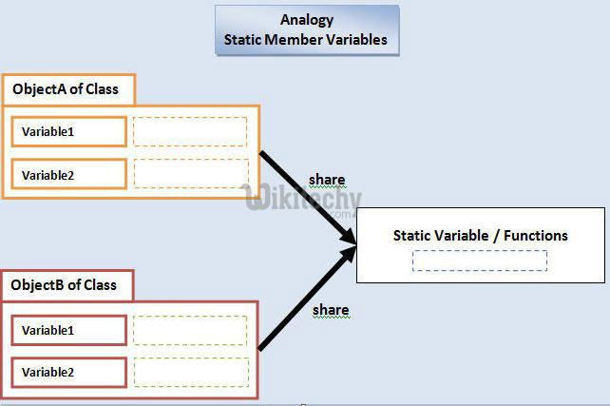
Static Members and Functions
Static member variables
All objects of class "share" one copy
One object changes it → all see change
Useful for "tracking"
How often a member function is called
How many objects exist at given time
Place keyword static before type
e.g., static int staticValue = 0;
Member functions can be static
If no access to the member data needed, i.e., cannot access member data
And still "must" be the member of the class
Make it a static function
Can then be called outside class
From non-class objects: Server::getTurn();
Via class objects: myObject.getTurn();
Can only use static data, functions!

Slide 46
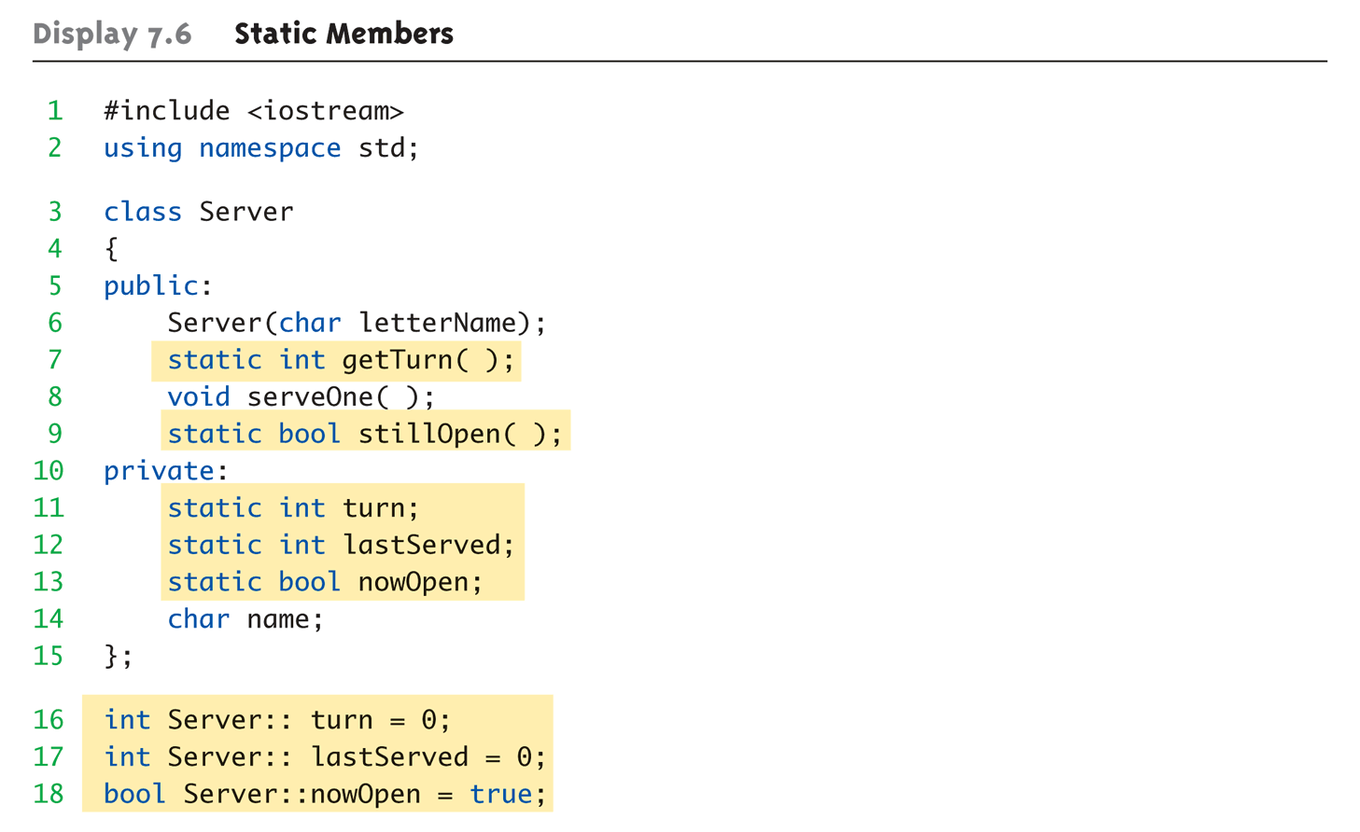
Static Members Example: Display 7.6 Static Members (1 of 4)

Slide 47
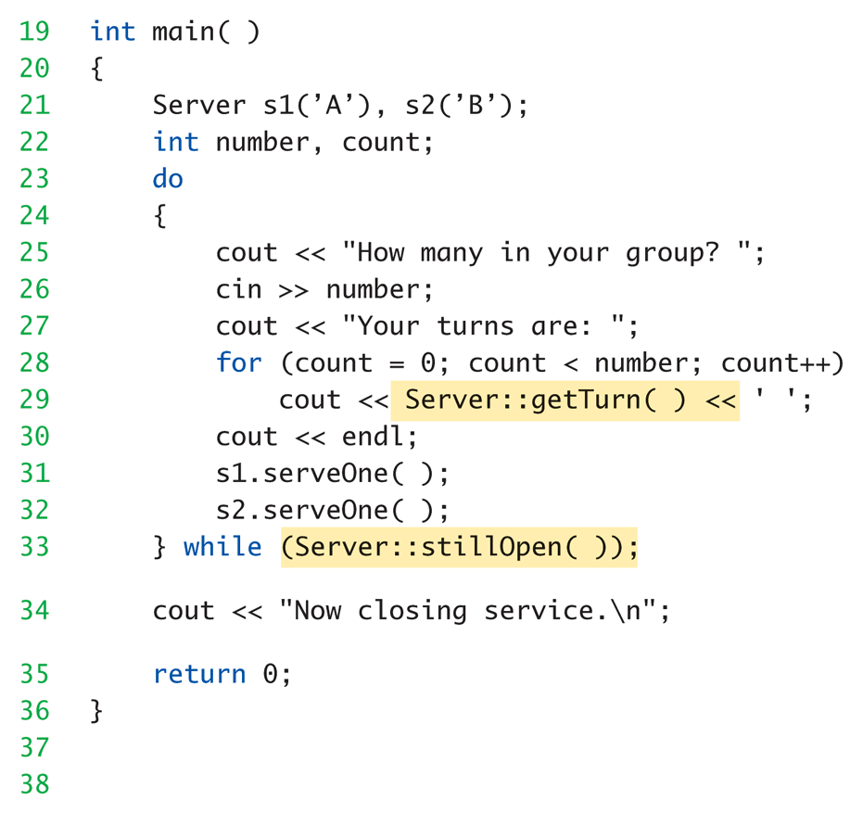
Static Members Example: Display 7.6 Static Members (2 of 4)

Slide 48
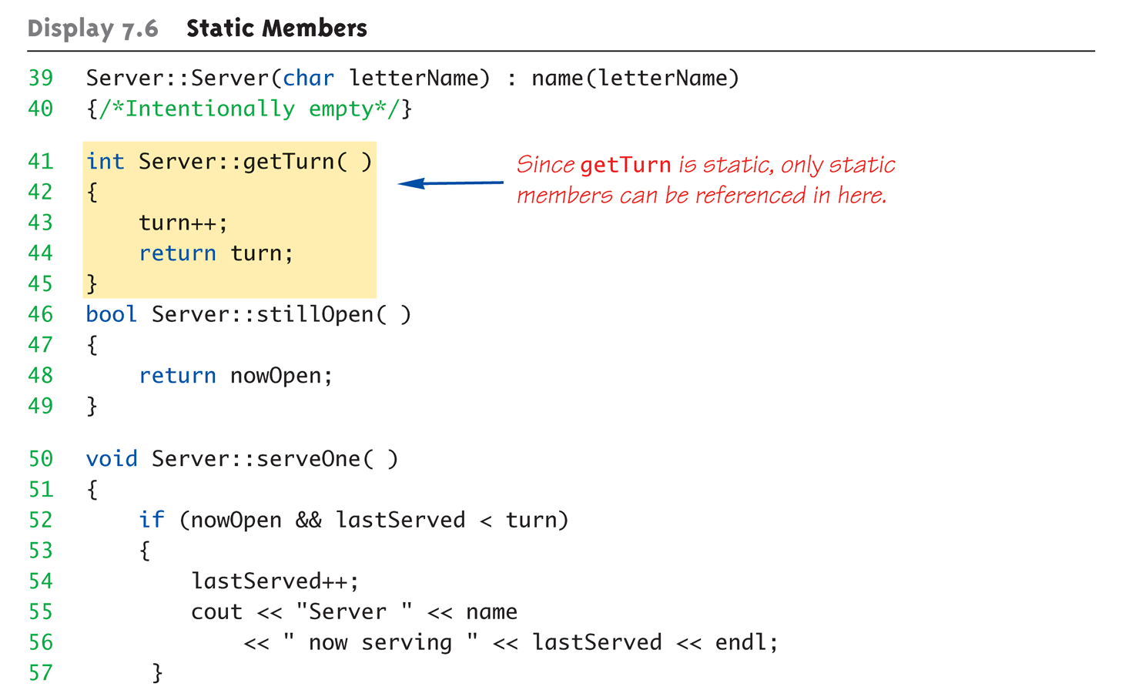
Static Members Example: Display 7.6 Static Members (3 of 4)

Slide 49
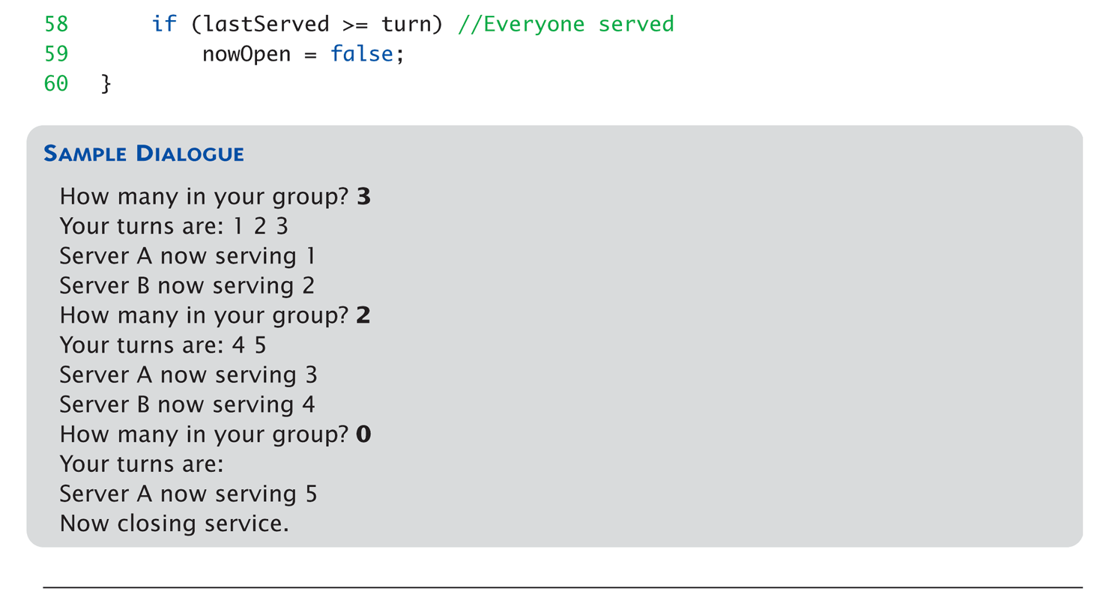
Static Members Example: Display 7.6 Static Members (4 of 4)

Slide 50
Static
寫在 class 定義外面的 static 定義：僅屬於該編譯單元的符號
編譯單元
一個 .cpp 檔編譯成一個 .o 為一個編譯單元
最終連結器會將所有 .o 以及 .a/.lib 連結成執行檔

Slide 51
Example: 陷阱
迷宮中會擺設機關陷阱，妨礙玩家。
當陷阱被觸發時會發出巨響，使的玩家被所有生物發現。
生物間利用靜態變數判斷事件是否被觸發。
機關呼叫生物的靜態函式，告知生物事件觸發。
!
!
!
當陷阱觸發時，會令所有生物發現玩家
生物間利用靜態變數判斷陷阱觸發

Slide 52
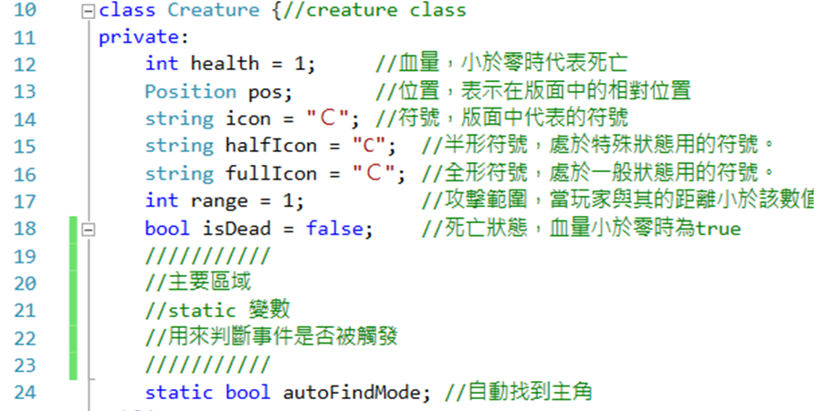
Example: 陷阱
靜態變數:用以判斷機關觸發

Slide 53
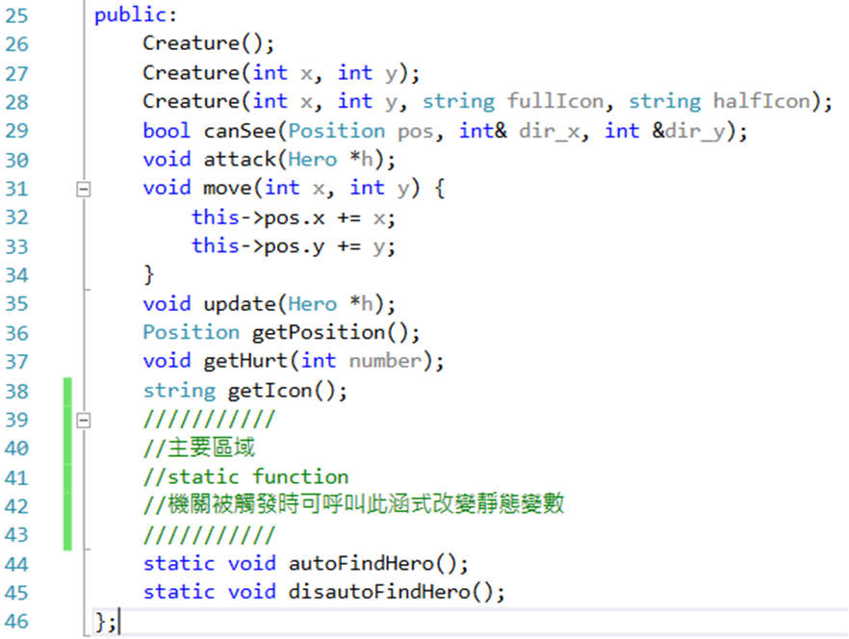
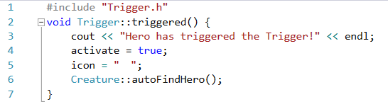
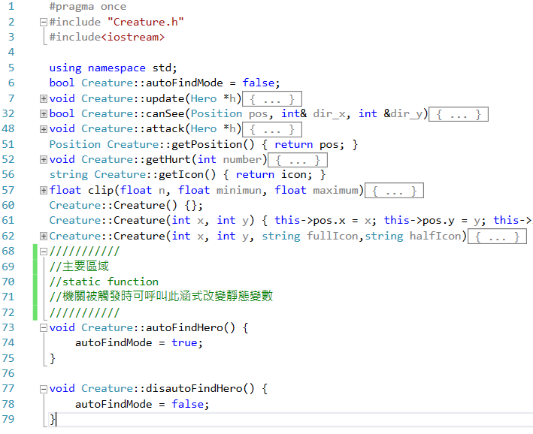
Example: 陷阱
機關觸發時會呼叫生物的靜態涵式

Slide 54
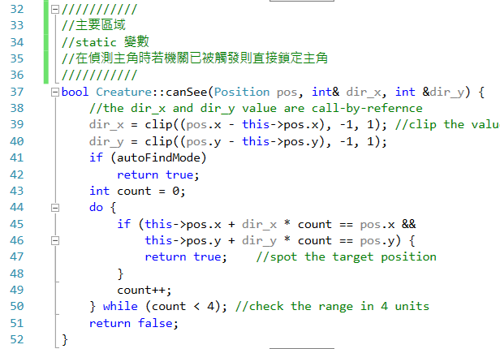
Example: 陷阱
在.cpp檔使用static變數前須在檔案上方宣告變數
當在偵測主角時若機關已被觸發則直接鎖定主角

Slide 55
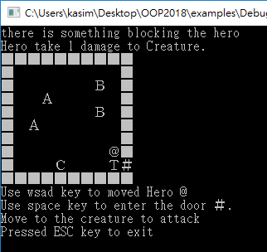
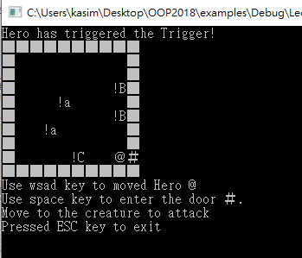
Example: 陷阱
陷阱觸發前生物不會追逐在視線外的玩家
陷阱觸發後生物鎖定並追逐玩家

Slide 56
Summary 1
Constructors: automatic initialization of class data
Called when objects are declared
Constructor has same name as class
Default constructor has no parameters
Should always be defined
Class member variables
Can be objects of other classes
Require initialization-section

Slide 57
Summary 2
Constant call-by-reference parameters
More efficient than call-by-value
Can inline very short function definitions
Can improve efficiency
Static member variables
Shared by all objects of a class
Vector classes
Like: "arrays that grow and shrink"

