Slide 1
Chapter 11
Separate Compilation and Namespaces

Slide 2
Learning Objectives
Separate Compilation
Encapsulation reviewed
Header and implementation files
Namespaces
using directives
Qualifying names
Unnamed namespaces
Hiding helping functions
Nested namespaces

Slide 3
想一想
遊戲中會不會有遊戲元素需要知道彼此？
程式架構要如何設計才能避免發生重複定義類別或是令程式容易維護？

Slide 4
想一想
遊戲中有許多元素會需要知道彼此
管理器需要管理英雄、生物等類別，而英雄與生物在移動時也需要和管理器取得版圖資料。
英雄與生物在攻擊時需要知道互相的存在。
…
程式架構要如何設計才能避免發生重複定義類別或是令程式容易維護
使用.h 與 .cpp 將宣告與實作分隔。
…

Slide 5
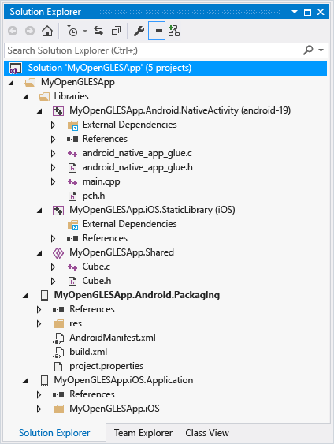
Separate Compilation
Program Parts
Kept in separate files
Compiled separately
Linked together before program runs
Class definitions
Separate from "using" programs
Build library of classes
Re-used by many different programs
Just like predefined libraries

Slide 6
Class Separation
Class Independence
Separate class declaration (or specification)
Called "interface"
Separate class definition (or implementation)
Place in two files
If implementation changes → only that file need be changed
Class specification need not change
"User" programs need not change

Slide 7
Encapsulation Reviewed
Encapsulation principle:
Separate how class is used by programmer from details of class’s implementation
"Complete" separation
Change to implementation → NO impact on any other programs
Basic OOP principle

Slide 8
Encapsulation Rules
Rules to ensure separation:
All member variables should be private
Basic class operations should be:
Public member functions
Friend or ordinary functions
Overloaded operators
Group class definition and prototypes together
Called "interface" for class
Make class implementation unavailable to users of class

Slide 9
More Class Separation
Interface File
Contains class definition with function and operator declarations/prototypes
Users "see" this
Separate compilation unit
Implementation File
Contains member function definitions
Separate compilation unit

Slide 10
Class Header Files
Class interface always in header file
Use .h naming convention
Programs that use class will "include" it
#include “Creature.h"
Quotes indicate you wrote header
Find it in "your" working directory
Recall library includes, e.g., <iostream>
< > indicate predefined library header file
Find it in library directory

Slide 11
Class Implementation Files
Class implementation in .cpp file
Typically give interface file and implementation file same name
Creature.h and Creature.cpp
All class’s member function defined here
Implementation file must #include class’s header file
.cpp files in general, typically contain executable code
e.g., Function definitions, including main()

Slide 12
Class Files
Class header file #included by:
Implementation file
Program file
Often called "application file" or "driver file"
Organization of files is system dependent
Typical IDE has "project" or "workspace"
Implementation files "combined" here
Header files still "#included"

Slide 13
Multiple Compiles of Header Files
Header files
Typically included multiple times
e.g., class interface included by class implementation and program file
Must only be compiled once!
No guarantee "which #include" in which file, compiler might see first
Use preprocessor
Tell compiler to include header only once

Slide 14
Using #ifndef
Header file structure:
#ifndef CREATURE_H #define CREATURE _H … //Contents of header file … #endif
Or using #pragma once

Slide 15
Namespaces
Namespace defined: A collection of name definitions
Class definitions
Variable declarations
Programs use many classes, functions
Commonly have same names
Namespaces deal with this
Can be "on" or "off"
If names might conflict → turn off

Slide 16
using Directive
#include <iostream>
Places all name definitions (cin, cout, etc.) into std namespace
Program doesn’t know names
Must specify this namespace for program to access names
std::cout << …
using namespace std;
Makes all definitions in std namespace available
cout << …
Why might you NOT want this?
Can make cout, cin have non-standard meaning
Perhaps a need to redefine cout, cin
Can redefine any others

Slide 17
Global Namespace
All code goes in some namespace
Unless specified → global namespace
No need for using directive
Global namespace always available
Implied "automatic" using directive

Slide 18
Multiple Names
Multiple namespaces
e.g., global, and std typically used
What if name defined in both?
Error
Can still use both namespaces
Must specify which namespace used at what time

Slide 19
Specifying Namespaces
Given namespaces Creature1_NS, Creature2_NS
Both have void function move() defined differently
{ using namespace Creature1_NS; move(); // Creature1_NS::move(); } { using namespace Creature2_NS; move(); // Creature2_NS::move(); }
using directive has block-scope

Slide 20
Creating a Namespace
Use namespace grouping: namespace Direction { Some_Code } // namespace Direction
Places all names defined in Some_Code into namespace Direction
Can then be made available:
using namespace Direction

Slide 21
Creating a Namespace Example
Function declaration: namespace Direction { void printDir(); }
Function definition: namespace Direction { void printDir() { cout << “Creature moving torwards (“<< dir.x << ”, ” << dir.y << “) direction.\n”; } }

Slide 22
int main( )
{
{
using namespace Space2;
greeting( );
}
{
using namespace Space1;
greeting( );
}
bigGreeting( );
return 0;
}
#include <iostream>
using namespace std;
namespace Space1
{
void greeting( );
}
namespace Space2
{
void greeting( );
}
void bigGreeting( );

Slide 23
namespace Space1
{
void greeting( )
{
cout << "Hello from namespace Space1.\n";
}
}
namespace Space2
{
void greeting( )
{
cout << "Greetings from namespace Space2.\n";
}
}
void bigGreeting( )
{
cout << "A Big Global Hello!\n";
}

Slide 24
using Declarations
Can specify individual names from namespace
Consider: Namespaces Direction, Move exist! Each have functions printDir (), printMove()
Declaration syntax: using Name_Space::Function_Name;
Specify which name from each: using Direction::printDir; using Move::printMove;

Slide 25
using Definitions and Declarations
Differences:
using declaration
Makes ONE name in namespace available
Introduces names so no other uses of name are allowed
using directive
Makes ALL names in namespace available
Only "potentially" introduces names

Slide 26
Qualifying Names
Can specify where name comes from
Use "qualifier" and scope-resolution operator
Used if only intend one use (or few)
Move::moveRight();
Specifies that moveRight() comes from namespace Move
Especially useful for parameters: int getInput(std::istream inputStream);
Parameter found in istream’s std namespace
Eliminates need for using directive or declaration

Slide 27
Naming Namespaces
Include unique string
Like last name
Reduces chance of other namespaces with same name
Often multiple programmers write namespaces for same program
Must have distinct names
Without → multiple definitions of same name in same scope
Results in error

Slide 28
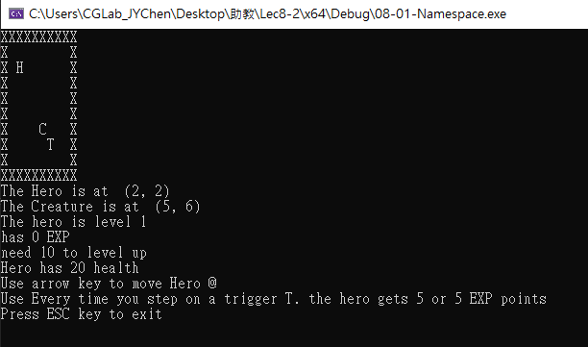

namespace:常用名稱
遊戲中有許多常用的變數名稱可能會其他程式撞名
移動時的上下左右
UP、DOWN、LEFT、RIGHT
迷宮版圖的符號名稱
Wall(牆)、floor(地板)
使用namespace區隔不同scope的變數

Slide 29
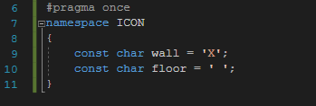
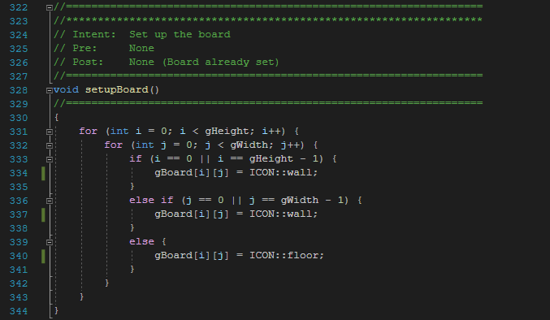
namespace:常用名稱
namespace ICON
使用ICON:: 取得變數
使用namespace可避免floor與 取下限整數的floor搞混

Slide 30
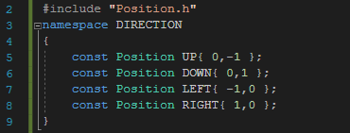
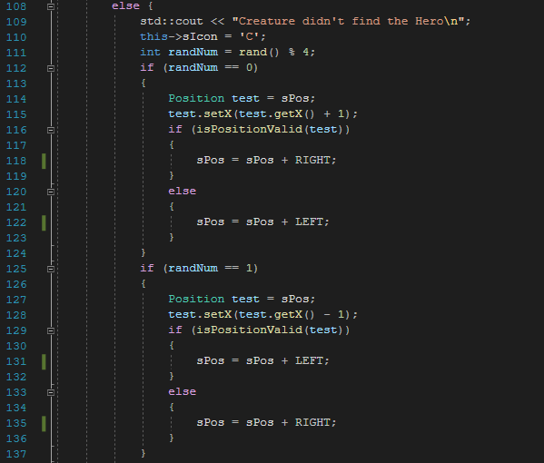

namespace:常用名稱
namespace DIRECTION
在沒有變數名稱重複的情況下，可先將namespace納入scope中
預先using DIRECTION namespace，可以省去DIRECTION::的部分

Slide 31
namespace { declarations }
Called anonymous or unnamed namespaces
Create an explicit namespace but not give it a name
namespace
{
int xPosition(){}
}
Useful to make variable declarations invisible to code in other files (i.e. give them internal linkage)
All code in the same file can see the identifiers in an unnamed namespace but the identifiers are not visible outside that file
More precisely outside the translation unit.

Slide 32
Unnamed Namespaces
Compilation unit defined:
A file, along with all files #included in file
Every compilation unit has unnamed namespace
Written same way, but with no name
All names are then local to compilation unit
Use unnamed namespace to keep things "local"
Scope of unnamed namespace is compilation unit

Slide 33
Global vs. Unnamed Namespaces
Not same
Global namespace:
No namespace grouping at all
Global scope
Unnamed namespace:
Has namespace grouping, just no name
Local scope

Slide 34
Namespace Examples
namespace {
int i; // defines ::(unique)::i
}
void f() {
i++; // increments ::(unique)::i
}
namespace A {
namespace {
int i; // A::(unique)::i
int j; // A::(unique)::j
}
void g() { i++; } // A::unique::i++
}
using namespace A; // introduces all names from A into global namespace
void h() {
i++; // error: ::(unique)::i and ::A::(unique)::i are both in scope
A::i++; // ok, increments ::A::(unique)::i
j++; // ok, increments ::A::(unique)::j
}
Unnamed namespaces as well as all namespaces declared directly or indirectly within an unnamed namespace have internal linkage
Unnamed namespace is with unique name eventually

Slide 35
Nested Namespaces
Legal to nest namespaces namespace GameObject { namespace Movement { void update() { … } }
Qualify names twice:
GameObject::Movement::update();

Slide 36
Nested Namespace Examples
namespace Q {
namespace V { // original-namespace-definition for V
void f(); // declaration of Q::V::f
}
void V::f() {} // OK
void V::g() {} // Error: g() is not yet a member of V
namespace V { // extension-namespace-definition for V
void g(); // declaration of Q::V::g
}
}
namespace R { // not a enclosing namespace for Q
void Q::V::g() {} // Error: cannot define Q::V::g inside R
}
void Q::V::g() {} // OK: global namespace encloses Q

Slide 37
Hiding Helping Functions
Recall helping function:
Low-level utility
Not for public use
Two ways to hide:
Make private member function
If function naturally takes calling object
Place in class implementation’s unnamed namespace!
If function needs no calling object
Makes cleaner code (no qualifiers)

Slide 38
Summary 1
Can separate class definition and implementation → separate files
Separate compilation units
Namespace is a collection of name definitions
Three ways to use name from namespace:
Using directive
Using declaration
Qualifying

Slide 39
Summary 2
Namespace definitions are placed inside namespace groupings
Unnamed namespace
Used for local name definitions
Scope is compilation unit
Global namespace
Items not in a namespace grouping at all
Global scope

