Slide 1
Chapter 10
Pointers and Dynamic Arrays

Slide 2
Learning Objectives
Pointers
Pointer variables
Memory management
Dynamic Arrays
Creating and using
Pointer arithmetic
Classes, Pointers, Dynamic Arrays
The this pointer
Destructors, copy constructors

Slide 3
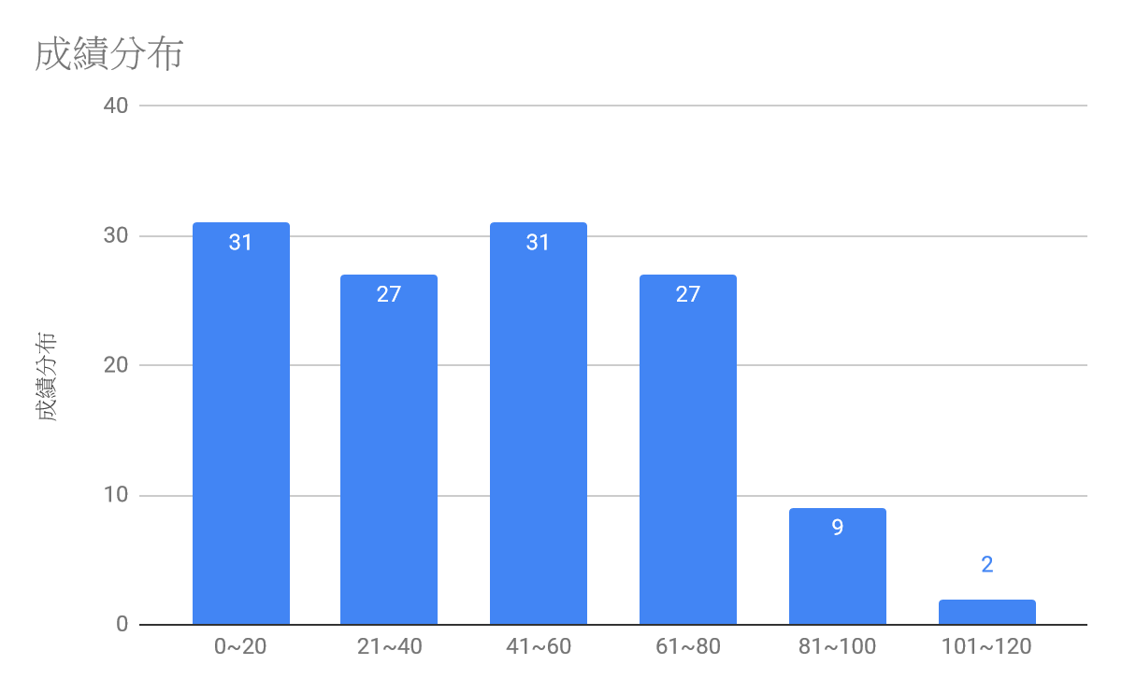
期中考
各題成績分布
 | 0 | 5 | 10 | 15 | 20
Quiz 1 | 83 | 0 | 0 | 0 | 49
Quiz 2 | 41 | 1 | 6 | 5 | 79
Quiz 3 | 70 | 0 | 21 | 0 | 41
Quiz 4 | 105 | 24 | 0 | 1 | 2
Quiz 5 | 19 | 0 | 1 | 0 | 112
Quiz 6 | 121 | 10 | 0 | 1 | 0

Slide 4
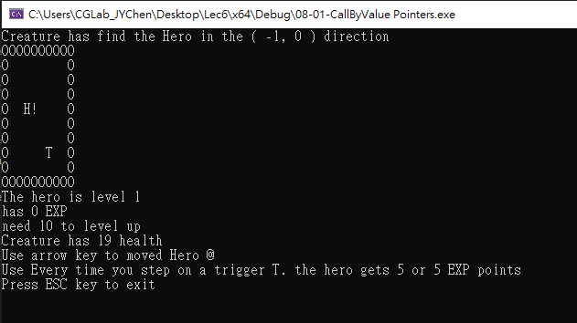
想一想
當遊戲進入下一關時，有哪些元素會變動
迷宮版圖。
生物群。
…。
如何處理會不斷改動值的變數?
遊戲裡的物件會隨著遊戲進行不斷改變

Slide 5
Pointer Introduction
Pointer definition:
Memory address of a variable
Recall: memory divided
Numbered memory locations
Addresses used as name for variable
You’ve used pointers already!
Call-by-reference parameters: Address of actual argument was passed
Pointers are "typed“, like an array for computer to know its size
Can store pointer in variable
Not int, double, etc. Instead: A POINTER to int, double, etc.!
Example:
double *p; // pointer to double
"*" must be before each variable to produce "pointer to" that type
int *p1, *p2, v1, v2; // p1, p2 are int pointer
// and v1 and v2 are int variables

Slide 6
Addresses and Numbers
Pointer is an address, and address is a 64 bit integer for 64bit machine.
Pointer is NOT an int!
C++ forces pointers to be used as addresses
Cannot be used as numbers, even though it "is" a number
Terminology: pointing and point to instead of address
Talk of "pointing", not "addresses"
Pointer variable "points to" ordinary variable
Leave "address" talk out
Makes visualization clearer: "See" memory references

Slide 7
Pointing to …
int *p1, *p2, v1, v2; p1 = &v1; // read like "p1 equals address of v1"
// or "p1 points to v1“
Sets pointer variable p1 to "point to" int variable v1
Operator, &,determines "address of" variable
Also used to specify call-by-reference parameter because it passes "address of" the actual argument.
Both uses are closely related
Two ways to see v1’s value
Variable v1 itself: cout << v1;
Via pointer p1: cout << *p1;
Dereference operator, *
Pointer variable "derereferenced"
Means: "Get data that p1 points to"
p1
p2
v1
v2
*
*
?
?
p1
v1
*
?

Slide 8
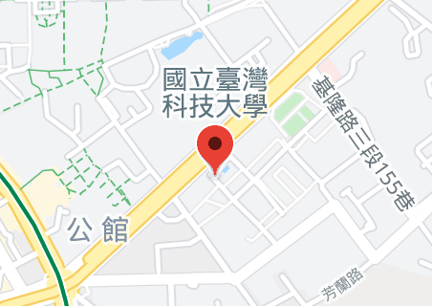
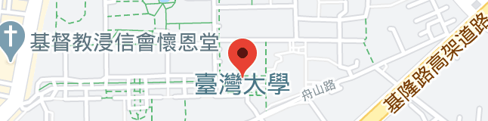
Similar Concept: Address
國立台灣科技大學
校園
郵局
台北巿基隆路四段四十三號
10607
*
*
國立台灣大學
校園
郵局
台北巿羅斯福路四段一號
10617
*
*

Slide 9
"Pointing to" Example
Consider: v1 = 0;
p1 = &v1;
*p1 = 42;
p1 and v1 refer to same variable
v1
0
p1
v1
*
0
p1
v1
*
42

Slide 10
"Pointing to" Example
Pointer variables can be "assigned":
Do not confuse with:
p2 = p1;
p2 = &v2;
p1
v1
p2
v2
*
42
*
?
p2
*
p1
v1
p1
v1
*
42
*
42
*p2 = *p1;
p2
v2
p2
v2
*
?
*
42

Slide 11
The new Operator
Think about the usage "create an int pointer that points to 17"
Do you want the pointer "point to" an existing int variable that holds 17?
Using the new operator!
Creates a variable and return the pointer pointing to the variable!
Example:
p1 = new int;
Creates an int variable, and makes p1 "point to" it
nameless int variable
Can access with *p1

Slide 12
More on new Operator
Creates new dynamic variable
Returns pointer to the new variable
If type is class type:
Constructor is called for new object
Can invoke different constructor with initializer arguments:
MyClass *mcPtr; mcPtr = new MyClass(32.0, 17);
Can still initialize non-class types: int *n; n = new int(17); //Initializes *n to 17

Slide 13
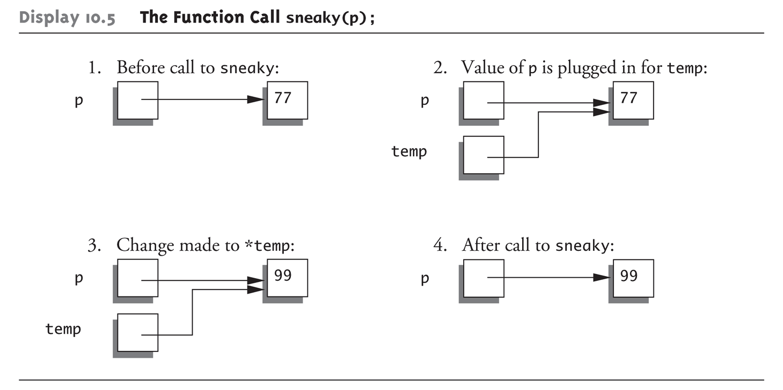
Pointers and Functions
Pointers are full-fledged types for being used just like other types
Can be function parameters and returned from functions
Example: int* findOtherPointer(int* p);
Has "pointer to an int" parameter
Returns "pointer to an int" variable
Behavior subtle and troublesome
int *p;
p = new int;
*p = 77;
sneaky(p);
…
void sneaky(int* temp){
*temp = 99;
}

Slide 14
Null Pointer
表示無效的指標
通常以指向位址 0 的指標實現
void *ptr = NULL; // C style
void *ptr = nullptr; // C++ style
在 C++ 盡可能只使用 nullptr，因為 NULL 一般只是數字0，沒有類別確認，極端情形下可能會有類別判定上的問題。
#define NULL 0 //多數編譯器的 NULL 實現
原則上不允許 Null reference 存在
對 nullptr 取值立刻會當掉

Slide 15
Memory Management
Stack
Reserved for local variables that their size is known before execution
Heap
Also called "freestore"
Reserved for dynamically-allocated variables
All new dynamic variables consume memory in freestore
If too many → could use all freestore memory →new operation might fail
To check if new operation succeeded, we need exception handling (Chapter 18)

Slide 16
Checking new Success
Old style: test if null returned by call to new
int *p;
p = new int;
if (p == NULL){ // if (p)
cout << "Error: Insufficient memory.\n";
exit(1);
}
New style: If new operation fails, the program terminates automatically, and produce an error message.
Still good practice to use NULL check

Slide 17
Freestore Size and delete Operator
Varies with implementations, but typically large for most programs
Memory management
Still good practice, and solid software engineering principle
Memory IS finite regardless of how much there is! → Long running programs generally require memory management.
delete: De-allocate dynamic memory to freestore when no longer needed
int *p; p = new int(5); … // Some processing… delete p; // “Destroys" memory “pointed to by pointer p“
p = NULL;
After deleting, p still points to the memory, and *p may have unpredictable results! i.e. dangling pointers
To avoid dangling by assigning pointer to NULL after delete

Slide 18
Dynamic and Automatic Variables
Dynamic variables
Created with new operator, and Created and destroyed while program runs
Local variables i.e. "automatic" variables
Declared within function definition and Not dynamic
Created when function is called
Destroyed when function call completes

Slide 19
Define Type Name: typedef
To use a easily-memorized name for a type
Can "name" pointer types to be able to declare pointers like other variables for elimination of the need for "*" in pointer declaration
typedef int* IntPtr; // Defines a "new type" alias
IntPtr p; // The two are equivalent
int *p;

Slide 20



Call-by-value Pointers:攻擊生物
遊戲中的生物會被玩家攻擊導致其生命值受到損害。
當生物站在玩家的移動路徑上->攻擊他!
玩家的attack(*Creature c)會呼叫生物的getHurt(int amount)，使其受到傷害
我想要移動。
任何有我的pointer的玩家都可以呼叫我的getHurt()讓我受傷
但這個*生物擋住你了。
玩家
那我只好攻擊這個*生物了。
GM

Slide 21
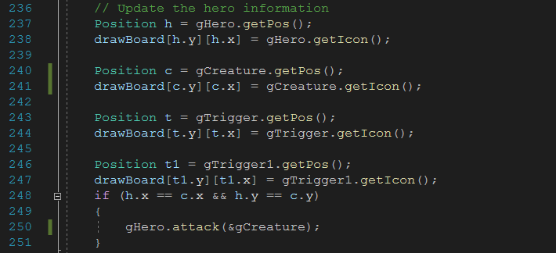
Call-by-value Pointers:攻擊生物
擷取資料及位置判斷區塊
當玩家生物位於同一格時，找出他的pointer並呼叫攻擊函式

Slide 22
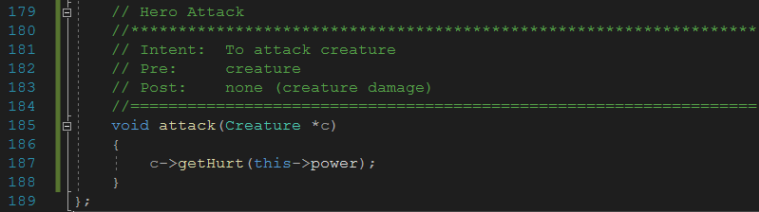
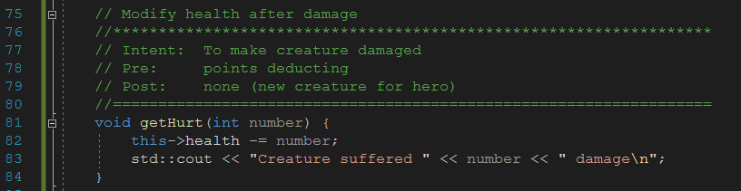
Call-by-value Pointers:攻擊生物
玩家從GM得到生物的pointer，並對其造成傷害

Slide 23

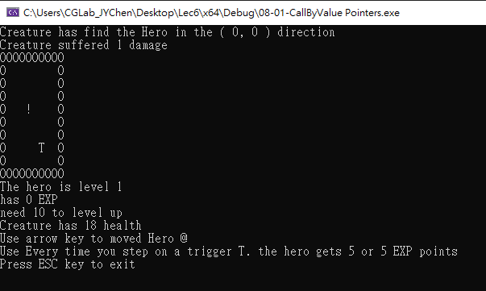
Call-by-value Pointers:攻擊生物
找出擋路的生物並對其造成傷害
玩家向右移動

Slide 24
Dynamic Arrays
Array variables is actually pointer variables!
Array variable "refers to" first indexed variable
Standard array: Fixed size
Dynamic array: size is dynamically determined while running
int a[10]; // a and p are both int * p; // pointer variables!
a and p are pointer variables
Can perform assignments: p = a; // Legal.
p now points where a points, i.e., to the first variable of array a
a = p; // ILLEGAL!
Array pointer is CONSTANT pointer!

Slide 25
Dynamic Arrays
int a[10] is actually int *const a
Read it backwards! i.e., constant pointer to int
Pointer itself is constant, hence prohibited to be redirected
Compare with constant "pointer variables"
const int *a == int const *a
pointer to constant int
*a = 1; // ILLEGAL!

Slide 26
Dynamic Arrays
Array limitations: must specify size first but may not know until running! → Must "estimate" maximum size needed
Dynamic arrays: Can grow and shrink as needed
Use new operator to create and delete operator to delete.
typedef double * DoublePtr; DoublePtr d; d = new double[10]; //Size in brackets
Creates dynamically allocated array variable d, with ten elements, base type double
d = new double[10]; … //Processing delete [] d;
Brackets indicate "array" is there.
Recall: d still points there! Should set d = NULL;

Slide 27
Dynamic Arrays
自訂的類別要有公開的預設建構子才能宣告成陣列
class A{
private:
A(){};
};
A v[100]; // compile error
A *p = new A[100];
vector 也有包含預設建構子在內的要求

Slide 28
Function that Returns an Array
Array type NOT allowed as return-type of function
Example: int [] someFunction(); // ILLEGAL!
Instead return pointer to array base type: int* someFunction(); // LEGAL!

Slide 29
Pointer Arithmetic
Can perform arithmetic on pointers
"Address" arithmetic
Example: typedef double* DoublePtr; DoublePtr d; d = new double[10];
d contains address of d[0]
d + 1 evaluates to address of d[1]
d + 2 evaluates to address of d[2]
Equates to "address" at these locations

Slide 30
Alternative Array Manipulation
Use pointer arithmetic!
"Step thru" array without indexing: for (int i = 0; i < arraySize; i++) cout << *(d + i) << " " ;
Equivalent to: for (int i = 0; i < arraySize; i++) cout << d[i] << " " ;
const char *g = “hello world”; for(const char *i=g; *i!=’\0’; i++){
cout << *i;
}
Only addition/subtraction on pointers
No multiplication, division
Can use ++ and -- on pointers

Slide 31
Multidimensional Dynamic Arrays
Recall: "arrays of arrays"
Type definitions help "see it": int **m = new int*[3];
Creates array of three pointers
Make each allocate array of 4 ints
for (int i = 0; i < 3; i++) m[i] = new int[4];
Results in three-by-four dynamic array!
記得 new 幾次就要 delete 幾次
for (int i = 0; i < 3; i++) delete [] m[i];
delete [] m;

Slide 32
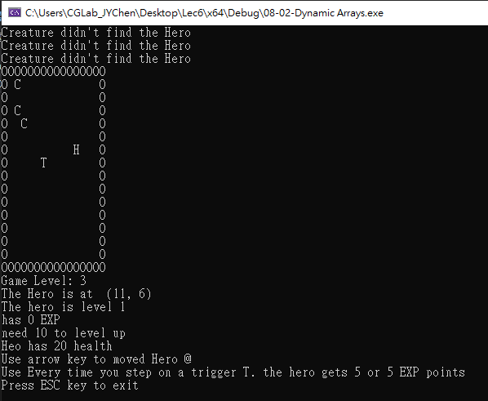
Dynamic Arrays:陣列管理
遊戲中的生物數量會隨著關卡等級動態改變。
生物數量 = 關卡等級
遊戲中的互動物件數量會隨著遊戲進行而改變

Slide 33
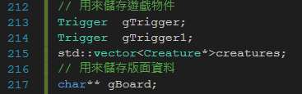
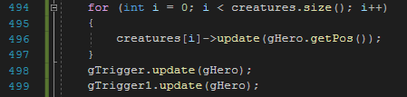
Dynamic Arrays:陣列管理
管理生物記憶體空間的pointer vector以及管理盤面的二維的動態陣列
由Pointer vector資訊更新各生物資訊：使用->以存取及編輯記憶體內資訊

Slide 34
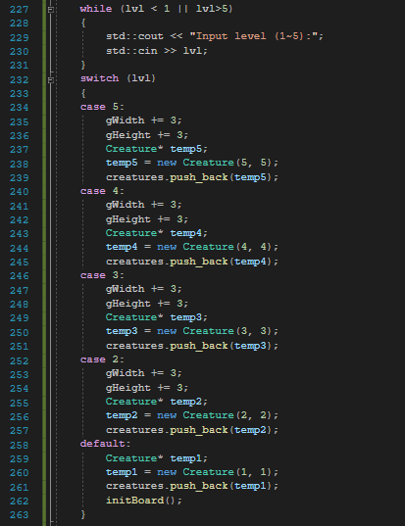
更改動態陣列生成參數
建立生物記憶體空間並配置於pointer vector管理
初始化遊戲版面

Slide 35
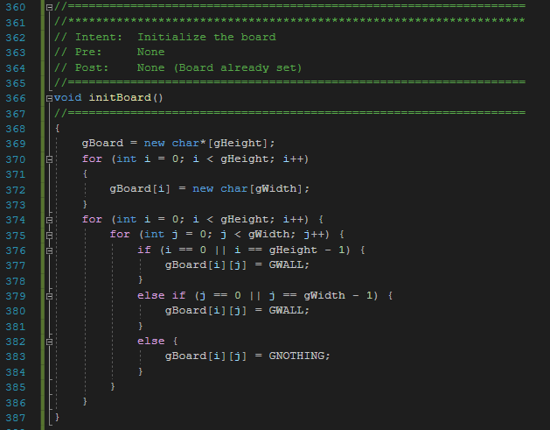
Dynamic Arrays:陣列管理
依前面的版面資訊生成版面
產生動態pointer陣列 的動態陣列
產生並配置一維動態陣列
配置版圖資訊

Slide 36
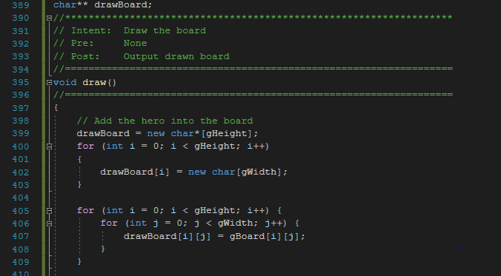
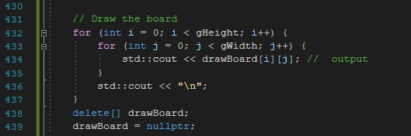
Dynamic Arrays:陣列管理
生成輸出盤面
Correct?
釋放記憶體空間

Slide 37
Back to Classes
The -> operator
Shorthand notation to combine dereference operator, *, and dot operator
Specifies member of class "pointed to“ by given pointer
MyClass *p; p = new MyClass; p->grade = "A"; // Equivalent to: // (*p).grade = "A";
Member functions might need to refer to itself, and can use predefined this pointer
Class Simple { public: void showStuff() const {
cout << stuff; // or cout << this->stuff;
} private: int stuff; };

Slide 38
The this Pointer
遊戲中的生物有許多欄位紀錄物件狀態。
利用This Pointer可以取得自身的變數與函式
血量
生命狀態
位置
攻擊範圍
代表符號
生物擁有許多不同的欄位

Slide 39
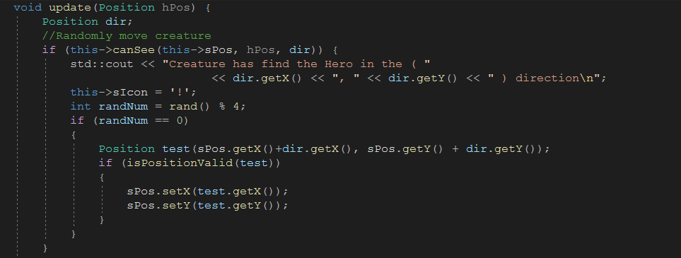
The this Pointer: Creature
this pointer也可用於函式呼叫
在沒有變數名稱重複的疑慮時this可以省去

Slide 40
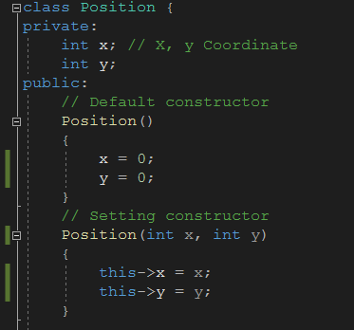
The this Pointer: Position
若出現衝突 this pointer可以用來區隔

Slide 41
Overloading Assignment Operator
Assignment operator returns reference for "chains" are possible
e.g., a = b = c; // Sets a and b equal to c
// => requires (a = b) = s3;
// =>(a = b) must return object of a’s type
// and pass to " = s3";
Operator must return "same type" as it’s left-hand side
Assignment operator must be member of the class
s1 = s2; // Think of like: s1.=(s2);
The this pointer will help with this!

Slide 42
Overloaded = Operator Definition
StringClass& StringClass::operator=(const StringClass& rtSide){
if (this == &rtSide) // if right side same as left side
return *this;
else {
capacity = rtSide.length;
length = rtSide.length;
delete[] this->a;
this->a = new char[capacity];
for (int I = 0; I < length; I++)
this->a[I] = rtSide.a[I];
return *this;
}
}
What does it mean?
Shallow copy
Assignment copies only member variable contents over
Default assignment and copy constructors
Deep copy
Pointers, dynamic memory involved
Must dereference pointer variables to "get to" data for copying
Write your own assignment overload and copy constructor in this case!

Slide 43
Destructor
Dynamically-allocated variables → Do not go away until "deleted"
If pointers are only private member data
They dynamically allocate "real" data in constructor
Must have means to “deallocate” when object is destroyed
Answer: destructor!
Opposite of constructor
Automatically called when object is out-of-scope.
Default to only remove ordinary variables but not dynamic.
Defined like constructor, just add ~
MyClass::~MyClass(){ //Perform delete clean-up duties };
A destructor has no parameters and thus, can have only one destructor;

Slide 44
Destructor Example
PFArrayD::~PFArrayD( )
{
delete [] a;
}
class PFArrayD
{
public:
PFArrayD( );
PFArrayD(int capacityValue);
PFArrayD(const PFArrayD& pfaObject);
…
~PFArrayD( );
private:
double *a; //for an array of doubles.
int capacity;
int used;
};
{ …
do
{
testPFArrayD( );
}while ((ans == 'y') || (ans == 'Y'));
}
void testPFArrayD( )
{ …
PFArrayD temp(cap);
while ((next >= 0) && (!temp.full( )))
{
temp.addElement(next);
cin >> next;
}
int ct = temp.getNumberUsed( );
for (i = 0; index < ct; i++) cout << temp[i] << " ";
…
} // calling destructor of temp
What if no our own destructor?
Memory leak

Slide 45
Copy Constructors
A copy constructor: one parameter of the same type as the class
Parameter must be a call-by-reference const parameter.
Defined and used just like any other constructor.
Automatically called when:
Class object declared and initialized to other object
When a function returns class type object
When a class is passed in a function based on call-by-value parameter
Requires "temporary copy" of object
Default copy constructor
Like default "=", performs member-wise copy
Classes have data members of pointers → write your own copy constructor!

Slide 46
An Example of Copy Constructor
PFArrayD b(20);
for ( int i = 0; i < 20; i++)
b.addElement(i);
PFArrayD temp(b); //Initialized by the copy constructor
PFArrayD::PFArrayD(const PFArrayD& pfaObject)
:capacity(pfaObject.getCapacity( )), used(pfaObject.getNumberUsed( )){
a = new double[capacity];
for (int i =0; i < used; i++)
a[i] = pfaObject.a[i];
}
Why not a= pfaObject.a instead?

Slide 47
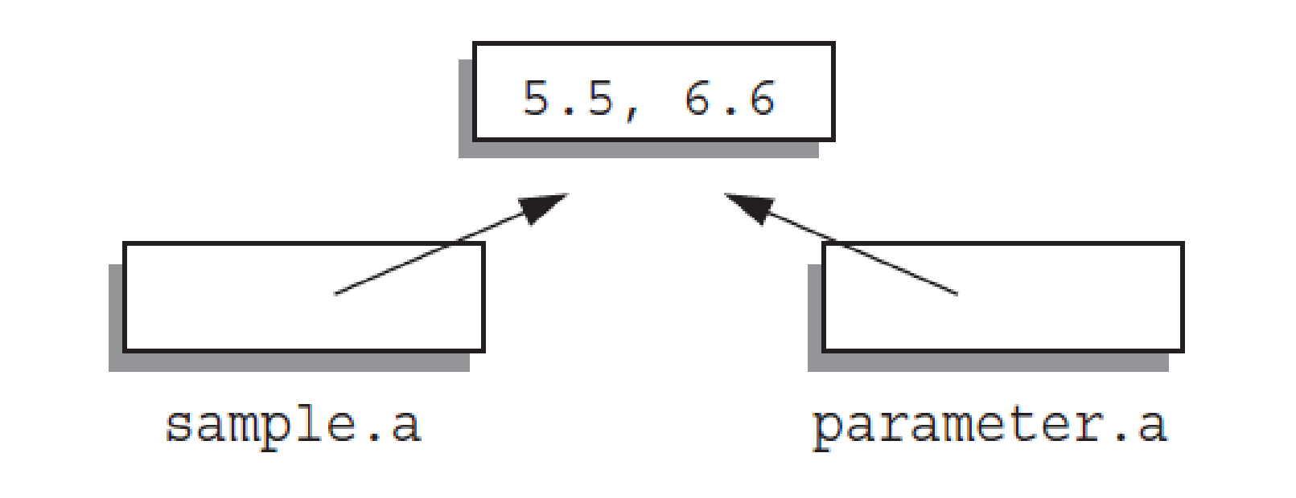
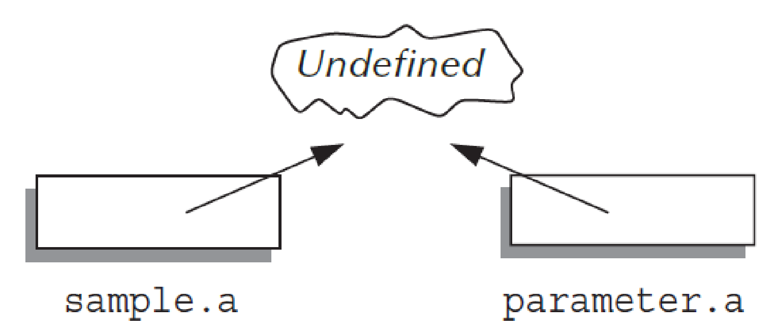
Default Copy Constructor
It simply copies the contents of member variables, namely
“sample” is copied to the local variable “parameter”, so
parameter.a = sample.a
What’s wrong with “copy to local variable?
Destructor delete the array
PFArrayD::~PFArrayD( )
{
delete [] a;
}
“delete [] a”=> delete [] parameter.a;

Slide 48
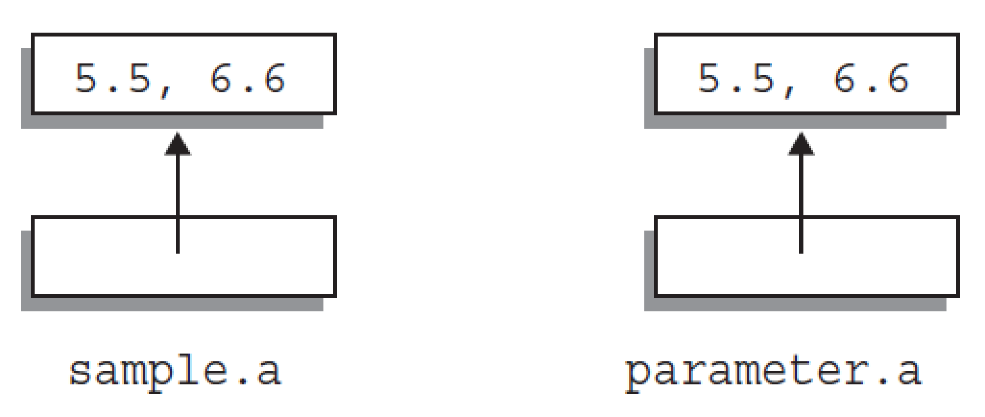
Using Our Copy Constructor
Changes made to parameter.a has no effect on the argument sample → the destructor deletes a different dynamic array
Similarly, a function returns a value of a class type needs your own “copy constructor”
PFArrayD b(20);
for ( int i = 0; i < 20; i++)
b.addElement(i);
PFArrayD temp(b); // Initialized by the copy constructor
temp is initialized so that its array member variable is different from the array member variable of b.
Any change that is made to temp will have no effect on b.

Slide 49
Why Use Copy Constructor for 2 & 3?
void showPFArrayD(PFArrayD parameter)
{
cout << "The first value is: "
<< parameter[0] << endl;
}
Main() { …
PFArrayD sample(1);
sample.addElement(5.5);
showPFArrayD(sample);
cout << "After call: " << sample[0] << endl;
…}
What output will be?
What output will be if use default copy constructor?

Slide 50
If use default copy constructor
When the function call, showPFArrayD(), ends
the destructor of “parameter” is called to return the memory
PFArrayD::~PFArrayD( )
{
delete [] a;
}
“delete [] a”=> delete [] parameter.a;

Slide 51
The Big Three
Big three { copy constructor, = assignment operator, the destructor };
While using any of them, you need all three
Any class uses pointers and the new operator, must define your own BIG THREE
CopyConstructible

Slide 52
STL 容器容納的類別
std::vector<A>
A 需要具備公開有效的：
預設建構子(Default constructor)
複製建構子(Copy constructor)
賦值運算子(operator=)
解構子(Destructor)
std::vector<A*>

Slide 53
Summary 1
Pointer is memory address
Provides indirect reference to variable
Dynamic variables
Created and destroyed while program runs
Freestore
Memory storage for dynamic variables
Dynamically allocated arrays
Size determined as program runs

Slide 54
Summary 2
Class destructor
Special member function
Automatically destroys objects
Copy constructor
Single argument member function
Called automatically when temp copy needed
Assignment operator
Must be overloaded as member function
Returns reference for chaining

