Slide 1
Chapter 8
Operator Overloading, Friends, and References

Slide 2
想一想
Why do we have to use Operatior Overloading?
Position heroPos(1,1);
Position moveUp(0,1);
HeroPos.x += 1;
heroPos = heroPos + moveUp;
Difference?

Slide 3
Why Operatior Overloading?
When there are many different structures：
Hard to keep track of different manipulations！
Attributes
Hp
Mp
Model file …
Behavior
Set/input hp, mp, etc.
Show attributes
Merge two character : hp+ hp, mp+mp
Split from one: hp- hp, mp- mp
Compare: “==“, “<“
…

Slide 4
Learning Objectives
Basic Operator Overloading
Unary operators
As member functions
Friends and Automatic Type Conversion
Friend functions, friend classes
Constructors for automatic type conversion
References and More Overloading
<< and >>
Operators: =, [], ++, --

Slide 5
Operator Overloading
Operators +, -, %, ==, etc.
Simply "called" with different syntax: x + 7
"+" is binary operator with x & 7 as operands
We "like" this notation as humans
Think of it as: +(x, 7)
"+" is the function name
x, 7 are the arguments
Function "+" returns "sum" of it’s arguments
We can overload them!
To work with OUR types!
To add "Chair types", or "Money types"
As appropriate for our needs
In "notation" we’re comfortable with
Always overload with similar "actions"!
Two types of implementation
As standalone functions
As member functions.

Slide 6
Example: Money class
class Money
{
public:
Money( );
Money(double amount);
Money(int theDollars, int theCents);
Money(int theDollars);
double getAmount( ) const;
int getDollars( ) const;
int getCents( ) const;
void input( ); //Reads the dollar sign as well as the amount number.
void output( ) const;
private:
int dollars; //A negative amount is represented as negative dollars and
int cents; //negative cents. Negative $4.50 is represented as -4 and -50
int dollarsPart(double amount) const;
int centsPart(double amount) const;
int round(double number) const;
};
const Money operator +(const Money& amount1, const Money& amount2);
const Money operator -(const Money& amount1, const Money& amount2);
bool operator ==(const Money& amount1, const Money& amount2);
const Money operator -(const Money& amount);

Slide 7
Overloading Basics
Overloading operators
VERY similar to overloading functions
Operator itself is the "name" of function
Example Declaration:
Overloads + for operands of type Money
Uses constant reference parameters for efficiency
Returned value is type Money
Allows addition of "Money" objects
Return const for what?
const Money operator +(const Money& amount1, const Money& amount2);

Slide 8
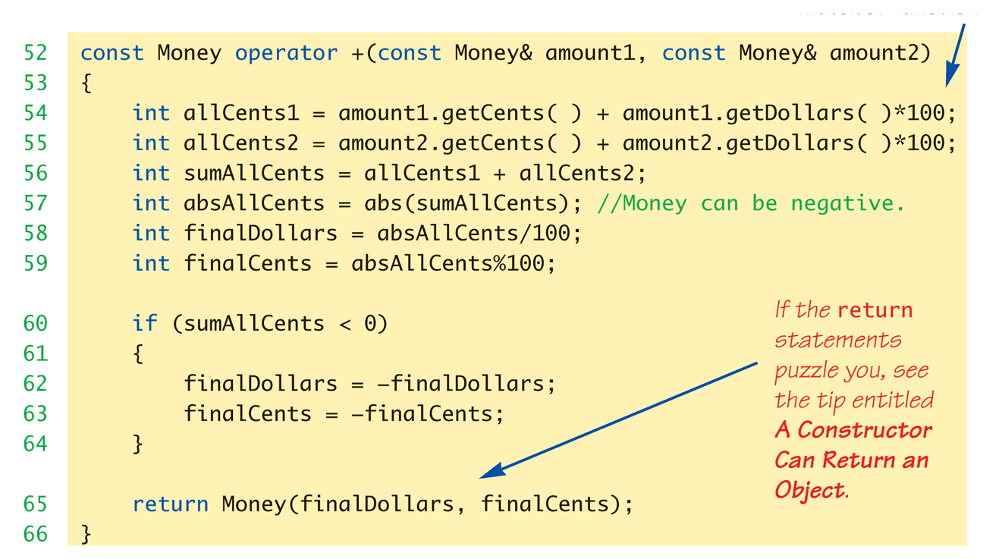
Definition and Usage of "+" operator
int main( )
{
Money yourAmount, myAmount(10, 9);
…
Money ourAmount = yourAmount + myAmount;
…
Money diffAmount = yourAmount - myAmount;
…
return 0;
}

Slide 9
Constructors Returning Objects
Constructor a "void" function?
We "think" that way, but no
A "special" function: with special properties and CAN return a value!
Recall return statement in "+" overload for Money type:
return Money(finalDollars, finalCents);
Returns an "invocation" of Money class!
So constructor actually "returns" an object!
Called an "anonymous object"

Slide 10
Redefining Movement
Original: Use int in struct for manipulation: struct Position{ int x, y; }; Position heroPos; heroPos.x += a; heroPos.y += b;
New thinking: What if we could add up position info? Position up = {0, 1}; heroPos = heroPos + up;
Eliminates confusion and second-level changes
How to implement??

Slide 11
Redefining Movement
Other overloadable operators may also be used: heroPos += 1; //move up 1 heroPos -= 1; //move down 1 heroPos *= 1; //move right 1 heroPos /= 1; //move left 1
Overloading operators could be further customized
How to return value for changes?

Slide 12
Returning by const Value
Consider "+" operator overload again: const Position operator +(const Position& heroPos, const Position& moveDir);
Returns a "constant object"?
Why?
Consider impact of returning "non-const“ object to see…
We could invoke member functions on object returned by expression m1+m2:
(heroPos+moveDir).output(); //Legal, right?
Not a problem: doesn’t change anything
(heroPos+moveDir).input(); //Legal, but MODIFIES!
Allows modification of "anonymous" object!
Logically strange!
So we define the return object as const

Slide 13
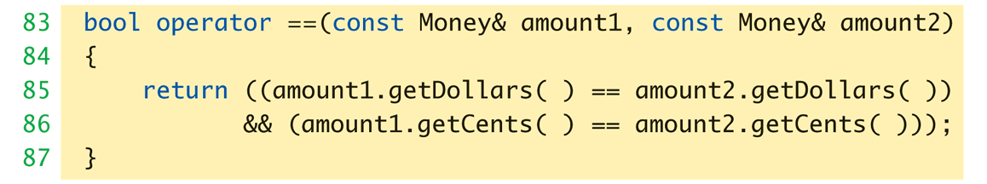
Overloaded "=="
Equality operator, ==
Enables comparison of Money objects
Declaration: bool operator ==(const Money& amount1, const Money& amount2);
Returns bool type for true/false equality
Again, it’s a non-member function (like "+" overload)

Slide 14
Position Check Function
Predefined “==“ : int comparison int x = 0, y = 5; x == y; // false
For new class or structure: undefined use of operators e.g. Comparing two positions in Dungeon: if (hero.getPos() == creature. getPos()) { //Do Domething }

Slide 15
Overloaded "<"、">"
介面格式與 == 基本相同
也有 “<=” 以及 “>=”
實現了 “<”，才能夠直接使用 std::sort、std::map
bool operator <(const Money& amount1, const Money& amount2);
bool operator >(const Money& amount1, const Money& amount2);
bool operator <=(const Money& amount1, const Money& amount2);
bool operator >=(const Money& amount1, const Money& amount2);
std::vector<Money> prices = {3.14, 9.8, 2.718};
std::sort(prices.begin(), prices.end());
std::map<Money, std::string> menu = {
{3.14, “PI”}, {9.8, “G”, {2.718, “e”}
}

Slide 16
Overloading Unary Operators
C++ has unary operators:
Defined as taking one operand
e.g., - (negation): x = -y; // Sets x equal to negative of y
Other unary operators: ++, --
Unary operators can also be overloaded
Overloaded "-" function declaration
const Money operator –(const Money& amount);
Notice: only one argument
"-" operator is overloaded twice!
For two operands/arguments (binary)
For one operand/argument (unary)
Definitions must exist for both
const Money operator –(const Money& amount) { return Money(-amount.getDollars(), -amount.getCents());
}

Slide 17
Overloaded "-" Usage
Position heroPos(10,1), moveDir(0,1), endPos; endPos = heroPos - moveDir;
Calls binary "-" overload
endPos.output(); // Displays(10,0) endPos = -heroPos;
Calls unary "-" overload
endPos.output() ; // Displays(-10,-1)

Slide 18
Overloading as Member Functions
Can overload as "member operator"
Only ONE parameter, not two!
Calling object serves as 1st parameter
Money cost(1, 50), tax(0, 15), total; total = cost + tax;
If "+" overloaded as member operator:
Variable/object cost is calling object
Object tax is single argument
Think of as: total = cost.+(tax);
Declaration of "+" in class definition:
Money operator +(const Money& amount);
Notice only ONE argument

Slide 19
Sample Implementation
const Money Money::operator +(const Money& secondOperand) const
{
int allCents1 = cents + dollars*100;
int allCents2 = secondOperand.cents + secondOperand.dollars*100;
int sumAllCents = allCents1 + allCents2;
int absAllCents = abs(sumAllCents); //Money can be negative.
int finalDollars = absAllCents/100;
int finalCents = absAllCents%100;
if (sumAllCents < 0)
{
finalDollars = -finalDollars;
finalCents = -finalCents;
}
return Money(finalDollars, finalCents);
}

Slide 20
Sample Implementation
int Money::dollarsPart(double amount) const
{
return static_cast<int>(amount);
}
int Money::centsPart(double amount) const
{
double doubleCents = amount*100;
int intCents = (round(fabs(doubleCents)))%100;//% can misbehave on negatives
if (amount < 0)
intCents = -intCents;
return intCents;
}
int Money::round(double number) const
{
return static_cast<int>(floor(number + 0.5));
}
What have you noticed a special keyword?

Slide 21
Constant Functions
Formal syntax
<return-value> <class>::<mbr-fun>(<args>) const {
// ...
}
When to make function const?
Constant functions not allowed to alter class member data
Constant objects can ONLY call constant member functions
Also, only constant member functions can be called inside constant member function
Any member function that will NOT modify data should be made const

Slide 22
Overloading Operators: Which Method?
Object-Oriented-Programming
Principles suggest member operators
Many agree, to maintain "spirit" of OOP
Member operators more efficient
No need to call accessor & mutator functions
At least one significant disadvantage
Automatic type conversion problem!

Slide 23
Automatic Type Conversion (1 of 2)
Overload a binary operator as a member operator
1st argument is a calling object, and only the second “argument” is a true argument
So, Any automatic type conversion will only apply to the second argument
Example
Money baseAmount(100, 60), fullAmount;
fullAmount = baseAmount + 25;
Legal!
Money has a constructor with one argument of type int , and so the value 25 will be automatically converted to a value of type Money

Slide 24
Automatic Type Conversion (2 of 2)
What if
Money baseAmount(100, 60), fullAmount;
fullAmount = 25 + baseAmount ;
Illegal!
int is a primitive type ad the addition with Money class is undefined
Overloading an operator as a non-member gives you automatic type conversion of all arguments

Slide 25
The friend Specifier
There is a way to overload an operator that offers both of advantages:
Efficiency
Auto type conversion
Overloading as a friend function
class Money {
…
friend const Money operator +(const Money& amount1, const Money& amount2);
friend const Money operator -(const Money& amount1, const Money& amount2);
friend bool operator ==(const Money& amount1, const Money& amount2);
friend const Money operator -(const Money& amount);
…
};

Slide 26
friend Functions
Disadvantage of non-member functions such as operator overloading
Access data through accessor and mutator functions
Very inefficient due to overhead of calls
friend specifier can directly access private class data
No overhead, more efficient
Best to make non-member operator overloading as friends!
friend function of a class
Not a member function
Has direct access to private members, just as member functions do
Use keyword friend in front of function declaration
Specified IN class definition
But they’re NOT member functions!
Friends can be any function
not only for operator overloading!

Slide 27
More on the friend Specifier
Friends not pure?
"Spirit" of OOP dictates all operators and functions be member functions
Many believe friends violate basic OOP principles
Advantageous?
For operators: very!
Allows automatic type conversion
Still encapsulates: friend is in class definition
Improves efficiency
Entire class can also be friends
class Monster {
…
friend class Creature;
};
class Creature is friend of class Monster
All class member functions of Creature are friends of Monster
NOT reciprocated

Slide 28
Non-member Example
Compare to overloaded as
member functions
functions
const Money operator +(const Money& amount1, const Money& amount2) {
int allCents1 = amount1.cents + amount1.dollars * 100;
int allCents2 = amount2.cents + amount2.dollars * 100;
int sumAllCents = allCents1 + allCents2;
int absAllCents = abs(sumAllCents); // Money can be negative.
int finalDollars = absAllCents / 100;
int finalCents = absAllCents % 100;
if (sumAllCents < 0) {
finalDollars = -finalDollars;
finalCents = -finalCents;
}
return Money(finalDollars, finalCents);
}

Slide 29
References
Reference defined:
Name of a storage location
Similar to "pointer"
Example:
int robert; int& bob = robert;
bob is reference to storage location for robert
Changes made to bob will affect Robert
Useful in several cases:
Call-by-reference
Often used to implement this mechanism
Returning a reference
Allows operator overload implementations to be written more naturally
Think of as returning an "alias" to a variable

Slide 30
Returning Reference
Formal syntax:
double& sampleFunction(double& variable);
double& and double are different
Must match in function declaration and definition
Returned item MUST have a valid reference
Cannot be expression like "x+5"
Has no place in memory to "refer to"
Very dangerous if the reference points to a local variable in the function.

Slide 31
Example of Returning a Reference
double& sampleFunction(double& variable) { return variable;
}
double m = 99;
cout << sampleFunction(m) << endl;
sampleFunction(m) = 42;
cout << m << endl;
output 99 and then 42

Slide 32
Types of Returning Value
A function can return a value of type T in four different ways:
By plain old value, as in the function declaration T f();
By constant value, as in the function declaration const T f();
By reference, as in the function declaration T& f();
By const reference, as in the function declaration const T& f();

Slide 33
Other Overloads
Function call operator, ()
Must be overloaded as member function
Allows use of class object like a function
Can overload for all possible numbers of arguments
Example: Aclass anObject; anObject(42); // If ( ) overloaded → calls overload
&& and || operator
Predefined versions work for bool types
Recall "short-circuit evaluation"
func1() && func2()
func1() || func2()
When overloaded, no longer uses short-circuit
Uses "complete evaluation" instead
Contrary to expectations
Generally should NOT overload these operators

Slide 34
Overloading >> and << (1 of 3)
Enables input and output of our objects
Similar to other operator overloads, but with new subtleties
Improves readability
Enables: cout << myObject; → Returns its first argument type, ostream cin >> myObject; → Returns its first argument type, istream
Instead of need for: myObject.output(); myObject.input();

Slide 35
Overloading >> and << (2 of 3)
Insertion operator, <<
Used with cout, and a binary operator
Example: cout << "Hello";
Operator is <<
1st operand is predefined object cout
From library iostream
2nd operand is literal string "Hello"

Slide 36
Overloading >> and << (3 of 3)
What to return?
cout object!
Returns its first argument type, ostream
Why?
To allow cascading: Money amount(100); cout << amount; cout << "I have " << amount;

Slide 37
Example of Overloading <<
class Money {
public:
Money( );
…
friend ostream& operator <<(ostream& outputStream, const Money& amount);
friend istream& operator >>(istream& inputStream, Money& amount);
…
};
ostream& operator <<(ostream& outputStream, const Money& amount) {
int absDollars = abs(amount.dollars);
int absCents = abs(amount.cents);
if (amount.dollars < 0 || amount.cents < 0)
//accounts for dollars == 0 or cents == 0
outputStream << "$-";
else
outputStream << '$';
outputStream << absDollars;
if (absCents >= 10)
outputStream << '.' << absCents;
else
outputStream << '.' << '0' << absCents;
return outputStream;
}

Slide 38
Example of Overloading >>
class Money {
public:
Money( );
…
friend ostream& operator <<(ostream& outputStream, const Money& amount);
friend istream& operator >>(istream& inputStream, Money& amount);
…
};
istream& operator >>(istream& inputStream, Money& amount) {
char dollarSign;
inputStream >> dollarSign; //hopefully
if (dollarSign != '$') {
cout << "No dollar sign in Money input.\n";
exit(1);
}
double amountAsDouble;
inputStream >> amountAsDouble;
amount.dollars = amount.dollarsPart(amountAsDouble);
amount.cents = amount.centsPart(amountAsDouble);
return inputStream;
}

Slide 39
Example of Overloading >> and <<
class Money {
public:
Money( );
…
friend ostream& operator <<(ostream& outputStream, const Money& amount);
friend istream& operator >>(istream& inputStream, Money& amount);
…
};
int main() {
Money yourAmount, myAmount(10, 9);
cout << "Enter an amount of money: ";
cin >> yourAmount;
cout << "Your amount is " << yourAmount << endl;
cout << "My amount is " << myAmount << endl;
if (yourAmount == myAmount)
cout << "We have the same amounts.\n";
else
cout << "One of us is richer.\n";
Money ourAmount = yourAmount + myAmount;
cout << yourAmount << " + " << myAmount
<< " equals " << ourAmount << endl;
return 0;
}

Slide 40
>> and << as Member Function
Can we overload >> and << as member function?

Slide 41
>> and << as Member Function
Can we overload >> and << as member function?
No. But why?

Slide 42
>> and << as Member Function
Can we overload >> and << as member function?
No. But why?
Similar with the automatic type conversion issue
YOUR class is unknown to the istream/ostream class, so cannot be put on the right side as the single argument
Alternative way:
class A {
ostream& write(std::ostream& dest) const {
// write self to dest
return dest;
}
};
ostream& operator<<(ostream& os, A const& m) {
return m.write(os);
}

Slide 43
Assignment Operator =
Must be overloaded as member operator
Automatically overloaded
Default assignment operator:
Member-wise copy
Default OK for simple classes
But with pointers → must write our own!

Slide 44
Increment and Decrement
Each operator has two versions
Prefix notation: ++x;
Postfix notation: x++;
Must distinguish in overload
Standard overload method → Prefix
Add 2nd parameter of type int → Postfix
Just a marker for compiler!
Specifies postfix is allowed
The increment and decrement operator on simple types, such as int and char , return
by reference in the prefix form and
by value in the postfix form. (why?)
Simply return by value for all versions of the increment and decrement operators.

Slide 45
Examples of Increment and Decrement
class IntPair {
public:
IntPair(int firstValue, int secondValue);
IntPair operator++( ); // Prefix version
IntPair operator++(int); // Postfix version
void setFirst(int newValue);
void setSecond(int newValue);
int getFirst( ) const;
int getSecond( ) const;
private:
int first;
int second;
};

Slide 46
Array Operator []
Can only be overloaded as member function
Better return a reference
class CharPair {
public:
char& operator[](int index);
private:
char first;
char second;
};
char& CharPair::operator[](int index) {
if (index == 1)
return first;
else if (index == 2)
return second;
else {
cout << "Illegal index value.\n";
exit(1);
}
}

Slide 48
Summary 1
C++ built-in operators can be overloaded
To work with objects of your class
Operators are really just functions
Friend functions have direct private member access
Operators can be overloaded as member functions
1st operand is calling object

Slide 49
Summary 2
Friend functions add efficiency only
Not required if sufficient accessors/mutators available
Reference "names" a variable with an alias
Can overload <<, >>
Return type is a reference to stream type

