Slide 1
Chapter 12
Streams and File I/O

Slide 2
Learning Objectives
I/O Streams
File I/O
Character I/O
Tools for Stream I/O
File names as input
Formatting output, flag settings
Stream Hierarchies
Preview of inheritance
Random Access to Files

Slide 3
想一想
遊戲中有哪些功能牽涉到輸入與輸出功能?
這些功能需要遊戲中的那些資訊來達成?

Slide 4
想一想
遊戲中有哪些功能牽涉到輸入與輸出功能?
使用者操作。
存讀檔。
……
這些功能需要遊戲中的那些資訊來達成?
鍵盤資訊。
關卡資訊。

Slide 5
Introduction
Streams: A flow of characters
Special objects for input and output
File I/O
Uses inheritance but will be covered in chapter 14
File I/O very useful, so covered here
Input stream: Flow into program and can come from keyboard, file, and string and character arrays
Output stream: Flow out of program and can go to screen, file, and string and character arrays.
We’ve used streams already
cin: Input stream object connected to keyboard
cout: Output stream object connected to screen
ifstream: Input stream object connected to file
ofstream: Output stream object connected to file
Can define other streams: to or from files and string and character arrays.

Slide 6
Streams Usage Like cin, cout
Consider:
Defines stream inStream from some file: int HP; inStream >> HP; // Reads value from stream,
// assigned to HP
Program defines stream outStream that goes to some file outStream << “Hero has” << HP << “ health”;
// Writes value to stream, which goes to file

Slide 7
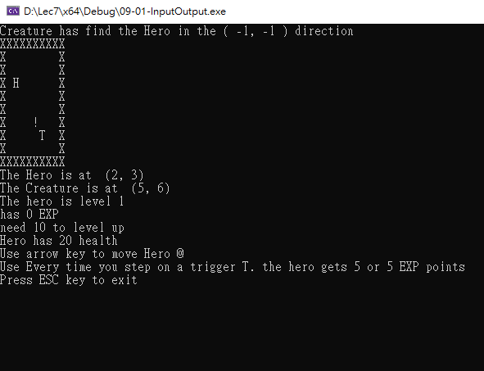
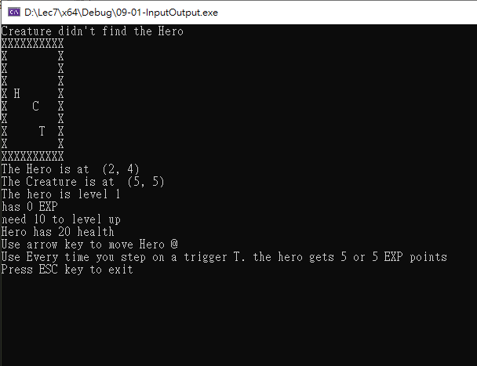
訊息輸出入
地城遊遊中的輸出入訊息，是透過_getch()與cout處理
輸出遊戲畫面與資訊。
輸入鍵盤操作。
輸入向下

Slide 8
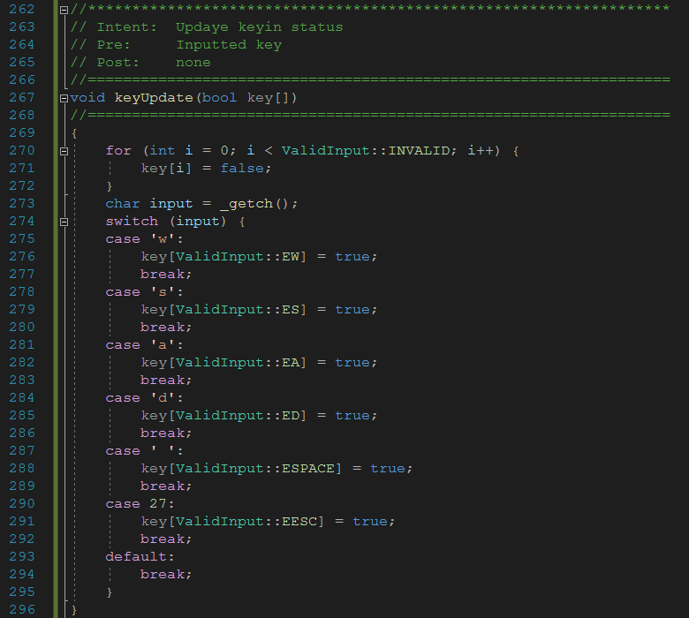
訊息輸出入
_getch()讓可在使用者不需輸入enter的情況下讀取鑑盤輸入資訊
遊戲透過輸入資訊處理主角的移動、觸發開關等操作

Slide 9
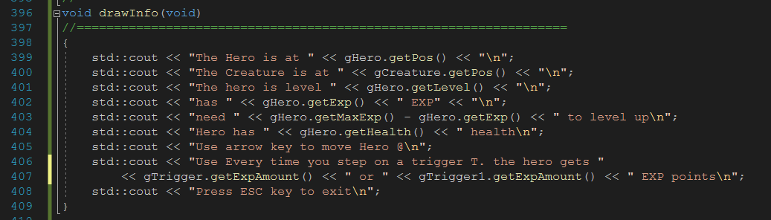
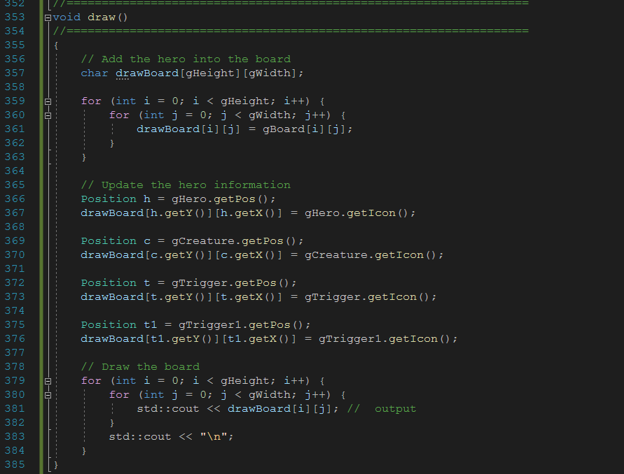
訊息輸出入
每個update遊戲會清空畫面並重新輸出遊戲中的版面與資訊

Slide 10
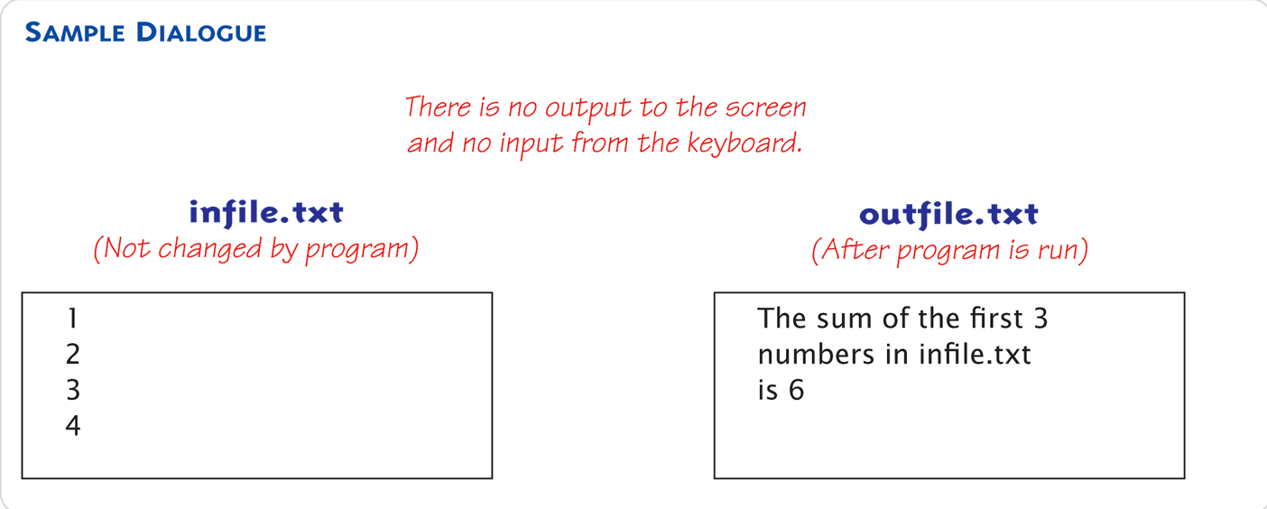
Files
We’ll use text files but they can also be binary files
Reading from file for taking input
Writing to file for sending output
Start at beginning of file to end
Other methods available and the following discuss this simple text file access
#include <iostream> //for endl
#include <fstream>
int main( )
{
std::ifstream inStream;
std::ofstream outStream;
inStream.open("infile.txt");
outStream.open("outfile.txt");
int first, second, third;
inStream >> first >> second >> third;
outStream << “The sum of the first 3\n” << “numbers in infile.txt\n” << "is " << (first + second + third) << std::endl;
inStream.close( );
outStream.close( );
return 0;
}

Slide 11
File Connection
Must first connect file to stream object
Classes ifstream and ofstream defined in <fstream> under std namespace
For input file → ifstream object
For output file → ofstream object
#include <fstream> using std::ifstream; using std::ofstream;

Slide 12
Declare and Use Streams
Stream must be declared like any other class variable: std::ifstream inStream; std::ofstream outStream;
Must then "connect" to file: "opening the file“ with member function open
inStream.open(“InputMap.txt");
outStream.open(“SaveFile.txt");
Can specify complete pathname.
Once declared, use normally!
int heroHP, heroEXP; inStream >> heroHP >> heroEXP;
outStream << “Hero Health = " << heroHP << " Hero Experience = " << heroEXP;

Slide 13
File Names
Files have two names to our programs
External file name: "physical file name“/"real file name" like "infile.txt"
Used only once in program (to open)
Stream name: also called "logical file name"
Program uses this name for all file activity

Slide 14
File Names
fstream 由幾個元素組成：
存取的檔案路徑
目前的存取位址(讀寫頭位址)
緩衝區
狀態(檔案結尾/發生錯誤)
比起一個檔案，更近似一個指標
FILE *

Slide 15
Close and Flush Files
Files should be closed
When program completed getting input or sending output
Disconnects stream from file
inStream.close(); outStream.close();
Note no arguments
Files automatically close when program ends
Output often "buffered“ i.e. temporarily stored before written to file→Written in "groups“ for efficiency.
Flush: force writing
outStream.flush(); // member functions of
// all output stream
Closing file automatically calls flush()

Slide 16
Appending and Checking Open Status
Standard open for output begins with empty file
Even if file exists → contents lost
Open for append: std::ofstream outStream; outStream.open(“saveFile.txt", std::ios::app);
If file doesn’t exist → creates it
If file exists → appends to end
2nd argument is class ios defined constants in <iostream>, std namespace
File opens could fail due to
If input file doesn’t exist
No write permissions to output file
Unexpected results
Member function fail()
inStream.open(“SaveFile.txt"); if (inStream.fail()){ cout << "File open failed.\n"; exit(1); }

Slide 17
Alternative Syntax for File Opens
Can specify filename at declaration
Passed as argument to constructor
ifstream inStream; inStream.open(“saveFile.txt"); EQUIVALENT TO: ifstream inStream("saveFile.txt");

Slide 18
File’s Character I/O and Check End of File
File streams can use the same character I/O of cin and cout!
Member functions work same:
get, getline
put, putback,
peek, ignore
Two ways to test for end of file
Member function eof()returns bool
Read operation returns bool value! (inStream >> next)
inStream.get(HP); while (!inStream.eof()){ cout << HP; inStream.get(HP); }
double HP, addHP = 0; while (inStream >> addHP) HP = HP + addHP; cout << “Hero Has " << HP << “ HP” << endl;

Slide 19
Examples
char next;
int n = 1;
fin.get(next);
fout << n << " ";
while (! fin.eof( )) {
fout << next;
if (next == '\n'){
n++;
fout << n << ' ';
}
fin.get(next);
}
fin.close( );
fout.close( );
return 0;
} //
int main( )
{
ifstream fin;
ofstream fout;
fin.open("story.txt");
if (fin.fail( )) {
cout << "Input file opening
failed.\n";
exit(1);
}
fout.open("numstory.txt");
if (fout.fail( )) {
cout << "Output file
opening failed.\n";
exit(1);
}

Slide 20
Conversion Operator
Recall that >> should return the reference itself
istream& operator>> (bool& val)
Why it can be evaluated as bool?
Conversion operator
operator bool()
returns whether the stream has errors
Generally, don’t write your own conversion operator

Slide 21
Binary Mode
在 ifstream/ofstream 的建構子或者 open() 的第二個參數填入 std::ios::binary
std::ofstream fp("test.txt", std::ios::binary);
讀寫介面
read(char* s, std::streamsize count)
write(const char_type* s, std::streamsize count)

Slide 22
Tools
Stream open() operation
Its argument is a string type (or filesystem::path since c++17), and can be literal (used so far) or variable for more flexibility char fileName[16]; ifstream inStream; cout << "Enter file name: "; cin >> fileName; inStream.open(fileName);
File streams can also uses output formatting as cout: cout.setf(ios::fixed); cout.setf(ios::showpoint); cout.precision(2);
Member function precision(x)sets the number of digits after decimal
Member function setf()sets the output flags which are constants in class ios defined in library <iostream>, std namespace

Slide 23
setf() Examples
Common flag constants:
outStream.setf(ios::fixed);
Sets fixed-point notation (decimal)
outStream.setf(ios::showPoint)
Always include decimal point
outStream.setf(ios::right);
Sets right-justification
Set multiple flags with one call: outStream.setf(ios::fixed | ios::showpoint |ios::right);

Slide 24
Tools
Member functions width(x):
Sets width to "x" for outputted value to form "columns", and it only affects "next" outputted
Must set width before each value in order to affect all which are typical to have "varying" widths
Manipulator defined: "A function called in nontraditional way“.
Can have arguments and placed after insertion operator
Do same things as member functions but in different way.
Commonly to use both member functions and manipulators "together“.
setw() and setprecision() are in library <iomanip>, std namespace

Slide 25
setw() and setprecision()
cout << "Start" << setw(4) << 10 << setw(4) << 20 << setw(6) << 30;
Results in: Start 10 20 30
Note: setw() affects only NEXT outputted value i.e. must have setw() before each outputted item to affect all.
cout.setf(ios::fixed | ios::showpoint); cout << "$" << setprecision(2) << 10.3 << " " << "$" << 20.5 << endl;
Results in: $10.30 $20.50

Slide 26
Flags
Recall: member function setf()
Sets condition of output flags
All output streams have setf() member
Flags are constants in class ios
In library <iostream>, std namespace

Slide 27
Manipulator setprecision()
setprecision() manipulator: cout.setf(ios::fixed | ios::showpoint); cout << "$" << setprecision(2) << 10.3 << " " << "$" << 20.5 << endl;
Results in: $10.30 $20.50

Slide 28
Saving Flag Settings
Flag settings "stay" until changed
Precision and setf flags can be saved and restored
Function precision() returns current setting if called with no arguments
Member function flags() provides similar capability
void outputStuff(ofstream& outStream){ int precisionSetting = outStream.precision(); long flagSettings = outStream.flags(); outStream.setf(ios::fixed | ios::showpoint); outStream.precision(2); outStream.precision(precisionSetting); outStream.flags(flagSettings); }
Function that saves & restores "typical" settings

Slide 29
Restoring Default setf Settings
Can also restore default settings: cout.setf(0, ios::floatfield);
Not necessarily the "last" setting!
Default values are implementation-dependent
Does not reset precision settings
Only setf settings

Slide 30
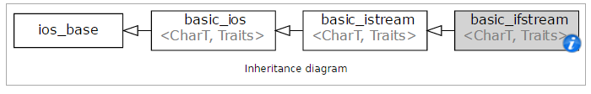
Stream Hierarchies
Class Relationships
"Derived from"
One class obtained from another class
Then features are "added"
Example:
Input file streams class is derived from class of all input streams
It then adds open and close member functions
i.e.: ifstream is derived from istream
http://en.cppreference.com/w/cpp/io/basic_ifstream

Slide 31
Class Inheritance "Real" Example
Class of all convertibles is derived from class of all automobiles
Every convertible is an automobile
Convertible "adds features" to automobile

Slide 32
Stream Class Inheritance
Consider:
If D is derived class of class B
All objects of type D are also of type B
e.g., A convertible is also an automobile
Regarding streams:
An ifstream object is also an istream object
Should use istream objects for parameters
More objects can be plugged in!
B
D

Slide 33
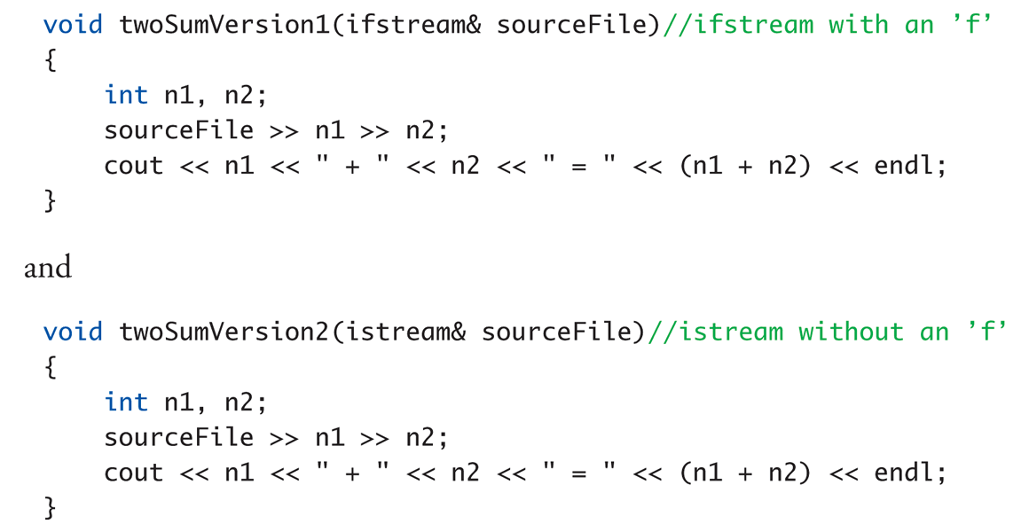
Stream Class Inheritance Example

Slide 34
Stream Class Inheritance Example Calls
Considering previous functions:
// ifstream fileIn;
// istream cin;
twoSumVersion1(fileIn); // Legal!
twoSumVersion1(cin); // ILLEGAL!
Because cin is not of type ifstream!
twoSumVersion2(fileIn); // Legal!
twoSumVersion2(cin); // Legal!
More versatile
istream parameter accepts both objects

Slide 35
stringstream
The stringstream class is another example of inheritance
Derived from the iostream class
Allows you to perform stream operations to or from a string, similar to how you perform stream operations from cin or from a file
Shares or inherits the same methods
Useful for converting strings to other data types and vice versa

Slide 36
stringstream
The stringstream class is derived from iostream when extracting/putting fields from/to the string, i.e., converting strings to other data types and vice versa
To use
#include <sstream>
using std::stringstream;
Create an object of type stringstream
stringstream ss;
To clear and initialize to blank
ss.clear( );
ss.str("");
To create a string from other variables
ss << Icon << " " << HP; // Icon is a char, HP is an int
To extract variables from a string
ss << “H 10";
ss >> Icon >> HP;
// Icon is set to ‘H' and HP is set to 10

Slide 37
stringstream Demo
int main( )
{
stringstream ss;
string scores = "Luigi 70 100 90";
// Clear the stringstream
ss.str(""); // gets or sets the contents
ss.clear(); // clears error and eof flags
// Put the scores into the stringstream
ss << scores;
// Extract the name and average the scores
string name = "";
int total = 0, count = 0, average = 0;
int score;
ss >> name; // Read the name
while (ss >> score){ // Read until the end of the string
count++;
total += score;
}

Slide 38
stringstream Demo
if (count > 0) {
average = total / count;
}
// Clear the stringstream
ss.clear();
ss.str("");
// Put in the name and average
ss << "Name: " << name << " Average: " << average;
// Output as a string
cout << ss.str() << endl;
return 0;
}

Slide 39
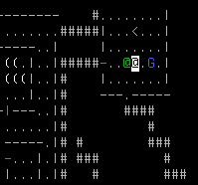
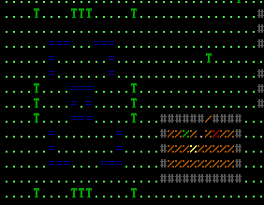
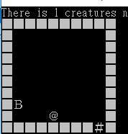
讀檔範例:讀取遊戲地圖
不同地城遊戲使用的地圖不一定一樣，可增加遊戲彈性，
空地、牆壁、主角、門、生物……

Slide 40
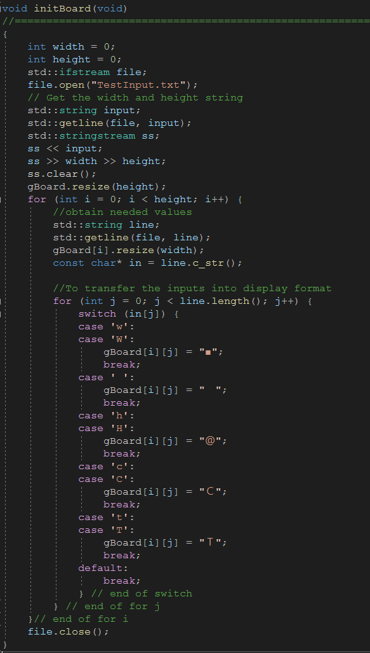
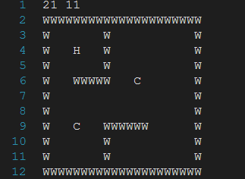
讀檔範例:讀取遊戲地圖
讀取檔案
StringStream讀入字串輸出數字
逐行獲得資訊
分析每一行資訊並更新符號定義
讀入之檔案

Slide 41
Random Access to Files
Sequential Access: Most commonly used
Random Access: Access "randomly" to any part of file
Rapid access to records and the database may be very large
Use fstream objects
Opens same as istream or ostream with the second argument
fstream rwStream; rwStream.open("stuff", ios::in | ios:: out);
Move about in file
rwStream.seekp(1000); // Position put-pointer
// at 1000th byte
rwStream.seekg(1000); // Position get-pointer
// at 1000th byte

Slide 42
Exmples: Random Access Tools
#include <iostream>
#include <string>
#include <sstream>
int main()
{
std::string str = "Hello, world";
std::istringstream in(str);
std::string word1, word2;
in >> word1;
in.seekg(0); // rewind
in >> word2;
std::cout << "word1 = " << word1 << '\n'
<< "word2 = " << word2 << '\n';
}
Output:
word1 = Hello,
word2 = Hello,

Slide 43
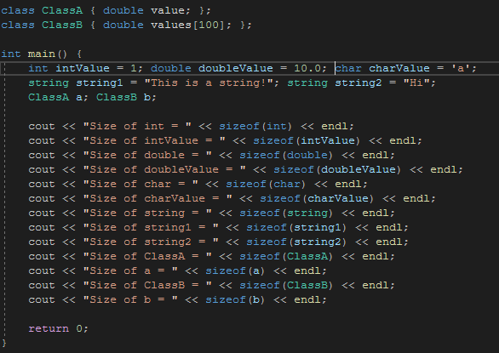
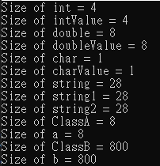
Random Access Sizes
To perform random access → must know sizes
sizeof() operator determines number of bytes
Position put-pointer at 100th record of objects: rwStream.seekp(100*sizeof(myObject) – 1);

Slide 44
寫檔範例:儲存遊戲進度
許多遊戲都有儲存進度的功能，確保遊戲能夠在程式重開後繼續進行
當前關卡紀錄
主角資訊
地圖版面資訊
……

Slide 45
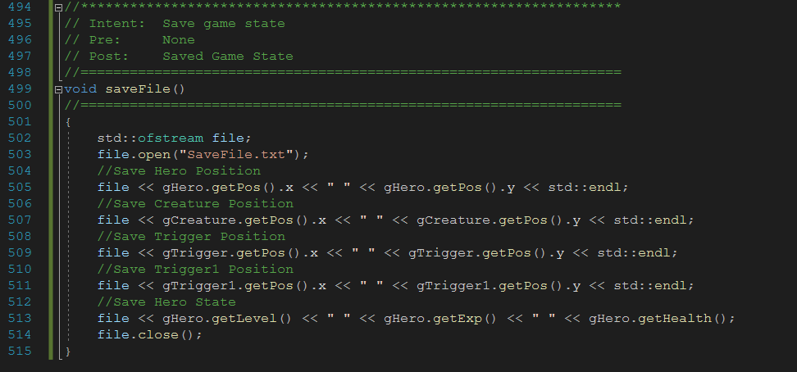
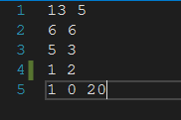
寫檔範例:儲存遊戲進度
遊戲需儲存必要的資訊才能完全復原遊戲進度
開啟檔案stream
寫入遊戲進度資料
關閉檔案stream
寫入遊戲參數資料.txt

Slide 46
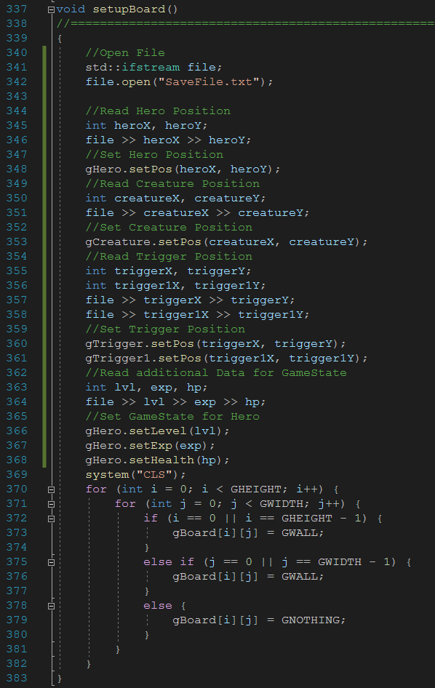
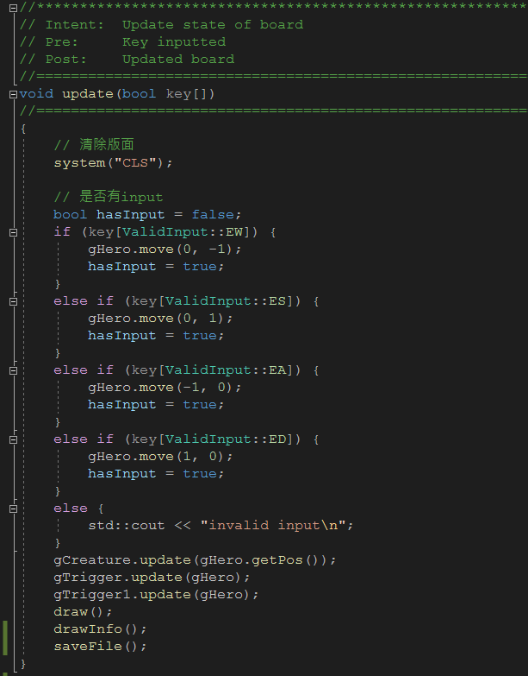
寫檔範例:儲存遊戲進度
於遊戲開始匯入先前進度
於每次Update儲存進度(紀錄參數)

Slide 47
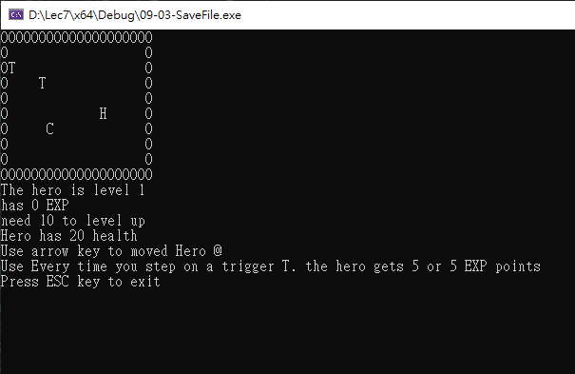
寫檔範例:儲存遊戲進度
讀取紀錄

Slide 48
Binary Copy
Any better ways?
#include<…>
int main(int argc, char *argv[])
{
//Open an input and output stream in binary mode
ifstream in("myimage.jpg",ios::binary);
ofstream out("myimage1.jpg",ios::binary);
if(in.is_open() && out.is_open()){
while(!in.eof()){
out.put(in.get());
}
}
// Close both files
in.close();
out.close();
}

Slide 49
Reading and Writing Complex Data
#include <fstream.h>
class Data {
int key;
double value;
};
Data x;
Data *y = new Data[10];
fstream myFile ("data.bin", ios::in | ios::out | ios::binary);
myFile.seekp (location1);
myFile.write ((char*)&x, sizeof (Data));
...
myFile.seekg (0);
myFile.read ((char*)y, sizeof (Data) * 10);
myFile.close();
...

Slide 50
#include<iostream>
#include<fstream>
class Student{
private:
char name[20];
int mark;
public:
void GetStudentData();
void ShowStudentData();
};
void Student :: GetStudentData(){
std::cout << "Enter Student Name:" << std::endl;
std::cin >> name;
std::cout << "Enter Student Mark:" << std::endl;
std::cin >> mark;
}
void Student :: ShowStudentData(){
std::cout << "Student Details are:" << std::endl;
std::cout << "Name: " << name << std::endl
<< "Mark: " << mark << std::endl;
}
int main(int argc, char *argv[]){
char ans='y';
Student sobj;
std::ofstream out("student.dat", std::ios::app); //open in append mode
if(out.is_open()) {
//Loop will continue until something other then y is entered
while( ans == 'y') {
std::cout << std::endl << "Continue ?";
std::cin >> ans;
if(ans == 'y') {
sobj.GetStudentData();
out.write((char*) & sobj, sizeof(sobj));
}
}
}
out.close();
std::ifstream in("student.dat");
if(in.is_open()) {
while(!in.eof()) {
in.read((char*) &sobj, sizeof(sobj));
if(!in.eof()) {
sobj.ShowStudentData();
}
}
}
in.close();
return true;
}

Slide 51
Std Filesystem Library Reference
#include<filesystem>
https://zh.cppreference.com/w/cpp/filesystem
需要 C++17，以前的檔案系統處理只能使用各自作業系統提供的 API
雖然有 POSIX 標準，但是 windows 沒有在遵守，其他 Unix、Linux、FreeBSD 系列基本上可以使用 POSIX API
C++14 有體驗版
#include<experimental/filesystem>
大部分常用功能都已經具備
或者使用其原型 boost.filesystem
http://www.boost.org/doc/libs/release/libs/filesystem/doc/index.htm

Slide 52
Std Filesystem Library Reference
可以處理一定程度上的編碼問題
namespace filesystem = std::filesystem;
filesystem::path p1(“/local/encoded/path”);
filesystem::path p2 = filesystem::u8path(“/utf8/encoded/path”);
std::cout << p2.native() << std::endl; //print native encoding
std::cout << p1.u8string() << std::endl; //print utf8 encodeing
常用工具
走訪目錄下的檔案：directory_iterator
確認檔案是否存在：exists()
確認路徑指向目錄或一般檔案：is_directory()、 is_regular_file()
重新命名：rename()
空間使用狀態：space()
檔案大小：file_size()
最後修改時間：last_write_time()

Slide 53
C Run-Time Library Reference
The main categories of Microsoft run-time library routines are:
Argument Access | Buffer Manipulation
Byte Classification | Character Classification
Data Alignment | Data Conversion
Debug Routines | Directory Control
Error Handling (CRT) | Exception Handling Routines
File Handling | Floating-Point Support
Input and Output | Internationalization
Memory Allocation | Process and Environment Control
Robustness | Run-Time Error Checking
Searching and Sorting | String Manipulation (CRT)
System Calls | Time Management
Sample check
Sample check

Slide 54
Directory Control
Routine | Use
_chdir, _wchdir | Change current working directory
_chdrive | Change current drive
_getcwd, _wgetcwd | Get current working directory for default drive
_getdcwd, _wgetdcwd | Get current working directory for specified drive
_getdiskfree | Populates a _diskfree_t structure with information about a disk drive.
_getdrive | Get current (default) drive
_getdrives | Returns a bitmask representing the currently available disk drives.
_mkdir, _wmkdir | Make new directory
_rmdir, _wrmdir | Remove directory
_searchenv, _wsearchenv,_searchenv_s, _wsearchenv_s | Search for given file on specified paths
Take a look at

Slide 55
File Handling
Routine | Use
_chsize,_chsize_s | Change file size
_filelength, _filelengthi64 | Get file length
_fstat, _fstat32, _fstat64, _fstati64, _fstat32i64, _fstat64i32 | Get file-status information on descriptor
_get_osfhandle | Return operating-system file handle associated with existing C run-time file descriptor
_isatty | Check for character device
_locking | Lock areas of file
_open_osfhandle | Associate C run-time file descriptor with existing operating-system file handle
_setmode | Set file-translation mode
Sample check

Slide 56
Determine the File Size
Ver 1:
Ver 2:
ifstream file( "example.txt", ios::binary | ios::ate);
return file.tellg();
std::streampos fileSize( const char* filePath ){
std::streampos fsize = 0;
std::ifstream file( filePath, std::ios::binary );
fsize = file.tellg();
file.seekg( 0, std::ios::end);
fsize = file.tellg() - fsize;
file.close();
return fsize;
}

Slide 57
Summary 1
Streams connect to files with open operation
Member function fail() checks successes
Stream member functions format output
e.g., width, setf, precision
Same usage for cout (screen) or files
Stream types can be formal parameters
But must be call-by-reference

Slide 58
Summary 2
istream (no "f") parameters accept cin or ifstream objects as arguments
ostream (no "f) parameters accept cout or ofstream objects as arguments
Member function eof
Used to test for end of input file
Streams use inheritance to share common methods and variables in an “is-a” relationship between classes

