Slide 1
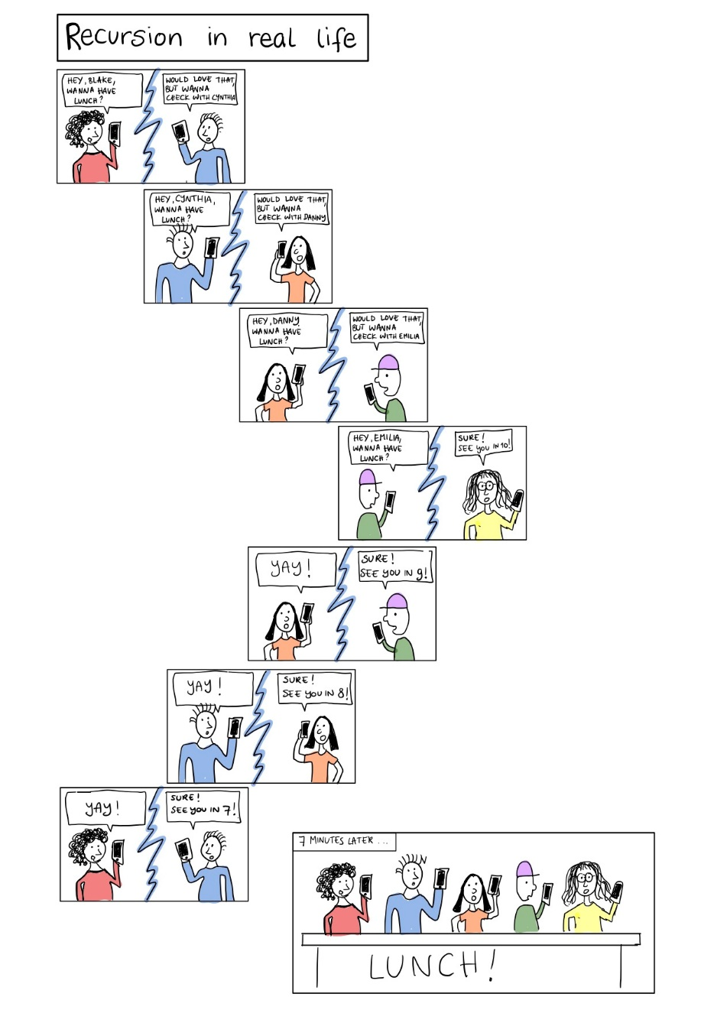
Chapter 13
Recursion

Slide 2
想一想
許多Rogue類型的遊戲都具有地圖隨機生成的功能。
演算法要如何設計才能確保生成的地圖是能玩的?

Slide 3
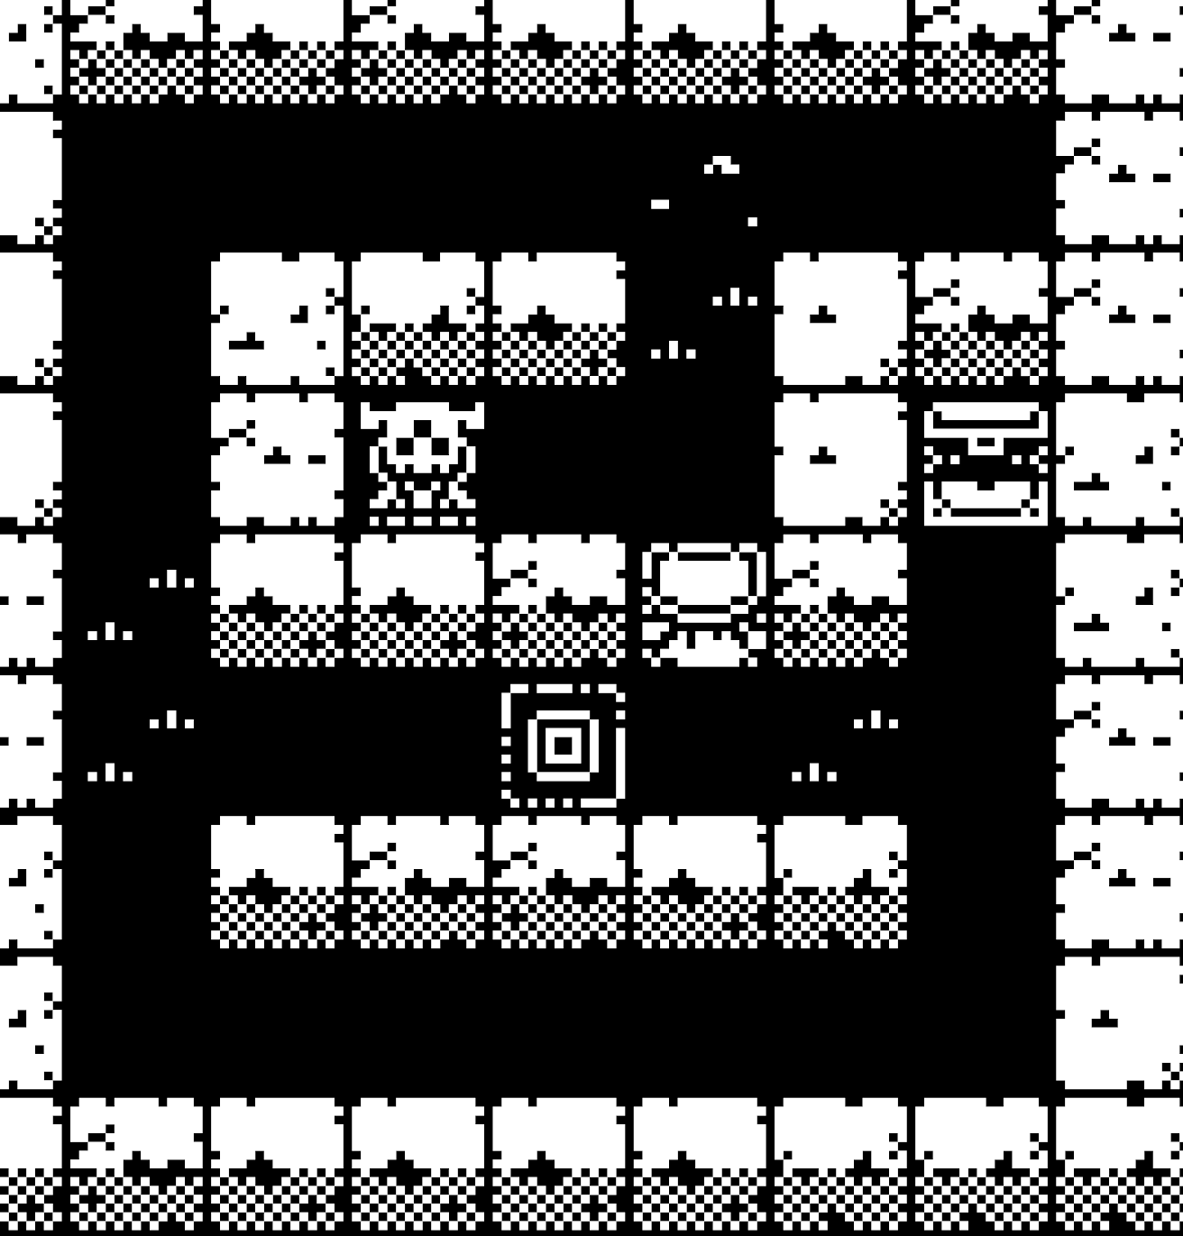
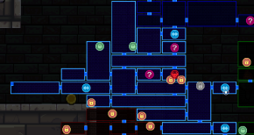
想一想
許多Rogue類型的遊戲都具有地圖隨機生成的功能。
牆壁、房間隨機排列。
道具、敵人生成隨機產生。
…。
演算法要如何設計才能確保生成的地圖是能玩的?
不能有封死的房間，房間之間要有連接。
敵人生成的數量與強度要符合關卡等級。
…。
隨機產生可玩的遊戲內容是Rogue類型遊戲的重要特色

Slide 4
Learning Objectives
Recursive void Functions
Tracing recursive calls
Infinite recursion, overflows
Recursive Functions that Return a Value
Powers function
Thinking Recursively
Recursive design techniques
Binary search

Slide 5
Introduction to Recursion
A function that "calls itself“ is defined as recursion.
Inside the function definition, codes to call to the same function
C++ allows recursion as most high-level languages
Can be a useful programming technique, but has limitations
Divide and Conquer break a large task into small subtasks
Current software design concept.
Subtasks could be smaller versions of the original task! → recursion
For example binary search:
Search list for a value
Subtask 1: search 1st half of list
Subtask 2: search 2nd half of list
Subtasks are smaller versions of original task!
When this occurs, recursive function can be used.
Usually results in an "elegant" solution

Slide 6
Vertical Numbers
Task: Display digits of number vertically, one per line
Break problem into two cases
Simple/base case: if n<10
Simply write number n to screen
Recursive case: if n>=10, two subtasks:
1- Output all digits except last digit
2- Output last digit
Example: argument 1234:
1st subtask displays 1, 2, 3 vertically
2nd subtask displays 4
writeVertical(1234); Produces output: 1 2 3 4
void writeVertical(int n){ if (n < 10) // Base case cout << n << endl; else { // Recursive step writeVertical(n/10); cout << (n%10) << endl; } }
Example call: writeVertical(123); writeVertical(12); (123/10) writeVertical(1); (12/10) cout << 1 << endl; cout << 2 << endl; cout << 3 << endl;

Slide 7
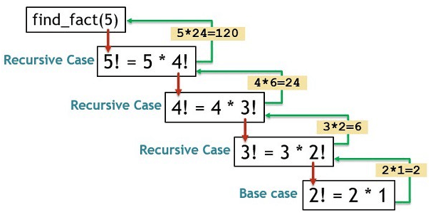
Recursion—A Closer Look
Track recursive calls
Stops current function, and Saves all information needed for current call for later usage.
Must know results of new recursive call before proceeding
Proceeds with evaluation of new recursive call
When THAT call is complete, returns to "outer" computation.
A successful recursive function should have:
“Recursive case(s)“ to accomplish it’s task by making one or more recursive calls to solve smaller versions of original task.
"Base case(s)" or "stopping case(s) " to accomplish it’s task without recursive calls → MUST eventually be entered or infinite recursion

Slide 8
Infinite Recursion Example
writeVertical must down to 1-digit number
Consider alternate function definition:
Seems "reasonable" enough but missing "base case"!
Recursion never stops
void newWriteVertical(int n){ newWriteVertical(n/10); cout << (n%10) << endl; }

Slide 9
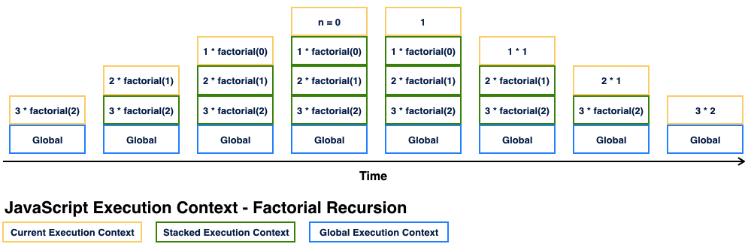
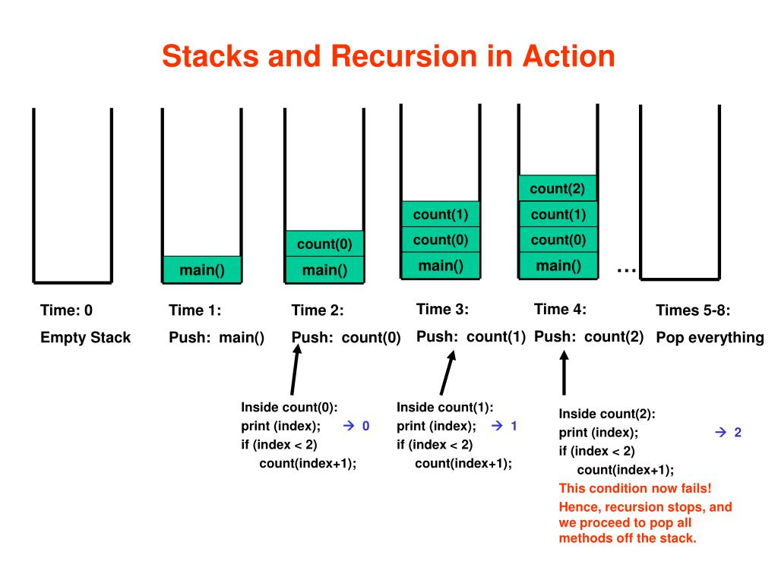
Recursion Stacks and Overflow
A stack is specialized memory structure like stack of paper
Place new on top and remove when needed from top
Called "last-in/first-out" memory structure
Recursion uses stacks
Each recursive call placed on stack
When one completes, last call is removed from stack
Size of stack limited i.e. memory is finite
Long chain of recursive calls continually adds to stack and may grow beyond limit → Stack overflow error

Slide 10
Recursion Stacks and Overflow

Slide 11
Recursion Versus Iteration
Recursion is not always "necessary“ and not even allowed in some primitive languages or with limited memory resource.
Pros: Elegant solution; less coding
Cons: Runs slower, uses more storage
Recursion can generally be transformed to iteration, i.e. loops
Just do stack yourself.
Stack<Params> s;
s.push(param);
while(!s.empty()){
Params d = s.pop();
… //do something with d
if(cond1){ s.push(param1); }
if(cond2){ s.push(param2); }
…
}

Slide 12
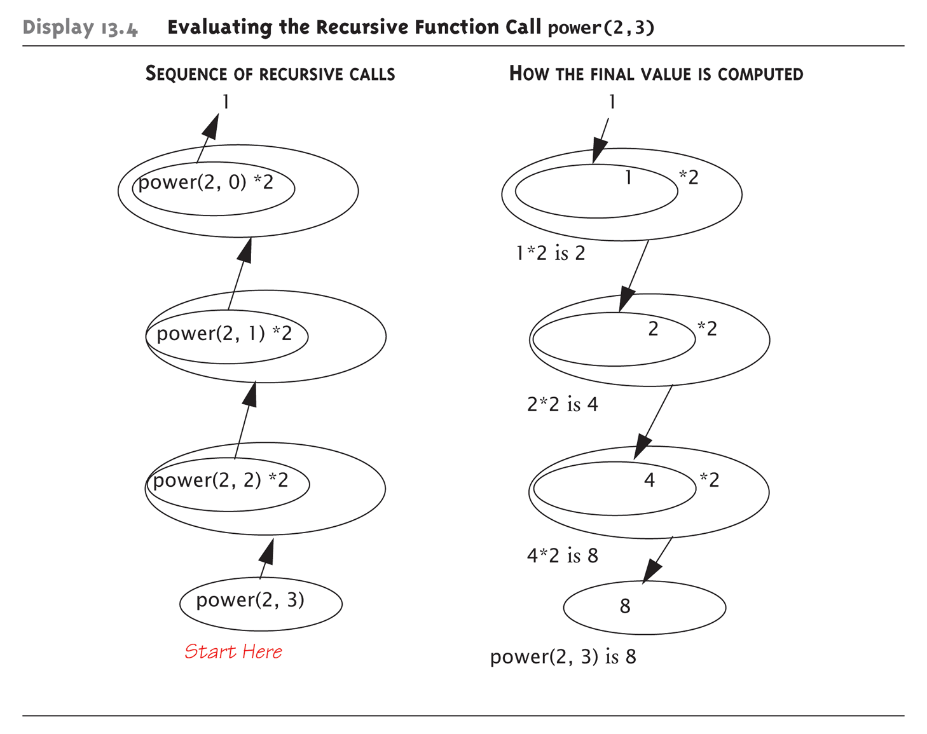
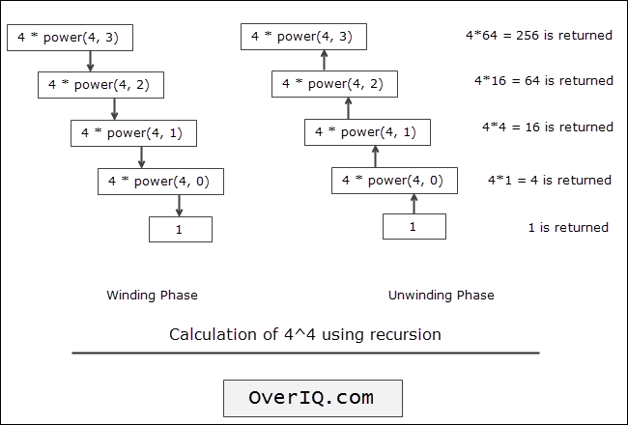
Recursion with Value Return
Recursion is not limited to void functions
Can return a value of any type
Recursive cases to return a value computed by recursive calls which should be smaller.
Base cases to return a value computed without recursive calls
Example:
result = pow(2.0,3.0);
int power(int x, int n){ if (n<0){ cout << "Illegal argument"; exit(1); } if (n>0) return (power(x, n-1)*x); else return (1); }

Slide 13
Thinking Recursively
Ignore details
Forget how stack works and the suspended computations
Yes, this is an "abstraction" and “encapsulation” principle!
Let computer do "bookkeeping“ and you only think "big picture“
Example to recursive definition of power():
power(x, n)
returns power(x, n – 1) * x
Just ensure "formula" correct
And ensure base case will be met.
A design technique
Don’t trace entire recursive sequence!
Just check 3 properties:
No infinite recursion
Stopping cases return correct values
Recursive cases return correct values

Slide 14
Recursive Design Check: power()
Check power() against 3 properties:
No infinite recursion:
2nd argument decreases by 1 each call
Eventually must get to base case of 1
Stopping case returns correct value:
power(x,0) is base case
Returns 1, which is correct for x⁰
Recursive calls correct:
For n>1, power(x,n) returns power(x,n-1)*x
Plug in values → correct
int power(int x, unsigned int n)
{ if (n>0) return (power(x, n-1)*x); else return (1); }

Slide 15
Examples
Is the input is a prime
Sum up the number
bool isPrime(int p, int i=2)
{
if (i==p) return 1; // i*i > p for faster
if (p%i == 0) return 0;
return isPrime (p, i+1);
}
int sum (int num)
{
if (num==0) return 0;
return (sum(num-1)+(num));
}

Slide 16
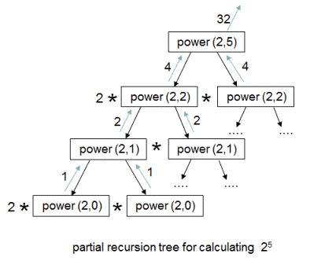
Design a faster version for power()
Analysis
int power(int x, unsigned int n){
if (n > 0)
return (power(x, n-1)*x);
else
return (1);
}
int power(int x, unsigned int n){
if (n == 0)
return (1);
else if(n % 2)
return x *(power((x*x),(n-1)/2);
else
return (power((x*x), n/2);
}

Slide 17
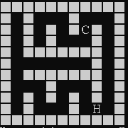
Recursion: 走迷宮
用遞迴找出逃脫迷宮的路線，確認地圖走得通
輸入：讀檔案或由 console 輸入地圖，地圖包含起點與終點
輸出：逃脫路線圖
提示：迷宮右手法則/深度優先搜尋(DFS)
同樣的方法，可以幫怪物找出襲擊玩家的路線
但需要其他演算法如 BFS 才能找到最短路徑
範例輸入
5 5.. wwwww w...w w.wsw e.w.w wwwww
範例輸出
wwwww w321w w4wsw e5w.w wwwww

Slide 18
Tail and Mutual Recursion
Tail recursion is defined as no further computation occurs after the recursive call, i.e., the function immediately returns.
It can easily be converted to a more efficient iterative solution
May be done automatically by your compiler
Mutual recursion refers to when two or more functions call each other.
Example: Determine if a string has an even or odd number of 1’s by invoking a function that keeps track if the number of 1’s seen so far is even or odd
// Function prototypes
bool evenNumberOfOnes(string s);
bool oddNumberOfOnes(string s);
// If the recursive calls end here
// with an empty string then we had
// an even number of 1's.
bool evenNumberOfOnes(string s){
if (s.length() == 0)
return true; // Is even
else if (s[0]=='1’)
return oddNumberOfOnes(s.substr(1));
else
return evenNumberOfOnes(s.substr(1));
}
bool oddNumberOfOnes(string s){
if (s.length() == 0)
return false; // Not even
else if (s[0]=='1’)
return evenNumberOfOnes(s.substr(1));
else
return oddNumberOfOnes(s.substr(1));
}
int main() {
string s = "10011";
if (evenNumberOfOnes(s))
cout << "Even number of ones." << endl;
else
cout << "Odd number of ones." << endl;
return 0;
}

Slide 19
Binary Search

Slide 20
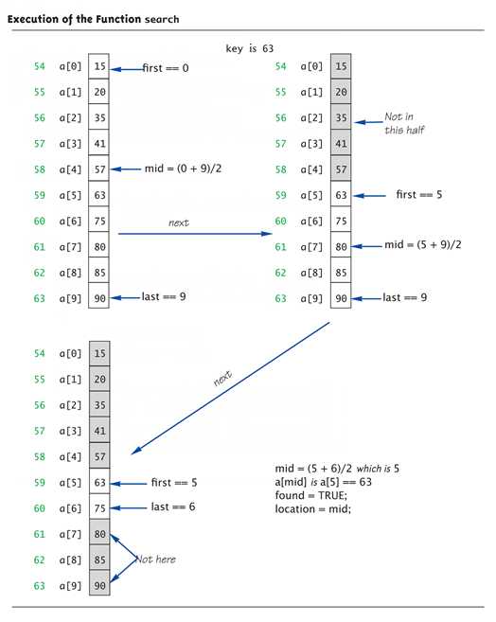
Binary Search
Recursively search an array to determines IF item is in list, and if so: Where in list it is
Assumes array is sorted
Breaks list in half
Determines if item in 1st or 2nd half
Then searches again just that half
Recursively (of course)!

Slide 21
Binary Search
int search(const int a[], int lowEnd,
int highEnd, int key) {
if (lowEnd > highEnd)
return -1;
int midIdx = (lowEnd + highEnd) / 2;
if (a[midIdx] == key)
return midIdx;
else if (key < a[midIdx])
return search(a, lowEnd, midIdx - 1, key);
else
return search(a, midIdx + 1, highEnd, key);
}
Check against criteria:
No infinite recursion:
Each call increases first or decreases last
Eventually first will be greater than last
Stopping cases perform correct action:
If first > last → no elements between them, so key can’t be there!
IF key == a[mid] → correctly found!
Recursive calls perform correct action
If key < a[mid] → key in 1st half – correct call
If key > a[mid] → key in 2nd half – correct call

Slide 22
Efficiency of Binary Search
Extremely fast while comparing with sequential search
Half of the array eliminated at start!
Then a quarter, then 1/8, etc.
Essentially eliminate half with each call
Example of 100 elements:
Binary search never needs more than 7 compares!
Logarithmic efficiency (log n)

Slide 23
Recursive Solutions
Notice binary search algorithm actually solves "more general" problem
Original goal: design function to search an entire array
Our function: allows search of any interval of array
By specifying bounds first and last
Very common when designing recursive functions
https://zh.cppreference.com/w/cpp/algorithm
std::binary_search()
std::lower_bound()

Slide 24
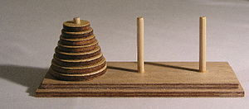
Tower of Hanoi
A game consists of three rods, and a number of disks of different sizes which can slide onto any rod.
Game goal: move the entire stack to another rod
Mechanics:
Starts with the disks in a neat stack in ascending order of size on one rod, the smallest at the top, thus making a conical shape.
Move disk to another rod, obeying the following simple rules:
Only one disk can be moved at a time.
Each move consists of taking the upper disk from one of the stacks and placing it on top of another stack
i.e. a disk can only be moved if it is the uppermost disk on a stack.
No disk may be placed on top of a smaller disk.
Min(moves) to solve a Tower of Hanoi with n disks is 2^{n - 1}

Slide 25
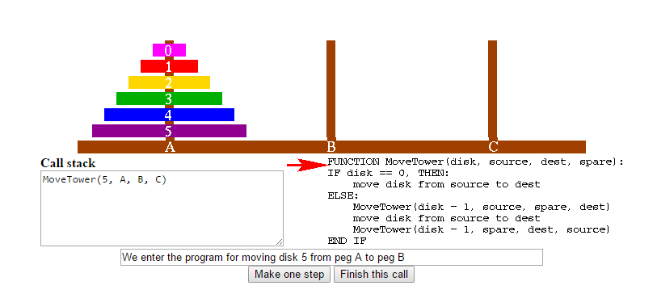
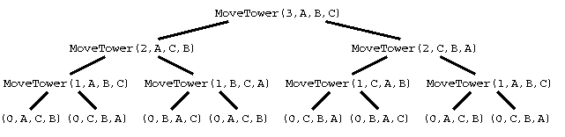
Program Trace: https://www.cs.cmu.edu/~cburch/survey/recurse/hanoiex.html

Slide 26
#include<ctype.h> /* Character Class Tests */
#include<stdio.h> /* Standard I/O. */
#include<stdlib.h> /* Utility Functions. */
#define EMPTY 0 /* Empty disk position. */
#define DISKS 3 /* Number of disks. */
int pos[3][DISKS]; /* Disk position array, [rows][columns]. */
char code[3] = {'A', 'B', 'C'}; /* Tower names. */
void towers( int n, int source, int temporary, int destination );
void moveDisk( int source, int destination );
int main( int argc, char *argv[] )
{
int i=0, j=0, hold = 0;
printf( "\n\n The Towers of Hanoi: %d Disks\n\n", DISKS );
/* Initialize disk positions. */
for( i = 0; i < 3; ++i )
{
for( j = 0; j < DISKS; ++j )
if( i == 0 ) pos[ i ][ j ] = j + 1;
else pos[ i ][ j ] = EMPTY;
}
towers( DISKS, 0, 1, 2 );
return 0;
}

Slide 27
void moveDisk( int source, int destination )
{
int i = 0, j= 0;
/* Determine source location. */
while( pos[ source ][ i ] == EMPTY ) { i++; }
/* Determine destination location. */
while(( pos[ destination ][ j ] == EMPTY ) && ( j < DISKS )) { j++; }
j -= 1;
/* Move disk. */
printf( "\n Move disk #%d from %c to %c:\n\n",
pos[ source ][ i ], code[ source ], code[ destination ] );
pos[ destination ][ j ] = pos[ source ][ i ];
pos[ source ][ i ] = EMPTY;
/* Print disk positions after move. */
printf( "\n\n A B C\n" );
printf( " - - -\n" );
for( j = 0; j < DISKS; ++j )
{
printf( "%11.1d %d %d\n", pos[ 0 ][ j ], pos[ 1 ][ j ], pos[ 2 ][ j ] );
}
printf( "\n" );
return;
}

Slide 28
void towers( int n, int source, int temporary, int destination )
{
if ( n == 1 ) /* Base case. */
moveDisk( source, destination );
else
{
towers( n - 1, source, destination, temporary );
moveDisk( source, destination );
towers( n - 1, temporary, source, destination );
}
return;
}

Slide 29
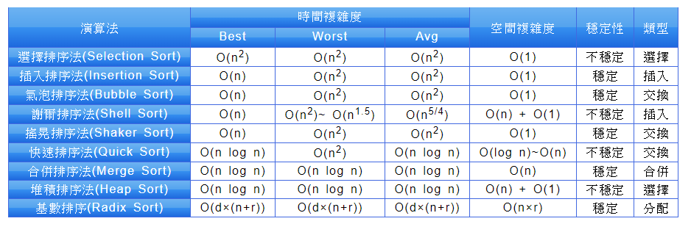
Sorting
A sorting algorithm is an algorithm that puts elements of a list in a certain order.
Various algorithms

Slide 30
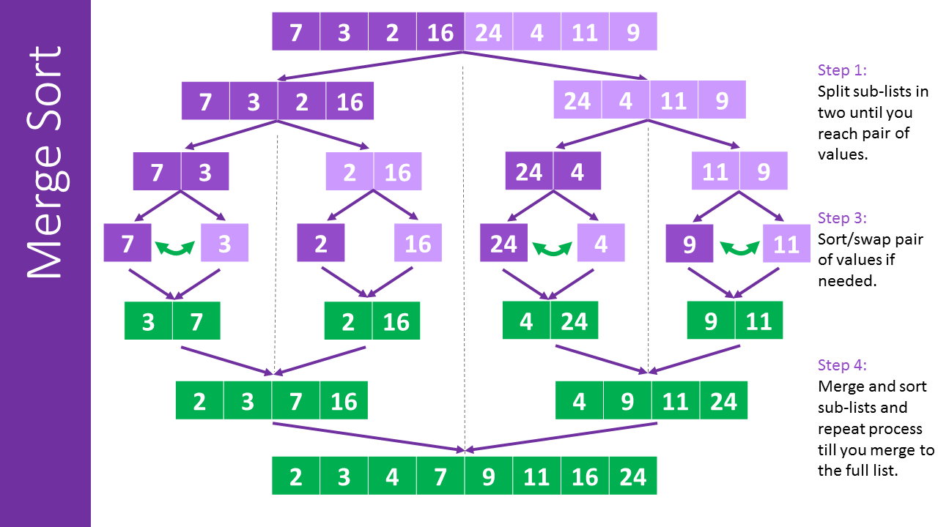
Merge Sort

Slide 31
Recursion: Map Generation
迷宮能夠增加遊戲的難度與複雜度，提升遊戲性。
不能有無法到達的區域。
每一關隨機生城地圖。

Slide 32
Summary 1
Reduce problem into smaller instances of same problem -> recursive solution
Recursive algorithm has two cases:
Base/stopping case
Recursive case
Ensure no infinite recursion
Use criteria to determine recursion correct
Three essential properties
Typically solves "more general" problem

