Slide 1
Chapter 14
Inheritance

Slide 2
想一想
地城遊戲中有需多物件
這些物件有哪些相似的行為
要避免重複實作相同或類似的功能

Slide 3
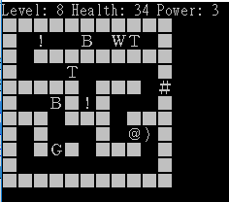
想一想
地城遊戲中有需多物件
主角。
生物：蝙蝠、狼…。
機關：門、陷阱…。
這些物件有哪些相似的行為
移動、觸發機關、攻擊…
要避免重複實作相同或類似的功能
遊戲中有許多不同的物件在場上表示
G、B和W：敵對生物。
T： 陷阱。
)： 武器。
!： 藥水。
#： 門。

Slide 4
Learning Objectives
Inheritance Basics
Derived classes, with constructors
protected: qualifier
Redefining member functions
Non-inherited functions
Programming with Inheritance
Assignment operators and copy constructors
Destructors in derived classes
Multiple inheritance

Slide 5
Why Inheritance?
Let’s see the following code snippets!

Slide 6
Why Inheritance? - Dungeon
class Hero {
private:
Position sPos;
char sIcon = 'H';
int sLevel = 1;
int sMaxExp;
int sCurrentExp;
int sHp = 10;
public:
Hero(){…}
…
Position getPos(){…}
char getIcon(){…}
void setPos(…){…}
void setIcon(…){…}
…
};
class Creature {
private:
Position sPos;
char sIcon = 'C';
int sHp = 5;
int sAttRange = 1;
int sAttPower = 1;
public:
Creature(){…}
…
Position getPos(){…}
char getIcon(){…}
void setPos(…){…}
void setIcon(…){…}
…
void update(Hero& h){…}
};
class Trigger {
private:
Position sPos;
char sIcon = 'T';
int sExpAmount;
public:
bool touchTrigger=false;
Trigger(){…}
…
Position getPos(){…}
char getIcon(){…}
void setPos(…){…}
void setIcon(…){…}
…
void update(Hero& h){…}
};

Slide 7
Common Elements in All Three Classes
Common data members:
Position sPos;
char sIcon = 'T';
Common functions:
Position getPos(){…}
char getIcon(){…}
void setPos(…){…}
void setIcon(…){…}
Common functions but work differently
void update(Hero& h) {…}

Slide 8
HourlyEmployee
class HourlyEmployee
{
public:
HourlyEmployee( );
HourlyEmployee(const string& theName, const string& theSsn, double theWageRate, double theHours);
string getName( ) const; void setName(const string& newName);
string getSsn( ) const; void setSsn(const string& newSsn);
double getNetPay( ) const; void setNetPay(double newNetPay);
double getRate( ) const; void setRate(double newWageRate);
double getHours( ) const; void setHours(double hoursWorked);
void printCheck( ) ;
private:
string name;
string ssn;
double wageRate;
double hours;
double netPay;
};

Slide 9
HourlyEmployee
void HourlyEmployee::printCheck( )
{
setNetPay(hours * wageRate);
cout << "\n________________________________________________\n";
cout << "Pay to the order of " << getName( ) << endl;
cout << "The sum of " << getNetPay( ) << " Dollars\n";
cout << "________________________________________________\n";
cout << "Check Stub: NOT NEGOTIABLE\n";
cout << "Employee Number: " << getSsn( ) << endl;
cout << "Hourly Employee. \nHours worked: " << hours
<< " Rate: " << wageRate << " Pay: " << getNetPay( ) << endl;
cout << "_________________________________________________\n";
}

Slide 10
SalariedEmployee
class SalariedEmployee
{
public:
SalariedEmployee( );
SalariedEmployee (const string& theName, const string& theSsn, double theWeeklySalary);
string getName( ) const; void setName(const string& newName);
string getSsn( ) const; void setSsn(const string& newSsn);
double getNetPay( ) const; void setNetPay(double newNetPay);
double getSalary( ) const; void setSalary(double newSalary);
void printCheck( );
private:
string name;
string ssn;
double salary; // Weekly
};

Slide 11
SalariedEmployee
void SalariedEmployee::printCheck( )
{
setNetPay(salary);
cout << "\n_______________________________________________\n";
cout << "Pay to the order of " << getName( ) << endl;
cout << "The sum of " << getNetPay( ) << " Dollars\n";
cout << "_________________________________________________\n";
cout << "Check Stub NOT NEGOTIABLE \n";
cout << "Employee Number: " << getSsn( ) << endl;
cout << "Salaried Employee. Regular Pay: " << salary << endl;
cout << "_________________________________________________\n";
}

Slide 12
Common Elements in All Three Classes
Common data members
string name;
string ssn;
Common functions
string getName( ) const;
void setName(const string& newName);
string getSsn( ) const;
void setSsn(const string& newSsn);
Common functions but work differently
void printCheck( );

Slide 13
Introduction to Inheritance
Powerful OOP tech for abstraction dimension
Define a general form of class (Base class)
Specialized ones inherit properties of the general (Derived class)
New class
Automatically has base class’s:
Member variables
Member functions
Add to it/modify it’s functionality:
extra member functions
extra member variables
Base class
Employee
Derived class
HourlyEmployee
SalariedEmployee

Slide 14
Common Components into Employee
class Employee
{
public:
Employee( );
Employee(const string& theName, const string& theSsn);
string getName( ) const; void setName(const string& newName);
string getSsn( ) const; void setSsn(const string& newSsn);
double getNetPay( ) const; void setNetPay(double newNetPay);
void printCheck( ) const;
private:
string name;
string ssn;
double netPay;
};

Slide 15
Difference into Its Own
class HourlyEmployee : public Employee
{
public:
HourlyEmployee( );
HourlyEmployee(const string& theName, const string& theSsn,
double theWageRate, double theHours);
void setRate(double newWageRate); double getRate( ) const;
void setHours(double hoursWorked); double getHours( ) const;
void printCheck( ) ;
private:
double wageRate;
double hours;
};

Slide 16
Difference into Its Own
class SalariedEmployee : public Employee
{
public:
SalariedEmployee( );
SalariedEmployee (const string& theName, const string& theSsn,
double theWeeklySalary);
double getSalary( ) const; void setSalary(double newSalary);
void printCheck( );
private:
double salary;//weekly
};

Slide 17
Usage Example
#include <iostream>
#include "hourlyemployee.h“
#include "salariedemployee.h"
using std::cout;
using std::endl;
using SavitchEmployees::HourlyEmployee;
using SavitchEmployees::SalariedEmployee;
int main( ) {
HourlyEmployee joe;
joe.setName("Mighty Joe"); joe.setSsn("123-45-6789");
joe.setRate(20.50); joe.setHours(40);
cout << "Check for " << joe.getName( )
<< " for " << joe.getHours( ) << " hours.\n";
joe.printCheck( );
cout << endl;
SalariedEmployee boss("Mr. Big Shot", "987-65-4321", 10500.50);
cout << "Check for " << boss.getName( ) << endl;
boss.printCheck( );
return 0;
}

Slide 18
Base and Derived Classes
Base class: Employees,contain all "things" about employees
Names and social security numbers for the same data: SSN, Name, and Pay
Associated functions of "basics" →Accessor and Mutator functions
Dervied classes from "Employee": SalariedEmployee, HourlyEmployee
Composed of Salaried and Hourly employees which are "subset" of employees
Consider printCheck() function:
Will always be "redefined" in derived classes
So different employee types can have different checks
Makes no sense really for “undifferentiated” employee
So function printCheck() in Employee class says just that
Error message stating "printCheck called for undifferentiated employee!! Aborting…"

Slide 19
Deriving from Employee Class
Derived classes from Employee class:
Automatically have all member variables
Automatically have all member functions
Derived class said to "inherit" members from base class
Can then redefine existing members and/or add new members

Slide 20
HourlyEmployee Class
Specifies "publicly inherit" from Employee class class HourlyEmployee : public Employee { …
Derived class interface only lists new or "to be redefined" members
Since all others inherited are already defined, i.e., "all" employees have ssn, name, etc.
HourlyEmployee adds:
Constructors.
wageRate, hours member variables
setRate(), getRate(), setHours(), getHours() member function

Slide 21
HourlyEmployee Class
HourlyEmployee redefines:
printCheck(): "overrides" the printCheck() function implementation from Employee class
It’s definition must be in HourlyEmployee class’s implementation : New and "to be redefined"
As do other member functions declared in HourlyEmployee’s interface

Slide 22
Inheritance Terminology
Common to simulate family relationships
Parent class: refers to base class
Ancestor class: Class that’s a parent of a parent …
Child class: refers to derived class
Descendant class: Opposite of ancestor

Slide 23
Constructors in Derived Classes
Base class constructors are NOT inherited in derived classes, but they can be invoked within derived class constructor
Base class constructor must initialize all necessary base class member variables such as those inherited by derived class
So derived class constructor simply calls it
"First" thing derived class constructor does
HourlyEmployee::
HourlyEmployee(string theName, string theNumber,
double theWageRate, double theHours) : Employee(theName, theNumber),
wageRate(theWageRate), hours(theHours) { //Deliberately empty }
Portion after : is "initialization section“ and includes invocation of Employee constructor

Slide 24
Constructor: No Base Class Call
Derived class constructor should always invoke one of the base class’s constructors
If you do not, Default base class constructor automatically called
HourlyEmployee::
HourlyEmployee(): wageRate(0), hours(0){ }
Equivalent to: HourlyEmployee::
HourlyEmployee(): Employee(), wageRate(0),hours(0){ }

Slide 25
Pitfall: Base’s Private Data and Functions
Derived class "inherits" private member variables and functions
But still cannot directly access them, i.e. cannot be accessed outside interface and implementation of base class
Not even through derived class member functions!
Private member variables and functions can ONLY be accessed "by name" in member functions of the class they’re defined in
This is "reasonable"
Base’s variables can be accessed indirectly via accessor or mutator member functions
Private member functions should be simply "helper" functions and simply not available → Should be used only in class they’re defined

Slide 26
The protected: Qualifier
New classification of class members to allows access "by name" (directly) in derived class
But nowhere else, i.e., still no access "by name" in other classes → acts like private
Considered "protected" in derived class To allow future derivations
Many feel this "violates" information hiding

Slide 27
Redefinition of Member Functions
Recall the interface of derived class: new or redefined member functions
Inherited member functions are NOT declared which automatically inherited unchanged
Implementation of derived class will:
Define new member functions
Redefine inherited functions as declared
Redefine V.S. Overload
Very different!
Redefine: SAME parameter list and Essentially "re-writes" same function.
Overload: Different parameter list for different signatures
Recall definition of a "signature":
Function’s name
Sequence of types in parameter list including order, number, types

Slide 28
“Redefine” Example
SAME parameter list
void HourlyEmployee::printCheck( )
{
setNetPay(hours * wageRate);
cout << "\n________________________________________________\n";
cout << "Pay to the order of " << getName( ) << endl;
cout << "The sum of " << getNetPay( ) << " Dollars\n";
cout << "________________________________________________\n";
cout << "Check Stub: NOT NEGOTIABLE\n";
cout << "Employee Number: " << getSsn( ) << endl;
cout << "Hourly Employee. \nHours worked: " << hours
<< " Rate: " << wageRate << " Pay: " << getNetPay( ) << endl;
cout << "_________________________________________________\n";
}
void Employee::printCheck( ) const
{
cout << "\nERROR: printCheck FUNCTION CALLED FOR AN \n"
<< "UNDIFFERENTIATED EMPLOYEE. Aborting the program.\n"
<< "Check with the author of the program about this bug.\n";
exit(1);
}

Slide 29
Accessing Redefined Base Function
When redefined in derived class, base class’s definition is shadowed
Can specify it’s use: Employee JaneE; HourlyEmployee SallyH; JaneE.printCheck(); // Employee::printCheck() SallyH.printCheck(); // HourlyEmployee::printCheck() SallyH.Employee::printCheck(); // Employee::printCheck()
A more common usage
void HourlyEmployee::printCheck() {
Employee::printCheck();
……
}

Slide 30
Functions Not Inherited
All "normal" functions in base class are inherited in derived class
Exceptions:
(Copy) Constructors (we’ve seen, name is different)
But can be used in derived class definitions
Destructors (name is different)
Assignment operator
If not defined → default
But can be used in derived class definitions
Typically MUST be used!

Slide 31
Example
Derived& Derived::operator=(const Derived &rightSide) { Base::operator=(rightSide); … }
Calls assignment operator from base class
This takes care of all inherited member variables
Would then set new variables from derived class…
Derived::Derived(const Derived& Object) : Base(Object), … {…}
After “:” is invocation of base copy constructor
Sets inherited member variables of derived class object being created
Note Object is of type Derived; but it’s also of type Base, so argument is valid

Slide 32
Example
Derived& Derived::operator=(const Derived &rightSide) { Base::operator=(rightSide); … }
Derived& Derived::operator=(const Base &rightSide) { Base::operator=(rightSide); … }
Sometimes we need to overload the assignment for base class. Why?

Slide 33
Destructors in Derived Classes
When derived class destructor is invoked:
Automatically calls base class destructor! Thus, no need for explicit call
If base class destructor functions correctly, easy to write derived class destructor
So derived class destructors need only be concerned with derived class variables
And any data they "point" to
Base class destructor handles inherited data automatically
class B derives from class A class C derives from class B A ← B ← C
When object of class C goes out of scope:
Class C destructor called 1st
Then class B destructor called
Finally class A destructor is called
Opposite of how constructors are called

Slide 34
"Is a" vs. "Has a" Relationships
Inheritance
Considered an "Is a" class relationship
e.g., An HourlyEmployee "is a" Employee
Always convertible from derived to base!
But not the case from base to derived…
A class contains objects of another class as it’s member data
Considered a "Has a" class relationship
e.g., John "has" $10,000

Slide 35
Protected and Private Inheritance
New inheritance "forms"
Both are rarely used
Protected inheritance: class SalariedEmployee : protected Employee {…}
Public members in base class become protected in derived class
Private inheritance: class SalariedEmployee : private Employee {…}
All members in base class become private in derived class

Slide 36
Multiple Inheritance (1 of 2)
Derived class can have more than one base class!
Syntax just includes all base classes separated by commas: class derivedMulti : public base1, public base2 {…}
Possibilities for ambiguity are endless!
WingedAnimal::move() {}
Mammal::move() {}
Bat bat; bat.move(); // ??
Dangerous undertaking!
Some believe should never be used
Certainly should only be used by experienced programmers!
Animal
WingedAnimal
Mammal
Bat

Slide 37
Multiple Inheritance (2 of 2)
Common usage: Interface
Usually declaration only, leaves the implementation to derived class
IAudioInput
IAudioOutput
Phone
Television
Speaker

Slide 38
Multiple Inheritance Example
// multiple inheritance
#include <iostream>
using namespace std;
class Polygon {
protected:
int width, height;
public:
Polygon (int a, int b) : width(a), height(b) {}
};
class Output {
public:
static void print (int i);
};
void Output::print (int i) {
cout << i << '\n';
}

Slide 39
class Rectangle: public Polygon, public Output {
public:
Rectangle (int a, int b) : Polygon(a,b) {}
int area ()
{ return width*height; }
};
class Triangle: public Polygon, public Output {
public:
Triangle (int a, int b) : Polygon(a,b) {}
int area ()
{ return width*height/2; }
};
int main () {
Rectangle rect (4,5);
Triangle trgl (4,5);
rect.print (rect.area());
Triangle::print (trgl.area());
return 0;
}

Slide 40






繼承範例
地城中有許多物件在活動，並擁有類似的性質。
位置、表示符號…。
將具重複性質的物件相互繼承，可產生繼承樹關係。
基本物件
位置
主角
主動觸發的道具與環境
(藥水)
符號
敵對生物

Slide 41
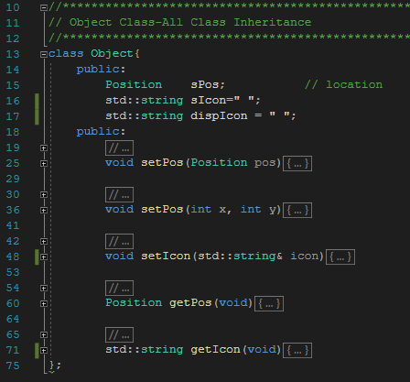

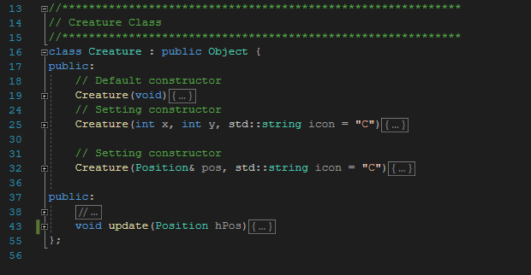
敵對生物
基本物件
基本類別儲存位置與符號資料
並能被子類別存取
敵對生物
敵對生物擁有更新狀態等基本資訊與行為

Slide 42
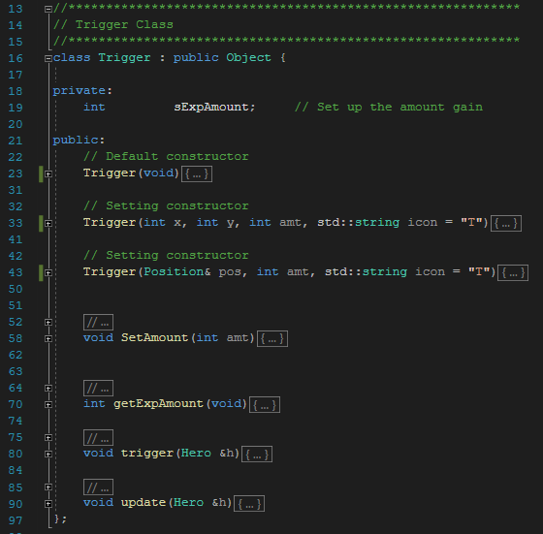
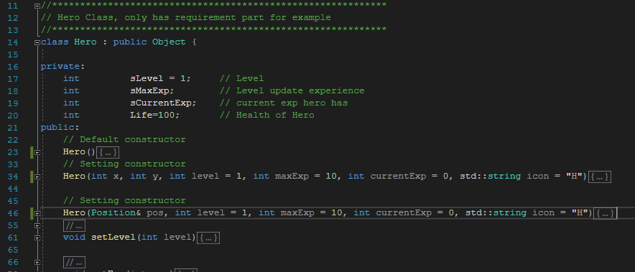
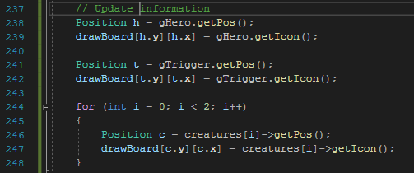
Hero, Trigger繼承基本物件
Hero, Trigger, Creature呼叫Object內函式

Slide 43
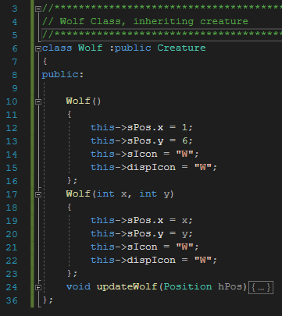
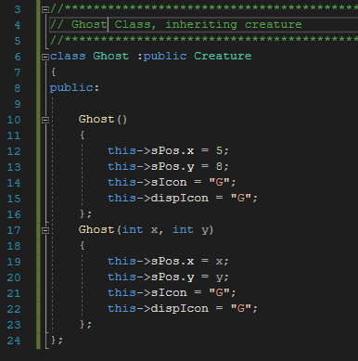

敵對生物
額外靈敏偵測部分
自己獨有的function
鬼只有基本功能，並沿用父類別實作
狼嗅覺靈敏，可以一回合發覺敵人兩次，先是一般偵測再靈敏偵測。

Slide 44
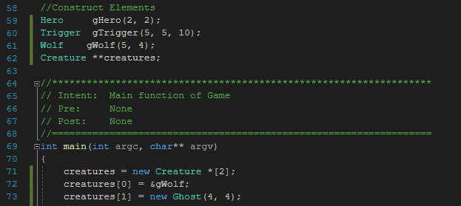


敵對生物管理
對遊戲來說，地城不需要知道生物有甚麼特別的行為，只要能夠更新生物狀態即可。
透過轉型，可以一次管理多個不同型態的陣列資料
敵對生物陣列
建立Creature陣列，
並將繼承生物轉型存入陣列中管理
*需為pointer陣列否則會失去子類別特性
當呼叫陣列生物的update()時，
會各別呼叫不同生物的行為。
額外呼叫子class特有的函式

Slide 45
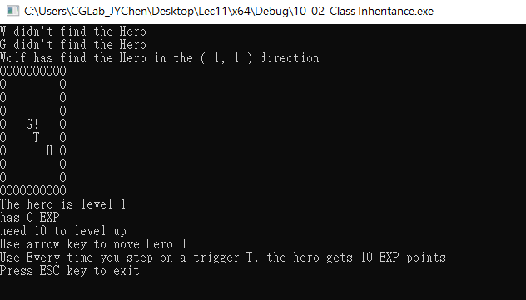
輸出結果
*Wolf基本偵測
*Ghost基本偵測
*Wolf額外偵測

Slide 46
想一想
範例中的繼承方式是否為最佳的?
要如何評估怎樣的繼承關係是有效率的?

Slide 47



想一想
範例中的繼承方式是否為最佳的?
移動生物只多了移動功能，有存在的必要?
遊戲中的牆壁也有位置與符號，是否也需要為其創立子類別?
機關觸發有分自動與手動兩類，在定義一層繼承關係是否更好?
…。
要如何評估怎樣的繼承關係是有效率的?
程式延展性。
行為相關性。
…。

Slide 48
Summary 1
Inheritance provides code reuse
Allows one class to "derive" from another, adding features
Derived class objects inherit members of base class
And may add members
Private member variables in base class cannot be accessed "by name" in derived
Private member functions are not inherited

Slide 49
Summary 2
Can redefine inherited member functions
To perform differently in derived class
Protected members in base class:
Can be accessed "by name" in derived class member functions
Overloaded assignment operator not inherited
But can be invoked from derived class
Constructors are not inherited
Are invoked from derived class’s constructor

