Slide 1
Chapter 14
Polymorphism

Slide 2
Real life Example of Polymorphism
When you buy something online, you have several choices to pay:
pay with cash.
pay with credit cards.
pay with remittance.
etc…
As a seller, they make no difference on the aspect of the truth that you get paid.

Slide 3
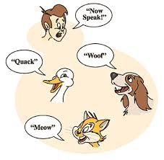
Types of Polymorphism in C++
C++ polymorphism means that a call to a member function will cause a different function to be executed.
Compile-time polymorphism
Function overloading
Run-time polymorphism
Achieved by virtual function
Polymorphism
Compile-time
Run-time
Function
Overloading
Operator
Overloading
Virtual
Function

Slide 4
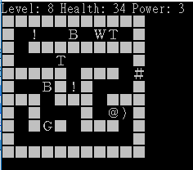
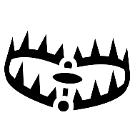



想一想
地城遊戲中有需多機關
陷阱。
武器。
藥水。
門。
…
這些物件有類似的行為
觸發機關、狀態更新…
要如何管理多個類似的物件？
遊戲中有許多不同的物件在場上表示
G、B、W:敵對生物
T: 陷阱
): 武器
!: 藥水
#: 門

Slide 5
想一想
要如何管理多個類似的物件？
將類似的部分抽象化歸類，像生物分類一樣
如上周，在update時呼叫同一個函式，但是在呼叫時可以讓他們擁有不一樣的功能！
這樣的設計使設計者可以不用多重呼叫不同函式！

Slide 6
Learning Objectives
Virtual Function Basics
Late binding
Implementing virtual functions
When to use a virtual functions
Abstract classes and pure virtual functions
Pointers and Virtual Functions
Extended type compatibility
Downcasting and upcasting
C++ "under the hood" with virtual functions

Slide 7
Virtual Function
Polymorphism: a fundamental principle of OOP.
Associating many meanings to one function
Virtual functions provide this capability
Existing in "essence" though not in fact
Can be "used" before it’s "defined“
Late binding or dynamic binding
C++ polymorphism means that a call to a member function will cause a different function to be executed depending on the type of object that invokes the function.

Slide 8
The Shape Example (1 of 4)
Classes for several kinds of figures
Rectangles, circles, and etc. which might be an object of a different class
Rectangle requires height, width, and center.
Circle require radius and center.
All derive from one parent class: Shape
Various shapes have draw()of different instructions, respectively.
We can call "draw" in each class, so: Rectangle r; Circle c; r.draw(); // Calls Rectangle::draw() c.draw(); // Calls Circle::draw()
Shape
draw()
Rectangle
draw()
Circle
draw()

Slide 9
The Shape Example (2 of 4)
While Shape has center() to move the shape to the screen center and redraw itself by calling draw()
Which draw() function? From which class?
While adding Triangle derived from Shape
Function center()inherited from Shape
Will it work for Triangle?
Actually, we want center() to call Triangle::draw() NOT Shape::draw()
But Triangle wasn’t even WRITTEN when Shape::center() was!
In other words, shape doesn’t know "triangles"!
Shape
draw()
Triangle
draw()
Rectangle
draw()
Circle
draw()

Slide 10
The Shape Example (3 of 4)
Suppose we have a function called reDraw(), which re-draws all existing shapes.
Easy to implement when we only have few instances.
How to deal with the complicated case?
vector<Rectangle*> rectangles;
vector<Circle*> circles;
vector<Triangle*> triangles;
// call draw() for each instances in the vector?
// …

Slide 11
The Shape Example (4 of 4)
In the case, we’d like to treat all figures as Shape!
vector<Shape*> shapes;
So for each instance, which draw() is called?
Now we add a new class Star derived from Shape to the system.
Can reDraw() take care of the new class? i.e., can Star::draw() be successfully invoked?
The above requirements can be achieved using virtual functions.
Even if the Star::draw() not even existed while reDraw() function was implemented!!

Slide 12
Virtual Functions
The actually invoked function is decided in the run-time phase.
Hence could be "used" before it’s "defined"
Tells compiler:
"Don’t know how function is implemented"
"Wait until used in program"
"Then get implementation from object instance"
Called late(or dynamic) binding
Virtual functions implement late binding

Slide 13

Another Example: Auto Parts
Record-keeping program for automotive parts store
Track sales
Don’t know all sales yet
1st only regular retail sales
Later: Discount sales, mail-order, etc.
Depend on other factors besides just price, tax
Program must:
Compute daily gross sales
Calculate largest/smallest sales of day
Perhaps average sale for day
All come from individual bills
But many functions for computing bills will be added "later"!
When different types of sales added!
So function for "computing a bill" will be virtual!

Slide 14
The Sale Class (1 of 2)
class Sale { // for each part (item) public: Sale(); Sale(double thePrice); double getPrice() const; virtual double bill() const; double savings(const Sale& other) const; private: double price; };
double Sale::savings(const Sale& other) const { return (bill() – other.bill()); }
bool operator < (const Sale& first, const Sale& second){ return (first.bill() < second.bill()); }

Slide 15
The Sale Class (2 of 2)
Represents basic sales with no added discounts or charges.
Notice the reserved word "virtual" in declaration of bill()
Sale::savings() and Sale::operator<() both make use of it!
Impact:
Later, derived classes of Sale can define THEIR bill()
Other member functions of Sale will use the ONE based on the derived class!
They won’t automatically use Sale’s version!

Slide 16
The DiscountSale Class
class DiscountSale : public Sale { public: DiscountSale(); DiscountSale(double thePrice, double the Discount); double getDiscount() const; void setDiscount(double newDiscount); double bill() const override; // omit “virtual” // double savings(const Sale& other) const; private: double discount; };
double DiscountSale::bill() const { double fraction = discount/100; return (1 – fraction) * getPrice(); }
Represents sales with additional discounts.
virtual specifier in the function declaration of derived class can be omitted
Automatically marked as virtual! But typically included anyway, for readability

Slide 17
The Power of Polymorphism
DiscountSale::bill() is differently than Sale::bill()
Member savings() and operator<
will use bill() for all DiscountSale objects!
Instead of "default" Sale::bill()!
Sale::savings() and Sale::operator<() can even be compiled before having ideas of DiscountSale
Yet in a call like: DiscountSale d1, d2; d1.savings(d2);
Call in savings() to function bill() knows to use the definition of bill() from DiscountSale
Very important and powerful principle in C++!
It involves late binding by using virtual functions.
Tells compiler to "wait" until the function is used in the program
Decide which definition to use based on calling object

Slide 18
Overriding
In order to separate two different derived mechanics, we have
Redefinition of virtual functions: override
Redefinition of non-virtual functions: redefine
One major disadvantage: overhead!
Uses more storage
Late binding is "on the fly", so programs run slower
So if virtual functions are not needed, they should not be used

Slide 19



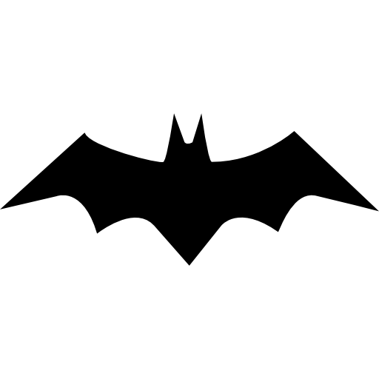

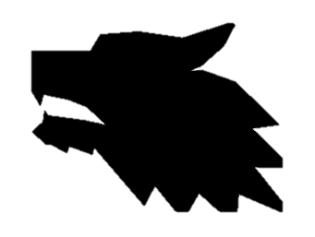
繼承範例：上週
地城中有許多物件在活動，並擁有類似的性質。
位置、表示符號…。
將具重複性質的物件相互繼承，可產生繼承樹關係。
基本物件
位置
主角
主動觸發的道具與環境
(藥水)
符號
敵對生物

Slide 20
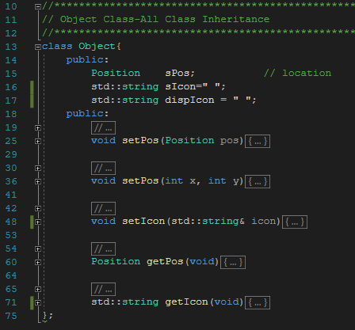

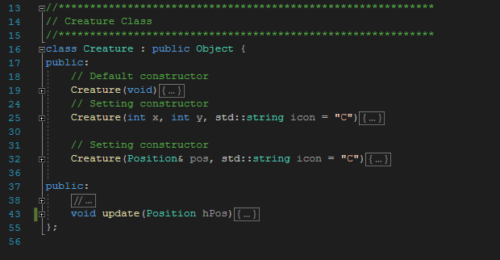
敵對生物
基本物件
基本類別儲存位置與符號資料
並能被子類別存取
敵對生物
敵對生物擁有更新狀態等基本資訊與行為

Slide 21
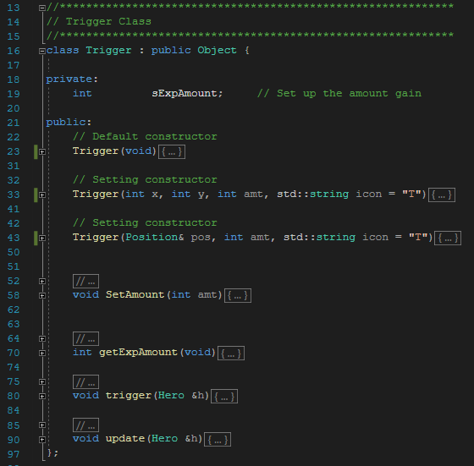
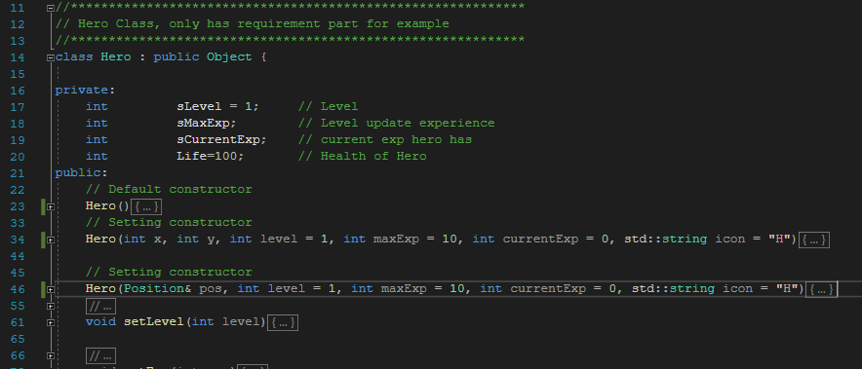
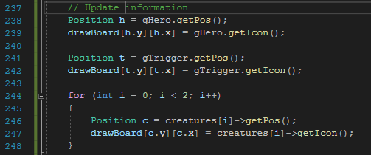
Hero, Trigger繼承基本物件
Hero, Trigger, Creature呼叫Object內函式

Slide 22
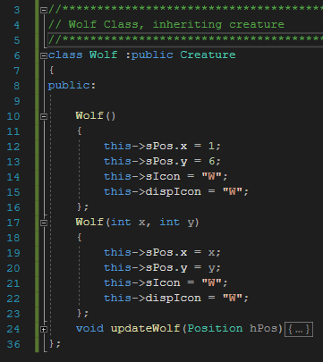
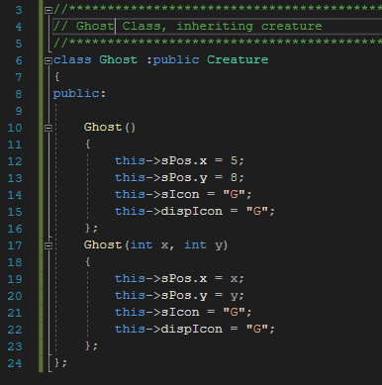
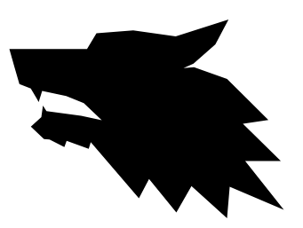
敵對生物
額外靈敏偵測部分
自己獨有的function
鬼只有基本功能，並沿用父類別實作
狼嗅覺靈敏，可以一回合發覺敵人兩次，先是一般偵測再靈敏偵測。

Slide 23
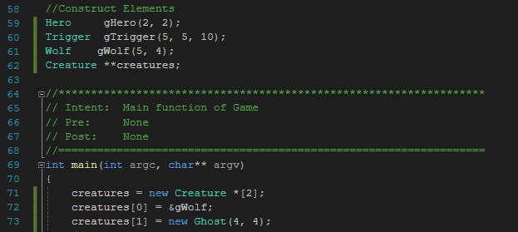


敵對生物管理
對遊戲來說，地城不需要知道生物有甚麼特別的行為，只要能夠更新生物狀態即可。
透過轉型，可以一次管理多個不同型態的陣列資料
敵對生物陣列
建立Creature陣列，
並將繼承生物轉型存入陣列中管理
*需為pointer陣列否則會失去子類別特性
當呼叫陣列生物的update()時，
會各別呼叫不同生物的行為。
額外呼叫子class特有的函式

Slide 24
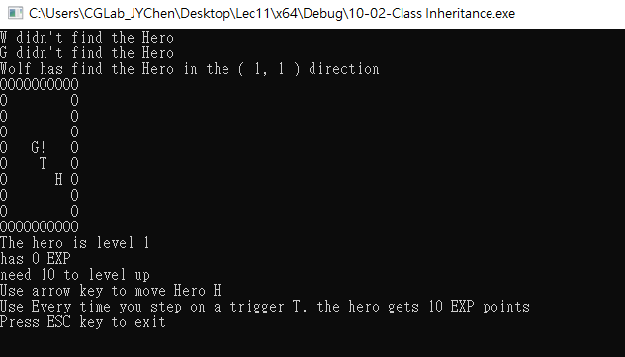
輸出結果
*Wolf基本偵測
*Ghost基本偵測
*Wolf額外偵測
如何避免額外偵測？

Slide 25
沒有Virtual Function(上週討論)：
不同功能需要被額外實作或呼叫
沒辦法根據子類別不同使一函式有不同功能
沒辦法統一管理
如何實作相似功能的統一管理以及呼叫？

Slide 26
多型範例
地城中的許多怪物，並擁有類似的性質。
更新狀態、判斷攻擊……。
使用多型實作底層類別行為，可方便管理。
位置
基本物件
符號
使用Virtual Function實作並統一update更新
偵測兩格以內
偵測4格以內

Slide 27
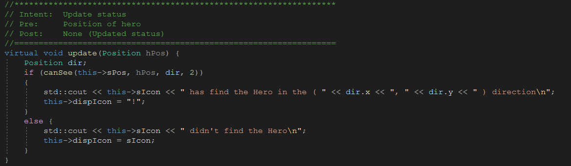
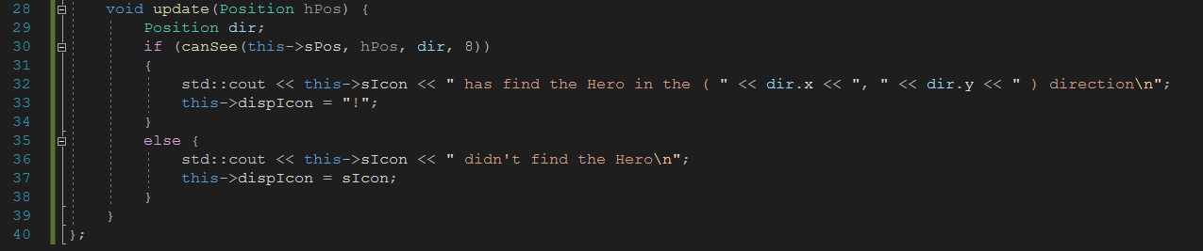
12-01-Class Virtual
將Creature::Update令為Virtual函式
子函式直接更改function內容

Slide 28
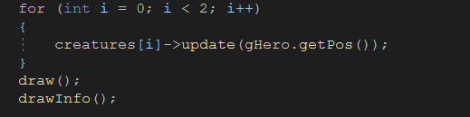
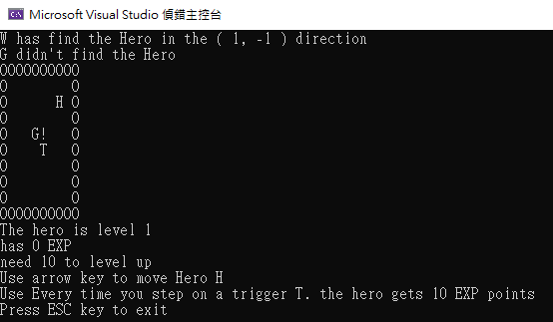
只進行基本呼叫
*使用更新後function的Wolf
*使用Base Function的Ghost

Slide 29
Pure Virtual Functions & Abstract Classes
Base class might not have "meaningful" definition for some of it’s members!
called pure virtual functions
force its descendants to implement.
Recall class Shape
All shapes are defined by its derived classes
Shape has no idea how to draw!
We can make it a pure virtual function: virtual void draw() = 0;
Classes with one or more pure virtual functions are abstract classes
Abstract classes cannot be used to instantiate objects and serves only as an interface
Since it doesn’t have complete "definitions" of some members!
If derived class fails to define all pure’s:
It’s an abstract class too

Slide 30
Example of Abstract Class
class Base // abstract class
{
public:
// pure virtual function
virtual void show() = 0;
};
class Derived : public Base
{
public:
void show(){
cout << "Implementation of Virtual Function in Derived class";
}
};
int main()
{
Base obj; //Compile Time Error
Base *b;
Derived d;
b = &d;
b->show();
}

Slide 31
Extended Type Compatibility
Objects of derived class can be assigned to variables with base class type
But NOT the other way!
A DiscountSale IS a Sale, but the reverse is not true!

Slide 32
Using Classes Pet and Dog
Now given declarations: Dog vdog; Pet *vpet;
Anything that "is a" dog "is a" pet:
vdog.name = "Tiny"; vdog.breed = "Great Dane"; vpet = &vdog;
These are allowable
Can assign values to parent-types, but not reverse
A pet "is not a" dog (not necessarily)
class Pet {
public:
string name;
virtual void print() const;
};
class Dog : public Pet {
public:
string breed;
virtual void print() const;
};

Slide 33
Virtual or not Virtual (1 of 3)
class Polygon {
protected:
int width, height;
public:
Polygon() :width(0), height(0) {}
void set_values(int a, int b){
width = a; height = b;
}
};
class Rectangle : public Polygon {
public:
int area(){
return width*height;
}
};
class Triangle : public Polygon {
public:
int area(){
return width*height / 2;
}
};
int main() {
Rectangle rect;
Triangle trgl;
Polygon *ppolyRect = &rect;
Polygon *ppolyTri = &trgl;
ppolyRect->set_values(4, 5);
ppolyTri->set_values(4, 5);
cout << rect.area() << '\n';
cout << trgl.area() << '\n';
return 0;
}
Output = ?

Slide 34
Virtual or not Virtual (1 of 3)
class Polygon {
protected:
int width, height;
public:
Polygon() :width(0), height(0) {}
void set_values(int a, int b){
width = a; height = b;
}
};
class Rectangle : public Polygon {
public:
int area(){
return width*height;
}
};
class Triangle : public Polygon {
public:
int area(){
return width*height / 2;
}
};
int main() {
Rectangle rect;
Triangle trgl;
Polygon *ppolyRect = &rect;
Polygon *ppolyTri = &trgl;
ppolyRect->set_values(4, 5);
ppolyTri->set_values(4, 5);
cout << rect.area() << '\n';
cout << trgl.area() << '\n';
return 0;
}
Output =
0
0

Slide 35
Virtual or not Virtual (2 of 3)
class Polygon {
protected:
int width, height;
public:
Polygon() :width(0), height(0) {}
void set_values(int a, int b){
width = a; height = b;
}
};
class Rectangle : public Polygon {
public:
int area(){
return width*height;
}
};
class Triangle : public Polygon {
public:
int area(){
return width*height / 2;
}
};
int main() {
Rectangle rect;
Triangle trgl;
Polygon * ppoly1 = &rect;
Polygon * ppoly2 = &trgl;
ppoly1->set_values(4, 5);
ppoly2->set_values(4, 5);
// ppoly1->area();
// ppoly2->area();
cout << rect.area() << '\n';
cout << trgl.area() << '\n';
return 0;
}
Output = ?

Slide 36
Virtual or not Virtual (2 of 3)
class Polygon {
protected:
int width, height;
public:
Polygon() :width(0), height(0) {}
void set_values(int a, int b){
width = a; height = b;
}
};
class Rectangle : public Polygon {
public:
int area(){
return width*height;
}
};
class Triangle : public Polygon {
public:
int area(){
return width*height / 2;
}
};
int main() {
Rectangle rect;
Triangle trgl;
Polygon * ppoly1 = &rect;
Polygon * ppoly2 = &trgl;
ppoly1->set_values(4, 5);
ppoly2->set_values(4, 5);
// ppoly1->area();
// ppoly2->area();
cout << rect.area() << '\n';
cout << trgl.area() << '\n';
return 0;
}
Output =
20
10

Slide 37
Virtual or not Virtual (3 of 3)
class Polygon {
protected:
int width, height;
public:
void set_values (int a, int b){ width=a; height=b;
}
virtual int area (){
return 0;
}
};
class Rectangle: public Polygon {
public:
int area (){
return width * height;
}
};
class Triangle: public Polygon {
public:
int area (){
return (width * height / 2);
}
};
int main () {
Rectangle rect;
Triangle trgl;
Polygon poly;
Polygon * ppolyRect = &rect;
Polygon * ppolyTri = &trgl;
Polygon * ppolyPly = &poly;
ppolyRect->set_values (4,5);
ppolyTri->set_values (4,5);
ppolyPly->set_values (4,5);
cout << ppolyRect->area() << '\n';
cout << ppolyTri->area() << '\n';
cout << ppolyPly->area() << '\n';
return 0;
}
Output = ?

Slide 38
Virtual or not Virtual (3 of 3)
class Polygon {
protected:
int width, height;
public:
void set_values (int a, int b){ width=a; height=b;
}
virtual int area (){
return 0;
}
};
class Rectangle: public Polygon {
public:
int area (){
return width * height;
}
};
class Triangle: public Polygon {
public:
int area (){
return (width * height / 2);
}
};
int main () {
Rectangle rect;
Triangle trgl;
Polygon poly;
Polygon * ppolyRect = &rect;
Polygon * ppolyTri = &trgl;
Polygon * ppolyPly = &poly;
ppolyRect->set_values (4,5);
ppolyTri->set_values (4,5);
ppolyPly->set_values (4,5);
cout << ppolyRect->area() << '\n';
cout << ppolyTri->area() << '\n';
cout << ppolyPly->area() << '\n';
return 0;
}
Output =
20
10
0

Slide 39
Slicing Problem
Given the following codes:
Dog dog; dog.name = "Tiny"; dog.breed = "Great Dane"; Pet pet = dog;
Information of dog is partially copied (assigned) to pet
Information is lost from those that are not copied, hence called object got sliced
cout << pet.breed;
Not allowed because pet IS a Pet, not a Dog

Slide 40
Values V.S. Pointers
Given the following codes:
Dog dog; Pet vPet = dog;
Pet *pPet = &dog;
vPet represents as a Pet, and it is actually a Pet
pPet represents as a Pet, but it is actually a Dog
cout << pPet->breed;
Still not allowed!
Object won’t get actually sliced for pointer-assignment
But the information of derived class will become invisible through base class type pointer
As pPet represents as a Pet, it should be treated as a Pet, not a Dog

Slide 41
Upcasting
Given the following codes:
Dog *dog = new Dog(); Pet *pet = dog; // implicit upcasting
pet = static_cast<Pet>(dog); // explicit upcasting
Upcasting (from descendant to ancestor) is always legal
Because a Dog IS ALWAYS a Pet

Slide 42
Downcasting
Given the following codes:
Pet *pet = new Dog(); Dog *dog = pet; // cannot do implicit downcasting
Implicit downcasting (from ancestor to descendant) is forbiddened
Because a Pet IS NOT ALWAYS a Dog
Can explicitly be done with dynamic_cast: Pet *pet = new Dog(); Dog *dog = dynamic_cast<Dog*>(pet);
dynamic_cast return nullptr if pet is not a Dog
It’s programmers responsibility to make sure pet here is actually a Dog.

Slide 43
Slicing Example
class BaseCls {
public:
BaseCls(const string& s) : name(s){
}
virtual void Show() const {
cout << "Base: " << name
<< " Show()" << endl;
}
private:
string name;
};
class DerivedCls : public BaseCls {
private:
string name;
string habitat;
public:
DerivedCls(const string& sp, const string &s, const string &h)
: BaseCls(sp), name(s), habitat(h) {};
virtual void Show() const {
cout << "DerivedCls: " << name
<< " Show() in " << habitat << endl;
}
};
void Fun1(BaseCls a) { a.Show(); }
void Fun (const BaseCls &a) { a.Show (); }
int main(){
BaseCls ocBase("Base");
DerivedCls ocDerived("Test","Test1", "Test1 & Test2");
cout << "pass-by-value" << endl;
Fun1(ocBase);
Fun1(ocDerived);
cout << "\npass-by-reference" << endl;
Fun(ocBase);
Fun(ocDerived);
return 0;
}
pass-by-value
Base: Base Show()
Base: Test Show()
pass-by-reference
Base: Base Show()
DerivedCls: Test1 Show() in Test1 & Test2

Slide 44
Virtual Destructors
Recall: destructors needed to de-allocate dynamically allocated data
Consider: Base *pBase = new Derived(); … delete pBase;
Would call Base class destructor even though pointing to Derived class object!
Making destructor virtual fixes this!
Good policy for all destructors to be virtual

Slide 45
Virtual Destructor
class Base {
public:
virtual ~Base() { cout << "Calling ~Base()" << endl; }
};
class Derived: public Base {
private:
int* m_pnArray;
public:
Derived(int nLength) { m_pnArray = new int[nLength]; }
virtual ~Derived()
{
cout << "Calling ~Derived()" << endl;
delete[] m_pnArray;
}
};
int main() {
Derived *pDerived = new Derived(5);
Base *pBase = pDerived;
delete pBase;
return 0;
}
this program produces the following result:
Calling ~Derived()
Calling ~Base()

Slide 46
Pure Virtual Destructors
For pure virtual destructors, (empty) function body must be provided.
Which is against the pure virtual behavior
Since destructors must exist for each class
There is no requirement of implementing pure virtual destructors in the derived classes.

Slide 47
Pure Virtual Destructors
class Base{
public:
virtual ~Base() = 0; // Pure Virtual Destructor
// you can also write
// virtual ~Base() = 0 {}
};
//Definition of Pure Virtual Destructor
Base::~Base() { cout << "Base Destructor"; }
class Derived: public Base {
public:
~Derived() { cout<< "Derived Destructor"; }
};

Slide 48
Inner Workings of Virtual Functions
Virtual function table
Compiler creates it for EACH class if virtual functions are involved
Has pointers for each virtual member function
Points to location of correct code for that function

Slide 49
介面(Interface)
只有虛函數成員定義，不具備實體，僅表達「介面規格」
在 C++ 只能以抽象類別模擬
在抽象類別中只定義公開的純虛函數，跟虛解構子
一種設計策略是只透過介面溝通自己親輩以外的類別
class Pet{
public:
virtual ~Pet() = 0;
virtual void print() const = 0;
};
Pet::~Pet(){}

Slide 50
Summary 1
Late binding delays decision of which member function is called until runtime
In C++, virtual functions use late binding
Pure virtual functions have no definition
Classes with at least one are abstract
No objects can be created from abstract class
Used strictly as base for others to derive

Slide 51
Summary 2
Derived class objects can be assigned to base class objects
Base class members are lost; slicing problem
Pointer assignments and dynamic objects
Allow "fix" to slicing problem
Make all destructors virtual
Good programming practice
Ensures memory correctly de-allocated

