Slide 1
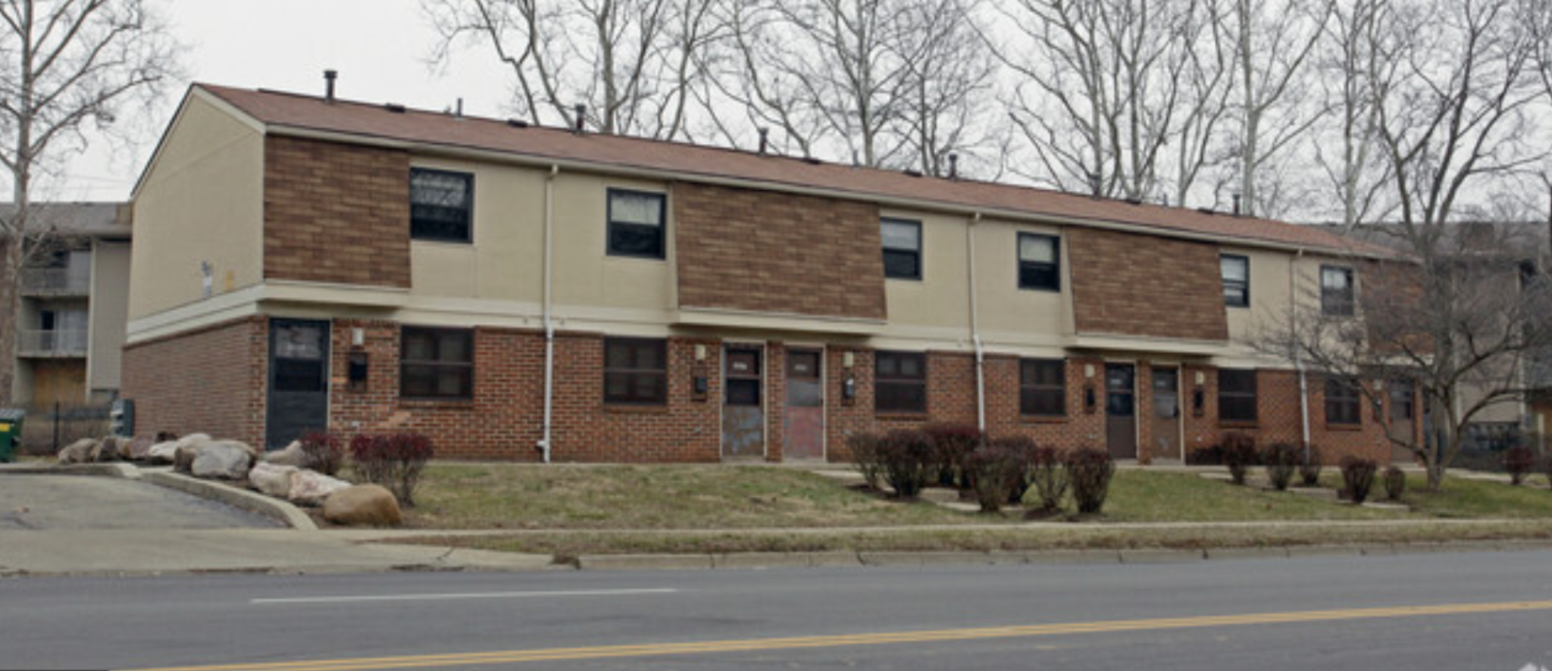
MPC Cornell Townhouse Community Building Climate Control
Xinyu Liu
MAE 6780 Final Project

Slide 2
Model Predictive Control (MPC)
Approximately 40% of the global energy consumption occurs in buildings, half is used for HVAC (Heating ,Ventilation, and Air Conditioning) system.
Model predictive control (MPC) is an advanced method of process control that is used to control a process while satisfying a set of constraints.
MPC uses a mathematical model of the building and predictions of disturbances over a given prediction horizon to formulate an optimization problem.
Find the control input trajectory that maintains the comfort for the occupants over the whole time horizon while minimizing some objective. (e.g. total energy use/price)
Notes:
Model predictive control has been recognized as one of the essential solutions to achieve considerable energy savings in buildings. Energy reductions can be realized by improving a building's HVAC systems
and construction, However, the majority of the building stock is already in place and refurbishments of buildings are expensive. By contrast, control systems can be upgraded and their operation optimized at comparatively low costs.

Slide 3
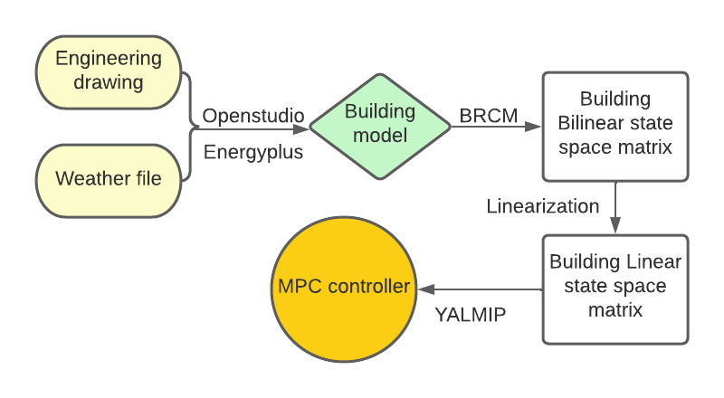
Project Outline
Fig (1) Project flowchart

Slide 4
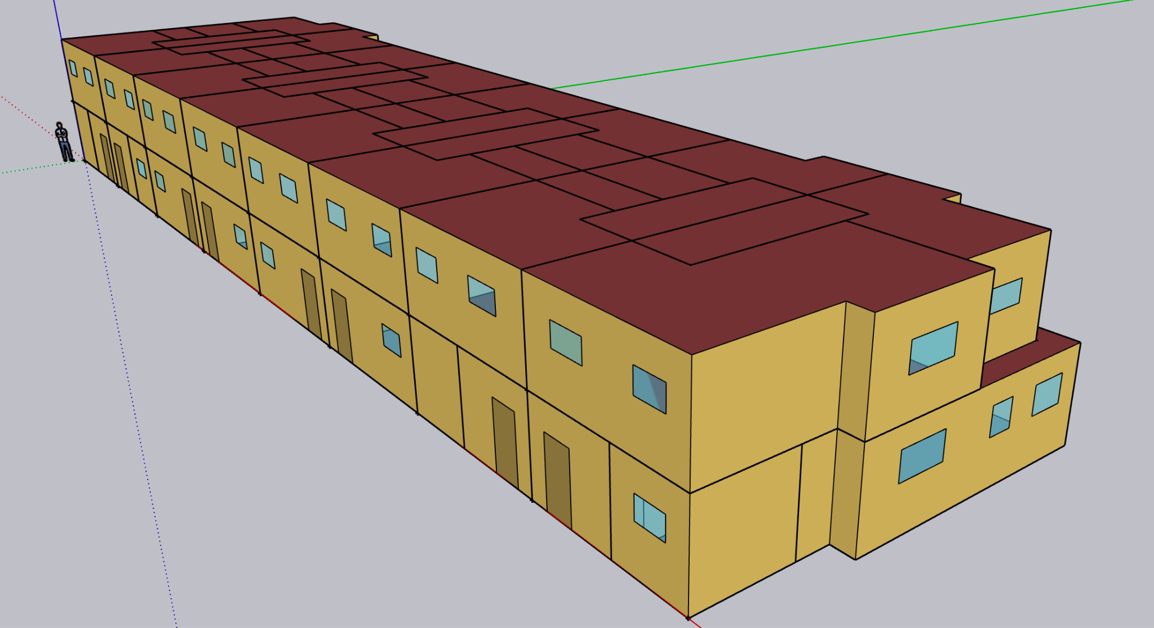
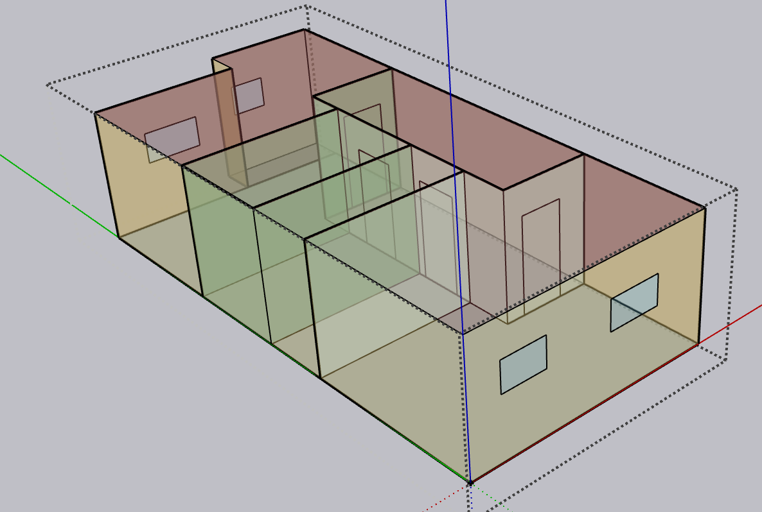
Building Model
16 rooms
16 thermal zones
Fig (3) Single unit detail
Fig (2) OpenStudio Townhouse community model

Slide 5
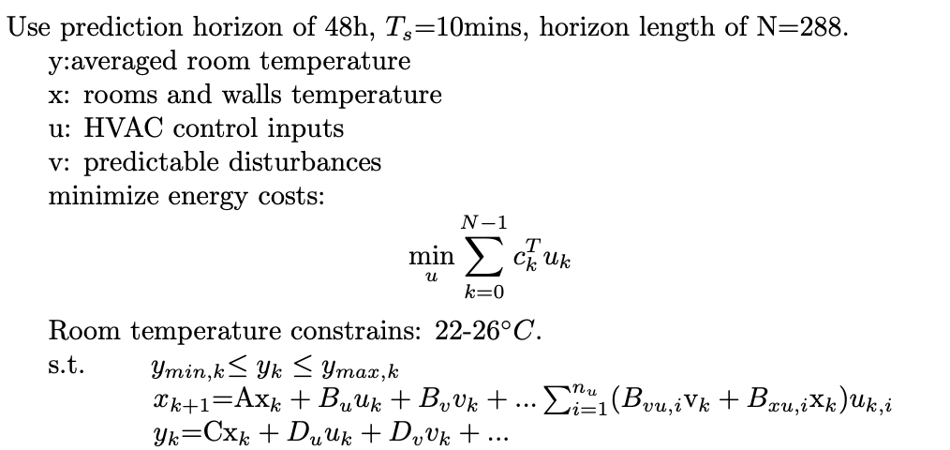
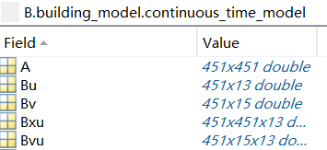
MPC Model
The main goal of the control system is to ensure the comfort of the occupants while minimizing operating costs.
Fig (5) Building Bilinear SSM converted from energyplus

Slide 6
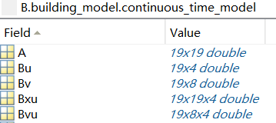

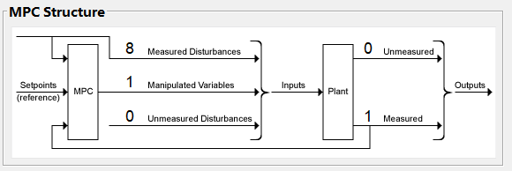
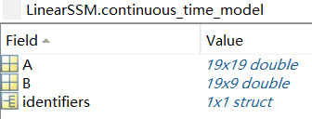
Linearization
u=[1,1,0,u]
The linearized system is stable, observable, controllable
Notes:
blinds control , AHU air handling

Slide 7
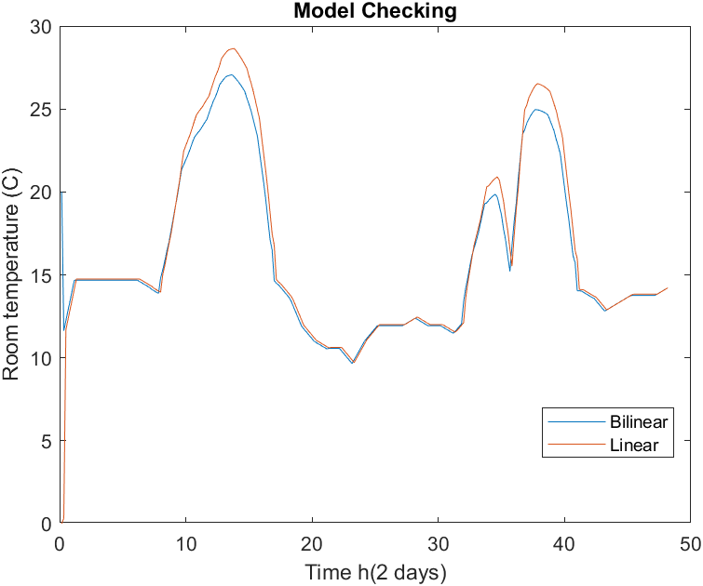
Model checking
Given inputs manually to check if the bilinear model and linearized model are match.

Slide 8
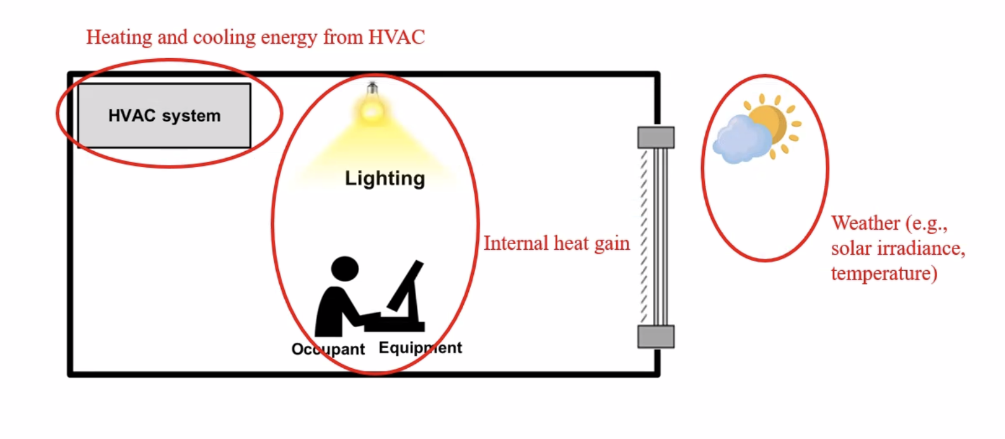
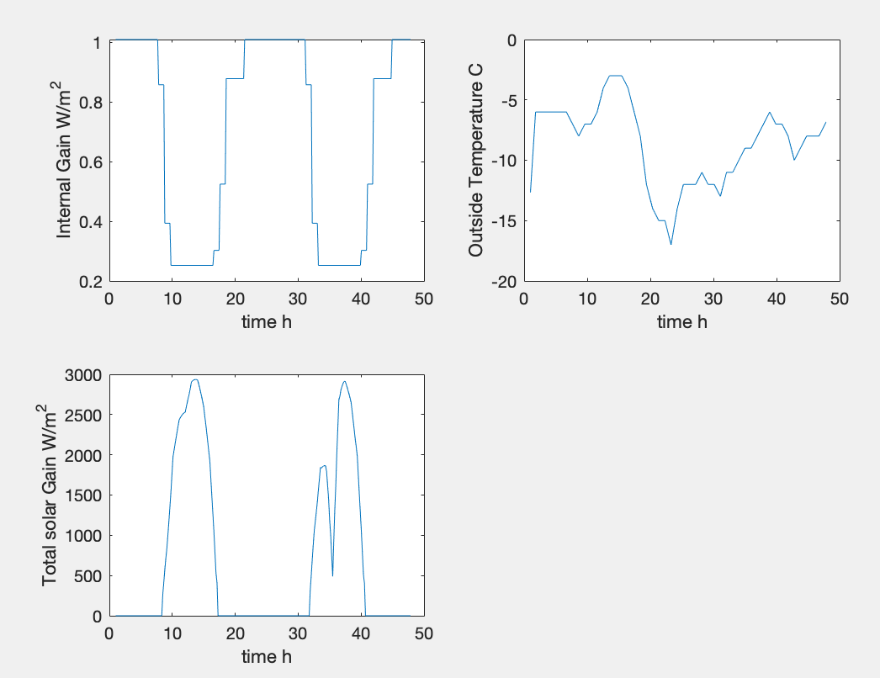
Control Input and Disturbances
1 control input: HVAC heating power
8 disturbances: Internal gain
Outside air temperature
Ground temperature
Solar gain from E,W,N,S,H
9 new control input after linearization

Slide 9
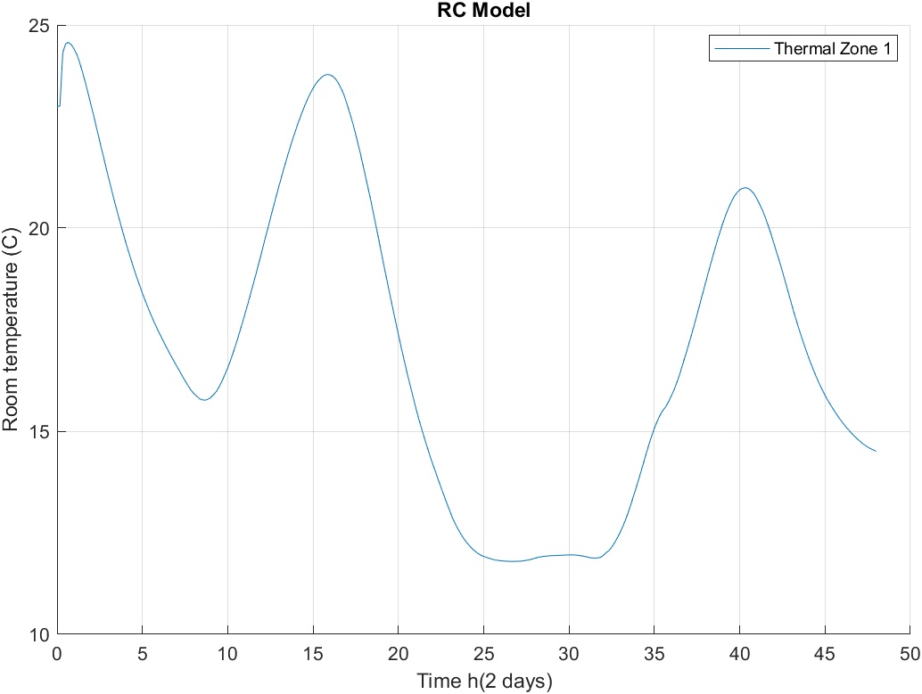
RC Model
Building Resistance-Capacitance Modeling (BRCM) Matlab toolbox generated bilinear RC (Resistance-Capacitance) model.
Energy cost 657 $
Notes:
Building Resistance-Capacitance Modeling (BRCM) Matlab toolbox
that we developed to enable the automatic generation of bilinear RC models from geometry,
construction, and systems data. Moreover, it supports the generation of the corresponding
potentially time-varying costs and constraints necessary to set up the MPC problem

Slide 10
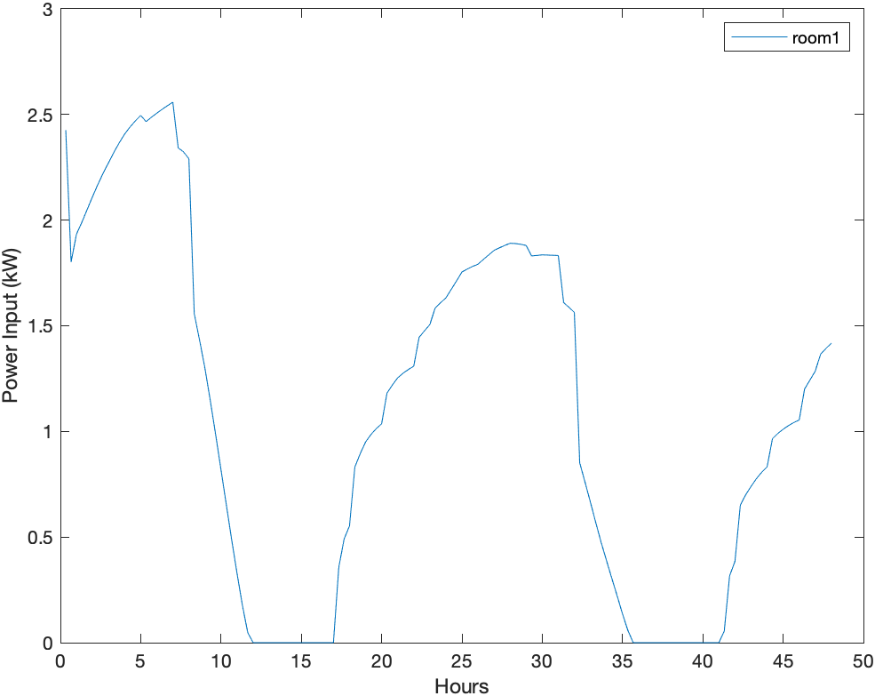
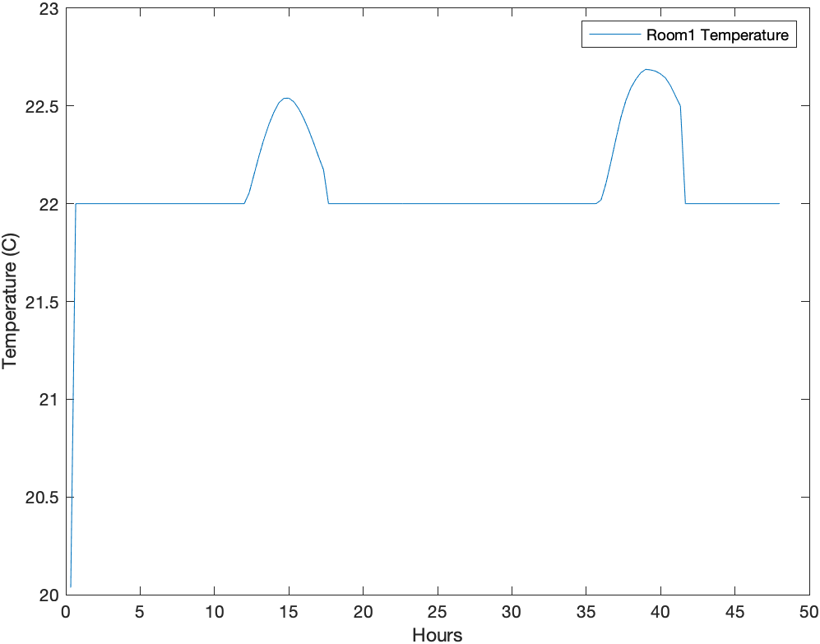
MPC Results with constant electricity price
Energy cost 320 $

Slide 11
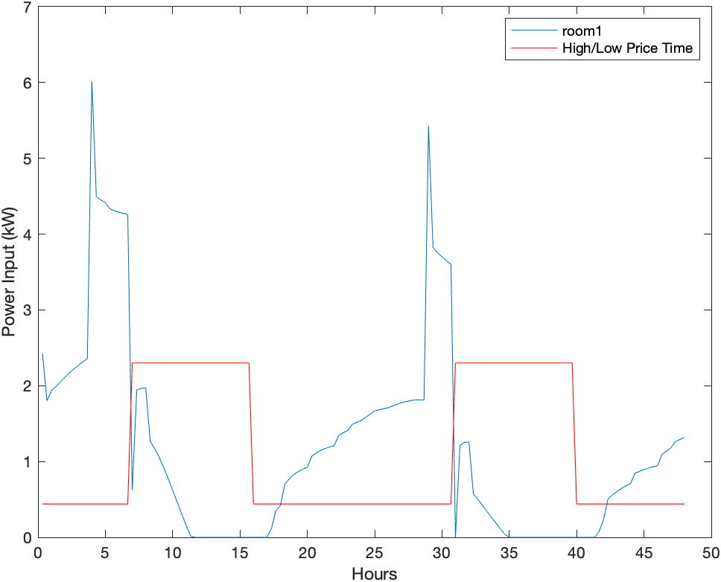
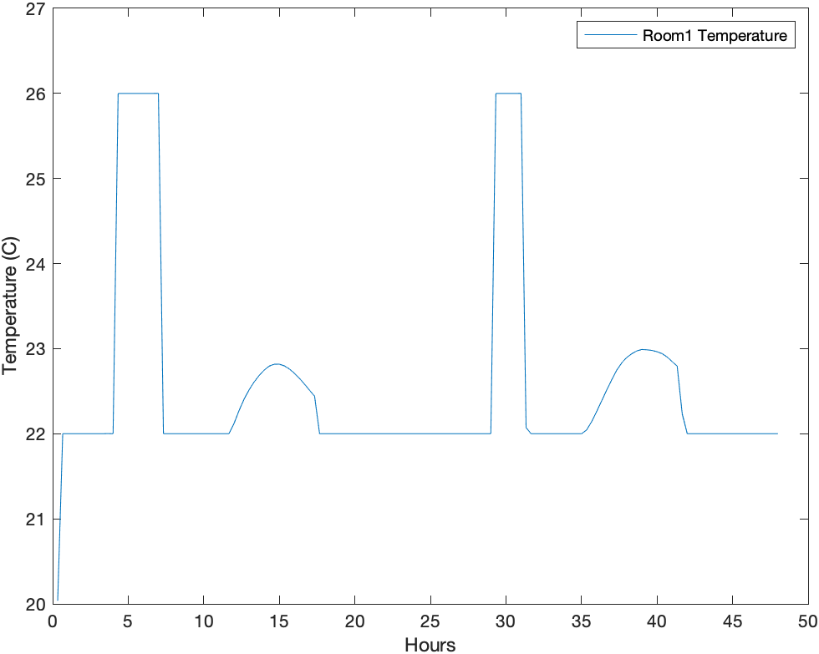
MPC Results with dynamic electricity price
Energy cost 119 $

Slide 12
Conclusion and Future works
Without MPC, the energy cost is 657$
With fixed electricity price, the energy cost is 320$
With dynamic electricity price, the energy cost is 119$
MPC save energy and keep the room temperature in comfort level.
MPC in building climate energy savings depend largely on the optimization function.
Learning-based MPC

Slide 13
Thank You!

