Slide 1

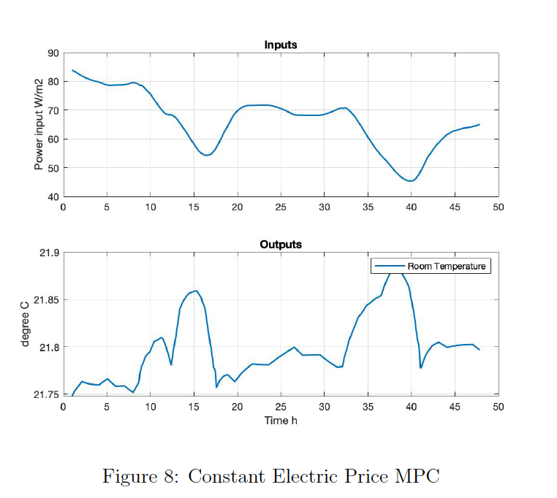
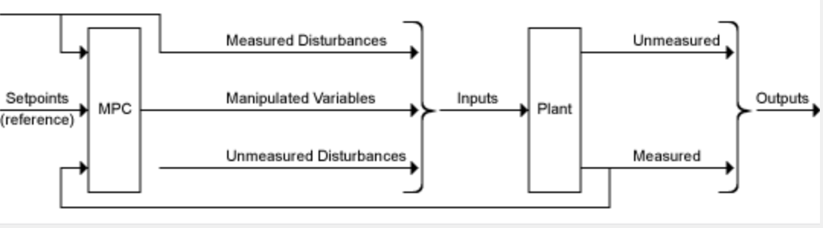
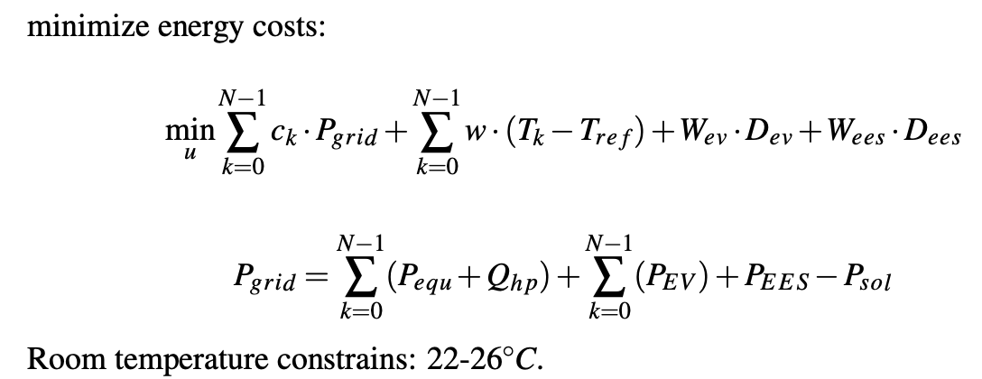
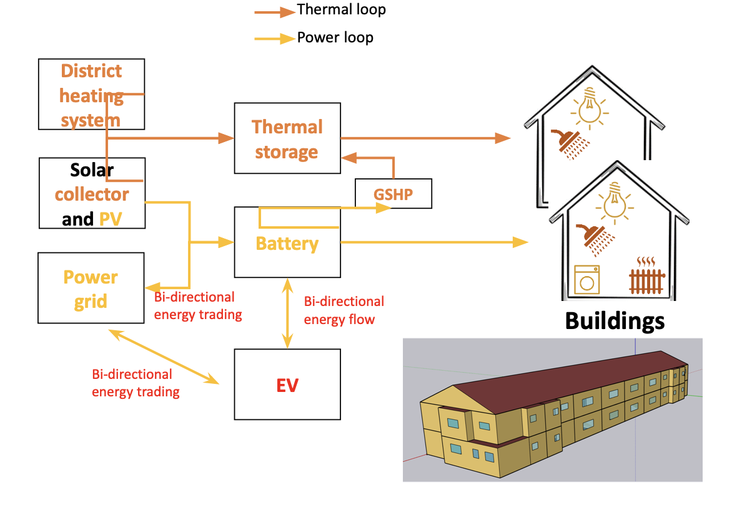
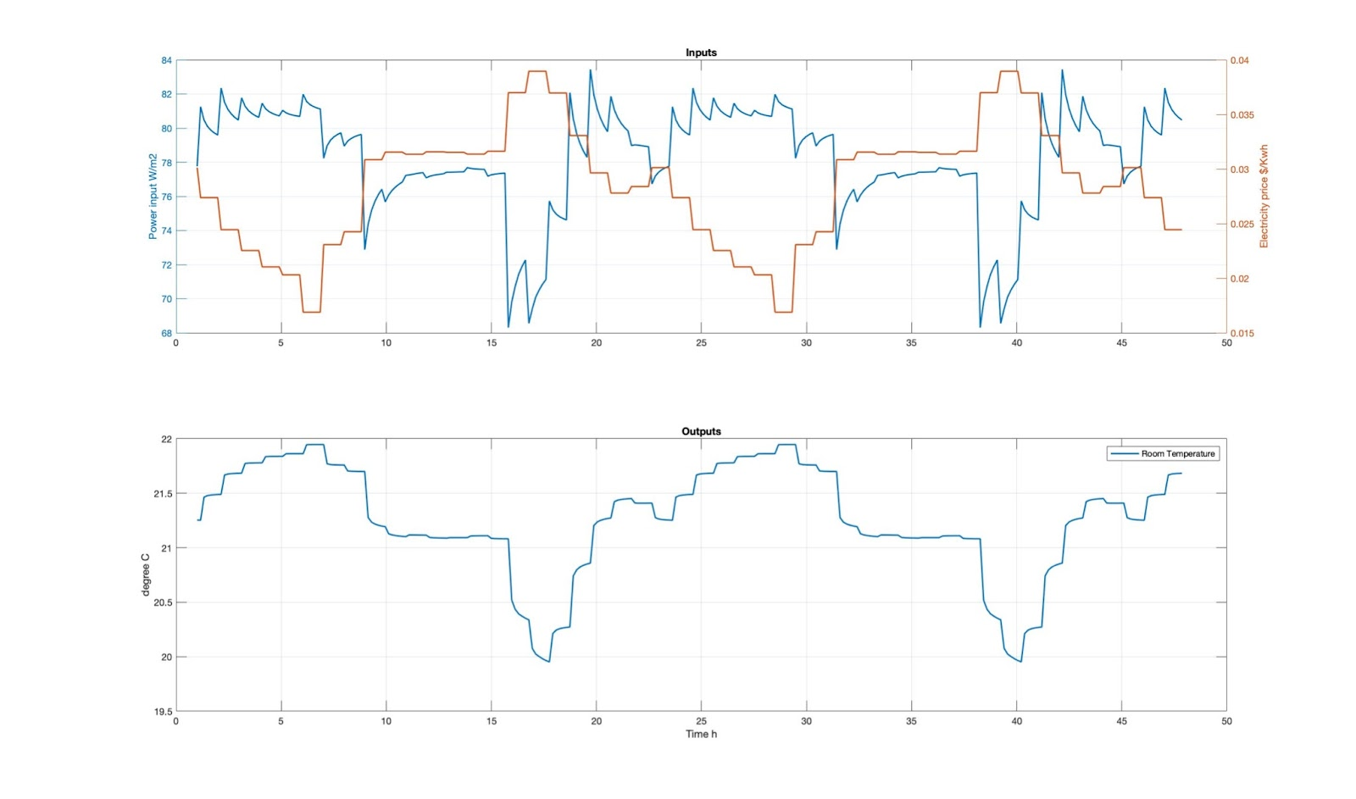
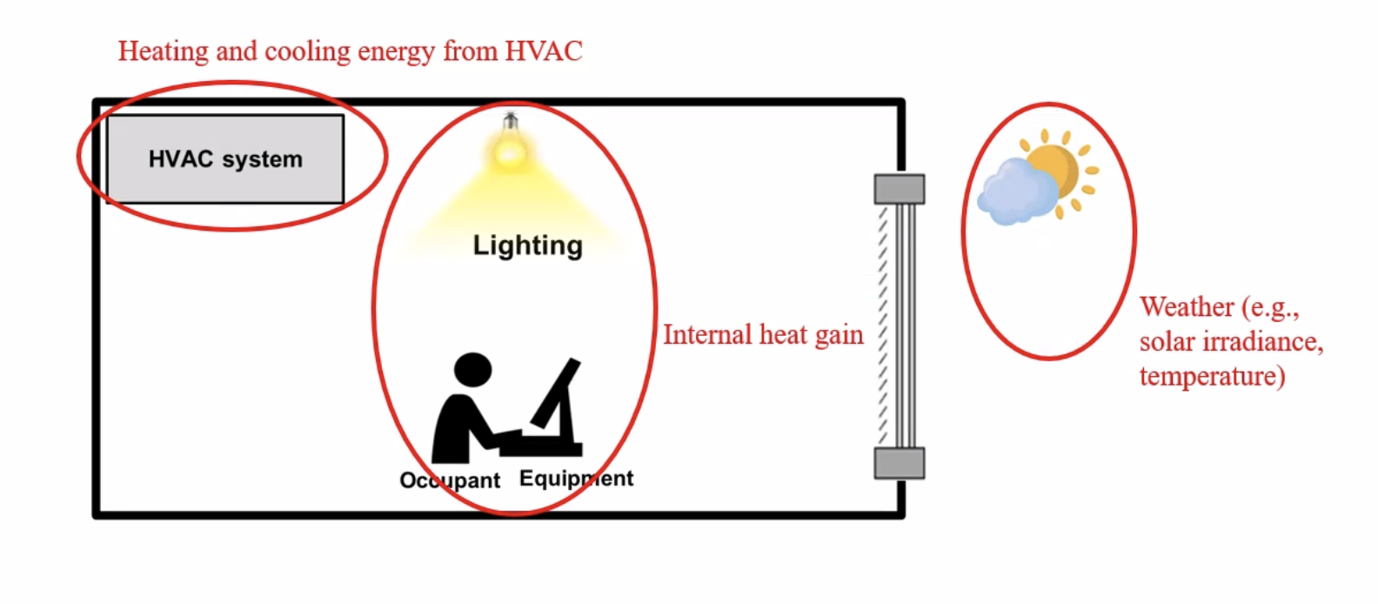
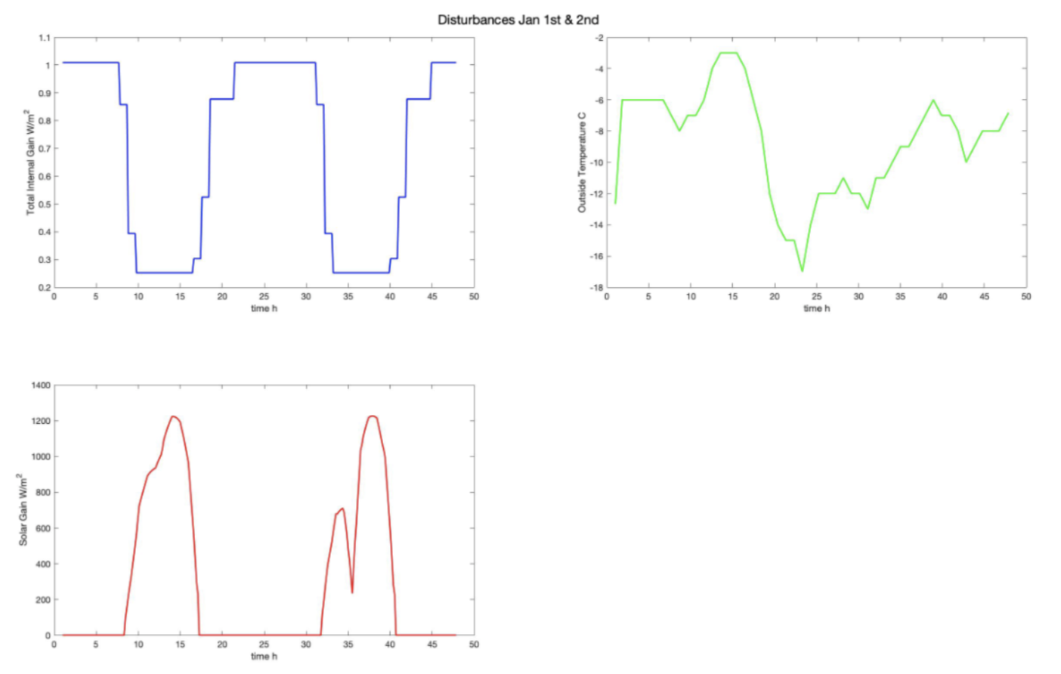
Model Predictive Building Climate Control with Smart EV Charging Optimization for Cornell Townhouse Community
Xinyu Liu (xl598)
Abstract
Approximately 40 % of the global energy consumption occurs in buildings, and half is used for HVAC systems. Energy reductions can be realized by improving a building’s HVAC systems and construction.[1] This project presented an accurate physics-based building model for Cornell townhouse residential building with an HVAC heating system, PV panel and an EV charging station. MPC controllers are used to minimize total energy cost while keeping the indoor temperature comfortable.
Major innovation
First time to conduct MPC of smart EV charging and building climate control considering bidirectional energy flow (G2B,G2V,B2V,V2B) and integration with renewable energy sources.
MPC Sturcture
Distrubance
Preliminary Results
Conclustion
Constant electricity price MPC can save 17% energy cost, while economic MPC can save 25.7%. MPC performance depends largely on the optimization function and controller setting.
References
[1]Sturzenegger, D., Gyalistras, D., Semeraro, V., Morari, M., amp; Smith, R. S. (2014). BRCM MATLAB TOOLBOX: Model generation for model predictive build-ing control. 2014 American Control Conference.
61
0
12
41
Constant Electric Price MPC
Dynamic Price Economic MPC

