Slide 1
A Blockchain-Based Provenance System for Ensuring AI Training Data Integrity and Auditability
Project Update & Refinement
Presenter: Xinyuan Hu | Date: 27 June, 2026
Notes:
Hello everyone, I will present an update on my project, A Blockchain-Based Provenance System for Ensuring AI Training Data Integrity and Auditability.

Slide 2
Project Progress
Key Research Updates & Findings
Engineering Implementation Progress
Correction to IPFS Stability
Implemented a mandatory local Pin mechanism to ensure data persistence, overriding the default garbage collection behaviour of the IPFS daemon.
MLOps Tool Limitation
Mainstream tools (e.g., MLflow) lack cryptographic tamper-proof guarantees for model lineage.
IPFS Network Realities
Data persistence is not default; explicit “Pin”ning is mandatory to prevent garbage collection.
Atomic Commit & Compensation Log
Successfully built a simplified two-phase commit protocol with a fault recovery log, ensuring that all distributed state changes either complete fully or roll back atomically.
Adversarial Testing
Fault Injection Analytics paradigm verifies atomic consistency against malicious state modifications.
Observability Standard
OpenTelemetry adopted as the unified standard for collecting traces, metrics, and logs across services.
Non-intrusive SDK Evolution
Shifted from framework hooks to a monkey-patch mechanism, achieving true zero-modification of user code while maintaining full observability.
Notes:
First, let‘s look at the project progress. On the research front, I have confirmed limitations in existing MLOps tools regarding security, and I've corrected the assumptions about IPFS data persistence. I've also identified robust methodologies for testing and observability. On the engineering side, I've implemented critical fixes for IPFS stability, successfully built the atomic commit mechanism, and evolved the Python SDK to be truly non-intrusive for users.

Slide 3
Refined Research Direction
From Initial Concepts to Precise Engineering Goals
RQ1: Hybrid Storage Architecture
RQ2: Fine-grained Metadata Collection
RQ3: Atomic Consistency & Fault Recovery
How to design a three-layer hybrid storage architecture (Blockchain, IPFS, OrbitDB) that provides end-to-end cryptographic verifiability for industrial-grade AI training, controls performance overhead, and enables rapid tampering detection and verification?
How to design a zero-code-intrusion metadata collection mechanism that automatically captures training data at Session, Epoch, and Step granularities, and constructs a verifiable hash chain to ensure data provenance and integrity across the AI lifecycle?
How to design an atomic consistency mechanism that maintains the integrity of the traceability chain through automated fault detection and compensation recovery, ensuring idempotency during recovery to prevent data corruption in distributed AI training environments?
The integration of decentralised storage and cryptographic primitives ensures that every step of the AI training process is transparent, verifiable, and resilient to failures.
Notes:
Next, my research direction has been significantly refined. I've moved from broad concepts to three precise, measurable research questions. RQ1 focuses on designing a performant hybrid storage architecture with cryptographic verifiability. RQ2 is about creating a truly non-intrusive metadata collection mechanism. And RQ3 addresses the critical challenge of maintaining data consistency and enabling reliable fault recovery in the distributed system.

Slide 4
Methodology: Design Science Research (DSR)
DSR Stages
• Stage 1: Problem Identification: Completed via systematic literature review, identifying three key research gaps in AI training traceability.
• Stage 2: Design & Development: The current core stage, constructing the system artefact (hybrid architecture, SDK, consistency mechanism) based on the identified gaps.
• Stage 3: Evaluation: Future work involving empirical testing to validate the artefact against the research questions.
Evaluation Strategy: Triangulation
A robust evaluation strategy ensures validity & reliability of results.
• RQ1 (Performance): Measure overhead via paired experiments & OpenTelemetry data.
• RQ2 (Audit Integrity): Verify metadata coverage & hash chain integrity.
• RQ3 (Consistency): Test recovery via fault injection & idempotency checks.
Validity & Reliability
• Construct Validity: Grounded in literature & standard metrics (overhead, recovery rate).
• Internal Validity: Controlled variables (e.g., identical hardware for testing).
• External Validity: Limited by controlled environments; future real-world deployment.
• Reliability: Repeatable experiments & automated scripts to reduce error.
Notes:
The chosen methodology is Design Science Research, or DSR. As shown on the left, I follow three stages: problem identification, which I've completed; design and development, which is the current focus; and future evaluation. For the evaluation stage, as detailed on the right, I've designed a robust triangulation strategy to test each research question from multiple angles. I've also carefully considered the validity and reliability of my study, ensuring the credibility of the results through rigorous design and repeatable experiments.

Slide 5
Software Engineering Principles
Separation of Concerns
Agile Development
A strict four-layer architecture isolates responsibilities across distinct components, enabling independent upgrades, maintenance, and scaling of each system part without disrupting the whole.
Bi-weekly sprints deliver functional components incrementally, enabling early detection of issues and iterative adjustment to requirements for rapid, reliable progress.
Programming to Interface
Observability Integration
Built on SRE-inspired pillars—Metrics, Logging, and Tracing—ensuring full-chain visibility into system behaviour, performance, and error states.
The system encapsulates storage backends behind standardized RESTful interfaces, abstracting implementation details to allow seamless replacement of underlying technologies as needs evolve.
Notes:
To ensure a high-quality system, I've adhered to core software engineering principles. I've implemented a clear separation of concerns through a layered architecture and programmed to interfaces for flexibility. My development follows an agile approach with short sprints, and I’ve used the industrial standard observability methods, incorporating metrics, logging, and tracing to ensure I can monitor and understand the system's behaviour.

Slide 6
Ethical & Cultural Considerations
Cross-Cultural Adaptability
Data Sovereignty & Compliance:
EU (GDPR): Adapt private IPFS clusters with geographical fencing.
China: Adapt private on-premises system deployment.
USA: Adapt modular compliance configuration interfaces.
Trust Models & Accessibility:
Trust: Support private/consortium (high-trust) & public (low-trust) blockchains.
Accessibility: Adapt SaaS/managed service model to lower barriers.
Key Ethical Issues & Mitigations
Privacy Risks:
Membership Inference Attack: Merkle tree may reveal training data presence.
  Mitigation: Access control for proof paths or salted hashes.
Right to be Forgotten: Immutable records conflict with deletion rights.
  Mitigation: Hash revocation mechanism on-chain.
Responsibility & Accountability:
Traceability must not enable evasion of algorithmic bias responsibility.
Mitigation: Clarify traceability is necessary but not sufficient for accountability.
Notes:
For ethical and cultural considerations, I’ve identified key privacy risks like membership inference and the 'right to be forgotten', and designed mitigations. To ensure cross-cultural adaptability, the system can be extended to support different data sovereignty requirements and trust models, making the system compliant and usable across various global regions.

Slide 7
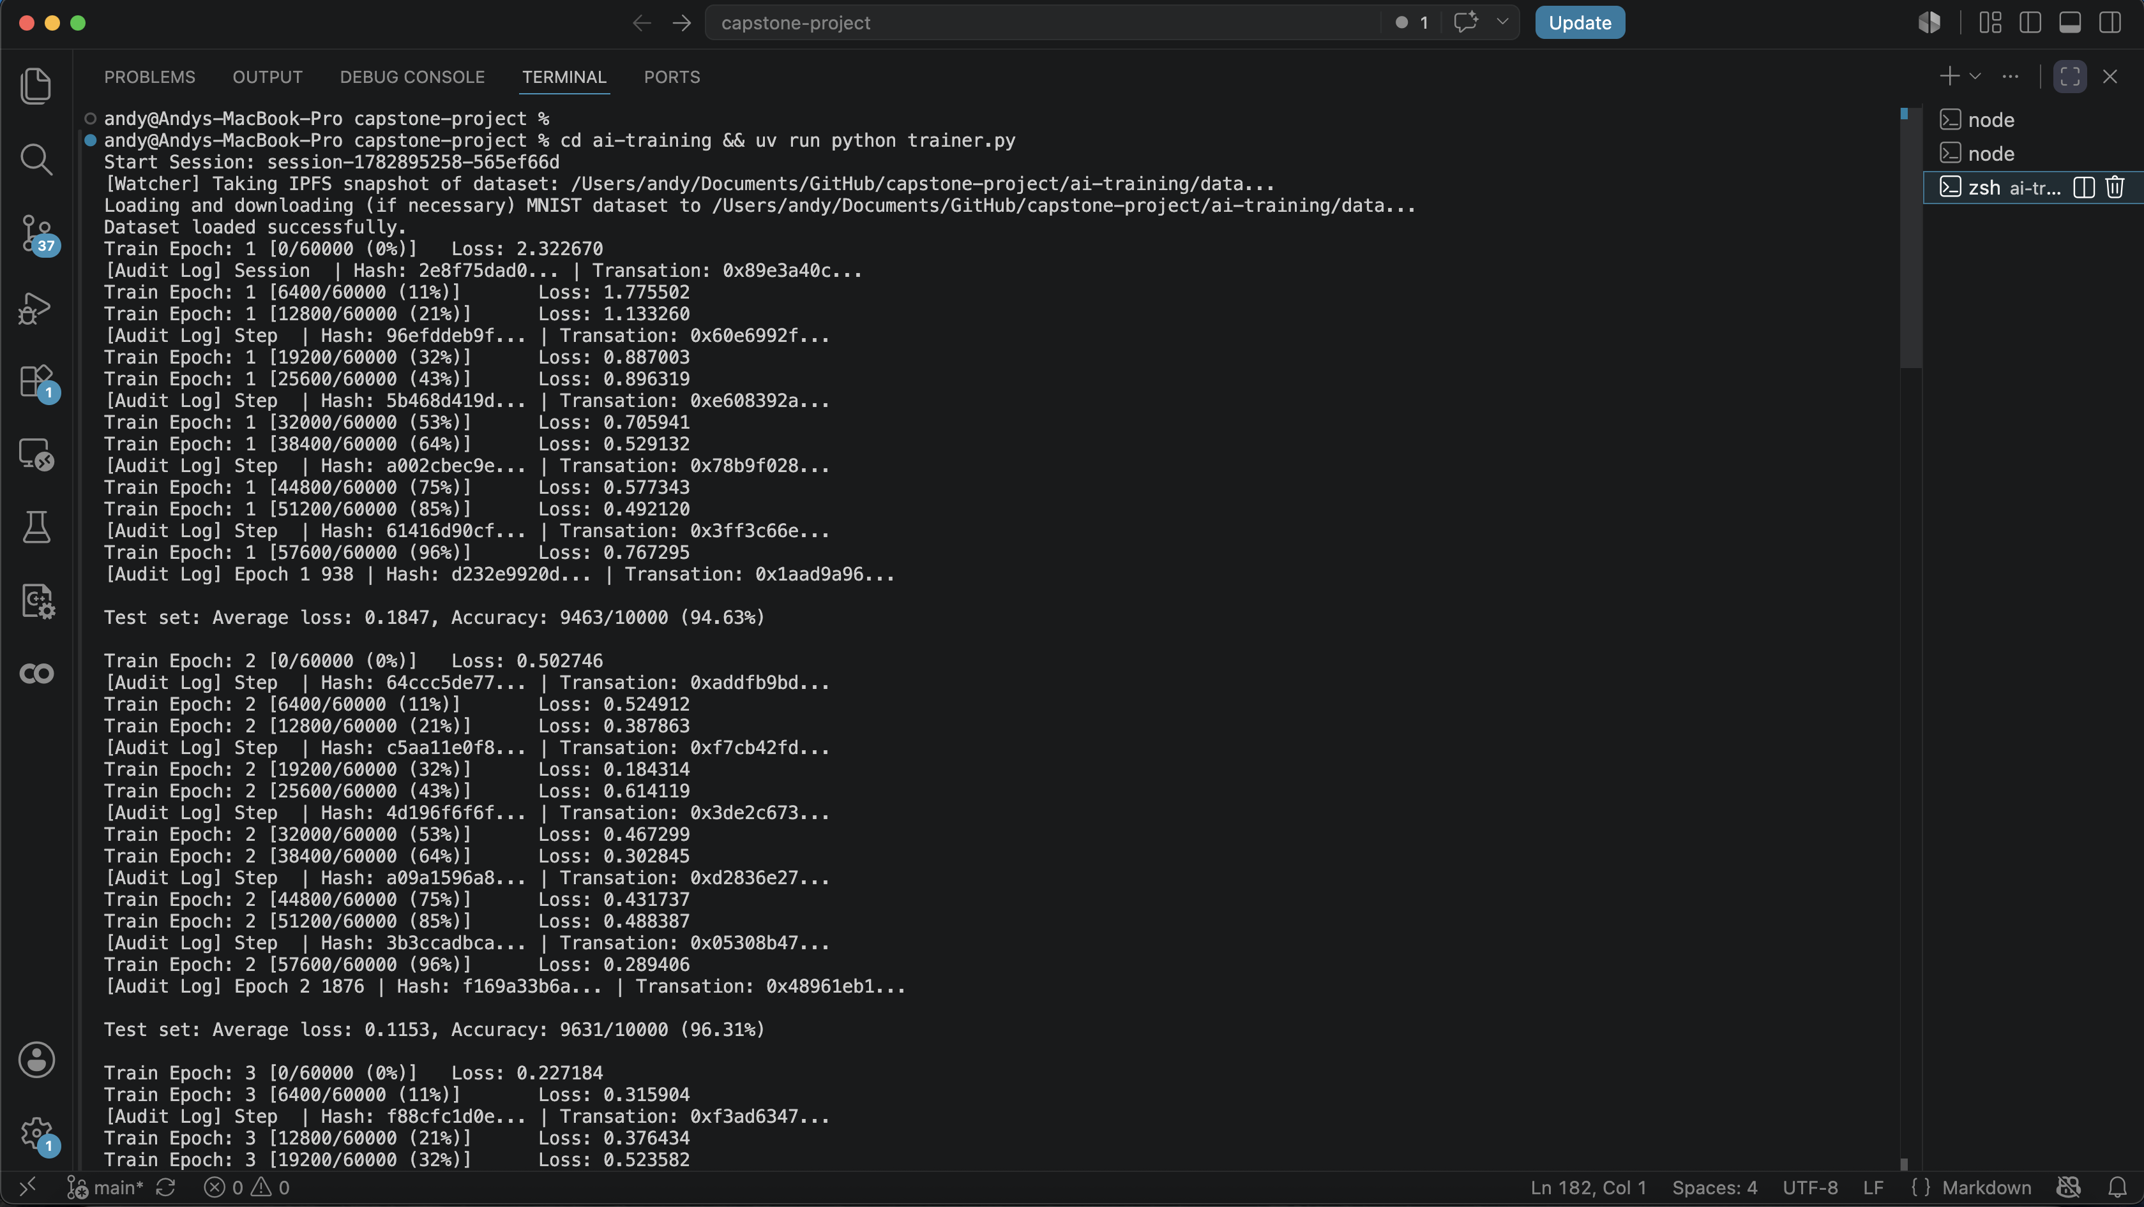
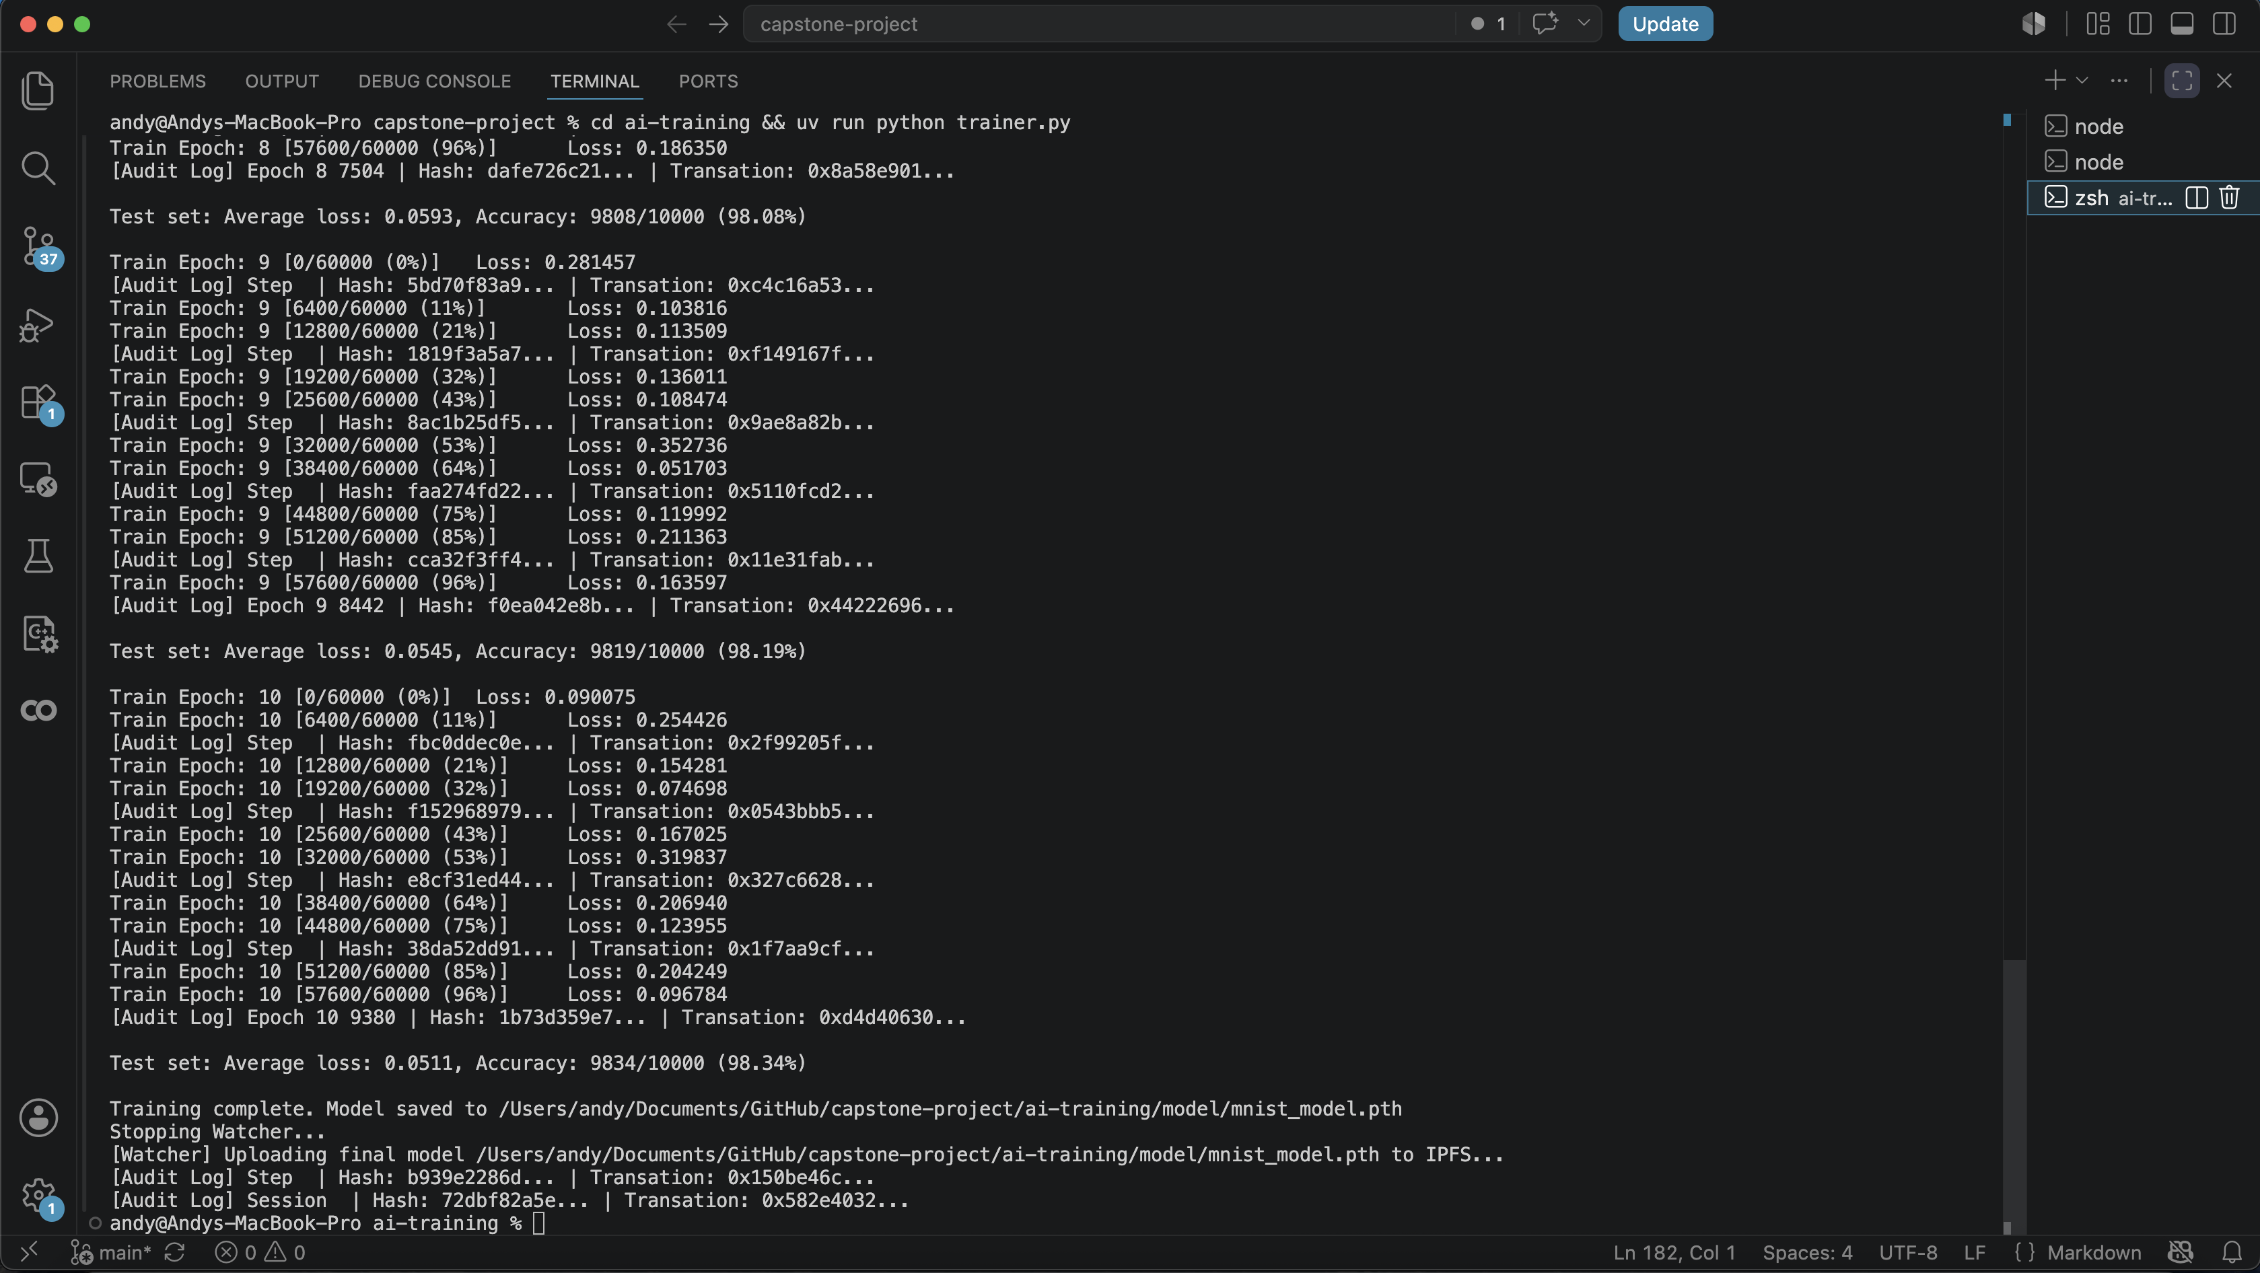
Screenshots of Running System – Model Training
Training AI models: “[Audit Log]” indicates that the training data are captured by the non-intrusive SDK

Slide 8
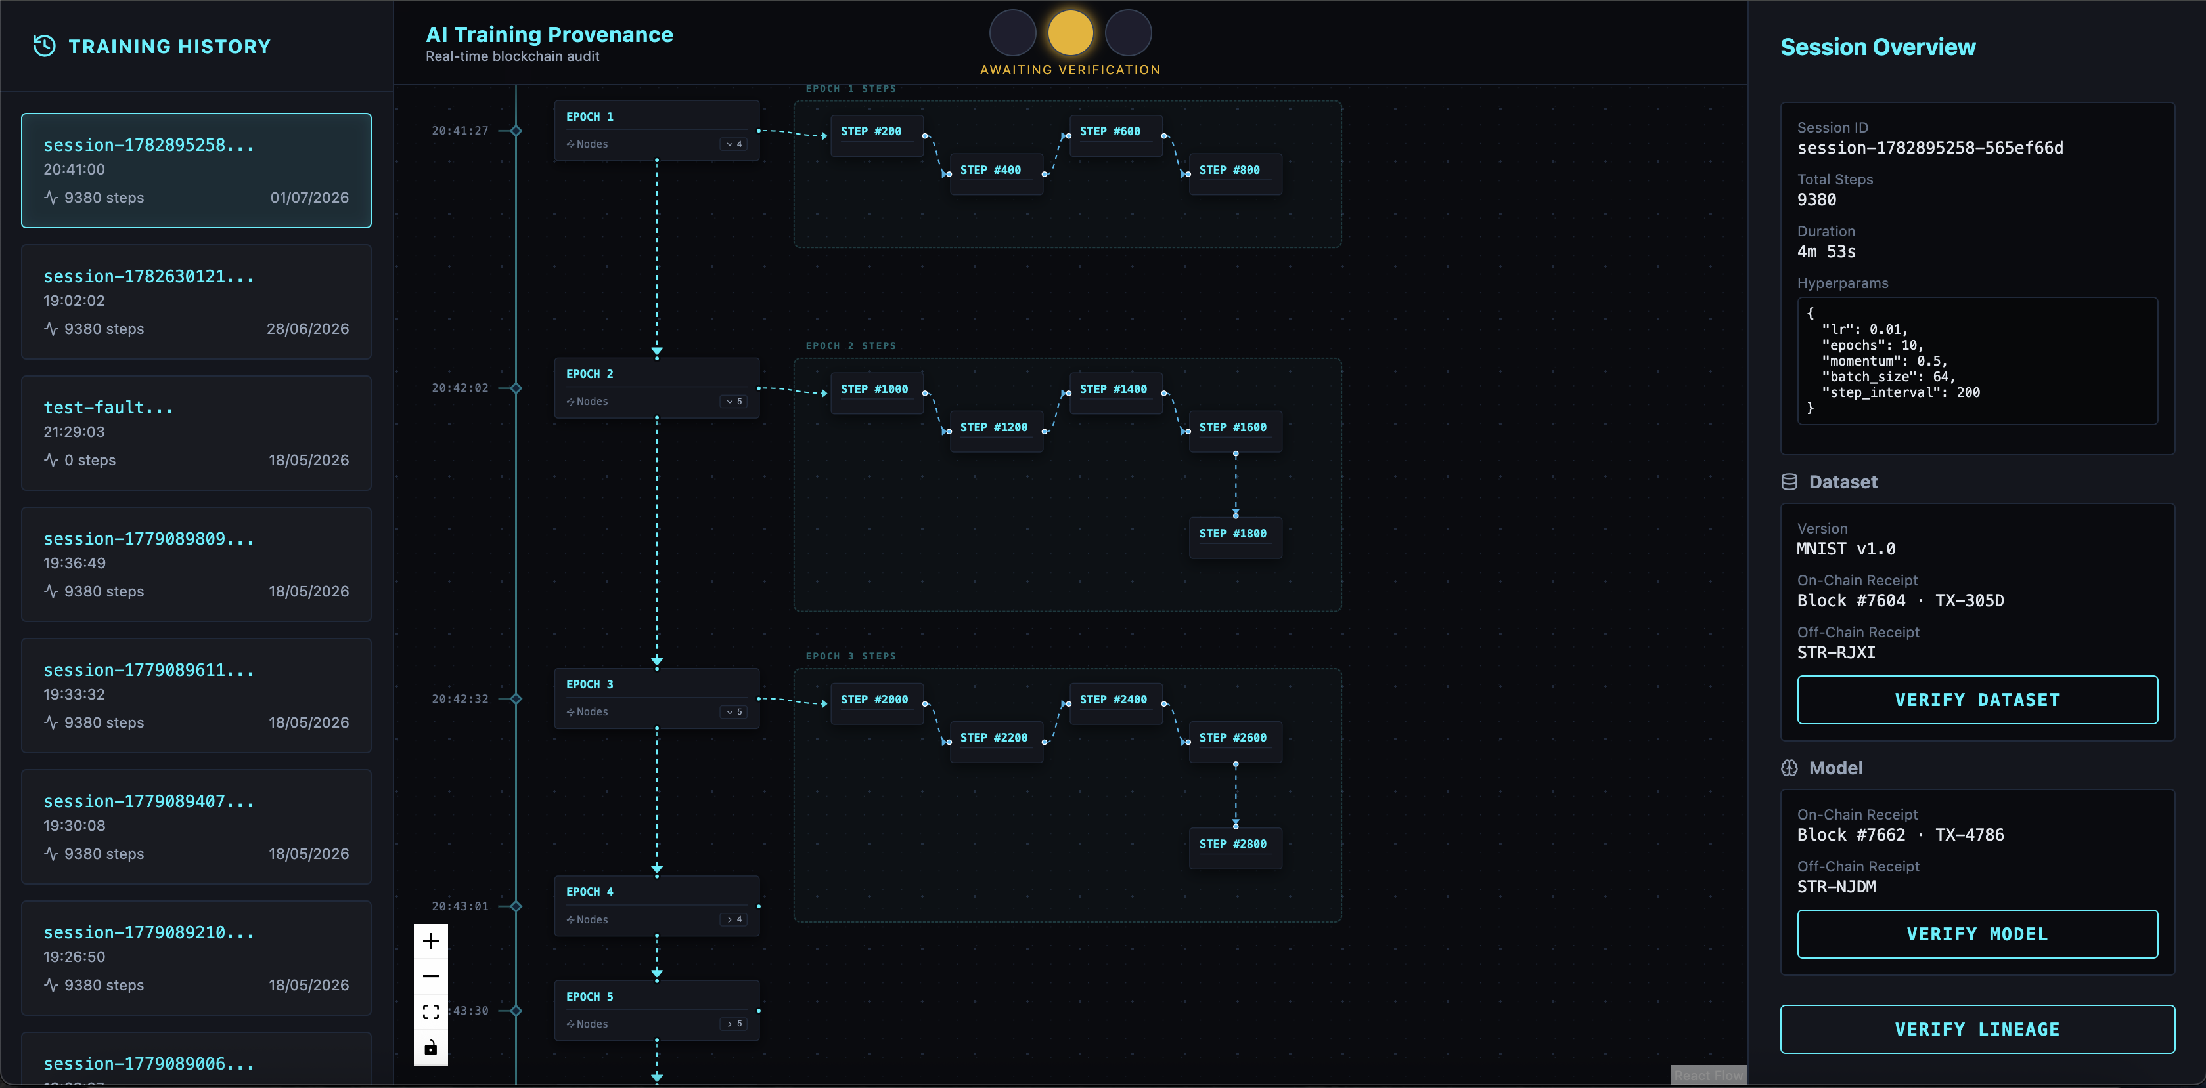
Screenshots of Running System – Dashboard UI
Shows training history, timeline, epoch and step nodes, and details of session and nodes.

Slide 9
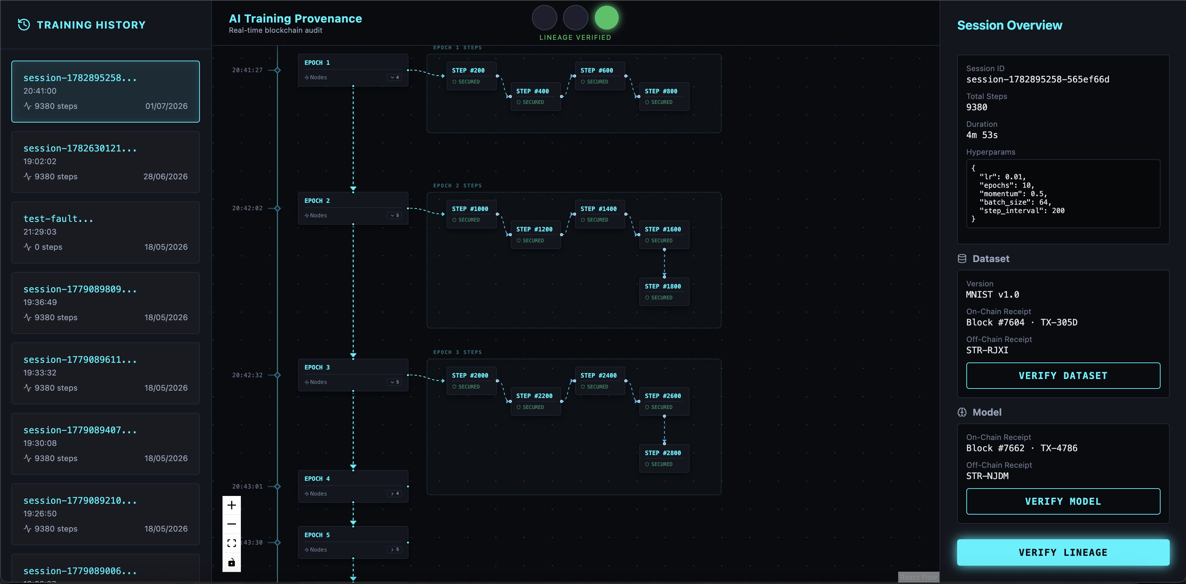
Screenshots of Running System – Dashboard UI
Result of clicking “VERIFY LINEAGE” button:

Slide 10
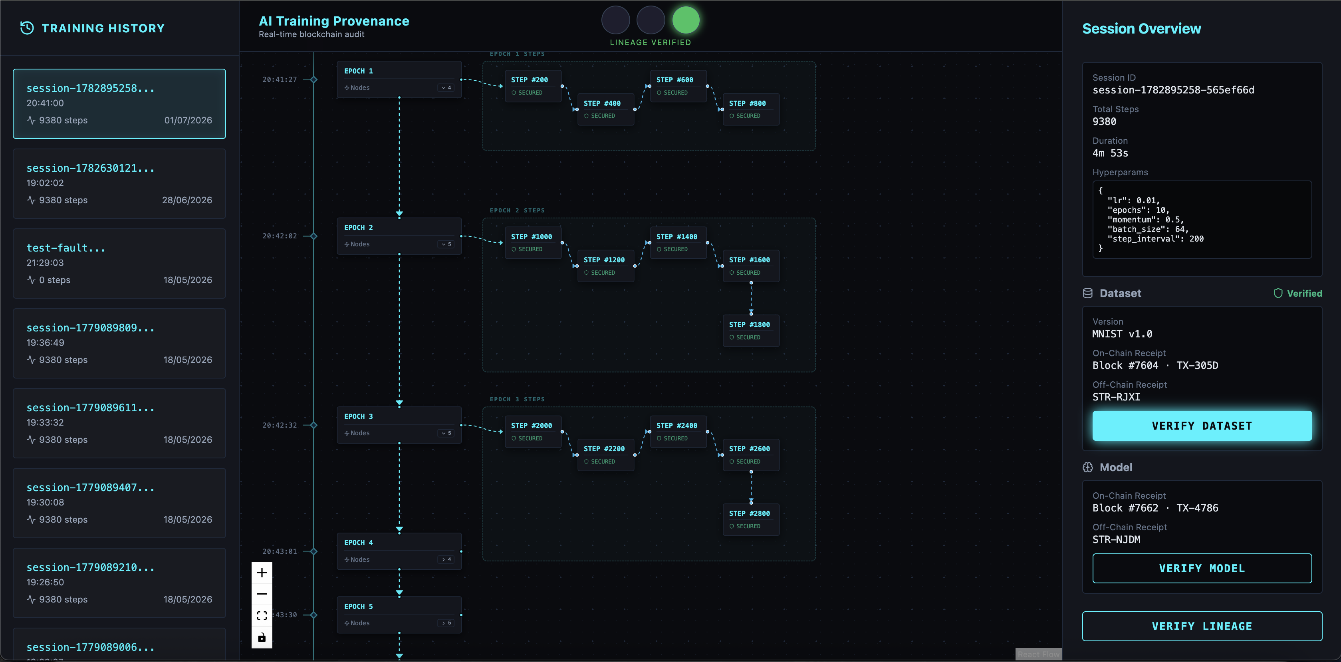
Screenshots of Running System – Dashboard UI
Result of clicking “VERIFY DATASET” button:

Slide 11
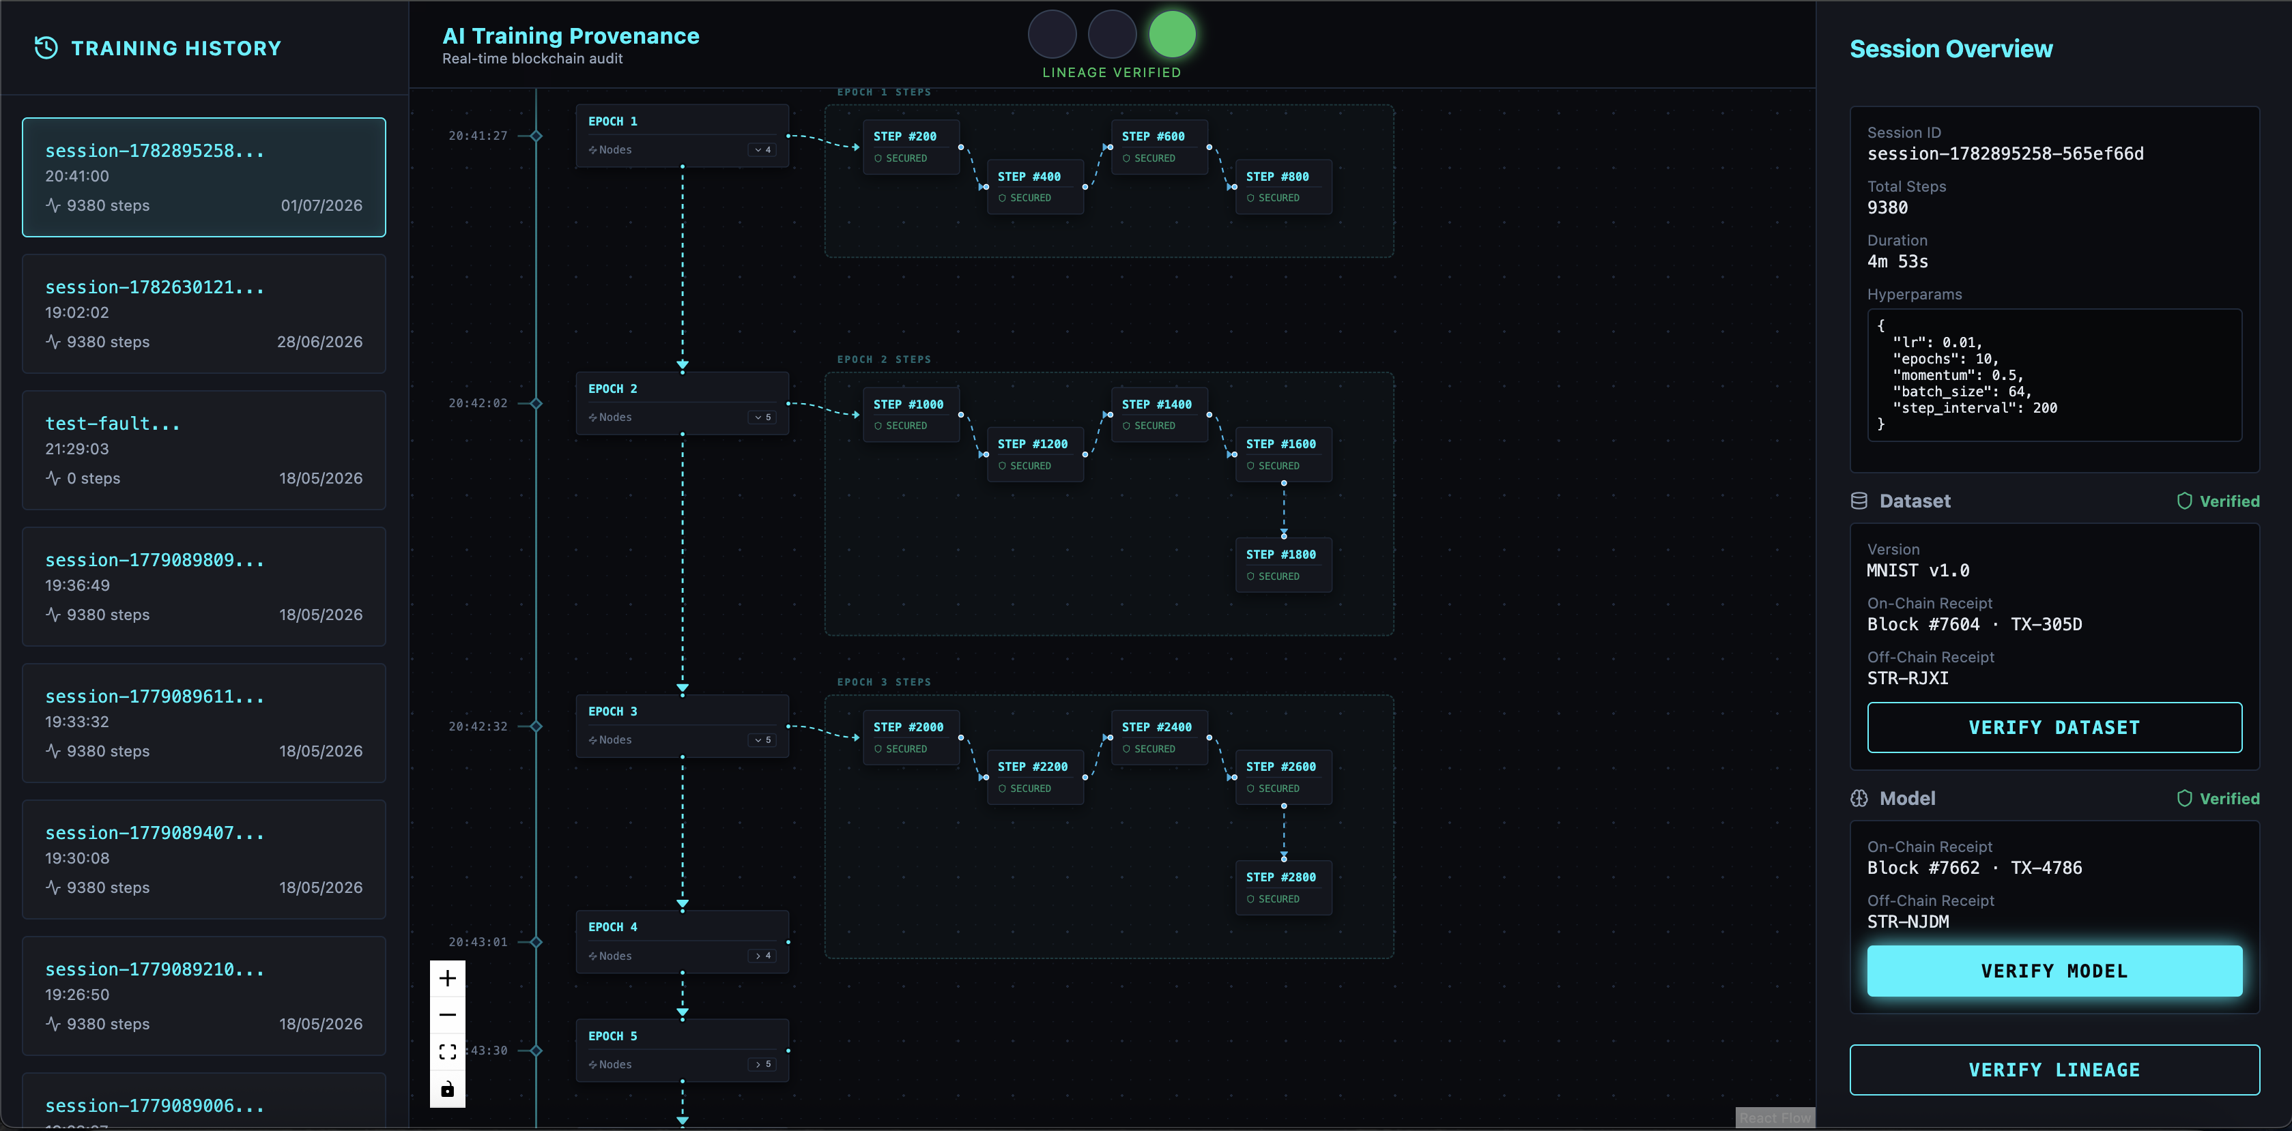
Screenshots of Running System – Dashboard UI
Result of clicking “VERIFY MODEL” button:

Slide 12
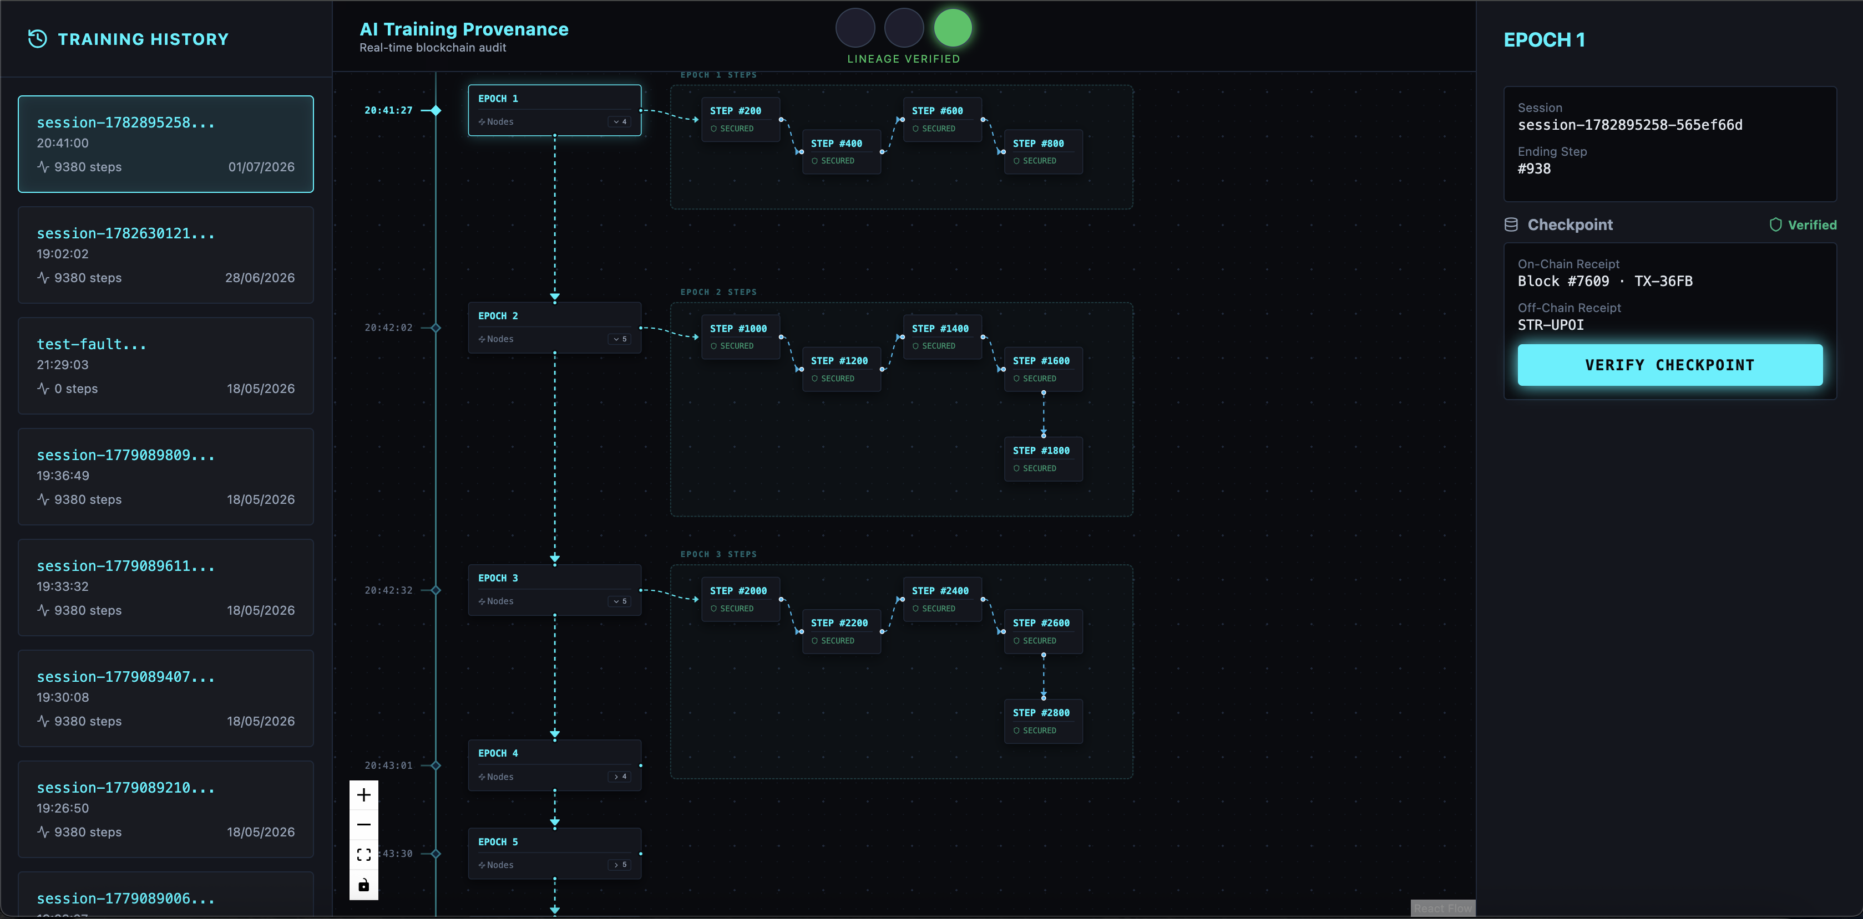
Screenshots of Running System – Dashboard UI
Result of clicking “VERIFY CHECKPOINT” button:

Slide 13
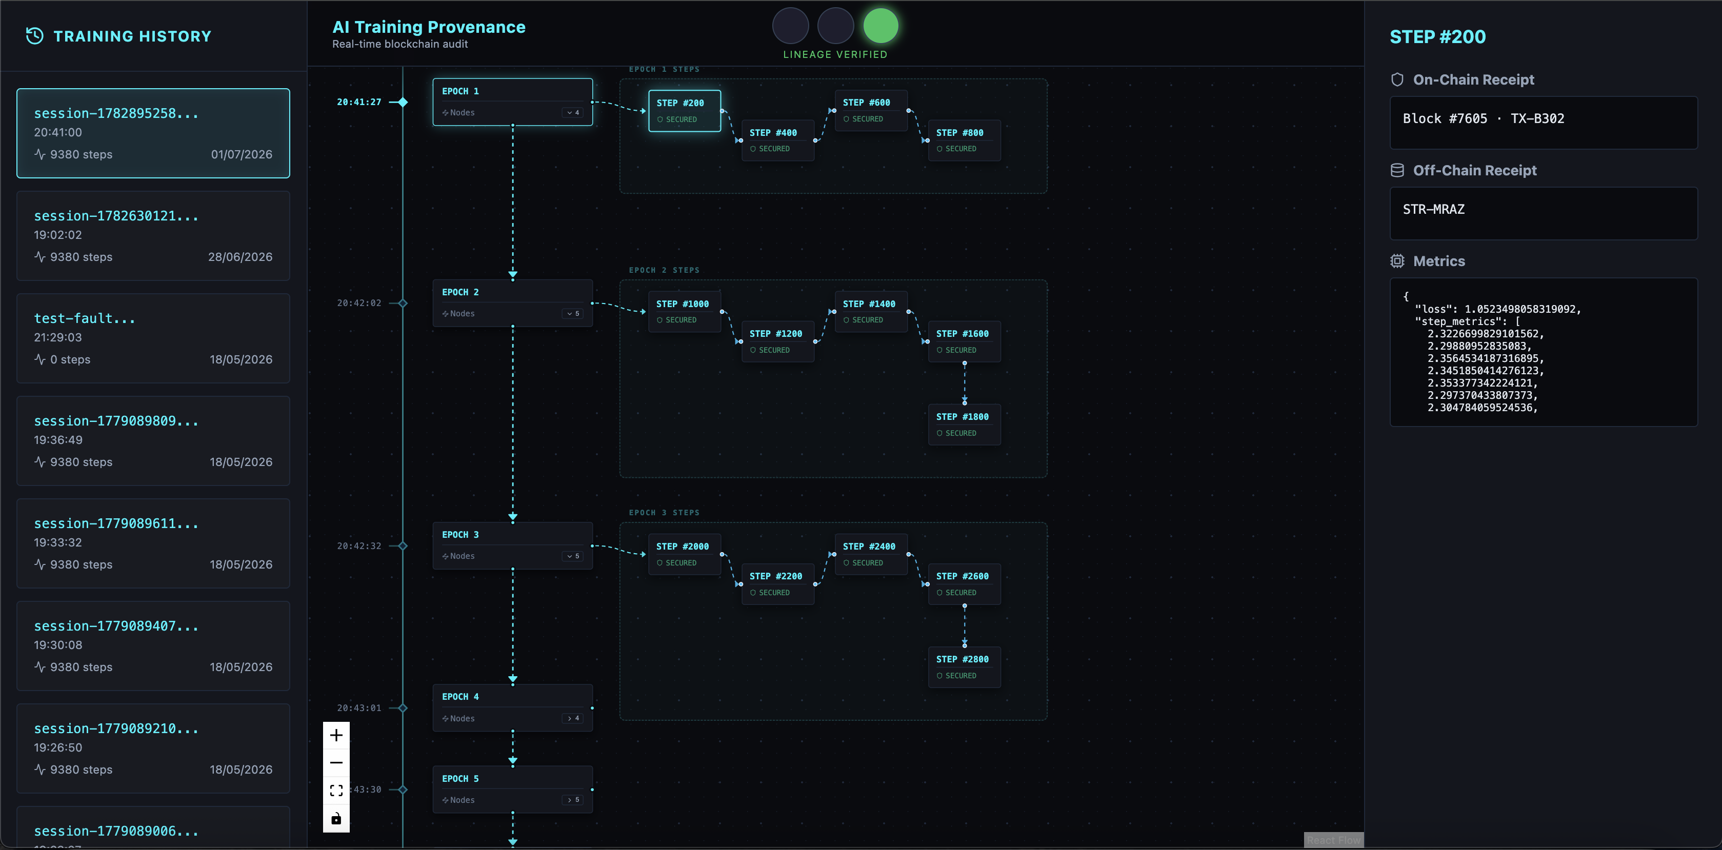
Screenshots of Running System – Dashboard UI
Details of step node:

Slide 14
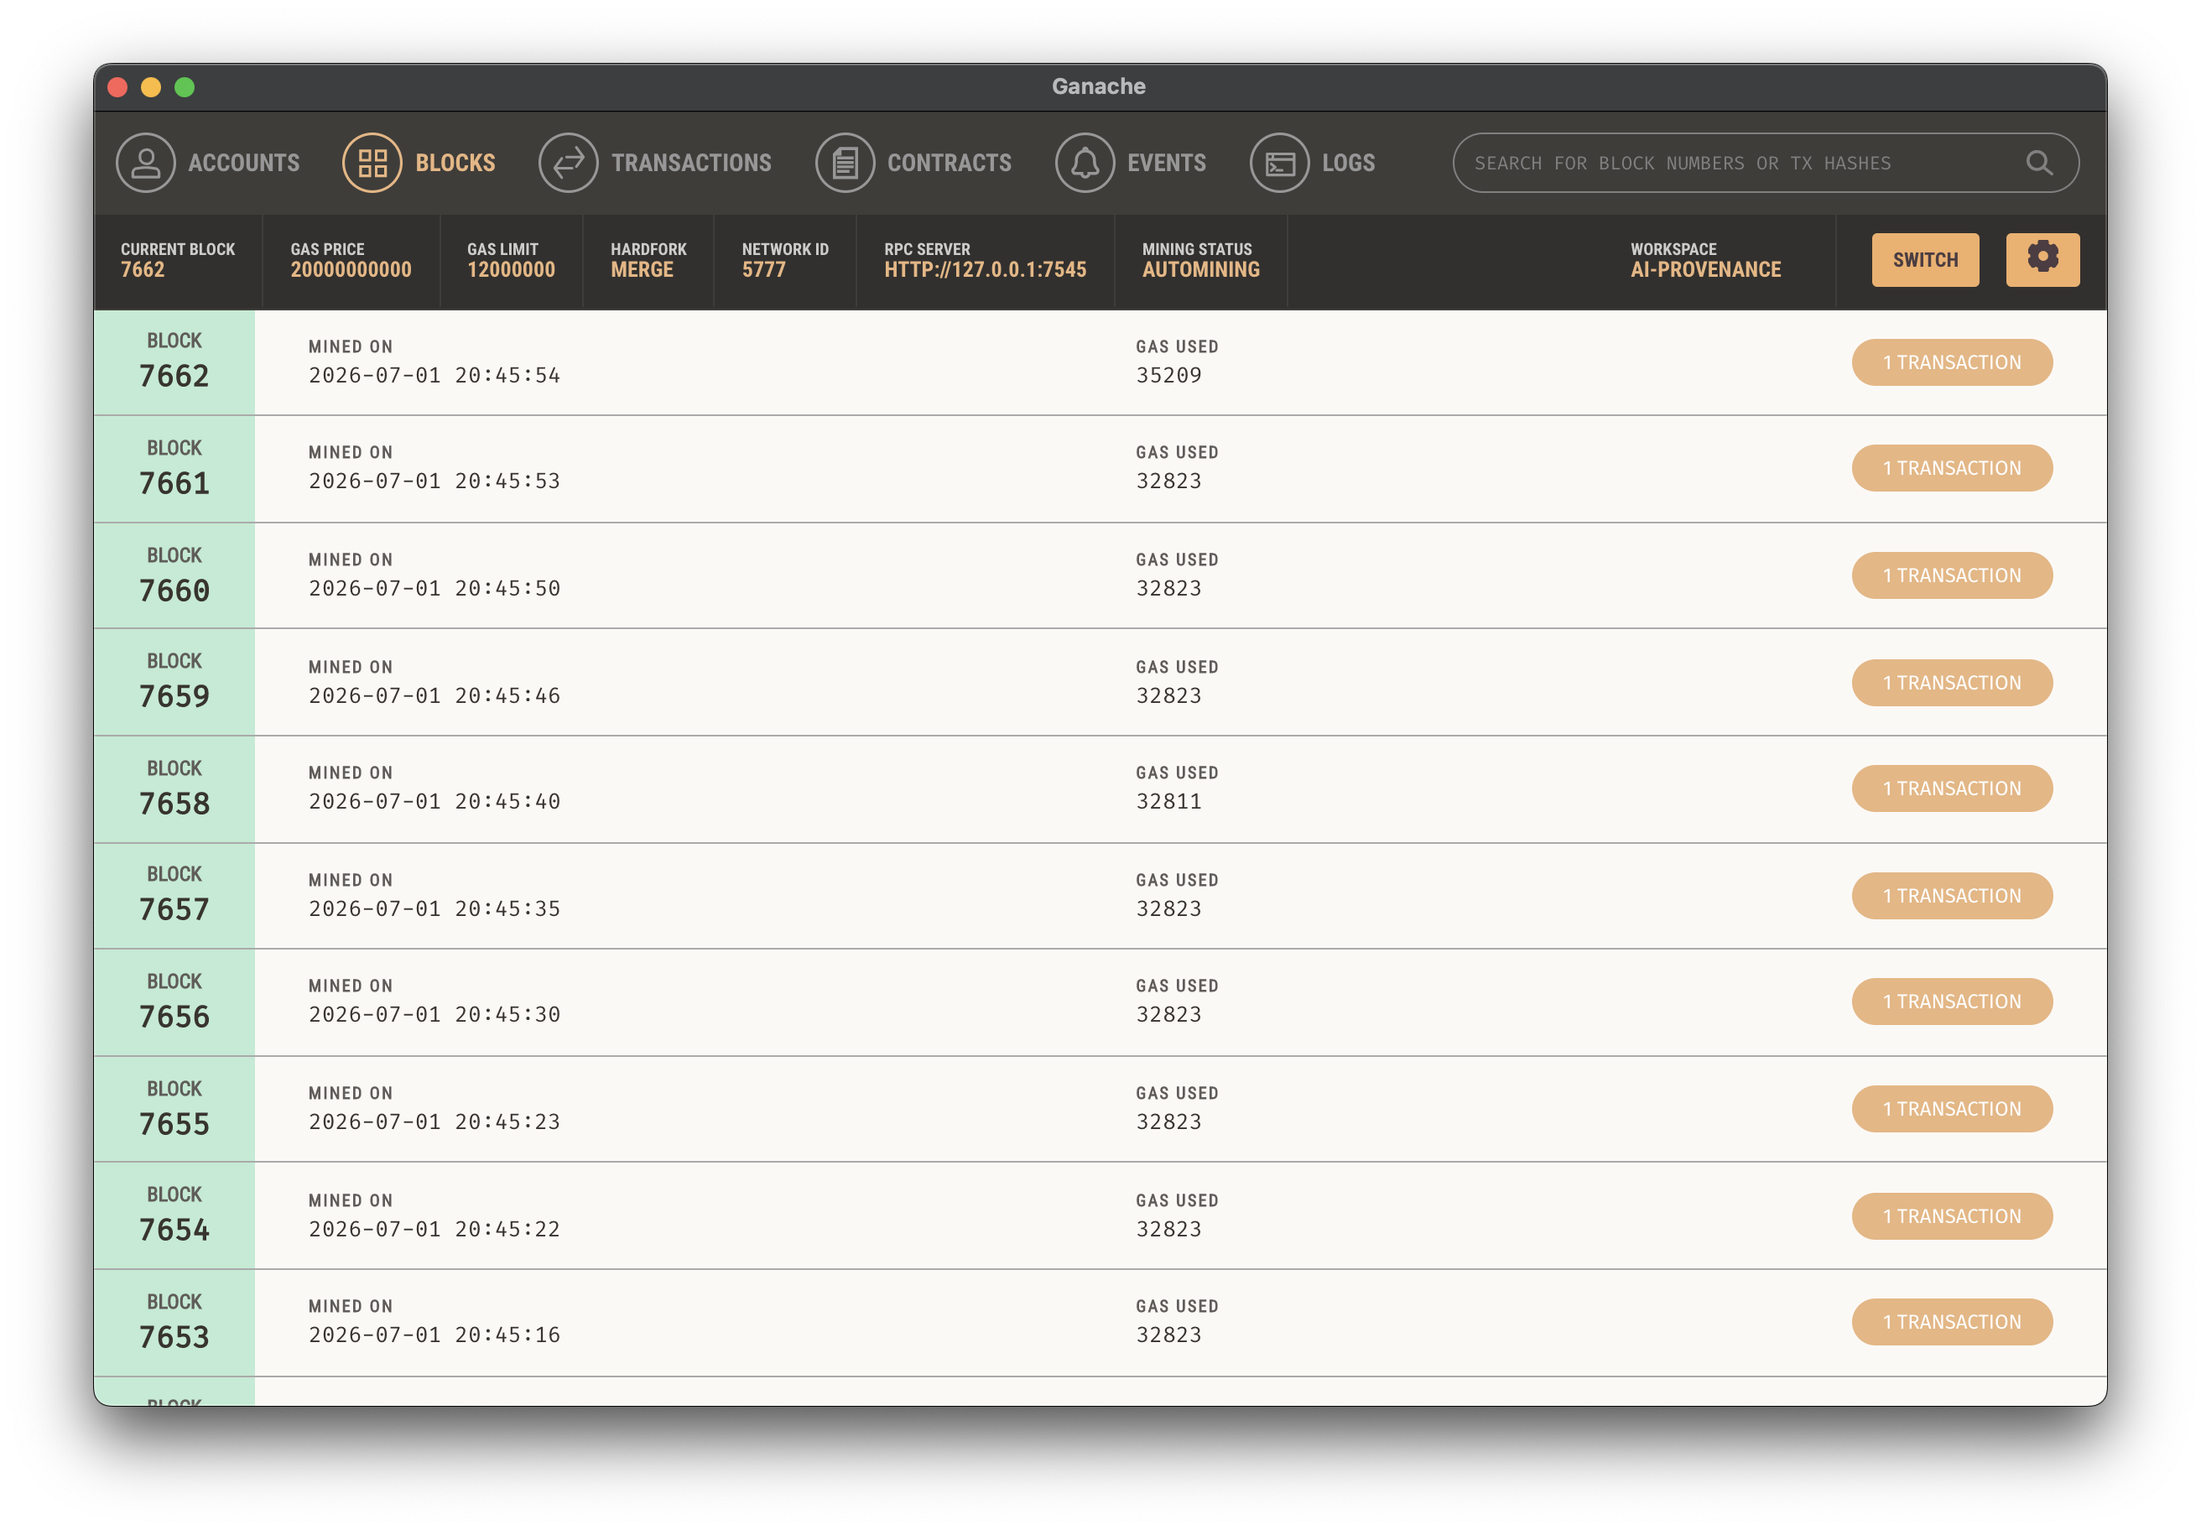
Screenshots of Running System – Blockchain
Shows blocks on the chain. Each block corresponds to an audit entry.

