Slide 1
A Blockchain-Based Provenance System for Ensuring AI Training Data Integrity and Auditability
Presented by Xinyuan Hu
Date: 19 May, 2026
Notes:
Good evening everyone, I will present my research on a system that leverages blockchain technology to ensure full-lifecycle traceability in AI model training. This system addresses critical challenges in AI trustworthiness, compliance, and security, offering a robust solution for the industrial application of AI.

Slide 2
Agenda
01
Executive Summary
Core challenges and proposed solutions.
04
Research Design & Methodology
Research questions, objectives, and methodology.
02
Research Background & Problem Statement
Trustworthiness challenges in industrial AI. Limitations of current solutions.
05
Proposed Solution
A detailed look at the four-layer architecture.
03
Literature Review & Research Gaps
Analysis of existing studies and identification of gaps.
06
Evaluation Plan & Expected Outcomes
How we measure success and anticipated results.
Notes:
My presentation will follow this agenda. I'll start with an executive summary, then dive into the research background, followed by a literature review. I will then detail my research design, present my proposed solution, and conclude with my evaluation plan and expected outcomes.

Slide 3
Executive Summary
This research focuses on Blockchain-Empowered AI Training Provenance. Current industrial AI models face significant challenges in ensuring data source reliability, the untraceability of dynamic training processes, and the lack of atomic consistency between on-chain hashes and off-chain data.
Key Limitations of Existing Solutions
Core Achievements
Theory–Engineering Gap: No usable hybrid blockchain + off-chain storage architecture.
Poor Audit Granularity: Only static checks; no full-lifecycle dynamic tracking.
No Atomic Consistency: No on-chain/off-chain fault tolerance, leading to inconsistency.
Low-overhead Hybrid Storage: Integrating Blockchain, IPFS, and OrbitDB.
Non-intrusive SDK & Lightweight Atomic Consistency: Capturing metadata and ensuring cross-chain integrity.
Visualised Provenance Dashboard: Facilitating effortless auditing & verification.
GOAL: Create a fully deployable, fine-grained, tamper-proof, and compliant AI training provenance system.
Notes:
In summary, my work addresses the critical gap in AI traceability. Current methods are insufficient for industrial use. My solution provides a comprehensive system that combines hybrid storage, a non-intrusive SDK, a robust consistency mechanism, and a user-friendly dashboard to ensure full-lifecycle traceability.

Slide 4

Part 1: Research Background & Problem Statement
1.1 Trustworthiness Challenges in Industrial AI
As AI is widely applied in finance, healthcare, autonomous driving and other critical sectors, model credibility, compliance and auditability have become essential for ethical AI deployment and social trust.
Trust Crisis
Security Risks
Black-box AI leads to opaque, unexplainable decisions, undermining user trust and accountability for system failures.
AI systems face data poisoning, adversarial attacks, and model tampering, leading to severe failures or biased results.
Compliance Pressure
Global regulations including the EU AI Act mandate strict standards for transparency, fairness, and data traceability.
Notes:
Let's begin with the background. The widespread use of AI in critical industries has created a pressing need for trust. We face a trust crisis due to black-box models, immense compliance pressure from regulations like the EU AI Act, and significant security risks from data poisoning and model tampering.

Slide 5
1.2 Limitations of Current Solutions
Despite theoretical frameworks for verifiable AI pipelines, practical implementation is lacking.
Theory vs. Engineering Gap
Insufficient Dynamic Audit Granularity
Lack of On/Off-Chain Consistency
Most proposals remain theoretical. Storing massive training metadata directly on a public blockchain is impractical due to high costs and scalability bottlenecks.
Audits often focus only on the final model and dataset. They ignore fine-grained tracking of parameter changes, intermediate states, and iterative trajectories during training.
Absence of atomic commit, crash recovery, and log compensation mechanisms between on-chain hash anchoring and off-chain storage can lead to data inconsistency and broken traceability.
Notes:
Current solutions fall short in three main areas. First, there's a significant gap between theory and practical engineering. Second, audits are not granular enough to track the dynamic training process. Third, and most critically, there's a lack of mechanisms to ensure consistency between data recorded on the blockchain and data stored off-chain, which can break the entire traceability.

Slide 6
1.3 Problem Statement
There is an urgent need in the field of industrial AI training for a reliable traceability system that offers low performance overhead, fine granularity, full-lifecycle coverage, and atomic consistency between on-chain and off-chain data.
Unengineered Frameworks
Static Audit Limitation
Lack of Strong Consistency
Existing theoretical frameworks cannot be directly engineered for practical real-world use, creating a gap between research and industrial deployment.
Conventional static audits are insufficient, as they fail to cover the full complexity of dynamic, continuous AI model training processes.
Without atomic consistency between on-chain hashes and off-chain data, effective auditing is impossible, hindering compliance and trustworthiness verification.
Notes:
To summarize the problem: The industry urgently needs a reliable traceability system. This system must be efficient, detailed, comprehensive, and consistent. Without it, AI models cannot be properly audited, and their compliance and trustworthiness remain in question. This is the core problem my research aims to solve.

Slide 7
Part 2: Literature Review & Research Gaps
2.1 Analysis of Existing Research
Storage Architecture
Audit Granularity
Consistency Mechanisms
Studies (Balan et al., 2025; Kurada & Baruah, 2023) focus heavily on cryptographic logic, but lack practical collaboration models between on-chain and off-chain storage. Full on-chain storage is deemed industrially unfeasible for large AI datasets.
Current research (Soldatos et al., 2021; Zakariae et al., 2025) primarily focuses on verifying the integrity of static datasets. A critical limitation is the omission of dynamic training processes, which are essential for trust in AI models (Sciammarelli, 2026).
While fine-grained provenance models exist (Ruan et al., 2019), they lack fault tolerance and scalability for large AI files. Belchior et al. (2022) stress that cross-layer systems must guarantee atomicity and fault tolerance to prevent traceability chain breaks.
Notes:
My literature review confirms these gaps. Existing research lacks practical storage architectures, focuses on static rather than dynamic audits, and fails to provide robust consistency mechanisms that can handle real-world failures, which are essential for a reliable system.

Slide 8
2.2 Three Core Research Gaps
01
02
03
The Gap between Theory and Engineering
Insufficient Dynamic Audit Granularity
Lack of On/Off-Chain Atomic Consistency
End-to-end verifiable frameworks exist only in cryptographic logic, lacking engineering implementations for blockchain and off-chain storage collaboration.
Current solutions only audit static dataset integrity and fail to capture dynamic process data at the Step or Epoch level.
There is a critical absence of reliable atomic commit and failure recovery mechanisms, which can lead to broken traceability chains.
Notes:
To reiterate, the three main gaps I aim to address are: the disconnect between theory and engineering, the lack of detailed dynamic auditing, and the absence of a robust consistency mechanism to prevent traceability failures. These gaps form the foundation of my research questions.

Slide 9
Part 3: Research Design & Methodology
3.1 Research Questions
RQ1: Architecture
RQ2: Auditability
RQ3: Consistency
How to effectively capture high-frequency training metadata at the Step or Epoch level using a non-intrusive SDK to achieve fine-grained auditability of the entire AI training lifecycle?
What mechanisms ensure atomic consistency and failure recoverability between on-chain cryptographic fingerprints and off-chain data, thus preventing traceability chain breaks and failures?
How to design a hybrid architecture integrating blockchain and content-addressable storage with low performance overhead, providing end-to-end cryptographic verifiability for AI training?
Notes:
To address these gaps, I formulated three key research questions. RQ1 focuses on the architecture and performance. RQ2 deals with capturing detailed training data. RQ3 tackles the critical issue of ensuring data consistency and recoverability.

Slide 10
3.2 Project Objectives
Hybrid Storage Architecture
Non-intrusive Python SDK
Two-Phase Commit Middleware
Combine Blockchain, IPFS, and OrbitDB technologies. Ensure the system maintains a high level of efficiency with training performance overhead strictly kept under 5%.
Seamlessly capture datasets, hyperparameters, step metrics, epoch checkpoints, and final model outputs. Automatically construct a complete, verifiable hash chain.
Orchestrate atomic consistency by prioritizing on-chain anchoring followed by off-chain storage. Enable robust recovery from failure logs to maintain data integrity.
Visualised Traceability Dashboard
Validation via Experiments & Simulations
Deliver a user-friendly interface with lineage map visualization, one-click verification capabilities, and support for independent component validation.
Conduct rigorous validation through controlled experiments and adversarial simulations to verify system performance, data integrity, horizontal scalability, and traceability accuracy.
Notes:
The project’s objectives are concrete and measurable. I aim to design the architecture, develop the SDK and middleware, create a user-friendly dashboard, and rigorously validate the system through experiments. Each objective directly addresses one or more of my research questions.

Slide 11
3.3 Research Methodology
Adopt a Design Science Research paradigm, focusing on solving engineering problems by building and evaluating an artifact to address real-world constraints.
Validation Logic
Data Collection
Tools & Stack
The research leverages standard and powerful tools for development, analysis, and documentation:
Python, Jupyter Notebook, Pandas, Matplotlib, Zotero.
A dual-path validation approach:
Controlled Experiment: Compare system performance metrics with and without the proposed solution.
Integrity Checks: Verify trustworthiness through cryptographic validation and failure simulation.
Literature Data: Identify gaps in current research.
Experimental Data: Collected for training latency, storage growth, and verification success rate.
Validation Data: Simulated tampering/anomalies to test consistency.
Notes:
The methodology is rooted in Design Science Research (DSR). I don't just theorize; I build a real system (the "artifact") and rigorously validate it.
First, my validation logic follows a dual path: I compare performance metrics in a controlled experiment, and I test the system's trustworthiness through integrity checks.
Second, I gather three types of data: literature to identify gaps, experimental data for performance benchmarks, and simulated validation data to stress-test consistency.
Finally, I use standard tools like Jupyter Notebook, Pandas, and Zotero to ensure the reproducibility and academic rigor of my work.

Slide 12
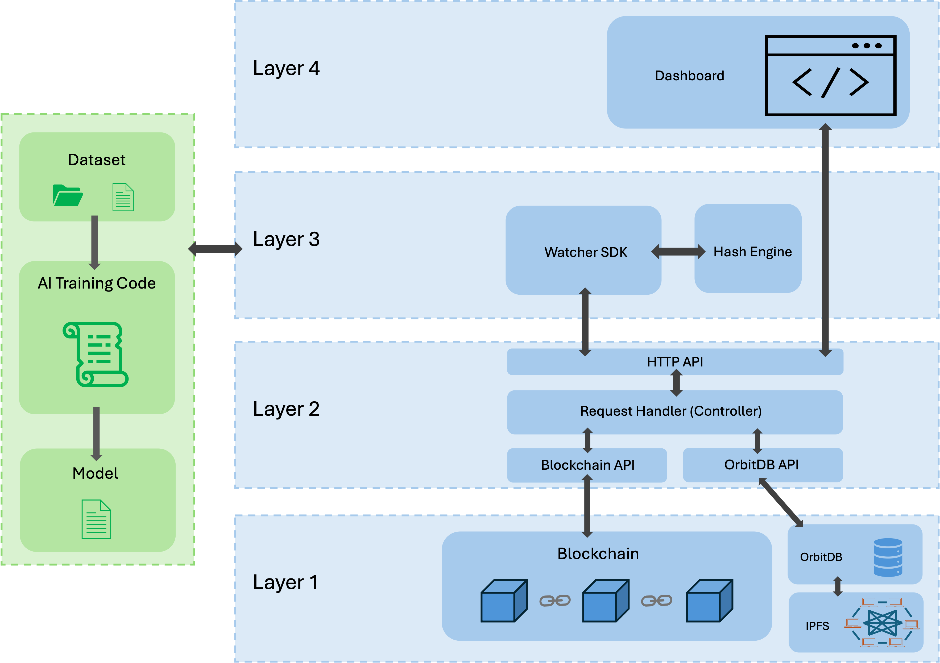
Part 4: Proposed Solution
This research proposes a hash-chain based, blockchain-powered AI training traceability system with a four-layer architecture to ensure data integrity and transparency.
04 Visualisation Layer
Timeline lineage map, one‑click verification, and traffic‑light result display.
03 SDK Layer
A non-intrusive Python SDK that hooks into the training loop to capture critical metadata.
02 Middleware Layer
Manages the two-phase atomic commit protocol to guarantee data consistency.
01 Storage Layer
Off‑chain: Large files via IPFS, metadata via OrbitDB; On‑chain: Only Merkle root, packet hash to reduce cost.
Notes:
Now, let's look at my proposed solution. It's a four-layer system designed for reliability and scalability.
The green part is where the user's AI training code runs. It connects to the SDK layer, which is the core, non-intrusive component that hooks into the training process to capture all the necessary metadata.
The Middleware Layer ensures the data is stored consistently using a two-phase commit protocol.
The Storage Layer uses a hybrid approach: blockchain for immutability and IPFS/OrbitDB for cost-effective, distributed storage.
Finally, the visualisation layer displays a timeline-based lineage map that consists of nodes corresponding to the capture points in the SDK layer. It also uses the traffic lights to provide an intuitive display of the verification result.

Slide 13
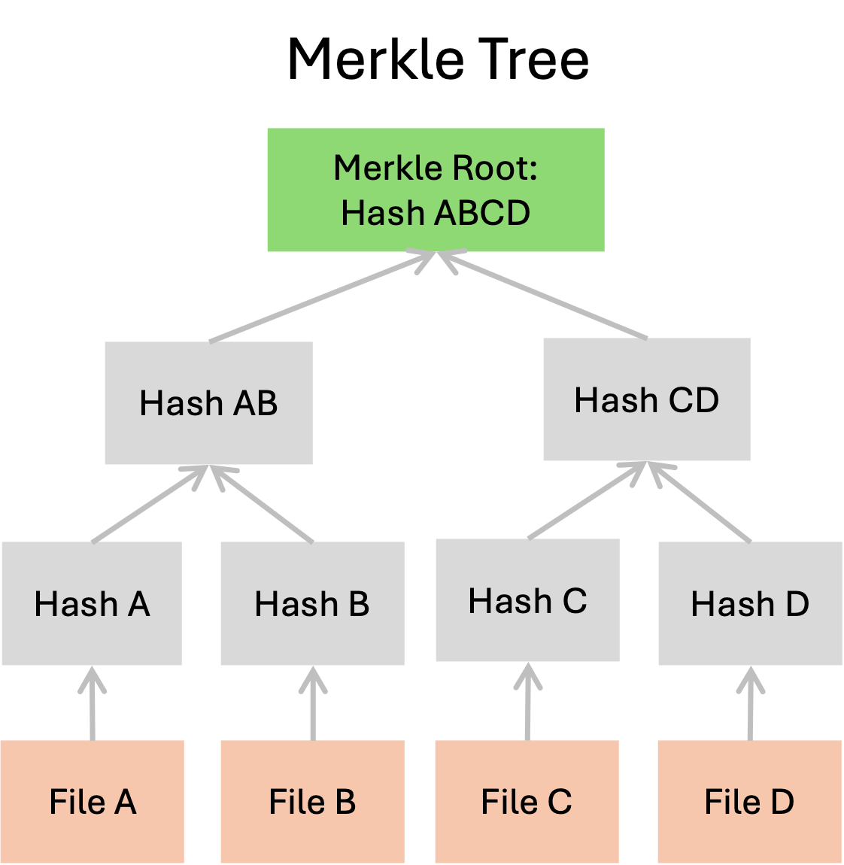

4.1 Hybrid Storage Strategy
On-Chain Storage
Immutable anchors for trust
Off-Chain Storage
Distributed file systems for scalability
IPFS (InterPlanetary File System)
Stores large files (model files, datasets). Uses content-addressing to ensure immutability and avoid duplication.
Minimalist & Efficient Anchoring
Only the Merkle Root, audit packet hash are stored on the blockchain.
This lightweight approach drastically reduces transaction fees while providing cryptographic proof that the off-chain data has not been tampered with.
OrbitDB
Stores training metadata (hyperparameters, metrics). A peer-to-peer database built on IPFS with Conflict-free Replicated Data Type (CRDT) support.
Notes:
The hybrid storage strategy is key to balancing security and efficiency. I use off-chain storage technologies IPFS and OrbitDB to handle the bulk of the data, leveraging their content-addressing and distributed nature. For on-chain storage, I only store the essential cryptographic fingerprints, like Merkle Root and packet hash, making the system both secure and cost-effective.

Slide 14
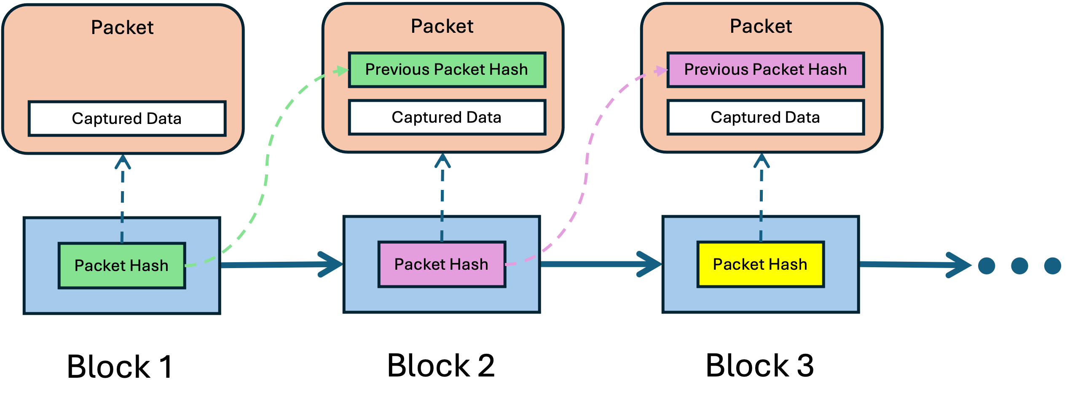
4.2 Non-intrusive Python SDK & Hash Chain
Automatic Capture
Using Hook technology, the SDK automatically captures full-lifecycle data from Session, Epoch, down to the Step level without requiring changes to the user's training code.
Building the Hash Chain
The captured data is sequentially formed into a hash chain. Each node's hash includes the hash of the previous node, ensuring the entire process is tamper-proof and traceable.
Notes:
The SDK is designed to be non-intrusive, making it easy to adopt. It automatically captures all necessary data and constructs a hash chain. This chain ensures that any tampering with the data at any step would be immediately detectable, as it would break the chain of hashes.

Slide 15
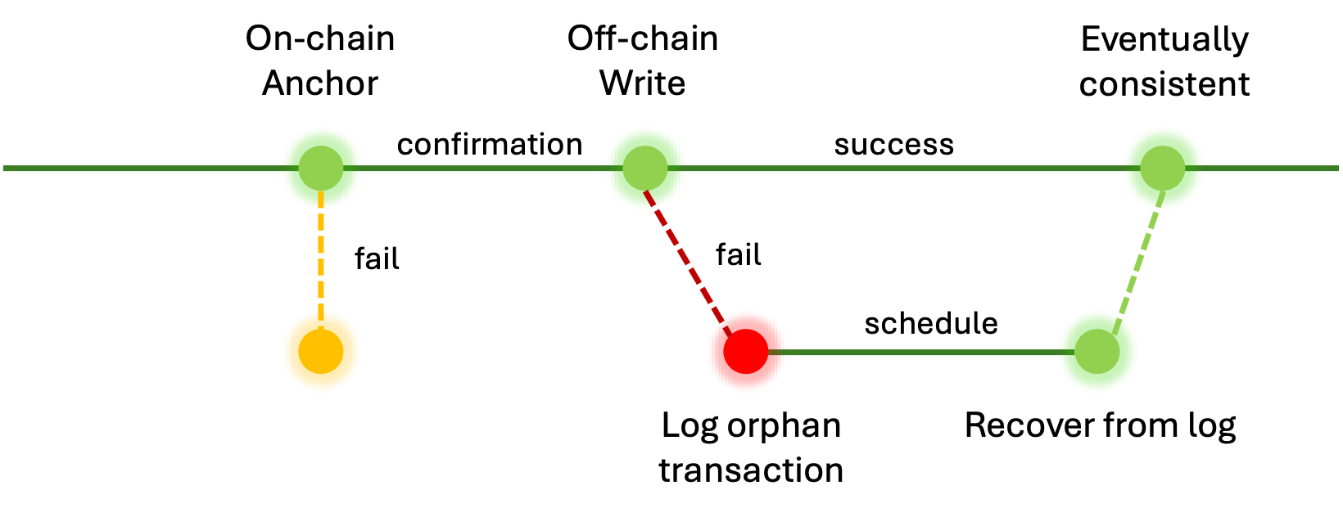
4.3 Simplified Two-Phase Atomic Commit Protocol
This is the core mechanism ensuring on/off-chain consistency.
Step 1: On-Chain Hash Anchor
Step 2: Off-Chain Storage Write
Failure Recovery Loop
First, commit the data's hash to the blockchain. This creates an immutable, verifiable record of the data's existence before any off-chain operations occur.
Only after the on-chain transaction is confirmed, write the actual data payload to OrbitDB and IPFS. This sequential order guarantees the hash is anchored before the data is stored.
If on-chain fails: No data is written.
If off-chain fails: Log the "orphan transaction".
Upon recovery: Retry off-chain write to ensure eventual consistency.
Notes:
The two-phase commit protocol is crucial for data integrity. By anchoring the hash on-chain first, an immutable record is created. Only then do it write the data off-chain. If anything goes wrong, the failure recovery mechanism ensures that the system can recover the state, preventing the "on-chain proof, off-chain data invalid" scenario.

Slide 16
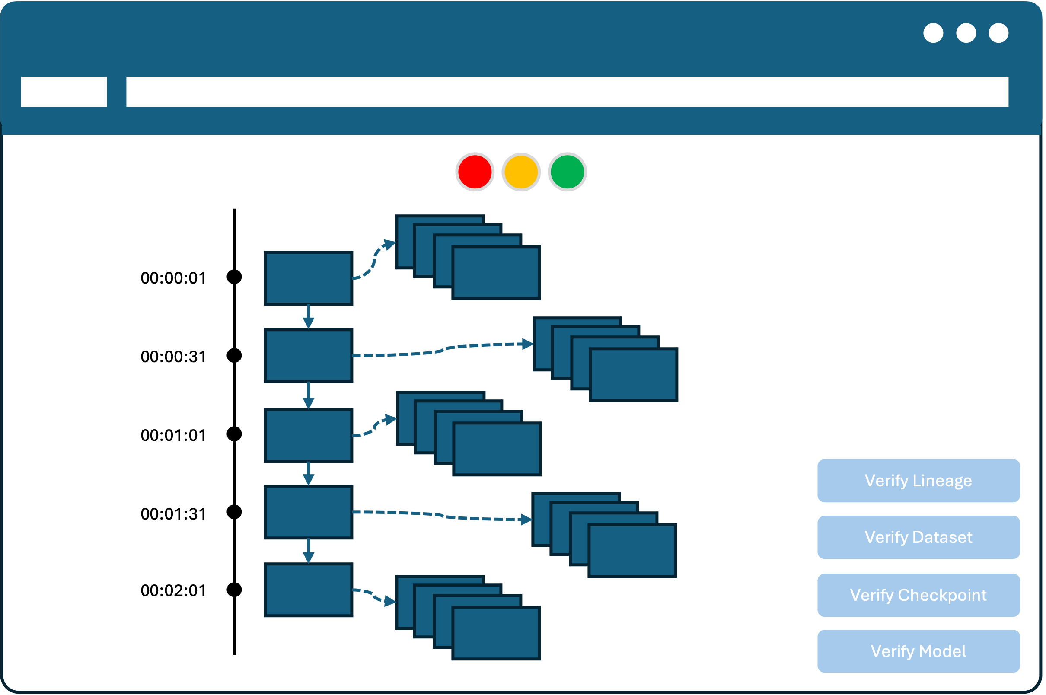
4.4 Visualised Traceability Dashboard
Lineage Map
One-Click Verify
Visually displays the entire training process's data flow and dependencies in a timeline format.
Automatically verify the integrity of the entire chain from raw data to the final model with one click.
Granular Check
"Traffic Light" View
Supports independent verification of individual components like datasets, models, or checkpoints.
Intuitively shows verification results as "Pass (Green)" or "Fail (Red)" for quick issue identification.
Notes:
Finally, a user-friendly dashboard is provided. It visualises the training lineage, allows for one-click or granular verification, and presents results clearly. This makes the power of the traceability system accessible to users without deep technical expertise.

Slide 17
Part 5: Evaluation Plan & Expected Outcomes
A detailed evaluation plan is developed to ensure the effectiveness of our solution.
Performance Overhead
Metric: Compare average epoch execution time and throughput with/without auditing.
Outcome: Latency increase < 5%; No request backlog under high concurrency.
Audit Effectiveness
Metric: Tamper detectability: Manipulate training data and observe if the system triggers an alert.
Outcome: Accurately identify all unauthorized tampering attempts.
Verification Response
Metric: Latency measurement from one-click verification request to final result display.
Outcome: Complete verification in < 2 seconds.
Storage Scalability
Metric: Monitor on-chain Gas cost for log storage and track the growth rate of off-chain metadata storage.
Outcome: Costs grow linearly with each iteration; No significant data bloat; remains sustainable for large-scale use.
Atomic Consistency & Recovery
Metric: Simulate a middleware crash during transaction processing and attempt to rebuild data using compensation logs.
Outcome: After automatic restart, on-chain transactions and off-chain metadata are perfectly aligned.
Notes:
The evaluation plan is comprehensive. I will measure performance overhead to ensure it's minimal, test audit effectiveness by attempting to tamper with data, benchmark verification speed, check storage scalability, and rigorously test the atomic consistency and recovery mechanism through crash simulations.

Slide 18
THANK YOU
Q & A
Notes:
Thank you for your attention.

