Slide 1
Description of New Model
Xinyu Dong
Department of Computer Science
Stony Brook University
October 22, 2023

Slide 2
Introduction
Target:
To learn the knowledge from clinical code (ICD code and ATC code), integrate the learned knowledge in the GNN model, so that to improve the performance
Idea:
The knowledge learned from clinical code, I think, are mainly two parts, one is from the textual information from the actual clinical meaning of the code; another one is the relative information of the code to other clinical codes.
So to learn this two kind of information, I want to integrate two models to learn the knowledge.

Slide 3
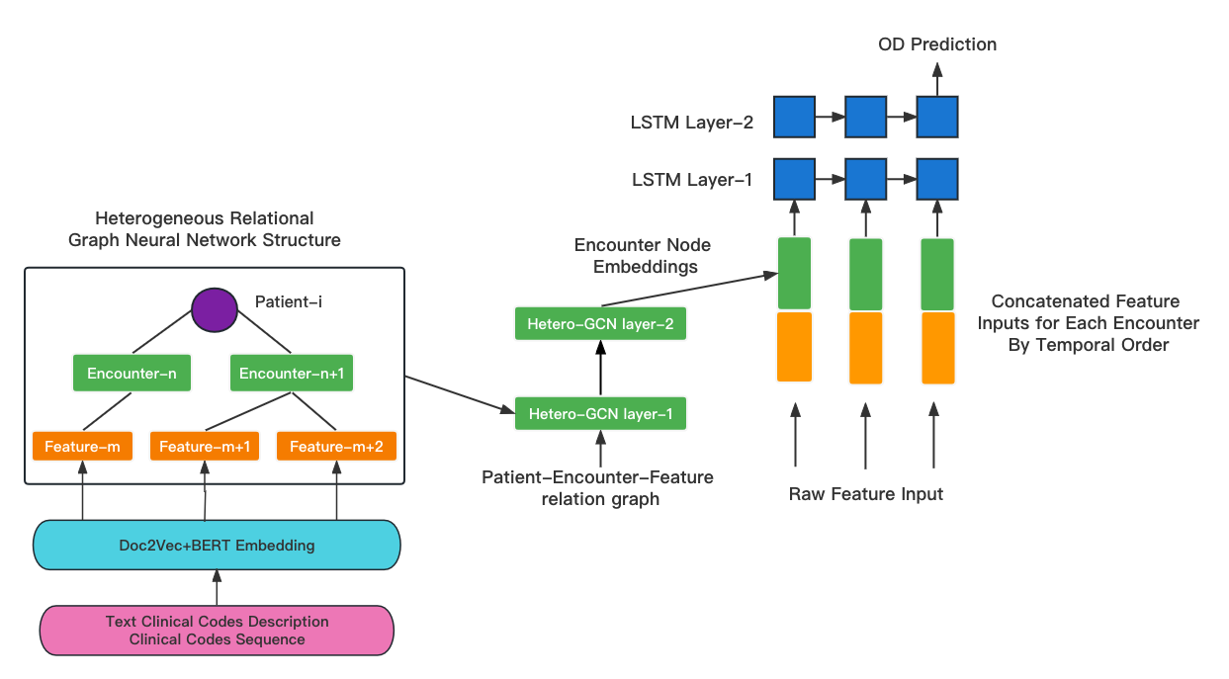
New Architect to Integrate Clinical Code Embedding

Slide 4
Clinical Code Embeddings
To initial the embedding for each clinical code, we use two embeddings together.
One is from Doc2Vec model, I use gensim package to implement it.
The other is from BERT model, I modify the originial BERT model adapted to clinical code sentence, then use the pretrained methods to initialize the model so that we can use the learned embedding layer to

Slide 5
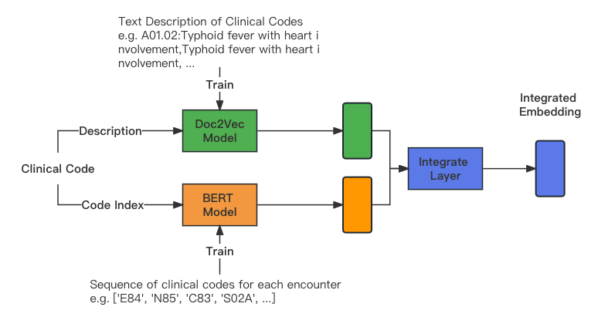
To learn the knowledge from codes
Doc2Vec embedding can encode the whole sentence into embedding.
BERT can learn the information of the relation of the code to other code.

Slide 6
BERT-Pretrain Methods
Next Sentence Prediction(NSP)
Masked Language Model(MLM)
Yes/No
Predict the token
Output
Output
BERT
BERT
Token
1
Token
2
Token
1
Token
2
Token
1
Token
2
[Mask]
Token
4
Sentence 1
Sentence 2

Slide 7
BERT adapted to clinical code
To adapt the BERT to clinical code sequence.
We change the sentence to a sequence of codes in one encounter.
MLM method is to predict the masked clinical code
NSL method is to judge if two sequences are from neighborhood encounters.

Slide 8
Performance
Model | Precision | Recall | F-1 | AUROC
LIGHTED (LSTM-HeteroRGNN) | 0.6463 | 0.6511 | 0.6486 | 0.8575
New Model integrated with | 0.6705 | 0.6339 | 0.6516 | 0.8883
* Cause of the limitation of time, I didn‘t test the whole data, test it with 50,000 patients, the performance is lower than the previous slides.

Slide 9
Reference
Gensim Doc2Vec Model. https://radimrehurek.com/gensim/auto_examples/tutorials/run_doc2vec_lee.html
Keras-bert. https://github.com/CyberZHG/keras-bert/
Node Classification with Graph Neural Networks. https://keras.io/examples/graph/gnn_citations/
Top 4 Sentence Embedding Techniques using Python. https://www.analyticsvidhya.com/blog/2020/08/top-4-sentence-embedding-techniques-using-python/#h-what-is-sentence-embedding/

Slide 10
Thanks!
https://github.com/xinyudong93/LSTM_GNN_IntegratedWithNodeEncoding

