Slide 1
Finite Fields
Dr. Xinyue Zhang
Assistant Professor
Department of Computer Science
Kennesaw State University
Marietta, GA, USA

Slide 2
Outline
Polynomial Division
Polynomial GCD

Slide 3

Polynomial Division
Let $F$ be a field. For polynomials $f\left(x\right),g\left(x\right)∈F\left[x\right]$, with $g\left(x\right)≠0$, there exist unique polynomials $q\left(x\right),r\left(x\right)$such that:
$$f(x)=q(x)g(x)+r(x)$$
where: $deg⁡(r(x))<deg⁡(g(x))$
We can also define: $f\left(x\right) mod g(x)=r(x)$
If $r\left(x\right)=0$, then: $g(x)∣f(x)$
Irreducible Polynomial
No zero divisors
Every nonzero element has inverse
Structure becomes a field
Reducible Polynomial
Zero divisors may exist
Inverses may fail

Slide 4
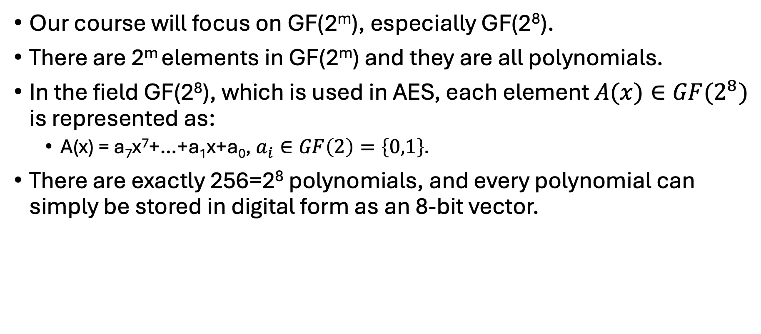
Finite Fields with Polynomial Arithmetic
Our course will focus on GF(2^{m}), especially GF(2⁸).
There are 2^{m} elements in GF(2^{m}) and they are all polynomials.
In the field GF(2⁸), which is used in AES, each element $A(x)∈GF(2^{8})$ is represented as:
A(x) = a₇x⁷+…+a₁x+a₀, $a_{i}∈GF\left(2\right)=\left\{0,1\right\}.$
There are exactly 256=2⁸ polynomials, and every polynomial can simply be stored in digital form as an 8-bit vector.

Slide 5
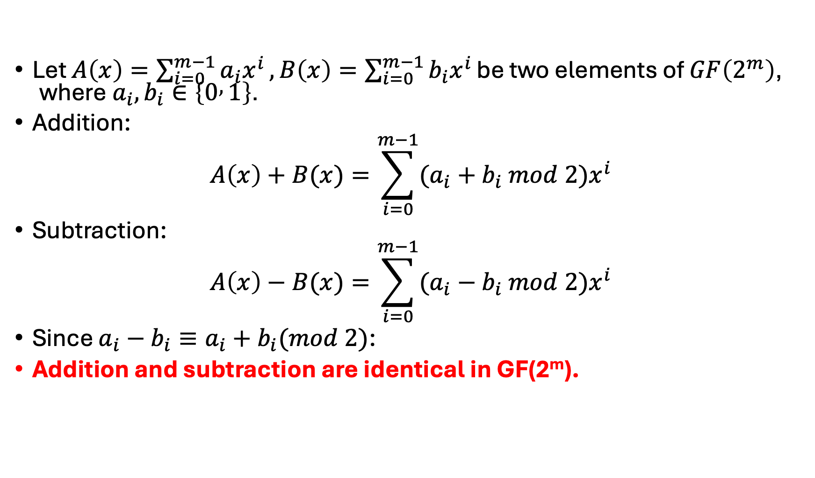
Finite Fields with Polynomial Arithmetic (cont.)
Let $A\left(x\right)=\sum_{i=0}^{m−1}{a_{i}x^{i}},B\left(x\right)=\sum_{i=0}^{m−1}{b_{i}x^{i}}\text{be} \text{two} \text{elements} \text{of} GF\left(2^{m}\right)\text{, }\text{where} a_{i},b_{i}∈\left\{0 , 1\right\}\text{.}$
Addition:
$$A\left(x\right)+B(x)=\sum_{i=0}^{m−1}{(a_{i}+b_{i} mod 2)x^{i}}$$
Subtraction:
$$A\left(x\right)−B(x)=\sum_{i=0}^{m−1}{(a_{i}−b_{i} mod 2)x^{i}}$$
Since $a_{i}−b_{i}​≡a_{i}+b_{i}​(mod 2)$:
Addition and subtraction are identical in GF(2^{m}).

Slide 6
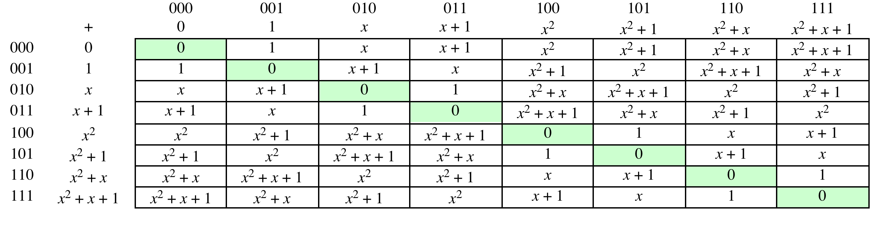
Table 5.3
Polynomial Arithmetic Modulo (x³ + x + 1) - Addition
(a) Addition
*Table resource: Stallings, William. Cryptography and Network Security: Principles and Practice, 7th ed. England: Pearson Education Limited, 2017.

Slide 7
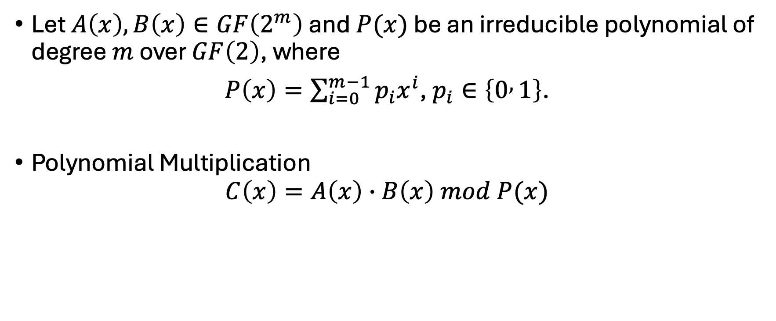
Finite Fields with Polynomial Arithmetic - Multiplication
Let $A\left(x\right),B\left(x\right)∈GF\left(2^{m}\right)$ and $P(x)$ be an irreducible polynomial of degree $m$ over $GF\left(2\right)$, where
$P\left(x\right)=\sum_{i=0}^{m−1}{p_{i}x^{i}}$, $p_{i}∈\left\{0 , 1\right\}$.
Polynomial Multiplication
$$C\left(x\right)=A\left(x\right)∙B\left(x\right) mod P(x)$$

Slide 8
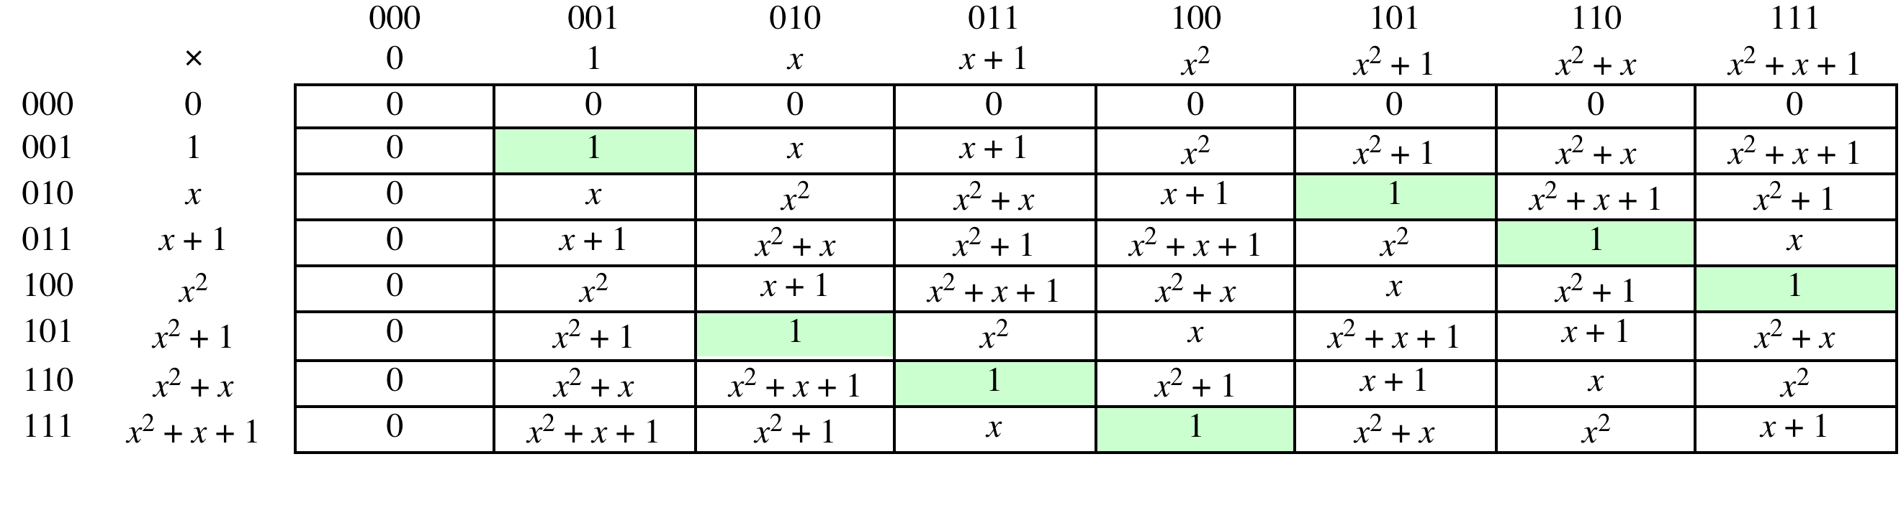
Polynomial Arithmetic Modulo (x³ + x + 1) - Multiplication
(b) Multiplication
*Table resource: Stallings, William. Cryptography and Network Security: Principles and Practice, 7th ed. England: Pearson Education Limited, 2017.

Slide 9
Polynomial Arithmetic Over GF(2⁸)

Slide 10
Polynomial GCD
The polynomial c(x) is the greatest common divisor of a(x) and b(x) if:
c(x) | a(x) and c(x) | b(x)
Any common divisor divides c(x)
Equivalent definition:
gcd[a(x), b(x)] is the polynomial of largest degree dividing both.
The Euclidean algorithm we learned can be extended to find the GCD in polynomial arithmetic of finite fields.

Slide 11
Polynomial GCD Example
Find gcd(a(x), b(x))
where a(x)=x⁶+x⁵+x⁴+x³+ x²+x+1
b(x)= x⁴+x²+x+1
Answer is on the next page.

Slide 12
Polynomial GCD - Solutions
Find gcd(a(x), b(x))
where a(x)=x⁶+x⁵+x⁴+x³+ x²+x+1
b(x)= x⁴+x²+x+1
gcd(a(x), b(x)) = x³ + x² + 1

Slide 13
Example Problems
A(x) = x²+1, B(x) = x+1, the prime polynomial is m(x) = x³+x+1.
F
ind
A(x) + B(x),
A(x) * B(x),
gcd(A(x), B(x)).

Slide 14
Example Problems - Solutions
A(x) = x²+1, B(x) = x+1, the prime polynomial is m(x) = x³+x+1.
Find
A(x) + B(x) = x²+x
A(x) * B(x) = (x²+1)*(x+1) mod m(x) = (x³+x)+(x²+1) mod (x³+x+1) = x³+x²+x+1 mod x³+x+1 = x²
gcd(A(x), B(x)):
x²+1 = (x+1)(x+1) + 0
gcd(A(x), B(x)) = x+1

Slide 15
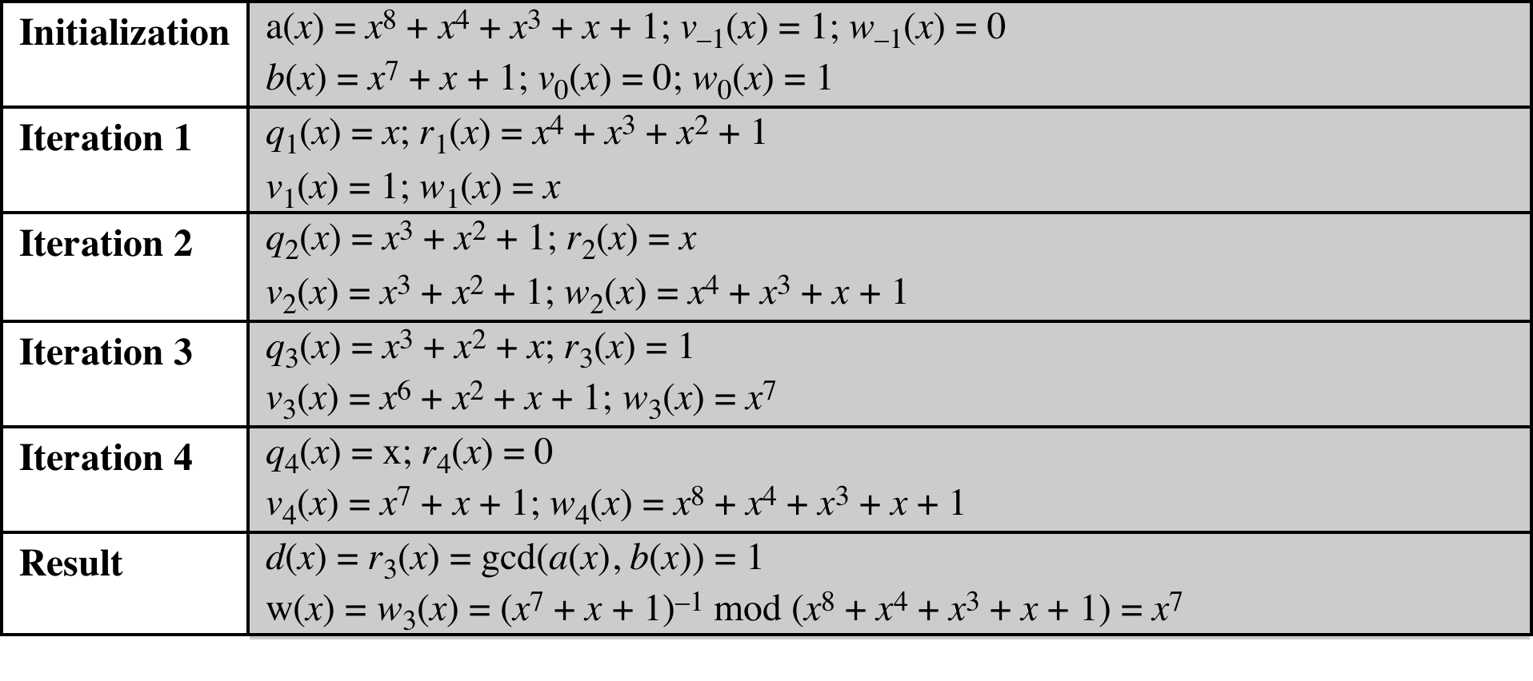
Table 5.4
Extended Euclid [(x⁸ + x⁴ + x³ + x + 1), (x⁷ + x + 1)]
Irreducible polynomial of GF(2⁸) in AES
*Table resource: Stallings, William. Cryptography and Network Security: Principles and Practice, 7th ed. England: Pearson Education Limited, 2017.

Slide 16
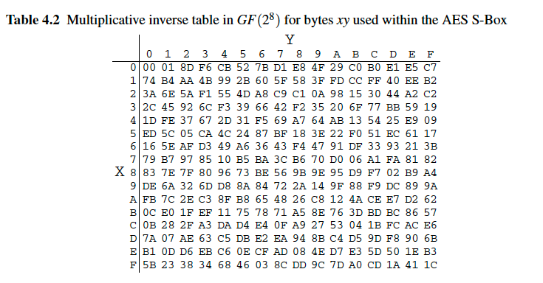
AES S-Box

Slide 17
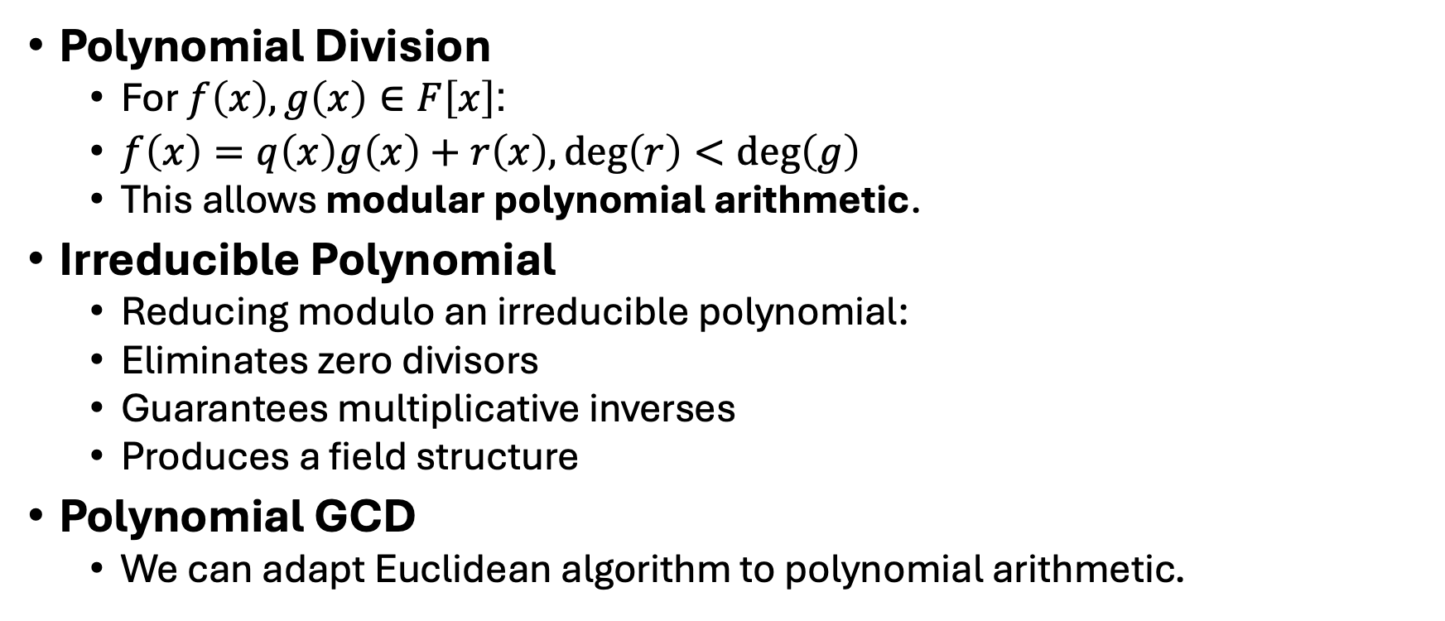
Summary
Polynomial Division
For $f\left(x\right),g\left(x\right)∈F\left[x\right]$:
$f\left(x\right)=q\left(x\right)g\left(x\right)+r\left(x\right), deg⁡\left(r\right)<deg⁡\left(g\right)$
This allows modular polynomial arithmetic.
Irreducible Polynomial
Reducing modulo an irreducible polynomial:
Eliminates zero divisors
Guarantees multiplicative inverses
Produces a field structure
Polynomial GCD
We can adapt Euclidean algorithm to polynomial arithmetic.

