Slide 1
Advanced Encryption Standard
Dr. Xinyue Zhang
Assistant Professor
Department of Computer Science
Kennesaw State University
Marietta, GA, USA

Slide 2
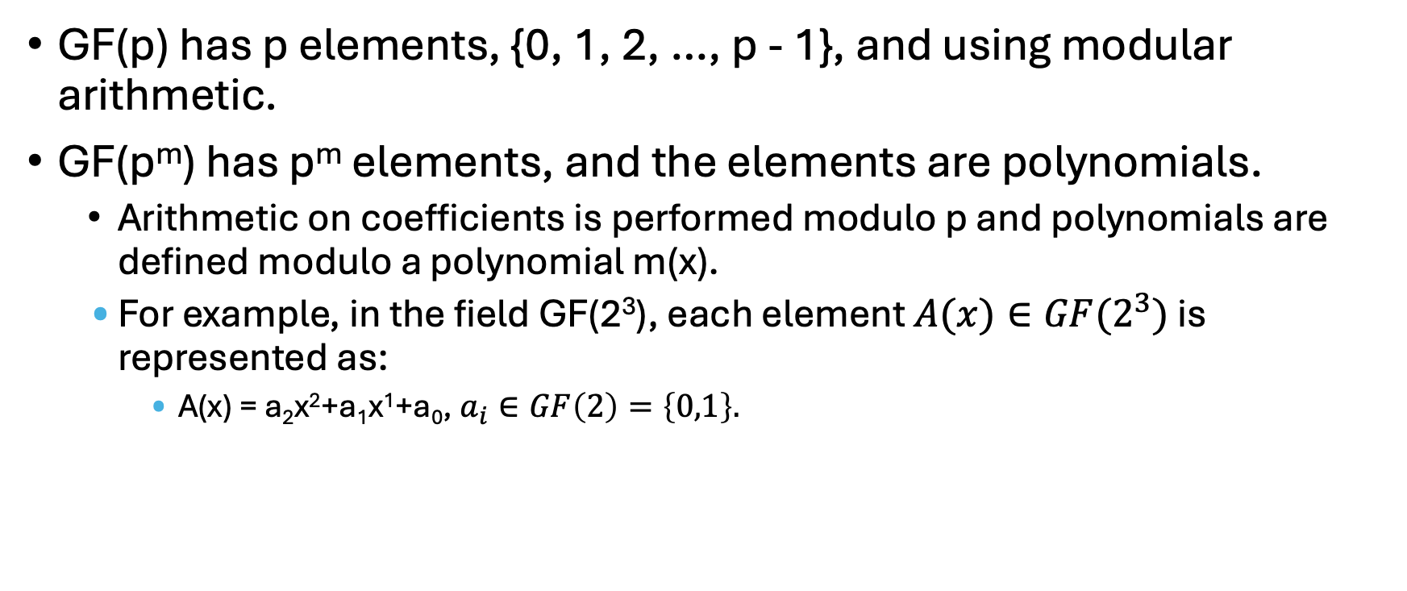
Finite Field Review
GF(p) has p elements, {0, 1, 2, …, p - 1}, and using modular arithmetic.
GF(p^{m}) has p^{m} elements, and the elements are polynomials.
Arithmetic on coefficients is performed modulo p and polynomials are defined modulo a polynomial m(x).
For example, in the field GF(2³), each element $A(x)∈GF(2^{3})$ is represented as:
A(x) = a₂x²+a₁x¹+a₀, $a_{i}∈GF\left(2\right)=\left\{0,1\right\}.$

Slide 3
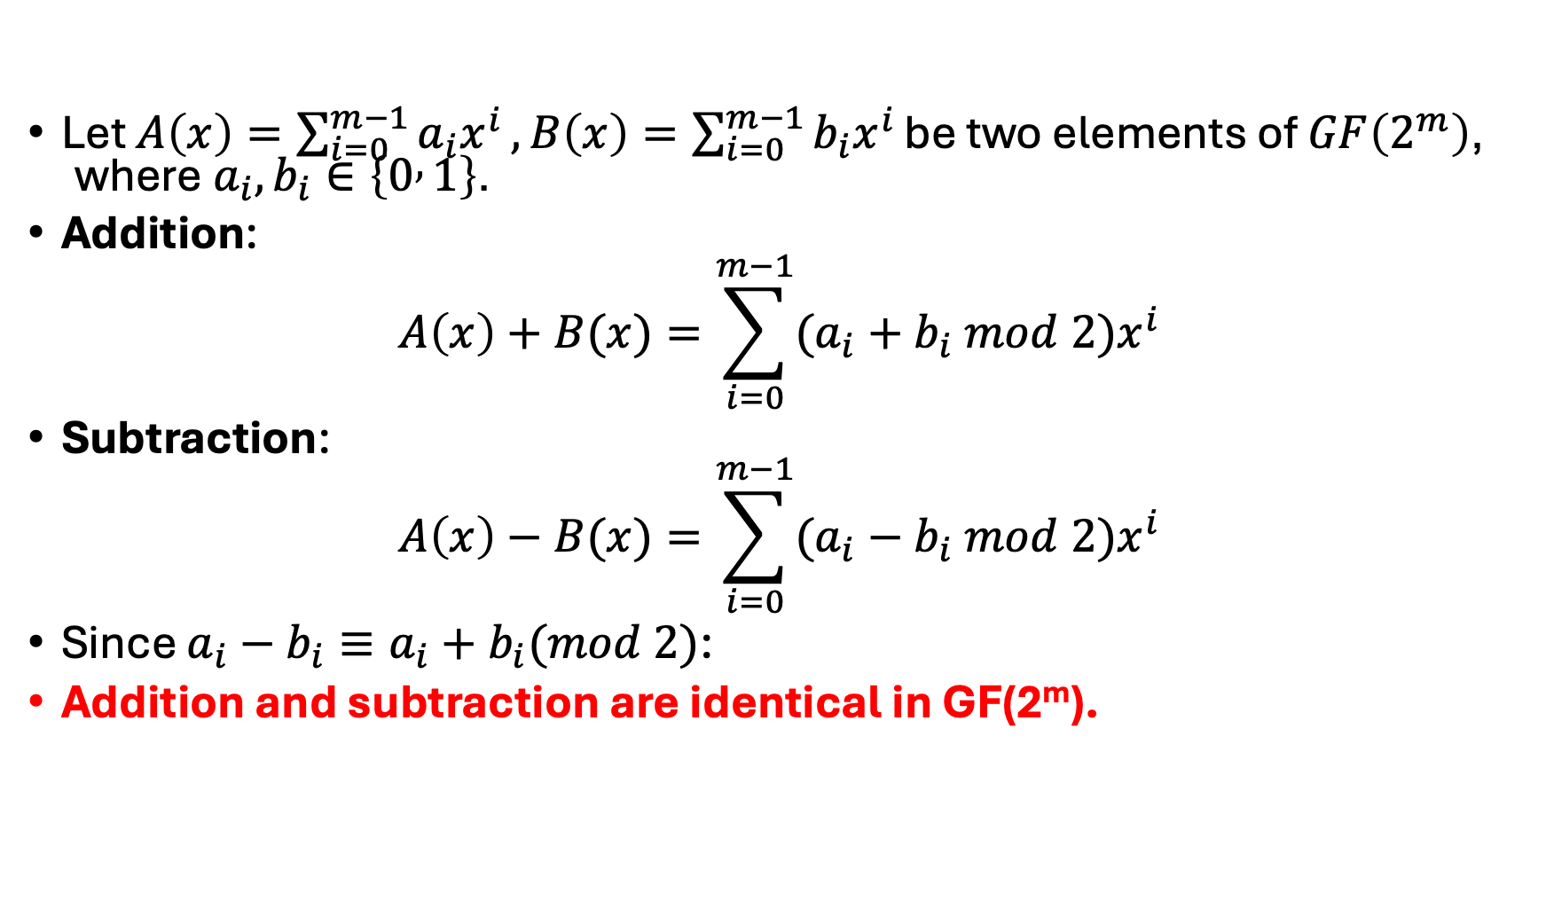
Finite Fields with Polynomial Arithmetic
Let $A\left(x\right)=\sum_{i=0}^{m−1}{a_{i}x^{i}},B\left(x\right)=\sum_{i=0}^{m−1}{b_{i}x^{i}}\text{be} \text{two} \text{elements} \text{of} GF\left(2^{m}\right)\text{, }\text{where} a_{i},b_{i}∈\left\{0 , 1\right\}\text{.}$
Addition:
$$A\left(x\right)+B(x)=\sum_{i=0}^{m−1}{(a_{i}+b_{i} mod 2)x^{i}}$$
Subtraction:
$$A\left(x\right)−B(x)=\sum_{i=0}^{m−1}{(a_{i}−b_{i} mod 2)x^{i}}$$
Since $a_{i}−b_{i}​≡a_{i}+b_{i}​(mod 2)$:
Addition and subtraction are identical in GF(2^{m}).

Slide 4
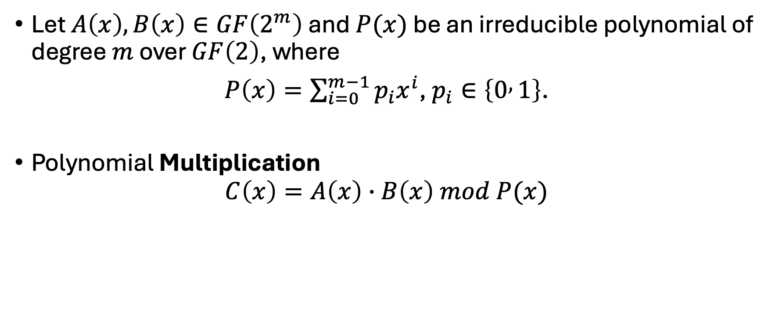
Finite Fields with Polynomial Arithmetic - Multiplication
Let $A\left(x\right),B\left(x\right)∈GF\left(2^{m}\right)$ and $P(x)$ be an irreducible polynomial of degree $m$ over $GF\left(2\right)$, where
$P\left(x\right)=\sum_{i=0}^{m−1}{p_{i}x^{i}}$, $p_{i}∈\left\{0 , 1\right\}$.
Polynomial Multiplication
$$C\left(x\right)=A\left(x\right)∙B\left(x\right) mod P(x)$$

Slide 5

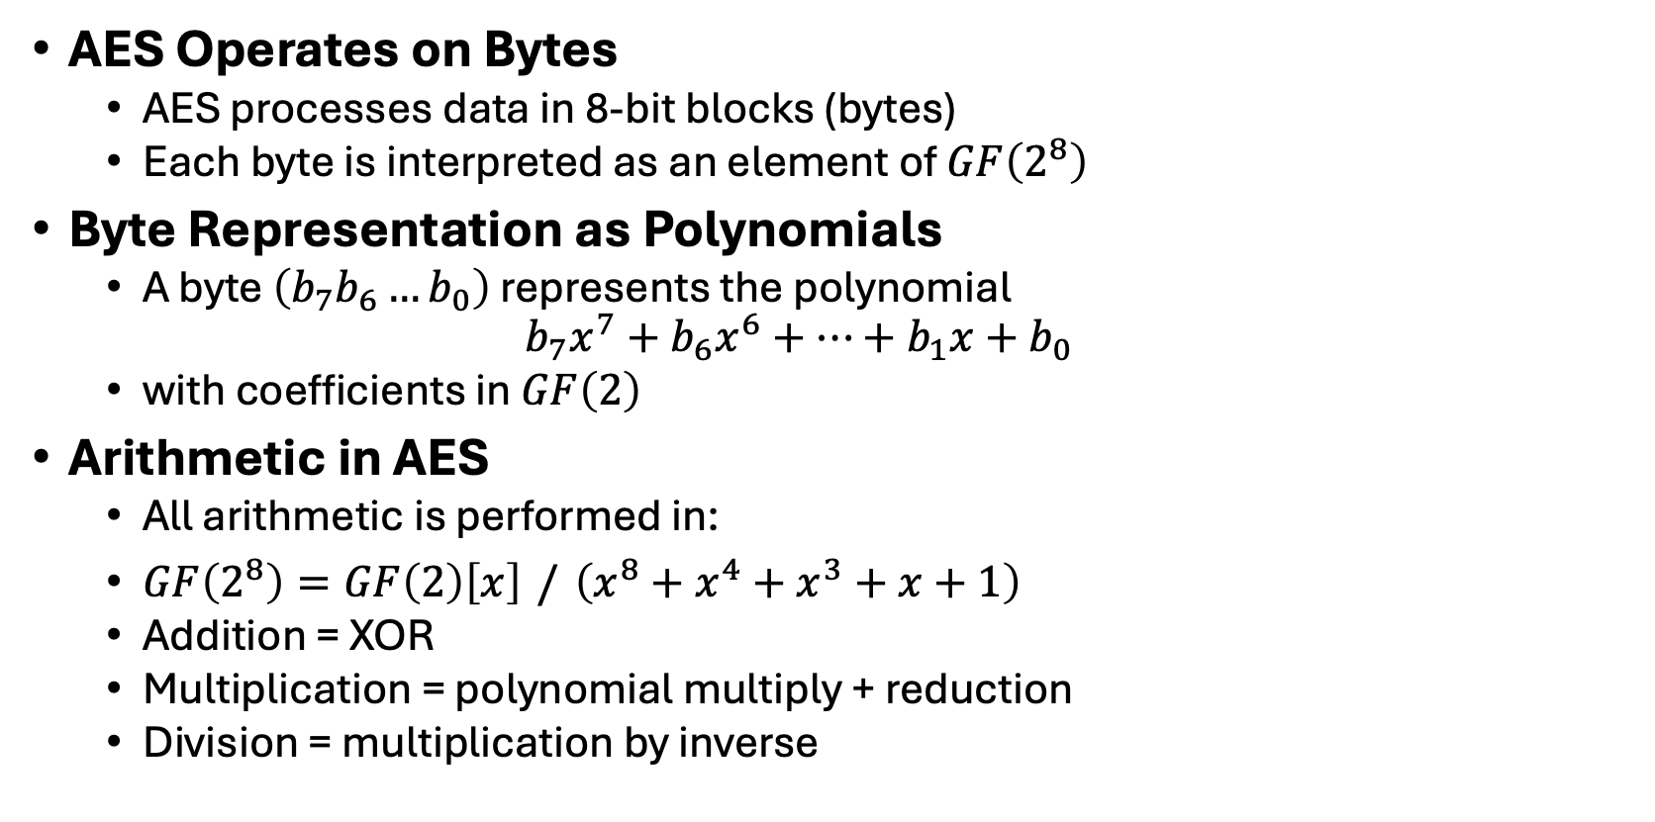
Why AES Uses $GF\left(2^{8}\right)$
AES Operates on Bytes
AES processes data in 8-bit blocks (bytes)
Each byte is interpreted as an element of $GF\left(2^{8}\right)$
Byte Representation as Polynomials
A byte $\left(b_{7}b_{6}…b_{0}\right)$ represents the polynomial
$$b_{7}x^{7}+b_{6}x^{6}+⋯+b_{1}x+b_{0}$$
with coefficients in $GF\left(2\right)$
Arithmetic in AES
All arithmetic is performed in:
$GF\left(2^{8}\right)=GF\left(2\right)\left[x\right] / \left(x^{8}+x^{4}+x^{3}+x+1\right)$
Addition = XOR
Multiplication = polynomial multiply + reduction
Division = multiplication by inverse
Every nonzero byte has a multiplicative inverse
The AES S-box is built using this inverse
Field structure guarantees well-defined, reversible operations

Slide 6
Advanced Encryption Standard (AES)
Examples of AES usage:
VPNs (Virtual Private Networks). The VPNs that use the advanced encryption standard with 256-bit keys include NordVPN, Surfshark, and ExpressVPN.
Wi-Fi. That’s right - wireless networks also use AES encryption (usually, together with WPA2).
Mobile applications. Many popular apps (like Snapchat and Facebook Messenger) use AES encryption in order to safely send info like photos and messages.
Archive and compression tools. All major file compression programs use AES to prevent data from leaking. These tools include 7z, WinZip, and RAR.
OS system components. Some operating system components (like file systems) use the advanced encryption standard for an extra layer of safety.

Slide 7
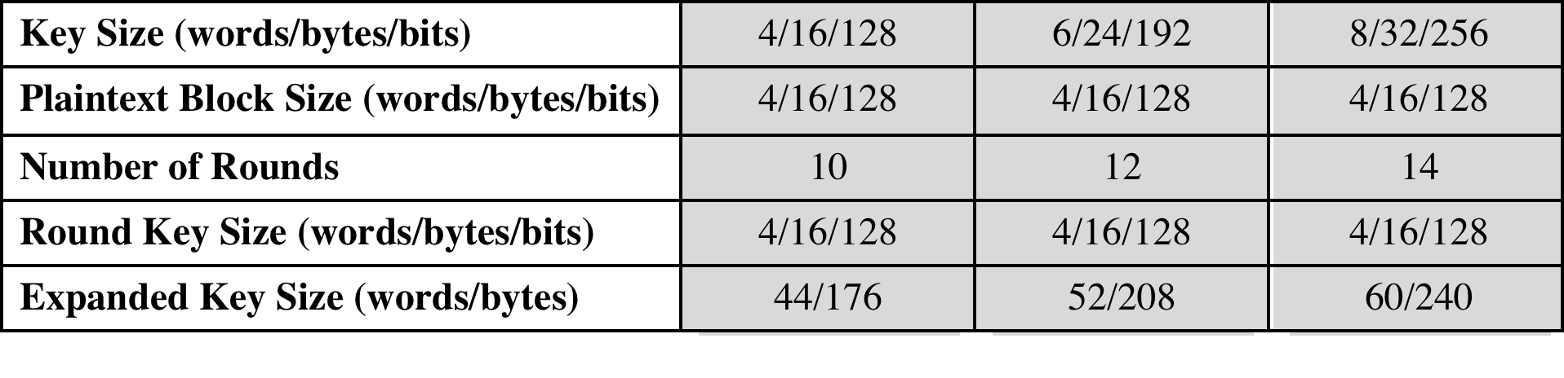
Table 6.1 AES Parameters

Slide 8
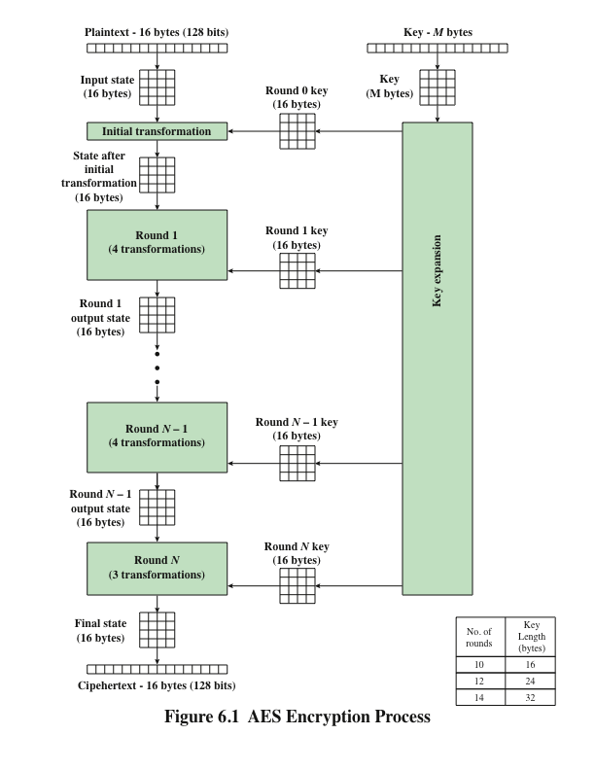
AES Encryption Process
*Figure resource: Stallings, William. Cryptography and Network Security: Principles and Practice, 7th ed. England: Pearson Education Limited, 2017.

Slide 9
State Definition in AES
*Figure resource: Stallings, William. Cryptography and Network Security: Principles and Practice, 7th ed. England: Pearson Education Limited, 2017.

Slide 10
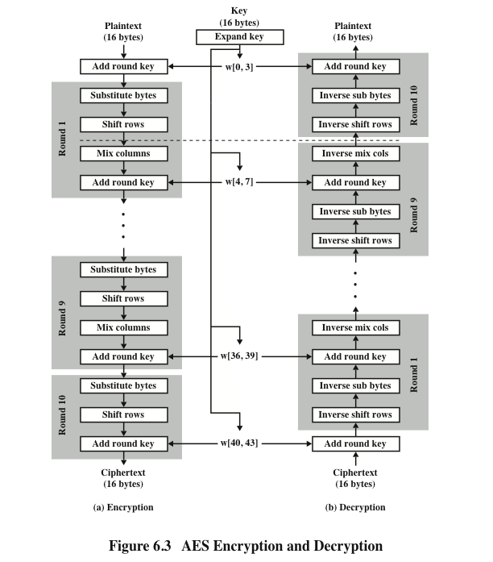
AES Encryption and Decryption Procedures
*Figure resource: Stallings, William. Cryptography and Network Security: Principles and Practice, 7th ed. England: Pearson Education Limited, 2017.

Slide 11
AES Overview
AES explained as a Flash animation
https://formaestudio.com/rijndaelinspector/archivos/Rijndael_Animation_v4_eng-html5.html
Video: https://www.youtube.com/watch?v=gP4PqVGudtg

Slide 12
AES Encryption Round
*Figure resource: Stallings, William. Cryptography and Network Security: Principles and Practice, 7th ed. England: Pearson Education Limited, 2017.

Slide 13
AES Byte-Level Operation of Substitute Byte and Add Round Key
*Figure resource: Stallings, William. Cryptography and Network Security: Principles and Practice, 7th ed. England: Pearson Education Limited, 2017.

Slide 14
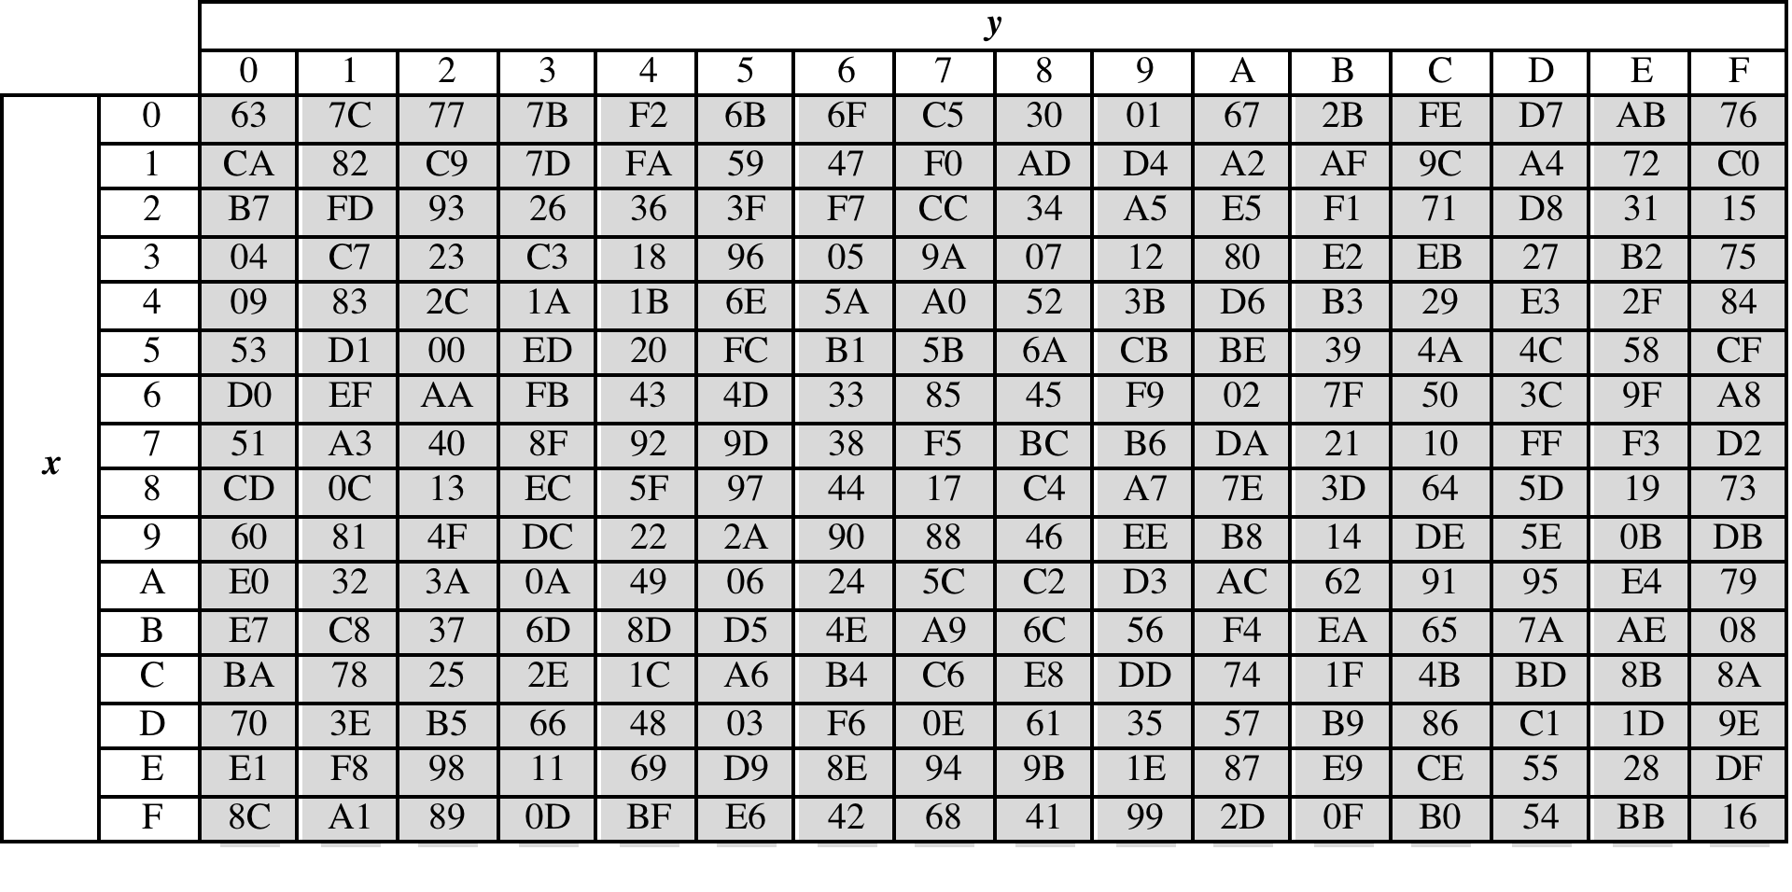
(a) S-box
Table 6.2
Input: {95}

Slide 15
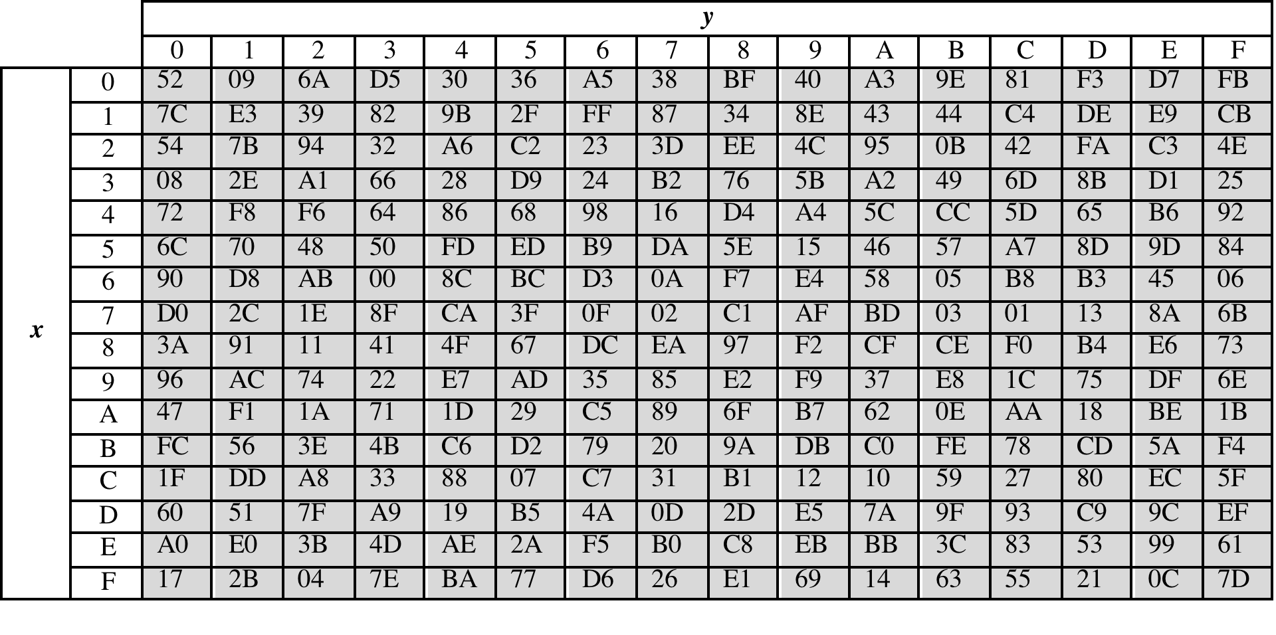
(b) Inverse S-box
Table 6.2
Input: {2A}

Slide 16
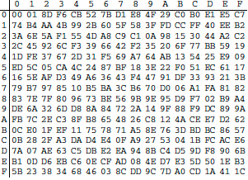
S-Box Overview
Input: {95}
Prime Polynomial:
*Figure resource: Stallings, William. Cryptography and Network Security: Principles and Practice, 7th ed. England: Pearson Education Limited, 2017.
Notes:
Construction of S-Box and IS-Box

Slide 17
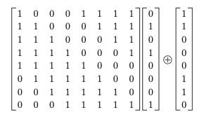
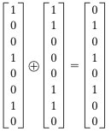
S-Box Example
Input: {95}
Inverse: {8A} = 1000 1010
Each byte consists of 8 bits labeled:
(b₇, b₆, b₅, b₄, b₃, b₂, b₁, b₀)
Result:
0010 1010 = {2A}
*Figure resource: Stallings, William. Cryptography and Network Security: Principles and Practice, 7th ed. England: Pearson Education Limited, 2017.
Notes:
Construction of S-Box and IS-Box

Slide 18
S-Box Rationale
The S-box is designed to be resistant to known cryptanalytic attacks
It must introduce strong nonlinearity.
nonlinearity → security
Why Multiplicative Inverse?
Inversion in a finite field is highly nonlinear
Not representable as a linear or affine function
Breaks simple linear relationships between input and output bits
After inversion:
Apply a fixed affine transformation
Further improves diffusion
Eliminates algebraic symmetry

Slide 19
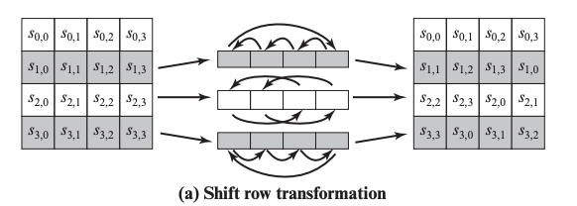
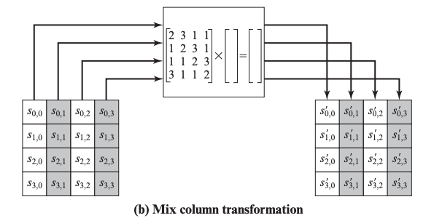
Shift Row & Mix Column
*Figure resource: Stallings, William. Cryptography and Network Security: Principles and Practice, 7th ed. England: Pearson Education Limited, 2017.

Slide 20
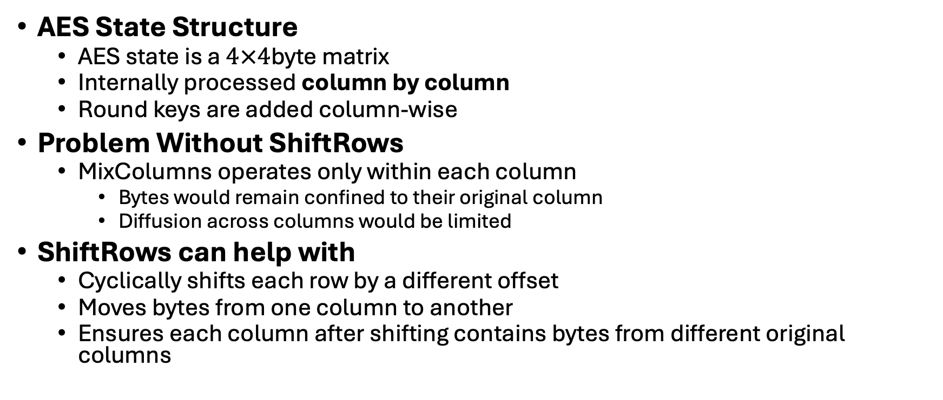
Shift Row Rationale
AES State Structure
AES state is a $4×4$byte matrix
Internally processed column by column
Round keys are added column-wise
Problem Without ShiftRows
MixColumns operates only within each column
Bytes would remain confined to their original column
Diffusion across columns would be limited
ShiftRows can help with
Cyclically shifts each row by a different offset
Moves bytes from one column to another
Ensures each column after shifting contains bytes from different original columns

Slide 21
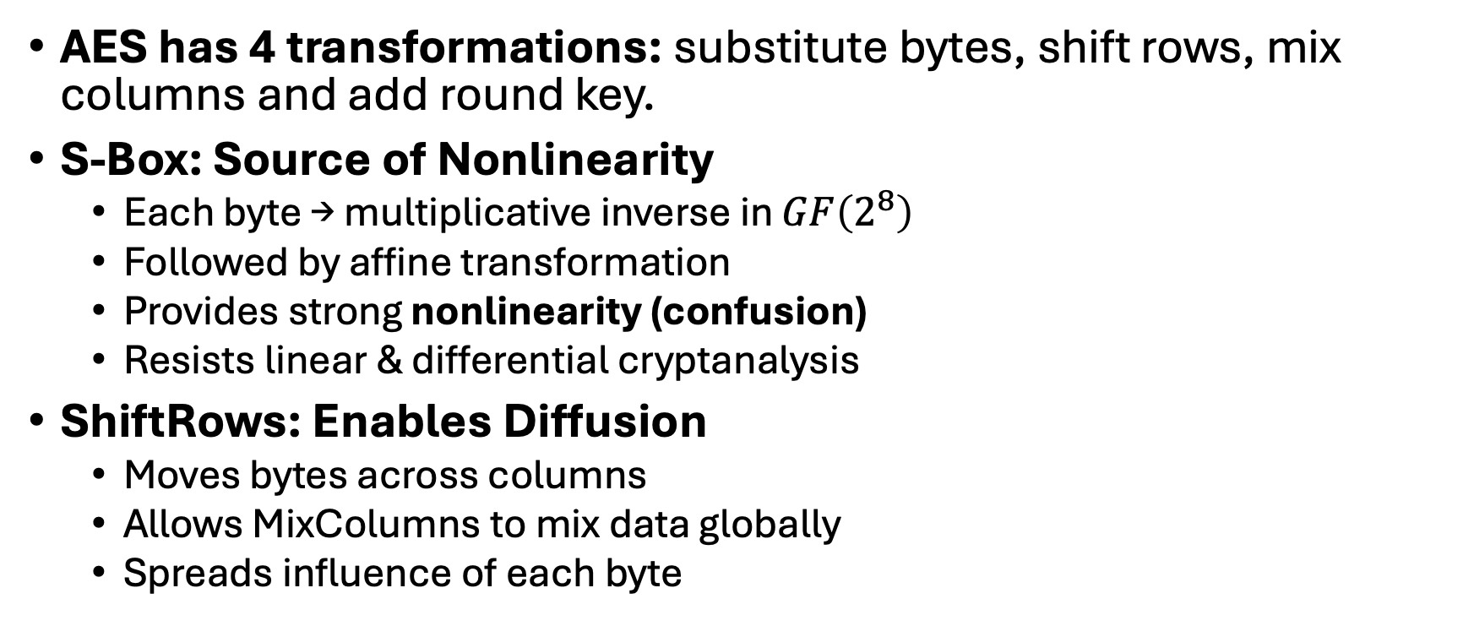
Summary
AES has 4 transformations: substitute bytes, shift rows, mix columns and add round key.
S-Box: Source of Nonlinearity
Each byte → multiplicative inverse in $GF\left(2^{8}\right)$
Followed by affine transformation
Provides strong nonlinearity (confusion)
Resists linear & differential cryptanalysis
ShiftRows: Enables Diffusion
Moves bytes across columns
Allows MixColumns to mix data globally
Spreads influence of each byte

