Slide 1
Advanced Encryption Standard
Dr. Xinyue Zhang
Assistant Professor
Department of Computer Science
Kennesaw State University
Marietta, GA, USA

Slide 2
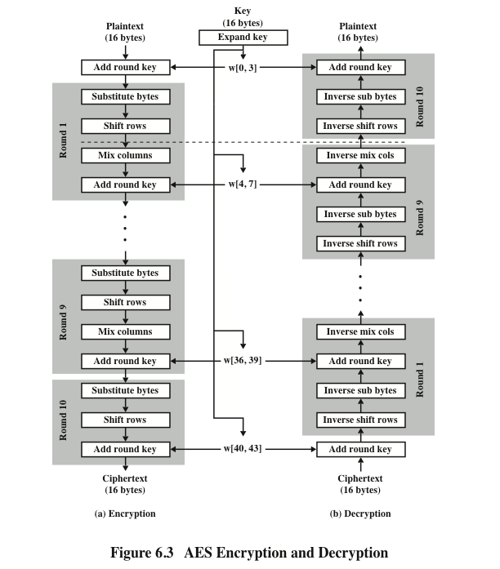
AES Encryption and Decryption
*Figure resource: Stallings, William. Cryptography and Network Security: Principles and Practice, 7th ed. England: Pearson Education Limited, 2017.

Slide 3
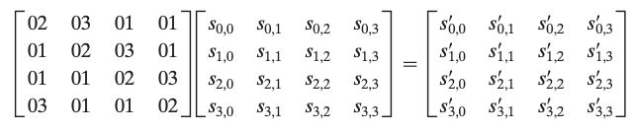
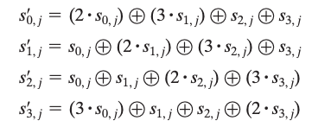
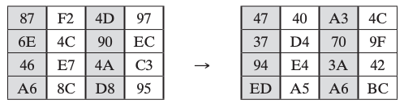
MixColumns
We will use the operations in GF(2⁸).

Slide 4
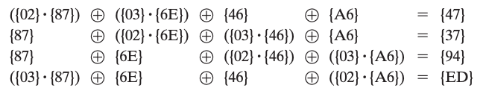
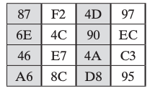
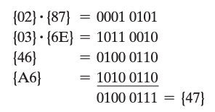
MixColumns Example

Slide 5
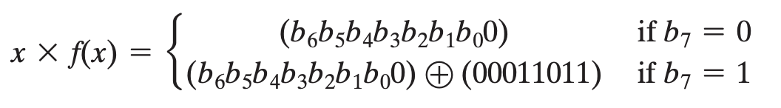
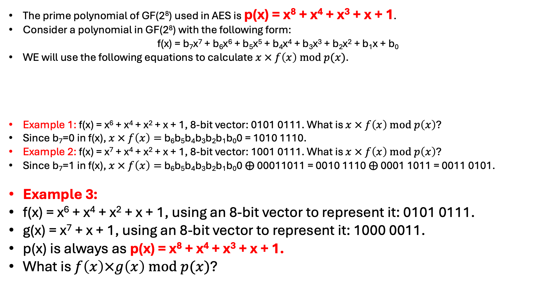
Fast Polynomial Multiplication in AES
Textbook Page 164-165.
The prime polynomial of GF(2⁸) used in AES is p(x) = x⁸ + x⁴ + x³ + x + 1.
Consider a polynomial in GF(2⁸) with the following form:
f(x) = b₇x⁷ + b₆x⁶ + b₅x⁵ + b₄x⁴ + b₃x³ + b₂x² + b₁x + b₀
WE will use the following equations to calculate $x × f\left(x\right) mod p(x)$.
Example 1: f(x) = x⁶ + x⁴ + x² + x + 1, 8-bit vector: 0101 0111. What is $x × f\left(x\right) mod p\left(x\right)$?
Since b₇=0 in f(x), $x × f\left(x\right)=$ b₆b₅b₄b₃b₂b₁b₀0 = 1010 1110.
Example 2: f(x) = x⁷ + x⁴ + x² + x + 1, 8-bit vector: 1001 0111. What is $x × f\left(x\right) mod p\left(x\right)$?
Since b₇=1 in f(x), $x × f\left(x\right)=$ b₆b₅b₄b₃b₂b₁b₀0 $⨁$ 00011011 = 0010 1110 $⨁$ 0001 1011 = 0011 0101.
Example 3:
f(x) = x⁶ + x⁴ + x² + x + 1, using an 8-bit vector to represent it: 0101 0111.
g(x) = x⁷ + x + 1, using an 8-bit vector to represent it: 1000 0011.
p(x) is always as p(x) = x⁸ + x⁴ + x³ + x + 1.
What is $f\left(x\right)×g\left(x\right) mod p(x)$?

Slide 6
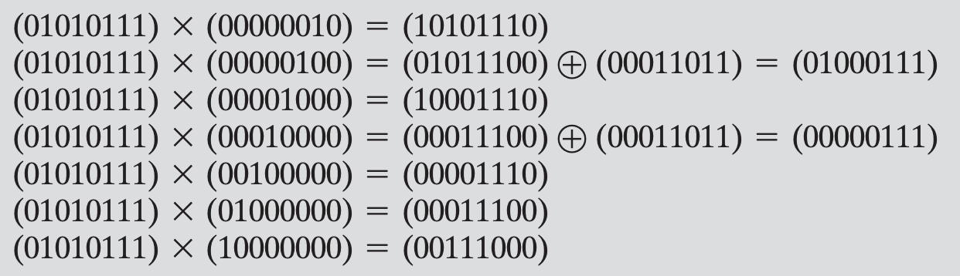
Fast Polynomial Multiplication in AES (cont)
Textbook Page 164-165.
Example 3:
f(x) = x⁶ + x⁴ + x² + x + 1, using an 8-bit vector to represent it: 0101 0111.
g(x) = x⁷ + x + 1, using an 8-bit vector to represent it: 1000 0011.
p(x) is always as p(x) = x⁸ + x⁴ + x³ + x + 1.
What is $f\left(x\right)×g\left(x\right) mod p(x)$?
$$f\left(x\right) × x$$
$$f\left(x\right) × x^{2}=f\left(x\right)× x × x$$
$$f\left(x\right) × x^{3}=f\left(x\right)× x^{2}× x$$
$$f\left(x\right) × x^{4}=f\left(x\right)× x^{3}× x$$
$$f\left(x\right) × x^{5}=f\left(x\right)× x^{4}× x$$
$$f\left(x\right) × x^{6}=f\left(x\right)× x^{5}× x$$
$$f\left(x\right) × x^{7}=f\left(x\right)× x^{6}× x$$
Result:
x⁷ + x⁶ +1

Slide 7
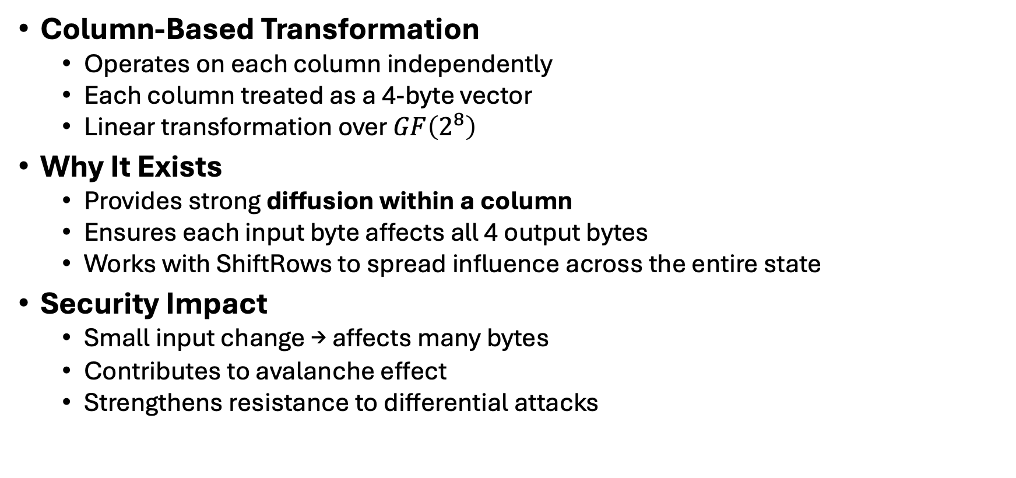
Mix Columns Rationale
Column-Based Transformation
Operates on each column independently
Each column treated as a 4-byte vector
Linear transformation over $GF\left(2^{8}\right)$
Why It Exists
Provides strong diffusion within a column
Ensures each input byte affects all 4 output bytes
Works with ShiftRows to spread influence across the entire state
Security Impact
Small input change → affects many bytes
Contributes to avalanche effect
Strengthens resistance to differential attacks

Slide 8
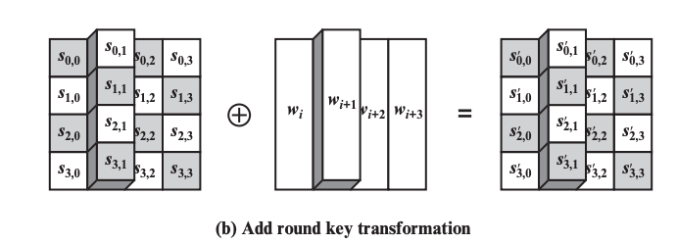
AddRoundKey Transformation
Rationale
Only step that directly injects the secret key
Keeps operation simple
Security relies on:
Key schedule complexity
Nonlinearity (S-box)
Diffusion (ShiftRows + MixColumns)
State are bitwise XORed with the round key
Why XOR?
XOR is linear and efficient
Invertible (XOR twice restores original value)
Ensures every bit of the key directly affects the State
*Figure resource: Stallings, William. Cryptography and Network Security: Principles and Practice, 7th ed. England: Pearson Education Limited, 2017.

Slide 9
One AES Round Overview
*Figure resource: Stallings, William. Cryptography and Network Security: Principles and Practice, 7th ed. England: Pearson Education Limited, 2017.

