Slide 1
Advanced Encryption Standard
Dr. Xinyue Zhang
Assistant Professor
Department of Computer Science
Kennesaw State University
Marietta, GA, USA

Slide 2
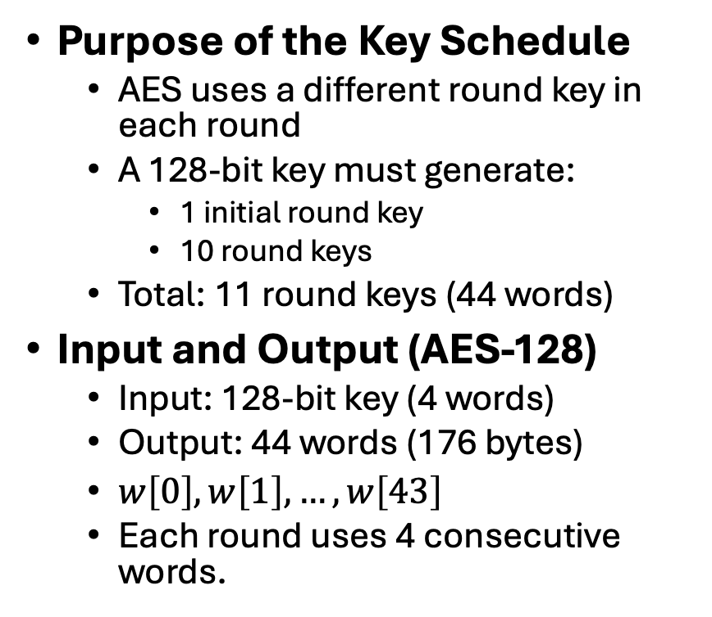
AES Key Expansion
Purpose of the Key Schedule
AES uses a different round key in each round
A 128-bit key must generate:
1 initial round key
10 round keys
Total: 11 round keys (44 words)
Input and Output (AES-128)
Input: 128-bit key (4 words)
Output: 44 words (176 bytes)
$w\left[0\right],w\left[1\right],…,w\left[43\right]$
Each round uses 4 consecutive words.
Design Idea
Each new word depends on:
The previous word
The word four positions back
Periodic nonlinear transformation strengthens security

Slide 3

G-function
g-function: 3 steps
RotWord performs a one-byte circular left shift on a word. This means that an input word [B0, B1, B2, B3] is transformed into [B1, B2, B3, B0].
SubWord performs a byte substitution on each byte of its input word, using the S-box.
The result of steps 1 and 2 is XORed with a round constant, Rcon[j].
The round constant is different for each round and is defined as Rcon[j] = (RC[j], 0, 0, 0), with RC[1] = 1, RC[j] = 2 * RC[j - 1] and with multiplication defined over the field GF(2⁸).
*Figure resource: Stallings, William. Cryptography and Network Security: Principles and Practice, 7th ed. England: Pearson Education Limited, 2017.

Slide 4

Key Expansion Example
Assume in Round 8, the round key is
What is the first 4 bytes of the round key for Round 9?
w₃₅= 7F 8D 29 2F
RotWord = 8D 29 2F 7F
SubWord = 5D A5 15 D2
Rcon₉ = [1B 00 00 00]
SubWord $⊕$ Rcon9 = 46 A5 15 D2
W₃₆ = w₃₂ $⊕$ 46 A5 15 D2 = AC 77 66 F3
w_32 | w_33 | w_34 | w_35
EA | B5 | 31 | 7F
D2 | 8D | 2B | 8D
73 | BA | F5 | 29
21 | D2 | 60 | 2F
*Figure resource: Stallings, William. Cryptography and Network Security: Principles and Practice, 7th ed. England: Pearson Education Limited, 2017.

Slide 5
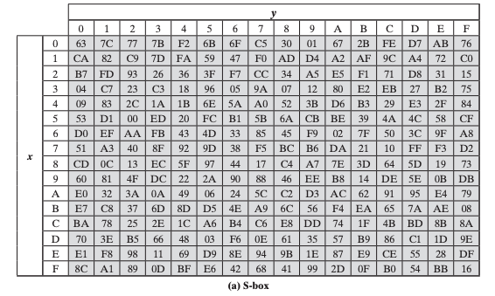
Table 6.4
Key Expansion
for
AES Example
What is w4?
*Figure resource: Stallings, William. Cryptography and Network Security: Principles and Practice, 7th ed. England: Pearson Education Limited, 2017.

Slide 6
Table 6.4
Key Expansion
for
AES Example - Solutions
*Figure resource: Stallings, William. Cryptography and Network Security: Principles and Practice, 7th ed. England: Pearson Education Limited, 2017.

Slide 7
Key Expansion Rationale
Security Objectives
Resist known cryptanalytic attacks
Prevent simple relationships between round keys
Ensure partial knowledge of one round key does not reveal others
Diffusion of Key Material
Each new word depends on previous words
Small changes in the cipher key propagate across many round keys
Differences in the master key spread quickly
Controlled Nonlinearity
SubWord (S-box) introduces nonlinearity
Prevents purely linear key schedule
Makes related-key attacks more difficult
Practical Considerations
Invertible transformation
Efficient on software and hardware
Simple structure but strong security

Slide 8
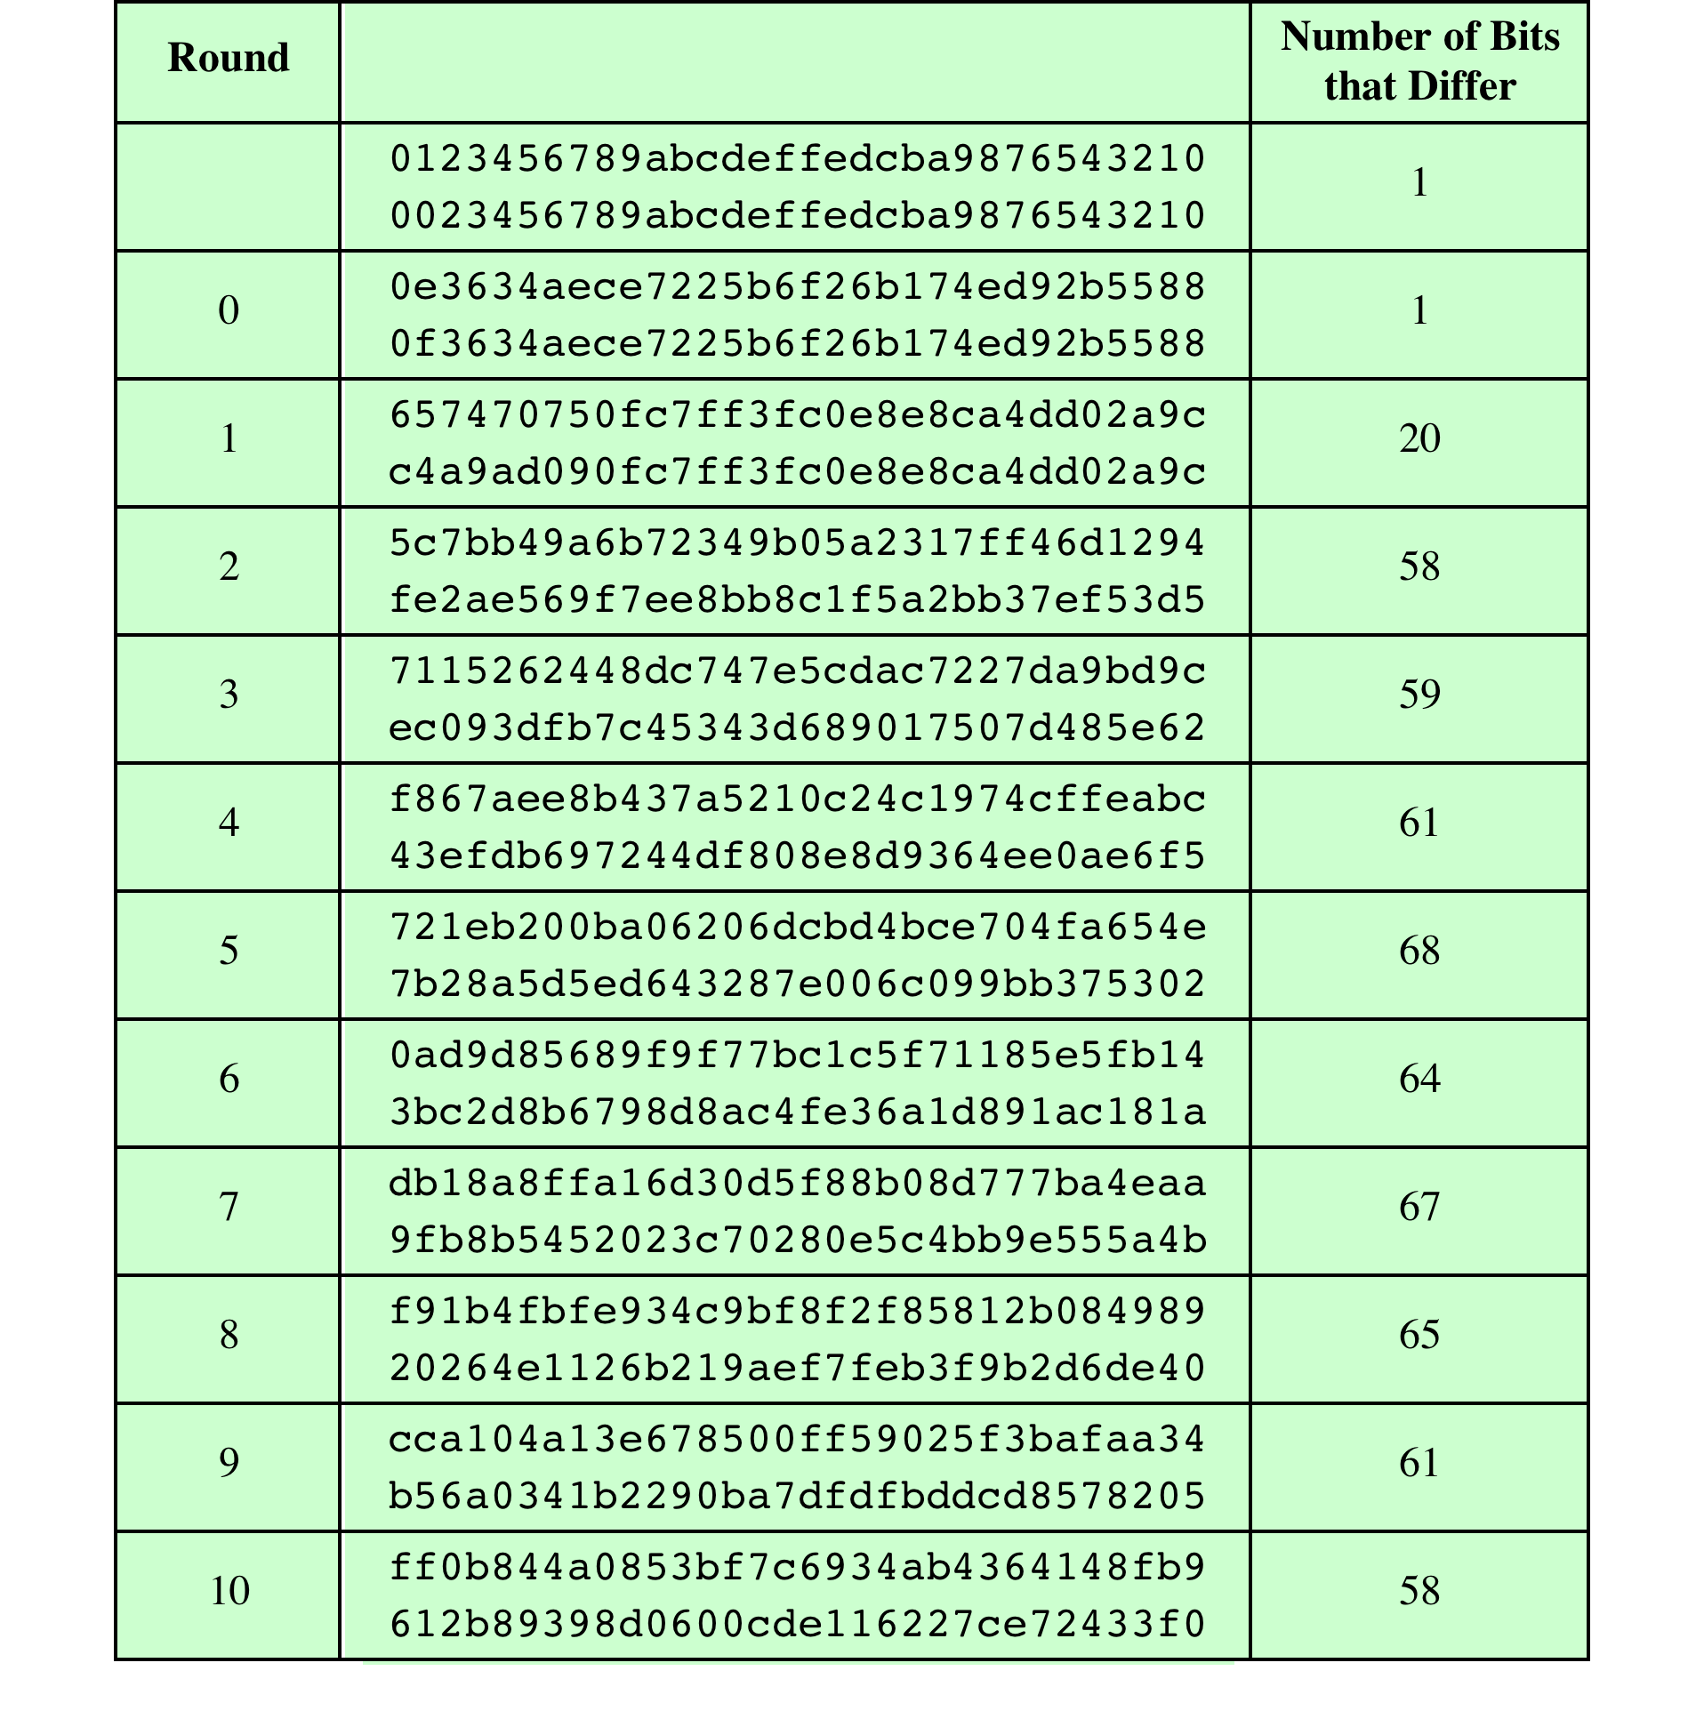
Table 6.6 Avalanche Effect
in AES: Change
in Plaintext
*Figure resource: Stallings, William. Cryptography and Network Security: Principles and Practice, 7th ed. England: Pearson Education Limited, 2017.

Slide 9
Table 6.7
Avalanche Effect
in
AES:
Change in Key
*Figure resource: Stallings, William. Cryptography and Network Security: Principles and Practice, 7th ed. England: Pearson Education Limited, 2017.

Slide 10
AES Review
AES explained as a Flash animation
https://formaestudio.com/rijndaelinspector/archivos/Rijndael_Animation_v4_eng-html5.html
Video: https://www.youtube.com/watch?v=gP4PqVGudtg

Slide 11
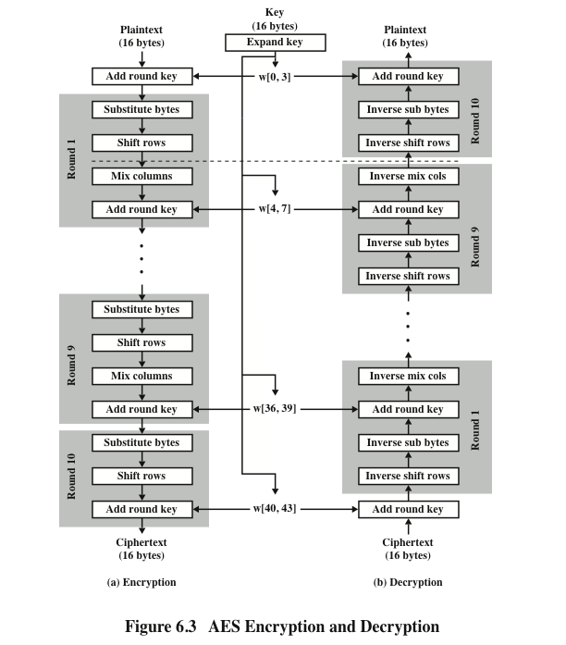
AES Encryption and Decryption Steps
*Figure resource: Stallings, William. Cryptography and Network Security: Principles and Practice, 7th ed. England: Pearson Education Limited, 2017.

Slide 12
AES Encryption vs. Decryption: Structural Difference
Not Identical Procedures
Encryption round:
SubBytes → ShiftRows → MixColumns → AddRoundKey
Decryption round:
InvShiftRows → InvSubBytes → AddRoundKey → InvMixColumns
Round Keys
Same expanded key
Used in reverse order during decryption
Implementation Issue
Different order of transformations
Inverse operations required
Naïvely requires separate encryption and decryption routines
Key Observation
AES encryption and decryption are mathematical inverses
but not mirror images in structure.

Slide 13
Interchanging InvShiftRows and InvSubBytes
InvShiftRows affects the sequence of bytes in State but does not alter byte contents and does not depend on byte contents to perform its transformation
InvSubBytes affects the contents of bytes in State but does not alter byte sequence and does not depend on byte sequence to perform its transformation
Thus, these two operations commute and can be interchanged

Slide 14
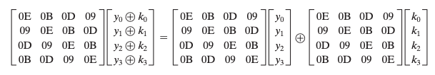

Interchanging AddRoundKey and InvMixColumns
S_{i} is a given state, w_{j} is a given round key
The first column of State S_{i} is the sequence (y₀, y₁, y₂, y₃)
The first column of the round key w_{j} is (k₀, k₁, k₂, k₃)

Slide 15
AES Decryption Deployment with Identical Structure of Encryption
*Figure resource: Stallings, William. Cryptography and Network Security: Principles and Practice, 7th ed. England: Pearson Education Limited, 2017.

Slide 16
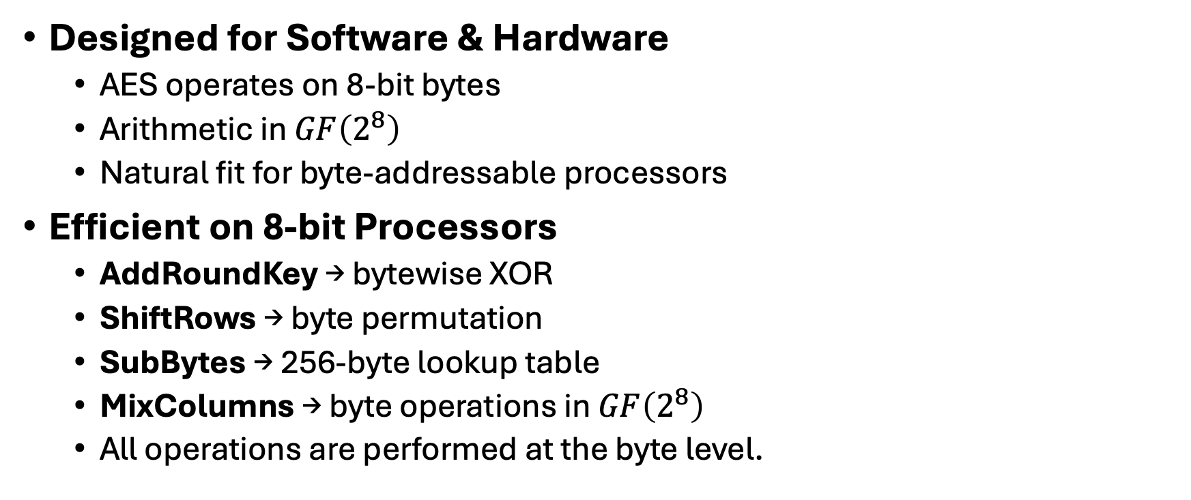
AES Implementation Efficiency: Byte-Oriented Design
Key Design Insight
AES was intentionally designed to:
Avoid bit-level permutations
Avoid large integer arithmetic
Use simple byte-based operations
Designed for Software & Hardware
AES operates on 8-bit bytes
Arithmetic in $GF\left(2^{8}\right)$
Natural fit for byte-addressable processors
Efficient on 8-bit Processors
AddRoundKey → bytewise XOR
ShiftRows → byte permutation
SubBytes → 256-byte lookup table
MixColumns → byte operations in $GF\left(2^{8}\right)$
All operations are performed at the byte level.

Slide 17
Efficient Implementation on 32-bit Processors
Word-Level Optimization
On 32-bit processors:
Represent each column as one 32-bit word
Process one column at a time
Table-Based Optimization
Precompute 4 tables of 256 32-bit words.
Then each column per round:
4 table lookups
4 XOR operations
Storage cost ≈ 4 KB
Why This Works
SubBytes and MixColumns can be combined
Linear structure enables precomputation
Finite-field arithmetic supports table merging
Practical Impact
Extremely fast software implementation
Balanced performance across platforms
One key reason for AES standardization

Slide 18
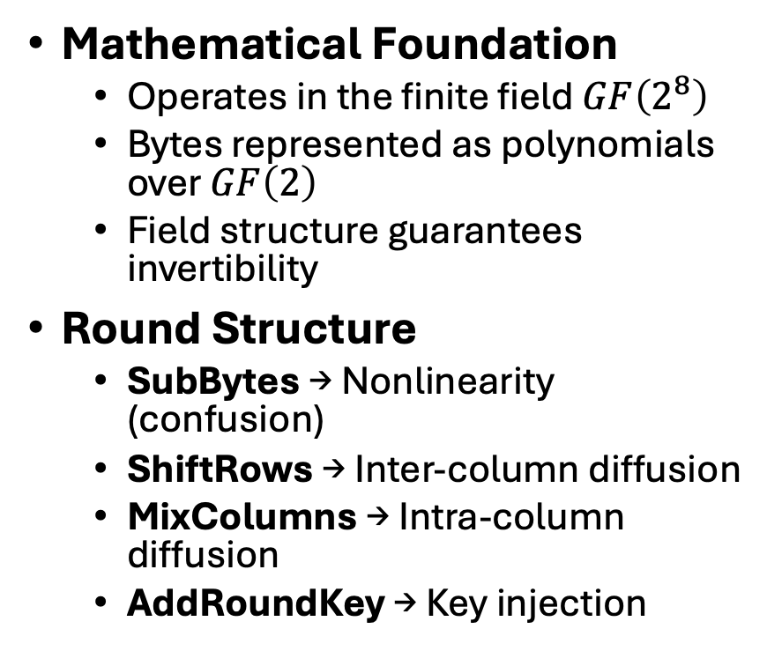
AES Summary
Mathematical Foundation
Operates in the finite field $GF\left(2^{8}\right)$
Bytes represented as polynomials over $GF\left(2\right)$
Field structure guarantees invertibility
Round Structure
SubBytes → Nonlinearity (confusion)
ShiftRows → Inter-column diffusion
MixColumns → Intra-column diffusion
AddRoundKey → Key injection
Key Schedule
Expands 128-bit key into round keys
Introduces nonlinearity + round constants
Diffuses key material across rounds
Design Strengths
Strong resistance to linear & differential cryptanalysis
Efficient on 8-bit and 32-bit processors
Clean algebraic structure

