Slide 1
Block Cipher Operation
Dr. Xinyue Zhang
Assistant Professor
Department of Computer Science
Kennesaw State University
Marietta, GA, USA

Slide 2

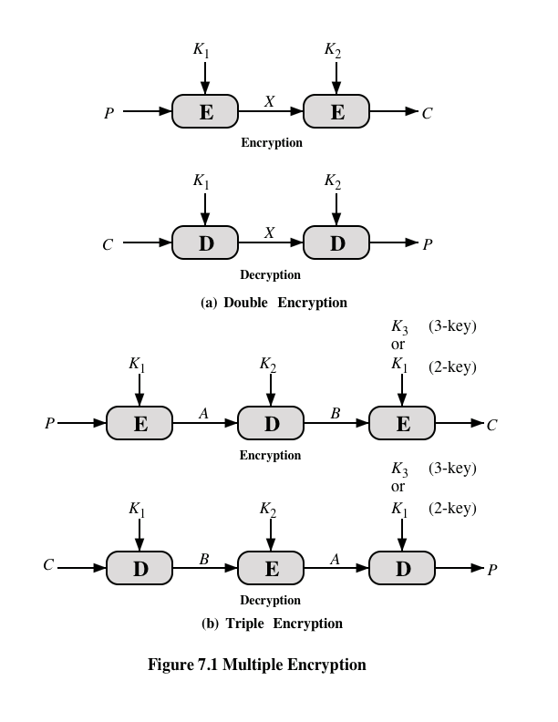
Double Encryption

Slide 3
Meet in the middle Attack
A meet-in-the-middle attack is a cryptanalytic technique used against encryption schemes that apply multiple encryption stages independently, such as double encryption.
Instead of trying every full key combination directly, the attacker computes from both ends and looks for a match in the middle.
Meet-in-the-middle shows that simply applying a cipher twice does not necessarily double the security.
This is why Double DES does not provide the expected 112-bit security; its effective security is much lower because of the meet-in-the-middle attack.

Slide 4
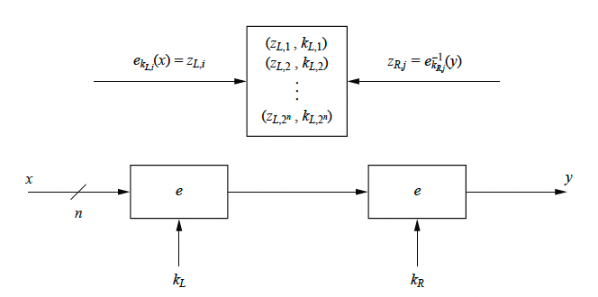

Meet-in-the-middle Attack (cont.)
Assume we know a plaintext-ciphertext pair (x, y)

Slide 5
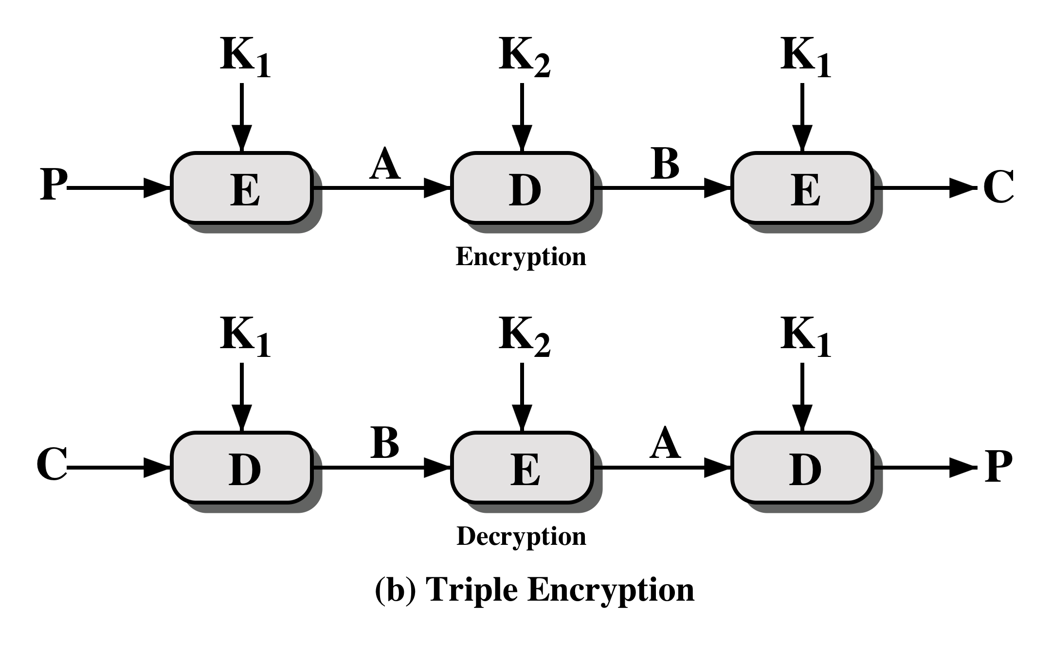
Triple Encryption

Slide 6
Why do we need a mode at all?
Block cipher primitive
Eₖ
Input: exactly one block
Output: exactly one block
A mode answers the practical questions:
How do we encrypt many blocks under one key?
How do we stop repeated plaintext blocks from leaking visible patterns?
Can blocks be processed in parallel or only sequentially?
What extra input do we need: IV, nonce, or counter?
What do we do when the plaintext length is not a multiple of the block size?

Slide 7
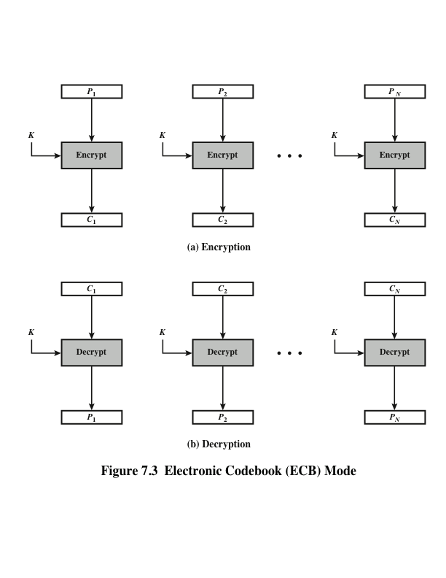
ECB Mode
For each block mᵢ, compute cᵢ = Eₖ(mᵢ). Each block is encrypted independently.
Very simple and fully parallelizable.
But identical plaintext blocks always produce identical ciphertext blocks under the same key.
ECB is good for learning, not for secure message encryption.

Slide 8

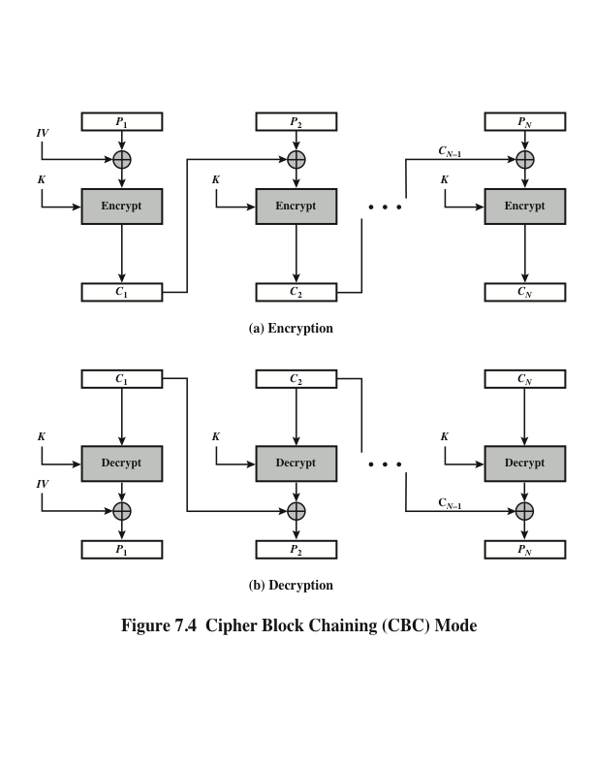
Cipher Block Chaining Mode (CBC)
Initialization vector (IV)
Known to both the sender and receiver but unpredictable by a third party
This could be done by sending the IV with ECB encryption.

Slide 9
Output Feedback Mode (OFB)
The initialization vector here is a nonce. A nonce is an arbitrary number that can be used just once in a cryptographic communication.

Slide 10
Output Feedback Mode (OFB) (cont.)

Slide 11
Output Feedback Mode (OFB) Details
OFB uses the block cipher to generate a keystream. Starting from an IV, we repeatedly encrypt the previous output and XOR the resulting keystream with plaintext.
OFB turns a block cipher into a stream-cipher-style construction.
The keystream depends on the key and IV, not on plaintext or ciphertext.
A one-bit ciphertext error gives a one-bit plaintext error after decryption.
Decryption uses the block cipher in the forward direction, not the inverse direction.

Slide 12
Cipher Feedback Mode (CFB)

Slide 13
Cipher Feedback Mode (CFB) (cont.)

Slide 14
Cipher Feedback Mode (CFB) Details
CFB also creates mask bits with the block cipher, but the next input is previous ciphertext rather than the previous internal output.
Like OFB, CFB behaves like a stream-cipher-style mode built from a block cipher.
Unlike OFB, its internal state tracks ciphertext feedback.
So transmission errors influence the current segment and also affect what happens next.
This dependence also limits straightforward parallel encryption.

Slide 15
Counter Mode (CTR)

Slide 16
Counter Mode (CTR) (cont.)

Slide 17
Counter Mode (CTR) Details
Choose a nonce or initial counter r, then use Eₖ(r), Eₖ(r+1), Eₖ(r+2), … as a keystream and XOR it with plaintext blocks.
Once the counter values are fixed, blocks can be processed independently.
Both encryption and decryption support parallelism and random access.
The critical rule is uniqueness: never reuse the same nonce/counter sequence with the same key.
CTR keeps independent block computation without ECB’s pattern leakage.

Slide 18
Comparing ECB, CBC, OFB, CFB, and CTR
Mode | Main idea | Parallel encryption? | Effect of a ciphertext bit error
ECB | Encrypt each block independently | Yes | Current block only, but repeated patterns leak
CBC | XOR with previous ciphertext before encryption | No | Current block badly corrupted; next block gets a one-bit error
OFB | Generate keystream from repeated cipher outputs | No, keystream generation is sequential | Matching plaintext bit flips only
CFB | Generate mask from previous ciphertext feedback | No | Current segment affected and later behavior also influenced
CTR | Encrypt nonce/counter values to form keystream | Yes | Matching plaintext bit flips only

Slide 19
Handling plaintexts that are not exact multiples of the block size -- Padding
A padding rule extends any input to a full-block multiple. After decryption, unpadding restores the original plaintext.
Padding is a reversible formatting rule, not a secrecy mechanism.
It is a public encoding rule that makes block-based encryption usable on arbitrary-length inputs.
Many padding conventions add a full extra block when the message is already block-aligned.
That avoids ambiguity when real data could otherwise look like padding.

Slide 20
Padding Schemes
Scheme | How the added bytes look | Why it is reversible
ANSI X9.23 | 00 … 00 b | The final byte b records how many padding bytes were added
PKCS#7 | b b … b | Every padding byte equals the padding length b
ISO/IEC 7816-4 | 80 00 … 00 | A single marker byte is followed by zeros

Slide 21
Summary
By the end of this lecture, you should be able to:
Explain why a block cipher needs a mode of operation for long messages.
Describe ECB, CBC, OFB, CFB, and CTR in words and simple diagrams.
Compare their parallelism, dependencies, and error propagation.
Explain why padding is formatting rather than security.

