Slide 1
Stream Cipher
Dr. Xinyue Zhang
Assistant Professor
Department of Computer Science
Kennesaw State University
Marietta, GA, USA

Slide 2
Why do we need random numbers?
Key generation
Stream cipher keystream generation
Nonces, IVs, challenges, masking values
Security depends on unpredictability

Slide 3
True random vs pseudorandom
TRNG: uses a physical entropy source
PRG/PRNG: deterministic algorithm from a short seed
TRNG gives unpredictability from nature
PRG gives efficiency and scalability

Slide 4
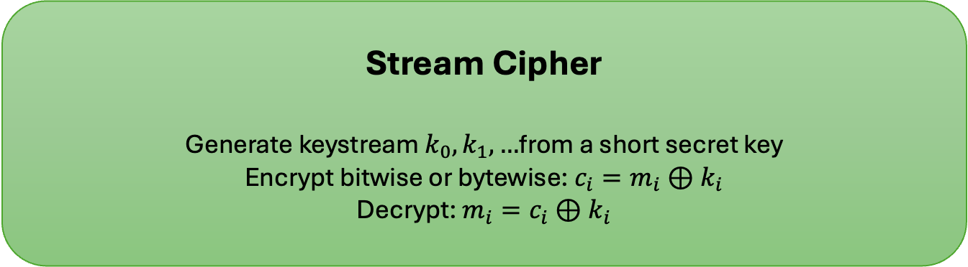
PRG & Stream Cipher
PRG expands a short seed into a longer pseudorandom string
Main application here: keystream generation
Stream cipher can be viewed as a length-flexible PRG
Same seed must not be reused carelessly
Stream Cipher
Generate keystream $k_{0},k_{1},…$from a short secret key
Encrypt bitwise or bytewise: $c_{i}​=m_{i}​⊕k_{i}​$
Decrypt: $m_{i}=c_{i}​​⊕k_{i}​$

Slide 5
Why stream ciphers are attractive and also risky
Very fast
Good for real-time data
Little or no error propagation
Main danger: keystream reuse

Slide 6
True random number generator pipeline
Entropy source
Digitization / sampling
Conditioning
Health tests
Final random output
Physical source
Sampled raw bits
Conditioning
Tests/monitoring
Random output

Slide 7
Entropy Sources
A nondeterministic source to produce randomness
Unpredictable natural processes
Keystroke timing
Mouse movement
Disk or hardware activity
Thermal noise / electrical noise
Natural physical variation

Slide 8
Entropy Sources (cont.)
A nondeterministic source to produce randomness
Unpredictable natural processes
Keystroke timing
Mouse movement
Disk or hardware activity
Thermal noise / electrical noise
Natural physical variation

Slide 9
Conditioning
Raw noise may be biased
Entropy rate
The rate at which a digitized noise source provides entropy
Is a measure of the randomness or unpredictability of a bit string
Will be a value between 0 (no entropy) and 1 (full entropy)
Conditioning reduces bias
Methods of modifying a bit stream to further randomize the bits
Typical methods:
hash function
block cipher based conditioning

Slide 10
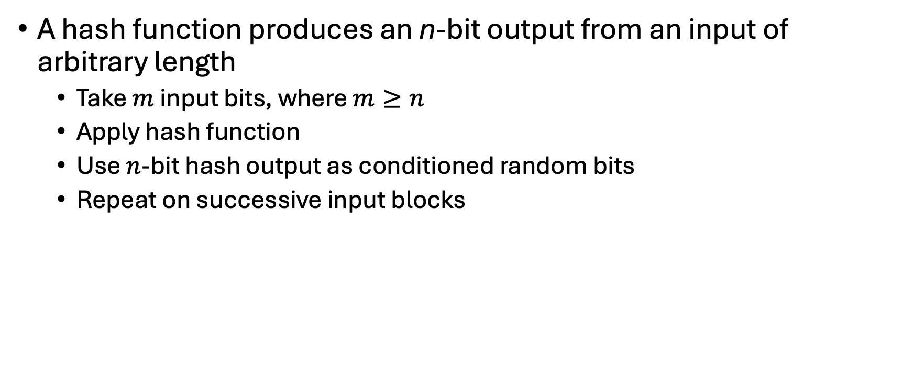
Hash Function
A hash function produces an n-bit output from an input of arbitrary length
Take $m$ input bits, where $m≥n$
Apply hash function
Use $n$-bit hash output as conditioned random bits
Repeat on successive input blocks

Slide 11
Nondeterministic Random Bit Generator
Validate noise source and conditioning are working as expected.

Slide 12
Health Tests on the Noise Source
In general, the assumption can be made that the digitized output of the noise source will exhibit some bias
Thus, traditional statistical tests are not useful for monitoring the noise source, because the noise source is likely to always fail
The tests on the noise source need to be tailored to the expected statistical behavior of the correctly operating noise source
The goal is not to determine if the source is unbiased, but if it is operating as expected

Slide 13
Health Tests on the Noise Source (cont.)
SP 800-90B specifies that continuous tests be done on digitized samples obtained from the noise source
The purpose is to test for variability and to determine if the noise source is producing at the expected entropy rate
Two tests
Repetition Count Test
Designed to quickly detect whether the noise source “stuck” on a single output value for a long time
Involves looking for consecutive identical samples
Adaptive Proportion Test
Designed to detect a large loss of entropy, such as might occur as a result of some physical failure or environmental change affecting the noise source
The test continuously measures the local frequency of occurrence of some sample value in a sequence of noise source samples to determine if the sample occurs too frequently

Slide 14
RC4
Designed in 1987 by Ron Rivest for RSA Security
Variable key size stream cipher with byte-oriented operations
Based on the use of a random permutation
the cipher can be expected to run very quickly in software
RC4 is used in the WiFi Protected Access (WPA) protocol that are part of the IEEE 802.11 wireless LAN standard
It is optional for use in Secure Shell (SSH) and Kerberos
RC4 was kept as a trade secret by RSA Security until September 1994 when the RC4 algorithm was anonymously posted on the Internet on the Cypherpunks anonymous remailers list

Slide 15
RC4 Overview

Slide 16
Strength of RC4
A fundamental vulnerability was revealed in the RC4 key scheduling algorithm that reduces the amount of effort to discover the key (2007)
Recent cryptanalysis results exploit biases in the RC4 keystream to recover repeatedly encrypted plaintexts (2013)
As a result of the discovered weaknesses the IETF issued RFC 7465 prohibiting the use of RC4 in TLS
In its latest TLS guidelines, NIST also prohibited the use of RC4 for government use

Slide 17
Stream Ciphers Using Feedback Shift Registers
Minimal memory, High efficiency, and Minimal power consumption
Most of the recently developed stream ciphers are based on the use of feedback shift registers (FSRs)
FSRs are well-suited to compact hardware implementation.
Theoretical results on the statistical properties of the bit sequences
An FSR consists of a sequence of 1-bit memory cells
an output line, which indicates the value currently stored, and an input line
At each clock cycle, the value in each storage device is replaced by the value indicated by its input line.
The rightmost (least significant) bit is shifted out as the output bit for this clock cycle; the other bits are shifted one bit position to the right; the new leftmost (most significant) bit is calculated as a function of the other bits in the FSR

Slide 18
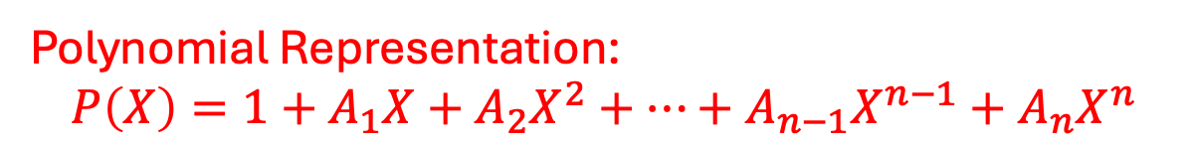
Binary Linear Feedback Shift Register
If A is 0, the XOR is eliminated.
Polynomial Representation:
$$P\left(X\right)=1+A_{1}X+A_{2}X^{2}+…+A_{n−1}X^{n−1}+A_{n}X^{n}$$

Slide 19

4-Bit LFSR Example
B₄=B₀$⨁$B₁
The period is 2^{n}-1.

Slide 20
Summary: TRNG, PRG, and stream cipher
TRNG collects physical entropy
Conditioning cleans raw source output
PRG stretches a short seed efficiently
Stream cipher uses pseudorandom keystream for encryption
Seed/key reuse is dangerous

