Slide 1
Public Key Cryptography and RSA
Dr. Xinyue Zhang
Assistant Professor
Department of Computer Science
Kennesaw State University
Marietta, GA, USA

Slide 2
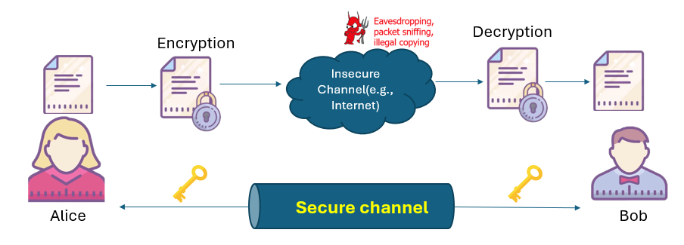
Private-Key Cryptography
Symmetric, parties are equal
Require secure channel for key distribution, impossible for two parties having no prior relationship
Needs many keys for n parties to communicate

Slide 3
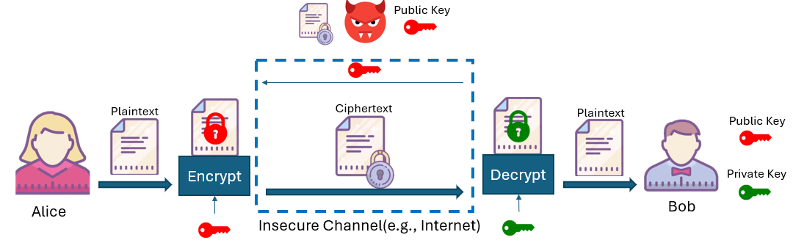
Public-Key Cryptography
Uses two keys – a public & a private key
Receiver needs to “publish” an encryption key, which is known as the public key.
Receiver needs a unique decryption key, which is known as the private key.

Slide 4
Public-Key Cryptography (cont. pg2)
Asymmetric since parties are not equal
It should not be possible to deduce the plaintext from knowledge of the ciphertext and the public key.

Slide 5
Public-Key Cryptography (cont. pg3)
Pros: No need for a secure channel
Cons: HIGH computation overhead

Slide 6
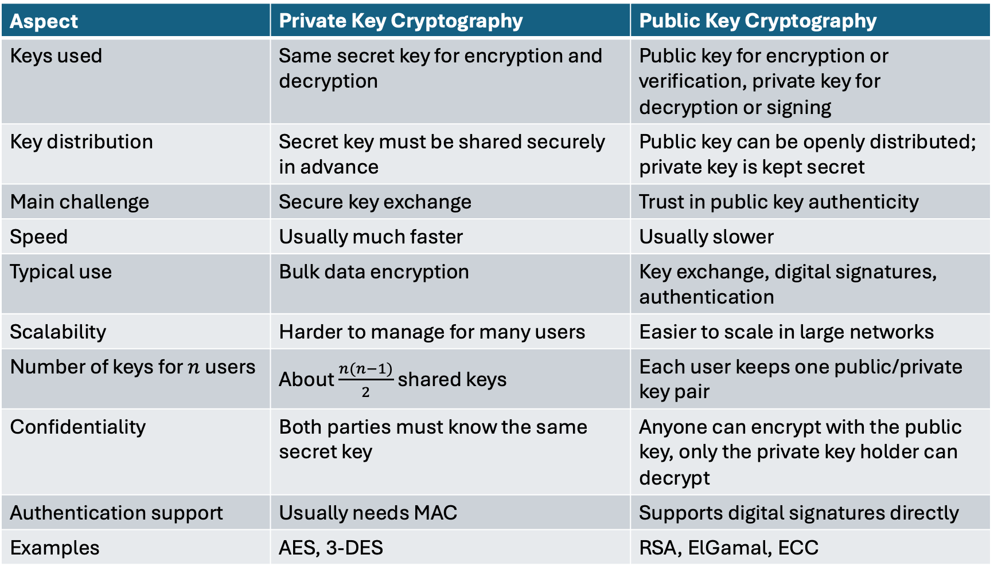
Public Key Cryptography vs Private Key Cryptography
Aspect | Private Key Cryptography | Public Key Cryptography
Keys used | Same secret key for encryption and decryption | Public key for encryption or verification, private key for decryption or signing
Key distribution | Secret key must be shared securely in advance | Public key can be openly distributed; private key is kept secret
Main challenge | Secure key exchange | Trust in public key authenticity
Speed | Usually much faster | Usually slower
Typical use | Bulk data encryption | Key exchange, digital signatures, authentication
Scalability | Harder to manage for many users | Easier to scale in large networks
Number of keys for $n$ users | About $\frac{n(n−1)}{2}$ shared keys | Each user keeps one public/private key pair
Confidentiality | Both parties must know the same secret key | Anyone can encrypt with the public key, only the private key holder can decrypt
Authentication support | Usually needs MAC | Supports digital signatures directly
Examples | AES, 3-DES | RSA, ElGamal, ECC

Slide 7
Applications of Public Key Cryptography
1. Secure key exchange
Used to establish a shared secret over an insecure channel
Then symmetric encryption is used for actual data transmission
2. Encryption for confidentiality
Anyone can encrypt using the recipient’s public key
Only the recipient can decrypt using the private key
3. Digital signatures
Sender signs with private key
Others verify with public key
Provides authenticity and integrity
4. Authentication
Confirms the identity of a user, server, or device
Common in certificates and login protocols
5. Public key infrastructure (PKI)
Supports digital certificates
Binds public keys to identities
6. Secure Internet communication
Used in TLS/HTTPS, email security, VPNs, and software signing

Slide 8
One-Way Trapdoor Function
A one-way trapdoor function is a function that is:
easy to compute in the forward direction
hard to invert without special information
easy to invert if the trapdoor information is known
It is the core idea behind public key cryptography.
Public key defines the forward computation
Private key is the trapdoor
Anyone can apply the function
Only the private key holder can efficiently reverse it
A trap-door one-way function f_{k} with k is the key, such that
Y = f_{k}(X) easy, if k and X are known
X = f_{k}^{–1}(Y) easy, if k and Y are known
X = f_{k}^{–1}(Y) infeasible, if Y known but k not known

Slide 9


RSA
The RSA public key encryption algorithm was the first practical implementation of public key encryption.
It remains the most used public key encryption algorithm today.
Detailed information of an email
RSA is used in the TLS protocol

Slide 10
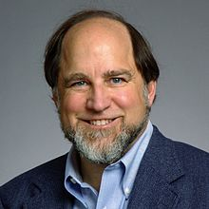


RSA History
It is named after the three researchers Ron Rivest, Adi Shamir and Leonard Adleman in 1977 at MIT.
Is a cipher in which the plaintext and ciphertext are integers between 0 and n – 1 for some n
A typical size for n is 1024 bits, or 309 decimal digits

Slide 11
RSA Steps
Key generation
Encryption
Decryption

Slide 12

Key Generation (page 1)
RSA Key Generation Output: public key: k_{pub} = (n, e) and private key: k_{pr} = d 1. Choose two large primes p and q. 2. Compute n = p·q. 3. Compute Φ(n) = (p−1)(q−1). 4. Select the public exponent e ∈ {1,2,...,Φ(n)−1} such that gcd(e,Φ(n)) = 1.
5. Compute the private key d such that d· e ≡ 1 mod Φ(n)
Remark:
p and q $≥2^{512}$ and n $≥2^{1024}$
1.choose p = 11 and q = 17
2. n = p · q = 187
3. Φ(n) = (p−1)(q−1) = 160
4. choose e = 7
5. 160k+1=161,321,481
161 is divisible by 7, giving d=161/7=23
d ≡e⁻¹ ≡ 23 mod 160
The Euclidean Algorithm can be used to calculate greatest common divisor (gcd).
The Extended Euclidean Algorithm (EEA) can be used to calculate modular inverse.
Ref: Euclidean Algorithm https://www.di-mgt.com.au/euclidean.html

Slide 13
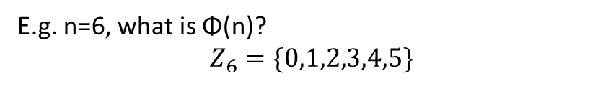
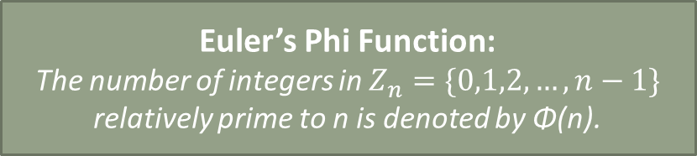
Key Generation (page 2)
RSA Key Generation Output: public key: k_{pub} = (n, e) and private key: k_{pr} = d 1. Choose two large primes p and q. 2. Compute n = p·q. 3. Compute Φ(n) = (p−1)(q−1). 4. Select the public exponent e ∈ {1,2,...,Φ(n)−1} such that gcd(e,Φ(n)) = 1.
5. Compute the private key d such that d· e ≡ 1 mod Φ(n)
Remark:
p and q $≥2^{512}$ and n $≥2^{1024}$
What is Φ(n)? Why we use it in key generation?
Euler’s Phi Function:
The number of integers in $Z_{n}=\{0,1,2,…,n−1\}$ relatively prime to n is denoted by Φ(n).
E.g. n=6, what is Φ(n)?
$$Z_{6}=\{0,1,2,3,4,5\}$$
1
2
3
2
1
Two numbers are relatively prime to 6, namely 1 and 5.
The phi function takes the value 2, i.e., Φ(6) = 2.
gcd(0,6)=6
gcd(1,6)=
gcd(2,6)=
gcd(3,6)=
gcd(4,6)=
gcd(5,6)=
Ref: Euler’s Phi Function https://www.whitman.edu/mathematics/higher_math_online/section03.08.html

Slide 14
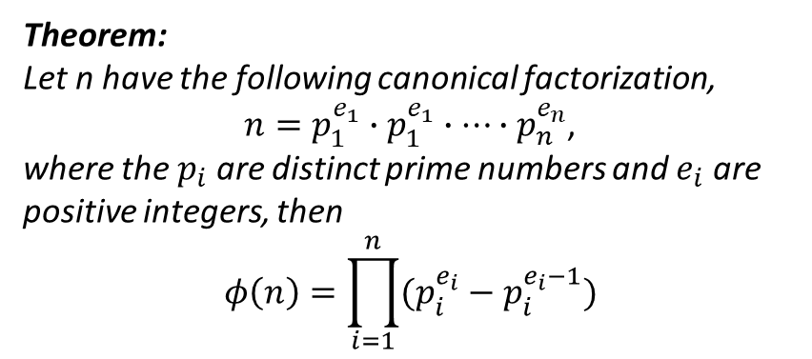
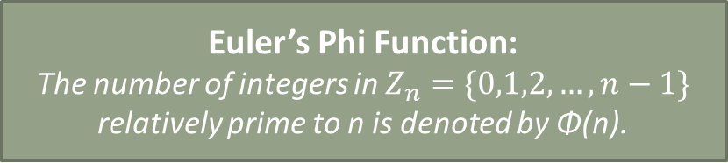
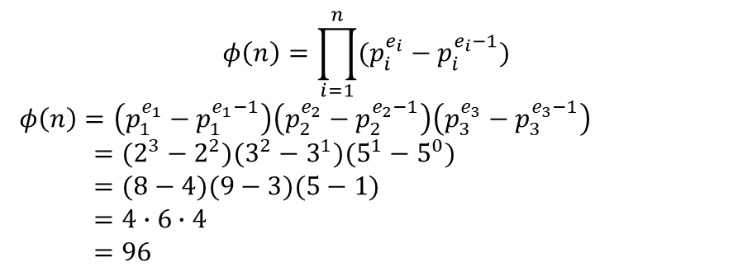
Key Generation (page 3)
Euler’s Phi Function:
The number of integers in $Z_{n}=\{0,1,2,…,n−1\}$ relatively prime to n is denoted by Φ(n).
Theorem:
Let n have the following canonical factorization,
$n=p_{1}^{e_{1}}∙p_{1}^{e_{1}}∙…∙p_{n}^{e_{n}}$,
where the $p_{i}$ are distinct prime numbers and $e_{i}$ are positive integers, then
$$φ\left(n\right)=\prod_{i=1}^{n}{(p_{i}^{e_{i}}−p_{i}^{e_{i}−1})}$$
RSA Key Generation Output: public key: k_{pub} = (n, e) and private key: k_{pr} = d 1. Choose two large primes p and q. 2. Compute n = p·q. 3. Compute Φ(n) = (p−1)(q−1). 4. Select the public exponent e ∈ {1,2,...,Φ(n)−1} such that gcd(e,Φ(n)) = 1.
5. Compute the private key d such that d· e ≡ 1 mod Φ(n)
Remark:
p and q $≥2^{512}$ and n $≥2^{1024}$
E.g. $n=360=8∙9∙5=2^{3}3^{2}5^{1}$, what is Φ(n)?
$$φ\left(n\right)=\prod_{i=1}^{n}{(p_{i}^{e_{i}}−p_{i}^{e_{i}−1})}$$
$φ\left(n\right)=\left(p_{1}^{e_{1}}−p_{1}^{e_{1}−1}\right)\left(p_{2}^{e_{2}}−p_{2}^{e_{2}−1}\right)\left(p_{3}^{e_{3}}−p_{3}^{e_{3}−1}\right)$
$=(2^{3}−2^{2})(3^{2}−3^{1})(5^{1}−5^{0})$
$=(8−4)(9−3)(5−1)$
$=4∙6∙4$
$=96$
Ref: Euler’s Phi Function https://www.whitman.edu/mathematics/higher_math_online/section03.08.html

Slide 15
Encryption & Decryption
RSA Encryption
Given the public key k_{pub} = (n, e) and the plaintext x, the encryption function is:
$y=e_{k_{pub}}\left(x\right)≡x^{e} mod n$
where $x∈ℤn=\{0,1,…,n−1\}.$
RSA Decryption
Given the private key k_{pr} = d and the ciphertext y, the decryption function is:
$x=d_{k_{pr}}\left(y\right)≡y^{d} mod n$
where $y∈ℤn$.
Exponentiation is computationally intense.

Slide 16
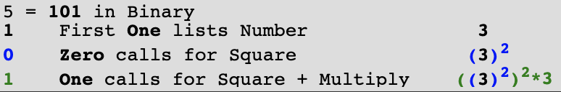
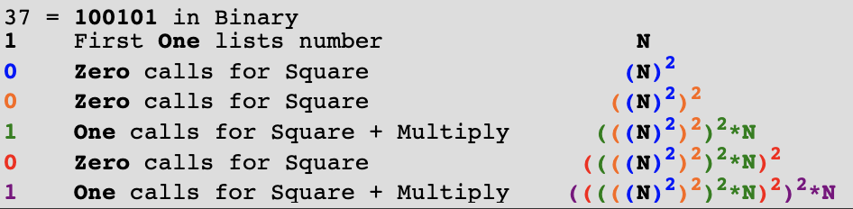
Square and Multiply Algorithm
Convert the exponent to Binary.
For the first 1, simply list the number
For each ensuing 0, do Square operation
For each ensuing 1, do Square and Multiply operations

Slide 17


RSA Example
RSA Key Generation Output: public key: k_{pub} = (n, e) and private key: k_{pr} = d 1. Choose two large primes p and q. 2. Compute n = p·q. 3. Compute Φ(n) = (p−1)(q−1). 4. Select the public exponent e ∈ {1,2,...,Φ(n)−1} such that gcd(e,Φ(n)) = 1.
5. Compute the private key d such that d· e ≡ 1 mod Φ(n)
1.choose p = 3 and q = 11
2. n = p · q = 33
3. Φ(n) = (p−1)(q−1) = 20
4. choose e = 3
message x = 4
5. d ≡e⁻¹ ≡ 7 mod 20
Alice
k_{pub} = (n, e)
Bob
y
$x≡y^{d} mod n$
$≡317 mod 33$
$≡{(−2)}^{7} mod 33$
$≡−128 mod 33$
$≡−4\left(33\right)+4 mod 33$
$≡4$
$y ≡ xe mod n$
$≡43 mod 33$
$≡64 mod 33$
$≡31$

Slide 18
RSA Example: From Text to Ciphertext
Encrypt: c = m^e mod n
Decrypt: m = c^d mod n
1. Public key setup
2. Encode the plaintext
3. Encrypt each block
Choose toy RSA parameters:
• p = 61, q = 53
• n = pq = 3233
• public key = (e, n) = (17, 3233)
• private key = (d, n) = (2753, 3233)
Anyone can use the public key to encrypt.
Message: “HI”
Use a simple mapping:
A = 01, B = 02, ... , Z = 26
So:
H → 08
I → 09
We encrypt each symbol as a small block:
m₁ = 8, m₂ = 9
Apply RSA encryption:
c = m^e mod n
For H:
c₁ = 8^17 mod 3233 = 2041
For I:
c₂ = 9^17 mod 3233 = 1972
Ciphertext sent: [2041, 1972]
In real RSA, n is hundreds or thousands of bits long.
Real systems use padding and standard encodings, not this toy mapping.
Receiver uses d = 2753 to recover 8 and 9, then decodes “HI”.
Note: this example shows the RSA workflow clearly, but actual RSA encryption must use secure padding (for example, OAEP), which will be introduced in the next lecture.

Slide 19
Summary
Public key cryptography uses two keys
Public/private key cryptography serve different purposes
Public key cryptography is useful for key exchange, authentication, and digital signatures; private key cryptography is faster for bulk data encryption
Trapdoor one-way functions are the foundation
The public operation is easy to compute, but reversing it is hard without the private key
Modular exponentiation is the core RSA operation
The square-and-multiply algorithm makes encryption and decryption practical
In practice, public key cryptography is usually combined with symmetric cryptography
Public key methods establish trust or keys, and symmetric methods handle fast data encryption

