Slide 1
Public Key Cryptography and RSA
Dr. Xinyue Zhang
Assistant Professor
Department of Computer Science
Kennesaw State University
Marietta, GA, USA

Slide 2
RSA
Key generation
Encryption
Decryption

Slide 3

Key Generation
RSA Key Generation Output: public key: k_{pub} = (n, e) and private key: k_{pr} = d 1. Choose two large primes p and q. 2. Compute n = p·q. 3. Compute Φ(n) = (p−1)(q−1). 4. Select the public exponent e ∈ {1,2,...,Φ(n)−1} such that gcd(e,Φ(n)) = 1.
5. Compute the private key d such that d· e ≡ 1 mod Φ(n)
Remark:
p and q $≥2^{512}$ and n $≥2^{1024}$

Slide 4
Encryption & Decryption
RSA Encryption
Given the public key k_{pub} = (n, e) and the plaintext x, the encryption function is:
$y=e_{k_{pub}}\left(x\right)≡x^{e} mod n$
where $x∈ℤn=\{0,1,…,n−1\}.$
RSA Decryption
Given the private key k_{pr} = d and the ciphertext y, the decryption function is:
$x=d_{k_{pr}}\left(y\right)≡y^{d} mod n$
where $y∈ℤn$.
Exponentiation is computationally intense.

Slide 5

Key Generation
RSA Key Generation Output: public key: k_{pub} = (n, e) and private key: k_{pr} = d 1. Choose two large primes p and q. 2. Compute n = p·q. 3. Compute Φ(n) = (p−1)(q−1). 4. Select the public exponent e ∈ {1,2,...,Φ(n)−1} such that gcd(e,Φ(n)) = 1.
5. Compute the private key d such that d· e ≡ 1 mod Φ(n)
Remark:
p and q $≥2^{512}$ and n $≥2^{1024}$
How to choose the value of e?
Ref: Euclidean Algorithm https://www.di-mgt.com.au/euclidean.html

Slide 6
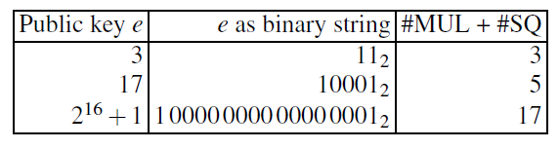

Key Generation
How to choose the value of e?
Encryption: $y=e_{k_{pub}}\left(x\right)≡x^{e} mod n$
Efficient Exponentiation
Square and Multiply Algorithm*
RSA Key Generation Output: public key: k_{pub} = (n, e) and private key: k_{pr} = d 1. Choose two large primes p and q. 2. Compute n = p·q. 3. Compute Φ(n) = (p−1)(q−1). 4. Select the public exponent e ∈ {1,2,...,Φ(n)−1} such that gcd(e,Φ(n)) = 1.
5. Compute the private key d such that d· e ≡ 1 mod Φ(n)
Remark:
p and q $≥2^{512}$ and n $≥2^{1024}$
*Ref: Square and Multiply Algorithm. https://www.practicalnetworking.net/stand-alone/square-and-multiply/

Slide 7
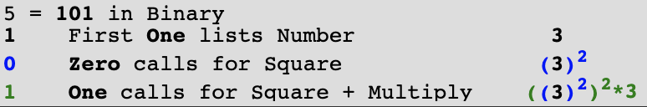
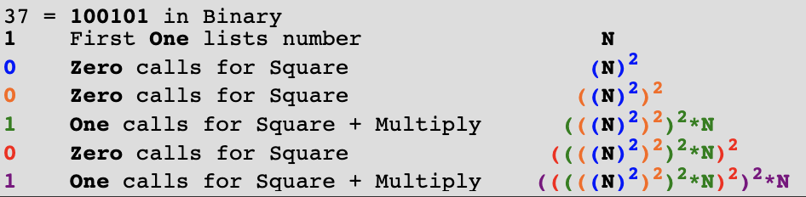
Square and Multiply Algorithm
Convert the exponent to Binary.
For the first 1, simply list the number
For each ensuing 0, do Square operation
For each ensuing 1, do Square and Multiply operations

Slide 8
Efficient Operation Using the Public Key
Normally, we need a specific choice of e for RSA
The most common choice is 65537 (2¹⁶ + 1)
Other two other popular choices are e=3 and e=17
The reason of these choices are:
Each of these choices has only two 1 bits, so the number of multiplications required to perform exponentiation is minimized
However, with a very small public key like e = 3, RSA becomes vulnerable to a simple attack

Slide 9

Key Generation
How to choose the value of e?
Special cases of e:
e=1?
If e=1, $y=e_{k_{pub}}\left(x\right)≡x^{1} mod n=x$.
e=3?
If e=3 and just encrypt a small message $x$ where $x^{3}<n$, ciphertext $y$can easily be broken by computing its real cube root.
E.g., the public key (n, e)=(25777,3), the small message $x$=10, then the ciphertext is $y$=1000. The attacker can easily find the plaintext $x$ by,
$$x=\sqrt[3]{y}=\sqrt[3]{1000}=10$$
Padding schemes
RSA Key Generation Output: public key: k_{pub} = (n, e) and private key: k_{pr} = d 1. Choose two large primes p and q. 2. Compute n = p·q. 3. Compute Φ(n) = (p−1)(q−1). 4. Select the public exponent e ∈ {1,2,...,Φ(n)−1} such that gcd(e,Φ(n)) = 1.
5. Compute the private key d such that d· e ≡ 1 mod Φ(n)
Remark:
p and q $≥2^{512}$ and n $≥2^{1024}$
*Ref: Optimal asymmetric encryption padding. https://en.wikipedia.org/wiki/Optimal_asymmetric_encryption_padding

Slide 10
Optimal Asymmetric Encryption Padding (OAEP)
Optional parameter
Message
Hash function
Data block
Mask generating function (a kind of hash function)
*Figure resource: Stallings, William. Cryptography and Network Security: Principles and Practice, 7th ed. England: Pearson Education Limited, 2017.

Slide 11
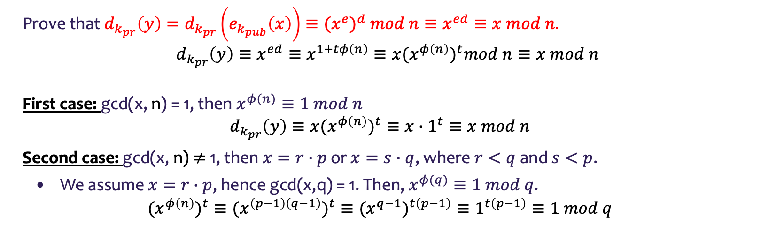

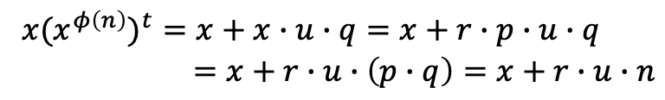

Proofs of Correctness
Prove that ${d_{k_{pr}}\left(y\right)=d}_{k_{pr}}\left(e_{k_{pub}}\left(x\right)\right)≡{(x}^{e})^{d} mod n≡x^{ed}≡x mod n.$
$$d_{k_{pr}}\left(y\right)≡x^{ed}≡x^{1+tφ\left(n\right)}≡x(x^{φ\left(n\right)})^{t}mod n≡x mod n$$
First case: gcd(x, n) = 1, then $x^{φ(n)}≡1 mod n$
$$d_{k_{pr}}\left(y\right)≡x(x^{φ\left(n\right)})^{t}≡x∙1^{t}≡x mod n$$
Second case: gcd(x, n) $≠$ 1, then $x=r∙p$ or $x=s∙q$, where $r<q$ and $s<p$.
We assume $x=r∙p$, hence gcd(x,q) = 1. Then, $x^{φ(q)}≡1 mod q$.
$$(x^{φ\left(n\right)})^{t}≡(x^{\left(p−1\right)\left(q−1\right)})^{t}≡(x^{q−1})^{t\left(p−1\right)}≡1^{t\left(p−1\right)}≡1 mod q$$
d· e ≡ 1 mod Φ(n)
d· e = 1 + tΦ(n)
Euler’s Theorem:
Let a and m be integers with gcd(a,m)=1, then:
$$a^{φ(m)}≡1 mod m$$
Fermat’s Little Theorem:
Any integer a and any prime number p, we have:
$a^{p}≡a mod p$.
If a is not divisible by p,
$$a^{p−1}≡1 mod p$$
$$(x^{φ\left(n\right)})^{t}=1+u∙q$$
$x(x^{φ\left(n\right)})^{t}=x+x∙u∙q=x+r∙p∙u∙q$
$=x+r∙u∙\left(p∙q\right)=x+r∙u∙n$
$$d_{k_{pr}}\left(y\right)=x(x^{φ\left(n\right)})^{t}≡x mod n$$
Ref: Fermat’s Little Theorem Fermat’s Little Theorem

Slide 12


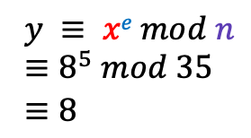
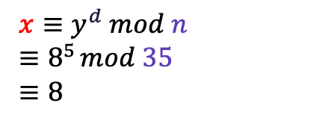
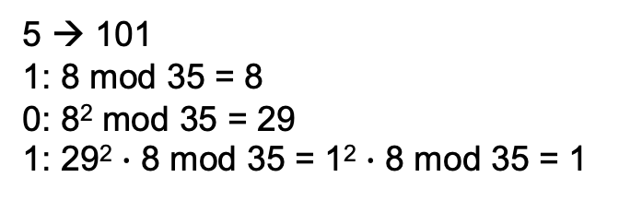
RSA Example
RSA Key Generation Output: public key: k_{pub} = (n, e) and private key: k_{pr} = d 1. Choose two large primes p and q. 2. Compute n = p·q. 3. Compute Φ(n) = (p−1)(q−1). 4. Select the public exponent e ∈ {1,2,...,Φ(n)−1} such that gcd(e,Φ(n)) = 1.
5. Compute the private key d such that d· e ≡ 1 mod Φ(n)
1.choose p = 7 and q = 5
2. n = p · q = 35
3. Φ(n) = (p−1)(q−1) = 24
4. choose e = 5
message x = 8
5. d ≡e⁻¹ ≡ 5 mod 24
Alice
k_{pub} = (n, e)
Bob
y
$x≡y^{d} mod n$
$≡8^{5} mod 35$
$≡8$
$y ≡ xe mod n$
$≡8^{5} mod 35$
$≡8$
5 → 101
1: 8 mod 35 = 8
0: 8² mod 35 = 29
1: 29² $∙$ 8 mod 35 = 1² $∙$ 8 mod 35 = 1

Slide 13
Key Generation
Before the application of the public-key cryptosystem each participant must generate a pair of keys:
Determine two prime numbers p and q
Select either e or d and calculate the other
Because the value of n = pq will be known to any potential adversary, primes must be chosen from a sufficiently large set
The method used for finding large primes must be reasonably efficient

Slide 14
Procedure for Picking a Prime Number
Pick an odd integer n at random
Pick an integer a < n at random
Perform the probabilistic primality test (such as Miller-Rabin) with a as a parameter. If n fails the test, reject the value n and go to step 1
If n has passed a sufficient number of tests, accept n; otherwise, go to step 2

Slide 15
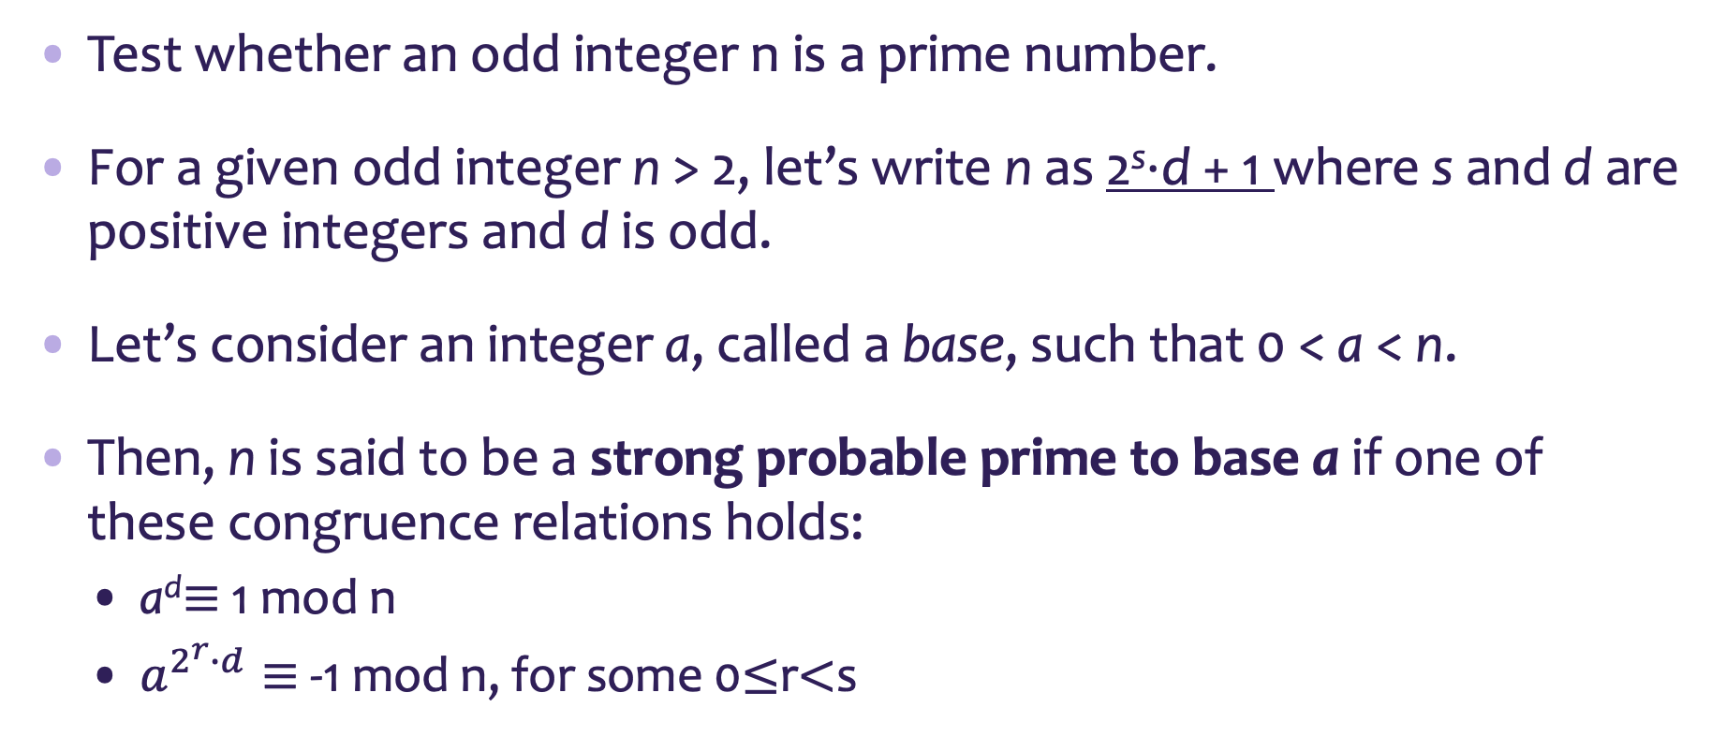
Miller–Rabin primality test
Test whether an odd integer n is a prime number.
For a given odd integer n > 2, let’s write n as 2^{s}⋅d + 1 where s and d are positive integers and d is odd.
Let’s consider an integer a, called a base, such that 0 < a < n.
Then, n is said to be a strong probable prime to base a if one of these congruence relations holds:
a^{d}$≡$1 mod n
$a^{2^{r}∙d}≡$-1 mod n, for some 0$≤$r$<$s

Slide 16
Why RSA Secure?
Prime Factorization
n = p · q
Here are two large prime numbers of 512 bits, about 150 decimal digits.
p = 109337661836325758176115170347306682871557999846322234541387456711212734562876
70008290843302875521274970245314593222946129064538358581018615539828479146469
q = 109106169673491102317237340786149226453370608821417489682098342251389760111799
93394299810159736904468554021708289824396553412180514827996444845438176099727
The public key n has 1024 bits. That is a number over 300 decimal digits long.
n =
11929413484016950905552721133125564964460656966152763801206748195494305685115033
38063159570377156202973050001186287708466899691128922122454571180605749959895170
80042105263427376322274266393116193517839570773505632231596681121927337473973220
312512599061231322250945506260066557538238517575390621262940383913963

Slide 17
RSA Security
In order to attack RSA, we can try the following methods:
Factor n into its two prime factors.
Then, we can calculate of ø(n) = (p – 1) x (q – 1), which in turn enables determination of d = e⁻¹ (mod ø(n))
Determine ø(n) directly without first determining p and q.
Again, this enables determination of d = e⁻¹ (mod ø(n))
Determine d directly without first determining ø(n)
However, none of them will be possible if we use large prime numbers p and q.

Slide 18
Summary
RSA algorithm details: key generation, encryption, decryption
Efficient modular exponentiation operation
Square and Multiply Algorithm
The choice of e
Padding algorithm
RSA security analysis
Prime factorization problem

