Slide 1
Diffie-Hellman Key Exchange
Dr. Xinyue Zhang
Assistant Professor
Department of Computer Science
Kennesaw State University
Marietta, GA, USA

Slide 2
Diffie-Hellman Key Exchange Intro
A number of commercial products employ this key exchange technique
Purpose is to enable two users to securely exchange a key that can then be used for subsequent symmetric encryption of messages
The algorithm itself is limited to the exchange of secret values
Its security depends on the difficulty of computing discrete logarithms

Slide 3
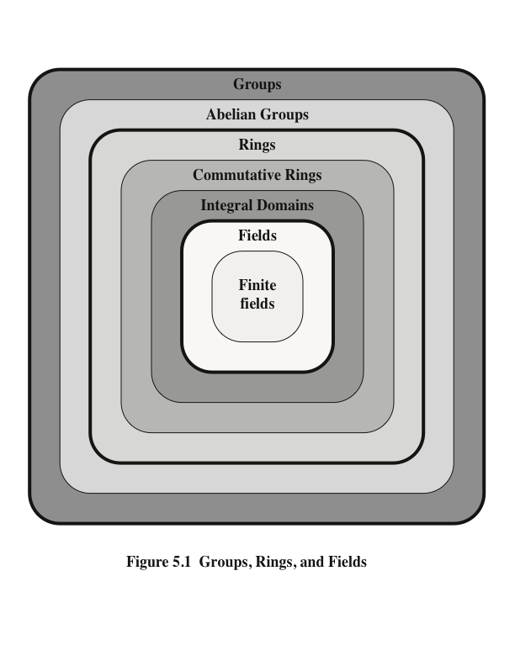
Groups, Rings and Fields
Abstract Algebra

Slide 4
Groups
A binary operation is a calculation that combines two elements to produce another element, such as addition, subtraction, multiplication, vector addition, matrix multiplication, etc.
Group G, also denoted by {G, *}
A set of elements with a binary operation denoted by * that associates to each ordered pair (a,b) of elements in G an element (a*b ) in G , such that the following axioms are obeyed:
(A1) Closure: If a and b belong to G, then a*b is also in G
(A2) Associative: a*(b*c) = (a*b)*c for all a, b, c in G
(A3) Identity element: There is an element e in G such that a*e = e*a = a for all a in G
(A4) Inverse element: For each a in G, there is an element a’ in G such that a*a’ = a’*a = e
(A5) Commutative:
a*b = b*a for all a, b in G
Abelian Group

Slide 5
Groups Examples
Yes!
Example 1: Is {Z, +} a group?
Z ={…,-4,-3,-2,-1,0,1,2,3,4, …}, operation: addition.
(A1) Closure: If a and b belong to G, then a+b is also in G
(A2) Associative: a+(b+c) = (a+b)+c for all a, b, c in G
(A3) Identity element: There is an element e in G such that a+e = e+a = a for all a in G. e=0
(A4) Inverse element: For each a in G, there is an element a’ in G such that a+a’ = a’ + a = 0
Example 2: Is {Z, *} a group?
Most of the elements do not have inverses in Z.
No!

Slide 6
Non-Abelian Group
S = {“”, “hello”, “OLLEH”, “world”, “DLROW”, “helloworld”, “worldhello”, …}
Operations:
‘+’: concatenation
Uppercase and lowercase letters are decreed to be inverses, meaning “Xx” == “xX” == “”, for any letter x whose uppercase version is X. “Desserts” + “STRESSEd” == “”
(A1) Closure: If a and b belong to G, then a*b is also in G
(A2) Associative: a*(b*c) = (a*b)*c for all a, b, c in G
(A3) Identity element: There is an element e in G such that a*e = e*a = a for all a in G
(A4) Inverse element: For each a in G, there is an element a’ in G such that a*a’ = a’*a = e
(A5) Commutative: a*b = b*a for all a, b in G (Cannot be satisfied)

Slide 7
Finite Abelian Group
Yes!
Is {Z₁₁*, Multiplication modulo 11} a finite abelian group?
Z₁₁*={1,2,3,4,5,6,7,8,9,10}
(A1) Closure: If a and b belong to G, then a*b mod 11 is also in G
(A2) Associative: a*(b*c mod 11) mod 11 = (a*b mod 11)*c mod 11 for all a, b, c in G
(A3) Identity element:
There is an element e=1 in G such that a*1 mod 11 = 1*a mod 11 = a for all a in G
(A4) Inverse element:
For each a in G, there is an element a’ in G such that a*a’ mod 11 = a’*a mod 11= 1
Because every element in Z₁₁* is relatively prime with 11. gcd(a, 11) = 1
(A5) Commutative:
a*b mod 11 = b*a mod 11, for all a, b in G

Slide 8
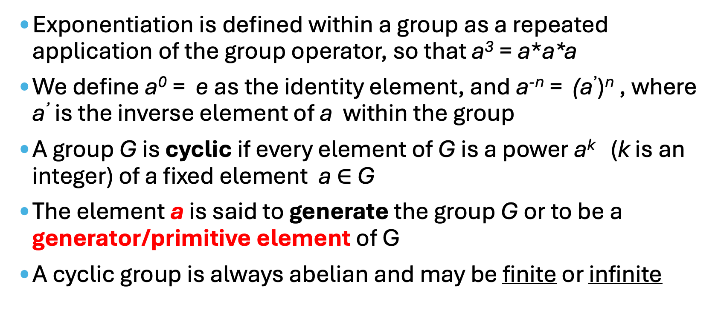
Cyclic Group
Exponentiation is defined within a group as a repeated application of the group operator, so that a³ = a*a*a
We define a⁰ = e as the identity element, and a^{-n} = (a’)^{n} , where a’ is the inverse element of a within the group
A group G is cyclic if every element of G is a power a^{k} (k is an integer) of a fixed element a $∈$ G
The element a is said to generate the group G or to be a generator/primitive element of G
A cyclic group is always abelian and may be finite or infinite

Slide 9
Cyclic Group (cont.)
Yes!
Example: Is {Z, +} a cyclic group?
Z ={…,-4,-3,-2,-1,0,1,2,3,4, …}
exponentiation: a³ = a+a+a
Identity element: 0, a⁰ = 0
Z ={…,a⁻³,a⁻²,a⁻¹,a⁰,a¹,a²,a³, …}
Generator/Primitive element: 1
The cyclic group is infinite

Slide 10
Finite Cyclic Group
Yes!
Example: Is {Z₁₁*, Multiplication modulo 11} a cyclic group?
Z₁₁*={1,2,3,4,5,6,7,8,9,10}, can you find the generator?
If the generator $a$ is 2,
$a^{1}mod 11=2$
$a^{2}mod 11=4$
$a^{3}mod 11=8$
$a^{4}mod 11=16 mod 11=5$
$a^{5}mod 11=5×2 mod 11=10$
$a^{6}mod 11=10×2 mod 11=9$
$a^{7}mod 11=9×2 mod 11=7$
$a^{8}mod 11=7×2 mod 11=3$
$a^{9}mod 11=3×2 mod 11=6$
$a^{10}mod 11=6×2 mod 11=1$
$a^{11}mod 11=1×2 mod 11=2$
Is there any other generators?
Generators: 2,6,7,8

Slide 11
Diffie-Hellman Key Exchange Steps

Slide 12
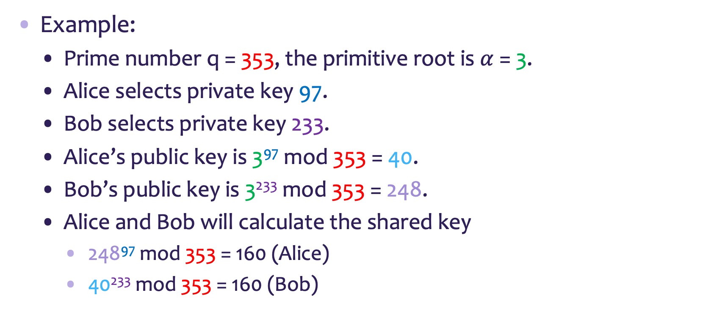
Diffie-Hellman Key Exchange Example
Example:
Prime number q = 353, the primitive root is $α$ = 3.
Alice selects private key 97.
Bob selects private key 233.
Alice’s public key is 3⁹⁷ mod 353 = 40.
Bob’s public key is 3²³³ mod 353 = 248.
Alice and Bob will calculate the shared key
248⁹⁷ mod 353 = 160 (Alice)
40²³³ mod 353 = 160 (Bob)

Slide 13
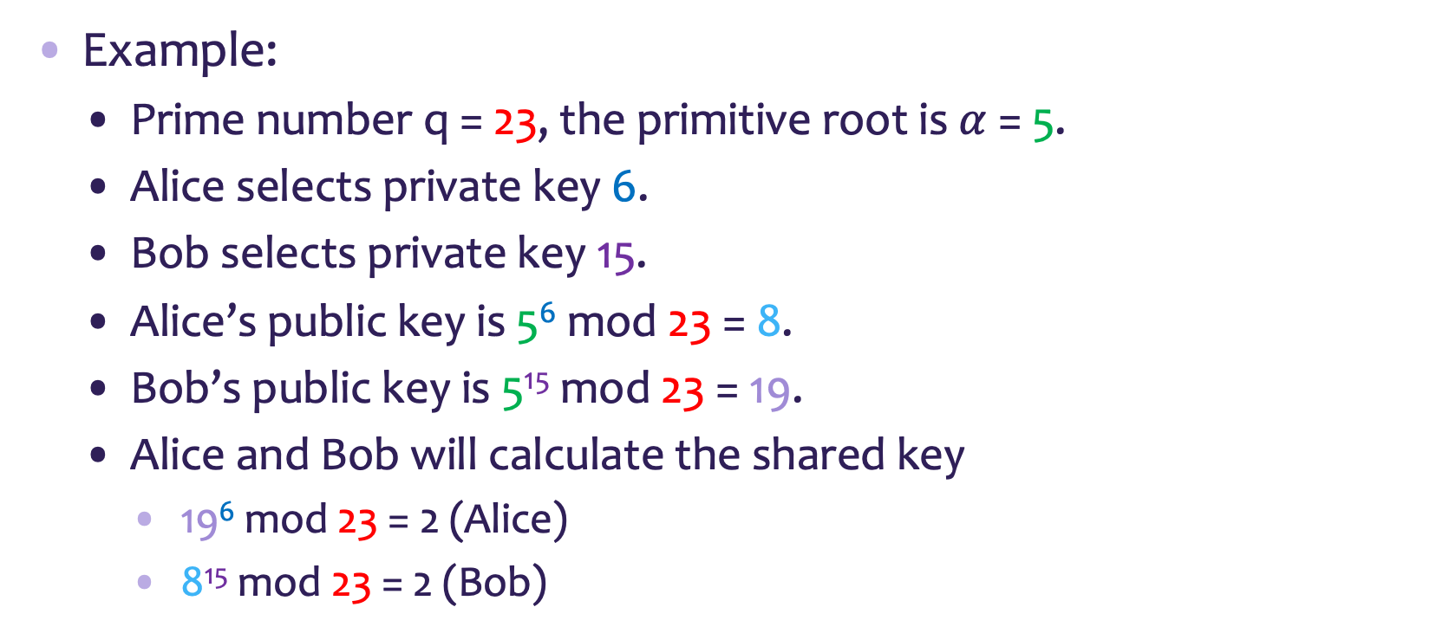
Diffie-Hellman Key Exchange Example (cont.)
Example:
Prime number q = 23, the primitive root is $α$ = 5.
Alice selects private key 6.
Bob selects private key 15.
Alice’s public key is 5⁶ mod 23 = 8.
Bob’s public key is 5¹⁵ mod 23 = 19.
Alice and Bob will calculate the shared key
19⁶ mod 23 = 2 (Alice)
8¹⁵ mod 23 = 2 (Bob)

Slide 14
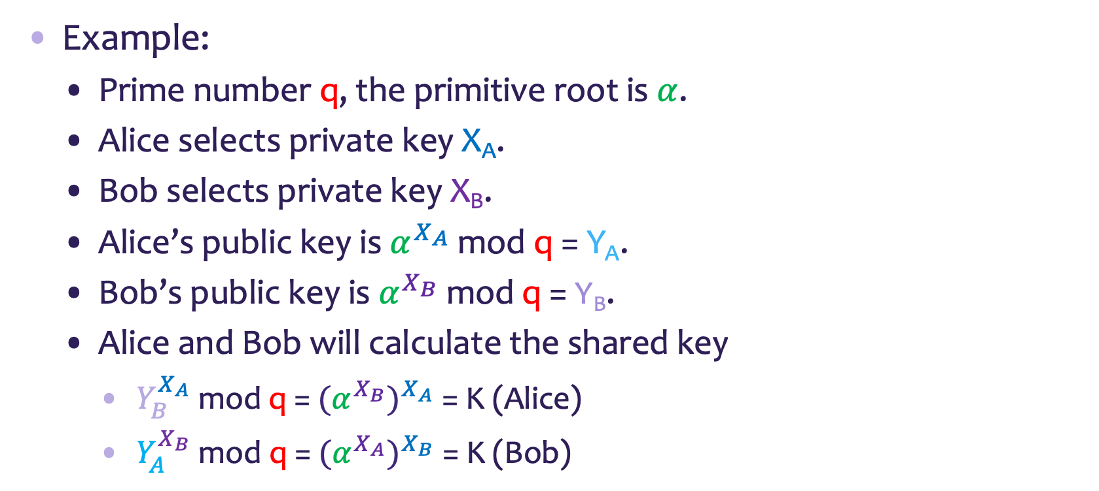
Diffie-Hellman Key Exchange Representation
Example:
Prime number q, the primitive root is $α$.
Alice selects private key X_{A}.
Bob selects private key X_{B}.
Alice’s public key is $α^{X_{A}}$ mod q = Y_{A}.
Bob’s public key is $α^{X_{B}}$ mod q = Y_{B}.
Alice and Bob will calculate the shared key
$Y_{B}^{X_{A}}$ mod q = $(α^{X_{B}})^{X_{A}}$ = K (Alice)
$Y_{A}^{X_{B}}$ mod q = $(α^{X_{A}})^{X_{B}}$= K (Bob)

Slide 15
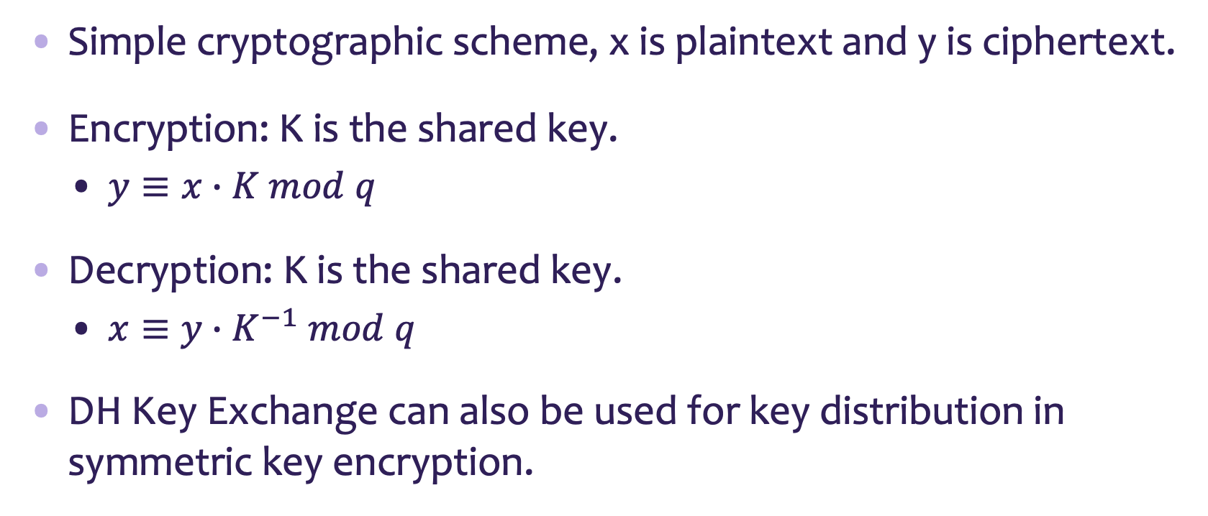
Encryption with DH Key Exchange
Simple cryptographic scheme, x is plaintext and y is ciphertext.
Encryption: K is the shared key.
$y≡x∙K mod q$
Decryption: K is the shared key.
$x≡y∙K^{−1} mod q$
DH Key Exchange can also be used for key distribution in symmetric key encryption.

Slide 16
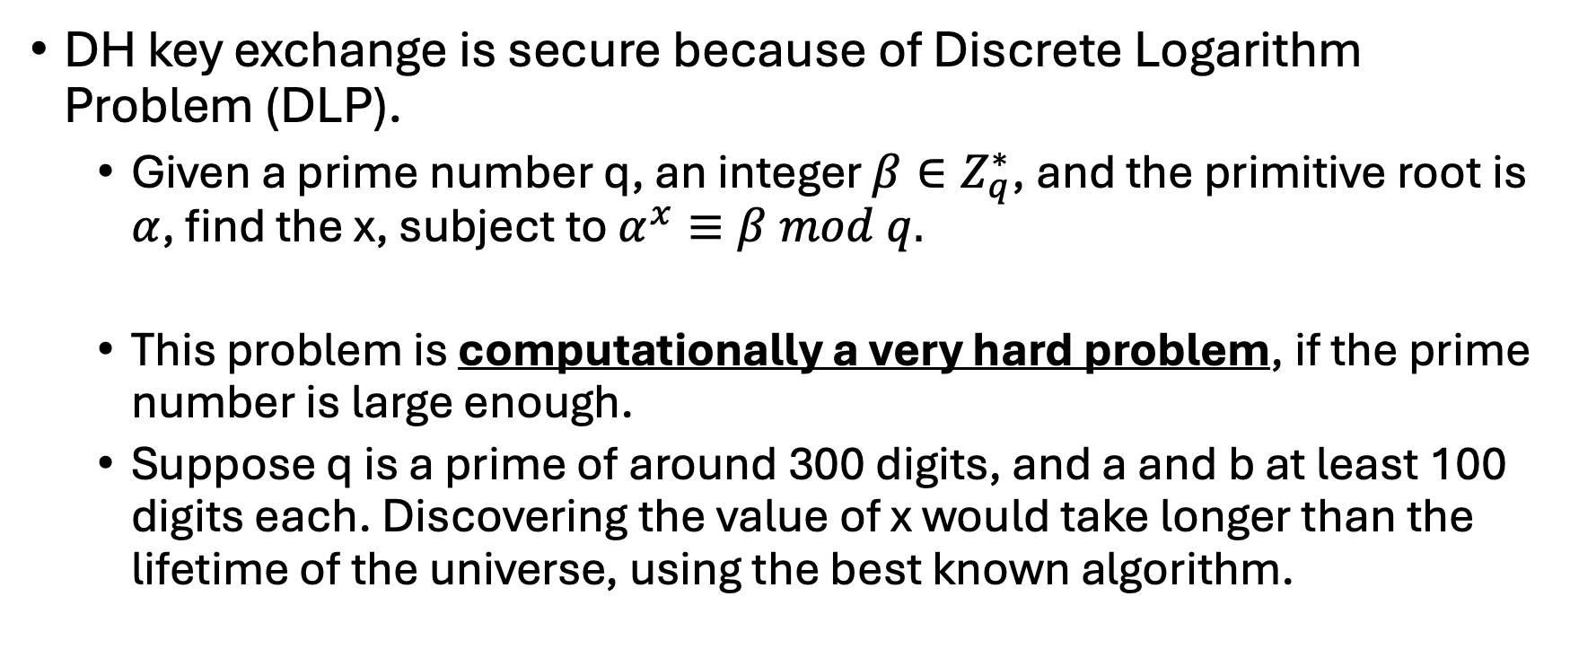
Security
DH key exchange is secure because of Discrete Logarithm Problem (DLP).
Given a prime number q, an integer $β∈Z_{q}^{∗}$, and the primitive root is $α$, find the x, subject to $α^{x}≡β mod q.$
This problem is computationally a very hard problem, if the prime number is large enough.
Suppose q is a prime of around 300 digits, and a and b at least 100 digits each. Discovering the value of x would take longer than the lifetime of the universe, using the best known algorithm.

Slide 17
Summary
Group
Cyclic Group
Generator
Use the generator, we can generate all elements in the cyclic group.
Diffie-Hellman Key Exchange
Security of the DH key exchange
Discrete Logarithm Problem

