Slide 1
Modular Arithmetic
Dr. Xinyue Zhang
Assistant Professor
Department of Computer Science
Kennesaw State University
Marietta, GA, USA

Slide 2
Outline
Review of Private-Key Cryptography & Public-Key Cryptography
Divisibility
Greatest Common Divisor & Euclidean Algorithm
Modular Arithmetic

Slide 3






Private-Key Cryptography
Symmetric, parties are equal
Require secure channel for key distribution, impossible for two parties having no prior relationship
Needs many keys for n parties to communicate
Decryption
Encryption
Insecure Channel(e.g., Internet)
Alice
Secure channel
Bob

Slide 4





Public-Key Cryptography
Asymmetric since parties are not equal
It should not be possible to deduce the plaintext from knowledge of the ciphertext and the public key.
Public Key
Plaintext
Ciphertext
Plaintext
Public Key
Encrypt
Decrypt
Private Key
Alice
Bob
Insecure Channel(e.g., Internet)

Slide 5
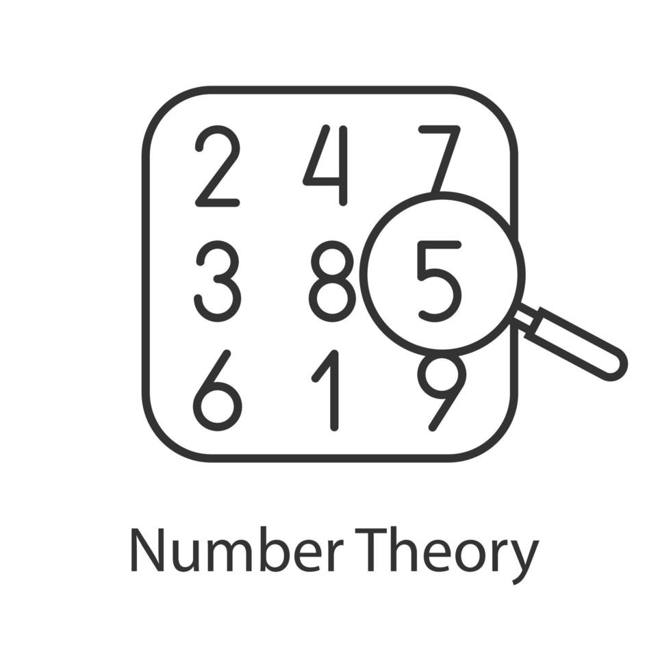
Number Theory
Why Do We Need Number Theory?
Cryptographic algorithms operate on integers
Security relies on hard mathematical problems
Modular arithmetic enables efficient computation

Slide 6
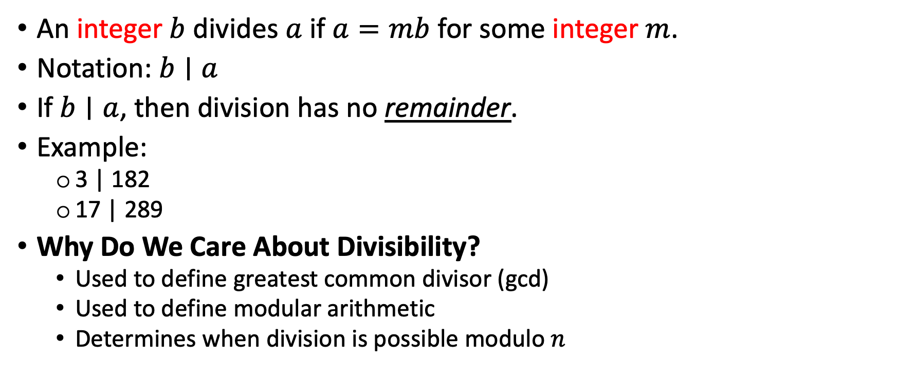
Divisibility
An integer $b$ divides $a$ if $a=mb$ for some integer $m$.
Notation: $b∣a$
If $b∣a$, then division has no remainder.
Example:
3 | 182
17 | 289
Why Do We Care About Divisibility?
Used to define greatest common divisor (gcd)
Used to define modular arithmetic
Determines when division is possible modulo $n$

Slide 7
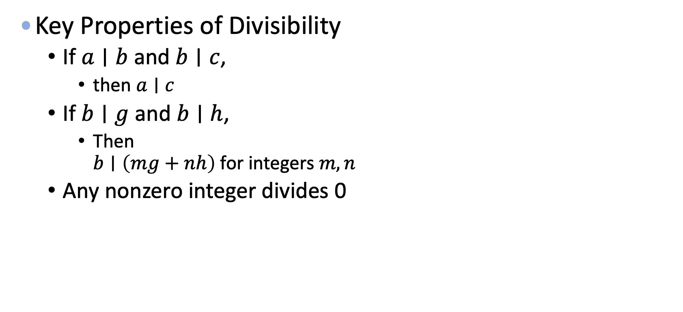
Properties of Divisibility
Key Properties of Divisibility
If $a∣b$ and $b∣c$,
then $a∣c$
If $b∣g$ and $b∣h$,
Then $b∣\left(mg+nh\right)$ for integers $m,n$
Any nonzero integer divides 0

Slide 8
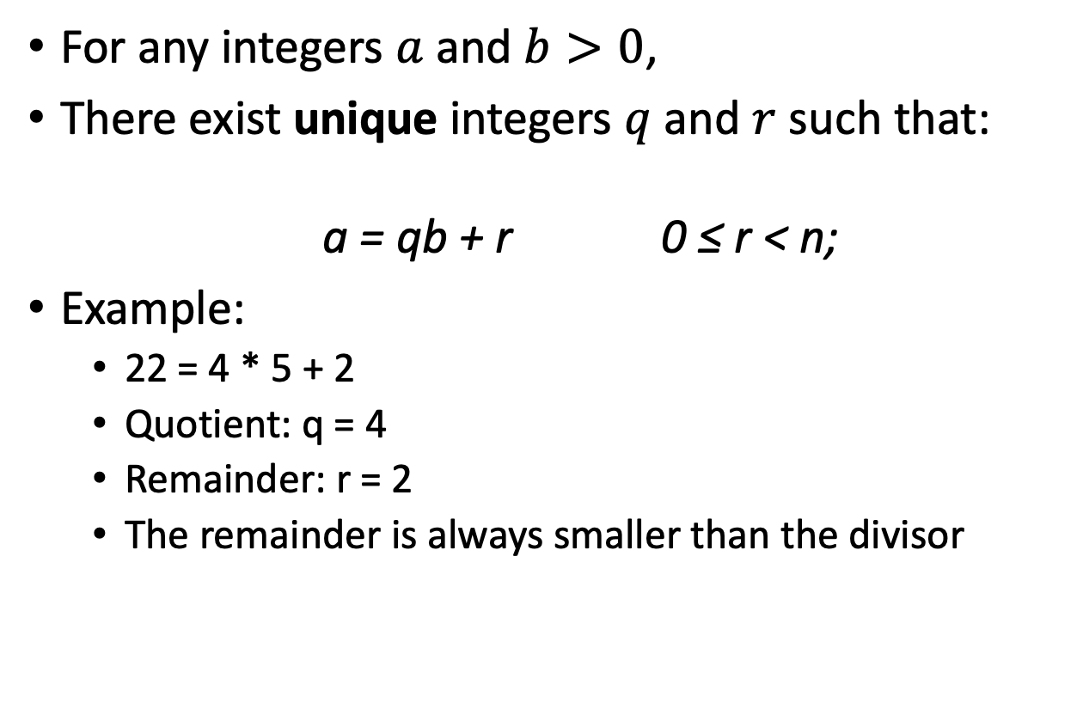
Division Algorithm
For any integers $a$ and $b>0$,
There exist unique integers $q$ and $r$ such that:
a = qb + r 0 ≤ r < n;
Example:
22 = 4 * 5 + 2
Quotient: q = 4
Remainder: r = 2
The remainder is always smaller than the divisor
Basis of modular arithmetic
Used in the Euclidean Algorithm
Enables efficient computation

Slide 9
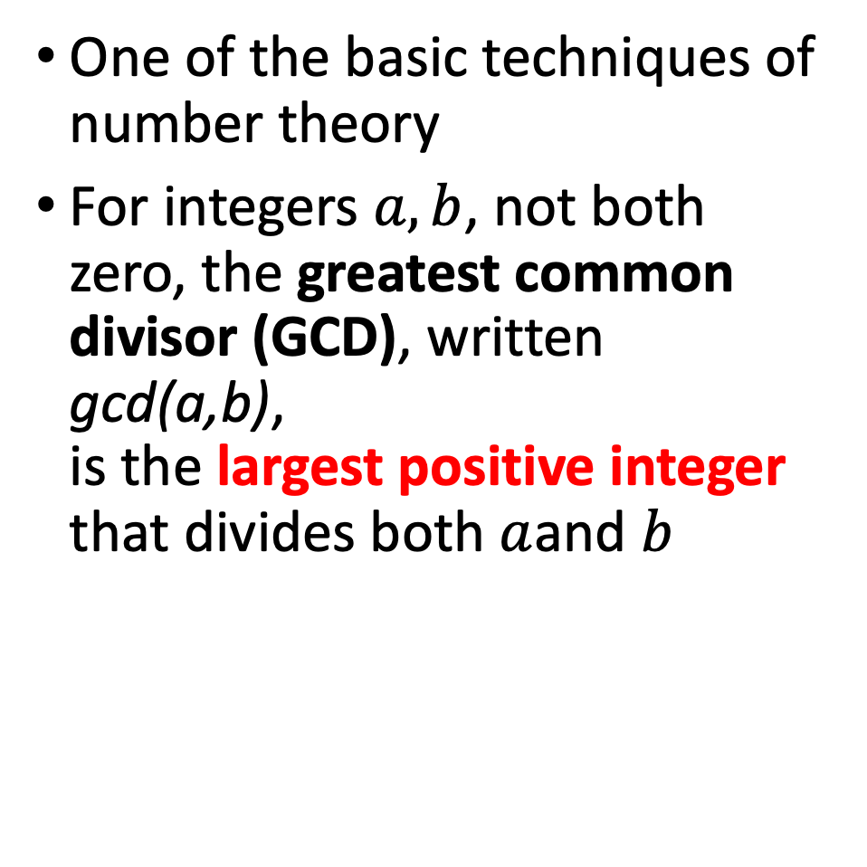
Greatest Common Divisor & Euclidean Algorithm
One of the basic techniques of number theory
For integers $a,b$, not both zero, the greatest common divisor (GCD), written gcd(a,b), is the largest positive integer that divides both $a$and $b$

Slide 10
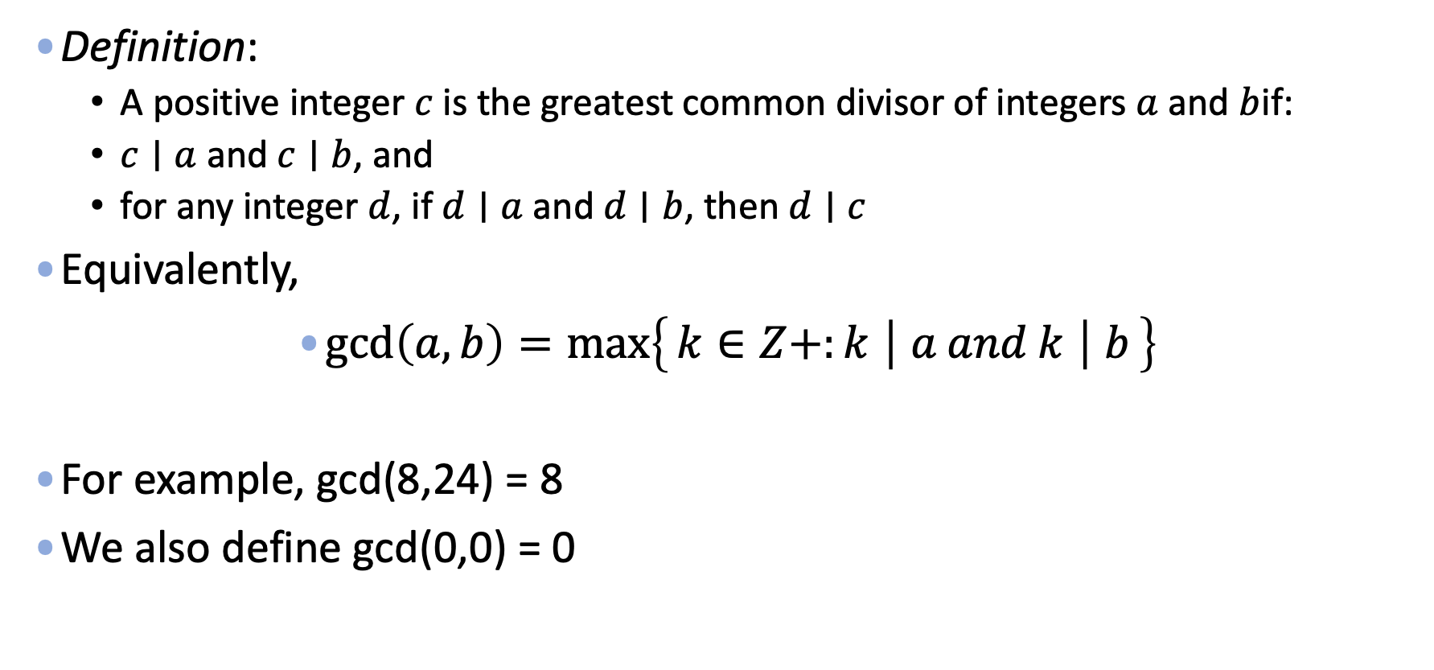
Greatest Common Divisor (GCD)
Definition:
A positive integer $c$ is the greatest common divisor of integers $a$ and $b$if:
$c∣a$ and $c∣b$, and
for any integer $d$, if $d∣a$ and $d∣b$, then $d∣c$
Equivalently,
$\gcd\left(a,b\right)=\max\left\{k∈Z+:k ∣ a and k ∣ b\right\}$
For example, gcd(8,24) = 8
We also define gcd(0,0) = 0

Slide 11
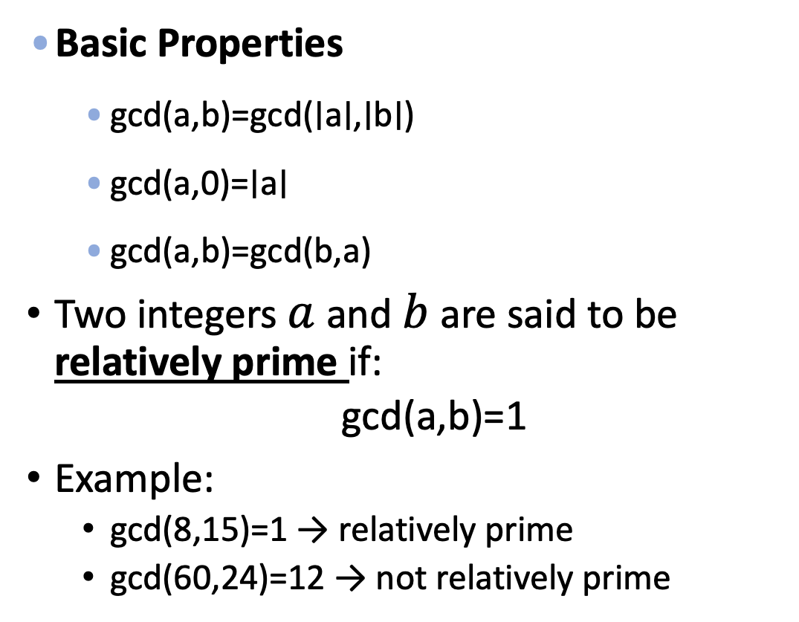
GCD
The greatest common divisor is used to:
Test whether two numbers are relatively prime
Determine whether modular inverses exist
Construct and validate cryptographic keys
Detect weak or incorrectly generated parameters
Basic Properties
gcd(a,b)=gcd(∣a∣,∣b∣)
gcd(a,0)=∣a∣
gcd(a,b)=gcd(b,a)
Two integers $a$ and $b$ are said to be relatively prime if:
gcd(a,b)=1
Example:
gcd(8,15)=1 → relatively prime
gcd(60,24)=12 → not relatively prime

Slide 12
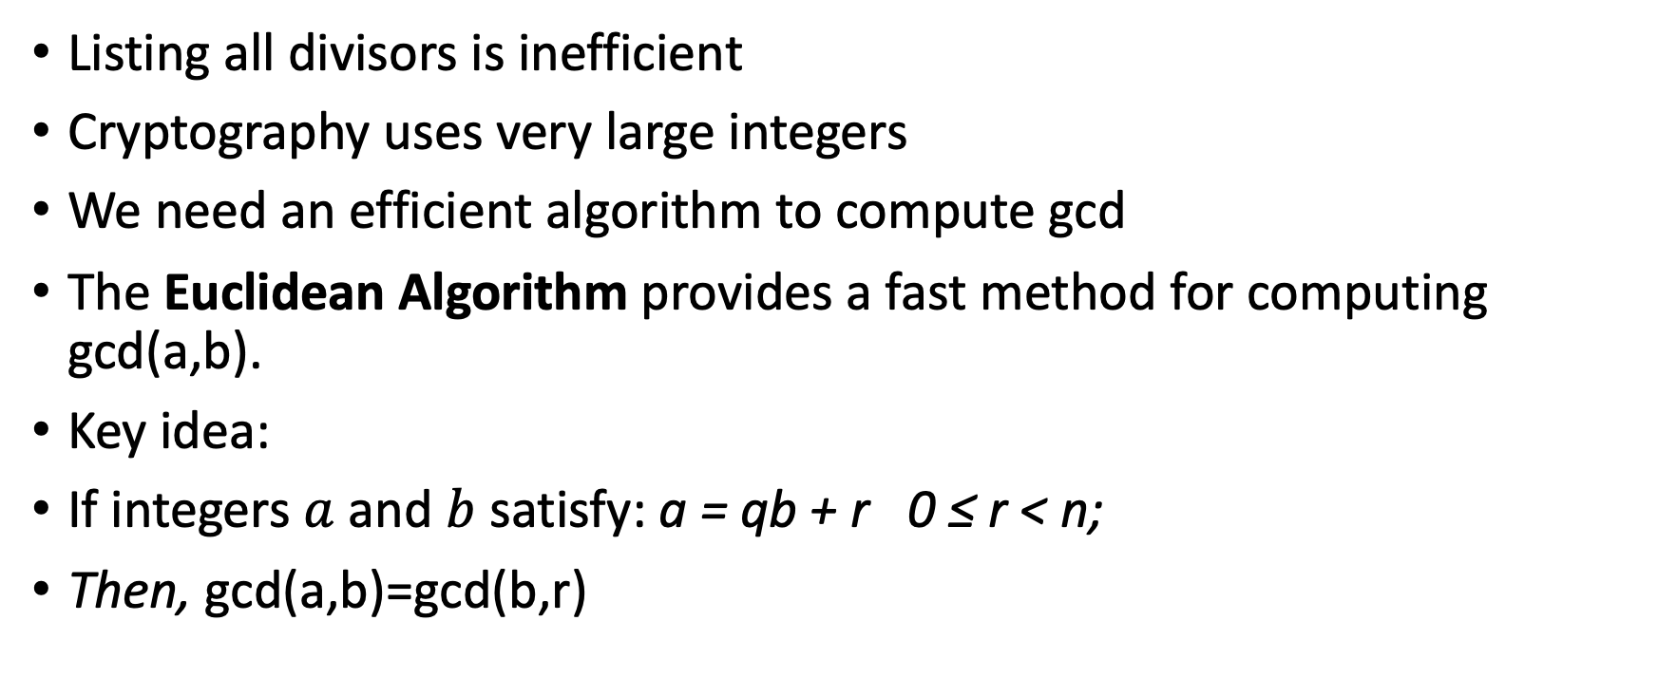
How to Compute GCD Efficiently?
Listing all divisors is inefficient
Cryptography uses very large integers
We need an efficient algorithm to compute gcd
The Euclidean Algorithm provides a fast method for computing gcd(a,b).
Key idea:
If integers $a$ and $b$ satisfy: a = qb + r 0 ≤ r < n;
Then, gcd(a,b)=gcd(b,r)

Slide 13
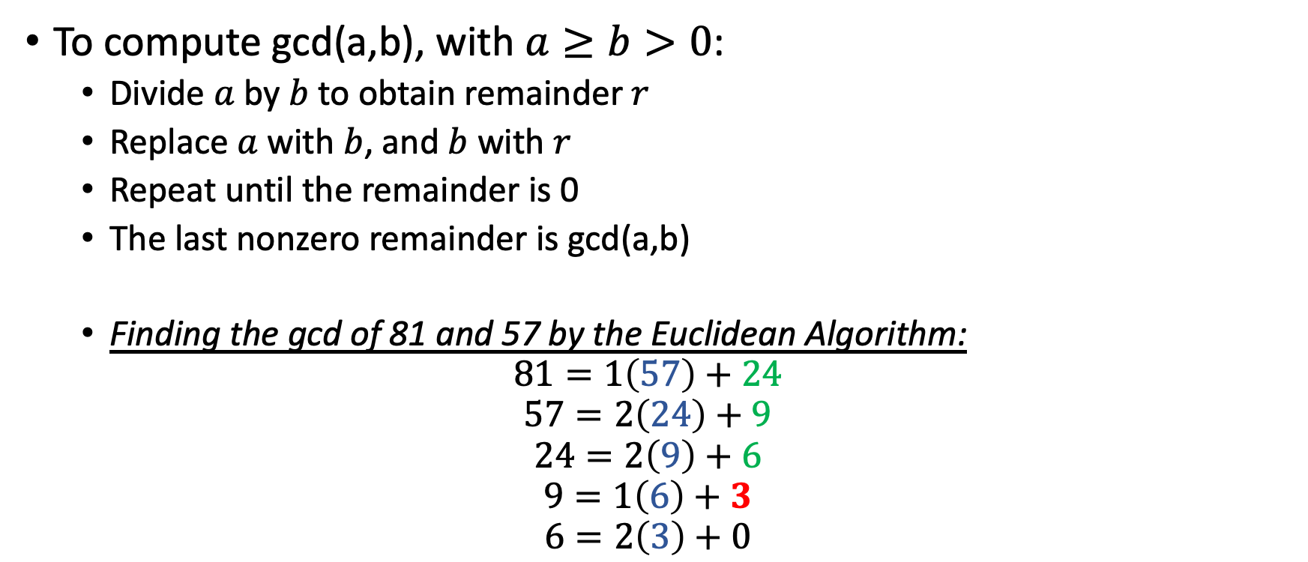
Euclidean Algorithm
To compute gcd(a,b), with $a≥b>0$:
Divide $a$ by $b$ to obtain remainder $r$
Replace $a$ with $b$, and $b$ with $r$
Repeat until the remainder is 0
The last nonzero remainder is gcd(a,b)
Finding the gcd of 81 and 57 by the Euclidean Algorithm:
$$81=1\left(57\right)+24$$
$$57=2\left(24\right)+9$$
$$24=2\left(9\right)+6$$
$$9=1\left(6\right)+3$$
$$6=2\left(3\right)+0$$

Slide 14
Why the Euclidean Algorithm Is Efficient
Each step strictly reduces the size of the inputs
Terminates in a small number of steps
Runs in time proportional to the number of digits
What next?
GCD enables modular inverses
Modular arithmetic builds on remainders
These tools power cryptographic algorithms

Slide 15
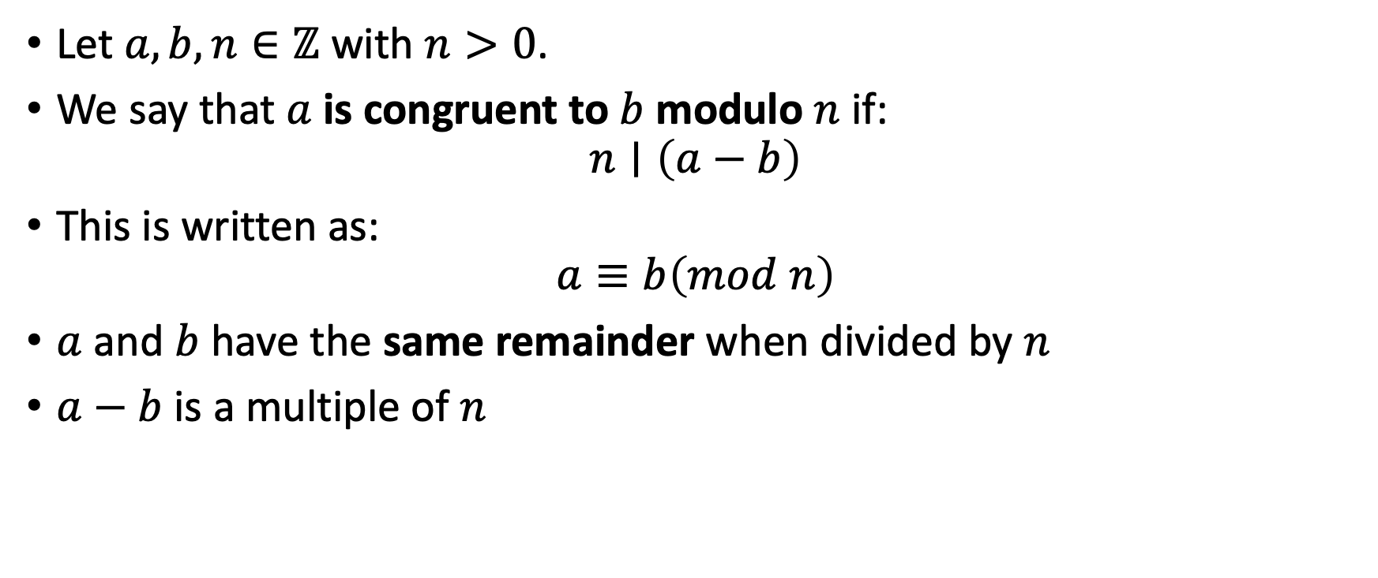
Modular Arithmetic Definition
Let $a,b,n∈ℤ$ with $n>0$.
We say that $a$is congruent to $b$ modulo $n$ if:
$$n∣\left(a−b\right)$$
This is written as:
$$a≡b\left(mod n\right)$$
$a$ and $b$ have the same remainder when divided by $n$
$a−b$ is a multiple of $n$
15 mod 7 = 1; 28 mod 12 = 4

Slide 16
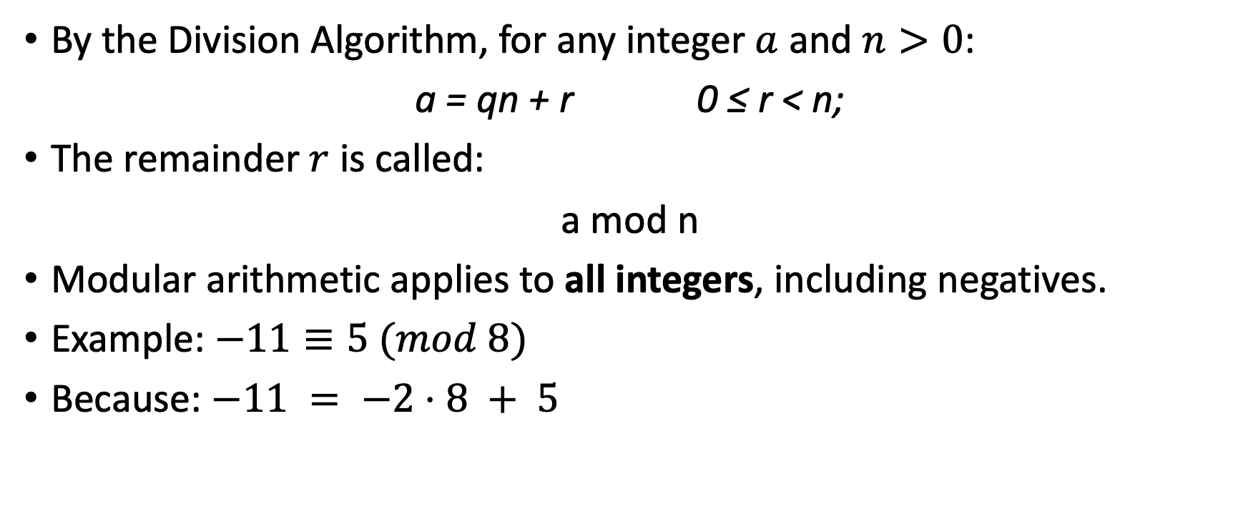
Remainders and the Division Algorithm
By the Division Algorithm, for any integer $a$ and $n>0$:
a = qn + r 0 ≤ r < n;
The remainder $r$ is called:
a mod n
Modular arithmetic applies to all integers, including negatives.
Example: $−11≡5 (mod 8)$
Because: $−11 = −2⋅8 + 5$

Slide 17
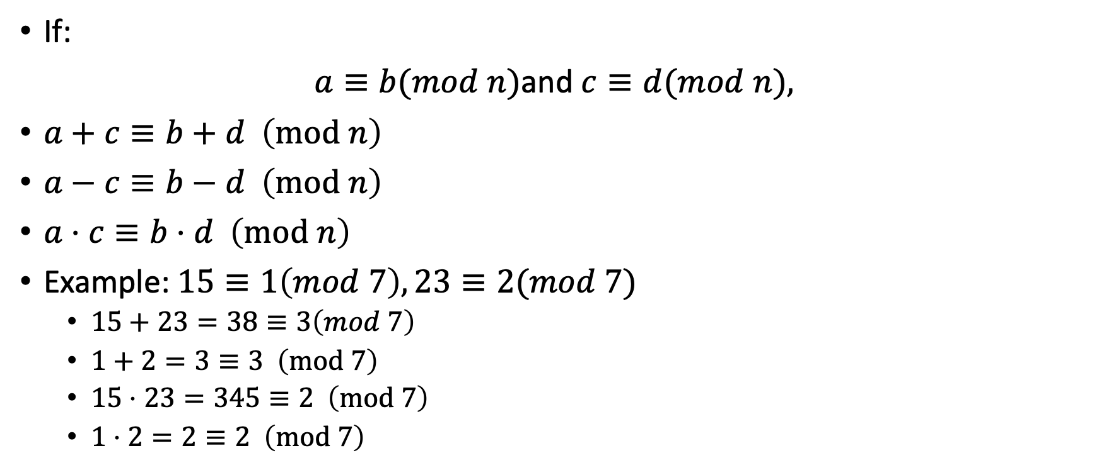
Properties of Congruences
If:
$a≡b(mod n)$and $c≡d(mod n),$
$a+c≡b+d \left(mod n\right)$
$a−c≡b−d \left(mod n\right)$
$a⋅c≡b⋅d \left(mod n\right)$
Example: $15≡1\left(mod 7\right),23≡2(mod 7)$
$15+23=38≡3\left(mod 7\right)$
$1+2=3≡3 \left(mod 7\right)$
$15⋅23=345≡2 \left(mod 7\right)$
$1⋅2=2≡2 \left(mod 7\right)$

Slide 18
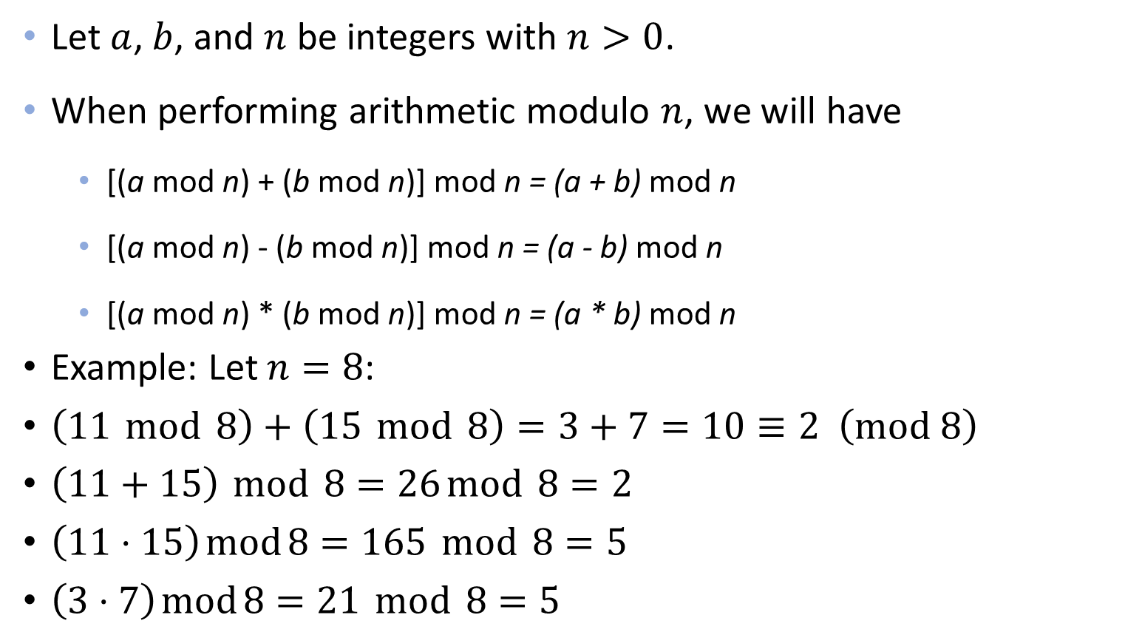
Modular Arithmetic Operations
Let $a$, $b$, and $n$ be integers with $n>0$.
When performing arithmetic modulo $n$, we will have
[(a mod n) + (b mod n)] mod n = (a + b) mod n
[(a mod n) - (b mod n)] mod n = (a - b) mod n
[(a mod n) * (b mod n)] mod n = (a * b) mod n
Example: Let $n=8$:
$\left(11 mod 8\right)+\left(15 mod 8\right)=3+7=10≡2 \left(mod 8\right)$
$\left(11+15\right) mod 8=26 mod 8=2$
$\left(11⋅15\right) mod 8=165 mod 8=5$
$\left(3⋅7\right) mod 8=21 mod 8=5$

Slide 19
Key Takeaways
Cryptographic algorithms operate on integers, not real numbers
Divisibility and the division algorithm formalize how remainders arise
The greatest common divisor (gcd) measures shared structure between integers
The Euclidean Algorithm computes gcd efficiently, even for large numbers
Modular arithmetic is arithmetic with remainders and preserves structure
These tools enable efficient and secure cryptographic computation

