Slide 1
ElGamal Cryptosystem
Dr. Xinyue Zhang
Assistant Professor
Department of Computer Science
Kennesaw State University
Marietta, GA, USA

Slide 2
Man-In-the-Middle Attack
This vulnerability can be overcome with the use of digital signatures and public-key certificates.

Slide 3
ElGamal Cryptography
Announced in 1984 by T. Elgamal inspired by Diffie-Hellman Key Exchange
Public-key scheme based on discrete logarithms closely related to the Diffie-Hellman technique
Used in the digital signature standard (DSS) and the S/MIME e-mail standard
Global elements are a prime number q and a which is a primitive root of q
Security is based on the difficulty of computing discrete logarithms

Slide 4
ElGamal

Slide 5
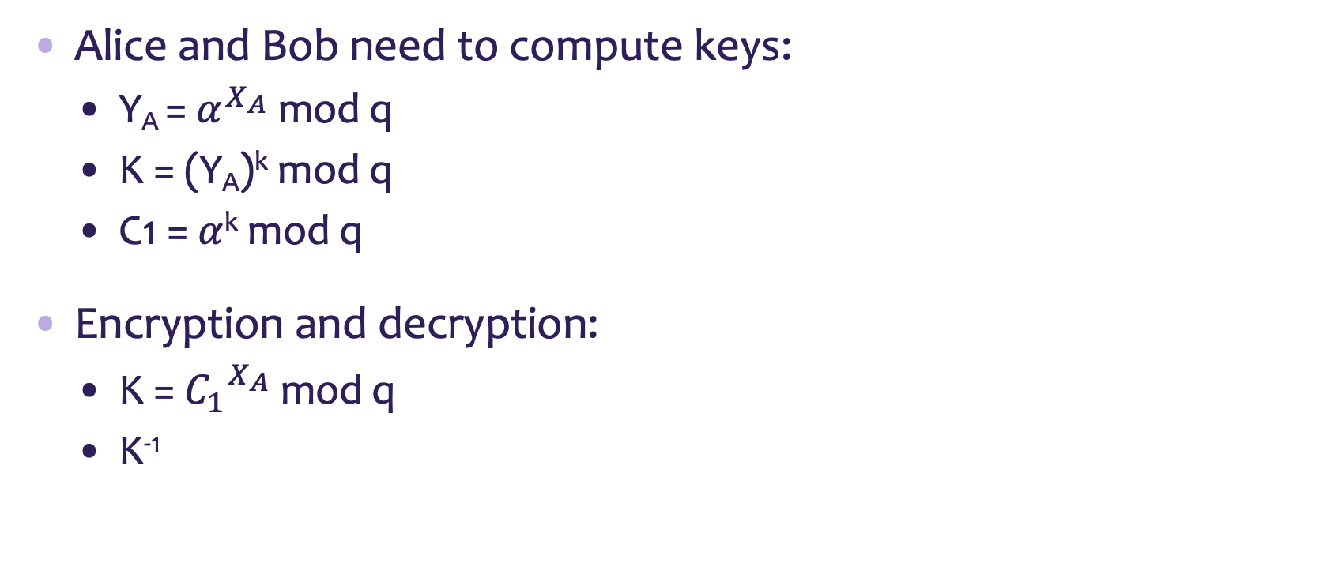
Computational Aspects
Alice and Bob need to compute keys:
Y_{A} = $α^{X_{A}}$ mod q
K = (Y_{A})^{k} mod q
C1 = $α$^{k} mod q
Encryption and decryption:
K = ${C_{1}}^{X_{A}}$ mod q
K⁻¹
Fast exponentiation:
Square and multiply algorithm
Extended Euclidean Algorithm

Slide 6
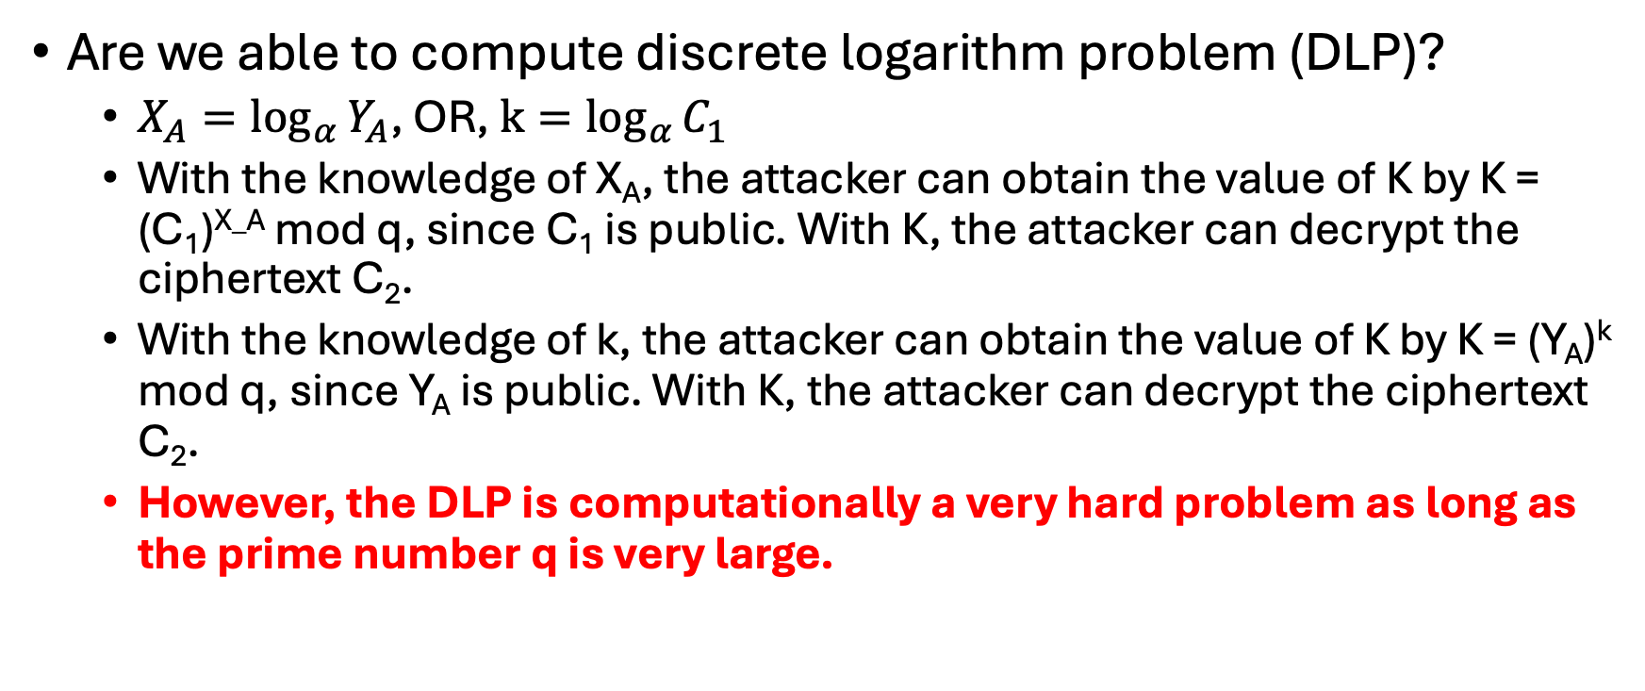
Attacks against ElGamal Algorithm
Are we able to compute discrete logarithm problem (DLP)?
$X_{A}=\log_{α}{Y_{A}}$, OR, $k=\log_{α}{C_{1}}$
With the knowledge of X_{A}, the attacker can obtain the value of K by K = (C₁)^{X_A} mod q, since C₁ is public. With K, the attacker can decrypt the ciphertext C₂.
With the knowledge of k, the attacker can obtain the value of K by K = (Y_{A})^{k} mod q, since Y_{A} is public. With K, the attacker can decrypt the ciphertext C₂.
However, the DLP is computationally a very hard problem as long as the prime number q is very large.

Slide 7
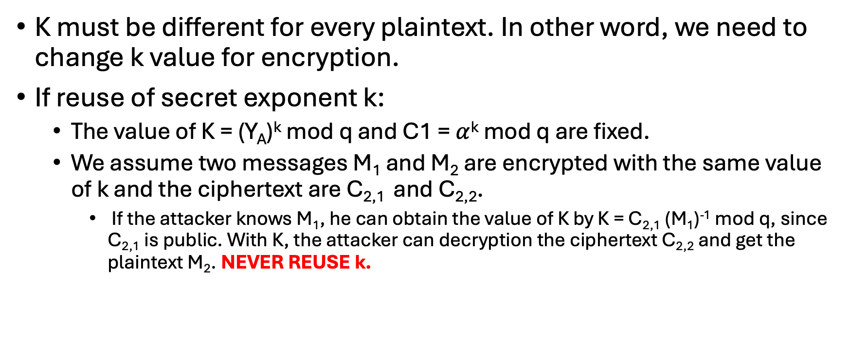
Problem of Reuse of secret exponent k
K must be different for every plaintext. In other word, we need to change k value for encryption.
If reuse of secret exponent k:
The value of K = (Y_{A})^{k} mod q and C1 = $α$^{k} mod q are fixed.
We assume two messages M₁ and M₂ are encrypted with the same value of k and the ciphertext are C_{2,1} and C_{2,2}.
If the attacker knows M₁, he can obtain the value of K by K = C_{2,1} (M₁)⁻¹ mod q, since C_{2,1} is public. With K, the attacker can decryption the ciphertext C_{2,2} and get the plaintext M₂. NEVER REUSE k.

Slide 8
Review
Review
RSA algorithm
Diffie-Hellman Key Exchange
Man-in-the-middle attack
Elgamal Cryptography

Slide 9

RSA Key Generation
RSA Key Generation Output: public key: k_{pub} = (n, e) and private key: k_{pr} = d 1. Choose two large primes p and q. 2. Compute n = p·q. 3. Compute Φ(n) = (p−1)(q−1). 4. Select the public exponent e ∈ {1,2,...,Φ(n)−1} such that gcd(e,Φ(n)) = 1.
5. Compute the private key d such that d· e ≡ 1 mod Φ(n)
Remark:
p and q $≥2^{512}$ and n $≥2^{1024}$

Slide 10
RSA Encryption & Decryption
RSA Encryption
Given the public key k_{pub} = (n, e) and the plaintext x, the encryption function is:
$y=e_{k_{pub}}\left(x\right)≡x^{e} mod n$
where $x∈ℤn=\{0,1,…,n−1\}.$
RSA Decryption
Given the private key k_{pr} = d and the ciphertext y, the decryption function is:
$x=d_{k_{pr}}\left(y\right)≡y^{d} mod n$
where $y∈ℤn$.

Slide 11
Diffie-Hellman Key Exchange
Notes:
Figure 10.1 summarizes the Diffie-Hellman key exchange algorithm. For this scheme, there are two publicly known numbers: a prime number q and an integer a that is a primitive root of q .
Figure 10.1 shows a simple protocol that makes use of the Diffie–Hellman calculation. Suppose that user A wishes to set up a connection with user B and use a secret key to encrypt messages on that connection. User A can generate a one-time private key X_{A}, calculate Y_{A}, and send that to user B. User B responds by generating a private value X_{B}, calculating Y_{B}, and sending Y_{B} to user A. Both users can now calculate the key. The necessary public values q and a would need to be known ahead of time. Alternatively, user A could pick values for q and a and include those in the first message.

Slide 12
Man-in-the-Middle Attack Review

Slide 13
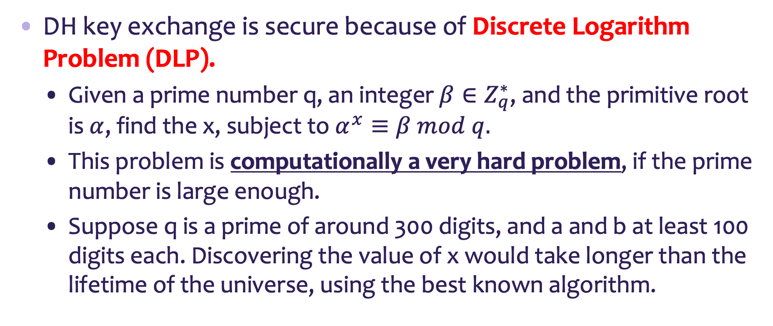
Security
DH key exchange is secure because of Discrete Logarithm Problem (DLP).
Given a prime number q, an integer $β∈Z_{q}^{∗}$, and the primitive root is $α$, find the x, subject to $α^{x}≡β mod q.$
This problem is computationally a very hard problem, if the prime number is large enough.
Suppose q is a prime of around 300 digits, and a and b at least 100 digits each. Discovering the value of x would take longer than the lifetime of the universe, using the best known algorithm.

Slide 14
ElGamal Review

