Slide 1
Elliptic Curve Cryptography
Dr. Xinyue Zhang
Assistant Professor
Department of Computer Science
Kennesaw State University
Marietta, GA, USA

Slide 2
Elliptic Curve Arithmetic
Most of the products and standards that use public-key cryptography for encryption and digital signatures use RSA
The key length for secure RSA use has increased over recent years and this has put a heavier processing load on applications using RSA
Elliptic curve cryptography (ECC) is showing up in standardization efforts including the IEEE P1363 Standard for Public-Key Cryptography
Principal attraction of ECC is that it appears to offer equal security for a far smaller key size

Slide 3
Elliptic Curves Cryptography
Elliptic curve cryptography uses curves whose variables and coefficients are finite
Two families of elliptic curves are used in cryptographic applications:
Binary curves over GF(2^{m})
Prime curves over Z_{p}
Variables and coefficients all take on values in GF(2^{m}) and in calculations are performed over GF(2^{m})
Best for hardware applications
Use a cubic equation in which the variables and coefficients all take on values in the set of integers from 0 through p-1 and in which calculations are performed modulo p
Best for software applications

Slide 4
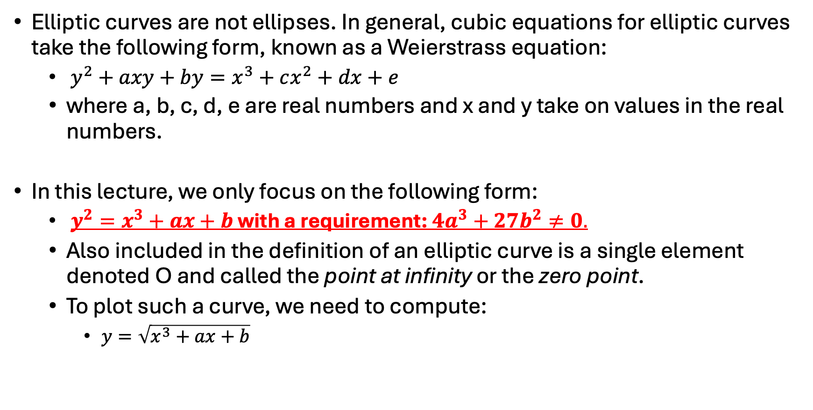
Elliptic Curves over Real Numbers
Elliptic curves are not ellipses. In general, cubic equations for elliptic curves take the following form, known as a Weierstrass equation:
$y^{2}+axy+by=x^{3}+cx^{2}+dx+e$
where a, b, c, d, e are real numbers and x and y take on values in the real numbers.
In this lecture, we only focus on the following form:
$y^{2}=x^{3}+ax+b$ with a requirement: $4a^{3}+27b^{2}≠0.$
Also included in the definition of an elliptic curve is a single element denoted O and called the point at infinity or the zero point.
To plot such a curve, we need to compute:
$y=\sqrt{x^{3}+ax+b}$

Slide 5
Example of Elliptic Curves

Slide 6
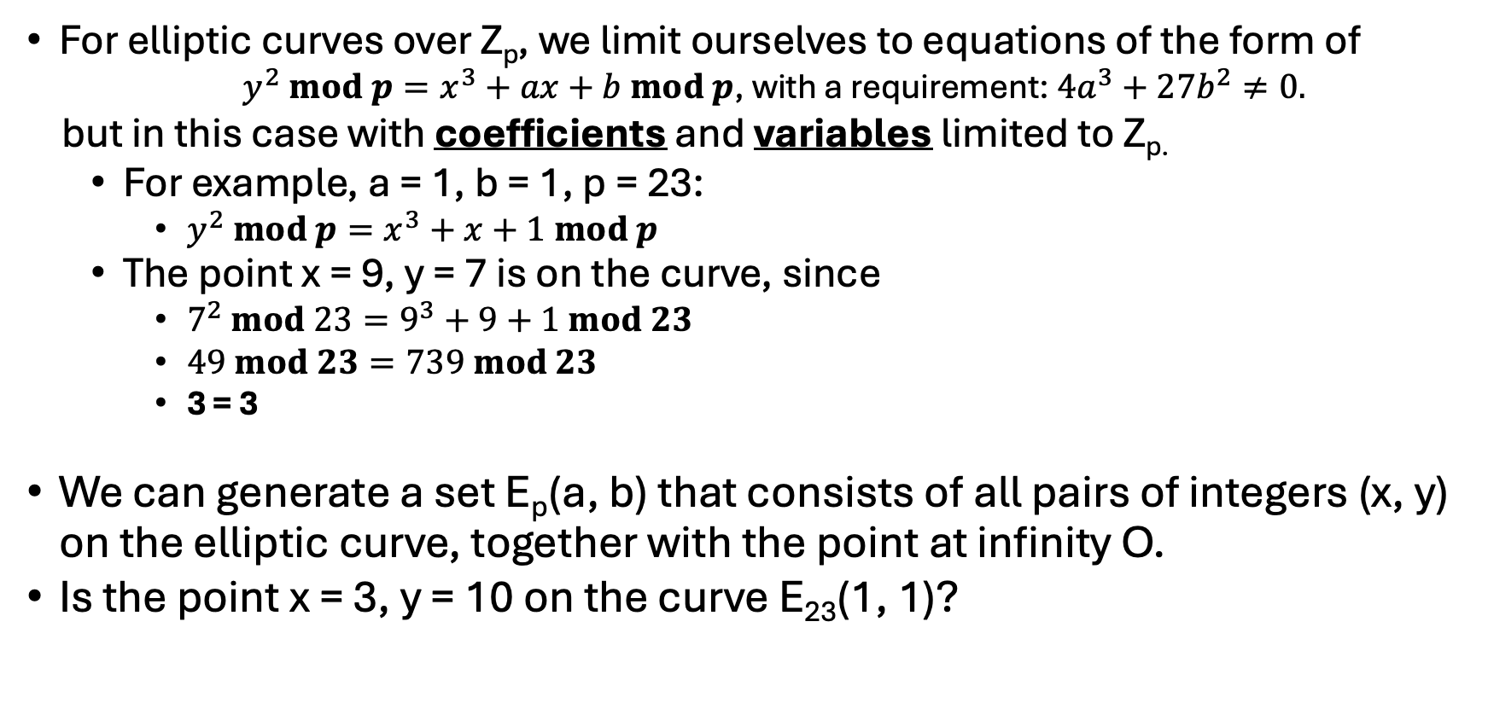
Elliptic Curves over Z_{p}
For elliptic curves over Z_{p}, we limit ourselves to equations of the form of
$y^{2} mod p=x^{3}+ax+b mod p$, with a requirement: $4a^{3}+27b^{2}≠0.$
but in this case with coefficients and variables limited to Z_{p.}
For example, a = 1, b = 1, p = 23:
$y^{2} mod p=x^{3}+x+1 mod p$
The point x = 9, y = 7 is on the curve, since
$7^{2} mod 23=9^{3}+9+1 mod 23$
$49 mod 23=739 mod 23$
3 = 3
We can generate a set E_{p}(a, b) that consists of all pairs of integers (x, y) on the elliptic curve, together with the point at infinity O.
Is the point x = 3, y = 10 on the curve E₂₃(1, 1)?
Yes!

Slide 7
Table 10.1
Points (other than O) on the Elliptic Curve E₂₃(1, 1)
Notes:
Table 10.1 Points (other than O) on the Elliptic Curve E₂₃(1, 1)

Slide 8
Discrete Elliptic Curve Example

Slide 9
Groups
A binary operation is a calculation that combines two elements to produce another element, such as addition, subtraction, multiplication, vector addition, matrix multiplication, etc.
Group G, also denoted by {G, *}
A set of elements with a binary operation denoted by * that associates to each ordered pair (a,b) of elements in G an element (a*b ) in G , such that the following axioms are obeyed:
(A1) Closure: If a and b belong to G, then a*b is also in G
(A2) Associative: a*(b*c) = (a*b)*c for all a, b, c in G
(A3) Identity element: There is an element e in G such that a*e = e*a = a for all a in G
(A4) Inverse element: For each a in G, there is an element a’ in G such that a*a’ = a’*a = e
(A5) Commutative:
a*b = b*a for all a, b in G
Abelian Group

Slide 10
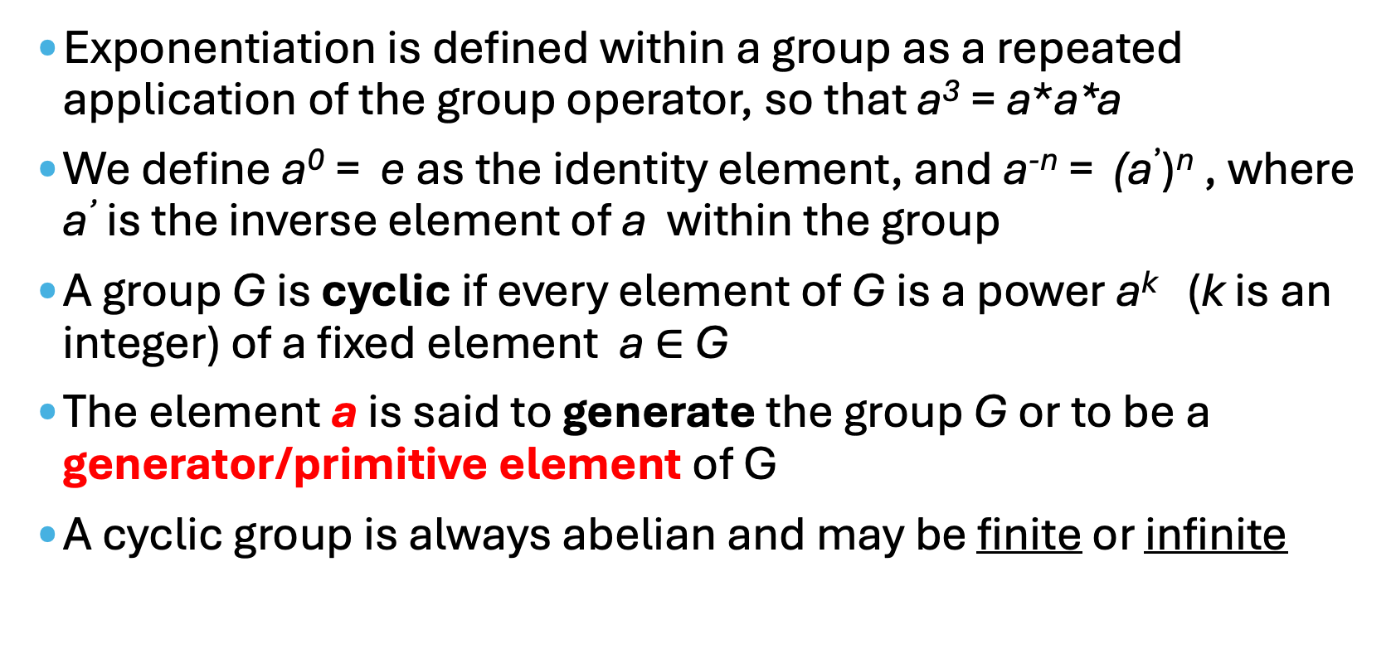
Cyclic Group
Exponentiation is defined within a group as a repeated application of the group operator, so that a³ = a*a*a
We define a⁰ = e as the identity element, and a^{-n} = (a’)^{n} , where a’ is the inverse element of a within the group
A group G is cyclic if every element of G is a power a^{k} (k is an integer) of a fixed element a $∈$ G
The element a is said to generate the group G or to be a generator/primitive element of G
A cyclic group is always abelian and may be finite or infinite

Slide 11
Geometric Description of Addition (page 1)
If 3 points on an elliptic curve lie on a straight line, their sum is O.
From this definition, we can define the rules of addition over an elliptic curve.
O serves as the additive identity. Thus O = -O; for any point P on the elliptic curve, P + O = P. In what follows, we assume P ≠ O and Q ≠ O.
The negative of a point P is the point with the same x coordinate but the negative of the y coordinate; that is, if P = (x, y), then -P = (x, -y). Note that these two points can be joined by a vertical line,
P + (-P) = P - P = O.

Slide 12
Geometric Description of Addition (page 2)
If 3 points on an elliptic curve lie on a straight line, their sum is O.
From this definition, we can define the rules of addition over an elliptic curve.
To add two points P and Q with different x coordinates, draw a straight line between them and find the third point of intersection R, which is a unique point. To form a group structure, we need to define addition on these three points: P + Q = -R. That is, we define P + Q to be the mirror image (with respect to the x axis) of the third point of intersection.

Slide 13
Geometric Description of Addition (page 3)
If 3 points on an elliptic curve lie on a straight line, their sum is O.
From this definition, we can define the rules of addition over an elliptic curve.
The geometric interpretation of the preceding item also applies to two points, P and -P, with the same x coordinate. The points are joined by a vertical line, which can be viewed as also intersecting the curve at the infinity point. We therefore have P + (-P) = O.
To double a point Q, draw the tangent line and find the other point of intersection S. Then Q + Q = 2Q = -S.

Slide 14
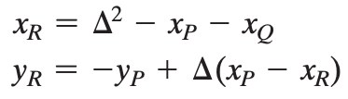
Algebraic Description of Addition (page 4)
For two distinct points, P = (x_{P}, y_{P}) and Q = (x_{Q}, y_{Q}), that are not negatives of each other, the slope of the line l that joins them is ∆ = (y_{Q} - y_{P})/(x_{Q} - x_{P}).
There is exactly one other point where l intersects the elliptic curve, and that is the negative of the sum of P and Q. After some algebraic manipulation, we can express the sum R = P + Q as

Slide 15
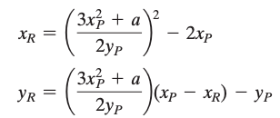
Algebraic Description of Addition (page 5)
For two distinct points, P = (x_{P}, y_{P}) and Q = (x_{Q}, y_{Q}), that are not negatives of each other, the slope of the line l that joins them is ∆ = (y_{Q} - y_{P})/(x_{Q} - x_{P}).
We also need to be able to add a point to itself: P + P = 2P = R, When y_{P} ≠ 0,

Slide 16
Algebraic Description of Addition (page 6)
For two distinct points, P = (x_{P}, y_{P}) and Q = (x_{Q}, y_{Q}), that are not negatives of each other, the slope of the line l that joins them is ∆ = (y_{Q} - y_{P})/(x_{Q} - x_{P}).
There is exactly one other point where l intersects the elliptic curve, and that is the negative of the sum of P and Q. After some algebraic manipulation, we can express the sum R = P + Q as
We also need to be able to add a point to itself: P + P = 2P = R, When y_{P} ≠ 0,
mod p
mod p

Slide 17
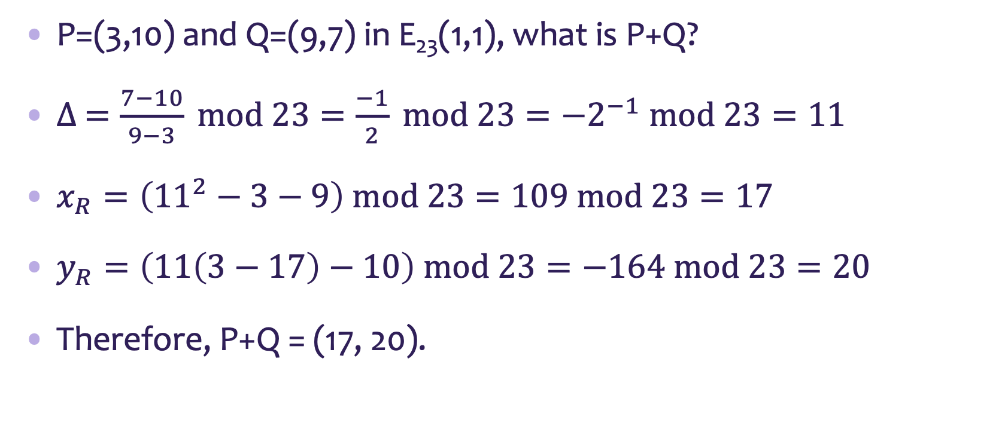
Elliptic Curve over Z_{p} Addition Example 1
P=(3,10) and Q=(9,7) in E₂₃(1,1), what is P+Q?
$∆ =\frac{7−10}{9−3} mod 23=\frac{−1}{2} mod 23={−2}^{−1} mod 23=11$
$x_{R}=\left({11}^{2}−3−9\right) mod 23=109 mod 23=17$
$y_{R}=\left(11\left(3−17\right)−10\right) mod 23=−164 mod 23=20$
Therefore, P+Q = (17, 20).
mod p

Slide 18
Points (other than O) on the Elliptic Curve E₂₃(1, 1)

Slide 19
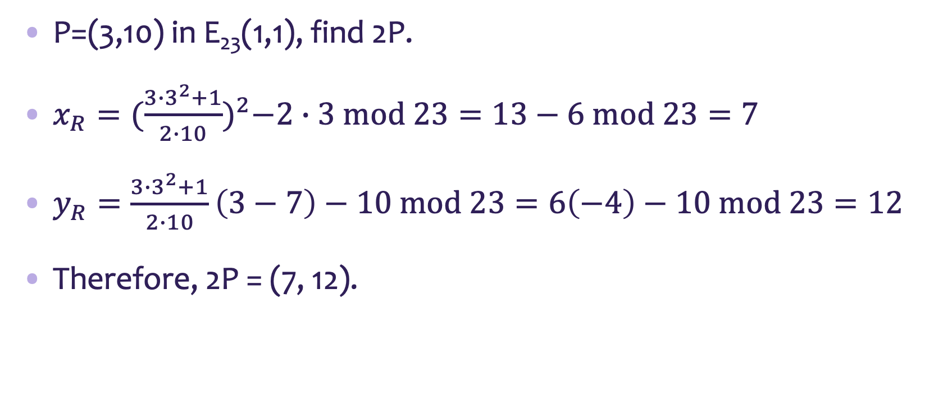
Elliptic Curve over Z_{p} Addition Example 2
P=(3,10) in E₂₃(1,1), find 2P.
$x_{R}={(\frac{3∙3^{2}+1}{2∙10})}^{2}−2∙3 mod 23=13−6 mod 23=7$
$y_{R}=\frac{3∙3^{2}+1}{2∙10}\left(3−7\right)−10 mod 23=6\left(−4\right)−10 mod 23=12$
Therefore, 2P = (7, 12).
mod p

Slide 20
(Show again) Points (other than O) on the Elliptic Curve E₂₃(1, 1)

Slide 21
Summary
Elliptic Curve Arithmetic
Basics of Elliptic Curves Cryptography
Elliptic Curves over Z_{p}
Review of cyclic groups
Geometric description of addition in elliptic curve
Algebraic description of addition in elliptic curve

