Slide 1
Cryptographic Hash Functions
Xinyue Zhang, Ph. D.
Assistant Professor
Department of Computer Science
Kennesaw State University
Marietta, GA, USA

Slide 2
Hash Functions
A hash function H accepts a variable-length block of data M as input and produces a fixed-size hash value
h = H(M)
Principal object is data integrity
Cryptographic hash function
An algorithm for which it is computationally infeasible to find either:
(a) a data object that maps to a pre-specified hash result (the one-way property)
(b) two data objects that map to the same hash result (the collision-free property)
Notes:
A hash function H accepts a variable-length block of data M as input and produces a fixed-size result h = H(M), referred to as a hash value or a hash code. A “good” hash function has the property that the results of applying the function to a large set of inputs will produce outputs that are evenly distributed and apparently random. In general terms, the principal object of a hash function is data integrity. A change to any bit or bits in M results, with high probability, in a change to the hash value.
The kind of hash function needed for security applications is referred to as a cryptographic hash function. A cryptographic hash function is an algorithm for which it is computationally infeasible (because no attack is significantly more efficient than brute force) to find either (a) a data object that maps to a pre-specified hash result (the one-way property) or (b) two data objects that map to the same hash result (the collision-free property). Because of these characteristics, hash functions are often used to determine whether or not data has changed.

Slide 3
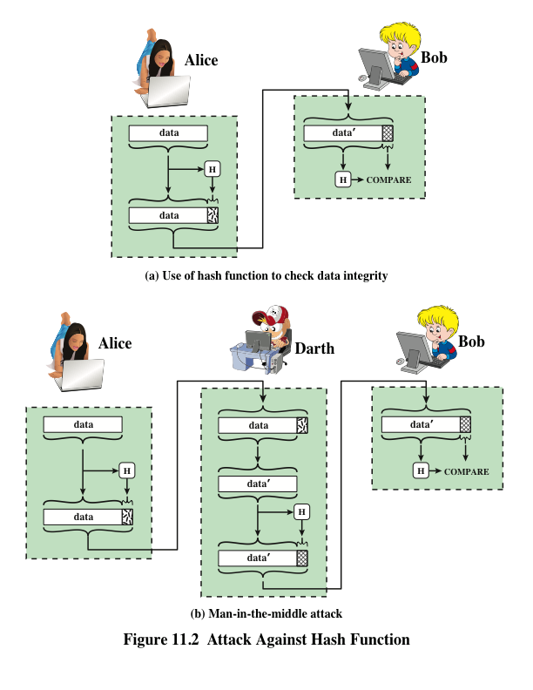
Message Authentication
To prevent this attack, the hash value generated by Alice must be protected.
Notes:
Message authentication is a mechanism or service used to verify the integrity of a message. Message authentication assures that data received are exactly as sent (i.e., there is no modification, insertion, deletion, or replay). In many cases, there is a requirement that the authentication mechanism assures that the purported identity of the sender is valid. When a hash function is used to provide message authentication, the hash function value is often referred to as a message digest.
The essence of the use of a hash function for message authentication is as
follows. The sender computes a hash value as a function of the bits in the message and transmits both the hash value and the message. The receiver performs the same hash calculation on the message bits and compares this value with the incoming hash value. If there is a mismatch, the receiver knows that the message (or possibly the hash value) has been altered (Figure 11.2a).
The hash function must be transmitted in a secure fashion. That is, the hash
function must be protected so that if an adversary alters or replaces the message,
it is not feasible for adversary to also alter the hash value to fool the receiver. This
type of attack is shown in Figure 11.2b. In this example, Alice transmits a data block and attaches a hash value. Darth intercepts the message, alters or replaces the data block, and calculates and attaches a new hash value. Bob receives the altered data with the new hash value and does not detect the change. To prevent this attack, the hash value generated by Alice must be protected.

Slide 4
Message Authentication Code (MAC)
Message authentication is achieved using a message authentication code (MAC), also known as a keyed hash function
Typically used between two parties that share a secret key to authenticate information exchanged between those parties
Takes as input a secret key and a data block and produces a hash value (MAC) which is associated with the protected message
If the integrity of the message needs to be checked, the MAC function can be applied to the message and the result compared with the associated MAC value
An attacker who alters the message will be unable to alter the associated MAC value without knowledge of the secret key
Notes:
More commonly, message authentication is achieved using a message authentication code (MAC), also known as a keyed hash function. Typically, MACs are used between two parties that share a secret key to authenticate information exchanged between those parties. A MAC function takes as input a secret key and a data block and produces a hash value, referred to as the MAC, which is associated with the protected message. If the integrity of the message needs to be checked, the MAC function can be applied to the message and the result compared with the associated MAC value. An attacker who alters the message will be unable to alter the associated MAC value without knowledge of the secret key. Note that the verifying party also knows who the sending party is because no one else knows the secret key.
Note that the combination of hashing and encryption results in an overall function that is, in fact, a MAC (Figure 11.3b). That is, E(K, H(M)) is a function of a variable-length message M and a secret key K, and it produces a fixed-size out- put that is secure against an opponent who does not know the secret key. In prac- tice, specific MAC algorithms are designed that are generally more efficient than an encryption algorithm.

Slide 5
Examples of Using Hash Function
The message plus concatenated hash code is encrypted using symmetric encryption.
Because only A and B share the secret key, the message must have come from A and has not been altered.
The hash code provides the structure or redundancy required to achieve authentication.
Because encryption is applied to the entire message plus hash code, confidentiality is also provided.
Notes:
Figure 11.3 illustrates a variety of ways in which a hash code can be used to
provide message authentication, as follows:
a. The message plus concatenated hash code is encrypted using symmetric
encryption. Because only A and B share the secret key, the message must
have come from A and has not been altered. The hash code provides the structure or redundancy required to achieve authentication. Because encryption is
applied to the entire message plus hash code, confidentiality is also provided.
b. Only the hash code is encrypted, using symmetric encryption. This reduces the
processing burden for those applications that do not require confidentiality.
c. It is possible to use a hash function but no encryption for message authentication. The technique assumes that the two communicating parties share a common secret value S. A computes the hash value over the concatenation of M and S and appends the resulting hash value to M. Because B possesses S, it can recompute the hash value to verify. Because the secret value itself is not sent, an opponent cannot modify an intercepted message and cannot generate a false message.
d. Confidentiality can be added to the approach of method (c) by encrypting the
entire message plus the hash code.
When confidentiality is not required, method (b) has an advantage over
methods (a) and (d), which encrypts the entire message, in that less computation
is required. Nevertheless, there has been growing interest in techniques that
avoid encryption (Figure 11.3c). Several reasons for this interest are pointed out in
[TSUD92].
• Encryption software is relatively slow. Even though the amount of data to be
encrypted per message is small, there may be a steady stream of messages into
and out of a system.
• Encryption hardware costs are not negligible. Low-cost chip implementations
of DES are available, but the cost adds up if all nodes in a network must have
this capability.
• Encryption hardware is optimized toward large data sizes. For small blocks
of data, a high proportion of the time is spent in initialization/invocation
overhead.
• Encryption algorithms may be covered by patents, and there is a cost associated with licensing their use.

Slide 6
Digital Signature
Operation is similar to that of the MAC
The hash value of a message is encrypted with a user’s private key
Anyone who knows the user’s public key can verify the integrity of the message
An attacker who wishes to alter the message would need to know the user’s private key
Implications of digital signatures go beyond just message authentication
Notes:
Another important application, which is similar to the message authentication
application, is the digital signature . The operation of the digital signature is similar
to that of the MAC. In the case of the digital signature, the hash value of a message
is encrypted with a user’s private key. Anyone who knows the user’s public key
can verify the integrity of the message that is associated with the digital signature.
In this case, an attacker who wishes to alter the message would need to know the
user’s private key. As we shall see in Chapter 14, the implications of digital signatures go beyond just message authentication.

Slide 7
Digital Signature with Hash Code
Notes:
Figure 11.4 illustrates, in a simplified fashion, how a hash code is used to provide
a digital signature.
a. The hash code is encrypted, using public-key encryption with the sender’s private key. As with Figure 11.3b, this provides authentication. It also provides a
digital signature, because only the sender could have produced the encrypted
hash code. In fact, this is the essence of the digital signature technique.
b. If confidentiality as well as a digital signature is desired, then the message
plus the private-key-encrypted hash code can be encrypted using a symmetric
secret key. This is a common technique.

Slide 8
Requirements and Security
Preimage
Collision
x is the preimage of h for a hash value h = H(x)
Is a data block whose hash function, using the function H, is h
Because H is a many-to-one mapping, for any given hash value h, there will in general be multiple preimages
Occurs if we have x ≠ y and H(x) = H(y)
Because we are using hash functions for data integrity, collisions are clearly undesirable
Notes:
Before proceeding, we need to define two terms. For a hash value h = H(x), we say that x is the preimage of h. That is, x is a data block whose hash value, using the function H, is h. Because H is a many-to-one mapping, for any given hash value h, there will in general be multiple preimages. A collision occurs if we have x ≠ y and H(x) = H(y). Because we are using hash functions for data integrity, collisions are clearly undesirable.

Slide 9
Attacks on Hash Functions
Brute-Force Attacks
Cryptanalysis
Does not depend on the specific algorithm, only depends on bit length
In the case of a hash function, attack depends only on the bit length of the hash value
Method is to pick values at random and try each one until a collision occurs
An attack based on weaknesses in a particular cryptographic algorithm
Seek to exploit some property of the algorithm to perform some attack other than an exhaustive search
Notes:
As with encryption algorithms, there are two categories of attacks on hash
functions: brute-force attacks and cryptanalysis. A brute-force attack does not depend on the specific algorithm but depends only on bit length. In the case of a hash function, a brute-force attack depends only on the bit length of the hash value. A cryptanalysis, in contrast, is an attack based on weaknesses in a particular cryptographic algorithm.

Slide 10
Preimage Attack and Second Preimage Attack
Preimage Attack:
Try to find the value of x, given the hash function value H(x).
If the input x has 80 bits, then the attack will need 2⁸⁰ steps.
Second preimage attack:
Given the hashed value H(x), try to find another value y, such that H(x) = H(y).
If the input x and y have 80 bits, then the attack will also need 2⁸⁰ steps.

Slide 11
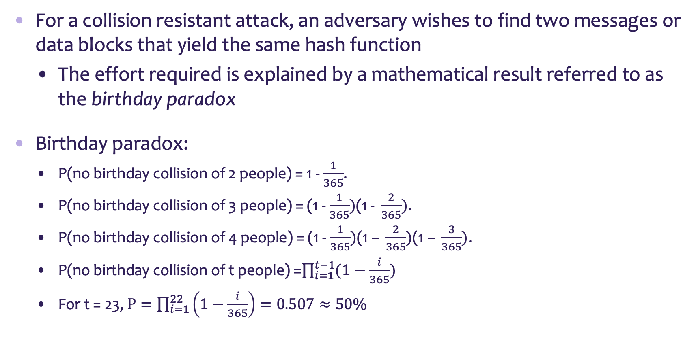
Collision Resistant Attacks
For a collision resistant attack, an adversary wishes to find two messages or data blocks that yield the same hash function
The effort required is explained by a mathematical result referred to as the birthday paradox
Birthday paradox:
P(no birthday collision of 2 people) = 1 - $\frac{1}{365}$.
P(no birthday collision of 3 people) = (1 - $\frac{1}{365})\text{(1 − }\frac{2}{365})\text{.}$
P(no birthday collision of 4 people) = (1 - $\frac{1}{365})\text{(1 − }\frac{2}{365})\text{(1 − }\frac{3}{365})\text{.}$
P(no birthday collision of t people) =$\prod_{i=1}^{t−1}{(1−\frac{i}{365})}$
For t = 23, $P=\prod_{i=1}^{22}{\left(1−\frac{i}{365}\right)}=0.507≈50\%$
Notes:
For a collision resistant attack, an adversary wishes
to find two messages or data blocks, x and y , that yield the same hash function:
H(x) = H(y). This turns out to require considerably less effort than a preimage or
second preimage attack. The effort required is explained by a mathematical result
referred to as the birthday paradox. In essence, if we choose random variables from a uniform distribution in the range 0 through N - 1, then the probability that a
repeated element is encountered exceeds 0.5 after √N choices have been made.
Thus, for an m-bit hash value, if we pick data blocks at random, we can expect to
find two data blocks with the same hash value within √2^{m} = 2^{m/2} attempts. The
mathematical derivation of this result is found in Appendix E.
Yuval proposed the following strategy to exploit the birthday paradox in a
Collision resistant attack [YUVA79].
The source, A, is prepared to sign a legitimate message x by appending the appropriate m-bit hash code and encrypting that hash code with A’s private key (Figure 11.4a).
2. The opponent generates 2^{m/2} variations x’ of x, all of which convey essentially
the same meaning, and stores the messages and their hash values.
3. The opponent prepares a fraudulent message y for which A’s signature is
desired.
4. The opponent generates minor variations y’ of y, all of which convey essentially
the same meaning. For each y’, the opponent computes H(y’), checks
for matches with any of the H(x’) values, and continues until a match is found.
That is, the process continues until a y’ is generated with a hash value equal to
the hash value of one of the x’ values.
5. The opponent offers the valid variation to A for signature. This signature can
then be attached to the fraudulent variation for transmission to the intended
recipient. Because the two variations have the same hash code, they will produce
the same signature; the opponent is assured of success even though the
encryption key is not known.
Thus, if a 64-bit hash code is used, the level of effort required is only on the
order of 2³² [see Appendix E, Equation (E.7)].
The generation of many variations that convey the same meaning is not difficult.
For example, the opponent could insert a number of “space-space-backspace”
character pairs between words throughout the document. Variations could then
be generated by substituting “space-backspace-space” in selected instances.
Alternatively, the opponent could simply reword the message but retain the
Meaning. Figure 11.7 provides an example.
To summarize, for a hash code of length m, the level of effort required, as we
have seen, is proportional to the following.
Preimage resistant 2^{m}
Second preimage resistant 2^{m}
Collision resistant 2^{m/2}

Slide 12
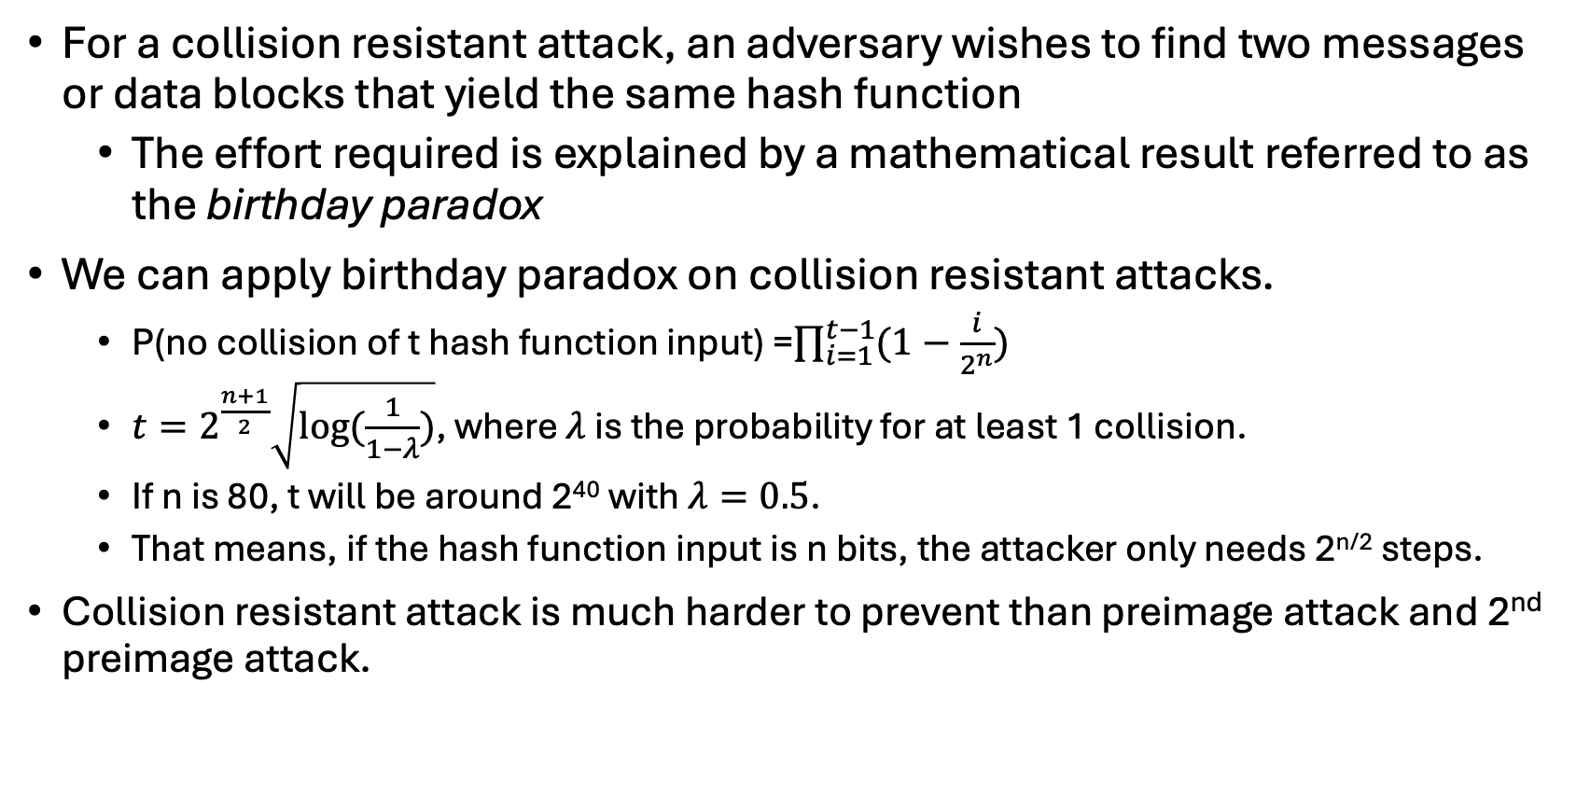
Collision Resistant Attacks (cont.)
For a collision resistant attack, an adversary wishes to find two messages or data blocks that yield the same hash function
The effort required is explained by a mathematical result referred to as the birthday paradox
We can apply birthday paradox on collision resistant attacks.
P(no collision of t hash function input) =$\prod_{i=1}^{t−1}{(1−\frac{i}{2^{n}})}$
$t=2^{\frac{n+1}{2}}\sqrt{log⁡(\frac{1}{1−λ})}$, where $λ$ is the probability for at least 1 collision.
If n is 80, t will be around 2⁴⁰ with $λ=0.5$.
That means, if the hash function input is n bits, the attacker only needs 2^{n/2} steps.
Collision resistant attack is much harder to prevent than preimage attack and 2nd preimage attack.
Notes:
For a collision resistant attack, an adversary wishes
to find two messages or data blocks, x and y , that yield the same hash function:
H(x) = H(y). This turns out to require considerably less effort than a preimage or
second preimage attack. The effort required is explained by a mathematical result
referred to as the birthday paradox. In essence, if we choose random variables from a uniform distribution in the range 0 through N - 1, then the probability that a
repeated element is encountered exceeds 0.5 after √N choices have been made.
Thus, for an m-bit hash value, if we pick data blocks at random, we can expect to
find two data blocks with the same hash value within √2^{m} = 2^{m/2} attempts. The
mathematical derivation of this result is found in Appendix E.
Yuval proposed the following strategy to exploit the birthday paradox in a
Collision resistant attack [YUVA79].
The source, A, is prepared to sign a legitimate message x by appending the appropriate m-bit hash code and encrypting that hash code with A’s private key (Figure 11.4a).
2. The opponent generates 2^{m/2} variations x’ of x, all of which convey essentially
the same meaning, and stores the messages and their hash values.
3. The opponent prepares a fraudulent message y for which A’s signature is
desired.
4. The opponent generates minor variations y’ of y, all of which convey essentially
the same meaning. For each y’, the opponent computes H(y’), checks
for matches with any of the H(x’) values, and continues until a match is found.
That is, the process continues until a y’ is generated with a hash value equal to
the hash value of one of the x’ values.
5. The opponent offers the valid variation to A for signature. This signature can
then be attached to the fraudulent variation for transmission to the intended
recipient. Because the two variations have the same hash code, they will produce
the same signature; the opponent is assured of success even though the
encryption key is not known.
Thus, if a 64-bit hash code is used, the level of effort required is only on the
order of 2³² [see Appendix E, Equation (E.7)].
The generation of many variations that convey the same meaning is not difficult.
For example, the opponent could insert a number of “space-space-backspace”
character pairs between words throughout the document. Variations could then
be generated by substituting “space-backspace-space” in selected instances.
Alternatively, the opponent could simply reword the message but retain the
Meaning. Figure 11.7 provides an example.
To summarize, for a hash code of length m, the level of effort required, as we
have seen, is proportional to the following.
Preimage resistant 2^{m}
Second preimage resistant 2^{m}
Collision resistant 2^{m/2}

Slide 13
Secure Hash Algorithm (SHA)
SHA was originally designed by the National Institute of Standards and Technology (NIST) and published as a federal information processing standard (FIPS 180) in 1993
Was revised in 1995 as SHA-1
Produces 160-bit hash values
In 2002 NIST produced a revised version of the standard that defined three new versions of SHA with hash value lengths of 256, 384, and 512
Collectively known as SHA-2
Notes:
In recent years, the most widely used hash function has been the Secure Hash
Algorithm (SHA). Indeed, because virtually every other widely used hash function
had been found to have substantial cryptanalytic weaknesses, SHA was more or
less the last remaining standardized hash algorithm by 2005. SHA was developed
by the National Institute of Standards and Technology (NIST) and published as a
federal information processing standard (FIPS 180) in 1993. When weaknesses were discovered in SHA, now known as SHA-0, a revised version was issued as FIPS 180-1 in 1995 and is referred to as SHA-1. The actual standards document is entitled “Secure Hash Standard.” SHA is based on the hash function MD4, and its design closely models MD4.
SHA-1 produces a hash value of 160 bits. In 2002, NIST produced a revised
version of the standard, FIPS 180-2, that defined three new versions of SHA, with
hash value lengths of 256, 384, and 512 bits, known as SHA-256, SHA-384, and
SHA-512, respectively. Collectively, these hash algorithms are known as SHA-2 .
These new versions have the same underlying structure and use the same types of modular arithmetic and logical binary operations as SHA-1.

Slide 14
Table 11.3 Comparison of SHA Parameters
Note: All sizes are measured in bits.
Notes:
A revised document was issued as FIP PUB 180-3 in 2008, which added a 224-bit version (Table 11.3). SHA-1 and SHA-2 are also specified in RFC 6234, which essentially duplicates the material in FIPS 180-3 but adds a C code implementation.
In 2005, NIST announced the intention to phase out approval of SHA-1 and move to a reliance on SHA-2 by 2010. Despite this, SHA-1 continued to be used for digital signature and other applications by numerous applications, such as web browsers. The reluctance to go through the expense and effort of transitioning to SHA-2 has been overcome by a breakthrough announced by are search team in 2017[STEV17,CONS17].The team demonstrated that SHA-1 collision attacks have finally become practical by pro- viding the first known instance of a collision. In total, the computational effort spent is equivalent to 263.1 SHA-1 compressions and took approximately 6500 CPU years and 100 GPU years. As a result, Microsoft, Google, Apple, and Mozilla have all announced that their respective browsers have stopped accepting SHA-1 SSL certificates in 2017.

Slide 15
General structure of secure hash code
Notes:
In recent years, there has been considerable effort, and some successes,
in developing cryptanalytic attacks on hash functions. To understand these, we
need to look at the overall structure of a typical secure hash function, indicated in
Figure 11.8. This structure, referred to as an iterated hash function, was proposed
by Merkle [MERK79, MERK89] and is the structure of most hash functions in use
today, including SHA, which is discussed later in this chapter. The hash function
takes an input message and partitions it into L fixed-sized blocks of b bits each.
If necessary, the final block is padded to b bits. The final block also includes the
value of the total length of the input to the hash function. The inclusion of the
length makes the job of the opponent more difficult. Either the opponent must
find two messages of equal length that hash to the same value or two messages of differing lengths that, together with their length values, hash to the same value.
The hash algorithm involves repeated use of a compression function, f, that
takes two inputs (an n-bit input from the previous step, called the chaining variable, and a b-bit block) and produces an n-bit output. At the start of hashing, the chaining variable has an initial value that is specified as part of the algorithm. The final value of the chaining variable is the hash value.

Slide 16
MAC Step 1
Step 1 Append padding bits. The message is padded so that its length is congruent to 896 modulo 1024. Padding is always added, even if the message is already of the desired length. Thus, the number of padding bits is in the range of 1 to 1024. The padding consists of a single 1 bit followed by the necessary number of 0 bits.
Notes:
The algorithm takes as input a message with a maximum length of less than 2128 bits and produces as output a 512-bit message digest. The input is processed in 1024-bit blocks. Figure 11.9 depicts the overall processing of a message to produce a digest. This follows the general structure depicted in Figure 11.8. The processing consists of the following steps.
Step 1 Append padding bits. The message is padded so that its length is congruent to 896 modulo 1024 [length = 896(mod 1024)]. Padding is always added, even if the message is already of the desired length. Thus, the number of
padding bits is in the range of 1 to 1024. The padding consists of a single 1
bit followed by the necessary number of 0 bits.
Step 2 Append length. A block of 128 bits is appended to the message. This block is treated as an unsigned 128-bit integer (most significant byte first) and
contains the length of the original message (before the padding).
The outcome of the first two steps yields a message that is an integer
multiple of 1024 bits in length. In Figure 11.9, the expanded message is
represented as the sequence of 1024-bit blocks M₁ , M₂ , . . . , M_{N} , so that the
total length of the expanded message is N * 1024 bits.
Step 3 Initialize hash buffer. A 512-bit buffer is used to hold intermediate
and final results of the hash function. The buffer can be represented as eight 64-bit registers (a, b, c, d, e, f, g, h). These registers are initialized to the following
64-bit integers (hexadecimal values):
a = 6A09E667F3BCC908 e = 510E527FADE682D1
b = BB67AE8584CAA73B f = 9B05688C2B3E6C1F
c = 3C6EF372FE94F82B g = 1F83D9ABFB41BD6B
d = A54FF53A5F1D36F1 h = 5BE0CD19137E2179
These words were obtained by taking the first sixty-four bits of the frac- tional parts of the square roots of the first eight prime numbers. The val- ues are stored in big-endian format, which is the most significant byte of a word in the low-address (leftmost) byte position. In contrast, in little-endian format, the least significant byte is stored in the lowest address.
Step 4 Process message in 1024-bit (128-word) blocks. The heart of the algorithm is a module that consists of 80 rounds; this module is labeled F in Figure 11.9. The logic is illustrated in Figure 11.10.
Each round takes as input the 512-bit buffer value, abcdefgh, and
updates the contents of the buffer. At input to the first round, the buffer
has the value of the intermediate hash value, H_{i-1} . Each round t makes
use of a 64-bit value W_{t}, derived from the current 1024-bit block being processed
(M_{i} ). These values are derived using a message schedule described
subsequently. Each round also makes use of an additive constant K_{t} , where
0 ≤ t ≤ 79 indicates one of the 80 rounds. These words represent the first
64 bits of the fractional parts of the cube roots of the first 80 prime numbers.
Step 5 Output. After all N 1024-bit blocks have been processed, the output from
the Nth stage is the 512-bit message digest.

Slide 17
MAC Step 2
Step 2 Append length. A block of 128 bits is appended to the message. This block is treated as an unsigned 128-bit integer and contains the length of the original message in bits (before the padding). The outcome of the first two steps yields a message that is an integer multiple of 1024 bits in length.
Notes:
The algorithm takes as input a message with a maximum length of less than 2128 bits and produces as output a 512-bit message digest. The input is processed in 1024-bit blocks. Figure 11.9 depicts the overall processing of a message to produce a digest. This follows the general structure depicted in Figure 11.8. The processing consists of the following steps.
Step 1 Append padding bits. The message is padded so that its length is congruent to 896 modulo 1024 [length = 896(mod 1024)]. Padding is always added, even if the message is already of the desired length. Thus, the number of
padding bits is in the range of 1 to 1024. The padding consists of a single 1
bit followed by the necessary number of 0 bits.
Step 2 Append length. A block of 128 bits is appended to the message. This block is treated as an unsigned 128-bit integer (most significant byte first) and
contains the length of the original message (before the padding).
The outcome of the first two steps yields a message that is an integer
multiple of 1024 bits in length. In Figure 11.9, the expanded message is
represented as the sequence of 1024-bit blocks M₁ , M₂ , . . . , M_{N} , so that the
total length of the expanded message is N * 1024 bits.
Step 3 Initialize hash buffer. A 512-bit buffer is used to hold intermediate
and final results of the hash function. The buffer can be represented as eight 64-bit registers (a, b, c, d, e, f, g, h). These registers are initialized to the following
64-bit integers (hexadecimal values):
a = 6A09E667F3BCC908 e = 510E527FADE682D1
b = BB67AE8584CAA73B f = 9B05688C2B3E6C1F
c = 3C6EF372FE94F82B g = 1F83D9ABFB41BD6B
d = A54FF53A5F1D36F1 h = 5BE0CD19137E2179
These words were obtained by taking the first sixty-four bits of the frac- tional parts of the square roots of the first eight prime numbers. The val- ues are stored in big-endian format, which is the most significant byte of a word in the low-address (leftmost) byte position. In contrast, in little-endian format, the least significant byte is stored in the lowest address.
Step 4 Process message in 1024-bit (128-word) blocks. The heart of the algorithm is a module that consists of 80 rounds; this module is labeled F in Figure 11.9. The logic is illustrated in Figure 11.10.
Each round takes as input the 512-bit buffer value, abcdefgh, and
updates the contents of the buffer. At input to the first round, the buffer
has the value of the intermediate hash value, H_{i-1} . Each round t makes
use of a 64-bit value W_{t}, derived from the current 1024-bit block being processed
(M_{i} ). These values are derived using a message schedule described
subsequently. Each round also makes use of an additive constant K_{t} , where
0 ≤ t ≤ 79 indicates one of the 80 rounds. These words represent the first
64 bits of the fractional parts of the cube roots of the first 80 prime numbers.
Step 5 Output. After all N 1024-bit blocks have been processed, the output from
the Nth stage is the 512-bit message digest.

Slide 18
MAC Step 3
Step 3 Initialize hash buffer. A 512-bit buffer is used to hold intermediate and final results of the hash function. The buffer can be represented as eight 64-bit registers (a, b, c, d, e, f, g, h). We need to give initialization values in the hash buffer
Notes:
The algorithm takes as input a message with a maximum length of less than 2128 bits and produces as output a 512-bit message digest. The input is processed in 1024-bit blocks. Figure 11.9 depicts the overall processing of a message to produce a digest. This follows the general structure depicted in Figure 11.8. The processing consists of the following steps.
Step 1 Append padding bits. The message is padded so that its length is congruent to 896 modulo 1024 [length = 896(mod 1024)]. Padding is always added, even if the message is already of the desired length. Thus, the number of
padding bits is in the range of 1 to 1024. The padding consists of a single 1
bit followed by the necessary number of 0 bits.
Step 2 Append length. A block of 128 bits is appended to the message. This block is treated as an unsigned 128-bit integer (most significant byte first) and
contains the length of the original message (before the padding).
The outcome of the first two steps yields a message that is an integer
multiple of 1024 bits in length. In Figure 11.9, the expanded message is
represented as the sequence of 1024-bit blocks M₁ , M₂ , . . . , M_{N} , so that the
total length of the expanded message is N * 1024 bits.
Step 3 Initialize hash buffer. A 512-bit buffer is used to hold intermediate
and final results of the hash function. The buffer can be represented as eight 64-bit registers (a, b, c, d, e, f, g, h). These registers are initialized to the following
64-bit integers (hexadecimal values):
a = 6A09E667F3BCC908 e = 510E527FADE682D1
b = BB67AE8584CAA73B f = 9B05688C2B3E6C1F
c = 3C6EF372FE94F82B g = 1F83D9ABFB41BD6B
d = A54FF53A5F1D36F1 h = 5BE0CD19137E2179
These words were obtained by taking the first sixty-four bits of the frac- tional parts of the square roots of the first eight prime numbers. The val- ues are stored in big-endian format, which is the most significant byte of a word in the low-address (leftmost) byte position. In contrast, in little-endian format, the least significant byte is stored in the lowest address.
Step 4 Process message in 1024-bit (128-word) blocks. The heart of the algorithm is a module that consists of 80 rounds; this module is labeled F in Figure 11.9. The logic is illustrated in Figure 11.10.
Each round takes as input the 512-bit buffer value, abcdefgh, and
updates the contents of the buffer. At input to the first round, the buffer
has the value of the intermediate hash value, H_{i-1} . Each round t makes
use of a 64-bit value W_{t}, derived from the current 1024-bit block being processed
(M_{i} ). These values are derived using a message schedule described
subsequently. Each round also makes use of an additive constant K_{t} , where
0 ≤ t ≤ 79 indicates one of the 80 rounds. These words represent the first
64 bits of the fractional parts of the cube roots of the first 80 prime numbers.
Step 5 Output. After all N 1024-bit blocks have been processed, the output from
the Nth stage is the 512-bit message digest.

Slide 19
MAC Step 4
Step 4 Process message in 1024-bit (128-byte) blocks. The heart of the algorithm is a module that consists of 80 rounds; this module is labeled F in the figure.
Notes:
The algorithm takes as input a message with a maximum length of less than 2128 bits and produces as output a 512-bit message digest. The input is processed in 1024-bit blocks. Figure 11.9 depicts the overall processing of a message to produce a digest. This follows the general structure depicted in Figure 11.8. The processing consists of the following steps.
Step 1 Append padding bits. The message is padded so that its length is congruent to 896 modulo 1024 [length = 896(mod 1024)]. Padding is always added, even if the message is already of the desired length. Thus, the number of
padding bits is in the range of 1 to 1024. The padding consists of a single 1
bit followed by the necessary number of 0 bits.
Step 2 Append length. A block of 128 bits is appended to the message. This block is treated as an unsigned 128-bit integer (most significant byte first) and
contains the length of the original message (before the padding).
The outcome of the first two steps yields a message that is an integer
multiple of 1024 bits in length. In Figure 11.9, the expanded message is
represented as the sequence of 1024-bit blocks M₁ , M₂ , . . . , M_{N} , so that the
total length of the expanded message is N * 1024 bits.
Step 3 Initialize hash buffer. A 512-bit buffer is used to hold intermediate
and final results of the hash function. The buffer can be represented as eight 64-bit registers (a, b, c, d, e, f, g, h). These registers are initialized to the following
64-bit integers (hexadecimal values):
a = 6A09E667F3BCC908 e = 510E527FADE682D1
b = BB67AE8584CAA73B f = 9B05688C2B3E6C1F
c = 3C6EF372FE94F82B g = 1F83D9ABFB41BD6B
d = A54FF53A5F1D36F1 h = 5BE0CD19137E2179
These words were obtained by taking the first sixty-four bits of the frac- tional parts of the square roots of the first eight prime numbers. The val- ues are stored in big-endian format, which is the most significant byte of a word in the low-address (leftmost) byte position. In contrast, in little-endian format, the least significant byte is stored in the lowest address.
Step 4 Process message in 1024-bit (128-word) blocks. The heart of the algorithm is a module that consists of 80 rounds; this module is labeled F in Figure 11.9. The logic is illustrated in Figure 11.10.
Each round takes as input the 512-bit buffer value, abcdefgh, and
updates the contents of the buffer. At input to the first round, the buffer
has the value of the intermediate hash value, H_{i-1} . Each round t makes
use of a 64-bit value W_{t}, derived from the current 1024-bit block being processed
(M_{i} ). These values are derived using a message schedule described
subsequently. Each round also makes use of an additive constant K_{t} , where
0 ≤ t ≤ 79 indicates one of the 80 rounds. These words represent the first
64 bits of the fractional parts of the cube roots of the first 80 prime numbers.
Step 5 Output. After all N 1024-bit blocks have been processed, the output from
the Nth stage is the 512-bit message digest.

Slide 20
SHA-512
Each round has 3 inputs.
the 512-bit buffer value (8 buffers)
A 64-bit value W_{t} , derived from the 1024-bit block. (Message schedule)
An additive constant K_{t} (constants).
At input to the first round, the buffer has the value of the intermediate hash value, H_{i-1}.
The output of the eightieth round is added to the input to the first round (H_{i-1}) to produce H_{i}.
Notes:
The heart of the algorithm is a module that consists of 80 rounds; this module is labeled F in Figure 11.9. The logic is illustrated in Figure 11.10.

Slide 21
Table 11.4 SHA-512 Constants
K₀ to K₇₉
Notes:
The constants provide a “randomized” set of 64-bit patterns, which should
eliminate any regularities in the input data. Table 11.4 shows these constants
in hexadecimal format (from left to right).

Slide 22
Elementary SHA-512 Operation
Ch(e, f, g) = (e AND f) ⊕ (NOT e AND g)
Maj(a, b, c) = (a AND b) ⊕ (a AND c) ⊕ (b AND c)
(Σ a) = ROTR₂₈(a) ⊕ ROTR₃₄(a) ⊕ ROTR₃₉(a)
(Σ e) = ROTR₁₄(e) ⊕ ROTR₁₈(e) ⊕ ROTR₄₁(e)
ROTR_{n} (x) = circular right shift (rotation) of the 64-bit argument x by n bits
W_{t} = a 64-bit word derived from the current 1024-bit input block
K_{t} = a 64-bit additive constant
+ = addition modulo 2⁶⁴
Notes:
Let us look in more detail at the logic in each of the 80 steps of the processing
of one 512-bit block (Figure 11.11).

Slide 23

SHA-512 Processing
$σ_{0}$(x) = ROTR₁ (x) ⊕ ROTR₈ (x) ⊕ SHR₇ (x)
$σ_{1}$(x) = ROTR₁₉(x) ⊕ ROTR₆₁(x) ⊕ SHR₆ (x)
SHR_{n}(x) = right shift x by n bits with padding by zeros on the left
+ = addition modulo 2⁶⁴
Notes:
Figure 11.12 Creation of 80-word Input Sequence for SHA-512 Processing of Single Block

Slide 24
SHA-512 Step 5
Step 5 Output. After all N 1024-bit blocks have been processed, the output from the Nth stage is the 512-bit message digest.
Notes:
The algorithm takes as input a message with a maximum length of less than 2128 bits and produces as output a 512-bit message digest. The input is processed in 1024-bit blocks. Figure 11.9 depicts the overall processing of a message to produce a digest. This follows the general structure depicted in Figure 11.8. The processing consists of the following steps.
Step 1 Append padding bits. The message is padded so that its length is congruent to 896 modulo 1024 [length = 896(mod 1024)]. Padding is always added, even if the message is already of the desired length. Thus, the number of
padding bits is in the range of 1 to 1024. The padding consists of a single 1
bit followed by the necessary number of 0 bits.
Step 2 Append length. A block of 128 bits is appended to the message. This block is treated as an unsigned 128-bit integer (most significant byte first) and
contains the length of the original message (before the padding).
The outcome of the first two steps yields a message that is an integer
multiple of 1024 bits in length. In Figure 11.9, the expanded message is
represented as the sequence of 1024-bit blocks M₁ , M₂ , . . . , M_{N} , so that the
total length of the expanded message is N * 1024 bits.
Step 3 Initialize hash buffer. A 512-bit buffer is used to hold intermediate
and final results of the hash function. The buffer can be represented as eight 64-bit registers (a, b, c, d, e, f, g, h). These registers are initialized to the following
64-bit integers (hexadecimal values):
a = 6A09E667F3BCC908 e = 510E527FADE682D1
b = BB67AE8584CAA73B f = 9B05688C2B3E6C1F
c = 3C6EF372FE94F82B g = 1F83D9ABFB41BD6B
d = A54FF53A5F1D36F1 h = 5BE0CD19137E2179
These words were obtained by taking the first sixty-four bits of the frac- tional parts of the square roots of the first eight prime numbers. The val- ues are stored in big-endian format, which is the most significant byte of a word in the low-address (leftmost) byte position. In contrast, in little-endian format, the least significant byte is stored in the lowest address.
Step 4 Process message in 1024-bit (128-word) blocks. The heart of the algorithm is a module that consists of 80 rounds; this module is labeled F in Figure 11.9. The logic is illustrated in Figure 11.10.
Each round takes as input the 512-bit buffer value, abcdefgh, and
updates the contents of the buffer. At input to the first round, the buffer
has the value of the intermediate hash value, H_{i-1} . Each round t makes
use of a 64-bit value W_{t}, derived from the current 1024-bit block being processed
(M_{i} ). These values are derived using a message schedule described
subsequently. Each round also makes use of an additive constant K_{t} , where
0 ≤ t ≤ 79 indicates one of the 80 rounds. These words represent the first
64 bits of the fractional parts of the cube roots of the first 80 prime numbers.
Step 5 Output. After all N 1024-bit blocks have been processed, the output from
the Nth stage is the 512-bit message digest.

Slide 25
SHA-3
SHA-1 has not yet been "broken”
No one has demonstrated a technique for producing collisions in a practical amount of time
Considered to be insecure and has been phased out for SHA-2
NIST announced in 2007 a competition for the SHA-3 next generation NIST hash function
Winning design was announced by NIST in October 2012
SHA-3 is a cryptographic hash function that is intended to complement SHA-2 as the approved standard for a wide range of applications
SHA-2 shares the same structure and mathematical operations as its predecessors so this is a cause for concern
Because it will take years to find a suitable replacement for SHA-2 should it become vulnerable, NIST decided to begin the process of developing a new hash standard
Notes:
As of this writing, the Secure Hash Algorithm (SHA-1) has not yet been “broken.”
That is, no one has demonstrated a technique for producing collisions in a practical amount of time. However, because SHA-1 is very similar, in structure and in the basic mathematical operations used, to MD5 and SHA-0, both of which have been broken, SHA-1 is considered insecure and has been phased out for SHA-2.
SHA-2, particularly the 512-bit version, would appear to provide unassailable
security. However, SHA-2 shares the same structure and mathematical operations
as its predecessors, and this is a cause for concern. Because it will take years to find a suitable replacement for SHA-2, should it become vulnerable, NIST decided to begin the process of developing a new hash standard.
Accordingly, NIST announced in 2007 a competition to produce the next generation NIST hash function, to be called SHA-3. The winning design for SHA-3
was announced by NIST in October 2012. SHA-3 is a cryptographic hash function
that is intended to complement SHA-2 as the approved standard for a wide range
of applications.
NISTIR 7896 (Third-Round Report of the SHA-3 Cryptographic Hash Algorithm Competition) summarizes the evaluation criteria used by NIST to select from among the candidates for SHA-3, plus the rationale for picking Keccak, which was the winning candidate.This material is useful in understanding not just the SHA-3 design but also the criteria by which to judge any cryptographic hash algorithm.

Slide 26
The Sponge Construction
Underlying structure of SHA-3 is a scheme referred to by its designers as a sponge construction
Takes an input message and partitions it into fixed-size blocks
Each block is processed in turn with the output of each iteration fed into the next iteration, finally producing an output block
The sponge function is defined by three parameters:
f = the internal function used to process each input block
r = the size in bits of the input blocks, called the bitrate
pad = the padding algorithm
Notes:
The underlying structure of SHA-3 is a scheme referred to by its designers as a
sponge construction [BERT07, BERT11]. The sponge construction has the same general structure as other iterated hash functions (Figure 11.8). The sponge function takes an input message and partitions it into fixed-size blocks. Each block is processed in turn with the output of each iteration fed into the next iteration, finally producing an output block.
The sponge function is defined by three parameters:
f = the internal function used to process each input block
r = the size in bits of the input blocks, called the bitrate
pad = the padding algorithm

Slide 27
Sponge Function Input and Output
Notes:
A sponge function allows both variable length input and output, making it a
flexible structure that can be used for a hash function (fixed-length output), a pseudorandom number generator (fixed-length input), and other cryptographic functions. Figure 11.14 illustrates this point.
The sponge specification proposes [BERT11] proposes
two padding schemes:
• Simple padding: Denoted by pad10*, appends a single bit 1 followed by the
minimum number of bits 0 such that the length of the result is a multiple of the
block length.
• Multirate padding: Denoted by pad10*1, appends a single bit 1 followed by
the minimum number of bits 0 followed by a single bit 1 such that the length of
the result is a multiple of the block length. This is the simplest padding scheme
that allows secure use of the same f with different rates r . FIPS 202
uses multirate padding.

Slide 28
Sponge Construction
Notes:
Figure 11.15 shows the iterated structure of the sponge function. The sponge construction operates on a state variable s of b = r + c bits, which is initialized to all zeros and modified at each iteration. The value r is called the bitrate. This value is the block size used to partition the input message. The term bitrate reflects the fact that r is the number of bits processed at each iteration: the larger the value of r, the greater the rate at which message bits are processed by the sponge construction.
The value c is referred to as the capacity. A discussion of the security implications of the capacity is beyond our scope. In essence, the capacity is a measure of the achievable complexity of the sponge construction and therefore the achievable level of security. A given implementation can increase claimed security and reduce speed by increasing the capacity c and decreasing the bitrate r accordingly, or vice versa. The default values for Keccak are c = 1024 bits, r = 576 bits, and therefore b = 1600 bits.

Slide 29
Table 11.5
SHA-3 Parameters
Note: All sizes and security levels are measured in bits.
Notes:
Table 11.5 shows the supported values of r and c. As Table 11.5 shows, the hash function security associated with the sponge construction is a function of the capacity c.

Slide 30
Summary
Summarize the applications of cryptographic hash functions
Explain why a hash function used for message authentication needs to be secured
Understand the differences among preimage resistant, second preimage resistant, and collision resistant properties
Understand the operation of SHA-512
Notes:
Chapter 11 summary.

