Slide 1
Number Thoery “What number-theoretic facts make public-key cryptography possible?”
Dr. Xinyue Zhang
Assistant Professor
Department of Computer Science
Kennesaw State University
Marietta, GA, USA

Slide 2
Outline
Review
Extended Euclidean Algorithm (EEA)
Prime numbers
Fermat’s theorem
Euler’s function
Euler’s theorem
Chinese remainder theorem

Slide 3

Extended Euclidean Algorithm
Question: Find the inverse of 15 mod 26.
For the step 0 and step 1, the value of this number is given: $p_{0}=0$ and $p_{1}=1$.
For the remainder of the steps, we recursively calculate $p_{i}=p_{i−2}−p_{i−1}q_{i−2} mod n$. Continue this calculation for one step beyond the last step of the Euclidean algorithm.
The algorithm starts by "dividing" $n$ by $x$. If the last non-zero remainder occurs at step k, then if this remainder is 1, x has an inverse, and it is $p_{k+2}$.
We can find that the inverse of 15 mod 26 is 7.
$$15\left(7\right)=105=4\left(26\right)+1≡1 mod 26$$
Step 0: $26=1\left(15\right)+11$
Step 1: $15=1\left(11\right)+4$
Step 2: $11=2\left(4\right)+3$
Step 3: $4=1\left(3\right)+1$
Step 4: $3=3\left(1\right)+0$
$p_{0}=0$
$p_{1}=1$
$p_{2}=p_{0}−p_{1}q_{0} mod n=0−1\left(1\right) mod 26=25$
$p_{3}=1−25\left(1\right) mod 26=−24 mod 26=2$
$p_{4}=25−2\left(2\right) mod 26=21 mod 26=21$
$p_{5}=2−21\left(1\right) mod 26=−19 mod 26=7$

Slide 4


EEA Practice
Q: Find the inverse of 17 mod 72.
Step 0: $72=4\left(17\right)+4$
Step 1: $17=4\left(4\right)+1$
Step 2: $4=4\left(1\right)$
$p_{0}=0$
$p_{1}=1$
$p_{2}=p_{0}−p_{1}q_{0} mod n=0−1\left(4\right) mod 72=68$
$p_{3}=1−68\left(4\right) mod 72=−271 mod 72=17$
- 271 = -4 * 72 + 17

Slide 5
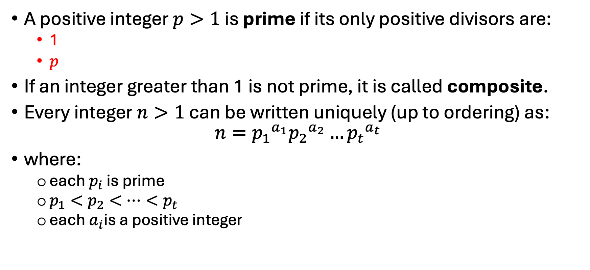
Prime Numbers
A positive integer $p>1$ is prime if its only positive divisors are:
1
$p$
If an integer greater than 1 is not prime, it is called composite.
Every integer $n>1$ can be written uniquely (up to ordering) as:
$$n={p_{1}}^{a_{1}}{p_{2}}^{a_{2}}…{p_{t}}^{a_{t}}$$
where:
each $p_{i}$ is prime
$p_{1}<p_{2}<⋯<p_{t}$
each $a_{i}$is a positive integer

Slide 6
What We Do Not Do With Primes
What Cryptography Does Not Rely On
Listing all primes
Memorizing prime tables
Factoring by hand
What It Does Rely On
Testing primality efficiently
Using primes as secret structure
Avoiding efficient factorization

Slide 7
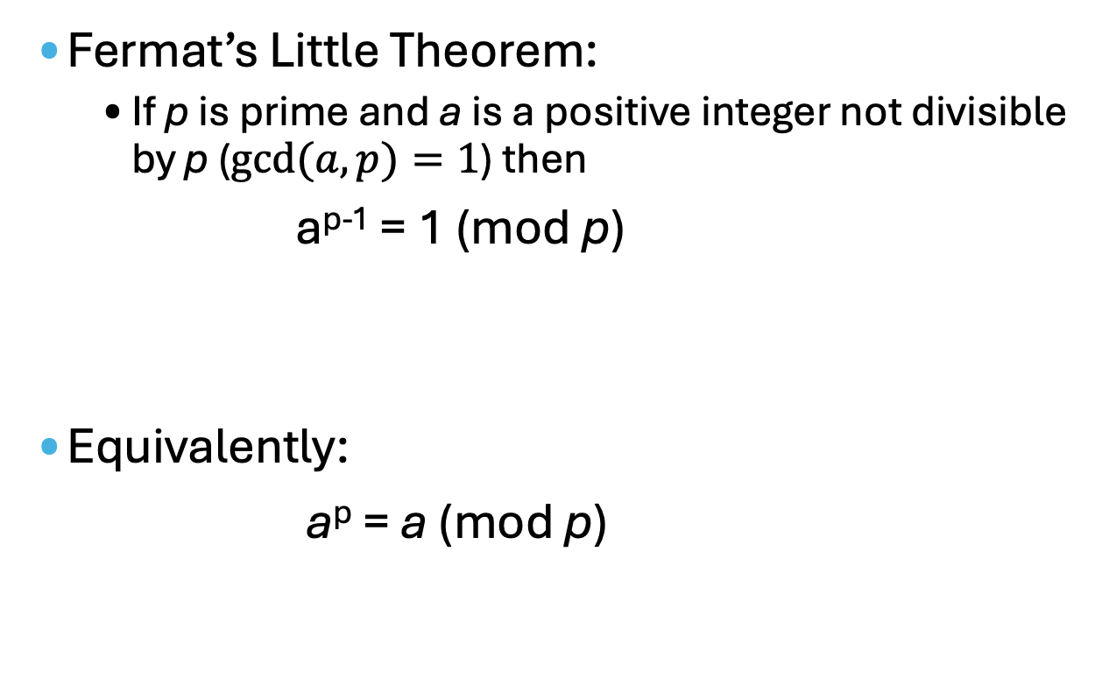
Fermat’s Little Theorem
Fermat’s Little Theorem:
If p is prime and a is a positive integer not divisible by p ($gcd⁡(a,p)=1$) then
a^{p-1} = 1 (mod p)
Equivalently:
a^{p} = a (mod p)

Slide 8
Fermat’s Little Theorem (cont.)
Fermat’s Little Theorem:
If p is prime and a is a positive integer not divisible by p ($gcd⁡(a,p)=1$) then
a^{p-1} = 1 (mod p)
Equivalently:
a^{p} = a (mod p)
Why This Matters
Explains regularity in modular exponentiation
Foundation for primality testing
Used in cryptographic proofs

Slide 9


Euler’s Totient Function ø(n)
Euler’s Totient Function:
The number of integers in $Z_{n}=\{0,1,2,…,n−1\}$ relatively prime to n is denoted by Φ(n).
E.g. n=6, what is Φ(n)?
$$Z_{6}=\{0,1,2,3,4,5\}$$
1
2
3
2
1
Two numbers are relatively prime to 6, namely 1 and 5.
The phi function takes the value 2, i.e., Φ(6) = 2.
gcd(0,6)=6
gcd(1,6)=
gcd(2,6)=
gcd(3,6)=
gcd(4,6)=
gcd(5,6)=

Slide 10
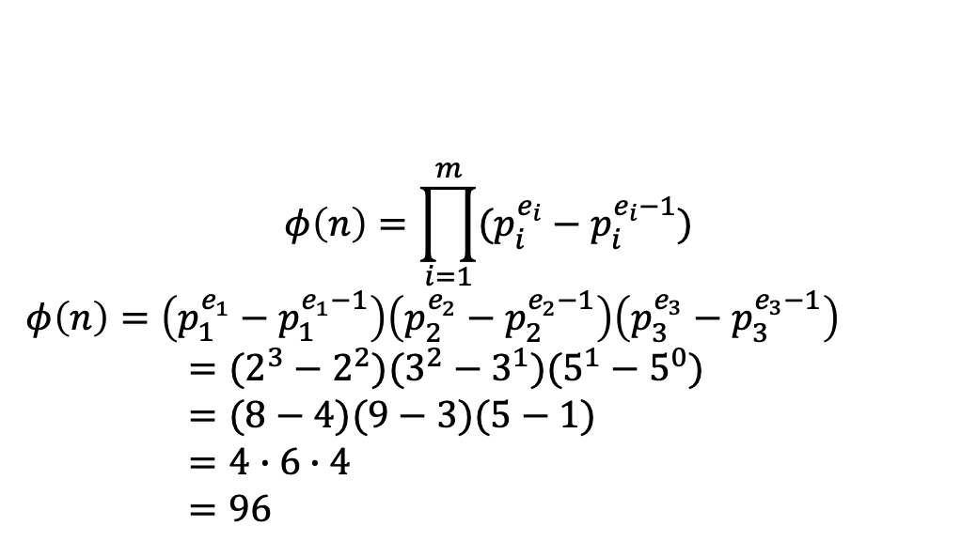
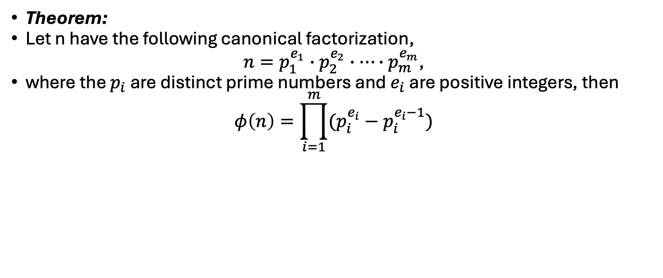
Euler’s Totient Function ø(n) (cont.)
Theorem:
Let n have the following canonical factorization,
$n=p_{1}^{e_{1}}∙p_{2}^{e_{2}}∙…∙p_{m}^{e_{m}}$,
where the $p_{i}$ are distinct prime numbers and $e_{i}$ are positive integers, then
$$φ\left(n\right)=\prod_{i=1}^{m}{(p_{i}^{e_{i}}−p_{i}^{e_{i}−1})}$$
E.g. $n=360=8∙9∙5=2^{3}3^{2}5^{1}$, what is Φ(n)?
$$φ\left(n\right)=\prod_{i=1}^{m}{(p_{i}^{e_{i}}−p_{i}^{e_{i}−1})}$$
$φ\left(n\right)=\left(p_{1}^{e_{1}}−p_{1}^{e_{1}−1}\right)\left(p_{2}^{e_{2}}−p_{2}^{e_{2}−1}\right)\left(p_{3}^{e_{3}}−p_{3}^{e_{3}−1}\right)$
$=(2^{3}−2^{2})(3^{2}−3^{1})(5^{1}−5^{0})$
$=(8−4)(9−3)(5−1)$
$=4∙6∙4$
$=96$

Slide 11
Euler's Theorem
States that for every a and n that are relatively prime:
a^{ø(n)} = 1(mod n)
Alternatively:
a^{ø(n)+1} = a(mod n)

Slide 12
Testing for Primality
Key challenge:
Large primes are easy to generate
Factoring large numbers is hard
Probabilistic Primality Testing
Miller–Rabin test
Fast and reliable in practice
Small probability of error
Cryptography is comfortable with negligible probability of error

Slide 13
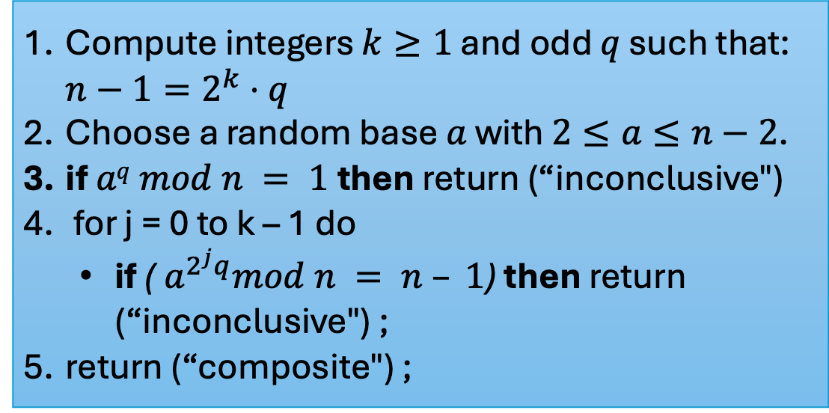
Miller-Rabin Algorithm
Test a large number for primality
Algorithm:
TEST (n)
Compute integers $k≥1$ and odd $q$ such that: $n−1=2^{k}⋅q$
Choose a random base $a$ with $2≤a≤n−2$.
if $aq mod n = 1$then return (“inconclusive")
for j = 0 to k – 1 do
if ($a^{2^{j}q}mod n = n – 1$) then return (“inconclusive") ;
return (“composite") ;

Slide 14
Chinese Remainder Theorem (CRT)
If:
moduli are pairwise relatively prime
Then:
a system of congruences has a unique solution modulo their product
Why CRT Is Important
Breaks large problems into smaller ones
Enables efficient computation
Used in cryptographic implementations
This can be useful when M is 150 digits or more. However, it is necessary to know beforehand the factorization of M.

Slide 15
Key Takeaways
Primes are the building blocks of integers
Factoring is hard; primality testing is easy
Fermat’s and Euler’s theorems explain modular regularities
Euler’s totient function measures invertibility
CRT enables efficient modular computation
These results power public-key cryptography

