Slide 1
Classical Ciphers
Dr. Xinyue Zhang
Assistant Professor
Department of Computer Science
Kennesaw State University
Marietta, GA, USA

Slide 2
Outline
Introduction
Substitution Ciphers
Monoalphabetic Ciphers
Polyalphabetic Ciphers
Block-Based Thinking

Slide 3
What Is Historical Cryptography?
Early cryptography focused on:
secrecy of messages
manual computation
human-readable text
Security relied on:
obscurity
secrecy of method
limited attacker capabilities
Classical cryptography was designed for humans, not computers.
For example,
Example (historical)
Military and diplomatic communication before the 20th century
Messages encrypted by hand, often under time pressure

Slide 4
Cryptography vs Cryptanalysis
Cryptography: designing methods to hide information
Cryptanalysis: breaking those methods
Historically, cryptography and cryptanalysis evolved together
In other words, every cipher must be evaluated against an attacker.
Arab scholars (e.g., Al-Kindi) formalizing cryptanalysis via statistics.

Slide 5
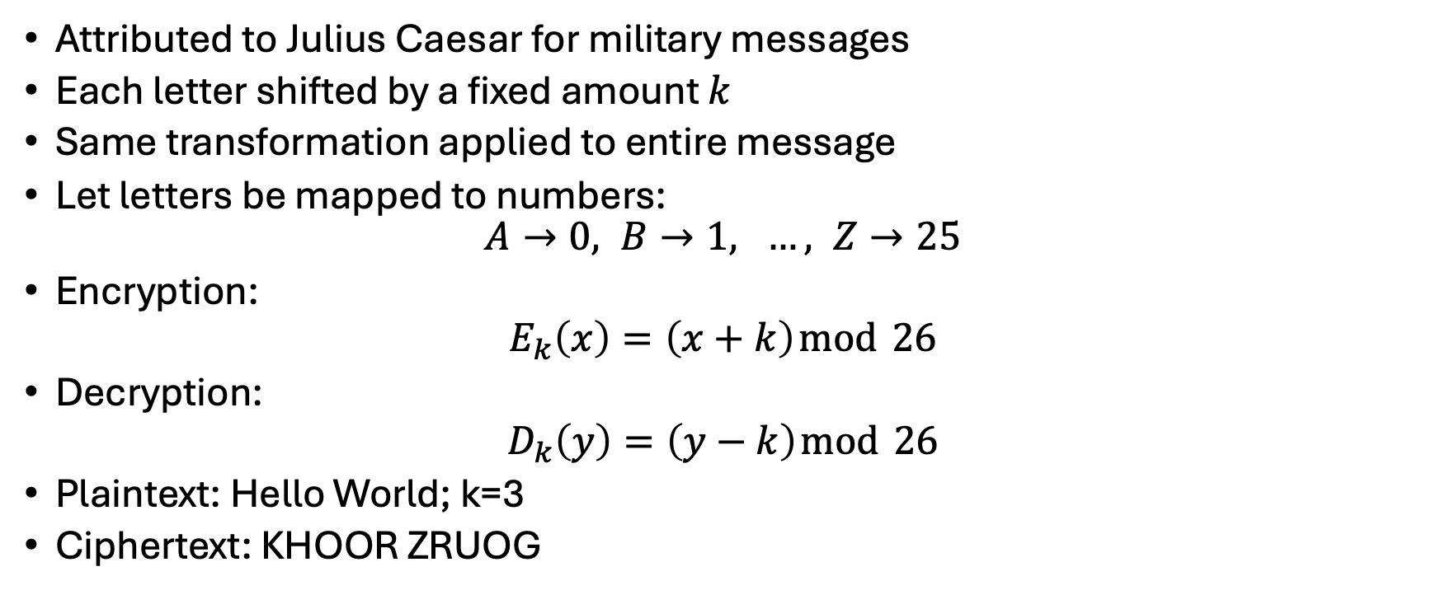
Substitution Ciphers: Caesar Cipher
Attributed to Julius Caesar for military messages
Each letter shifted by a fixed amount $k$
Same transformation applied to entire message
Let letters be mapped to numbers:
$$A→0, B→1, …, Z→25$$
Encryption:
$$E_{k}\left(x\right)=\left(x+k\right) mod 26$$
Decryption:
$$D_{k}\left(y\right)=\left(y−k\right) mod 26$$
Plaintext: Hello World; k=3
Ciphertext: KHOOR ZRUOG

Slide 6
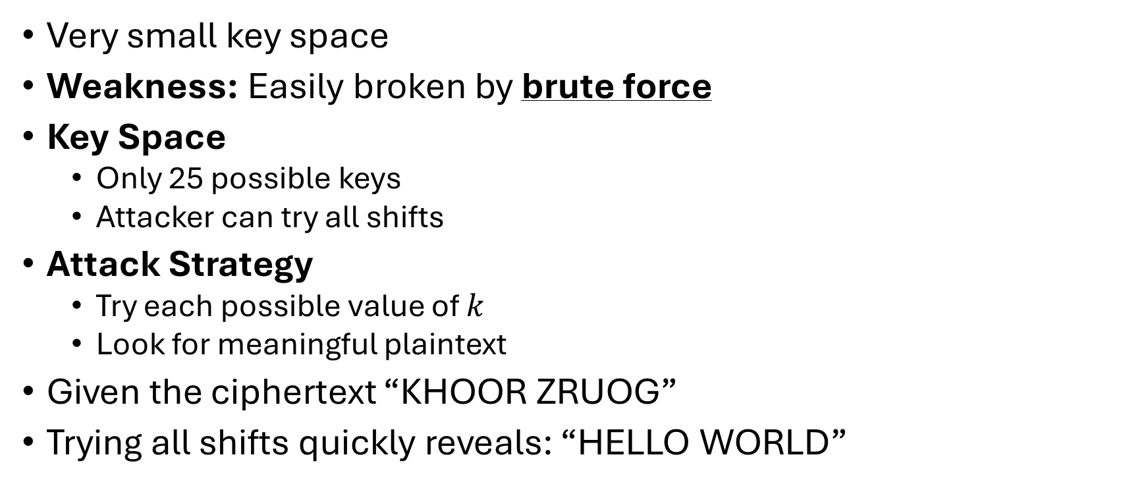
Why Caesar Cipher Fails
Very small key space
Weakness: Easily broken by brute force
Key Space
Only 25 possible keys
Attacker can try all shifts
Attack Strategy
Try each possible value of $k$
Look for meaningful plaintext
Given the ciphertext “KHOOR ZRUOG”
Trying all shifts quickly reveals: “HELLO WORLD”
A small key space offers no real security.

Slide 7
Monoalphabetic Substitution Cipher
Each plaintext letter maps to a unique ciphertext letter
Entire message uses the same substitution
Much larger key space than Caesar cipher
However, large key space
≠
secure

Slide 8
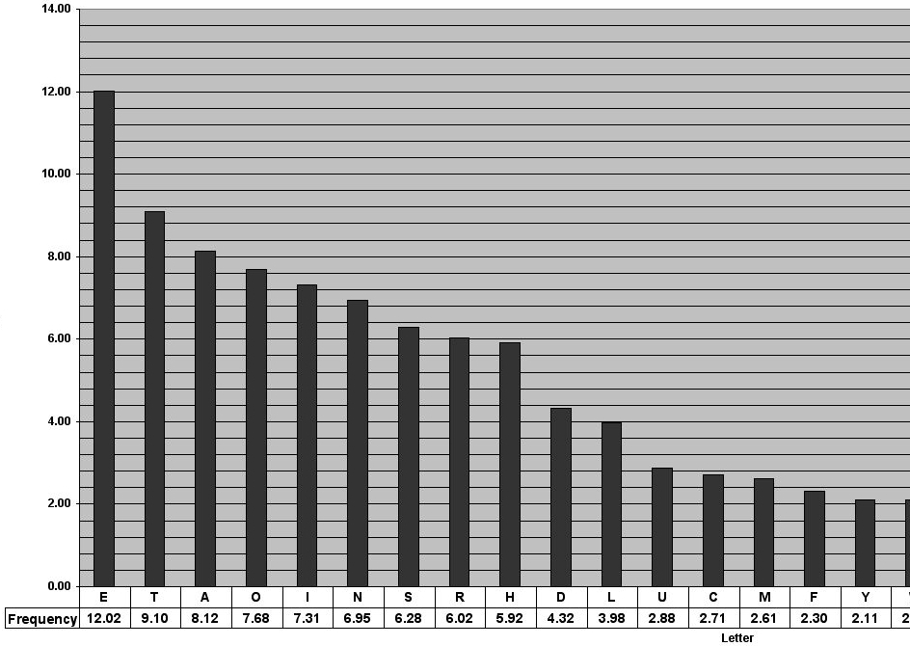
Monoalphabetic Substitution Cipher (cont.)
Human languages are highly redundant
Letters appear with predictable frequencies
Substitution preserves frequency patterns
Example:
“The most frequent ciphertext letter likely maps to ‘E’”
Figure Source: https://pi.math.cornell.edu/~mec/2003-2004/cryptography/subs/frequencies.html

Slide 9
Why Monoalphabetic Ciphers Fail
Deterministic substitution
Same plaintext → same ciphertext
Patterns repeat throughout the message
Ciphertext-only attack is sufficient
No semantic security
Cipher leaks information about plaintext

Slide 10
Polyalphabetic Ciphers
Goal: hide letter frequency
Idea: use multiple substitution alphabets
Encryption depends on position in message
Break the link between plaintext frequency and ciphertext frequency.

Slide 11
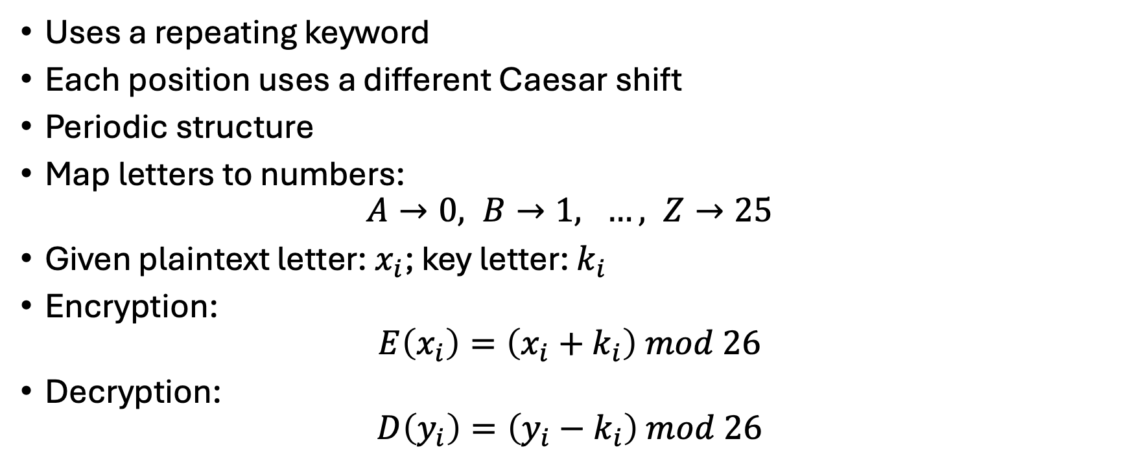
Vigenère Cipher
Uses a repeating keyword
Each position uses a different Caesar shift
Periodic structure
Map letters to numbers:
$$A→0, B→1, …, Z→25$$
Given plaintext letter: $x_{i}$; key letter: $k_{i}$
Encryption:
$$E\left(x_{i}​\right)=\left(x_{i}​+k_{i}\right) mod 26$$
Decryption:
$$D\left(y_{i}\right)=\left(y_{i}−k_{i}\right) mod 26$$

Slide 12
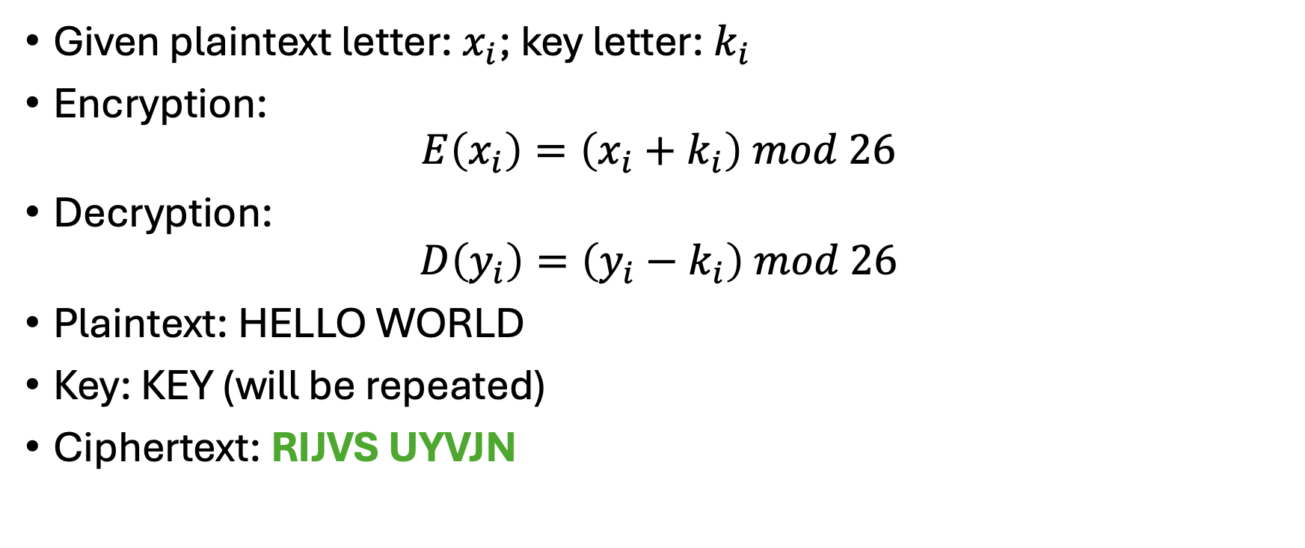
Vigenère Cipher (cont.)
Given plaintext letter: $x_{i}$; key letter: $k_{i}$
Encryption:
$$E\left(x_{i}​\right)=\left(x_{i}​+k_{i}\right) mod 26$$
Decryption:
$$D\left(y_{i}\right)=\left(y_{i}−k_{i}\right) mod 26$$
Plaintext: HELLO WORLD
Key: KEY (will be repeated)
Ciphertext: RIJVS UYVJN

Slide 13
Why Vigenère Cipher Is Still Broken
Key repeats
Period reveals structure
Message can be split into monoalphabetic components
Possible attack:
Attacker suspects a repeating key
Attacker guesses the key length
Ciphertext is split into multiple streams
Each stream is a monoalphabetic cipher
Example: If the key length is 3:
letters in positions 1,4,7,… use the same shift
letters in positions 2,5,8,… use the same shift
letters in positions 3,6,9,… use the same shift
Each group can be attacked separately.

Slide 14
Kasiski Examination
Goal: Determine the length of the Vigenère key
Key Observation
Repeated plaintext patterns
→ repeated ciphertext patterns
→ spaced at multiples of the key length
Method:
Identify repeated substrings in the ciphertext
Measure the distances between repetitions
Compute common factors of these distances
Likely factors correspond to key length

Slide 15
Block-Based Thinking – Playfair Cipher
Encrypts pairs of letters (digraphs)
Reduces single-letter frequency leakage
Introduces block-based encryption
First step toward modern block ciphers
Used by British military in WWI

Slide 16
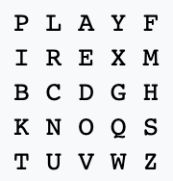
Playfair Key Matrix
Playfair example as “keyword”
The table:
i/j interchangeable
Plaintext: Hide the gold in the tree stump
HI DE TH EG OL DI NT HE TR EX ES TU MP

Slide 17
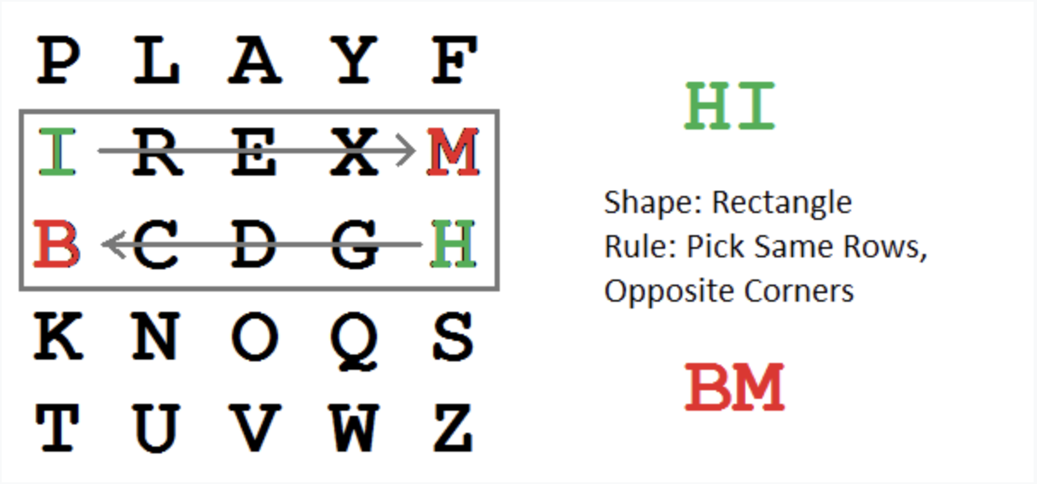
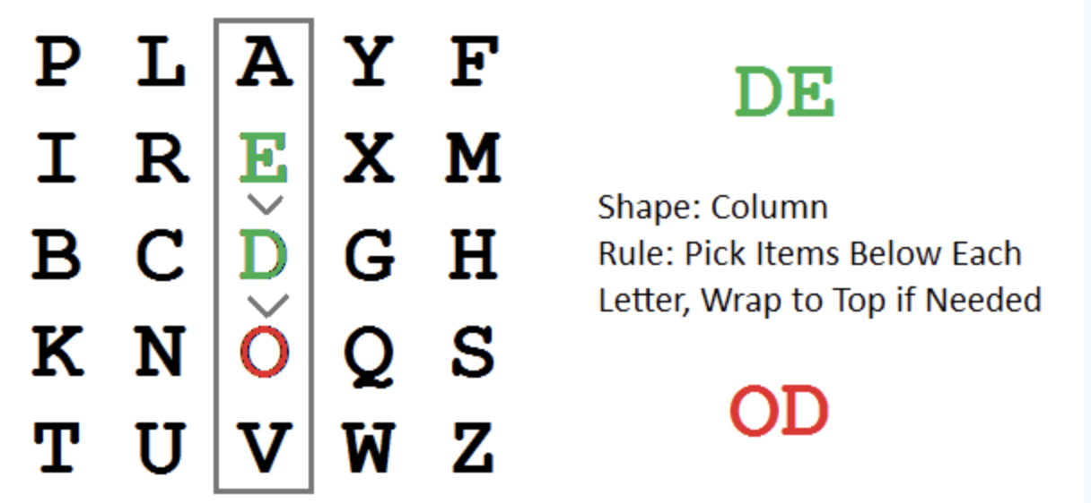
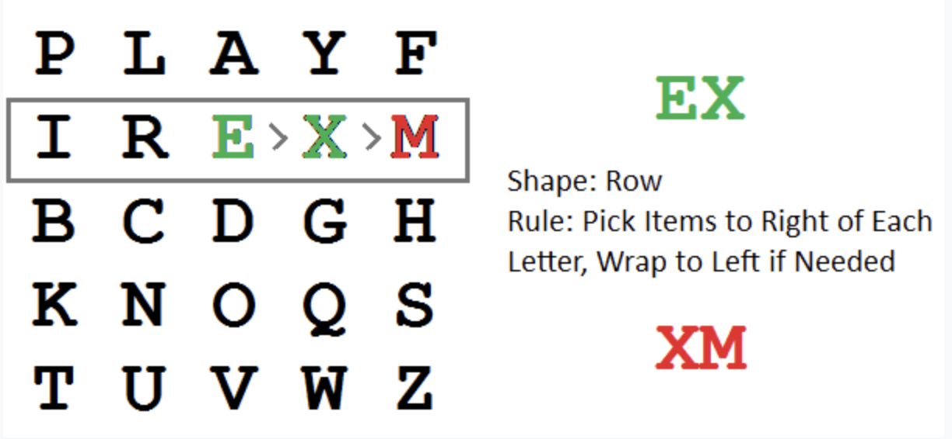
Playfair Key Matrix (cont.)
HI DE TH EG OL DI NT HE TR EX ES TU MP

Slide 18
Why Playfair Is Still Insecure
Deterministic encryption
Language structure still visible
Vulnerable to statistical attacks on digraphs
Bigger blocks help, but are not enough.

Slide 19
Why Classical Ciphers Fail
Common Failure Patterns
Deterministic encryption
Key reuse
Lack of randomness
Heavy reliance on language structure
Structure leaks information.
Lessons from Classical Cryptography
Security cannot rely on obscurity
Large key space alone is insufficient
Attackers exploit statistics, not just math

Slide 20
Key Takeaways
Classical ciphers were designed for human use, not machines
Encryption methods were deterministic and reused keys
Human language is highly structured and redundant
Statistical patterns survive encryption
Attackers exploit structure, not secret algorithms
Strong cryptography requires randomness and unpredictability

